Slide 1
China's Military-Civil Fusion (MCF)
Institutional Architecture and Technology Flows
Visualization Compendium

Slide 2
Institutional Architecture

Slide 3
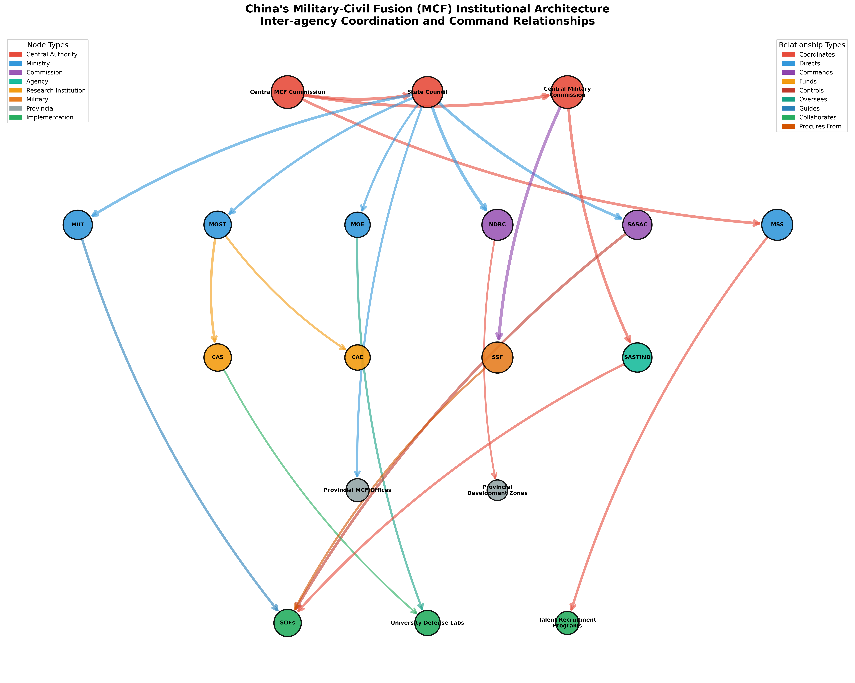
MCF Institutional Architecture - Complete Network
Notes:
Complete network of 18 institutions across 5 tiers, showing 21 key relationships. Node sizes represent power level, colors represent organization type. Hierarchical layout shows command structure from central leadership to implementation entities.

Slide 4
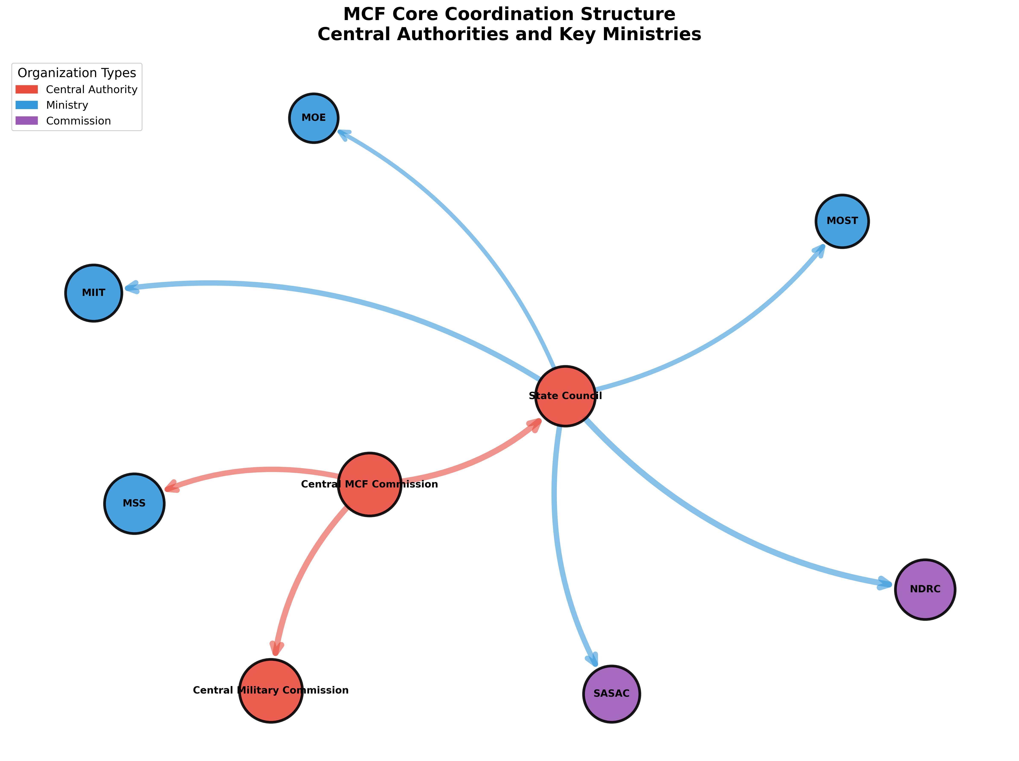
MCF Core Coordination Structure
Notes:
Simplified view focusing on Tier 1-2 central authorities and key ministries. Shows the core coordination mechanisms between central leadership and key government agencies.

Slide 5
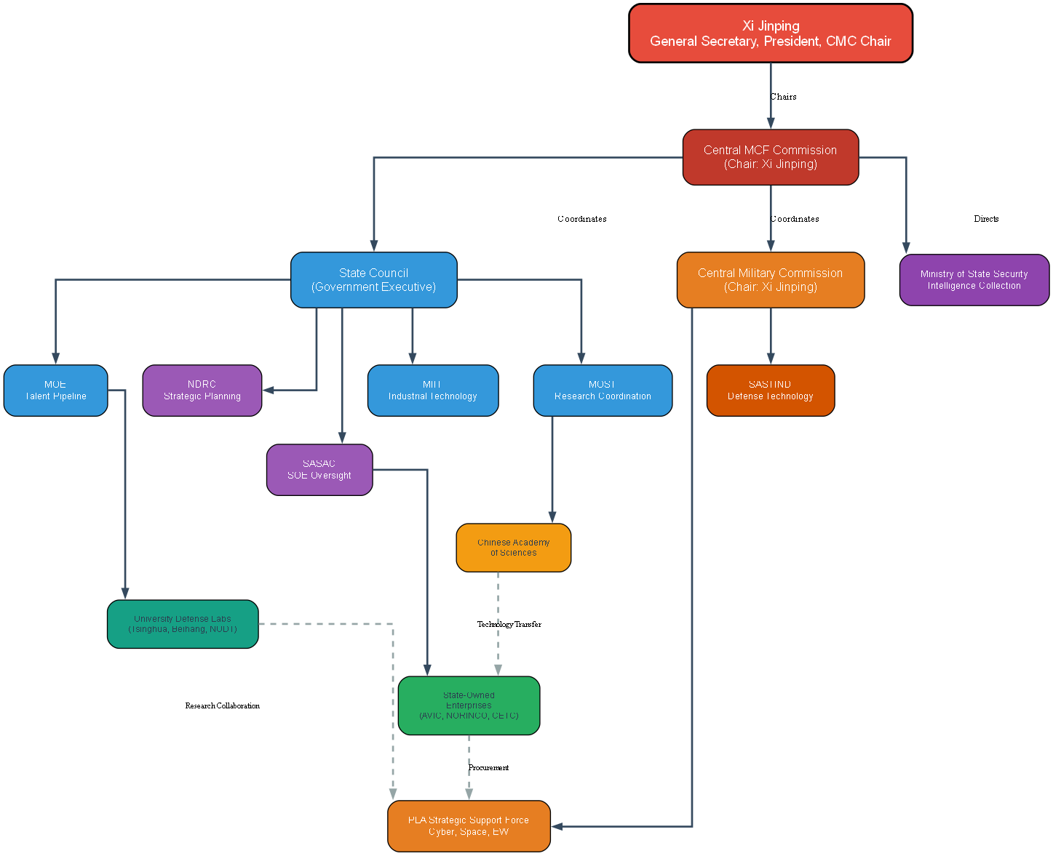
MCF Governance Hierarchy
Notes:
Tree structure showing Xi Jinping at apex, chairing both Central MCF Commission and Central Military Commission. Shows dual civilian-military command structure with coordinated oversight of ministries, agencies, research institutions, and implementation entities.

Slide 6
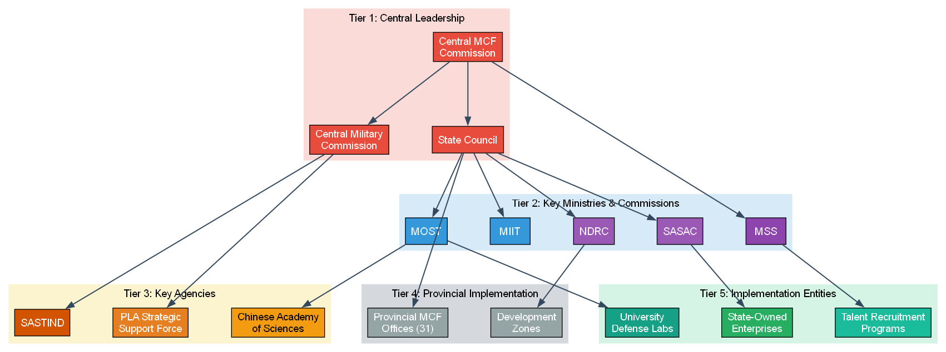
MCF Institutional Layers (Tier 1-5)
Notes:
Five-tier structure: (1) Central Leadership, (2) Key Ministries & Commissions, (3) Key Agencies, (4) Provincial Implementation, (5) Implementation Entities. Shows how directives flow from central coordination through provincial and institutional layers to operational implementation.

Slide 7
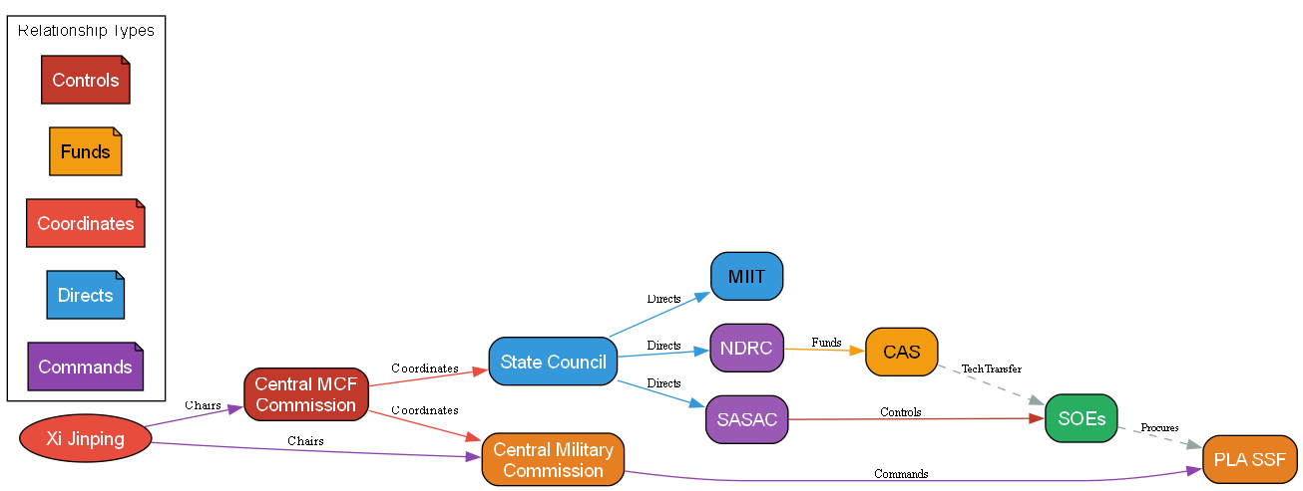
MCF Command and Control Flows
Notes:
Relationship types: Commands (military chain), Directs (government oversight), Coordinates (inter-agency cooperation), Funds (research support), Controls (SOE management). Dashed lines show technology transfer and procurement relationships.

Slide 8
Technology Flows

Slide 9
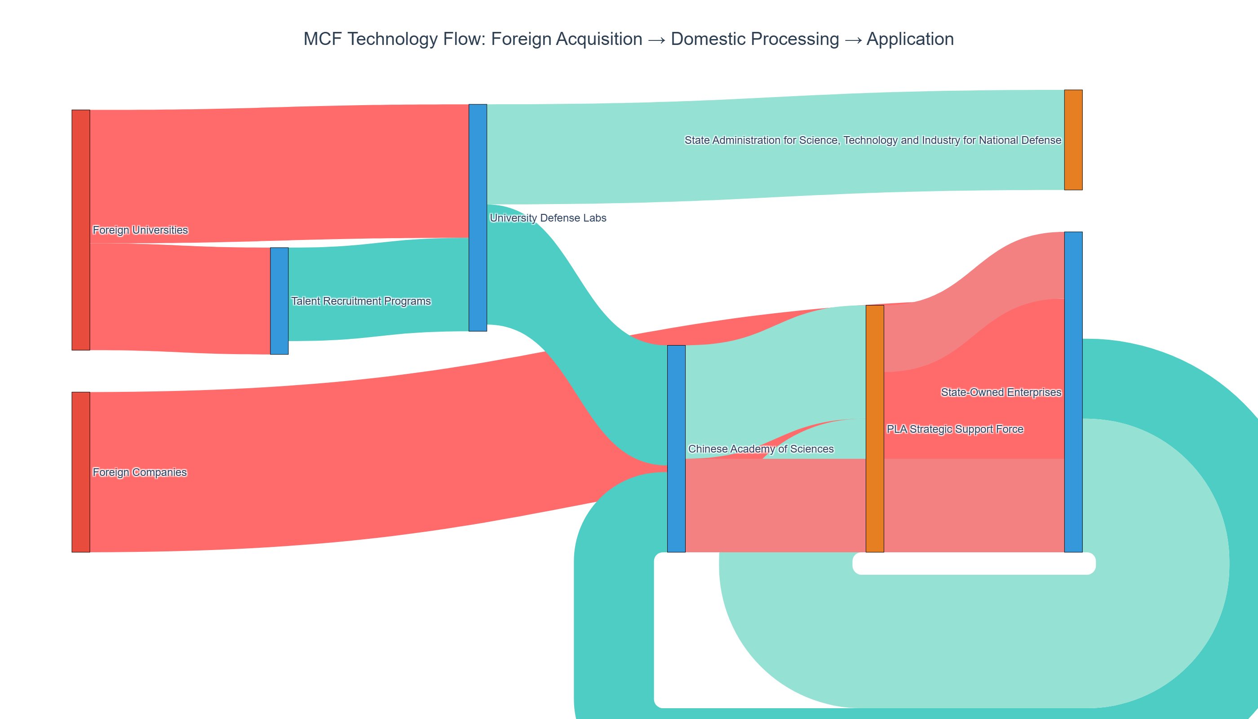
Technology Flow: Foreign Acquisition → Application
Notes:
Three-stage flow: (1) Foreign acquisition from universities and companies, (2) Domestic processing through CAS, university labs, and SOEs, (3) Application in military and civilian domains. Flow values represent relative intensity of technology transfer.

Slide 10
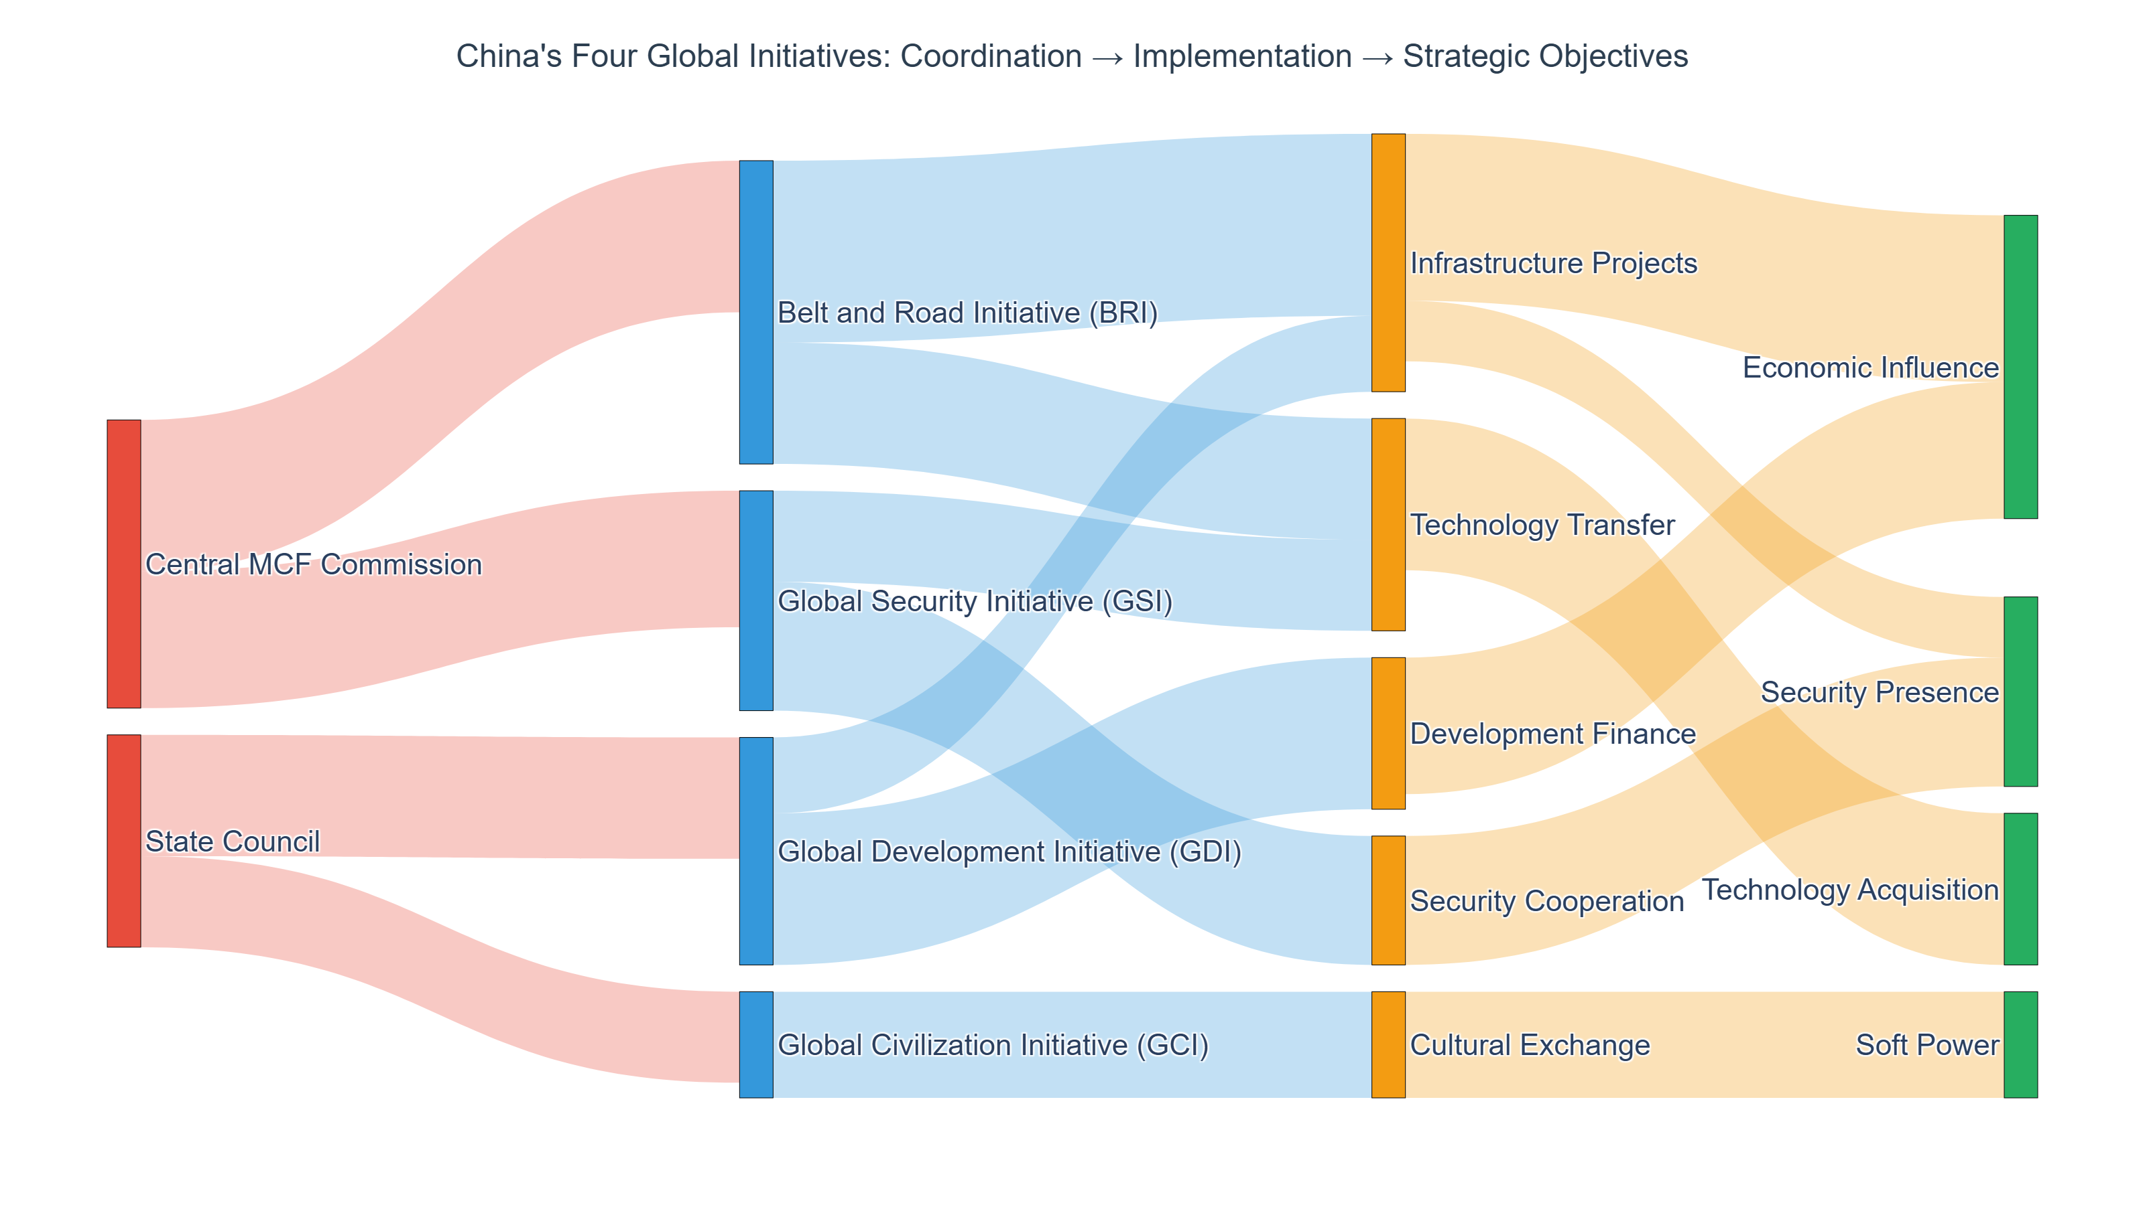
China's Four Global Initiatives Flow
Notes:
Shows coordination of Belt and Road Initiative (BRI), Global Development Initiative (GDI), Global Security Initiative (GSI), and Global Civilization Initiative (GCI). Demonstrates how these initiatives flow through implementation mechanisms (infrastructure, finance, technology, security, culture) to achieve strategic objectives (economic influence, technology acquisition, security presence, soft power).

Slide 11
Strategic Priority Sectors

Slide 12
Made in China 2025: Sectors → Research → Application
Interactive Sankey diagram available in HTML format:
mcf_sector_priority_flow.html
Eight priority sectors:
  Information Technology
  Robotics & Automation
  Aerospace & Aviation
  Maritime Equipment
  New Energy Vehicles
  Power Equipment
  New Materials
  Biopharmaceuticals

Slide 13
Visualization Summary
This presentation includes:
NetworkX network graphs (institutional architecture)
Plotly Sankey diagrams (technology and initiative flows)
Graphviz hierarchy trees (governance structure)
All visualizations available in multiple formats:
  • PNG (for presentations)
  • SVG (for editing/scaling)
  • PDF (for printing)
  • HTML (interactive, Sankey diagrams only)
Source data: scripts/visualization/mcf_network_data.py

