Slide 1

BidMobility
Used Phone Bidding System
Group 8: Shiyan Chen, Chenjie Bei, Xuanmao Huang, Zeyu Cui

Slide 2
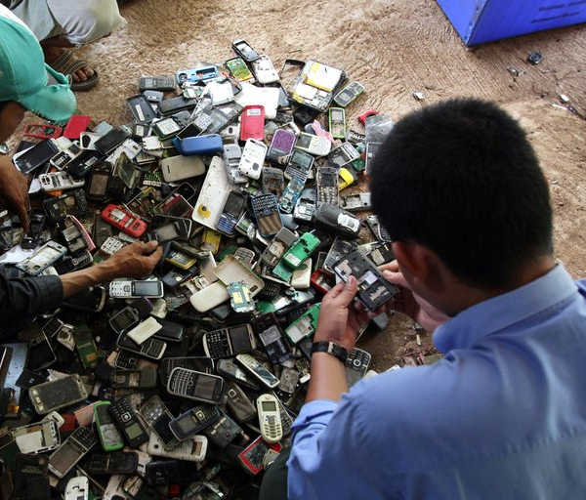

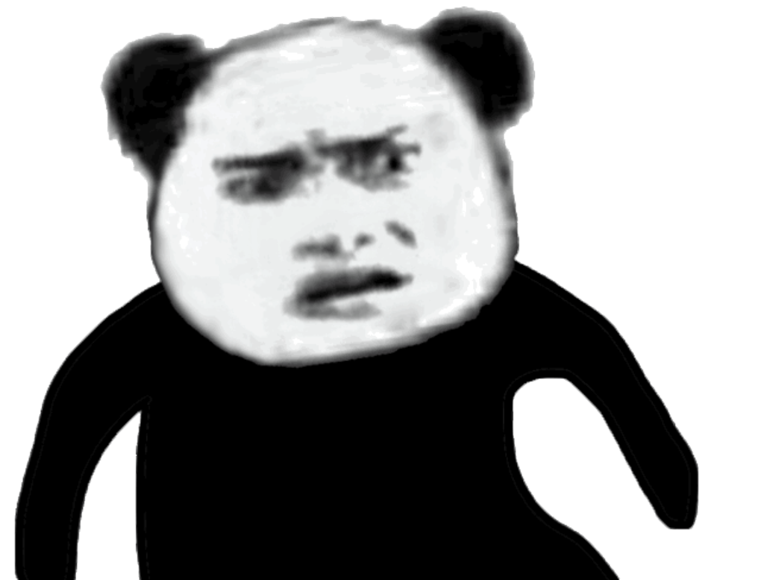
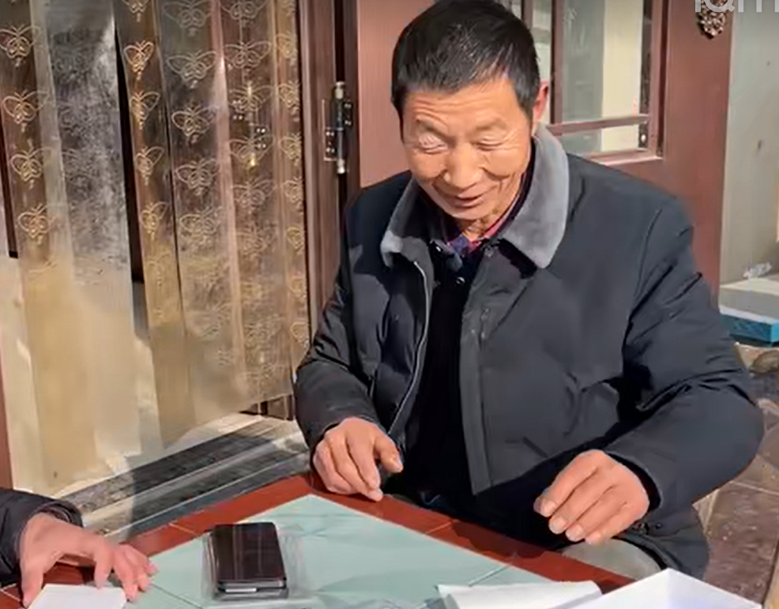
Introduction
Our Used Phone Bidding System addresses these challenges by providing a platform for trading pre-owned smartphones.
contributes to environmental conservation
empowers individuals with limited economic means to access high-quality devices.
In today's fast-paced technological landscape, smartphones undergo rapid updates, leading to a substantial number of devices being discarded annually.
In the mean time many people can not afford a smart phone: a 17-year-old teenager in Anhui, China, in 2011, who went to the black market and sold one of his kidneys to buy the then-latest iPhone 4S in order to keep up with the trend.

Slide 3
Introducing Team with Role
Chenjie Bei | Bidding Process, Database Migration, Payment
Shiyan Chen | Database Initialization, Chat Bot Integration, Messaging System
Xuanmao Huang | Home Page, Product Page, User Profile, Rating System
Zeyu Cui | Shipping Generation, Order History, Testing
Team Member
Role

Slide 4
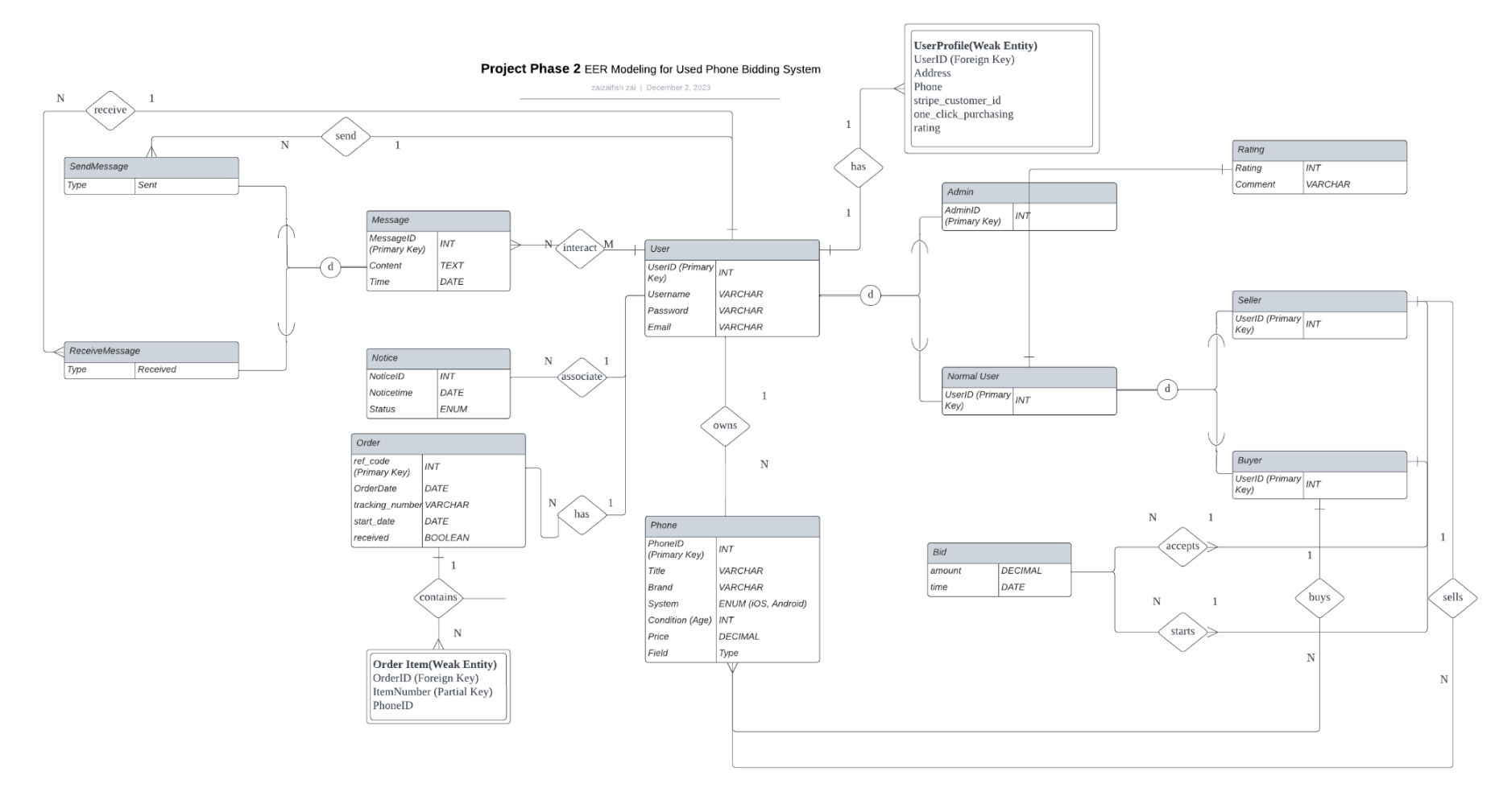
EER
Notes:
"Welcome to our overview of the Enhanced Entity-Relationship (EER) diagram for our Used Phone Bidding System. This diagram illustrates the complex relationships and entities that form the backbone of our application.
At the center, we have the 'User' entity, which is the primary entity in our system. Each user has a unique UserID serving as a primary key, and attributes like username, password, and email.
Linked to 'User' is the 'UserProfile', a weak entity dependent on 'User'. It includes additional details like address, phone, and stripe_customer_id for payment processing. Notably, the 'UserProfile' also holds a 'rating', representing the user's credibility within the system, which is calculated based on individual 'Rating' entries.
Moving on, we have the 'Phone' entity, where each phone listed in our marketplace has details like brand, system, condition, and price. Each phone has a unique PhoneID and is associated with a 'Seller', which in turn is a role played by a 'User'.
Bids are central to our auction system, with the 'Bid' entity recording the bid amount and time. Bids are linked to the 'Phone' entity and the 'Buyer' who places the bid.
Transactions are captured in the 'Order' entity, which contains details of the purchase process including a unique reference code, order date, and tracking number.
Messages facilitate communication between users, with 'SendMessage' and 'ReceiveMessage' types to track the flow of messages.
Lastly, the 'Notice' entity is used for system-generated alerts, which informs users about significant events such as bid status or order updates.
This EER diagram is designed to support a robust and scalable bidding platform, ensuring a seamless experience for buying and selling used phones."

Slide 5
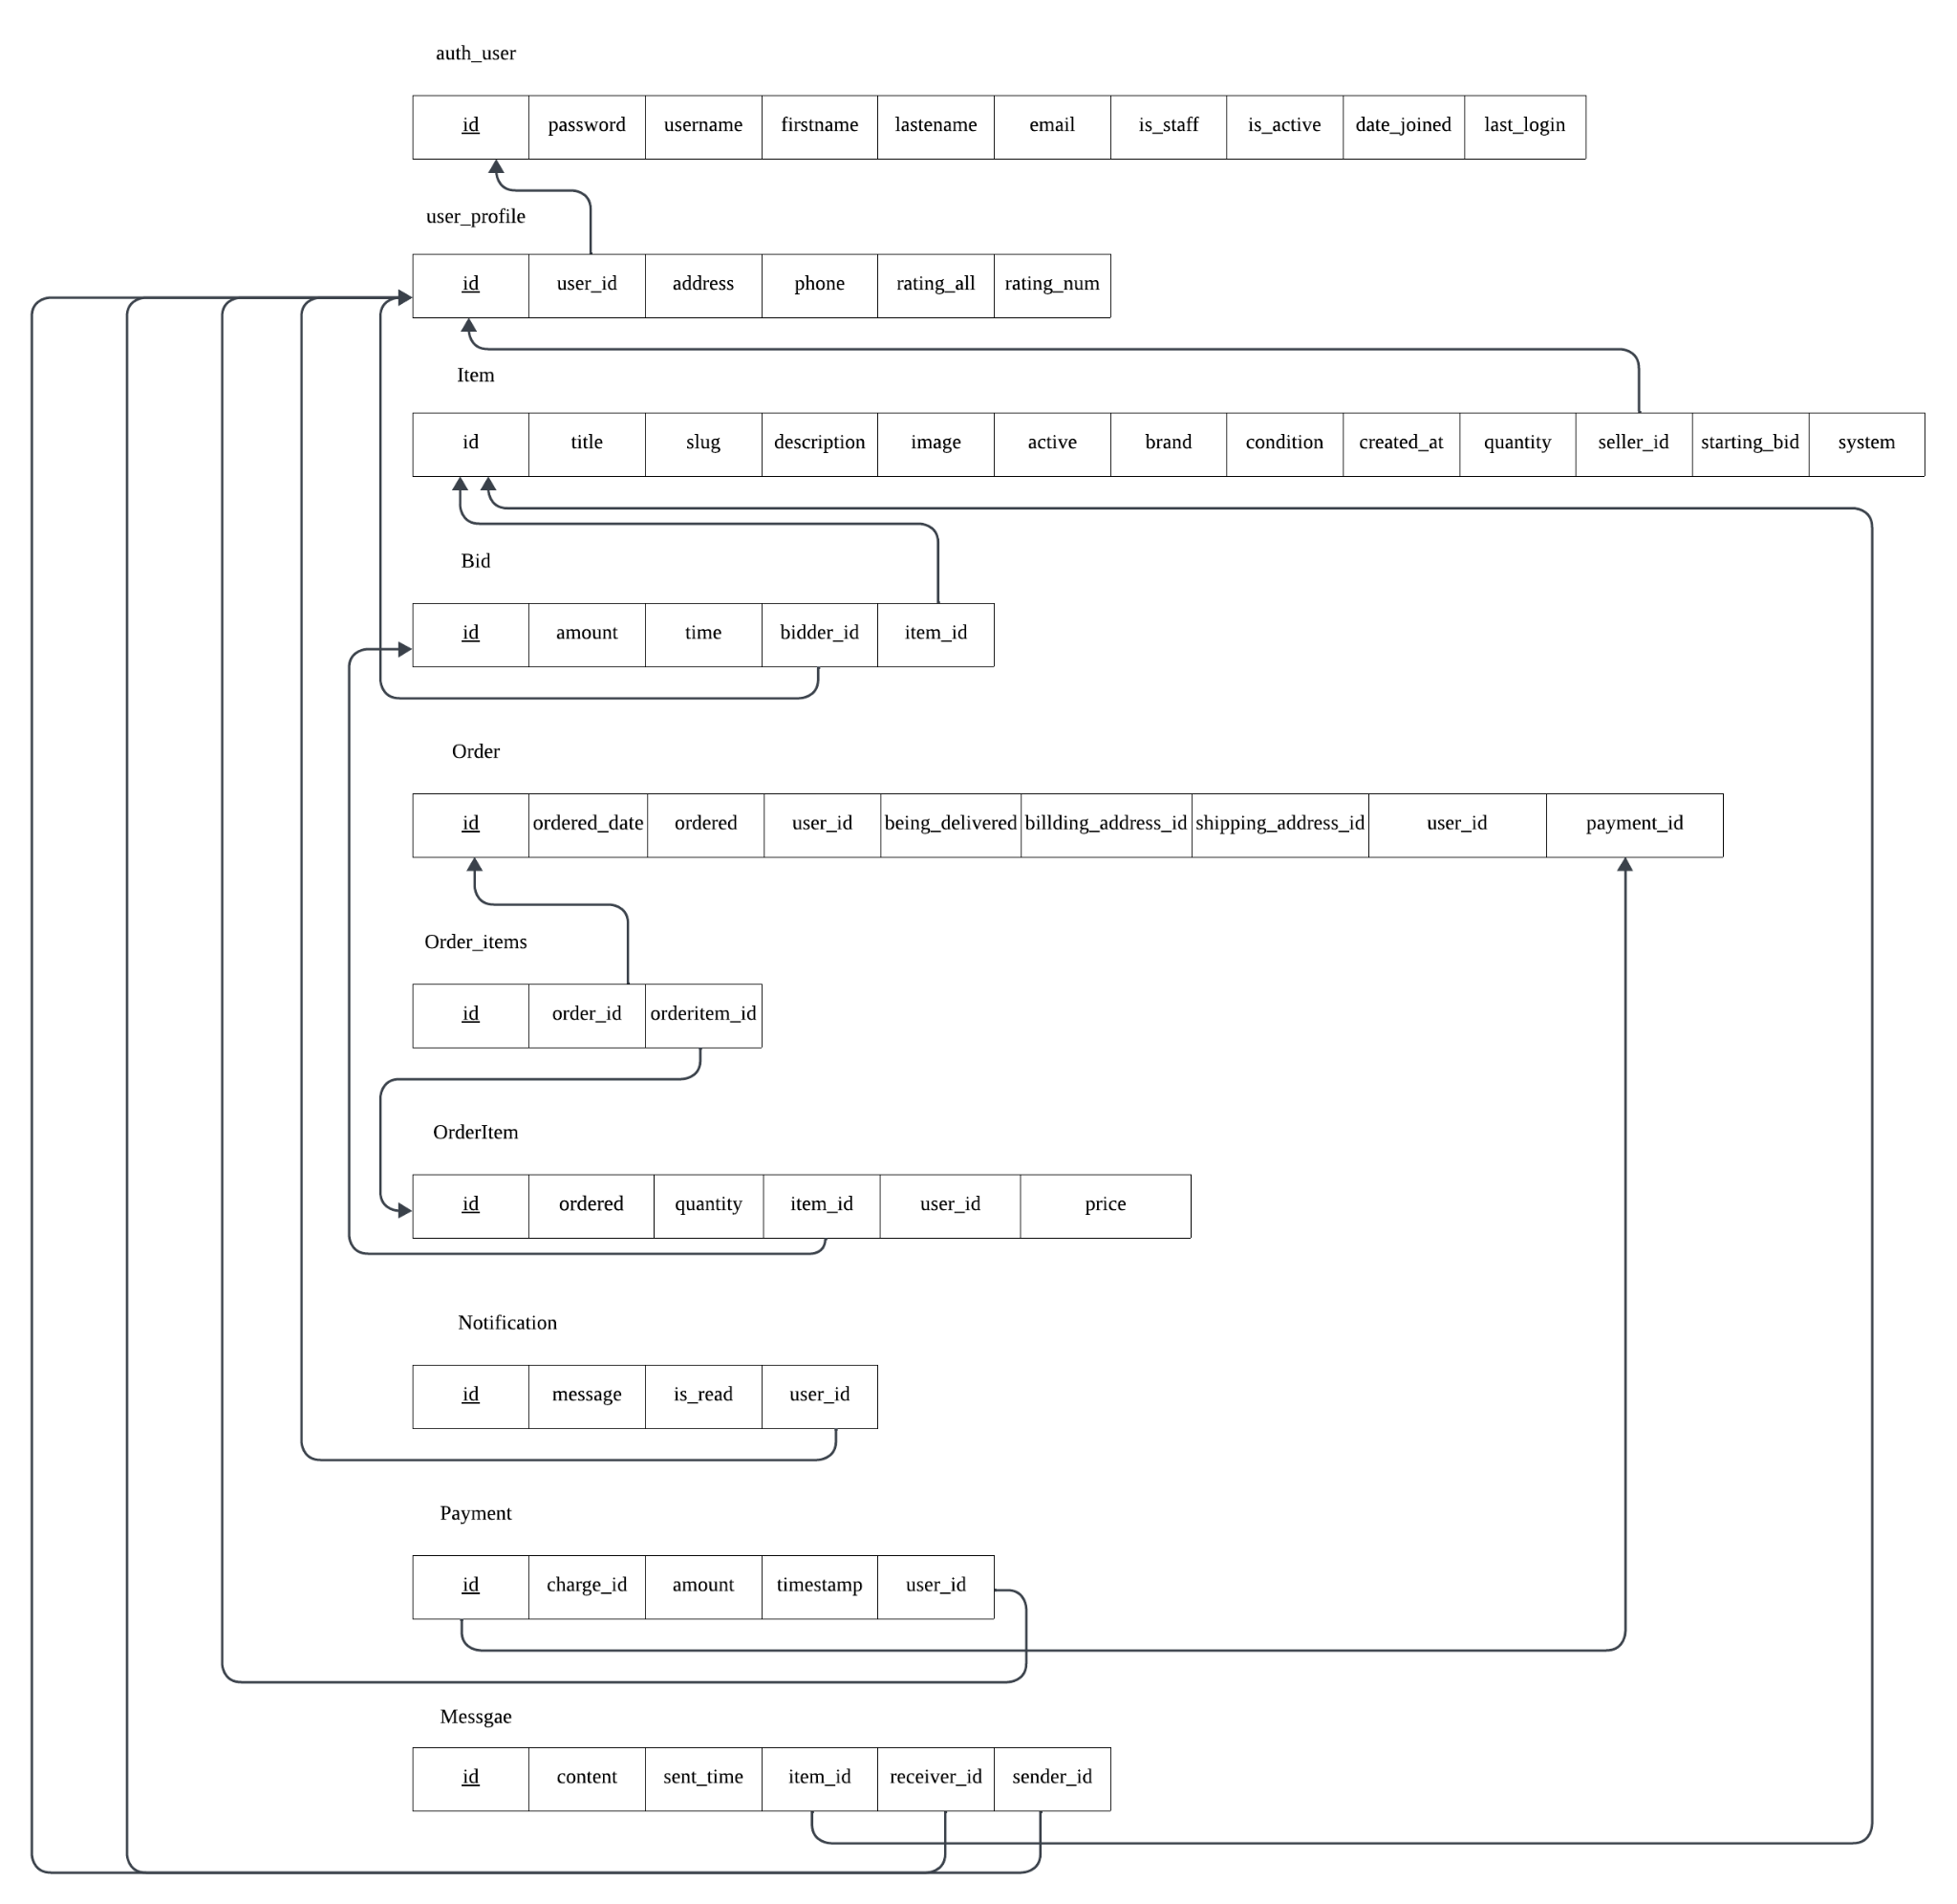
Relational schema diagram

Slide 6
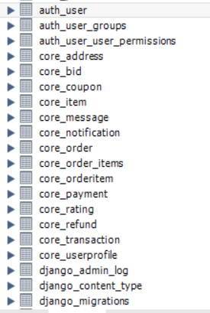
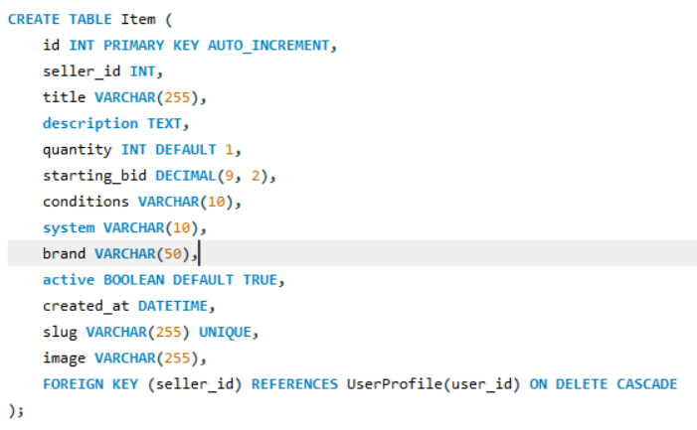
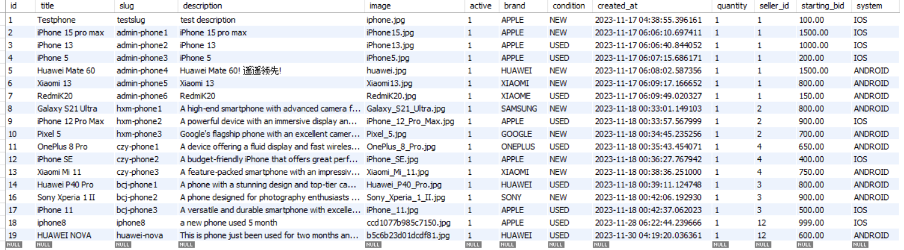
Database design

Slide 7
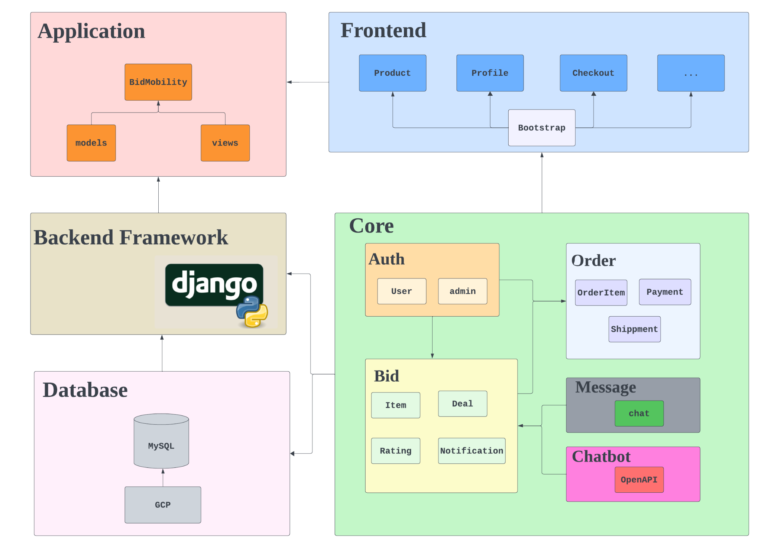
Architecture diagram

Slide 8
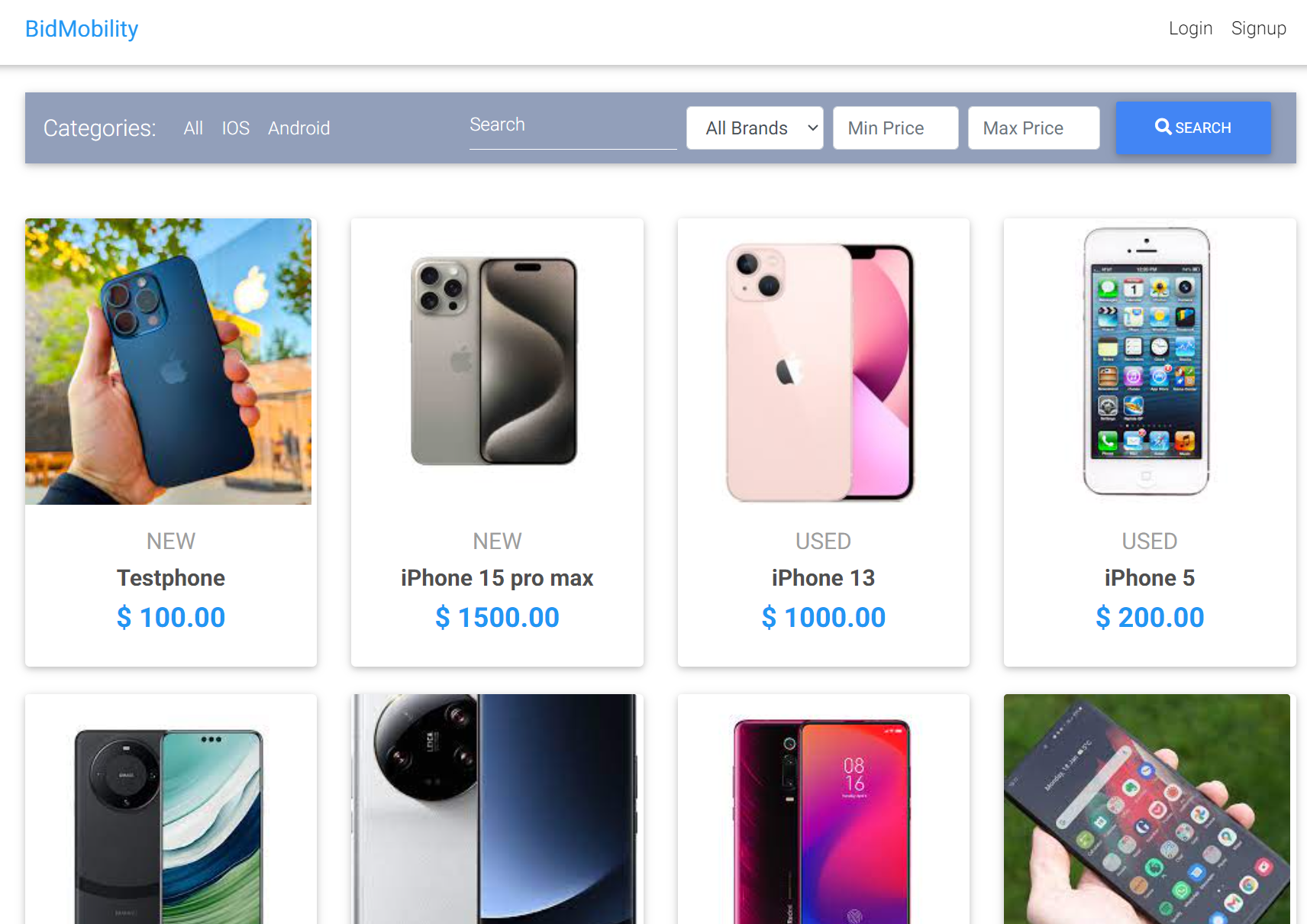
Demo
https://db-group8-401802.uw.r.appspot.com/

