Slide 1

BidMobility
Used Phone Bidding System
Group 8: Shiyan Chen, Chenjie Bei, Xuanmao Huang, Zeyu Cui

Slide 2
Introducing Team with Role
Chenjie Bei | Bidding Process; Database Migration
Zeyu Cui | Shipping & Payment Process
Shiyan Chen | Database Initialization;Chat Bot Integration
Xuanmao Huang | Home & Product Page; User Profile
Team Member
Role

Slide 3
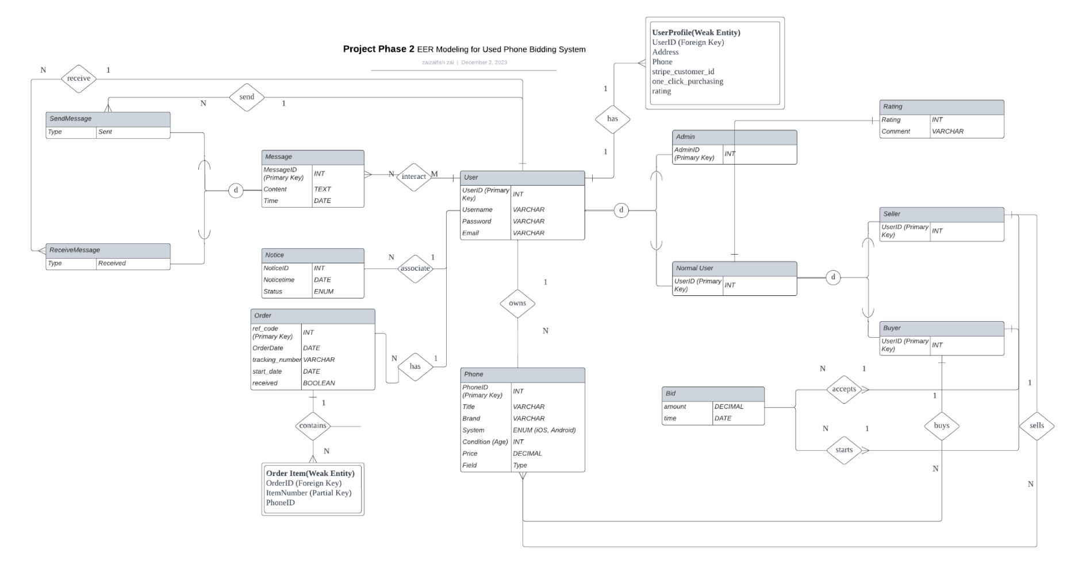
EER
Notes:
"Welcome to our overview of the Enhanced Entity-Relationship (EER) diagram for our Used Phone Bidding System. This diagram illustrates the complex relationships and entities that form the backbone of our application.
At the center, we have the 'User' entity, which is the primary entity in our system. Each user has a unique UserID serving as a primary key, and attributes like username, password, and email.
Linked to 'User' is the 'UserProfile', a weak entity dependent on 'User'. It includes additional details like address, phone, and stripe_customer_id for payment processing. Notably, the 'UserProfile' also holds a 'rating', representing the user's credibility within the system, which is calculated based on individual 'Rating' entries.
Moving on, we have the 'Phone' entity, where each phone listed in our marketplace has details like brand, system, condition, and price. Each phone has a unique PhoneID and is associated with a 'Seller', which in turn is a role played by a 'User'.
Bids are central to our auction system, with the 'Bid' entity recording the bid amount and time. Bids are linked to the 'Phone' entity and the 'Buyer' who places the bid.
Transactions are captured in the 'Order' entity, which contains details of the purchase process including a unique reference code, order date, and tracking number.
Messages facilitate communication between users, with 'SendMessage' and 'ReceiveMessage' types to track the flow of messages.
Lastly, the 'Notice' entity is used for system-generated alerts, which informs users about significant events such as bid status or order updates.
This EER diagram is designed to support a robust and scalable bidding platform, ensuring a seamless experience for buying and selling used phones."

Slide 4
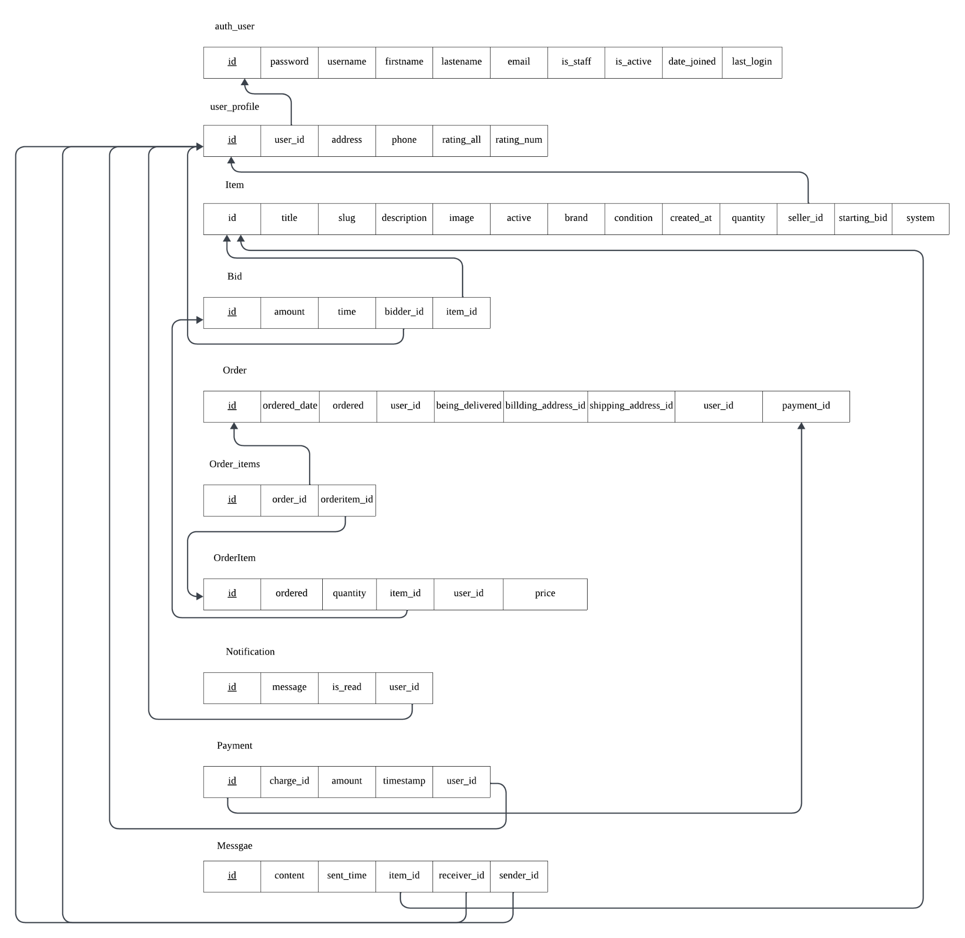
Relational schema diagram

Slide 5
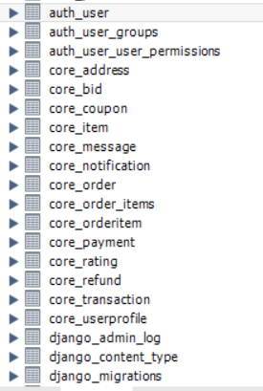
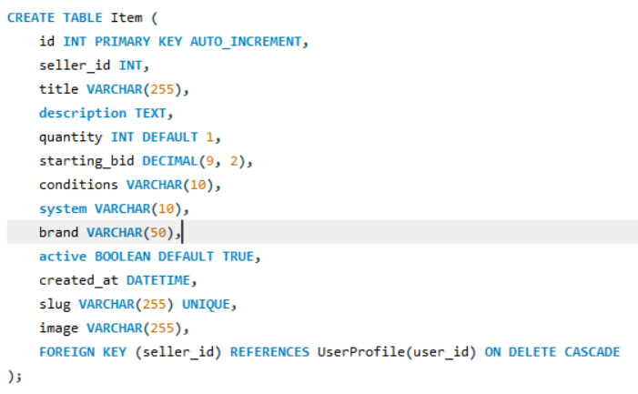
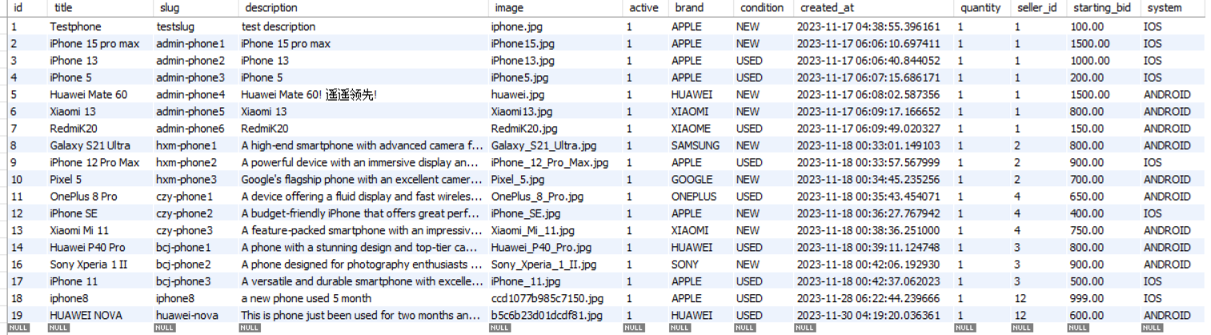
Database design

Slide 6
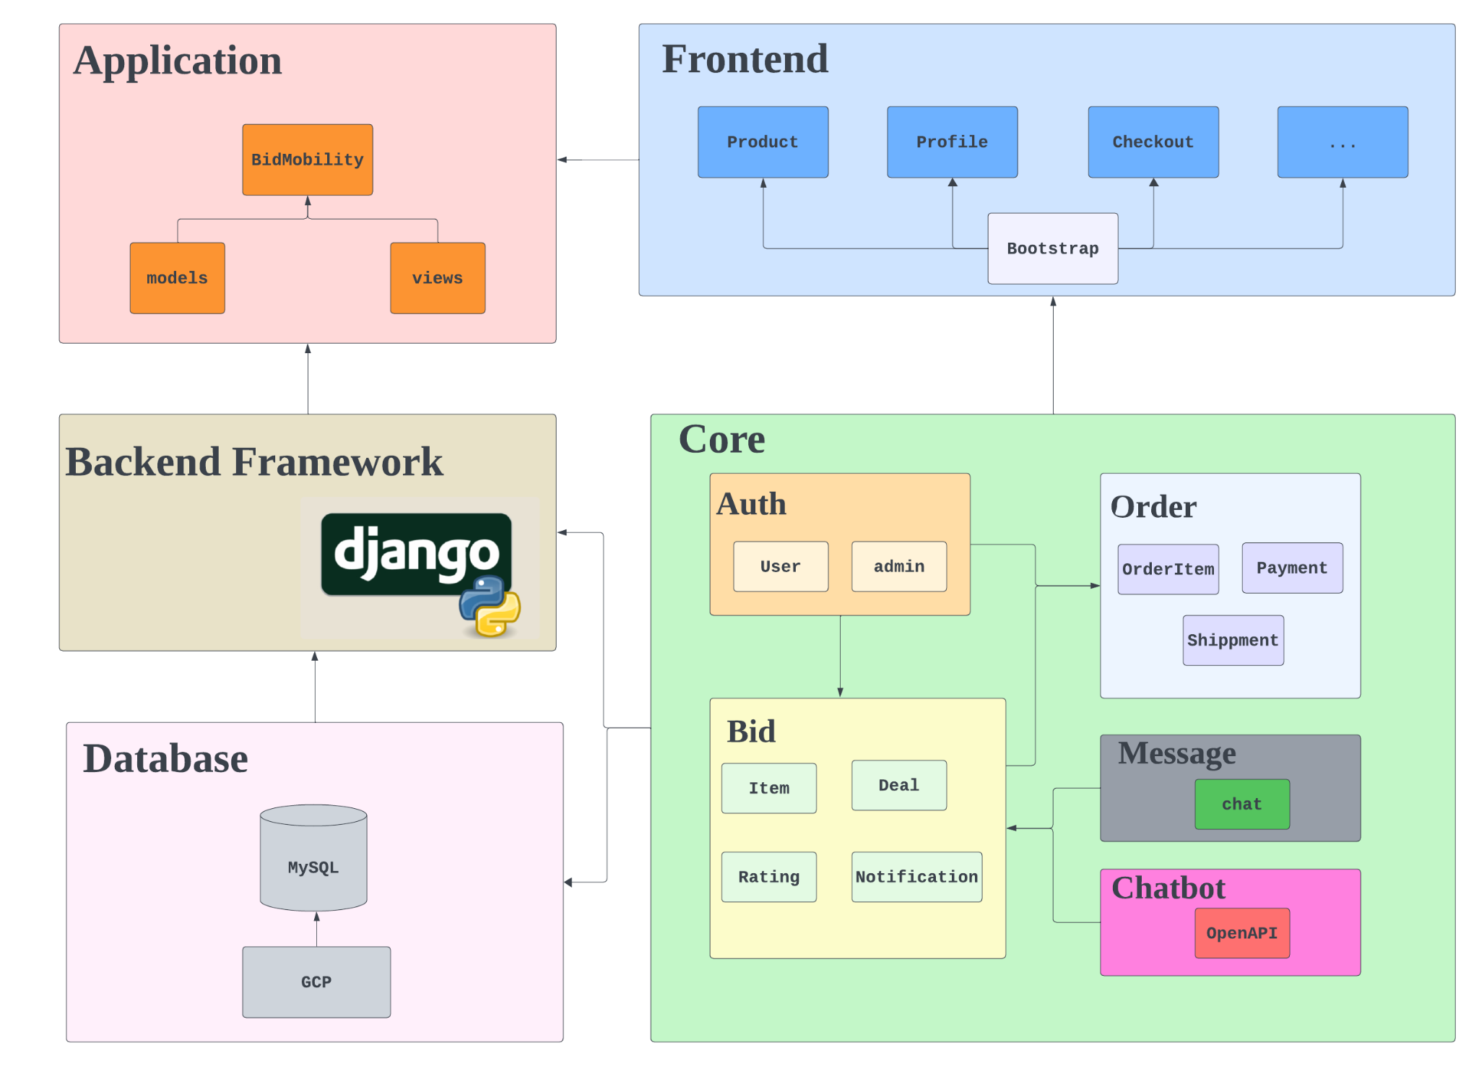
Architecture diagram

Slide 7
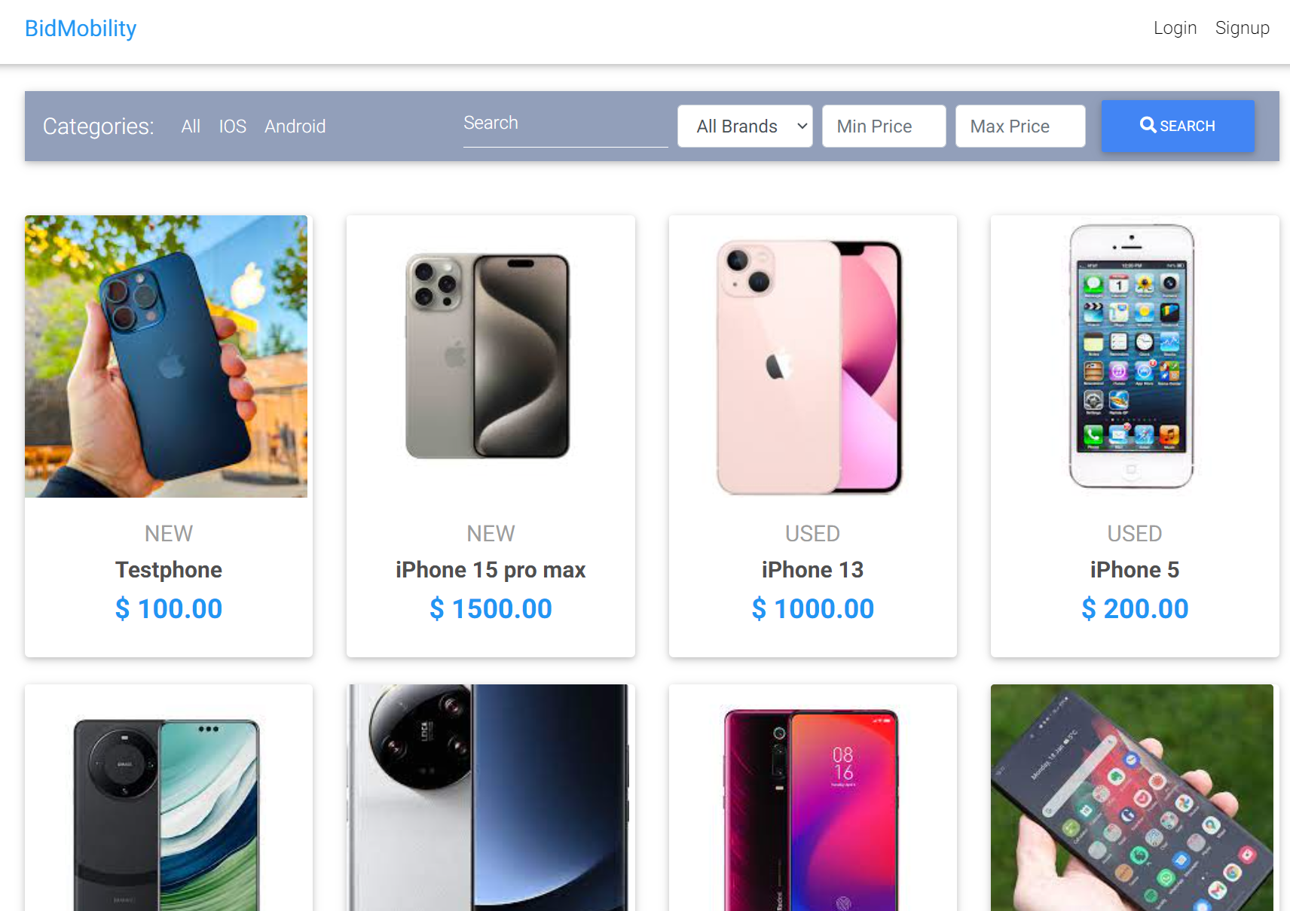
Demo
https://db-group8-401802.uw.r.appspot.com/

Slide 8
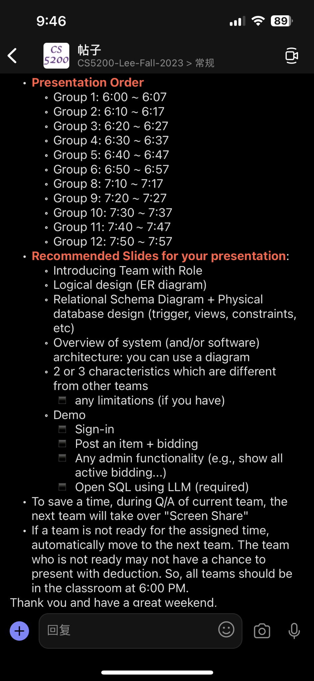
Content:
Introducing Team with Role - Huang
Logical design (ER diagram) - Huang
Relational schema diagram + physical database design - Bei
Characteristics (Architecture diagram) - Chen
Demo - Cui (4min)

Slide 9
Demo steps:
Seller:
post item
Buyer:
sign up + sign in + profile
search
check seller profile
message seller
bidding + order history
optional(rating updates)
chatbot
Admin
sales report
database management

Slide 10
bug：
post item图片问题
(optional) paypal payment
bid: agree和disagree

