Slide 1
Small Project Generate Ai Generating images from text
Pham Tuan Anh

Slide 2
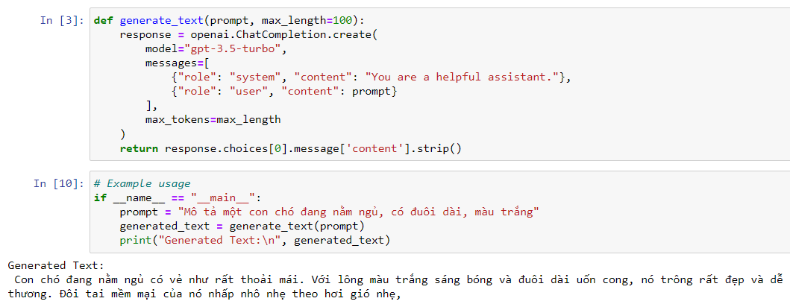
Generate a Descriptive Text Based on a Sample
Objective:
Automatically generate a description of an object based on a provided sample description.
Approach:
Use a pre-trained language model (e.g., GPT-3.5 or similar) to take a sample description as input and generate similar descriptions for other objects.

Slide 3
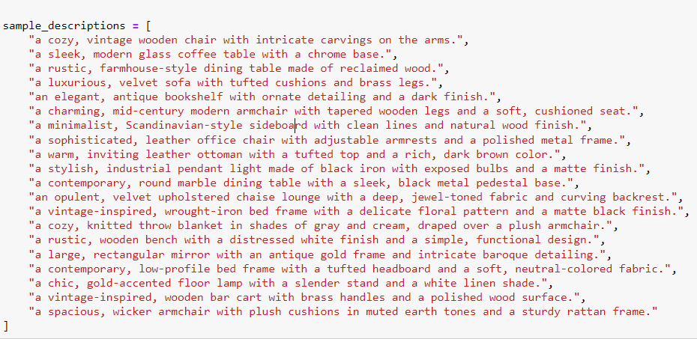
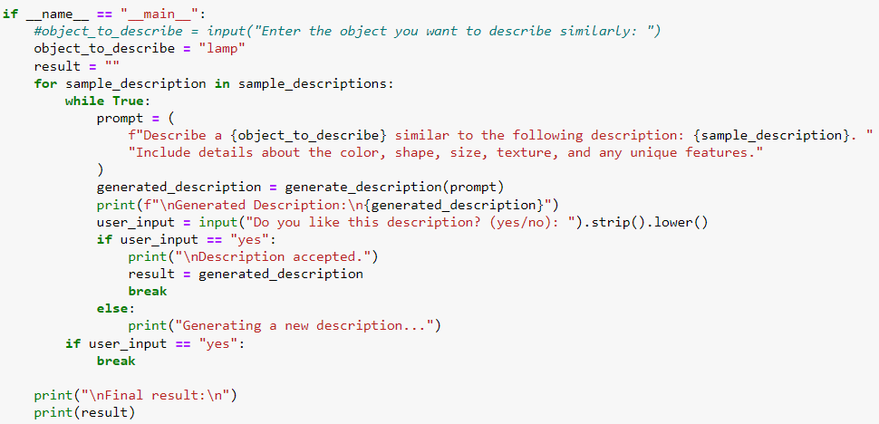
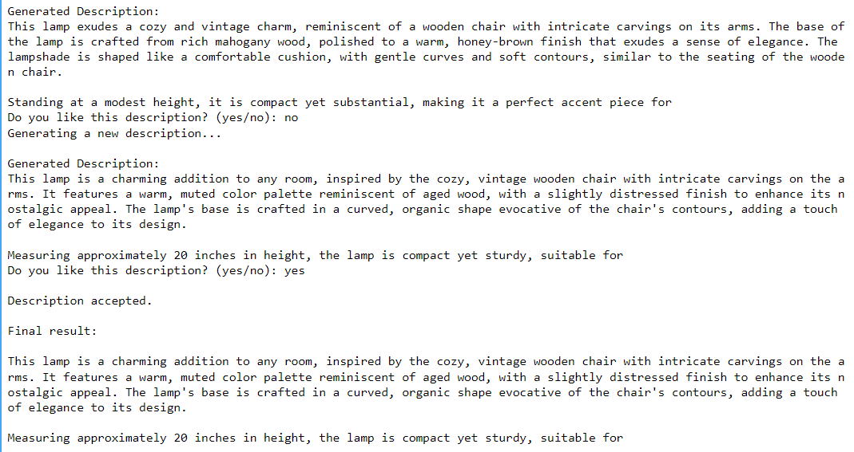
Generate a Descriptive Text Based on a Sample
Tasks:
Start with a sample description, like "a cozy, vintage wooden chair with intricate carvings on the arms.“
Experiment with prompts that lead the model to create variations on this description or describe similar items.
Use specific prompts such as, "Describe a lamp similar to the chair in the previous description" to guide generation.

Slide 4
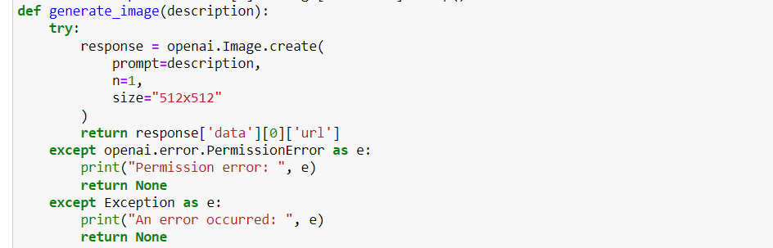
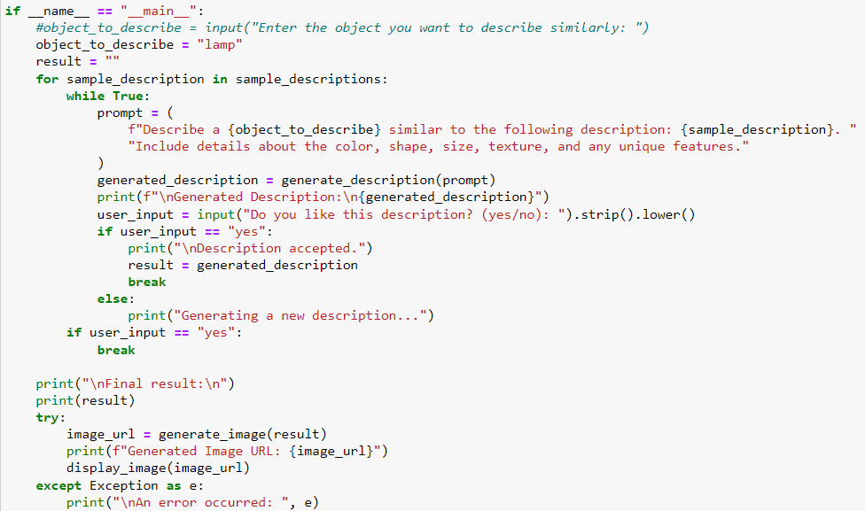
Generate an Image Based on the Description
Objective:
Improve the generated description to ensure it’s detailed enough to translate into a coherent image.
Approach:
Add cues in the description that specify aspects like color, texture, size, and any unique features.
Tasks:
Add details in the prompt like, "Include the color, shape, and size of the object in your description."
For example, if generating a description of a lamp, ensure it includes phrases such as, "a tall, slender metallic lamp with a bronze finish and a soft white light shade."

Slide 5
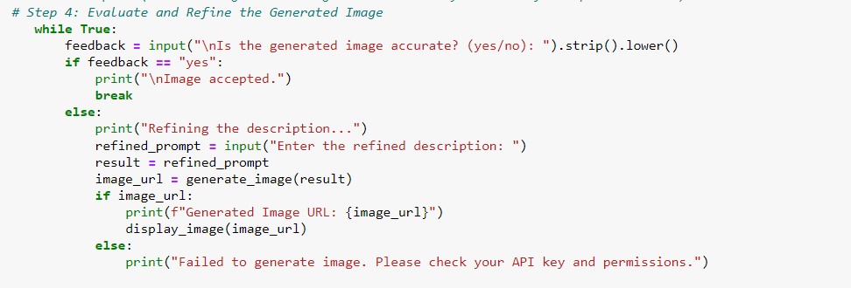
Generate an Image Based on the Description
Objective:
Use the refined description to create an image that reflects the text accurately.
Approach:
Use a text-to-image model, such as DALL-E or Stable Diffusion, which can generate images based on text prompts.
Tasks:
Input the descriptive text into the image generation model.
Experiment with different versions of the prompt if the generated image isn’t satisfactory. Slight adjustments in wording can influence visual outcomes significantly.

Slide 6
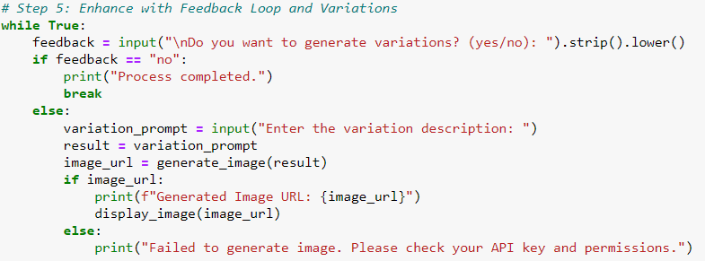
Enhance with Feedback Loop and Variations
Objective:
Use feedback to generate variations or improve the accuracy of both text descriptions and images.
Approach:
Implement a feedback loop where users or evaluators rate the alignment between text and image or suggest modifications.
Tasks:
Try multiple generations with slight variations in the prompt, collecting feedback on each.
Experiment with more complex or abstract objects to test the model's versatility in matching text-to-image consistency.

Slide 7
Thank you for watching

