Slide 1



Sports Products Analysis: Leveraging SQL and Power BI for Data Insights
In this project, I have utilized SQL to analyze a dataset of sports products sales, aiming to uncover insights that can drive business decisions and optimize profitability.
by Daipayan Maitra

Slide 2
Problem Statement and Objectives
Problem Statement
Objectives
The business faced challenges in understanding sales performance and profitability across different product categories and regions. There was a need to analyze sales data comprehensively to identify key insights and opportunities for improvement.
Analyze sales data to identify top-selling products and regional sales distribution.
Calculate key performance indicators (KPIs) such as total sales, operating profit margin, and sales growth rate.
Optimize business strategies based on data-driven insights to maximize revenue and profitability.

Slide 3
Data Collection and Cleaning Process
Data Collection
Data Cleaning
The dataset used for this project was sourced from fp20analytics.com. It contains 9644 rows of data and a single table named "sports".
I utilized Power Query to clean and preprocess the data. This involved renaming headers, changing data types, and removing any inconsistencies or duplicates to ensure data quality and reliability.

Slide 4
Results and Key Findings
Key Insights
Visualizations
Through exploratory data analysis, I uncovered key insights such as the top-selling products, regional sales distribution, and sales trends over time.
I have used various visualizations including bar charts, pie charts, and line graphs to visually represent the findings and make them easily understandable to stakeholders.

Slide 5



SQL Queries for KPIs
KPI 1 – Total Sales
KPI 2 – Operating Profit Margin
KPI 3 – Total Retailers
SELECT ROUND(SUM(Total_Sales)) AS TotalSales
FROM sports;
SELECT (SUM(Operating_Profit) / SUM(Total_Sales)) * 100 AS OperatingProfitMargin
FROM sports;
SELECT COUNT(DISTINCT Retailer) AS Total_Retailers
FROM SPORTS;

Slide 6
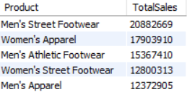
SQL Queries and Data Manipulation Techniques Used
I have utilized SQL queries to manipulate and analyze the data. Some of the queries used include:
Top 5 Selling Products by Total Sales
SELECT Product, SUM(Total_Sales) AS TotalSales
FROM sports
GROUP BY Product
ORDER BY TotalSales DESC
LIMIT 5;

Slide 7
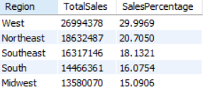
SQL Queries and Data Manipulation Techniques Used
Percentage of Total Sales by Region This regional distribution of sales provides valuable insights for targeting marketing efforts and allocating resources effectively.
SELECT Region, SUM(Total_Sales) AS TotalSales, (SUM(Total_Sales) / (SELECT SUM(Total_Sales) FROM sports)) * 100 AS SalesPercentage
FROM sports
GROUP BY Region
ORDER BY SalesPercentage DESC;

Slide 8

SQL Queries and Data Manipulation Techniques Used
Percentage of Operating Profit by Sales Method
This analysis suggests the effectiveness of in-store sales in driving profitability, highlighting potential areas for further investment or optimization.
SELECT Sales_Method, SUM(Operating_Profit) AS TotalOperatingProfit, (SUM(Operating_Profit) / (SELECT SUM(Operating_Profit) FROM sports)) * 100 AS ProfitPercentage
FROM sports
GROUP BY Sales_Method
ORDER BY ProfitPercentage DESC;

Slide 9
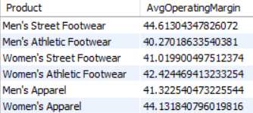
SQL Queries and Data Manipulation Techniques Used
Average Operating Margin by Product Category
These product categories demonstrate strong profitability potential, indicating opportunities for pricing adjustments or cost optimizations..
SELECT Product, AVG(Operating_Margin) AS AvgOperatingMargin
FROM sports
GROUP BY Product;

Slide 10

SQL Queries and Data Manipulation Techniques Used
Total Units Sold by Sales Method
This analysis suggests the popularity of online sales channels among customers, emphasizing the importance of optimizing the online shopping experience.
SELECT Sales_Method, SUM(Units_Sold) AS TotalUnitsSold
FROM sports
GROUP BY Sales_Method
ORDER BY TotalUnitsSold DESC;

Slide 11

SQL Queries and Data Manipulation Techniques Used
Query to identify the product category generating the highest total sales and operating profit
This category represents a significant revenue and profitability driver for the business, indicating the importance of focusing on and investing in this product category.
SELECT Product, SUM(Total_Sales) AS TotalSales, SUM(Operating_Profit) AS TotalOperatingProfit
FROM sports
GROUP BY Product
ORDER BY TotalOperatingProfit, totalsales DESC
LIMIT 1;

Slide 12
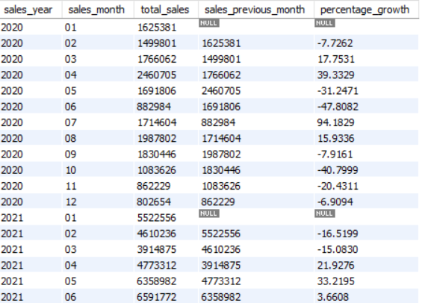
SQL Queries and Data Manipulation Techniques Used
Month on Month Growth:
Total sales by month and sales of the same month of the previous year, along with percentage
SELECT
YEAR(invoice_date) AS sales_year,
MONTH(invoice_date) AS sales_month,
SUM(total_sales) AS total_sales,
LAG(SUM(total_sales)) OVER (PARTITION BY YEAR(invoice_date) ORDER BY MONTH(invoice_date)) AS sales_previous_month,
((SUM(total_sales) - LAG(SUM(total_sales)) OVER (PARTITION BY YEAR(invoice_date) ORDER BY MONTH(invoice_date))) / LAG(SUM(total_sales)) OVER (PARTITION BY YEAR(invoice_date) ORDER BY MONTH(invoice_date))) * 100 AS percentage_growth
FROM
sports
GROUP BY
sales_year, sales_month
ORDER BY
sales_year, sales_month;

Slide 13
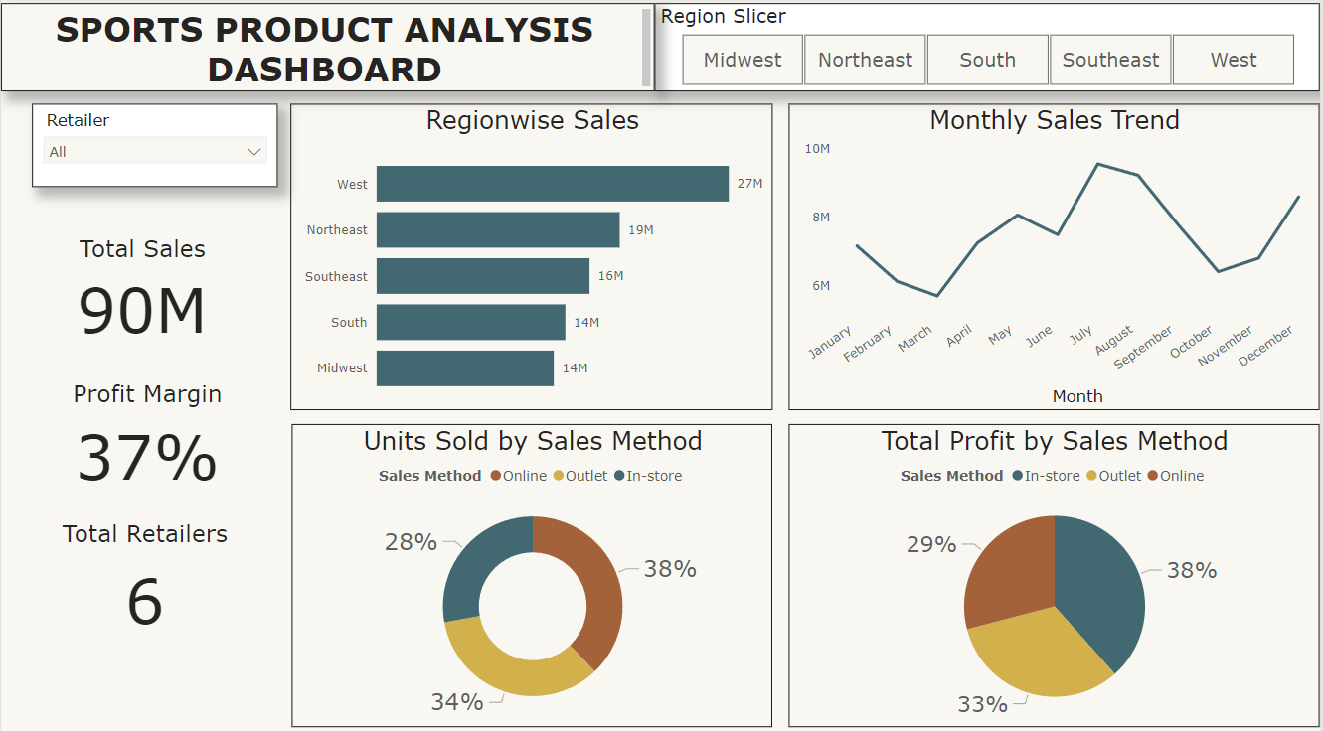
Visualization

