Slide 1
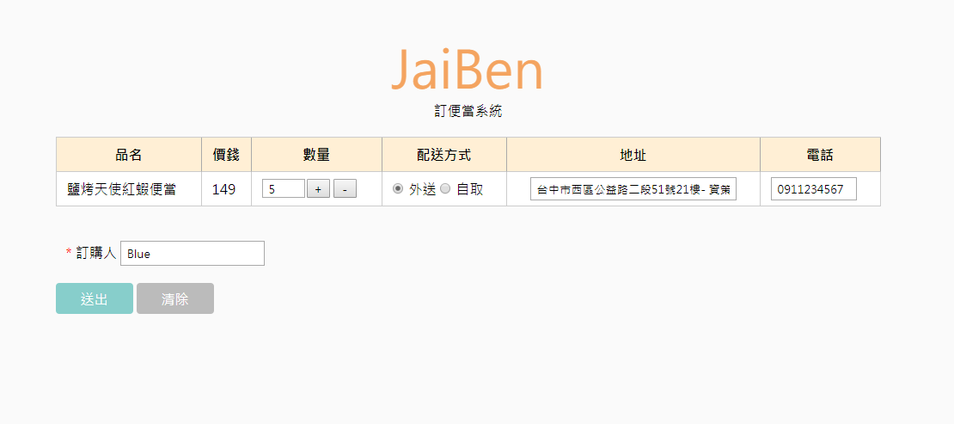
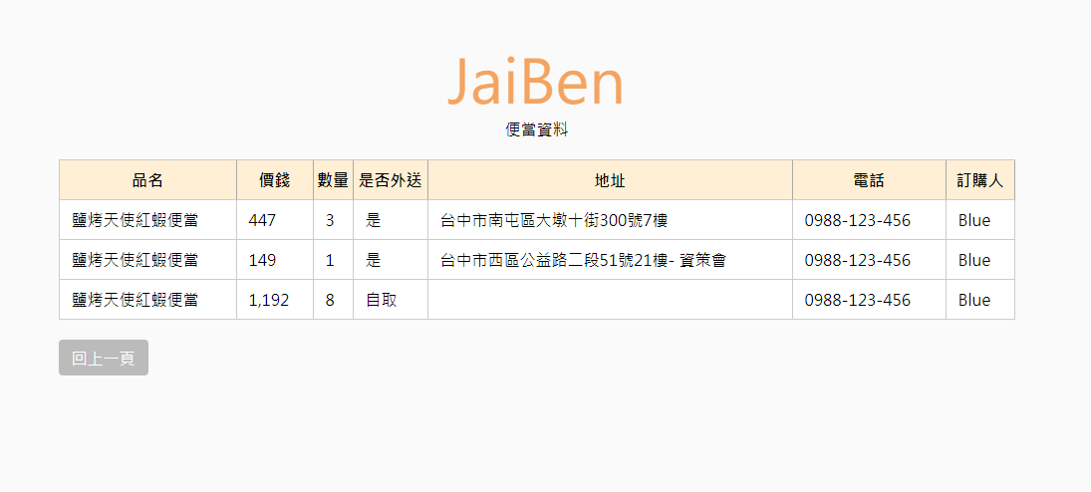
WEB PAGE
-五星便當-

Slide 2
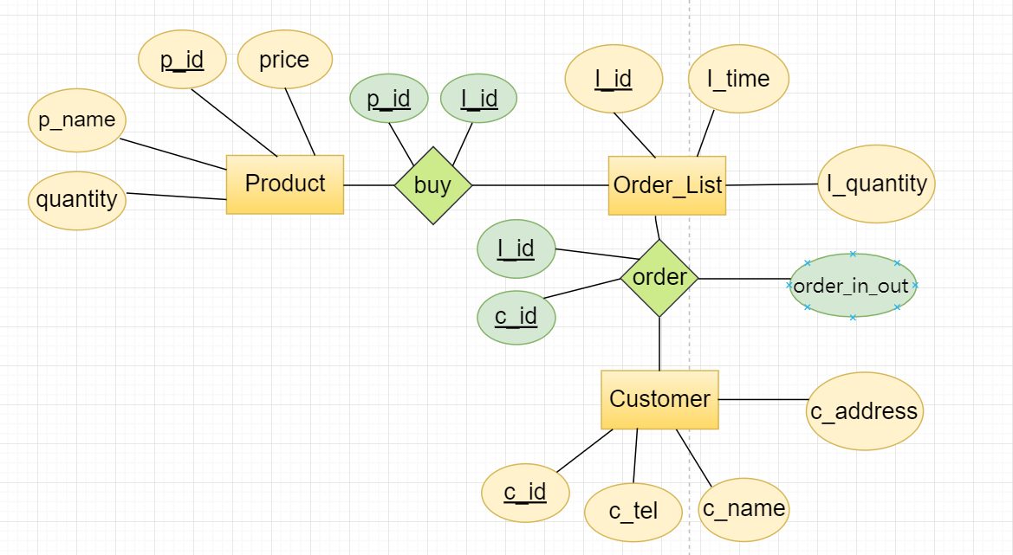
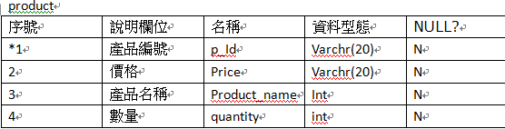
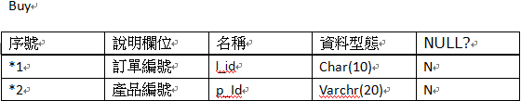
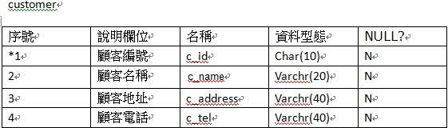
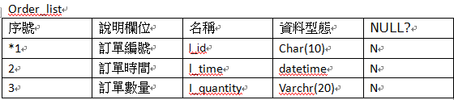
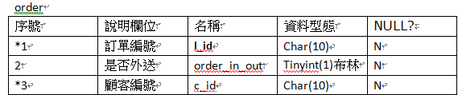
Entity-Relationship Diagrams
-五星便當-

Slide 3
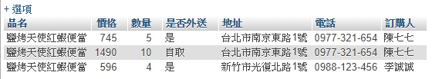

CODE
CREATE VIEW vw_TABLE AS
SELECT p_name AS 品名,價格,I_quantity AS 數量,if(order.order_in_out=1,"是","自取") as 是否外送,c_address AS 地址,c_tel AS 電話,c_name AS 訂購人
FROM `vw_price` left join `order` on `vw_price`.l_id = `order`.`I_id`
left join customer ON `order`.`c_id` = customer.c_id
delimiter $$
create PROCEDURE pro_table()
begin
SELECT * FROM vw_TABLE;
END$$
delimiter ;
CALL pro_table()
delimiter $$
create PROCEDURE pro_maxsale()
begin
SELECT MAX(`SUM(I_quantity)`) AS '最大總購買數' FROM vw_max;
END$$
delimiter ;
call pro_maxsale();
-五星便當-

