Slide 1

CommuniqElevate
AI-powered Language Assessment Platform
Group 2025-S1-12-11522
Team members
Meijing Chen| u3267026
Yuxuan Fu| u3271565
Haozhe Yin| u3249962
Xiaowen Zeng| u3270971

Slide 2
Background and Motivation
Traditional LSRW Assessment
CommuniqElevate
Real-Time Feedback
Objectivity
Continuous Improvement
Low Efficency
Subjectibity
Delay Feedback
AI

Slide 3
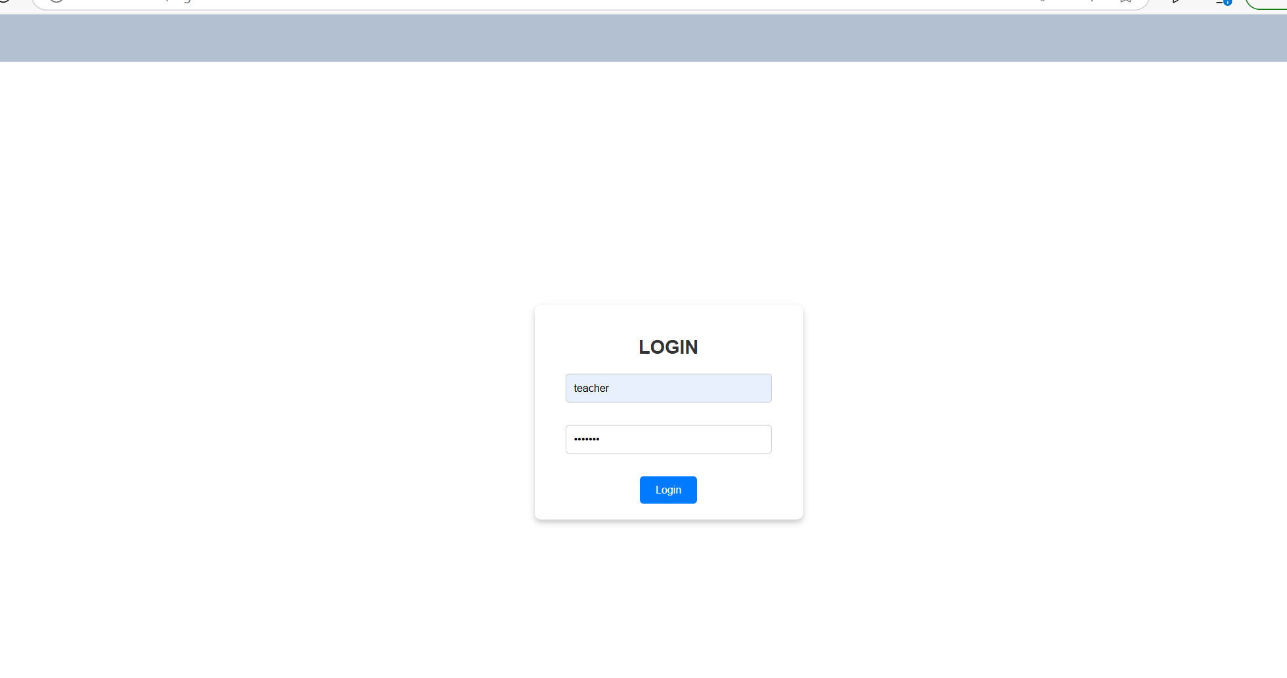
Demo
This demonstration showcases CommuniqElevate's intelligent language assessment system. Users can log in as a teacher or student, upload their submissions, and instantly receive AI-generated evaluations. Our platform analyzes grammar, fluency, coherence, and relevance, providing actionable feedback to support continuous language improvement.

Slide 4
Project Objective & Scope
Objective | Build an AI-powered platform to assess students’ LSRW (Listening, Speaking, Reading, Writing)skills with real-time, personalized feedback.
Scope | Writing: Grammar and relevance evaluation (BERT) Speaking & Listening: Speech-to-text & fluency scoring (Whisper ASR) Reading: Comprehension analysis using NLP(Natural Language Processing) Theme relevance: Semantic matching Tech stack: Vue.js, Flask, SQLite, Node.js

Slide 5
Stakeholder Needs
 | Students | Teachers | Institutions
 | Receive instant, personalized language feedback | Save time on manual grading | Scalable, cost-effective assessment solution
 | Practice LSRW skills with AI-guided evaluations | Monitor progress with analytics and dashboards | Aligns with digital education goals
 | Gain confidence and improve self-paced learning | Customize and post assessments easily | Promotes fairness and transparency in evaluations
Who Benefits from CommuniqElevate?

Slide 6





What we already achieved
Connections with institutions or society
Successful language model applied
Practice on Teacher-Student Interaction
1. Applications of multiple assessment on AI rating system.
1. Customized learning methods students.
1. A cheaper learning method that is easily accessible and usable.
2. Applied integration on NLP model and platform.
2. Provide experiences on future more intelligent educating tools.
3. iFLYTEK Suntone ISE integration with popular language models.

Slide 7

What we learnt from this?
Valuable experience: integrating multiple technologies, including natural language processing and personalized learning systems.
1. Communication and decision-making efficiency across group members (parallel departments).
Interdisciplinary collaboration requires:
2. Manage complex task under tight timelines.
Linguistics
Computer Science
—>>Ensure project milestones were successfully achieved.
Education
Practicing Flat management

Slide 8



Conclusion & Recommendations
Achieved goal: AI-based assessment for Listening, Speaking, Reading, and Writing
Improve AI scoring explainability
Include human review options
Create an AI ethics group

Slide 9



Future steps
Mobile App Integration
Multi-language Support
Learning Analytics Dashboard

Slide 10
Q&A
Thanks

