Slide 1
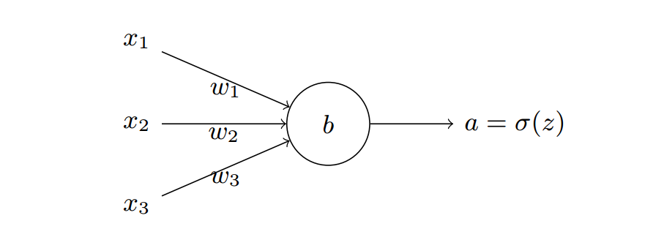
z_{i} = sigmoid(w₁x₁ + w₂x₂ + w₃x₃ + w_{b})

