Slide 1
CLIO vs Claude Code baseline: counted thesis trials (CLIO n = 5 / 5 / 5 for E1/E2/E3; baseline n = 5)
E1 / E2 / E3 Morphorm packets · updated 2026-10-13
• Does CLIO (clio-agent with the factorio-flat 0.5.0 blueprint) reach the same scientific outcome as the Claude Code baseline, and at what cost and time?
• Counted thesis trials: five per system per experiment. E1 uninterrupted, E2 interrupted recovery, E3 disparate storage.
• Measured: scored outcome (thesis scorer), cost, wall/model/tool/Slurm time, API calls, tokens, Morphorm jobs and restarts.
COUNTED THESIS TRIALS · CLIO (factorio-flat 0.5.0) vs Claude Code baseline · n = 5 per system per experiment

Slide 2
What we compared
Same frozen packets, prompts, model and agent-host contract; only the system around the model differs
• Baseline: the 5 counted Claude Code trials per experiment (Claude Code 2.1.295, claude-fable-5-1, CLI-default effort, --dangerously-skip-permissions).
• CLIO: 5 counted trials per experiment, each a fresh deployment in its own agent-host job with the baseline's Slurm contract: clio-agent 0.9.5b5.post2, provider claude_code driving the same Claude Code 2.1.295 binary and model, factorio-flat 0.5.0, approval bypass, CLI-default effort, runtime tuning 3600/3600/5400 s, private clio-core daemon, no user-configured MCP servers, stream audit on. The blueprint's own web MCP (one tool, web_fetch) was mounted; like the baseline's built-in WebSearch/WebFetch it was forbidden by the task rules and never called.
• Identical for both: frozen packets (FROZEN-EX8-v1 / FROZEN-EX16-v1 / E3 control packet), byte-identical prompts, one user message per session (no nudges), 6600 s session limit, same scorer, acceptance specs and tolerances, same packet verification.
• Trials ran one at a time (as the baseline did). Statistics: ratio of means with bootstrap 95 % CI; exact permutation test (252 splits) and exact Mann-Whitney U. 'Different' only when p < 0.05 and the CI excludes 1. With n = 5, 'no detectable difference' is not proof of equality.
COUNTED THESIS TRIALS · CLIO (factorio-flat 0.5.0) vs Claude Code baseline · n = 5 per system per experiment

Slide 3
Trial attempts
Same rule as the baseline: non-agent failures are kept, marked invalid and replaced with a new numbered attempt
Exp | Attempt | Status | Note
E1 | trial_03 | failed | CLIO server version probe of the pinned CLI shim failed transiently on notch272 ([Errno 14] Bad address, clio-server log), so CLIO fell back to ~/.local/bin/claude (2.1.296) instead of the pin 2.1.295; only the CLI pin checks failed; infrastructure (non-agent) cause; excluded; replaced by trial_03R; packet kept unchanged
E2 | trial_05 | failed | Session B made zero API calls: the Claude Code OAuth session had expired and could not be refreshed (ClaudeCodeSignedOutError at 10:50:29Z, 0 tokens); infrastructure (non-agent) cause; excluded; replaced by trial_05R; packet kept unchanged
E3 | trial_01 | aborted_before_launch | preflight stopped at init_node_local_staging (ACTION_REQUIRED tmpdir_contains_account_name): run_clio_e3_trial_v2.sh sourced the baseline config but did not export E3_ALLOW_ACCOUNT_NAME_IN_TMPDIR (the baseline runner does); no agent, CLIO deployment or model call was launched; runner fixed; replaced by clio/trial_06
E3 | trial_02 | awaiting_scoring | session completed (finished_idle, 31 min) and outputs passed 34/34 science checks in a test scoring, but the boundary audit FAILed: (a) 11 reads of the agent's own CLIO runtime (blueprint skills, own tool-output; re-labelled OWN_RUNTIME by the CLIO supplement adopted 2026-10-13) and (b) CHANGED clio/README.md, a researcher edit made during the trial; researcher-caused, excluded, not scored; replaced by clio/trial_07
COUNTED THESIS TRIALS · CLIO (factorio-flat 0.5.0) vs Claude Code baseline · n = 5 per system per experiment

Slide 4
Headline: outcome, cost and time (mean ± SD)
Wall/model/outside-Slurm minutes summed over sessions (E2 = A + B)
Exp | System | n | Outcome | Cost | Wall min | Model min | Outside Slurm min | API calls | Cancelled jobs
E1 | Claude Code baseline | 5 | accepted 5/5 | $7.98 ± 0.47 | 22.0 ± 1.4 | 11.6 ± 1.9 | 12.5 ± 1.8 | 34 ± 8 | 0.0 ± 0.0
E1 | CLIO 0.5.0 | 5 | accepted 5/5 | $5.75 ± 0.90 | 26.8 ± 2.2 | 8.9 ± 2.8 | 10.3 ± 2.9 | 29 ± 5 | 0.0 ± 0.0
E2 | Claude Code baseline | 5 | accepted 5/5 | $13.57 ± 0.86 | 68.3 ± 10.4 | 19.6 ± 1.2 | 21.1 ± 1.3 | 70 ± 10 | 0.8 ± 0.4
E2 | CLIO 0.5.0 | 5 | accepted 5/5 | $10.59 ± 0.33 | 58.2 ± 10.4 | 14.3 ± 2.3 | 16.2 ± 2.7 | 51 ± 3 | 0.0 ± 0.0
E3 | Claude Code baseline | 5 | accepted 5/5 | $7.45 ± 0.50 | 30.9 ± 1.2 | 11.7 ± 2.1 | 13.4 ± 2.1 | 49 ± 3 | 0.0 ± 0.0
E3 | CLIO 0.5.0 | 5 | accepted 5/5 | $6.21 ± 0.32 | 28.2 ± 5.0 | 9.3 ± 2.0 | 12.5 ± 2.5 | 27 ± 1 | 0.0 ± 0.0
COUNTED THESIS TRIALS · CLIO (factorio-flat 0.5.0) vs Claude Code baseline · n = 5 per system per experiment

Slide 5
Same or different? Statistical comparison
Ratio = CLIO 0.5.0 mean ÷ baseline mean; red = significant (p < 0.05 and CI excludes 1)
Metric | E1 | E2 | E3
Cost | ×0.72 [0.64–0.83] p=0.008 | ×0.78 [0.74–0.83] p=0.008 | ×0.83 [0.78–0.89] p=0.008
Wall time | ×1.22 [1.12–1.32] p=0.008 | ×0.85 [0.71–1.03] p=0.167 | ×0.91 [0.77–1.03] p=0.325
Model time | ×0.77 [0.57–1.00] p=0.127 | ×0.73 [0.65–0.84] p=0.016 | ×0.80 [0.65–1.00] p=0.127
Outside Slurm | ×0.82 [0.63–1.03] p=0.175 | ×0.77 [0.68–0.89] p=0.032 | ×0.94 [0.77–1.15] p=0.548
Slurm wait | ×1.74 [1.39–2.05] p=0.008 | ×0.89 [0.68–1.17] p=0.389 | ×0.90 [0.71–1.06] p=0.484
API calls | ×0.85 [0.68–1.06] p=0.325 | ×0.72 [0.64–0.81] p=0.008 | ×0.55 [0.52–0.58] p=0.008
Output tokens | ×0.68 [0.55–0.88] p=0.032 | ×0.67 [0.61–0.73] p=0.008 | ×0.70 [0.65–0.76] p=0.008
Cache writes | ×0.77 [0.71–0.83] p=0.008 | ×0.92 [0.88–0.98] p=0.048 | ×1.04 [0.97–1.12] p=0.309
• Tests: exact permutation test on the difference in means (also exact Mann-Whitney U, in data/stats.csv); bootstrap 95 % CI of the ratio. With n = 5, a non-significant result means 'no detectable difference', not 'equal'.
COUNTED THESIS TRIALS · CLIO (factorio-flat 0.5.0) vs Claude Code baseline · n = 5 per system per experiment

Slide 6
Verdict per experiment
• E1: outcomes CLIO accepted 5/5 vs baseline accepted 5/5
  E1 cost: LOWER for CLIO (×0.72, 95 % CI 0.64–0.83; p = 0.008)
  E1 wall time: HIGHER for CLIO (×1.22, 95 % CI 1.12–1.32; p = 0.008)
  E1 model time: no detectable difference (×0.77, 95 % CI 0.57–1.00; p = 0.127)
  E1 time outside Slurm: no detectable difference (×0.82, 95 % CI 0.63–1.03; p = 0.175)
  E1 API calls: no detectable difference (×0.85, 95 % CI 0.68–1.06; p = 0.325)
• E2: outcomes CLIO accepted 5/5 vs baseline accepted 5/5
  E2 cost: LOWER for CLIO (×0.78, 95 % CI 0.74–0.83; p = 0.008)
  E2 wall time: no detectable difference (×0.85, 95 % CI 0.71–1.03; p = 0.167)
  E2 model time: LOWER for CLIO (×0.73, 95 % CI 0.65–0.84; p = 0.016)
  E2 time outside Slurm: LOWER for CLIO (×0.77, 95 % CI 0.68–0.89; p = 0.032)
  E2 API calls: LOWER for CLIO (×0.72, 95 % CI 0.64–0.81; p = 0.008)
• E3: outcomes CLIO accepted 5/5 vs baseline accepted 5/5
  E3 cost: LOWER for CLIO (×0.83, 95 % CI 0.78–0.89; p = 0.008)
  E3 wall time: no detectable difference (×0.91, 95 % CI 0.77–1.03; p = 0.325)
  E3 model time: no detectable difference (×0.80, 95 % CI 0.65–1.00; p = 0.127)
  E3 time outside Slurm: no detectable difference (×0.94, 95 % CI 0.77–1.15; p = 0.548)
  E3 API calls: LOWER for CLIO (×0.55, 95 % CI 0.52–0.58; p = 0.008)
COUNTED THESIS TRIALS · CLIO (factorio-flat 0.5.0) vs Claude Code baseline · n = 5 per system per experiment

Slide 7
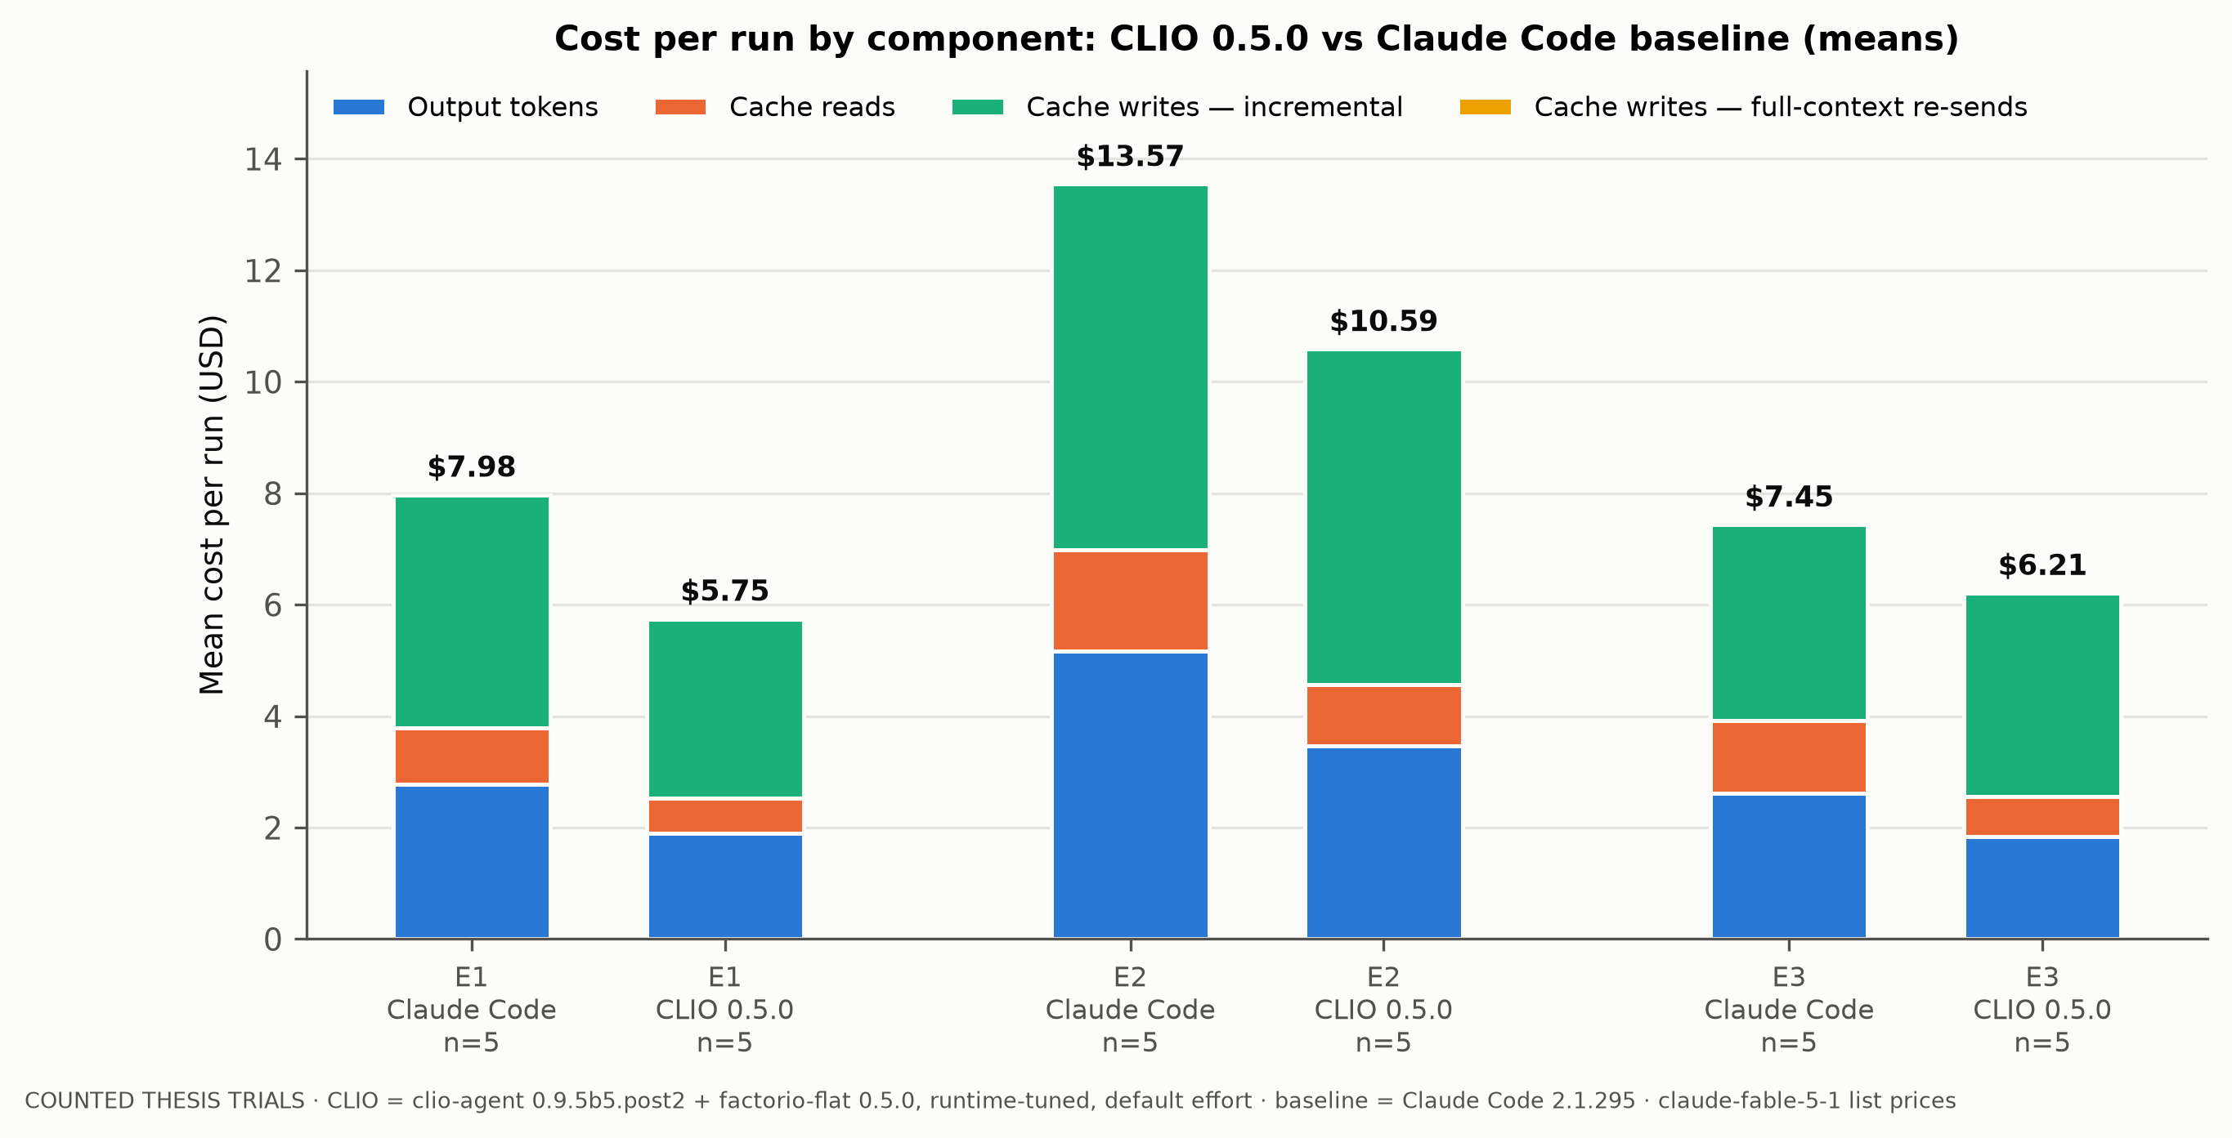
Where the money goes
Mean cost per run by component
COUNTED THESIS TRIALS · CLIO (factorio-flat 0.5.0) vs Claude Code baseline · n = 5 per system per experiment

Slide 8
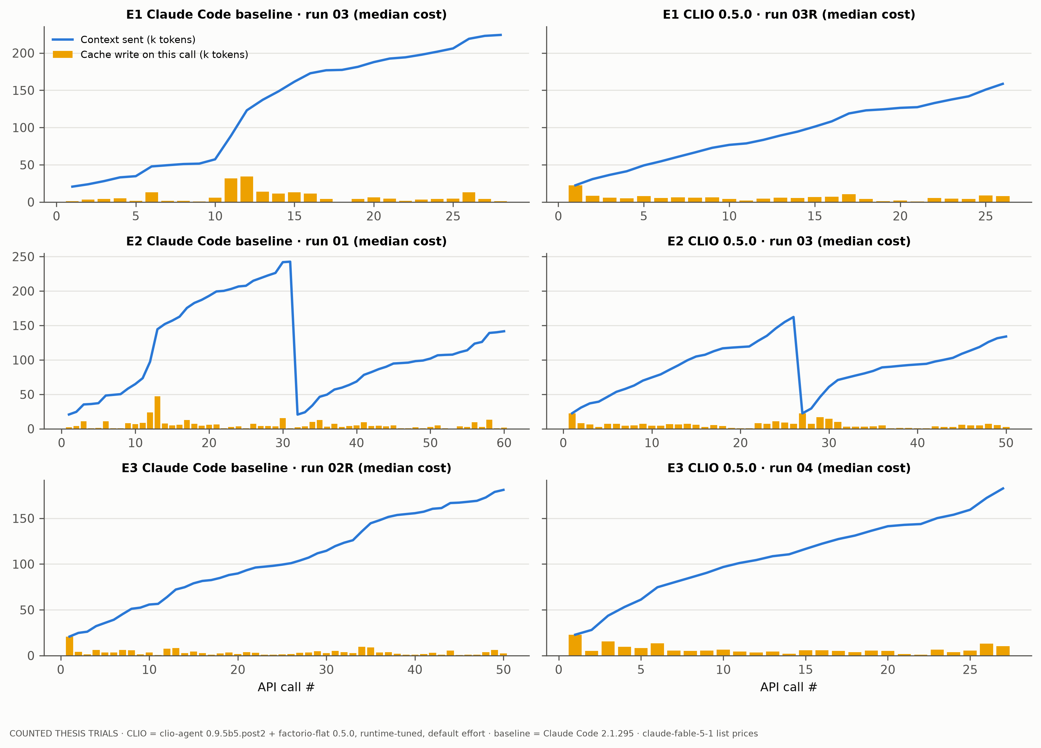
Per-call view: context sent and cache writes
Median-cost run of each system and experiment
COUNTED THESIS TRIALS · CLIO (factorio-flat 0.5.0) vs Claude Code baseline · n = 5 per system per experiment

Slide 9
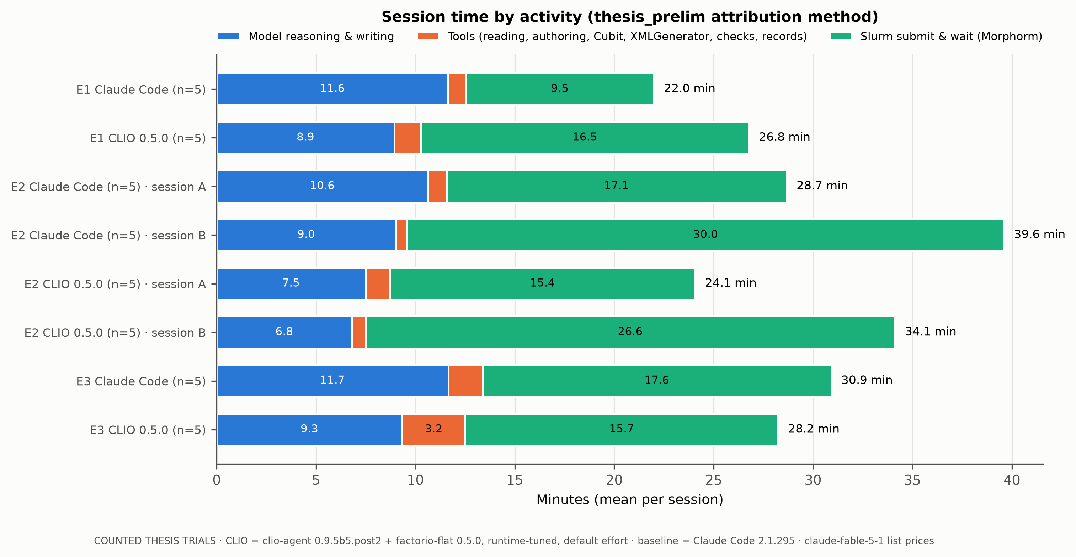
Time: model minutes, tools and Slurm waits
Slurm/Morphorm waits depend on node and contention; model and tool time are the agent's part
COUNTED THESIS TRIALS · CLIO (factorio-flat 0.5.0) vs Claude Code baseline · n = 5 per system per experiment

Slide 10
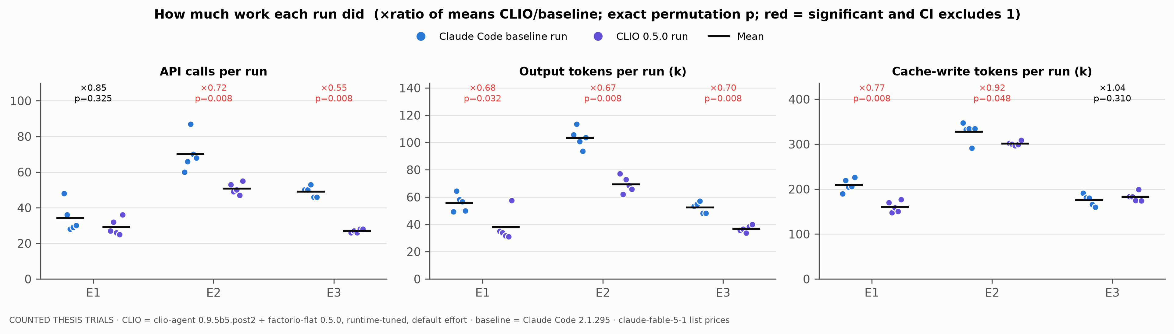
How much work each run did
Each dot is one run; bar = mean
COUNTED THESIS TRIALS · CLIO (factorio-flat 0.5.0) vs Claude Code baseline · n = 5 per system per experiment

Slide 11
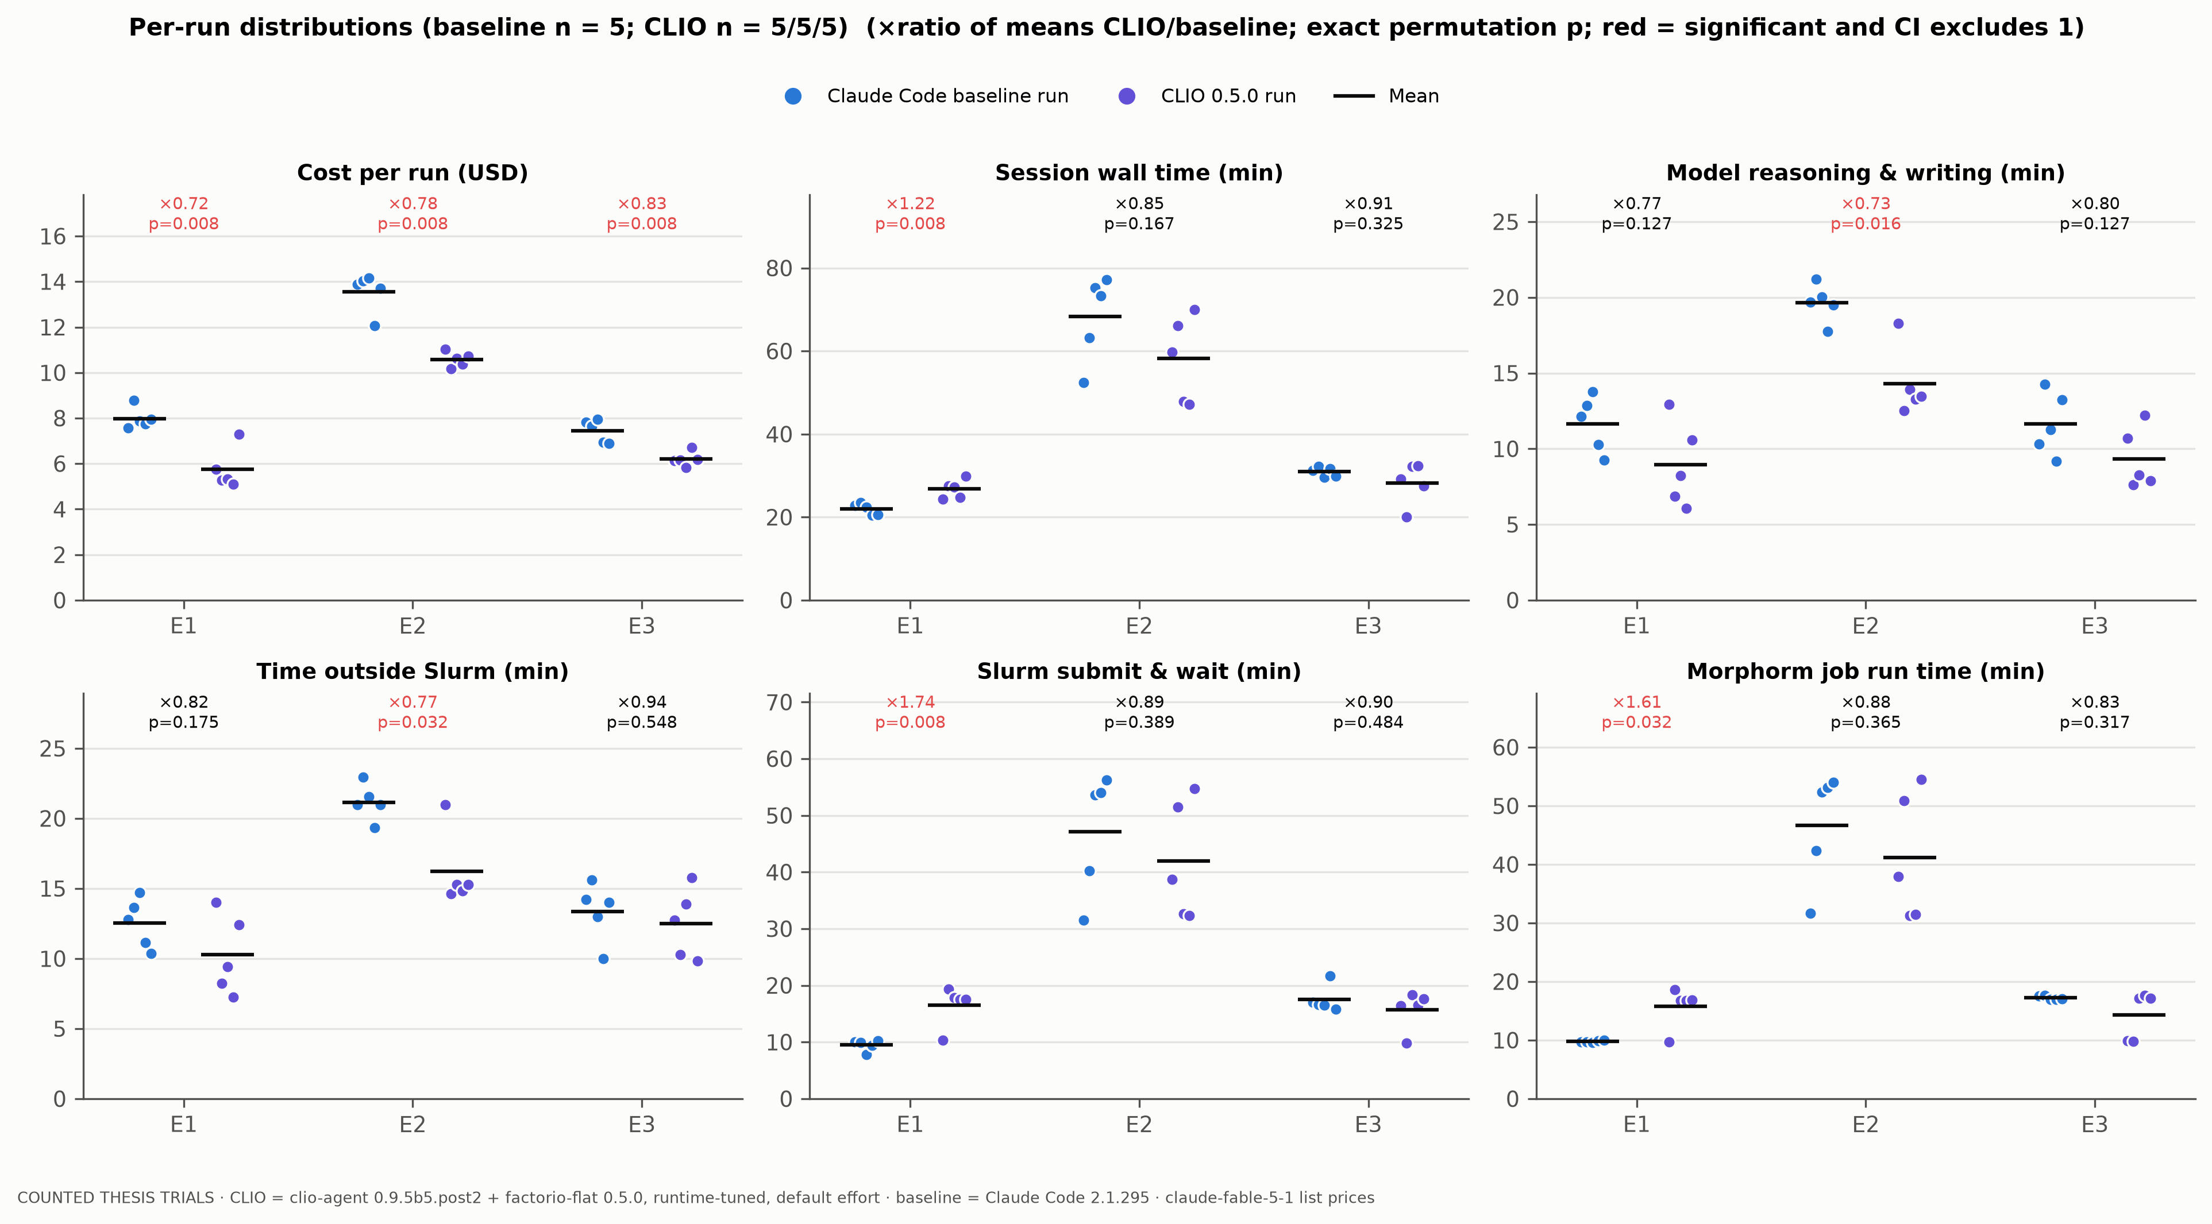
Per-run distributions: cost and time
n = 5 vs n = 5; ratio of means and exact permutation p above each pair
COUNTED THESIS TRIALS · CLIO (factorio-flat 0.5.0) vs Claude Code baseline · n = 5 per system per experiment

Slide 12
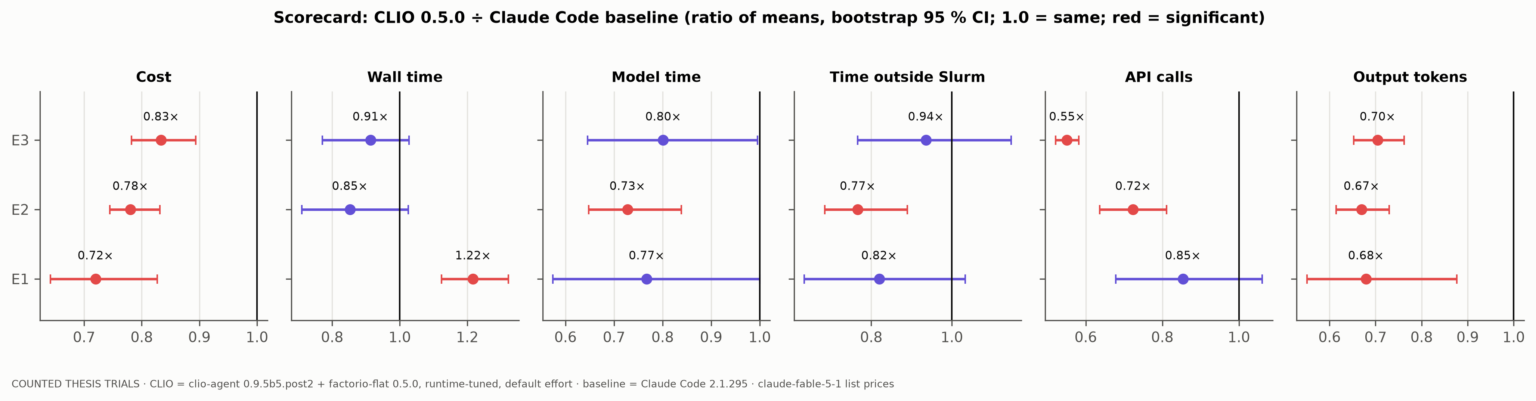
Scorecard: CLIO 0.5.0 relative to the baseline
Ratio of means with bootstrap 95 % CI; 1.0 = same
COUNTED THESIS TRIALS · CLIO (factorio-flat 0.5.0) vs Claude Code baseline · n = 5 per system per experiment

Slide 13
Morphorm jobs: nodes, run time and restarts
Every Morphorm/Cubit job submitted by the agent (sacct)
Exp | System | Runs | Jobs | Cancelled | Runs with a cancel | Mean completed job (min) | Nodes (completed jobs)
E1 | Claude Code | 5 | 5 | 0 | 0 | 9.8 | notch351×5
E1 | CLIO 0.5.0 | 5 | 5 | 0 | 0 | 15.7 | notch274×3, notch351×1, notch273×1
E2 | Claude Code | 5 | 16 | 4 | 4 | 19.5 | notch351×5, notch272×5, notch274×2
E2 | CLIO 0.5.0 | 5 | 10 | 0 | 0 | 20.6 | notch351×5, notch274×3, notch204×2
E3 | Claude Code | 5 | 5 | 0 | 0 | 17.2 | notch274×3, notch273×1, notch272×1
E3 | CLIO 0.5.0 | 5 | 5 | 0 | 0 | 14.3 | notch351×2, notch273×2, notch272×1
• E2 cancellations are the restart-index mistake (Stage 2 started from the wrong saved state, then cancelled and resubmitted).
• Job run time differs by node and load, which moves wall time independently of the agent.
COUNTED THESIS TRIALS · CLIO (factorio-flat 0.5.0) vs Claude Code baseline · n = 5 per system per experiment

Slide 14
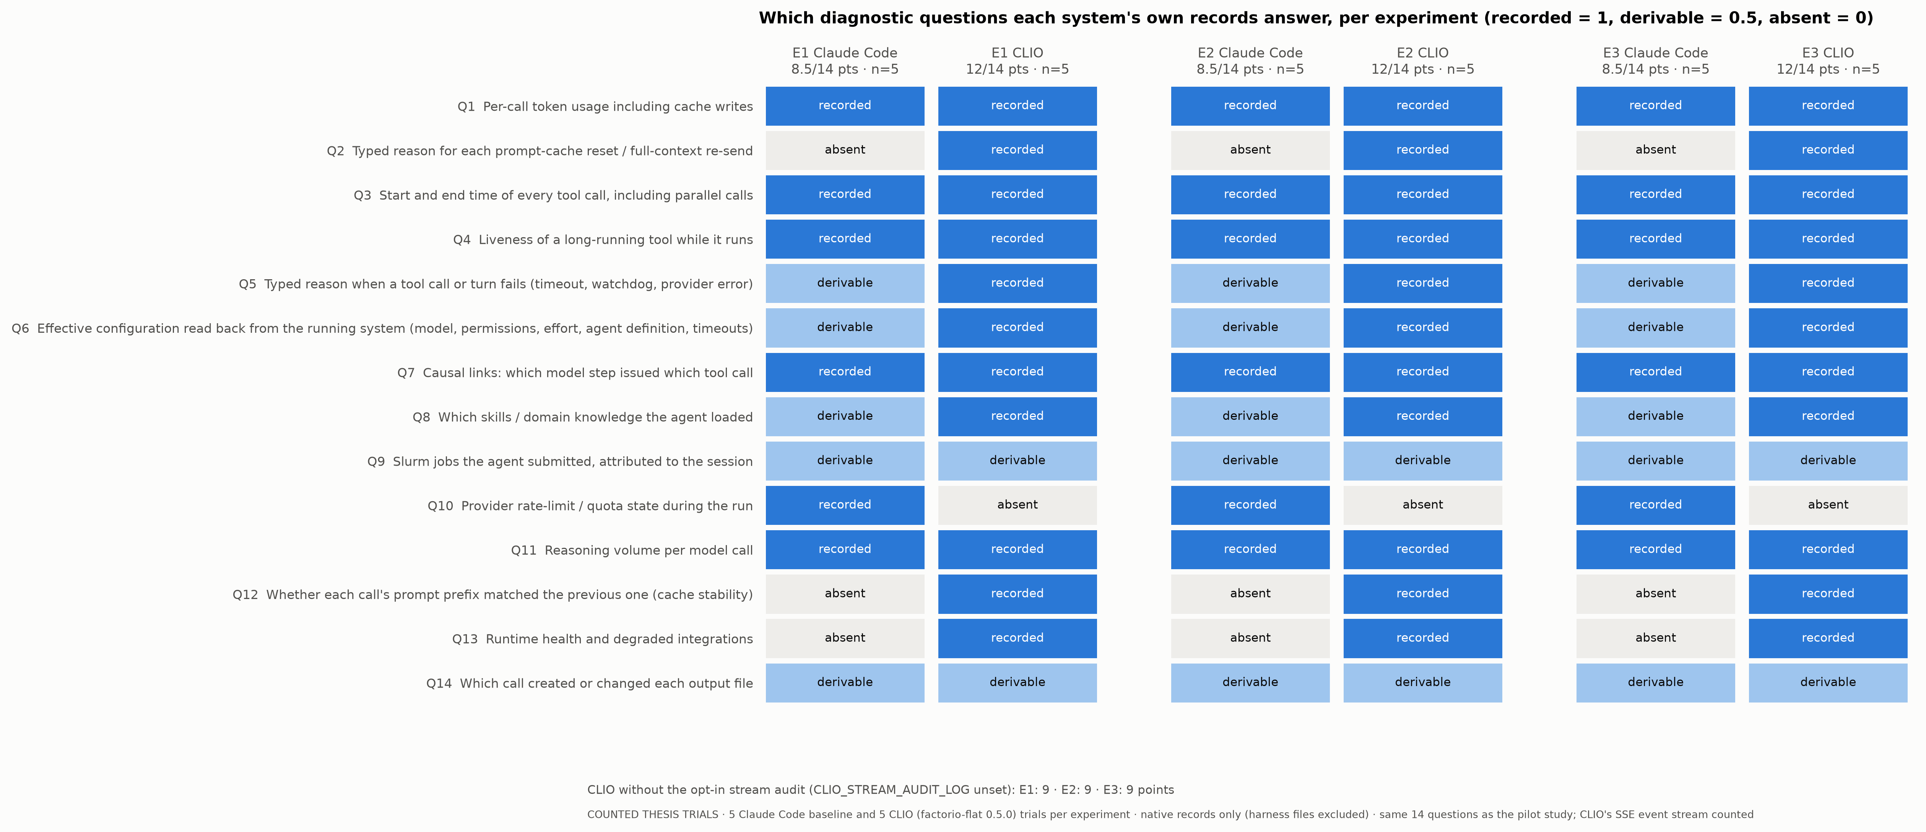
Observability: which questions each system's own records answer
Same 14 diagnostic questions and code-scored rules as the pilot study, now on the counted trials (n = 5 per system per experiment)
COUNTED THESIS TRIALS · CLIO (factorio-flat 0.5.0) vs Claude Code baseline · n = 5 per system per experiment

Slide 15
Observability in the counted trials: numbers
Only records each system writes about itself; files written by our runners are excluded
 | E1 | E2 | E3 | Pilots (for comparison)
Claude Code baseline: points / 14 (fully recorded) | 8.5 (6) | 8.5 (6) | 8.5 (6) | 8.5 (6)
CLIO with stream audit | 12 (11) | 12 (11) | 12 (11) | 11.5–12 (10)
CLIO without stream audit (opt-in) | 9 (8) | 9 (8) | 9 (8) | 8.5–9 (7)
Distinct record types per run: baseline vs CLIO | 31 vs 103 | 31 vs 103 | 31–35 vs 103 | 31 vs 73–80
Structured records per model call | 18–29 vs 188–246 | 21–24 vs 217–230 | 15–18 vs 213–257 | 15–29 vs 180–244
Disk for own records per run (CLIO + full exports) | 2.6 vs 21 MB (323 MB) | 4.0 vs 37 MB (849 MB) | 2.5 vs 23 MB (347 MB) | ≈2–4 vs 70–150 MB
• Same picture as the pilots, in all three experiments: CLIO answers 12 of 14 questions vs 8.5 for Claude Code; without the opt-in audit the two are close (9 vs 8.5) but cover different questions.
• Change from the pilots: Q4 (liveness of a long tool) is now 'recorded' for CLIO because the counted runner kept CLIO's SSE event stream (tool.call.progress); the pilots did not keep it.
• CLIO still lacks Q10 (running rate-limit state): it consumes the Claude Code stream and does not keep it. The baseline lacks Q2, Q12, Q13 (cache-reset reasons, prefix hashes, runtime health).
• Cost of the breadth: about 8–9× the storage for the records themselves, about 120–210× with CLIO's full session exports.
COUNTED THESIS TRIALS · CLIO (factorio-flat 0.5.0) vs Claude Code baseline · n = 5 per system per experiment

Slide 16
Observability in the counted trials: what it showed
Cases where CLIO's own records answered a question about a counted trial
• Cache stayed warm in every counted CLIO session (Q2): the stream audit typed all 535 model calls; 515 were incremental ('delta') and 20 were full sends, one first call per session (5 + 10 + 5 sessions). Zero 'session_evicted' re-sends, which confirms that the idle-reaper fix from the pilots held.
• E2-05 exclusion (Q5): CLIO recorded Session B's failure as a typed ClaudeCodeSignedOutError with 0 tokens, so the cause (expired login, not the agent) was clear from CLIO's own trace.
• E1-03 exclusion (Q6/Q13): CLIO's server log recorded the failed version probe of the pinned CLI ([Errno 14] Bad address) and its fallback to 2.1.296; the CLI-pin check caught it, and the log showed why.
• Which skills the agent used (Q8): every counted CLIO session recorded skill.loaded twice (the blueprint's packet-mode skills); the baseline has no such event.
• Effective configuration (Q6): model, approval mode, effort, blueprint id and version, and timeouts were read back from the running CLIO for every session and frozen in configuration_freeze.json before the prompt was sent.
• Limits: neither system attributes Slurm jobs to the session (Q9) or records which call wrote each output file (Q14); both are reconstructed from tool output.
COUNTED THESIS TRIALS · CLIO (factorio-flat 0.5.0) vs Claude Code baseline · n = 5 per system per experiment

Slide 17
Which parts of CLIO did E1–E3 exercise?
From each session's recorded toolset, SSE tool calls and stream audit (15 counted trials)
CLIO component | Used in E1–E3? | Evidence
clio-agent: GACT agent loop, provider claude_code, blueprint (factorio-flat 0.5.0) | yes | every session; this is what was compared
Tools | shell_bash, load_skill only | 45 tools offered; all 20 counted sessions called only shell_bash (25–55 per session) and load_skill (2)
clio-core: session/context store (events, transcript segments) | yes, passively | store.put / store.write rows in the audit; private daemon per session
Context engine (compaction, recall_context, memory search) | no | no session approached the context limit (compaction.auto_skipped); recall/memory tools never called
Assimilation engine (CAE: ingest files into tagged blobs) | no | no tool exposes it to the agent; not configured in the deployment
Transfer engine (CTE: tiered RAM/disk storage, FUSE) | no | Morphorm and E3 staging used plain files, Slurm and Globus as in the baseline
Exploration engine (CEE: query/retrieve) | no | no tool exposes it to the agent
• So the results measure CLIO as an agent harness (loop, blueprint, runtime, telemetry), not its data engines.
• The engines were tested separately, without a model (CLIO_engine_pilots/): transfer works but is slower than plain local storage when durability is matched and loses data on a crash; assimilation stores raw bytes without parsing Exodus; exploration has no semantic search in this build (indexer chimod missing).
COUNTED THESIS TRIALS · CLIO (factorio-flat 0.5.0) vs Claude Code baseline · n = 5 per system per experiment

Slide 18
What the experiments show (qualitative)
Same model and CLI in both arms; only the agent system around them differs
Experiment | What CLIO changed | Why
All three | Same accepted science, no human input; less writing, fewer and larger model calls, much richer self-records | The harness and blueprint change how the model works, not what it can solve
E1 uninterrupted | Went straight to a correct deck and job; output 0.68×, cost 0.72×; agent time n.s. | Blueprint Morphorm/Slurm guidance and bundled checks; wall time higher only from Slurm node speed
E2 interrupted recovery | Clearest advantage: no wrong-restart cancels (baseline 4/5 runs); model time 0.73×, cost 0.78× | Encoded restart-state knowledge, not memory: Session B was a fresh deployment, as in the baseline
E3 disparate storage | Cheaper (0.83×), calls 0.55×; time and context ≈ baseline; staging behaviour the same | Only the Morphorm half was helped; nothing in CLIO's blueprint or tools addressed finding and staging data
• Thesis point: CLIO's advantage scales with how much of the task its encoded domain knowledge covers.
COUNTED THESIS TRIALS · CLIO (factorio-flat 0.5.0) vs Claude Code baseline · n = 5 per system per experiment

Slide 19
Why E3 improved least
Not because E3 relied more on clio-core: the core was used as little in E3 as in E1
• No blueprint help for the data half: every E3 session loaded the same two skills as E1 (morphorm, hpc-batch-jobs). factorio-flat 0.5.0 has no skill for storage discovery, relevance judgement, Globus staging or provenance.
• Data engines not in play: the agent called only shell_bash and load_skill; staging used Globus and plain files exactly as the baseline (14.4 vs 14.8 files staged, 11.6 vs 13.2 Globus transfers per run).
• Reading that cannot be skipped: cache writes (≈ half the cost) track the final context. E1: CLIO 161k vs 221k tokens → cache-write cost 0.77×. E3: 183k vs 187k → 1.04×. CLIO's first prompt (≈22.5k vs ≈20.7k tokens) is also written to cache fresh every session, while the baseline's first call reads most of its prompt from a cache warmed by earlier sessions.
• Fewer calls, same work: 27 vs 49 calls, but ≈6.2k vs ≈3.5k new tokens per call, so the saving shows in cache reads (0.54×) and cost, not time.
• Tool-layer overhead where calls are many and small: E3 tool time 3.2 vs 1.7 min (reading and record-keeping around staging).
• So E3 does not show CLIO is weak at data movement; it shows that part of CLIO was not tested.
COUNTED THESIS TRIALS · CLIO (factorio-flat 0.5.0) vs Claude Code baseline · n = 5 per system per experiment

Slide 20
Next: E3 with the clio-core engines
Three levels, cheapest first; Levels 1–2 piloted (non-counted, Sonnet), Level 3 not run
Level | What changes | What it tests | Expected
1. Transparent transfer engine | FUSE mount over a private disk-only CTE tier at the existing $E3_STAGING_DIR path; packet, prompt and helpers unchanged | Does E3 run unchanged on the engine? | Piloted: yes, accepted; no change in time
2. Agent-visible engines | MCP tools over the 2.3.1 engines (BM25 search of staged files, ingest, read, manifest) + a staging/provenance skill | Does an engine-aware agent stage and find data more efficiently? | Piloted: tools never called (0 in 2 runs); skill alone halved files staged
3. Engine-dependent | Parsed assimilation (Exodus/HDF5) + semantic search (indexer chimod) | Can the agent query data instead of reading it? | Blocked: missing in iowarp-core 2.2.1
• Level 1 (2026-10-13): both arms accepted; same wall and Morphorm job time; staged files intact after clean stop + recover → compatible, no benefit at ≈2 MB.
• Level 2 (2026-10-14): all runs accepted; the agent made 0 engine-tool calls in 2 of 2 runs (kept grep/sed); the staging skill alone halved files staged and Globus transfers. Offering the engine is not using it: knowledge changed behaviour, tools did not.
• Constraints: crash loses files (2.2.1 pilot: 0/237 after kill -9) → clean unmount and stop; the agent's own store stays 2.2.1 (clio-agent pins ~=2.2.1).
COUNTED THESIS TRIALS · CLIO (factorio-flat 0.5.0) vs Claude Code baseline · n = 5 per system per experiment

Slide 21
Caveats
• The CLIO trials ran on 2026-10-13, three to four days after the baseline (2026-10-09/10), on the same partition; node and contention differ between runs.
• Slurm time depends on node and load (the same Morphorm job takes about 10 min on an idle notch351 and 17–19 min on notch272–274). Compare 'time outside Slurm' for agent speed.
• factorio-flat 0.5.0 contains generic Morphorm/Slurm guidance and helper scripts that the baseline agent did not have; two items were informed by non-counted pilots (filter keyword form, restart-state counting). The blueprint is part of the CLIO system under test.
• factorio-flat 0.5.0 here is the frozen pilot-validated copy (provenance and checksum: Thesis/automation/clio/blueprints/factorio-flat-0.5.0.PROVENANCE.md).
• CLIO's context, assimilation, transfer and exploration engines are not exercised by E1–E3 (see 'Which parts of CLIO did E1–E3 exercise?'); results reflect the agent harness, blueprint and runtime.
• E3 boundary audit (researcher decision 2026-10-13): reads of the CLIO agent's own runtime (its blueprint skills and its own session's saved tool output, 8–10 per trial) are re-labelled OWN_RUNTIME; every other finding still fails. The shared audit's own output (FAIL on those reads only) is kept in each trial. Counted CLIO E3 trials are 03–07 (06 and 07 replace the aborted 01 and the excluded 02).
COUNTED THESIS TRIALS · CLIO (factorio-flat 0.5.0) vs Claude Code baseline · n = 5 per system per experiment

Slide 22
Per-run table: Claude Code baseline
Minutes summed over sessions; Canc. = cancelled Morphorm jobs; Nudges = extra user messages (none allowed in counted trials)
Exp | Run | Outcome | Cost | Wall | Model | Out. Slurm | Slurm | Calls | Output | Canc. | Nudges | Morphorm node(s)
E1 | 01 | accepted | $7.58 | 22.8 | 12.1 | 12.8 | 10.0 | 48 | 49k | 0 | 0 | notch351
E1 | 02 | accepted | $8.78 | 23.6 | 12.8 | 13.6 | 9.9 | 36 | 64k | 0 | 0 | notch351
E1 | 03 | accepted | $7.86 | 22.4 | 13.8 | 14.7 | 7.8 | 28 | 58k | 0 | 0 | notch351
E1 | 04R2 | accepted | $7.74 | 20.5 | 10.3 | 11.2 | 9.4 | 29 | 57k | 0 | 0 | notch351
E1 | 05 | accepted | $7.96 | 20.6 | 9.2 | 10.4 | 10.3 | 30 | 50k | 0 | 0 | notch351
E2 | 01 | accepted | $13.89 | 52.5 | 19.7 | 21.0 | 31.5 | 60 | 106k | 1 | 0 | notch351
E2 | 02R | accepted | $14.02 | 63.1 | 21.2 | 22.9 | 40.2 | 66 | 113k | 0 | 0 | notch272+notch351
E2 | 03 | accepted | $14.15 | 75.2 | 20.0 | 21.6 | 53.7 | 87 | 101k | 1 | 0 | notch272+notch273+notch274
E2 | 04R | accepted | $12.06 | 73.3 | 17.7 | 19.3 | 54.0 | 70 | 94k | 1 | 0 | notch272+notch274
E2 | 05 | accepted | $13.70 | 77.2 | 19.5 | 21.0 | 56.2 | 68 | 104k | 1 | 0 | notch272
E3 | 01 | accepted | $7.81 | 31.3 | 10.3 | 14.2 | 17.1 | 50 | 53k | 0 | 0 | notch273
E3 | 02R | accepted | $7.65 | 32.2 | 14.2 | 15.6 | 16.6 | 50 | 55k | 0 | 0 | notch272
E3 | 03 | accepted | $7.96 | 29.5 | 11.3 | 13.0 | 16.5 | 53 | 57k | 0 | 0 | notch274
E3 | 04 | accepted | $6.95 | 31.7 | 9.2 | 10.0 | 21.7 | 46 | 48k | 0 | 0 | notch274
E3 | 05 | accepted | $6.88 | 29.9 | 13.2 | 14.0 | 15.8 | 46 | 48k | 0 | 0 | notch274
COUNTED THESIS TRIALS · CLIO (factorio-flat 0.5.0) vs Claude Code baseline · n = 5 per system per experiment

Slide 23
Per-run table: CLIO 0.5.0
Minutes summed over sessions; Canc. = cancelled Morphorm jobs; Nudges = extra user messages (none allowed in counted trials)
Exp | Run | Outcome | Cost | Wall | Model | Out. Slurm | Slurm | Calls | Output | Canc. | Nudges | Morphorm node(s)
E1 | 01 | accepted | $5.74 | 24.4 | 12.9 | 14.0 | 10.4 | 27 | 35k | 0 | 0 | notch351
E1 | 02 | accepted | $5.29 | 27.5 | 6.8 | 8.2 | 19.3 | 32 | 34k | 0 | 0 | notch273
E1 | 03R | accepted | $5.32 | 27.2 | 8.2 | 9.4 | 17.8 | 26 | 32k | 0 | 0 | notch274
E1 | 04 | accepted | $5.08 | 24.8 | 6.1 | 7.3 | 17.5 | 25 | 31k | 0 | 0 | notch274
E1 | 05 | accepted | $7.30 | 29.9 | 10.6 | 12.4 | 17.5 | 36 | 58k | 0 | 0 | notch274
E2 | 01 | accepted | $11.04 | 59.7 | 18.3 | 21.0 | 38.7 | 53 | 77k | 0 | 0 | notch274+notch351
E2 | 02 | accepted | $10.18 | 66.2 | 12.5 | 14.6 | 51.5 | 49 | 62k | 0 | 0 | notch274
E2 | 03 | accepted | $10.62 | 47.9 | 13.9 | 15.3 | 32.6 | 50 | 73k | 0 | 0 | notch351
E2 | 04 | accepted | $10.37 | 47.2 | 13.3 | 14.8 | 32.3 | 47 | 68k | 0 | 0 | notch351
E2 | 05R | accepted | $10.71 | 70.0 | 13.5 | 15.3 | 54.7 | 55 | 66k | 0 | 0 | notch204
E3 | 03 | accepted | $6.13 | 29.1 | 10.7 | 12.7 | 16.4 | 26 | 36k | 0 | 0 | notch351
E3 | 04 | accepted | $6.17 | 20.1 | 7.6 | 10.3 | 9.8 | 27 | 36k | 0 | 0 | notch351
E3 | 05 | accepted | $5.84 | 32.2 | 8.3 | 13.9 | 18.3 | 26 | 34k | 0 | 0 | notch273
E3 | 06 | accepted | $6.72 | 32.3 | 12.2 | 15.8 | 16.5 | 28 | 38k | 0 | 0 | notch272
E3 | 07 | accepted | $6.18 | 27.5 | 7.9 | 9.8 | 17.6 | 28 | 40k | 0 | 0 | notch273
COUNTED THESIS TRIALS · CLIO (factorio-flat 0.5.0) vs Claude Code baseline · n = 5 per system per experiment

Slide 24
Appendix: sources and how to rebuild
• Trials: Thesis/runs/<experiment>/{baseline,clio}/trial_NN; scores: Thesis/researcher_only/scores/<run_id>/ (researcher overrides in RESEARCHER_DECISIONS.md)
• CLIO runner: Thesis/automation/clio/run_counted_thesis_clio.sh (batch log in researcher_only/batch_logs/clio_counted_*.log); config: clio_trial_config.env
• Blueprint: Thesis/automation/clio/blueprints/factorio-flat-0.5.0 (+ .PROVENANCE.md, .SHA256SUMS.txt)
• Comparison data: clioSessions/CLIO_E1_API_pilots/official_thesis_clio/data/{per_run,stats,morphorm_jobs}.csv; method: official_compare.py docstring
• Rebuild: python3 official_thesis_clio/official_aggregate.py → python3 official_thesis_clio/official_compare.py → slides/.venv/bin/python slides/make_official_slides.py
• Observability: python3 official_thesis_clio/official_observability.py (→ official_thesis_clio/observability/{data,figures}; method as observability_study/OBSERVABILITY.md)
• Prices: claude-fable-5-1 list ($10/M input, $50/M output, $0.25/M cache read, $20/M 1-h cache write)
COUNTED THESIS TRIALS · CLIO (factorio-flat 0.5.0) vs Claude Code baseline · n = 5 per system per experiment

