Slide 1
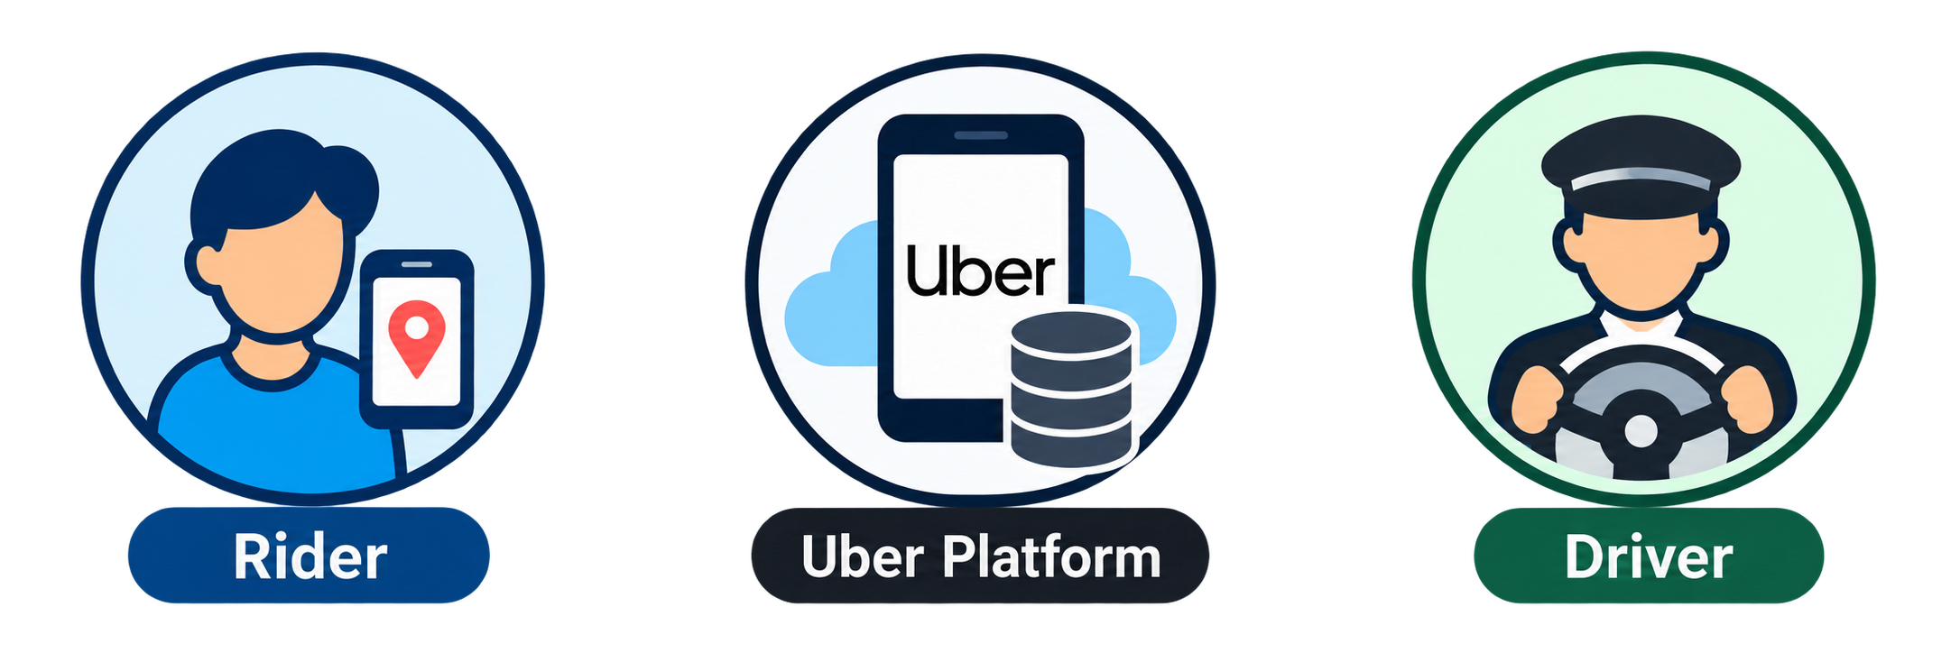
Uber as a Two-Sided Marketplace
Connecting riders who need transportation with drivers who provide it
Information flow
Platform decision flow
Service flow
Payment flow
Riders
(Demand Side)
1. Ride request
(origin, destination, time)
Uber Platform
(Marketplace Intermediary)
Drivers availability
(location, status)
Drivers
(Supply Side)
Request ride
(origin, destination, time)
Willingness to pay
Choose and accept matches
2. Match result
(driver info, ETA, price)
Match & Dispatch
Assign available drivers to rider requests
3. Dispatch
(trip details, route guidance)
Provide vehicle capacity
Report availability and location (online/offline, GPS)
Accept or decline requests
Complete trips
4. Tansportation service (driver provides the ride)
5. Fare payment
(rider pays through platform)
Uber
(takes a service fee)
6. Earnings payment
(driver receives earnings)

Slide 2



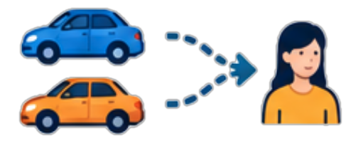








Historical demand
New
requests
1 Observe
2 Match
3 Serve & release
4 Update
$$s_{k}=(t_{k},R_{k},I_{k},B_{k})$$
$$x_{k}∈ A(s_{k})$$
$$t_{k}−a_{j}+p_{ij,k}≤W_{max}$$
$$u_{j}=t_{k}+p_{ij,k}$$
$$f_{j}=u_{j}+\hat{τ}(o_{j},d_{j};u_{j})$$
$$s_{k+1}=F(s_{k},x_{k},ξ_{k+1})$$
Requests · Idle drivers · Busy drivers
Most feasible matches
Available at destination
New requests + vehicle releases
Unassigned: wait in place;
idle time, no empty travel
Next decision epoch
Objective: maximize expected total requests served
Current assignments change future vehicle availability.

