Slide 1



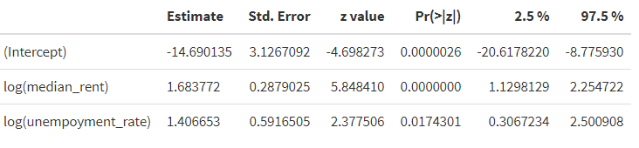
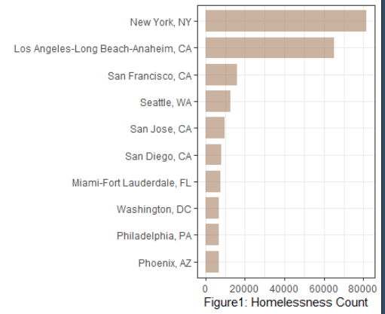
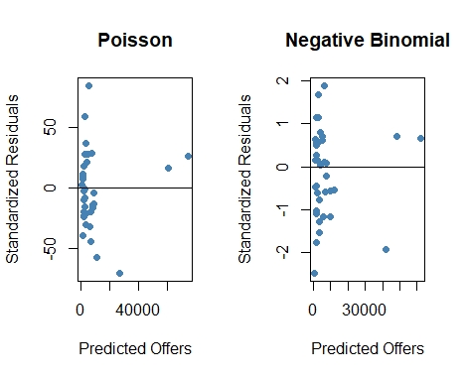
Homelessness Report
February 2023
Objective: Study what’s driving homelessness in big cities
Key findings & Methodology
36
of samples were collected across USA cities in 2019
The report found that more than 81,729 people experienced homelessness in New York on a single night in 2019. Some of the more densely populated cities like NY and CA do have higher counts of homelessness.Figure1 shows the ten top homelessness cities in USA. Study results illustrated the main drivers of homelessness in big cities are median rent and unemployment rate.
Negative Binomial(NB) model and Poisson model are compared. Residual plot below indicated that NB model are preform better. Count data often have an exposure variable, which indicates the number of times the event could have happened. Thus, population variable is incorporated into model with the use of the offset option.
Uses p-value 0.05 as threshold for significant findings. The statistically significant terms are the intercept, median rent, and unemployment rate. The output indicates the coefficients from our model.
What does that mean? Suppose median rent increase by 10%, and the coefficient for median rent is 1.683772, the rates of homelessness changes by exp(1.6838*log(1.1))= 1.174078. In other words, around 17% increase in the incident rate of homelessness.
In addition, suppose 5% increase in unemployment rate in the future, and there will be around 7% increase in the incident rate of homelessness.

Slide 2
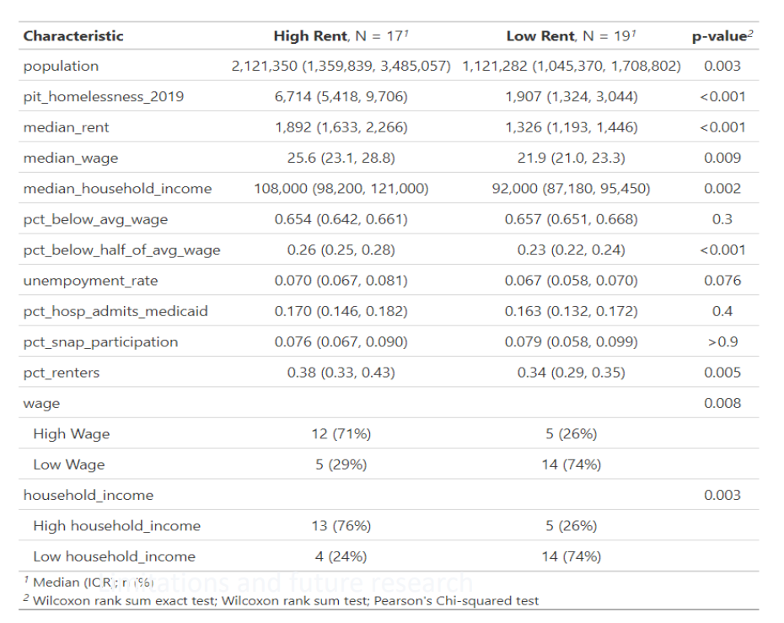

Table 1 Summary table illustrates descriptive statistics, p-value significant suggests these two distributions differ.
Limitations and future research
Limitations and future research
Homelessness is a complex issue caused by a variety of factors including economic factors, family relationships, mental illness, lack of affordable housing, drug abuse, and alcoholism. Social forces such as addictions, family breakdown, and mental illness are compounded by structural forces such as lack of available low-cost housing, poor economic conditions, and insufficient mental health services [1]. Based on the limited data we collected, we did not address some of those issues mentioned above.
Observed counts are need be adjusted to optimum conditions because it is not possible to be at every site of every annual period due to population fluctuations, weather conditions.
Collect more Demographic information include age, sex, education, and race etc. for further analysis. In addition, we should focus on collect more data over the time period and combine census data with population density to get more sense of the trending. Need to adjust for size of cities and its density.
Need to consider Political affiliation, collect more data related to the policies we want to validate and or promote for hypothesis testing;
1. Mago, V.K., Morden, H.K., Fritz, C. et al. Analyzing the impact of social factors on homelessness: a Fuzzy Cognitive Map approach. BMC Med Inform Decis Mak 13, 94 (2013). https://doi.org/10.1186/1472-6947-13-94

Slide 3
Appendix R code
######################################################################
# Assessment of what's driving homelessnesss in these big citites
######################################################################
#read data and load packages;
data<- read.csv("what_is_driving_homelessness.csv")
setwd("C:/Users/SSE6/Downloads")
library(ggplot2);library(dplyr);library(plotly);library(tidyverse); library(psych); library(biostat3);library(AER);
library(gtsummary);library(kableExtra);
set.seed(1)
#Conducting a Poisson regression will allow you to see which predictor variables (if any) have a statistically significant effect on the response variable.
summary(data)
# randomly assign new groups based on the median value of rent,wage,pop,income and to see if the variance across the groups
new_data<-data %>% select(-metro_id) %>%
mutate(rent=ifelse(median_rent> median(median_rent),"High Rent","Low Rent"),
wage=ifelse(median_wage> median(median_wage),"High Wage","Low Wage"),
household_income=ifelse(median_household_income>median(median_household_income),"High household_income","Low household_income"),
pop=ifelse(population> quantile(population,0.75),"High","Low"))
#check out variance between groups;
new_data %>%
filter(pop=="High") %>%
select(pit_homelessness_2019) %>%
var() / new_data %>%
filter(pop=="Low") %>%
select(pit_homelessness_2019) %>%
var()
new_data %>%
filter(household_income=="High household_income") %>%
select(pit_homelessness_2019) %>%
var() / new_data %>%
filter(household_income=="Low household_income") %>%
select(pit_homelessness_2019) %>%
var()
#summary table
new_data %>% select(-region_name) %>%
tbl_summary(by=rent) %>%
add_p()
#check distribution and overall summary for homelessness
describeBy(data$pit_homelessness_2019)
hist(data$pit_homelessness_2019)
#The variance is much greater than the mean, which suggests that we will have over-dispersion in the model.
data %>%
summarize(mean=mean(pit_homelessness_2019),var=var(pit_homelessness_2019))
#get top 10 cities for homelessness
data1 <- data %>%
group_by(region_name) %>%
summarise(homneless_mean = mean(pit_homelessness_2019)) %>%
arrange(desc(homneless_mean)) %>%
top_n(10)

Slide 4
Appendix R code
######################################################################
# Assessment of what's driving homelessnesss in these big citites
######################################################################
#read data and load packages;
data<- read.csv("what_is_driving_homelessness.csv")
setwd("C:/Users/SSE6/Downloads")
library(ggplot2);library(dplyr);library(plotly);library(tidyverse); library(psych); library(biostat3);library(AER);
library(gtsummary);library(kableExtra);
set.seed(1)
#Conducting a Poisson regression will allow you to see which predictor variables (if any) have a statistically significant effect on the response variable.
summary(data)
# randomly assign new groups based on the median value of rent,wage,pop,income and to see if the variance across the groups
new_data<-data %>% select(-metro_id) %>%
mutate(rent=ifelse(median_rent> median(median_rent),"High Rent","Low Rent"),
wage=ifelse(median_wage> median(median_wage),"High Wage","Low Wage"),
household_income=ifelse(median_household_income>median(median_household_income),"High household_income","Low household_income"),
pop=ifelse(population> quantile(population,0.75),"High","Low"))
#check out variance between groups;
new_data %>%
filter(pop=="High") %>%
select(pit_homelessness_2019) %>%
var() / new_data %>%
filter(pop=="Low") %>%
select(pit_homelessness_2019) %>%
var()
new_data %>%
filter(household_income=="High household_income") %>%
select(pit_homelessness_2019) %>%
var() / new_data %>%
filter(household_income=="Low household_income") %>%
select(pit_homelessness_2019) %>%
var()
#summary table
new_data %>% select(-region_name) %>%
tbl_summary(by=rent) %>%
add_p()
#check distribution and overall summary for homelessness
describeBy(data$pit_homelessness_2019)
hist(data$pit_homelessness_2019)
#The variance is much greater than the mean, which suggests that we will have over-dispersion in the model.
data %>%
summarize(mean=mean(pit_homelessness_2019),var=var(pit_homelessness_2019))
#get top 10 cities for homelessness
data1 <- data %>%
group_by(region_name) %>%
summarise(homneless_mean = mean(pit_homelessness_2019)) %>%
arrange(desc(homneless_mean)) %>%
top_n(10)
# plot the top 10 cities
data1 %>%
mutate(region_name = fct_reorder(region_name, homneless_mean)) %>%
ggplot(aes(x=region_name, y = homneless_mean)) +
geom_bar(stat="identity", fill="#A68060", alpha=.6, width=.8) +
coord_flip() +
xlab(" ") + ylab("Figure1: Homelessness Count") +
theme_bw()
#fit the poisson model
p_model <-glm(pit_homelessness_2019 ~ offset(log(population)) + median_rent + median_wage +
pct_below_avg_wage + pct_below_half_of_avg_wage +median_household_income+
unempoyment_rate + pct_hosp_admits_medicaid + pct_snap_participation,
family = poisson(link = "log"), data = new_data )
#view model output
summary(p_model)
#Over dispersion means the assumptions of the model are not met, hence we cannot trust its output;
dispersiontest(model)
#fit negative binomial regression model
summary(nb_model <- glm.nb(pit_homelessness_2019 ~ offset(log(population)) + median_rent + median_wage +
pct_below_avg_wage + pct_below_half_of_avg_wage +median_household_income+
unempoyment_rate + pct_hosp_admits_medicaid + pct_snap_participation,
data = new_data ))
par(mfrow = c(1, 2))
#Residual plot for Poisson regression
p_res <- resid(p_model)
plot(fitted(p_model), p_res, col='steelblue', pch=16,
xlab='Predicted Offers', ylab='Standardized Residuals', main='Poisson')
abline(0,0)
#Residual plot for negative binomial regression
nb_res <- resid(nb_model)
plot(fitted(nb_model), nb_res, col='steelblue', pch=16,
xlab='Predicted Offers', ylab='Standardized Residuals', main='Negative Binomial')
abline(0,0)
pchisq(2 * (logLik(nb_model) - logLik(p_model)), df = 1, lower.tail = FALSE)
# define the NB models to compare
cand.models <- list( )
cand.models[[1]] <- glm.nb(pit_homelessness_2019 ~ offset(log(population)) + median_rent + median_wage +
pct_below_avg_wage + pct_below_half_of_avg_wage +median_household_income+
unempoyment_rate + pct_hosp_admits_medicaid + pct_snap_participation,
data = new_data )
cand.models[[2]] <- glm.nb(pit_homelessness_2019 ~ offset(log(population)) + median_rent + median_wage +
pct_below_avg_wage + pct_below_half_of_avg_wage +median_household_income+
unempoyment_rate + pct_hosp_admits_medicaid,
data = new_data )
cand.models[[3]] <- glm.nb(pit_homelessness_2019 ~ offset(log(population)) + median_rent + median_wage +
pct_below_avg_wage + pct_below_half_of_avg_wage +median_household_income+
unempoyment_rate,
data = new_data )
cand.models[[4]] <- glm.nb(pit_homelessness_2019 ~ offset(log(population)) + median_rent + median_wage +
pct_below_avg_wage + pct_below_half_of_avg_wage +median_household_income,
data = new_data)
cand.models[[5]] <- glm.nb(pit_homelessness_2019 ~ offset(log(population)) + median_rent + median_wage +
pct_below_avg_wage,
data = new_data)
cand.models[[6]] <- glm.nb(pit_homelessness_2019 ~ offset(log(population)) + median_rent + unempoyment_rate ,
data = new_data)
cand.models[[7]] <- glm.nb(pit_homelessness_2019 ~ offset(log(population)) + median_rent,
data = new_data)
cand.models[[8]] <- glm.nb(pit_homelessness_2019 ~ offset(log(population)) ,
data = new_data)
# name the models
model.names <- c("1", "2", "3", "4", "5", "6", "7", "8")
names(cand.models) <- model.names
# calculate and combine AIC, AIC weights, and BIC
results <- data.frame(models = model.names)
results$bic.val <- unlist(lapply(cand.models, BIC))
results$bic.rank <- rank(results$bic.val)
results$aic.val <- unlist(lapply(cand.models, AIC))
results$aic.delta <- results$aic.val-min(results$aic.val)
results$aic.likelihood <- exp(-0.5* results$aic.delta)
results$aic.weight <- results$aic.likelihood/sum(results$aic.likelihood)
# sort models by AIC weight
results <- results[rev(order(results[, "aic.weight"])),]
results$cum.aic.weight <- cumsum(results[, "aic.weight"])
#Results for Final Count Regression Model (Negative Binomial)
results
#model 6 appears best across all model compassion
summary(cand.models[[6]])
coef(summary(cand.models[[6]]))
table<-exp(cbind(estimate = coef(summary(cand.models[[6]])),
confint(cand.models[[6]])))
kable(table, escape=F, align=c("l",rep("r",8))) %>%
kable_styling(full_width = F,position="left")
# plot the top 10 cities
data1 %>%
mutate(region_name = fct_reorder(region_name, homneless_mean)) %>%
ggplot(aes(x=region_name, y = homneless_mean)) +
geom_bar(stat="identity", fill="#A68060", alpha=.6, width=.8) +
coord_flip() +
xlab(" ") + ylab("Figure1: Homelessness Count") +
theme_bw()
#fit the poisson model
p_model <-glm(pit_homelessness_2019 ~ offset(log(population)) + median_rent + median_wage +
pct_below_avg_wage + pct_below_half_of_avg_wage +median_household_income+
unempoyment_rate + pct_hosp_admits_medicaid + pct_snap_participation,
family = poisson(link = "log"), data = new_data )
#view model output
summary(p_model)
#Over dispersion means the assumptions of the model are not met, hence we cannot trust its output;
dispersiontest(model)
#fit negative binomial regression model
summary(nb_model <- glm.nb(pit_homelessness_2019 ~ offset(log(population)) + median_rent + median_wage +
pct_below_avg_wage + pct_below_half_of_avg_wage +median_household_income+
unempoyment_rate + pct_hosp_admits_medicaid + pct_snap_participation,
data = new_data ))
par(mfrow = c(1, 2))
#Residual plot for Poisson regression
p_res <- resid(p_model)
plot(fitted(p_model), p_res, col='steelblue', pch=16,
xlab='Predicted Offers', ylab='Standardized Residuals', main='Poisson')
abline(0,0)
#Residual plot for negative binomial regression
nb_res <- resid(nb_model)
plot(fitted(nb_model), nb_res, col='steelblue', pch=16,
xlab='Predicted Offers', ylab='Standardized Residuals', main='Negative Binomial')
abline(0,0)
pchisq(2 * (logLik(nb_model) - logLik(p_model)), df = 1, lower.tail = FALSE)
# define the NB models to compare
cand.models <- list( )
cand.models[[1]] <- glm.nb(pit_homelessness_2019 ~ offset(log(population)) + median_rent + median_wage +
pct_below_avg_wage + pct_below_half_of_avg_wage +median_household_income+
unempoyment_rate + pct_hosp_admits_medicaid + pct_snap_participation,
data = new_data )
cand.models[[2]] <- glm.nb(pit_homelessness_2019 ~ offset(log(population)) + median_rent + median_wage +
pct_below_avg_wage + pct_below_half_of_avg_wage +median_household_income+
unempoyment_rate + pct_hosp_admits_medicaid,
data = new_data )
cand.models[[3]] <- glm.nb(pit_homelessness_2019 ~ offset(log(population)) + median_rent + median_wage +
pct_below_avg_wage + pct_below_half_of_avg_wage +median_household_income+
unempoyment_rate,
data = new_data )

Slide 5
Appendix R code
cand.models[[4]] <- glm.nb(pit_homelessness_2019 ~ offset(log(population)) + median_rent + median_wage +
pct_below_avg_wage + pct_below_half_of_avg_wage +median_household_income,
data = new_data)
cand.models[[5]] <- glm.nb(pit_homelessness_2019 ~ offset(log(population)) + median_rent + median_wage +
pct_below_avg_wage,
data = new_data)
cand.models[[6]] <- glm.nb(pit_homelessness_2019 ~ offset(log(population)) + median_rent + unempoyment_rate ,
data = new_data)
cand.models[[7]] <- glm.nb(pit_homelessness_2019 ~ offset(log(population)) + median_rent,
data = new_data)
cand.models[[8]] <- glm.nb(pit_homelessness_2019 ~ offset(log(population)) ,
data = new_data)
cand.models[[9]] <- glm.nb(pit_homelessness_2019 ~ offset(log(population)) + median_rent + log(unempoyment_rate) ,
data = new_data)
cand.models[[10]] <- glm.nb(pit_homelessness_2019 ~ offset(log(population)) + log(median_rent) + log(unempoyment_rate) ,
data = new_data)
# name the models
model.names <- c("1", "2", "3", "4", "5", "6", "7", "8","9","10")
names(cand.models) <- model.names
# calculate and combine AIC, AIC weights, and BIC
results <- data.frame(models = model.names)
results$bic.val <- unlist(lapply(cand.models, BIC))
results$bic.rank <- rank(results$bic.val)
results$aic.val <- unlist(lapply(cand.models, AIC))
results$aic.delta <- results$aic.val-min(results$aic.val)
results$aic.likelihood <- exp(-0.5* results$aic.delta)
results$aic.weight <- results$aic.likelihood/sum(results$aic.likelihood)
# sort models by AIC weight
results <- results[rev(order(results[, "aic.weight"])),]
results$cum.aic.weight <- cumsum(results[, "aic.weight"])
#Results for Final Count Regression Model (Negative Binomial)
results
final_model<-glm.nb(pit_homelessness_2019 ~ offset(log(population)) + log(median_rent) + log(unempoyment_rate) ,
data = new_data)
#model 10 appears best across all model compassion
summary(final_model)
coef(summary(final_model))
confint(final_model)
rm(table)
table<-cbind(estimate = coef(summary(final_model)),
confint(final_model))
kable(table, escape=F, align=c("l",rep("r",8))) %>%
kable_styling(full_width = F,position="left")
exp(1.6838*log(1.1))
exp(1.4067*log(1.05))

