Slide 1
Q1 Analysis
Daisy Shi

Slide 2
Introduction & Exploratory Data Analysis
We will first examine the frequency of responses by Exploratory data analysis. Further more, to investigate how the correlations between the items. And principal components are used to visualize and determine if Multi-dimensional or Uni-Dimensional approach shall be implemented in this analysis. And the scree plot which uses a plot of successive eigen vectors. Additionally to access the factor plot to understand the underlying structure of the dataset.

Slide 3
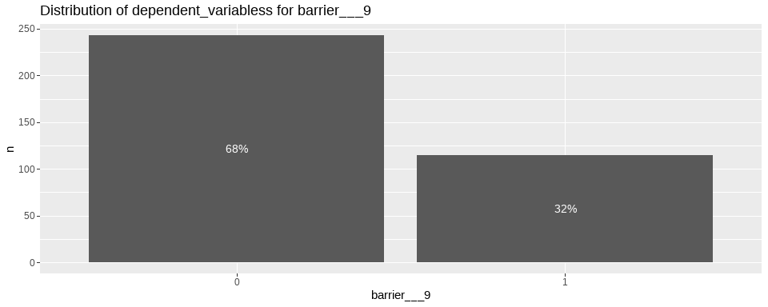

Slide 4
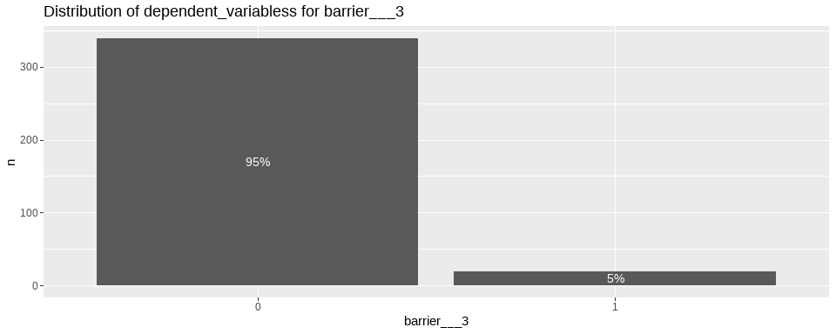

Slide 5
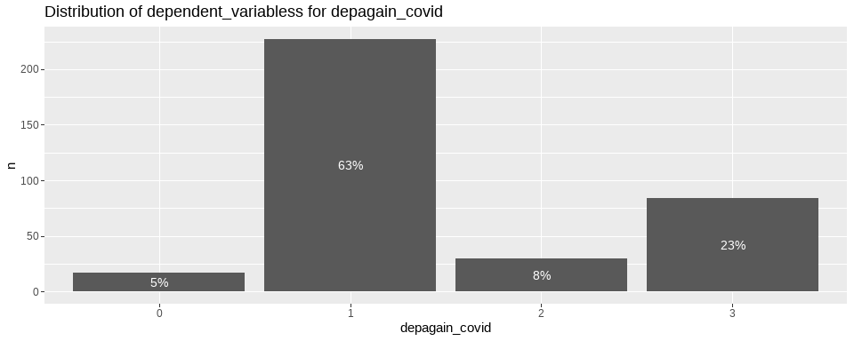

Slide 6
## Distribution of independent variables

Slide 7
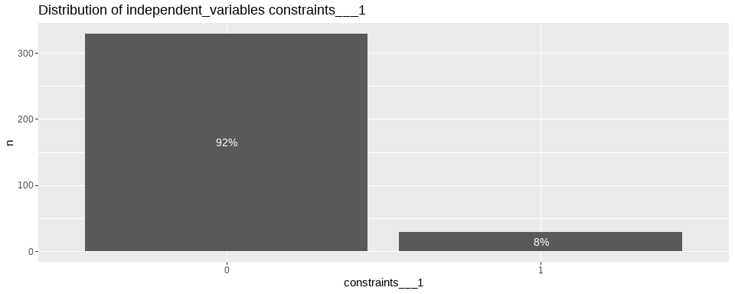

Slide 8
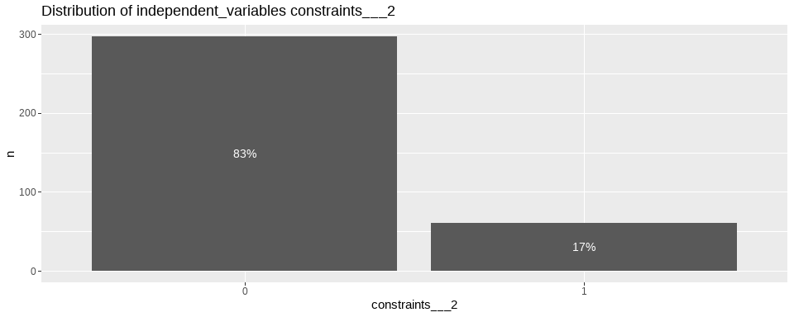

Slide 9
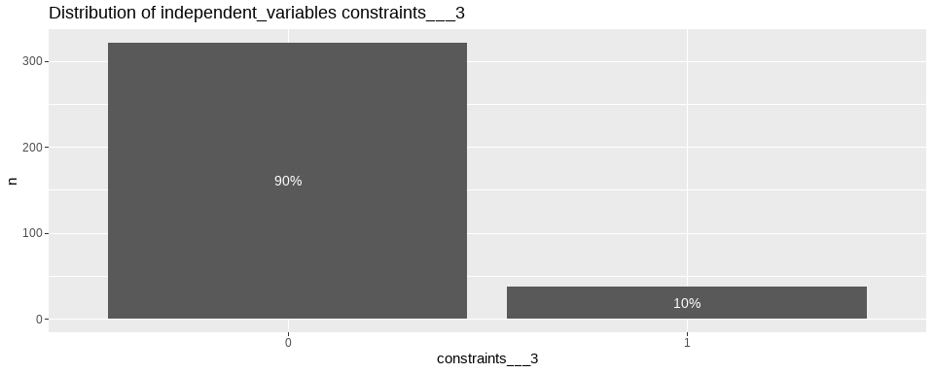

Slide 10
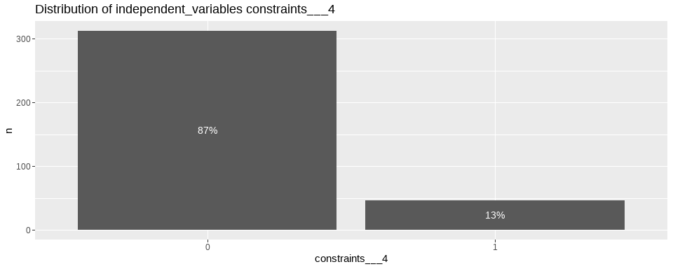

Slide 11
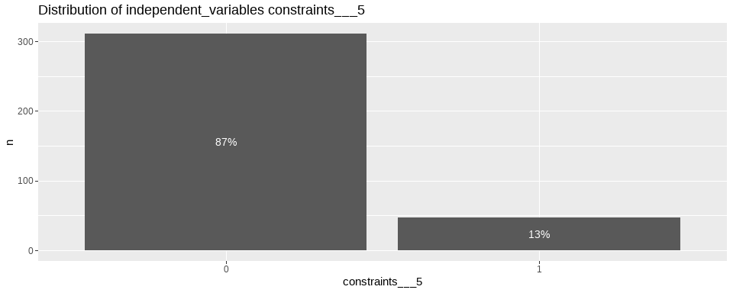

Slide 12


Slide 13
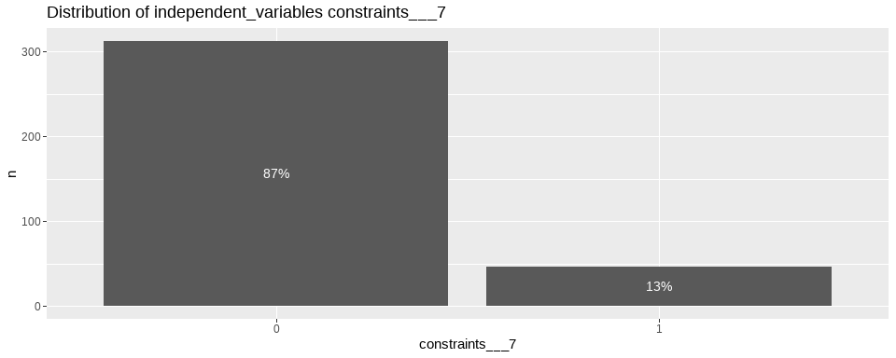

Slide 14
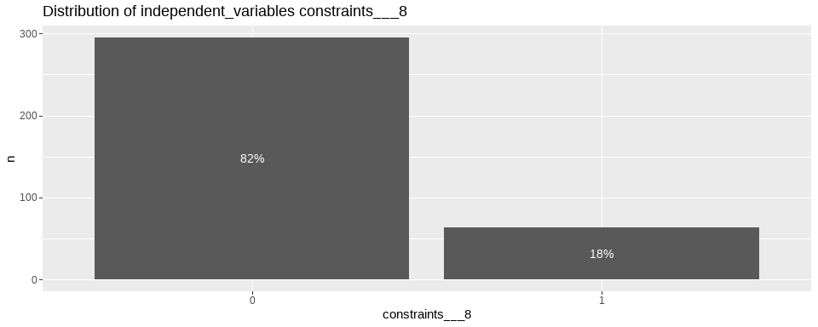

Slide 15
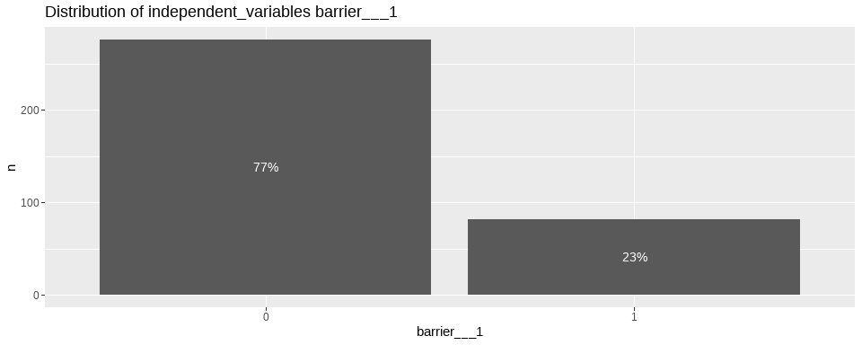

Slide 16
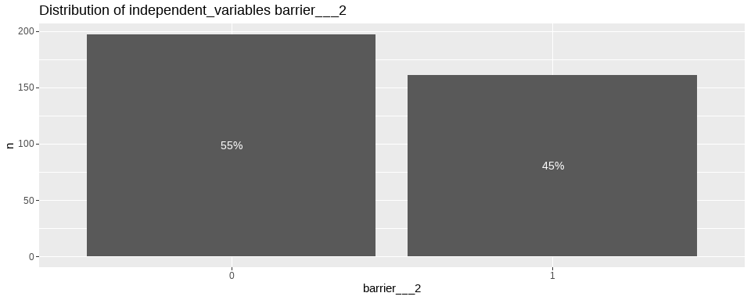

Slide 17
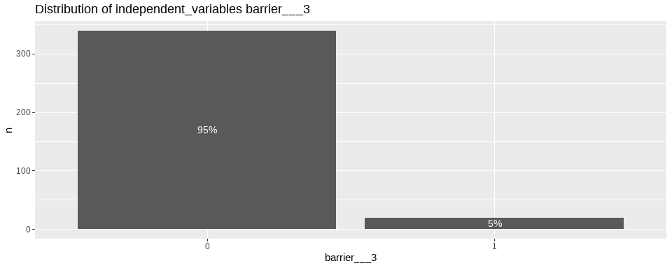

Slide 18
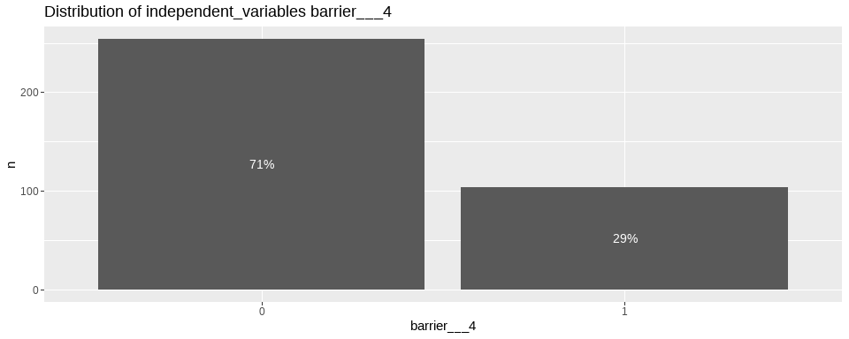

Slide 19
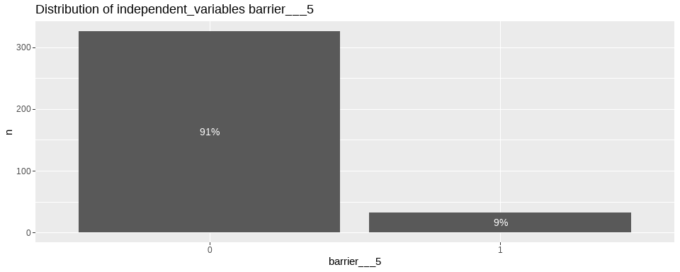

Slide 20
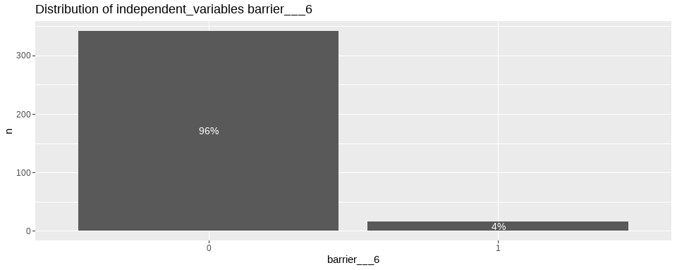

Slide 21
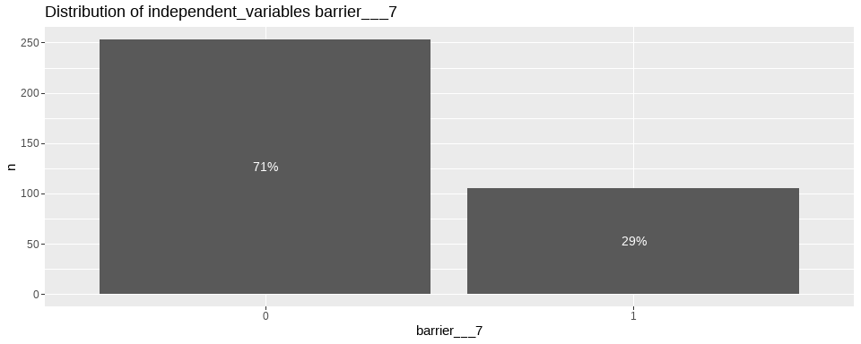

Slide 22
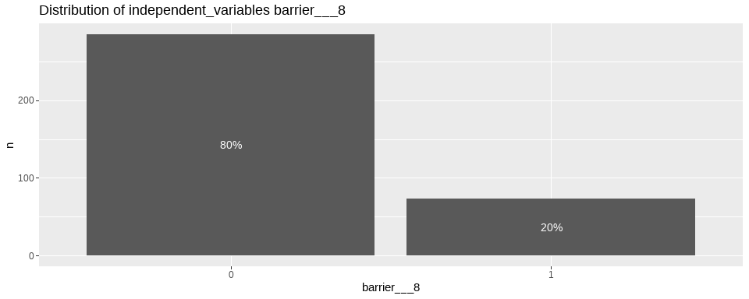

Slide 23


Slide 24
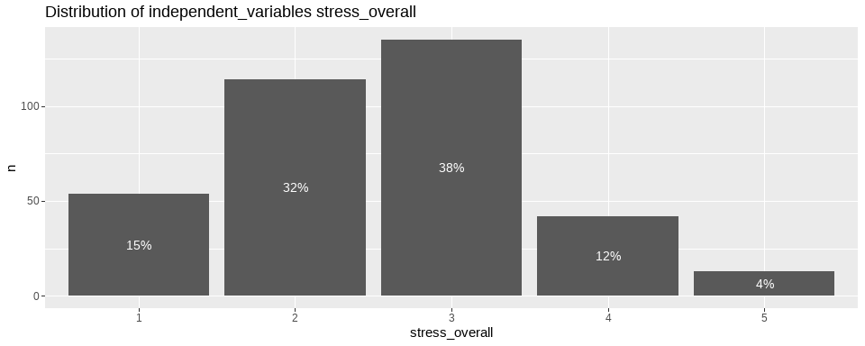

Slide 25
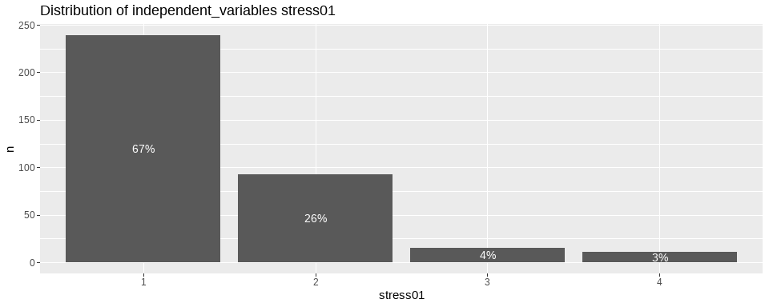

Slide 26
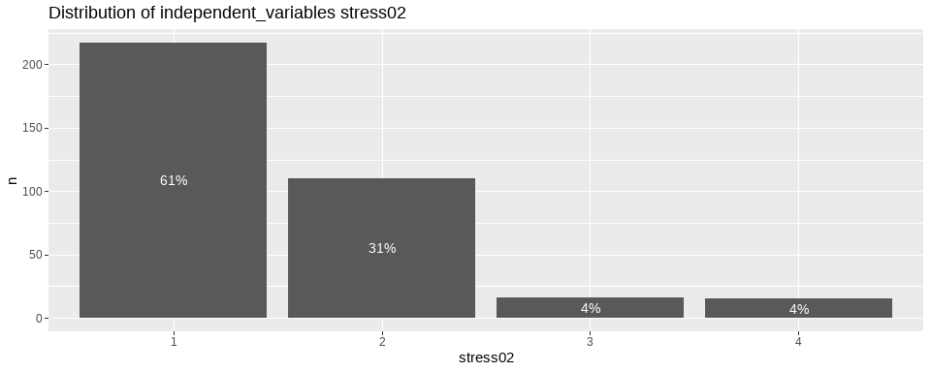

Slide 27
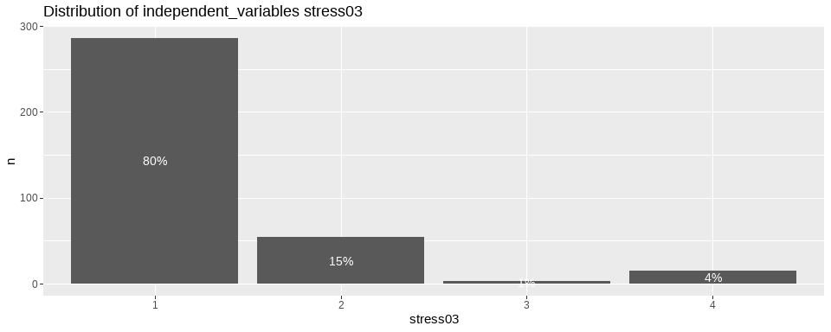

Slide 28
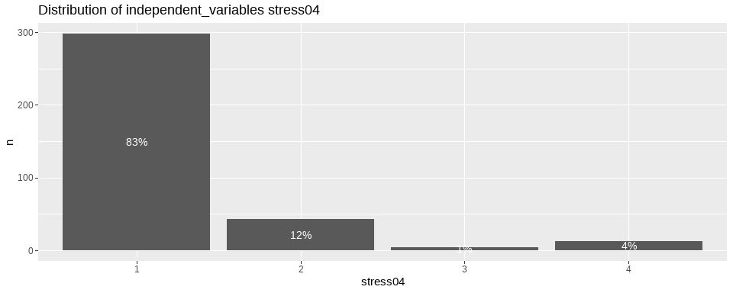

Slide 29
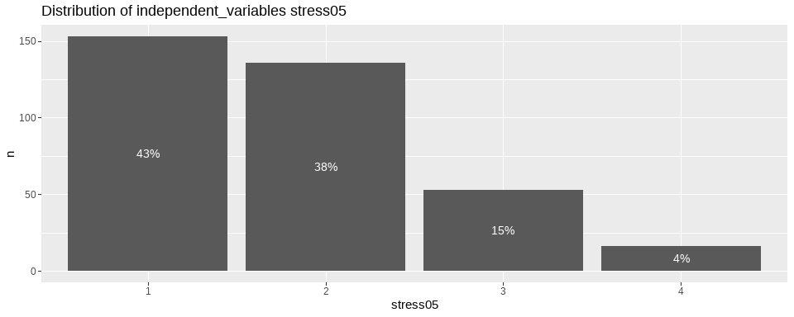

Slide 30
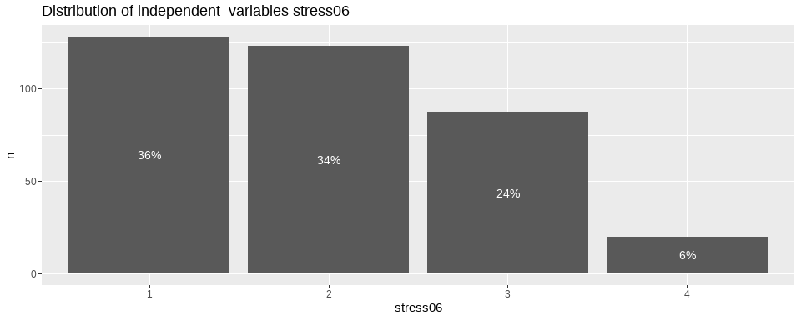

Slide 31
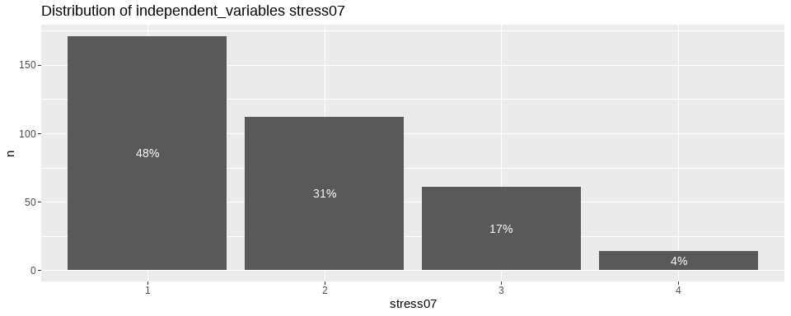

Slide 32
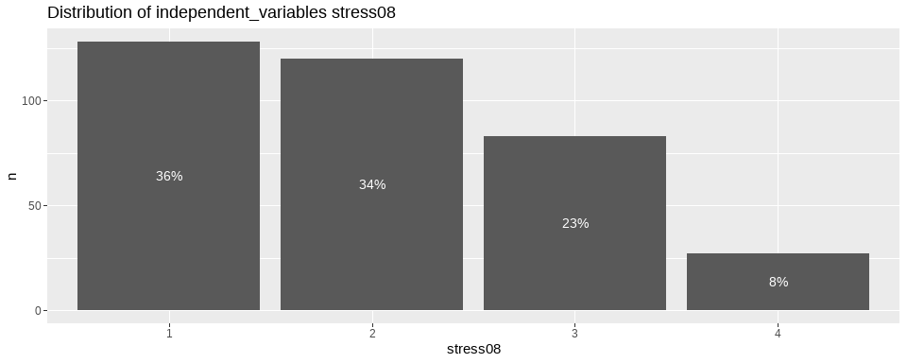

Slide 33
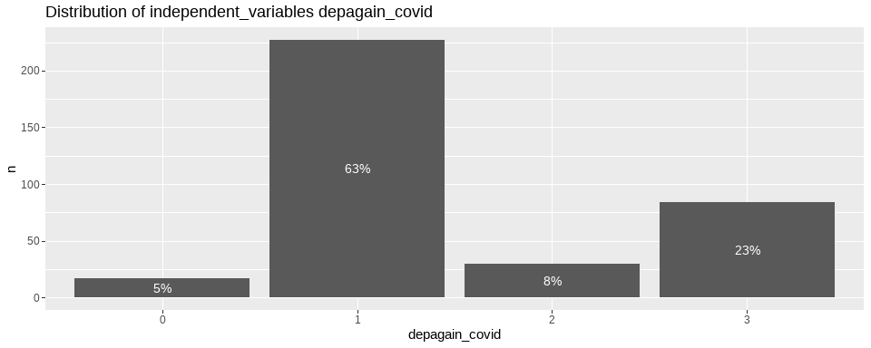

Slide 34
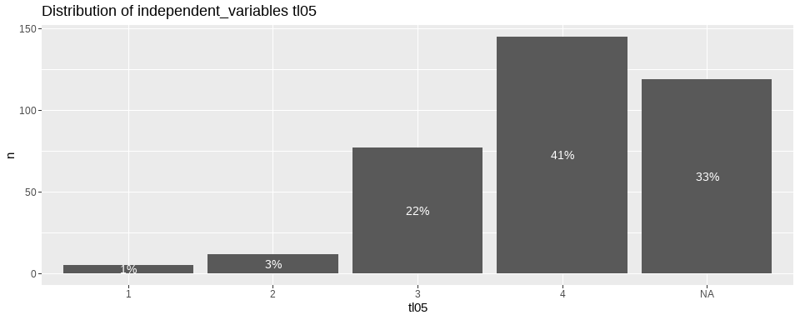

Slide 35
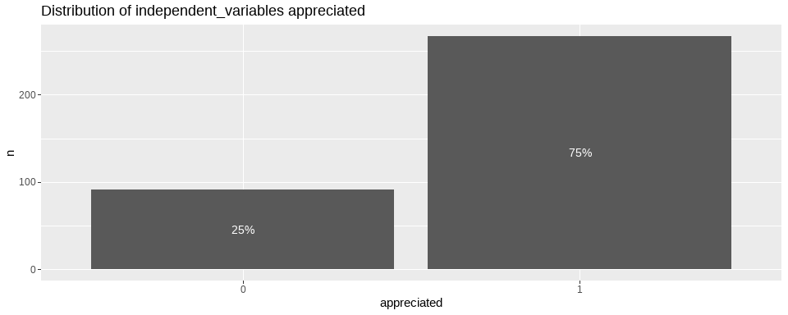

Slide 36
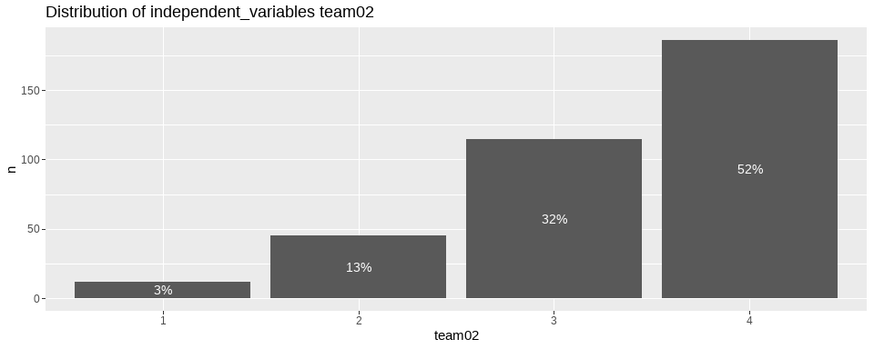

Slide 37
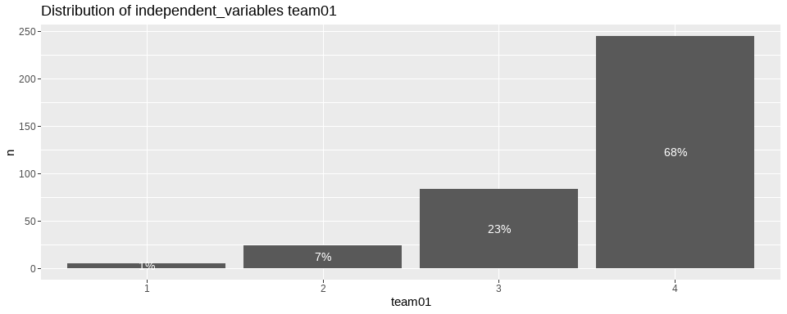

Slide 38
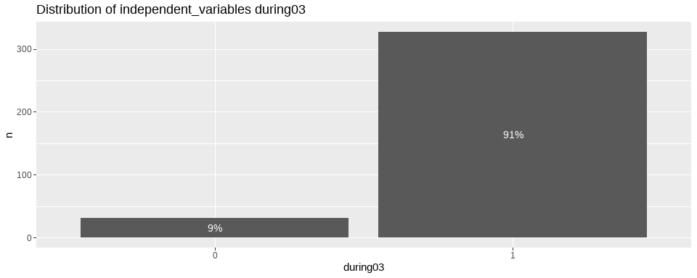

Slide 39
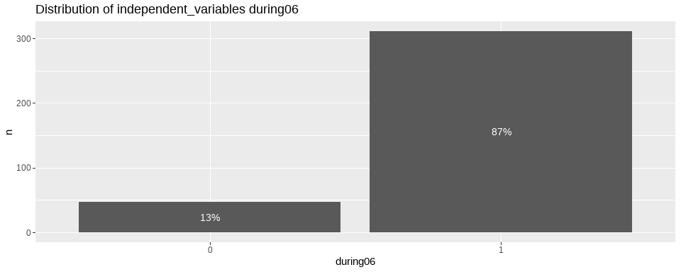

Slide 40
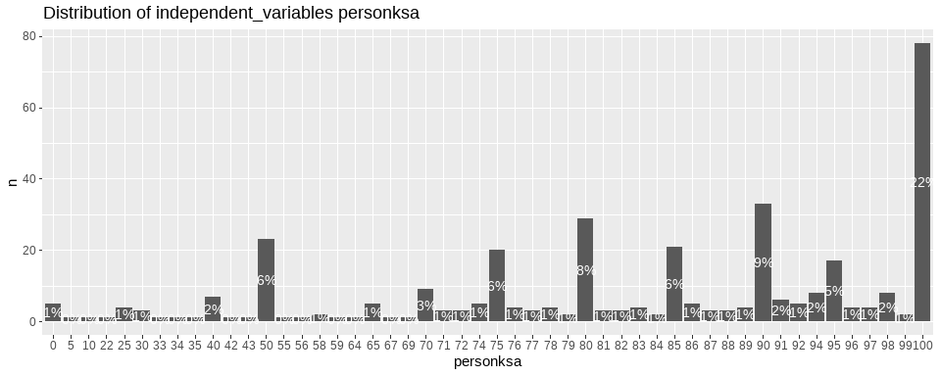

Slide 41
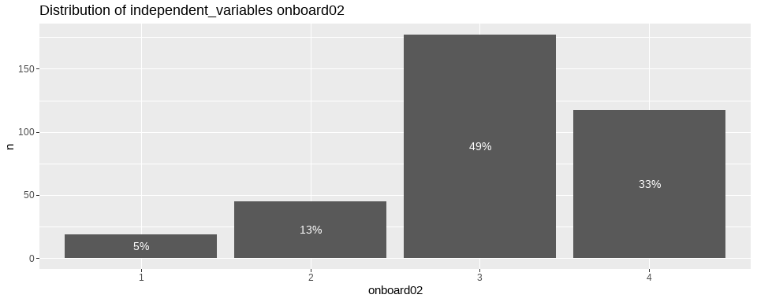

Slide 42
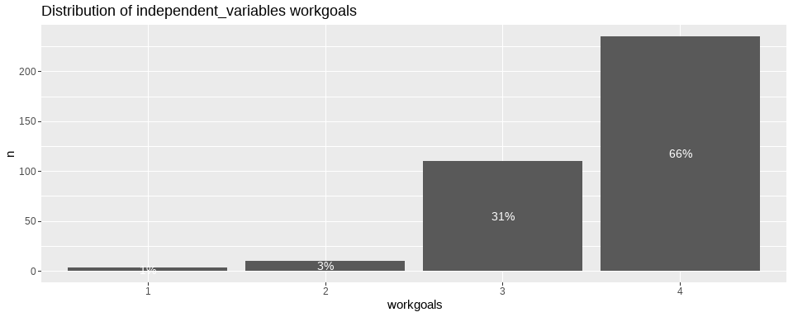

Slide 43
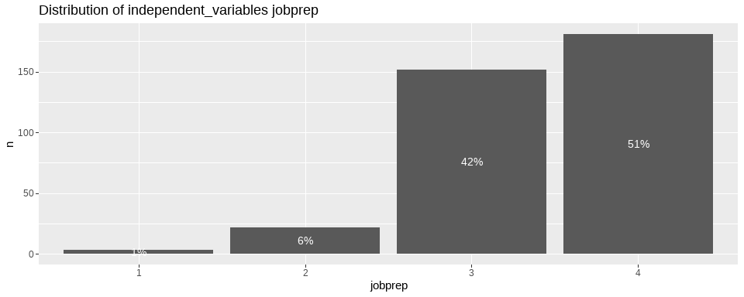

Slide 44
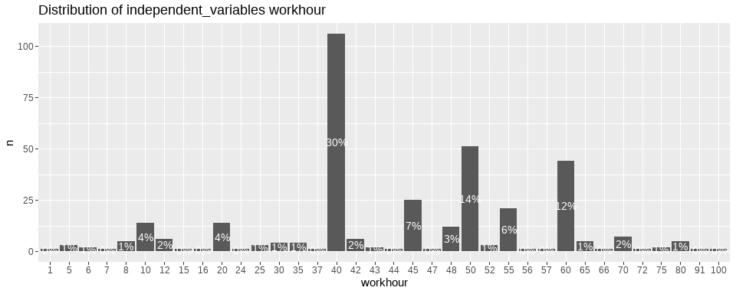

Slide 45
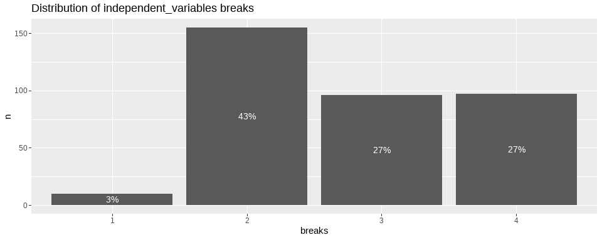

Slide 46
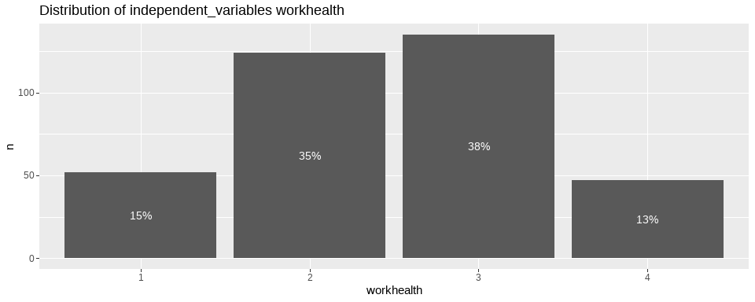

Slide 47
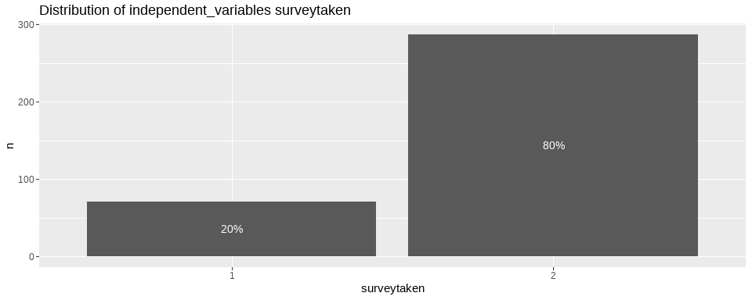

Slide 48
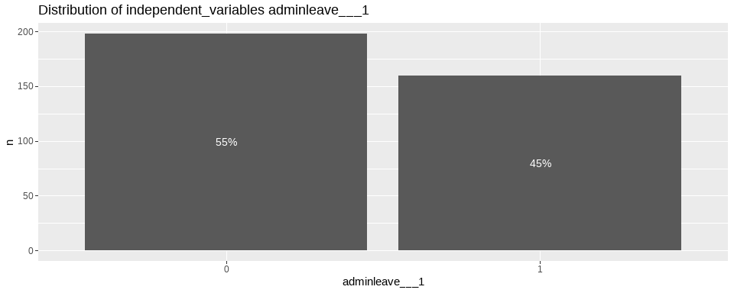

Slide 49
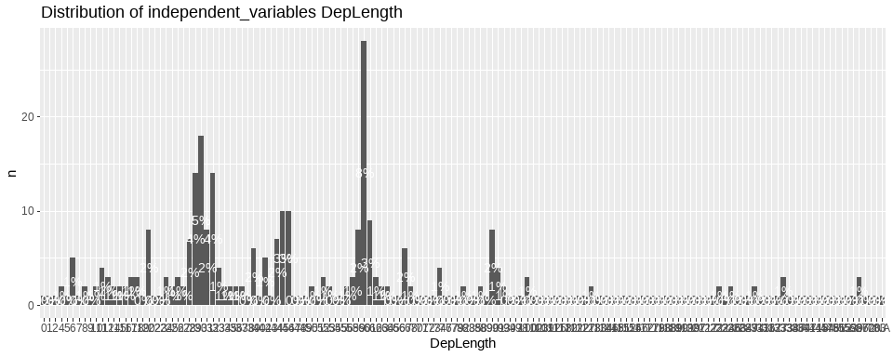

Slide 50
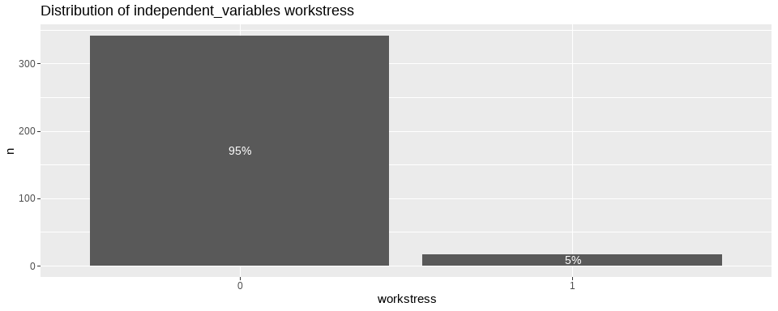

Slide 51


Slide 52
Check underlying structure of the dataset
Omega Call: omegah(m = m, nfactors = nfactors, fm = fm, key = key, flip = flip, digits = digits, title = title, sl = sl, labels = labels, plot = plot, n.obs = n.obs, rotate = rotate, Phi = Phi, option = option, covar = covar) Alpha: 0.64 G.6: 0.64 Omega Hierarchical: 0.4 Omega H asymptotic: 0.55 Omega Total 0.73
Schmid Leiman Factor loadings greater than 0.2 g F1* F2* F3* h2 u2 p2 constraints_1 0.28 0.42 0.27 0.73 0.30 constraints_2 0.38 0.73 0.68 0.32 0.21 constraints_3 0.24 0.50 0.31 0.69 0.19 constraints_4 0.04 0.96 0.48 constraints_5 0.25 0.30 0.16 0.84 0.37 constraints_6 0.46 0.30 0.28 0.38 0.62 0.56 constraints_7 0.70 0.71 1.00 0.00 0.49 constraints_8 0.23 0.51 0.32 0.68 0.17
With eigenvalues of: g F1* F2* F3* 1.12 0.61 0.80 0.63
general/max 1.4 max/min = 1.33 mean percent general = 0.35 with sd = 0.15 and cv of 0.44 Explained Common Variance of the general factor = 0.35
The degrees of freedom are 7 and the fit is 0.02 The number of observations was 358 with Chi Square = 6.36 with prob < 0.5 The root mean square of the residuals is 0.02 The df corrected root mean square of the residuals is 0.04 RMSEA index = 0 and the 10 % confidence intervals are 0 0.061 BIC = -34.8
Compare this with the adequacy of just a general factor and no group factors The degrees of freedom for just the general factor are 20 and the fit is 0.39 The number of observations was 358 with Chi Square = 136.82 with prob < 2e-19 The root mean square of the residuals is 0.11 The df corrected root mean square of the residuals is 0.13
RMSEA index = 0.128 and the 10 % confidence intervals are 0.108 0.149 BIC = 19.2
Measures of factor score adequacy g F1* F2* F3* Correlation of scores with factors 0.75 0.75 0.79 0.67 Multiple R square of scores with factors 0.56 0.57 0.62 0.45 Minimum correlation of factor score estimates 0.13 0.14 0.24 -0.11
Total, General and Subset omega for each subset g F1* F2* F3* Omega total for total scores and subscales 0.73 0.77 0.63 0.47 Omega general for total scores and subscales 0.40 0.44 0.15 0.13 Omega group for total scores and subscales 0.24 0.33 0.47 0.34 Omega Call: omegah(m = m, nfactors = nfactors, fm = fm, key = key, flip = flip, digits = digits, title = title, sl = sl, labels = labels, plot = plot, n.obs = n.obs, rotate = rotate, Phi = Phi, option = option, covar = covar) Alpha: 0.89 G.6: 0.93 Omega Hierarchical: 0.64 Omega H asymptotic: 0.67 Omega Total 0.95
Schmid Leiman Factor loadings greater than 0.2 g F1* F2* F3* h2 u2 p2 stress01 0.73 0.25 0.63 0.37 0.85 stress02 0.90 0.44 1.00 0.00 0.81 stress03 0.73 0.68 1.00 0.00 0.54 stress04 0.69 0.53 0.76 0.24 0.62 stress05 0.52 0.64 0.69 0.31 0.39 stress06 0.41 0.74 0.71 0.29 0.24 stress07 0.44 0.72 0.71 0.29 0.27 stress08 0.39 0.82 0.81 0.19 0.18
With eigenvalues of: g F1* F2* F3* 3.13 2.14 0.78 0.27
general/max 1.46 max/min = 8.06 mean percent general = 0.49 with sd = 0.26 and cv of 0.53 Explained Common Variance of the general factor = 0.5
The degrees of freedom are 7 and the fit is 0.04 The number of observations was 358 with Chi Square = 12.67 with prob < 0.081 The root mean square of the residuals is 0.01 The df corrected root mean square of the residuals is 0.02 RMSEA index = 0.047 and the 10 % confidence intervals are 0 0.089 BIC = -28.5
Compare this with the adequacy of just a general factor and no group factors The degrees of freedom for just the general factor are 20 and the fit is 2.88 The number of observations was 358 with Chi Square = 1016.16 with prob < 1.4e-202 The root mean square of the residuals is 0.26 The df corrected root mean square of the residuals is 0.31
RMSEA index = 0.373 and the 10 % confidence intervals are 0.354 0.393 BIC = 898.55
Measures of factor score adequacy g F1* F2* F3* Correlation of scores with factors 0.92 0.93 0.90 0.61 Multiple R square of scores with factors 0.85 0.86 0.81 0.37 Minimum correlation of factor score estimates 0.70 0.72 0.63 -0.26
Total, General and Subset omega for each subset g F1* F2* F3* Omega total for total scores and subscales 0.95 0.92 0.93 0.88 Omega general for total scores and subscales 0.64 0.24 0.54 0.75 Omega group for total scores and subscales 0.29 0.67 0.39 0.13 Omega Call: omegah(m = m, nfactors = nfactors, fm = fm, key = key, flip = flip, digits = digits, title = title, sl = sl, labels = labels, plot = plot, n.obs = n.obs, rotate = rotate, Phi = Phi, option = option, covar = covar) Alpha: 0.44 G.6: 0.48 Omega Hierarchical: 0.41 Omega H asymptotic: 0.7 Omega Total 0.59
Schmid Leiman Factor loadings greater than 0.2 g F1* F2* F3* h2 u2 p2 barrier_1 0.53 0.28 0.72 0.01 barrier_2 0.30 0.12 0.88 0.28 barrier_3 0.24 0.06 0.94 0.05 barrier_4 0.45 0.21 0.79 0.93 barrier_5 0.27 0.10 0.90 0.23 barrier_6 0.99 1.00 0.00 0.01 barrier_7 0.75 0.57 0.43 0.99 barrier_8- 0.03 0.97 0.04 barrier___9 0.69 0.48 0.52 0.99
With eigenvalues of: g F1* F2* F3* 1.32 0.00 1.06 0.47
general/max 1.25 max/min = 225.63 mean percent general = 0.39 with sd = 0.44 and cv of 1.13 Explained Common Variance of the general factor = 0.46
The degrees of freedom are 12 and the fit is 0.06 The number of observations was 358 with Chi Square = 21.35 with prob < 0.046 The root mean square of the residuals is 0.03 The df corrected root mean square of the residuals is 0.05 RMSEA index = 0.047 and the 10 % confidence intervals are 0.007 0.078 BIC = -49.22
Compare this with the adequacy of just a general factor and no group factors The degrees of freedom for just the general factor are 27 and the fit is 0.21 The number of observations was 358 with Chi Square = 73.53 with prob < 3.5e-06 The root mean square of the residuals is 0.07 The df corrected root mean square of the residuals is 0.08
RMSEA index = 0.069 and the 10 % confidence intervals are 0.051 0.089 BIC = -85.24
Measures of factor score adequacy g F1* F2* F3* Correlation of scores with factors 0.85 0.05 1.00 0.61 Multiple R square of scores with factors 0.72 0.00 1.00 0.38 Minimum correlation of factor score estimates 0.44 -0.99 0.99 -0.25
Total, General and Subset omega for each subset g F1* F2* F3* Omega total for total scores and subscales 0.59 0.68 0.49 0.24 Omega general for total scores and subscales 0.41 0.68 0.11 0.04 Omega group for total scores and subscales 0.15 0.00 0.38 0.20

Slide 53
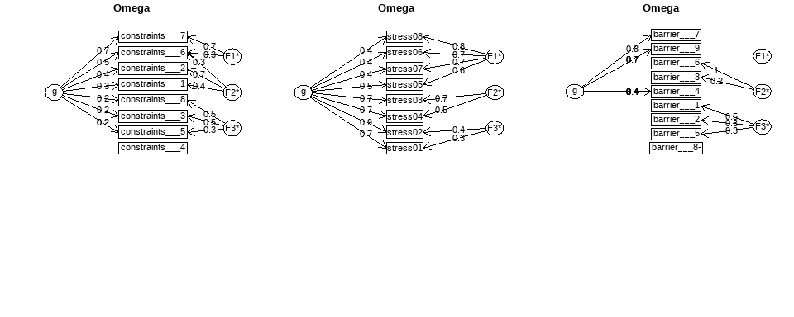

Slide 54
PCA interpretation
We can see that approximately 95% of the data is explained by the first principal component. In other words, The first PC(PC1) contribute ~95% of the total variation in the dataset.
Variables contributing similar information are grouped together. (constraints 1-8, barrier 1-9,stress overall,stress01-04) are highly associated and forms cluster.

Slide 55
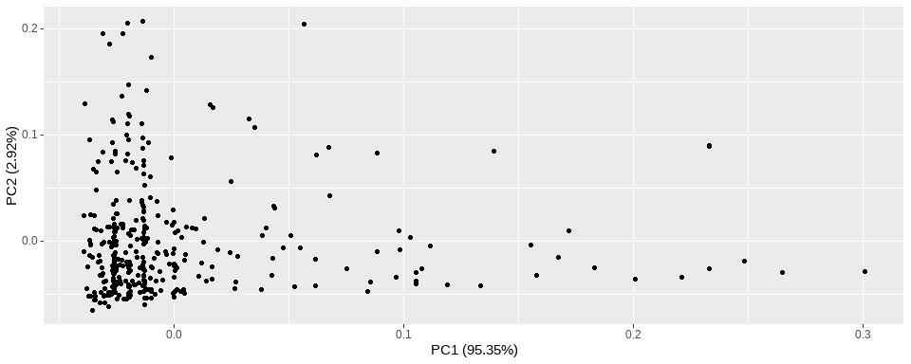

Slide 56
Penalized Logistic Regression
When we have multiple variables in logistic regression model, it might be useful to find a reduced set of variables resulting to an optimal performing model.
Penalized logistic regression imposes a penalty to the logistic model for having too many variables. This results in shrinking the coefficients of the less contributive variables toward zero. This is also known as regularization.
The most commonly used penalized regression include:
Ridge regression: variables with minor contribution have their coefficients close to zero. However, all the variables are incorporated in the model. This is useful when all variables need to be incorporated in the model according to domain knowledge.
Lasso regression: the coefficients of some less contributive variables are forced to be exactly zero. Only the most significant variables are kept in the final model. By using both regularization technics, results indicates all of the predictors are contribute to the model. Hence, we can not reduce the variables, which implies with the PCA analysis results.
## ## Call: ## glm(formula = barrier___9 ~ ., family = binomial, data = train.data) ## ## Deviance Residuals: ## Min 1Q Median 3Q Max ## -2.03459 -0.27084 -0.06482 0.03951 2.77738 ## ## Coefficients: ## Estimate Std. Error z value Pr(>|z|) ## (Intercept) -10.928773 5.472728 -1.997 0.04583 * ## constraints___1 0.454009 1.493108 0.304 0.76107 ## constraints___2 1.720332 1.064216 1.617 0.10598 ## constraints___3 1.328449 1.403172 0.947 0.34377 ## constraints___4 2.916155 1.217062 2.396 0.01657 * ## constraints___5 -2.611859 1.803909 -1.448 0.14765 ## constraints___6 -0.616874 1.513971 -0.407 0.68367 ## constraints___7 5.420110 1.885198 2.875 0.00404 ** ## constraints___8 -0.845071 1.047123 -0.807 0.41964 ## barrier___1 -2.180339 1.017070 -2.144 0.03205 * ## barrier___2 -0.902162 0.823184 -1.096 0.27310 ## barrier___3 0.134701 1.730325 0.078 0.93795 ## barrier___4 1.805692 0.806008 2.240 0.02507 * ## barrier___5 2.044297 1.334338 1.532 0.12551 ## barrier___6 -0.049664 1.594261 -0.031 0.97515 ## barrier___7 6.254562 1.313239 4.763 1.91e-06 *** ## barrier___8 0.988728 0.927897 1.066 0.28662 ## stress_overall -0.120748 0.466432 -0.259 0.79573 ## depagain_covid 1.529350 0.473821 3.228 0.00125 ** ## tl05 -1.078045 0.771777 -1.397 0.16246 ## appreciated -0.448549 0.811680 -0.553 0.58052 ## team02 -1.275635 0.645244 -1.977 0.04804 * ## team01 -0.534080 0.555668 -0.961 0.33648 ## during03 0.615330 1.644967 0.374 0.70835 ## during06 2.011165 1.344052 1.496 0.13456 ## personksa 0.031100 0.018551 1.676 0.09365 . ## onboard02 -0.244092 0.551101 -0.443 0.65783 ## workgoals 2.531306 0.995700 2.542 0.01101 * ## jobprep 1.812576 0.822567 2.204 0.02756 * ## workhour -0.016266 0.023376 -0.696 0.48651 ## breaks -1.039797 0.563755 -1.844 0.06512 . ## workhealth -0.936472 0.553356 -1.692 0.09058 . ## surveytaken -0.045044 0.889657 -0.051 0.95962 ## adminleave___1 2.586922 0.867921 2.981 0.00288 ** ## DepLength -0.004648 0.004065 -1.143 0.25293 ## workstress 1.237309 1.829862 0.676 0.49893 ## lifestress -0.350764 0.948841 -0.370 0.71162 ## --- ## Signif. codes: 0 '***' 0.001 '**' 0.01 '*' 0.05 '.' 0.1 ' ' 1 ## ## (Dispersion parameter for binomial family taken to be 1) ## ## Null deviance: 233.321 on 196 degrees of freedom ## Residual deviance: 87.947 on 160 degrees of freedom ## (90 observations deleted due to missingness) ## AIC: 161.95 ## ## Number of Fisher Scoring iterations: 7
## ## Call: ## glm(formula = barrier___9 ~ constraints___2 + constraints___4 + ## constraints___5 + constraints___7 + barrier___1 + barrier___2 + ## barrier___4 + barrier___5 + barrier___7 + depagain_covid + ## tl05 + team02 + during06 + personksa + workgoals + jobprep + ## breaks + workhealth + adminleave___1 + DepLength, family = binomial, ## data = train.data) ## ## Deviance Residuals: ## Min 1Q Median 3Q Max ## -2.07898 -0.30294 -0.09982 0.08111 2.55490 ## ## Coefficients: ## Estimate Std. Error z value Pr(>|z|) ## (Intercept) -12.324146 3.677655 -3.351 0.000805 *** ## constraints___2 2.081973 0.866919 2.402 0.016325 * ## constraints___4 2.569210 1.015100 2.531 0.011374 * ## constraints___5 -2.636665 1.547514 -1.704 0.088417 . ## constraints___7 4.335778 1.271768 3.409 0.000651 *** ## barrier___1 -1.635964 0.831181 -1.968 0.049040 * ## barrier___2 -1.136589 0.705407 -1.611 0.107125 ## barrier___4 1.880788 0.714379 2.633 0.008469 ** ## barrier___5 1.864576 1.123610 1.659 0.097025 . ## barrier___7 5.766839 1.053759 5.473 4.43e-08 *** ## depagain_covid 1.419534 0.410298 3.460 0.000541 *** ## tl05 -1.345480 0.626870 -2.146 0.031845 * ## team02 -1.017259 0.494249 -2.058 0.039572 * ## during06 1.874403 1.079184 1.737 0.082410 . ## personksa 0.024584 0.016152 1.522 0.127995 ## workgoals 2.537821 0.864696 2.935 0.003336 ** ## jobprep 1.505784 0.711644 2.116 0.034351 * ## breaks -0.882315 0.449163 -1.964 0.049489 * ## workhealth -0.891307 0.462756 -1.926 0.054094 . ## adminleave___1 2.057508 0.700138 2.939 0.003296 ** ## DepLength -0.004872 0.003496 -1.394 0.163411 ## --- ## Signif. codes: 0 '***' 0.001 '**' 0.01 '*' 0.05 '.' 0.1 ' ' 1 ## ## (Dispersion parameter for binomial family taken to be 1) ## ## Null deviance: 233.321 on 196 degrees of freedom ## Residual deviance: 92.233 on 176 degrees of freedom ## (90 observations deleted due to missingness) ## AIC: 134.23 ## ## Number of Fisher Scoring iterations: 7
## Analysis of Deviance Table ## ## Model 1: barrier___9 ~ constraints___1 + constraints___2 + constraints___3 + ## constraints___4 + constraints___5 + constraints___6 + constraints___7 + ## constraints___8 + barrier___1 + barrier___2 + barrier___3 + ## barrier___4 + barrier___5 + barrier___6 + barrier___7 + barrier___8 + ## stress_overall + depagain_covid + tl05 + appreciated + team02 + ## team01 + during03 + during06 + personksa + onboard02 + workgoals + ## jobprep + workhour + breaks + workhealth + surveytaken + ## adminleave___1 + DepLength + workstress + lifestress ## Model 2: barrier___9 ~ constraints___2 + constraints___4 + constraints___5 + ## constraints___7 + barrier___1 + barrier___2 + barrier___4 + ## barrier___5 + barrier___7 + depagain_covid + tl05 + team02 + ## during06 + personksa + workgoals + jobprep + breaks + workhealth + ## adminleave___1 + DepLength ## Resid. Df Resid. Dev Df Deviance Pr(>Chi) ## 1 160 87.947 ## 2 176 92.233 -16 -4.2858 0.9983

