Slide 1
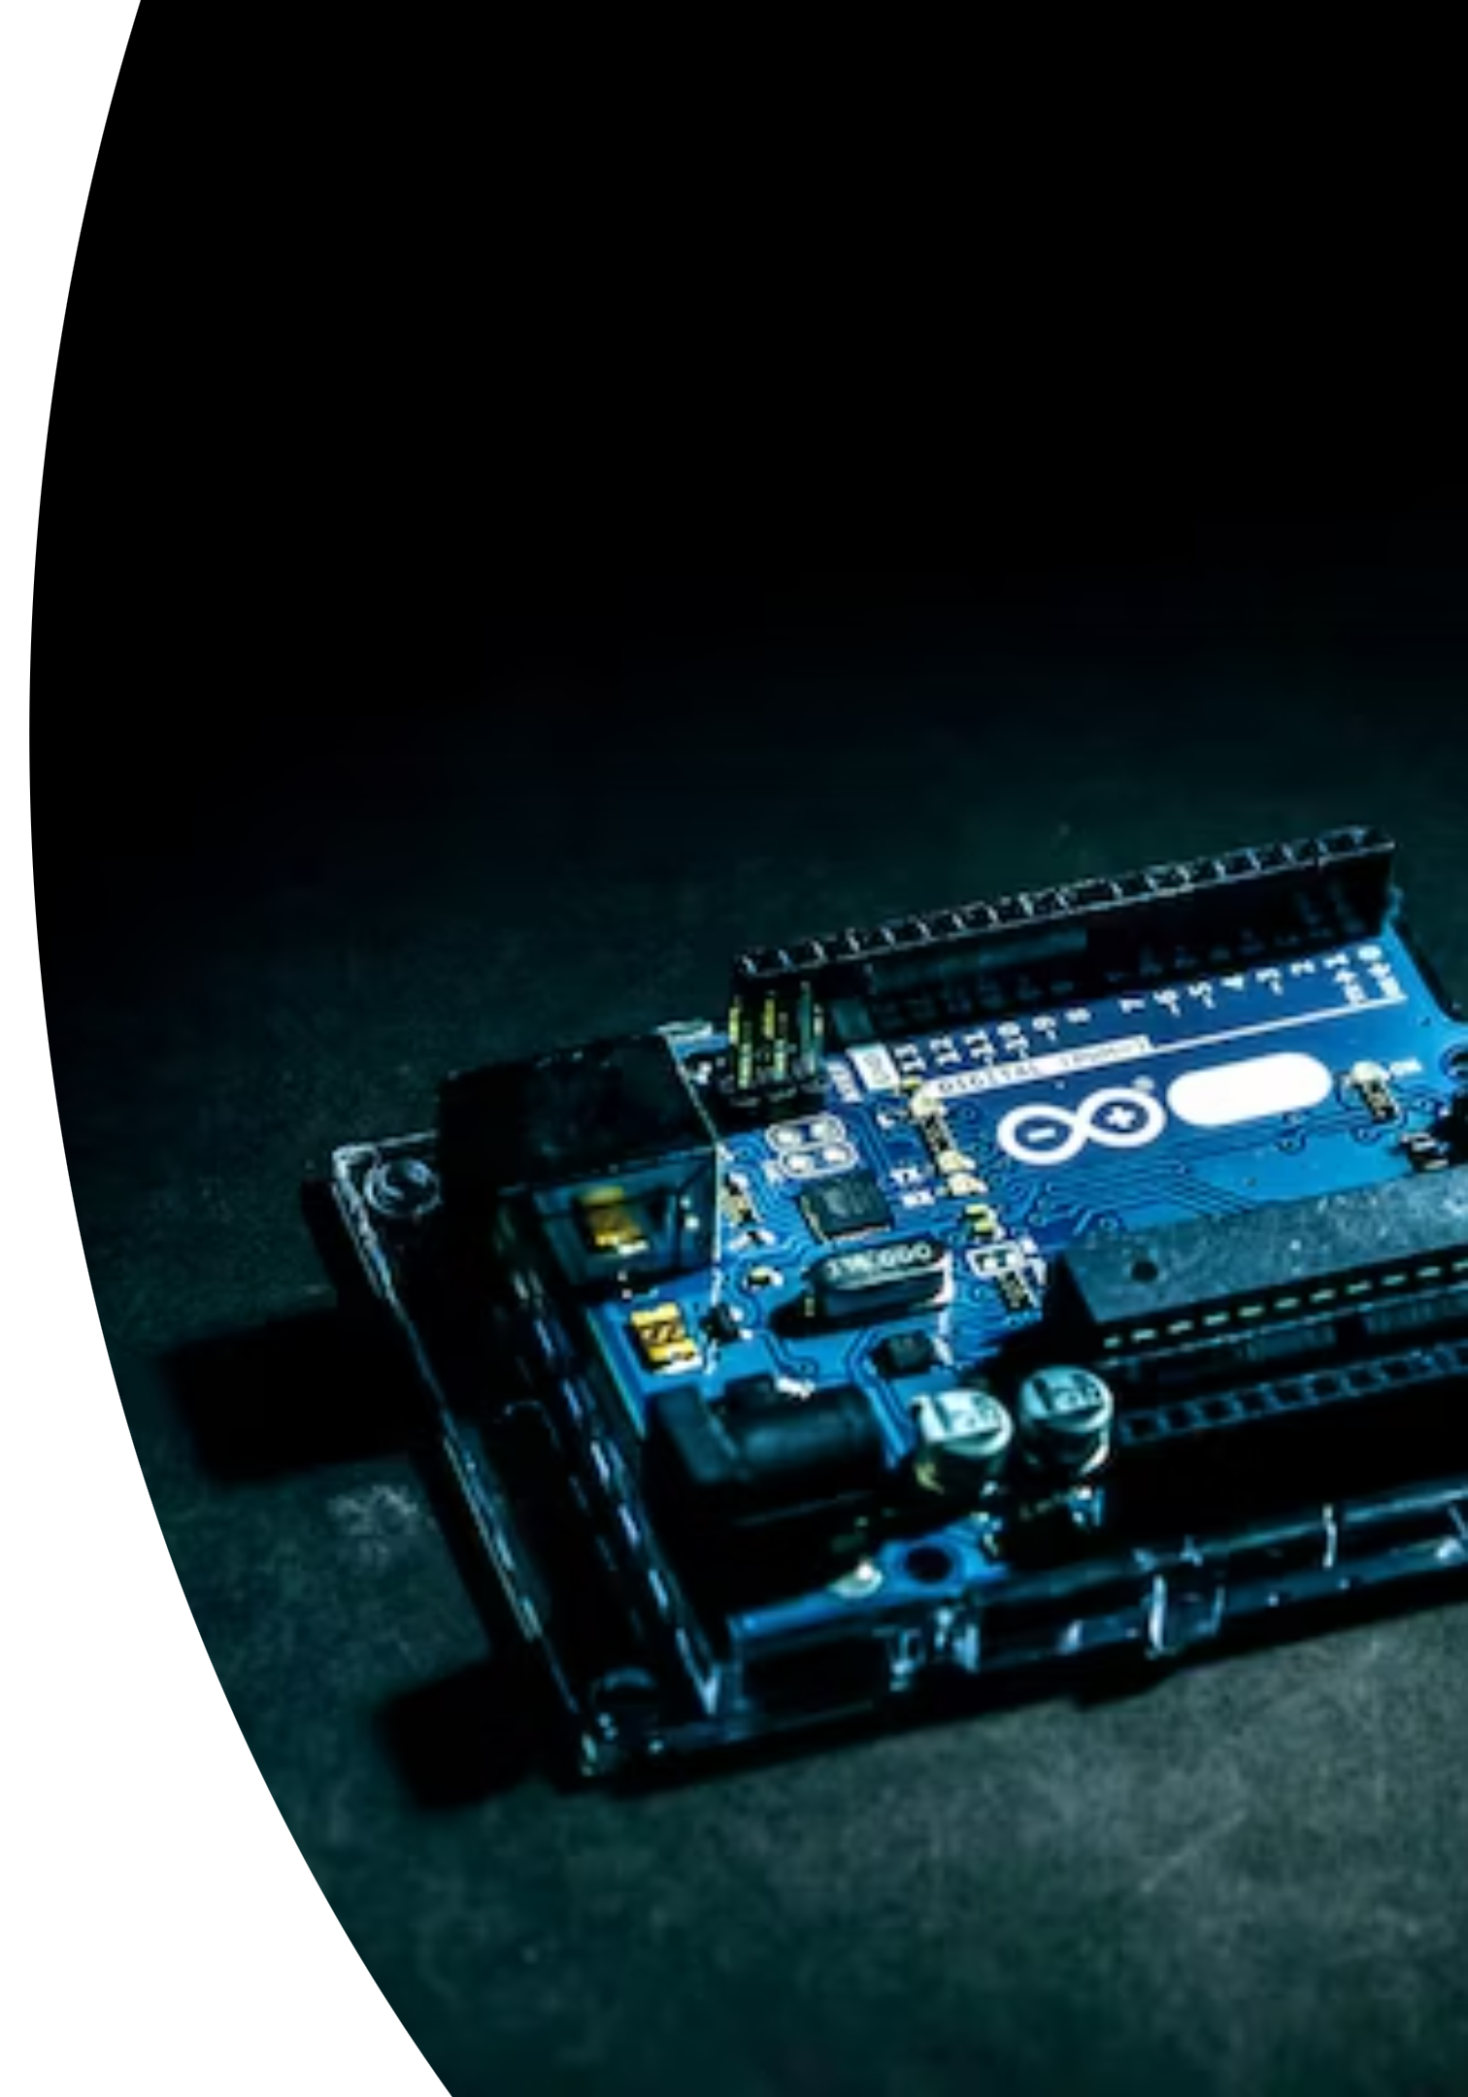
The Magic of Arduino Uno: Powering Creative Innovation

Slide 2
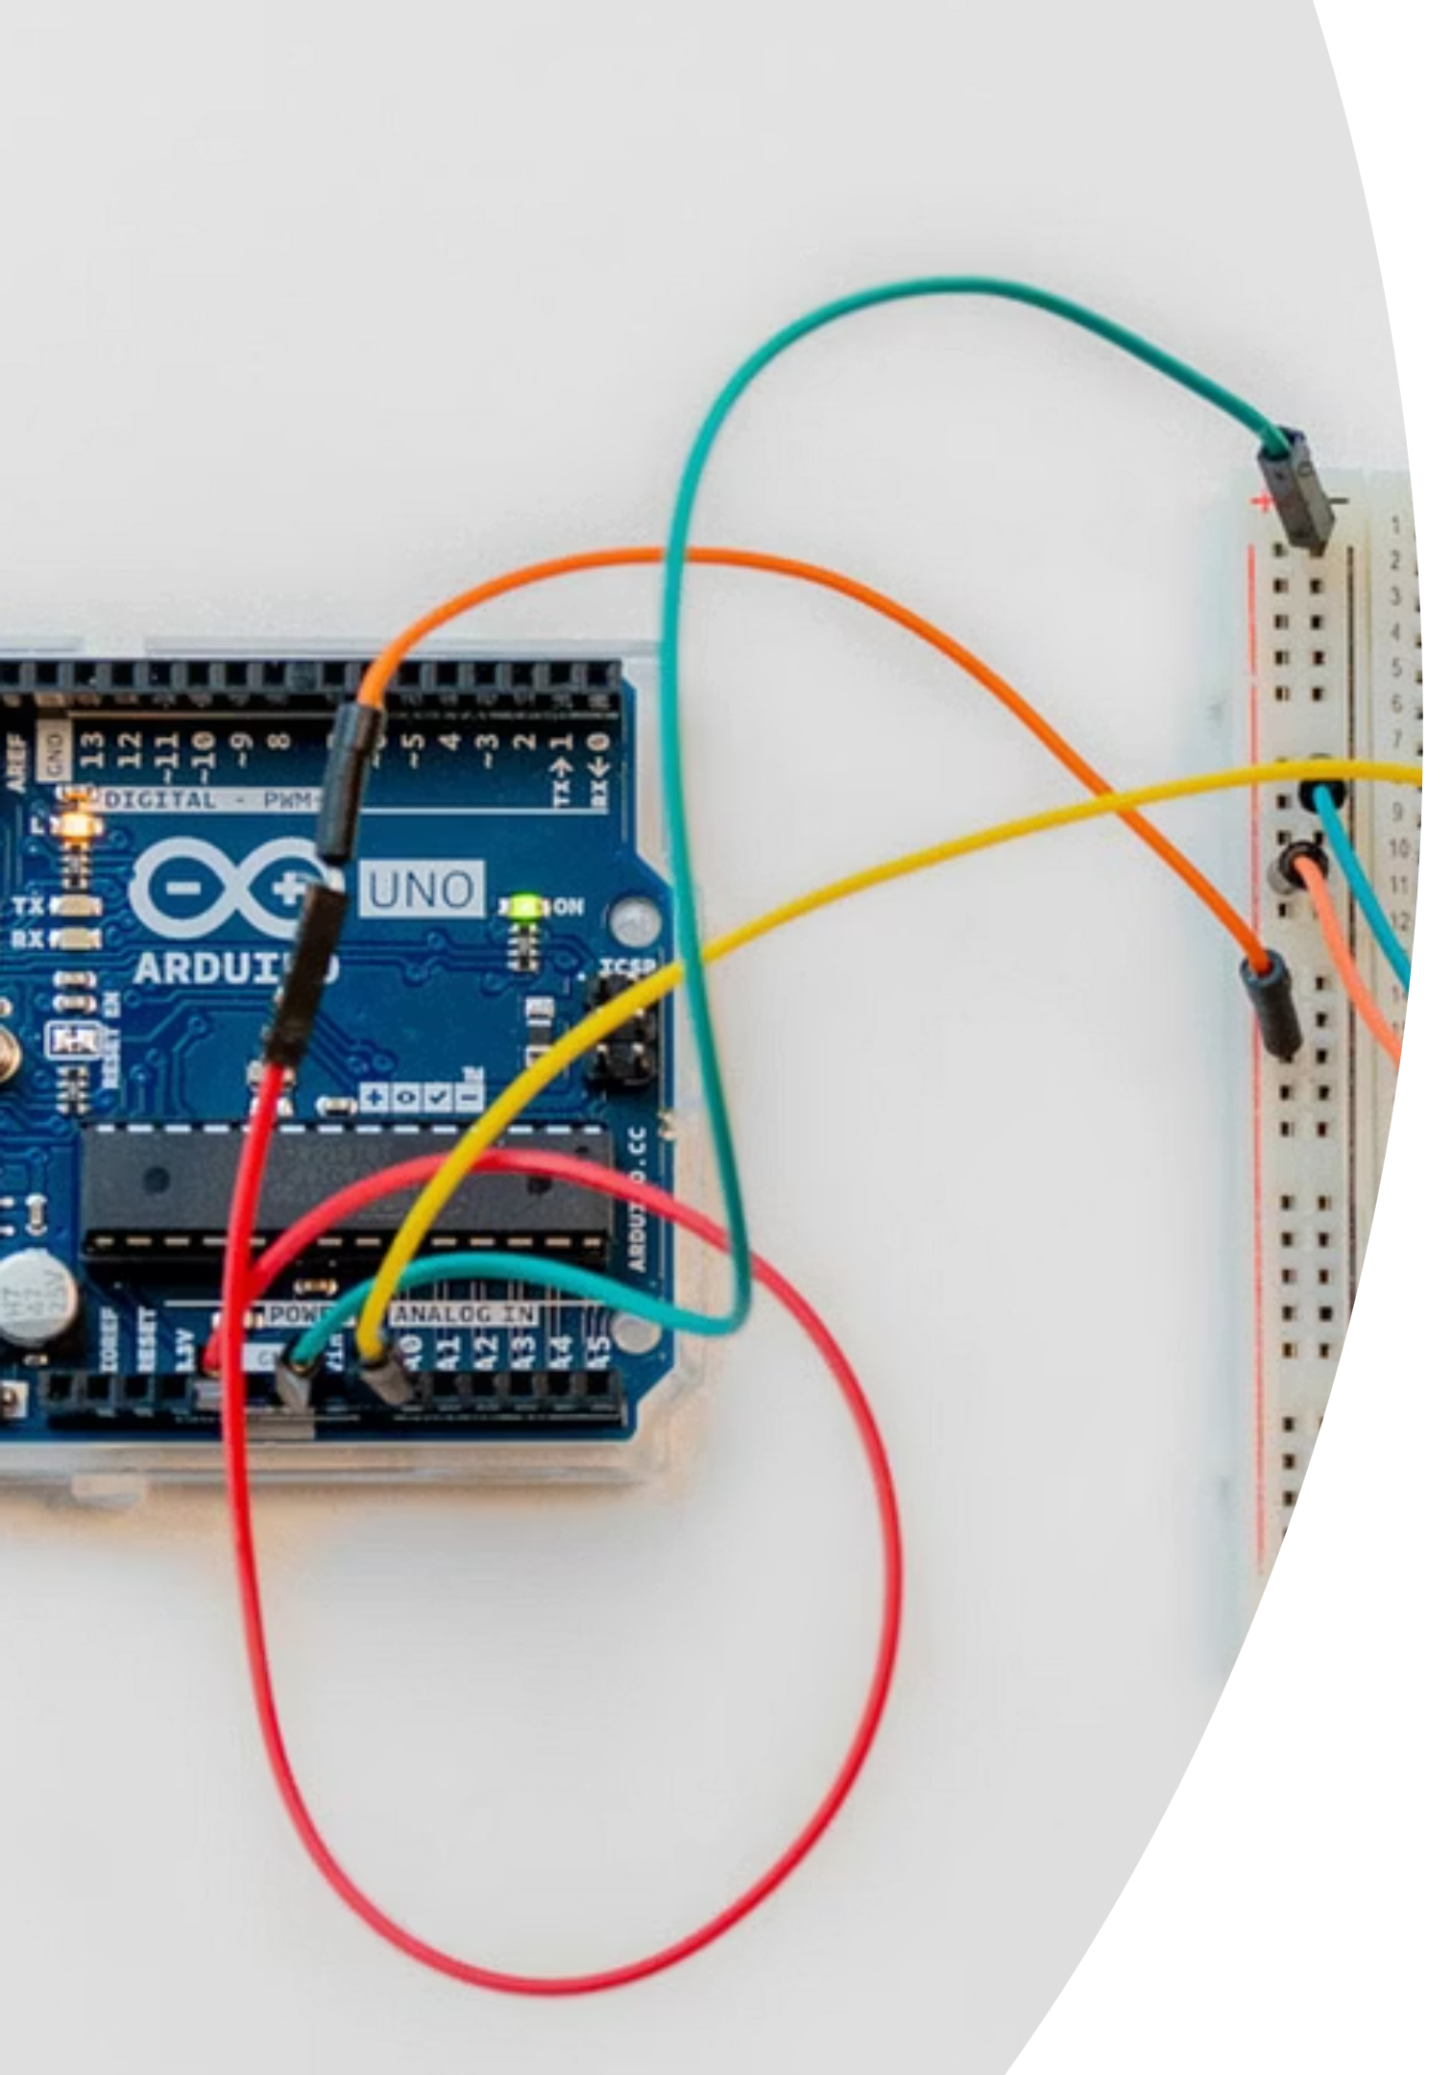

What is Arduino Uno? A Quick Refresh!
Think of Arduino Uno as the brain of your inventions! It's a tiny computer board that helps you control lights, motors, and sounds. It's super easy to use and perfect for bringing your creative ideas to life.

Slide 3




Beyond the Basics: Sensing the World
Motion Sensors
Temperature Sensors
These act like eyes for your Arduino, detecting when something moves nearby. Perfect for automatic lights or secret alarms!
Know how hot or cold it is! Your Arduino can use this to turn on a fan if it gets too warm, or warn you about chilly weather.
Light Sensors
These help your Arduino see how bright it is. You can make projects that react to daylight or even build a night light that turns on by itself.

Slide 4
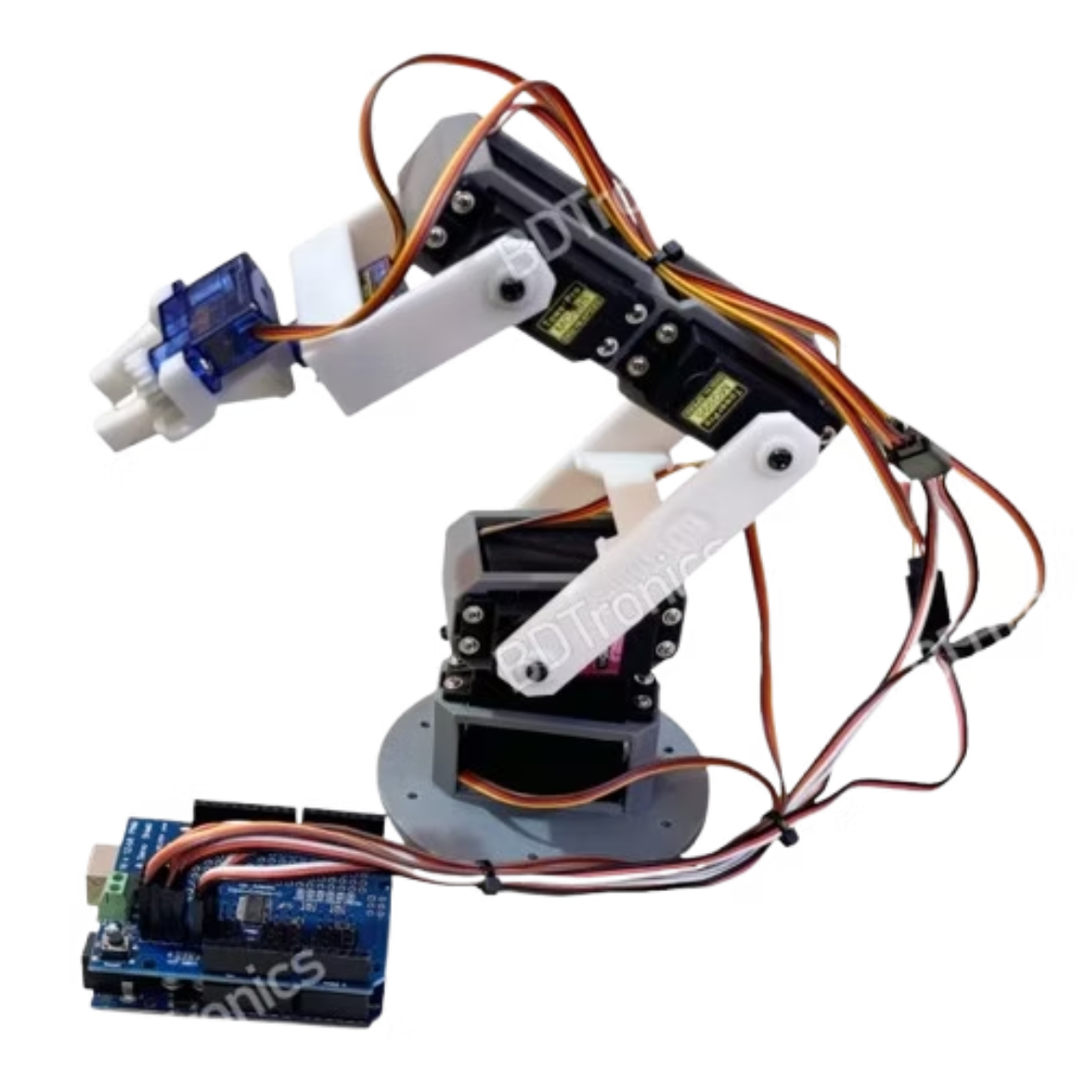
Bringing Things to Life: Motors
Make Things Move with Motors!
With Arduino, you can bring your creations to life! Control tiny motors to spin, push, or pull, enabling you to build robots that move, automated arms that grasp, or even your own interactive toys.

Slide 5


Sounds !🔊
We can use a Arduino and a piezo buzzer to make our Arduino play a song using a buzzer
What is a Buzzer?
A buzzer is a tiny speaker that makes sounds when we tell it to. We can make it sing high notes or low notes by sending special instructions from our Arduino!

Slide 6
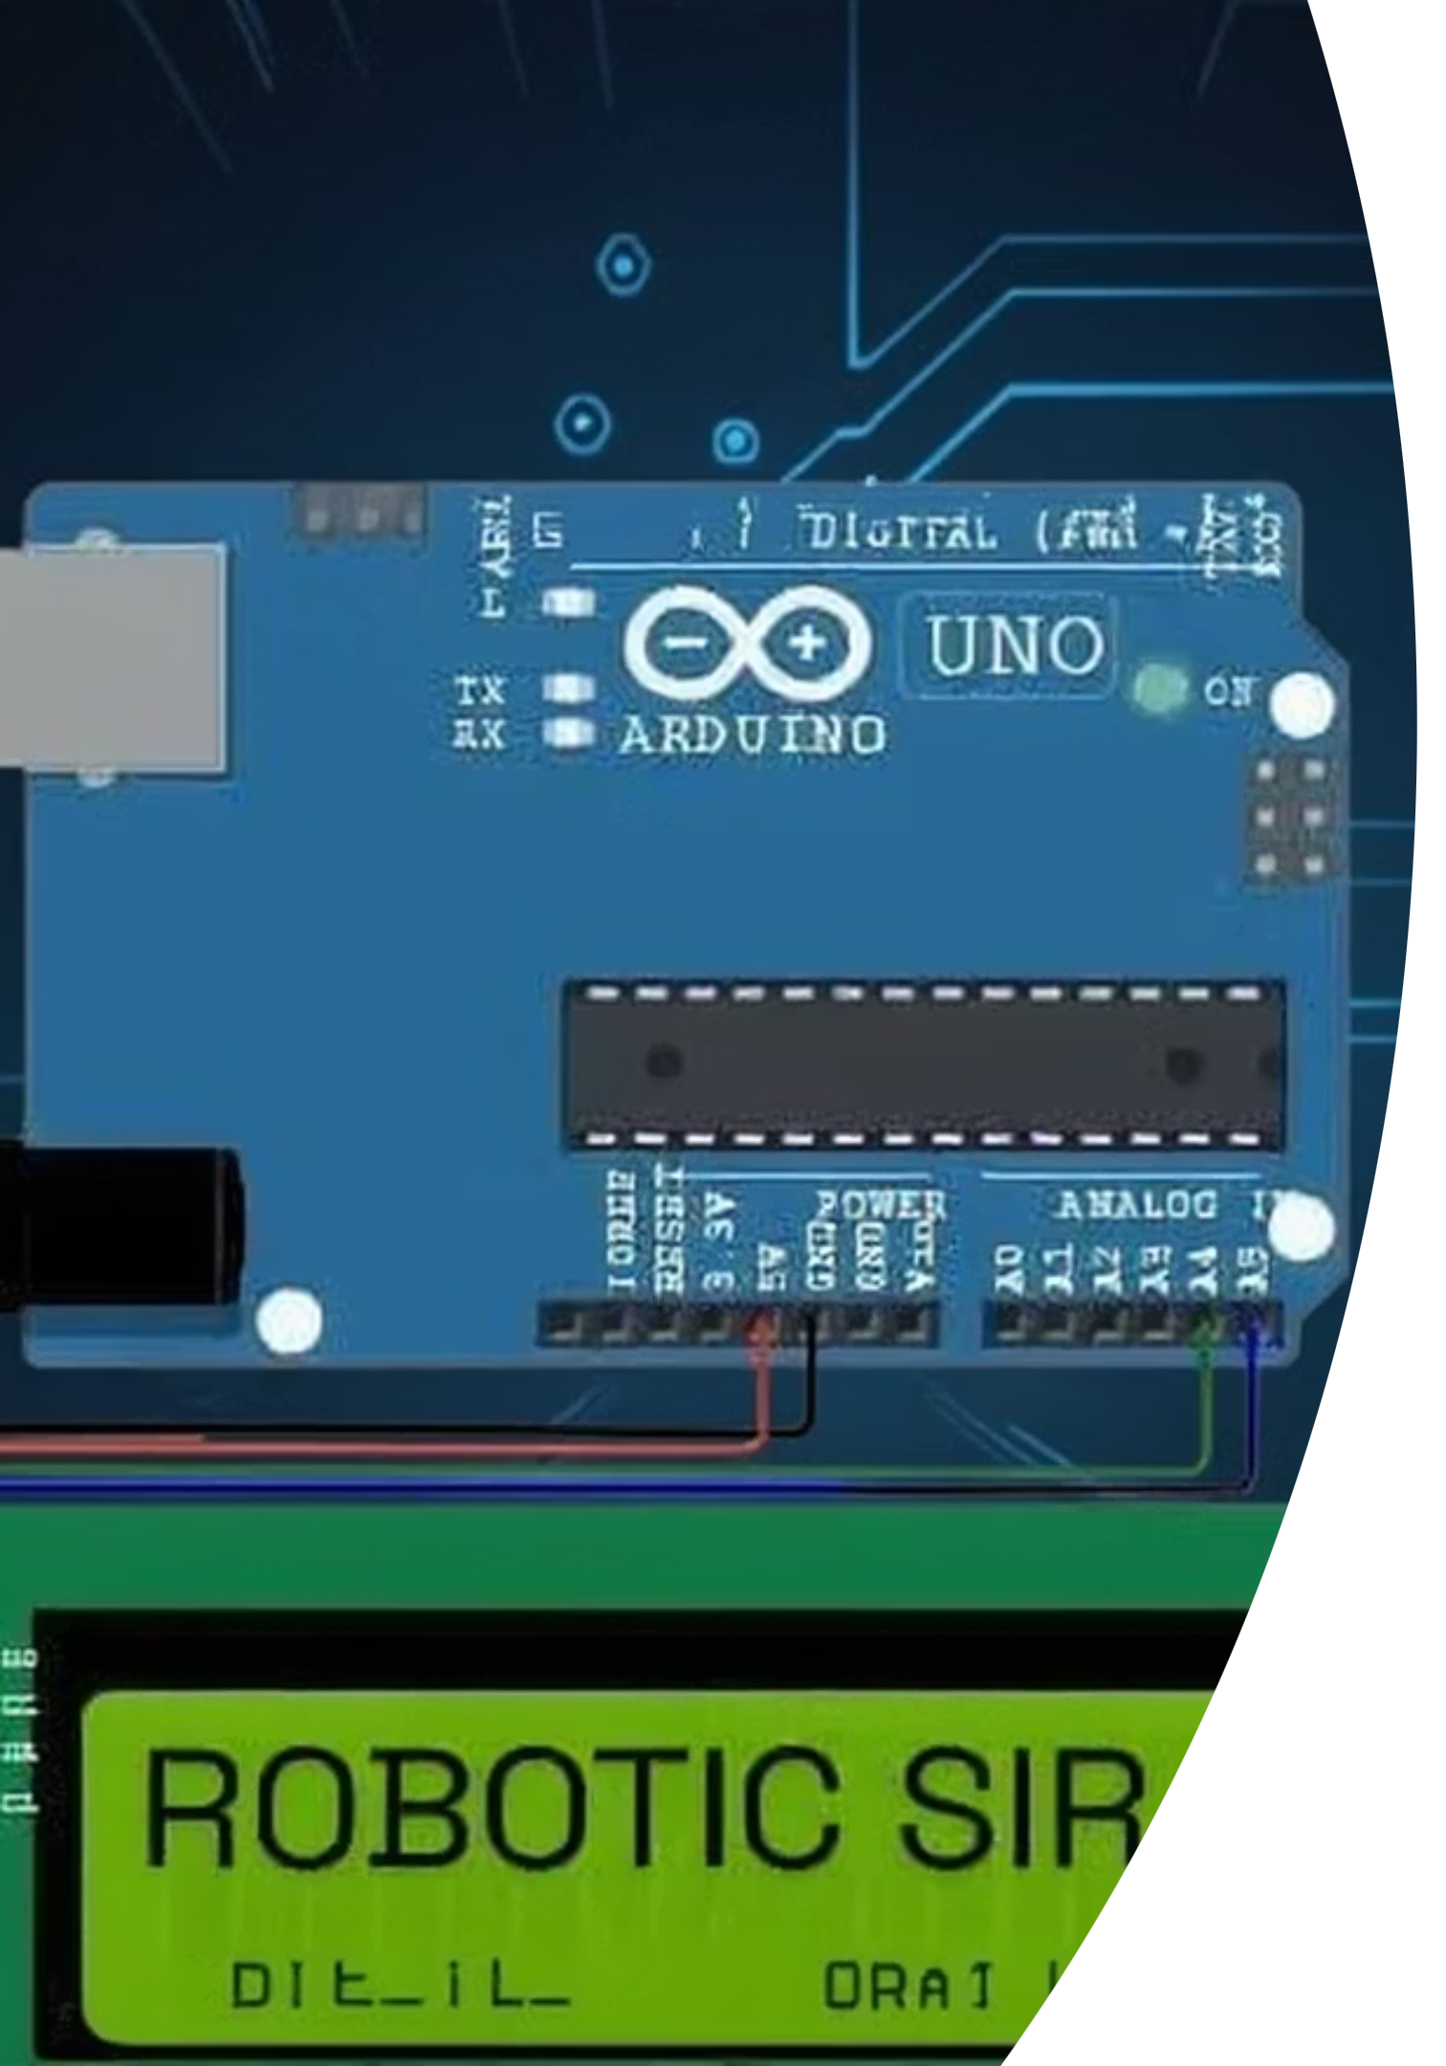
Let There Be Light!
From blinking indicators to dazzling displays, Arduino lets you control all kinds of lights. Easily connect LEDs and program them to turn on and off, fade, or create complex patterns. Perfect for interactive night lights, flashy warning signals, or adding cool visual flair to your robot's eyes!

Slide 7






Sounds, Lights, and Fun Robots!
Awesome Sounds
Add buzzers or tiny speakers to make your projects sing, beep, or even play a simple tune.
Cool Light Shows
Program LEDs to blink, fade, or create amazing patterns. Imagine a personal light show just for your room!
Interactive Robots
Combine everything to build robots that move, react to their environment, and even make sounds!

Slide 8

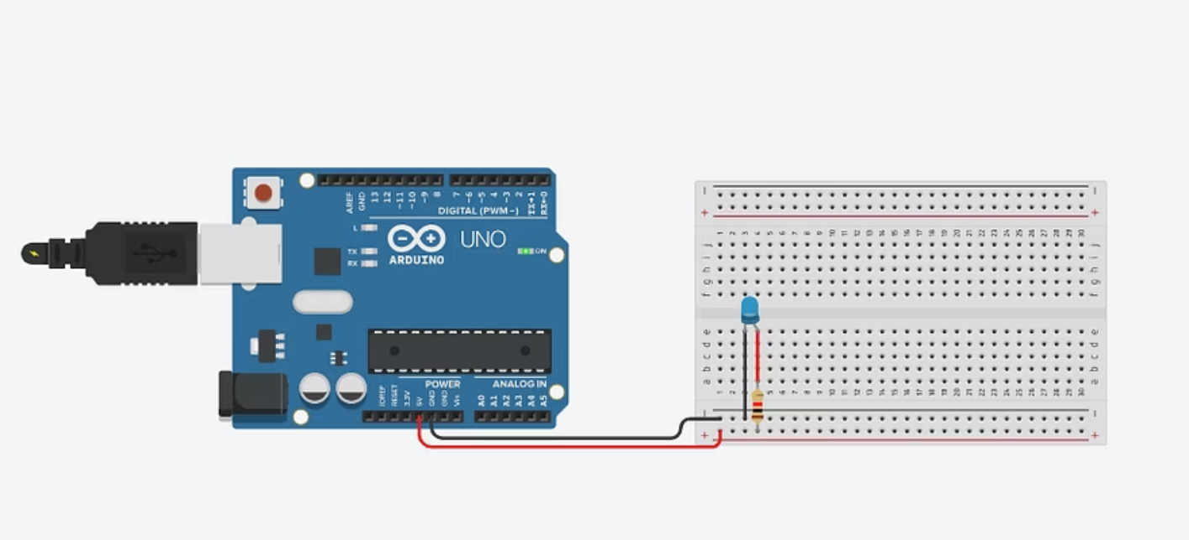
Exciting Arduino Projects We Build Today!
we are going to blow up a led with the help up of Arduino uno
step by step
first we are going to connect a led on breadboard
After that we will connect a 10k resistor to breadboard
connect the (—) negative of led to Ground of Arduino
connect the (+) positive of led to 3.3v pin of Arduino
plug in the power cable
And then "ready to boom 💥"

