Slide 1


Slide 2
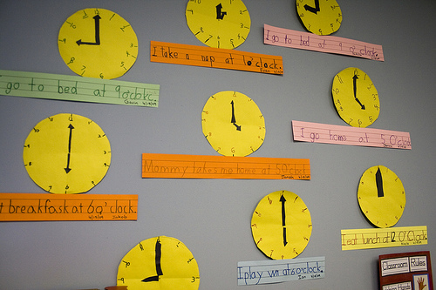
STUDENTS ACTIVITY
Students will be making clocks and showing time in the longitude assigned to them.
Follow up class – Students will show a different time on their clock and partners will locate the longitude having that local time.
21ST CENTURY SKILL USED –Critical thinking & problem solving, Collaboration( twin-pair-share method used)

Slide 3
ART INTEGRATED ACTIVITY – PAINTING/COLLAGE
TOPIC – MONSOON - A UNIFYING BOND IN INDIA
OBJECTIVE –Students will be able to
Understand the importance of monsoon throughout India.
Utilize visual arts to express the importance of monsoon in India and its effect on people, flora,fauna and culture

Slide 4
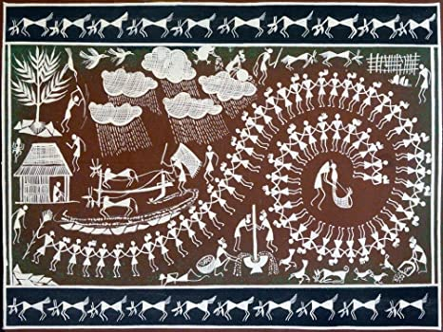
IN THE WORLI ART, NOTICE THE BIG SWIRL DEPICTING RISE IN WATER LEVEL, CLOUDS GIVING RAIN AND HELPING IN AGRICULTURAL ACTIVITIES, PEOPLE ARE RELAXED AND HAPPY.

Slide 5
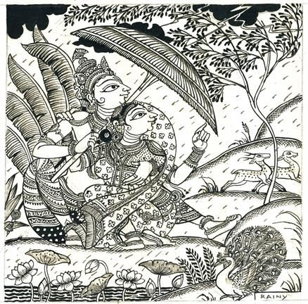
IN THIS PATTACHITRA WE CAN SEE THE LIFE IN FOREST REJOICES IN MONSOON. TREES ARE FRESH AND FULL OF LEAVES, DEERS PLAYING IN THE RAIN, PEACOCKS UNFURL THEIR FEATHERS AND DANCE IN RAIN, LOTUS,WATER LILY, JASMINE BLOSSOM ?

Slide 6
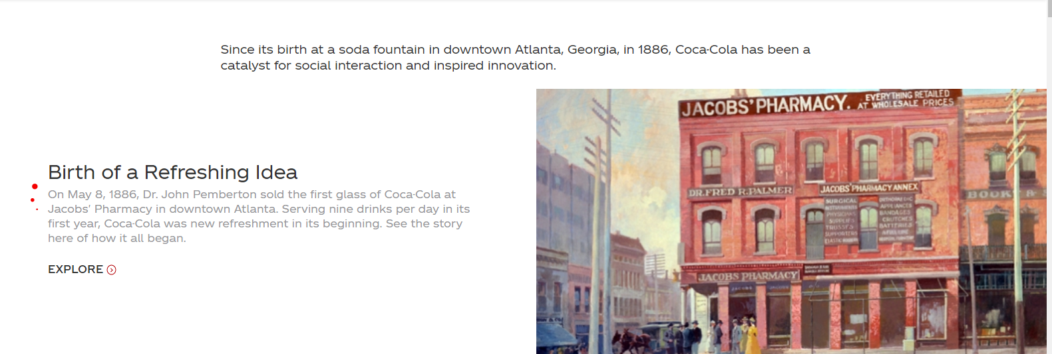
THE JOURNEY OF THE COKE BOTTLE -INTERLINKING COUNTRIES -WORTH A FULFILLING DRINK
The drink Coca-Cola was originated in 1886 by an Atlanta pharmacist, John S.Pemberton originally touted his drink as a tonic for most common ailments, basing it on cocaine from the coca leaf and caffeine-rich extracts of the kola nut; It was sold for 5 cents in drug stores all across Atlanta. It rapidly grew popular across USA.
The cocaine was removed from Coca-Cola's formula in about 1903.
TOOL USED FOR INTRODUCING TOPIC IS STORY MAPPING THROUGH LUCIDCHART

Slide 7
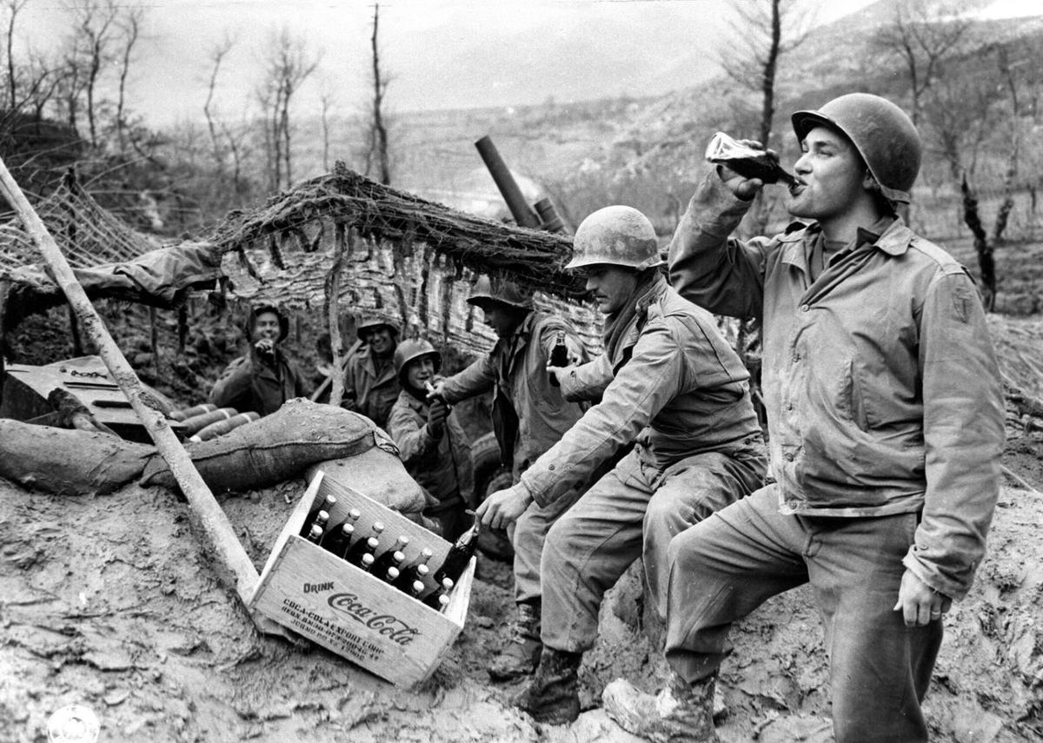
During World War II, Coca-Cola President Robert Woodruff believed that every American serviceman and woman should have a Coke at their disposal for five cents,which later established Coke as a global corporation by introducing the product to different markets

Slide 8
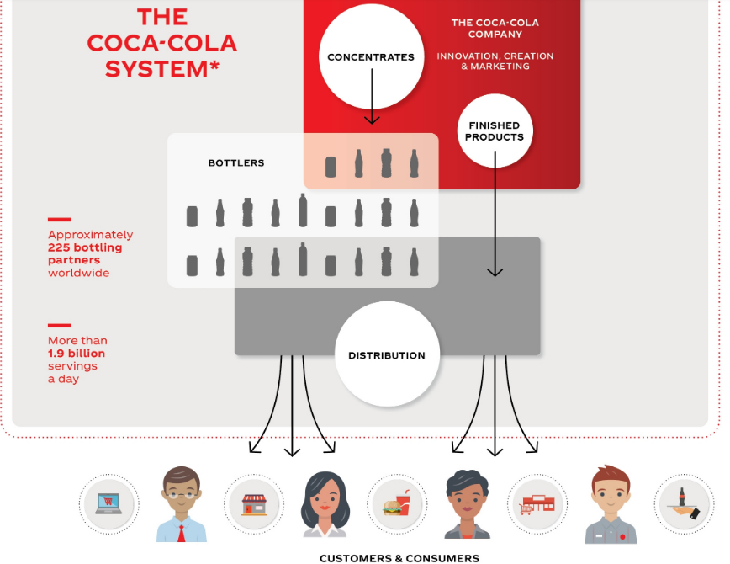
The Coca-Cola Company produces concentrate, which is then sold to licensed Coca-Cola bottlers throughout the world. The bottlers produce the final drink by mixing the syrup with filtered water and sweeteners, putting the mixture into cans and bottles, and carbonating it, which the bottlers then sell and distribute to retail stores.

