Slide 1
Diabetes Health Indicator
DS 675-102 Machine Learning
Submitted
to
Prof: Khalid Bakhshaliyev
Daivik Girish | dg643@njit.edu
Grahitha Eda | ge87@njit.edu
Rushmitha Kommana | rk958@njit.edu
Sai Sashank Pannala | sp3459@njit.edu

Slide 2
Problem Definition
Task: to classify individual’s diabetes status based on various health indicators.
Dataset: BRFSS 2015 with 253,680 entries and 22 features.
Motivation: Importance of early detection.
Objective: Develop a high-accuracy classification model.

Slide 3
Dataset Details
The dataset includes 253,680 entries and 22 columns, including the target column, Diabetes 012
Features related to health conditions: HighBP, HighChol, Stroke, Heart Disease or Attack
Lifestyle-related indicators: PhysActivity, Smoker, HvyAlcoholConsump, Fruits, Veggies
Healthcare access and health status indicators: AnyHealthcare, NoDocbcCost, GenHlth, MentHlth, PhysHlth, DiffWalk
Demographics: Sex, Age, Education, Income
Target: Diabetes 012 (three classes for diabetes status (0: No diabetes, 1: Prediabetes, 2: Diabetes))

Slide 4
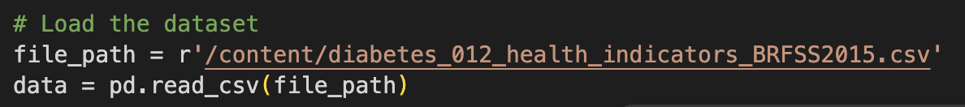
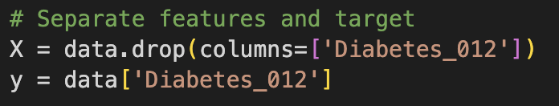
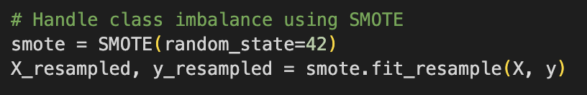
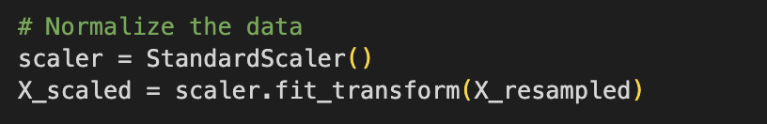
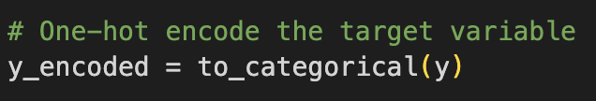
Pre-Processing Steps
Loading Data
Separating Feature and Target
Handling class imbalance
Standard Scaling
Splitting Data into train and test

Slide 5
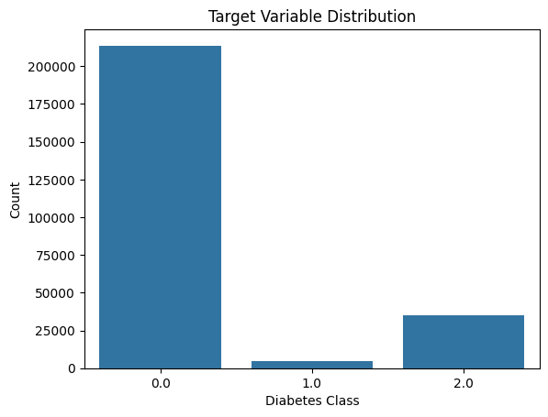
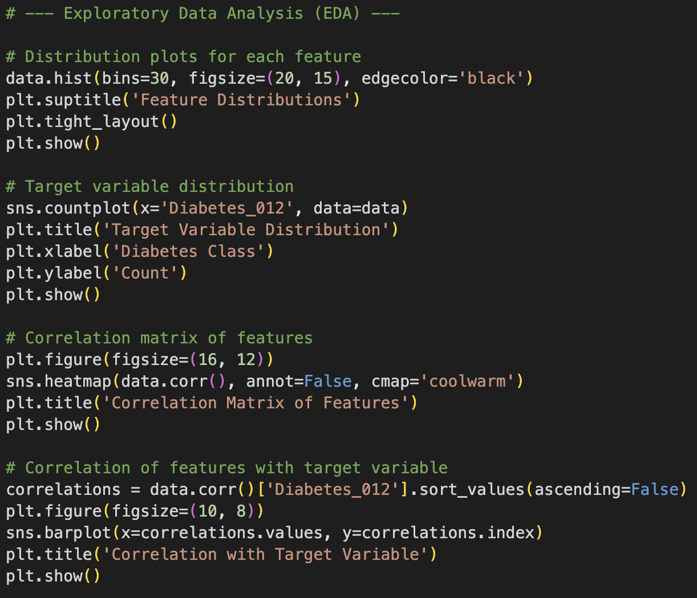
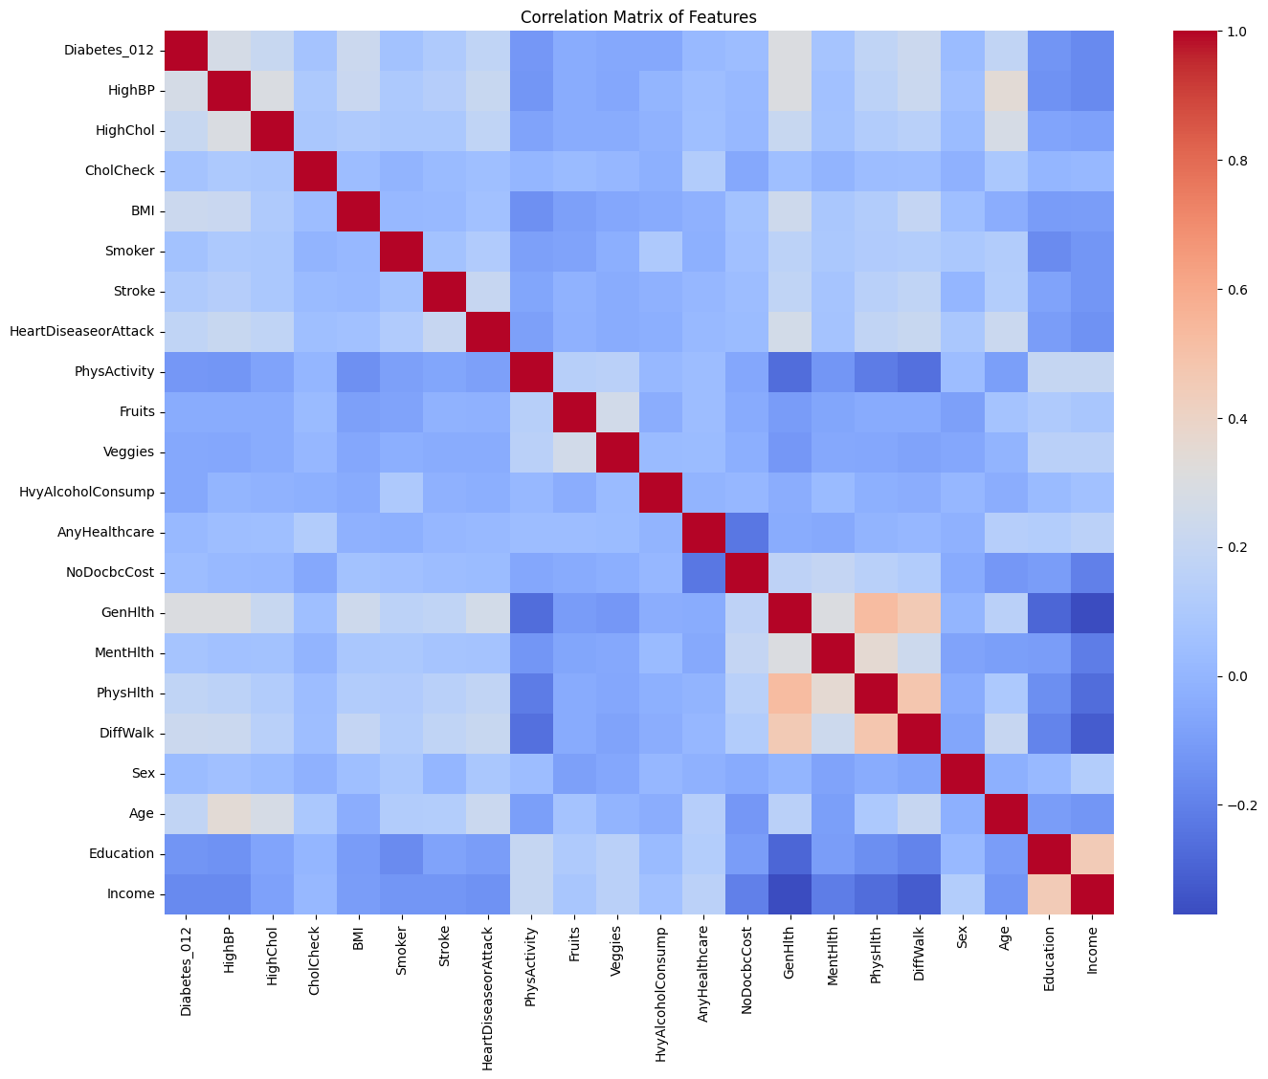
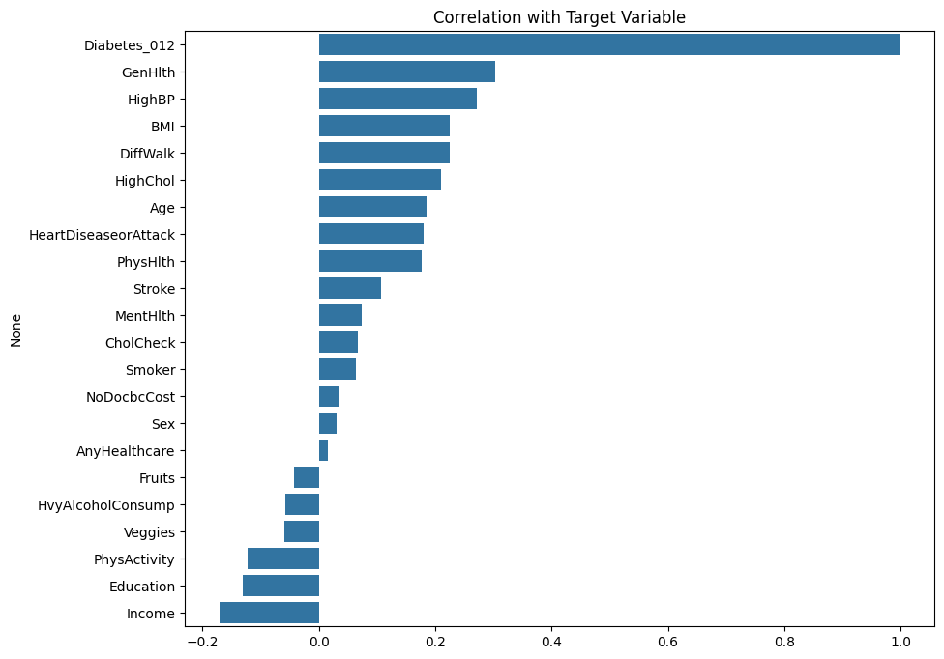
Exploratory Data Analysis

Slide 6
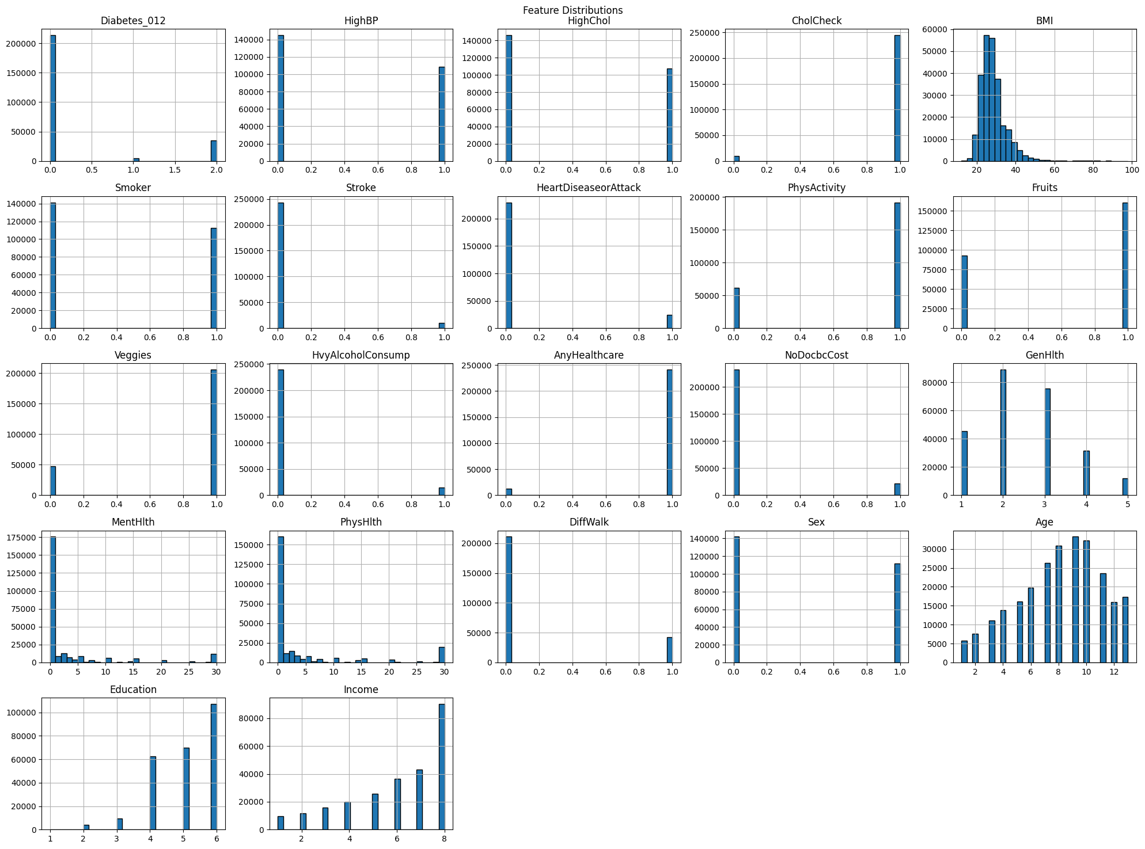

Slide 7
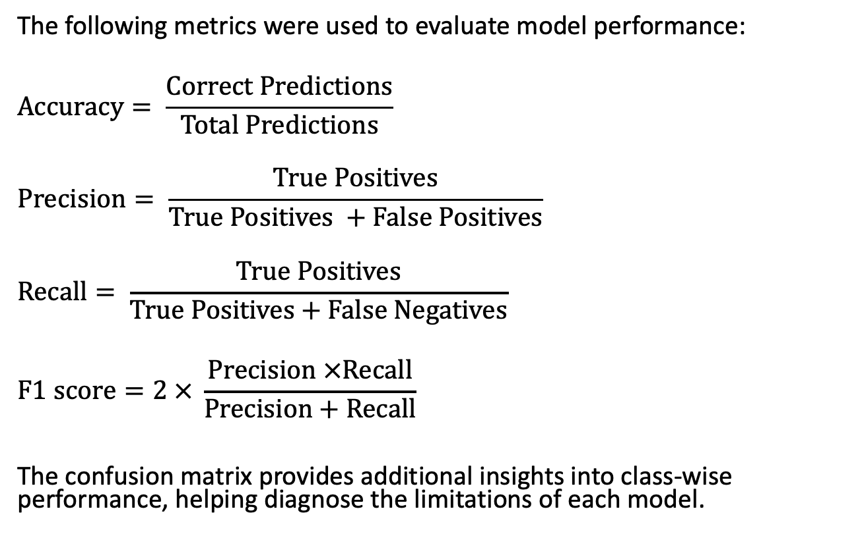
Evaluation Metrics
The following metrics were used to evaluate model performance:
$$Accuracy= \frac{Correct Predictions}{Total Predictions}$$
$$Precision= \frac{True Positives}{True Positives +False Positives}$$
$$Recall= \frac{True Positives}{True Positives+False Negatives}$$
$$F1 score=2 × \frac{Precision ×Recall}{Precision+Recall}$$
The confusion matrix provides additional insights into class-wise performance, helping diagnose the limitations of each model.

Slide 8
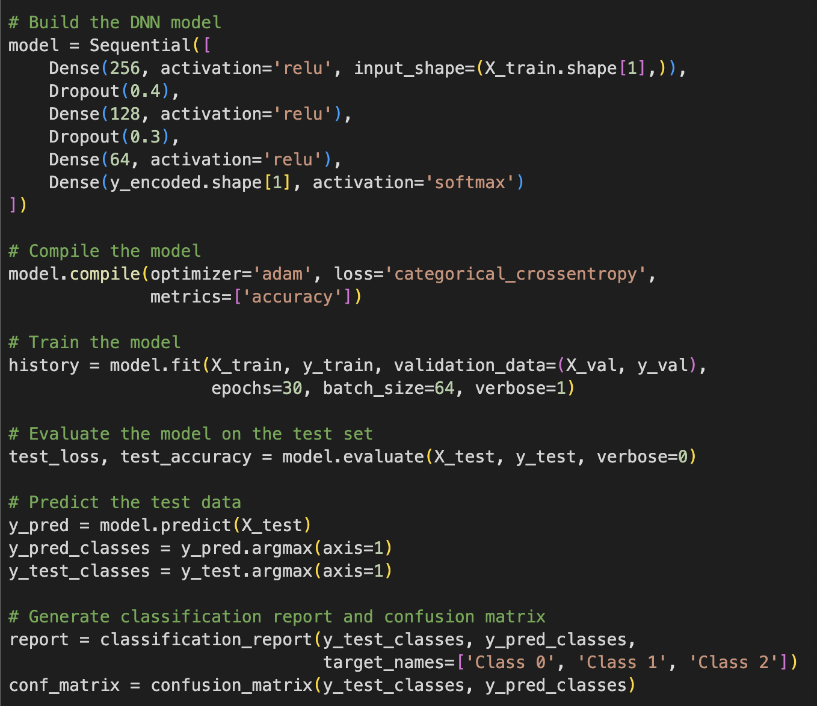
ML Model 1: Deep Neural Network
Build the DNN Model.
Compile and train the model.
Evaluate the model on the test set.
Predict the test set.
Generate classification report and confusion matrix.

Slide 9
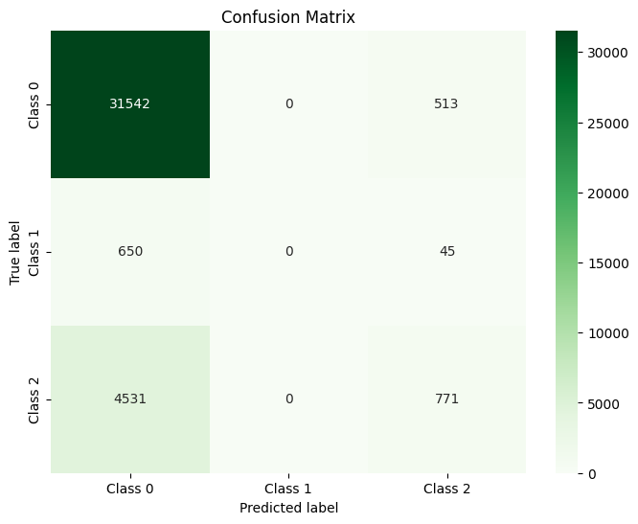
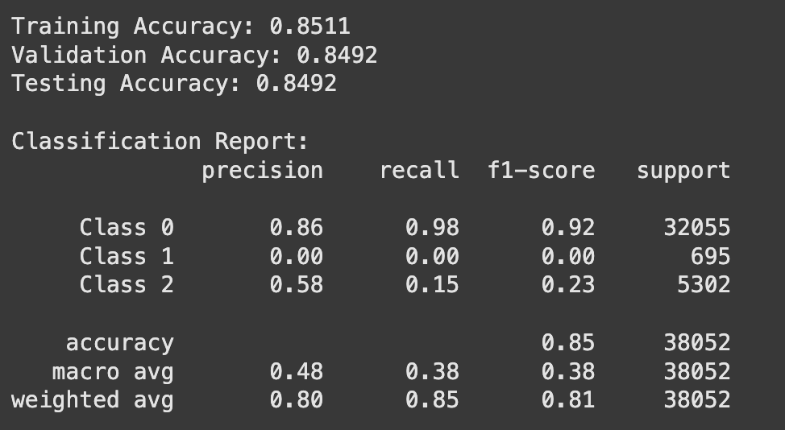
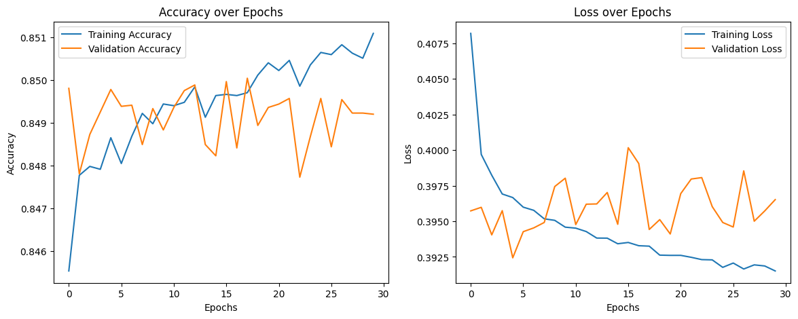
Results:

Slide 10
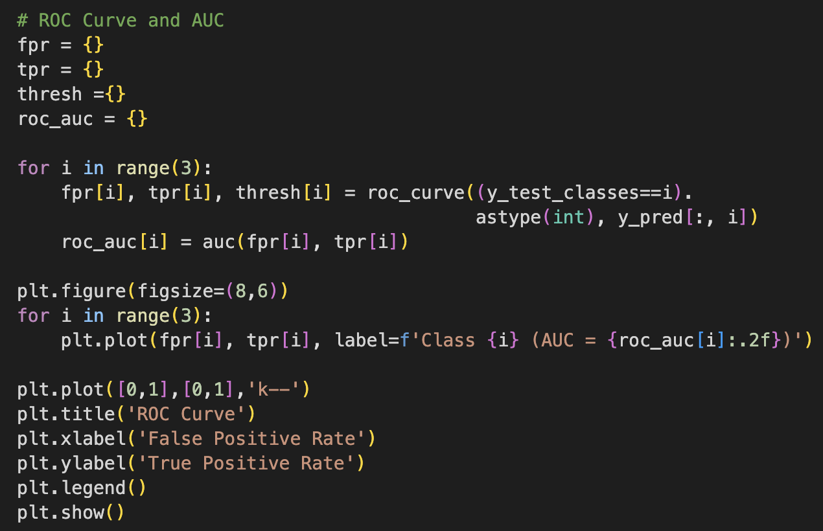
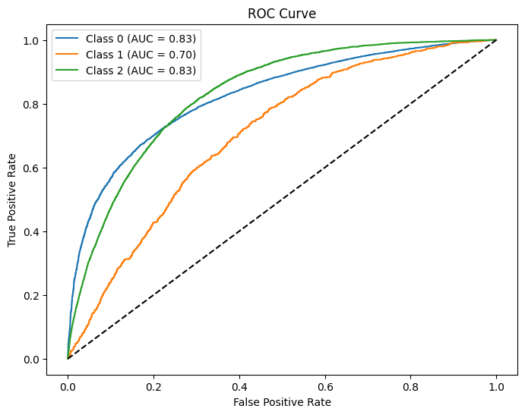
AUC-ROC Curve:

Slide 11
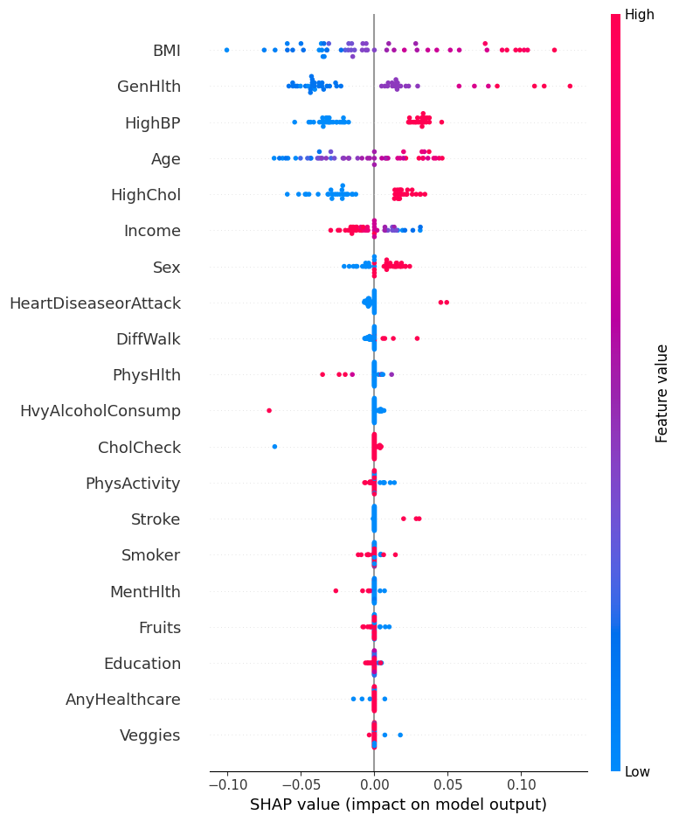
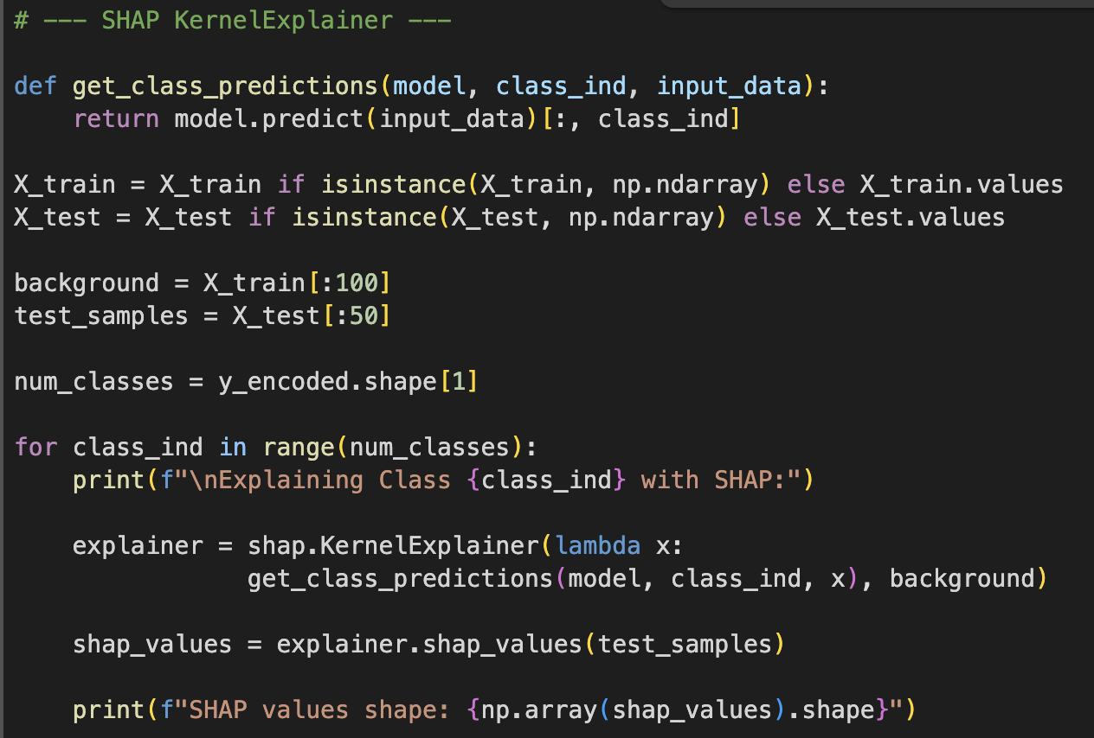
SHAP Values:

Slide 12
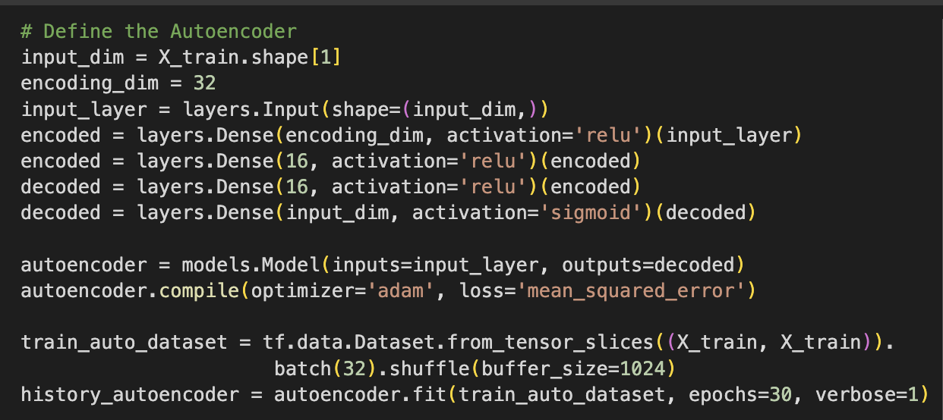
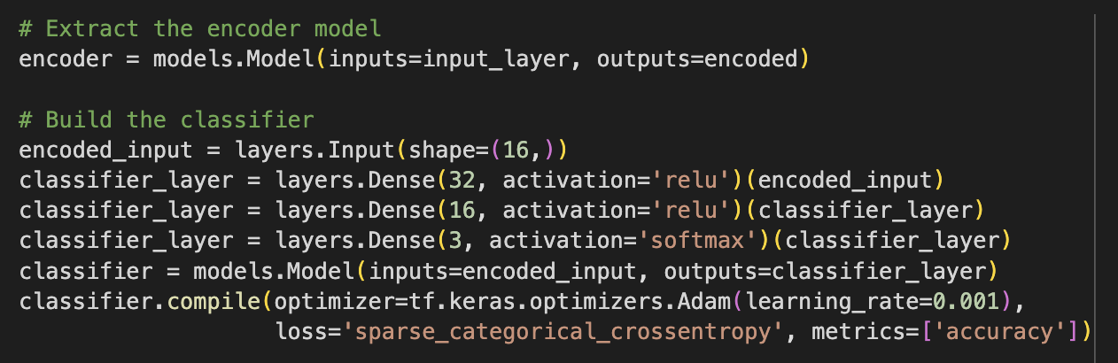
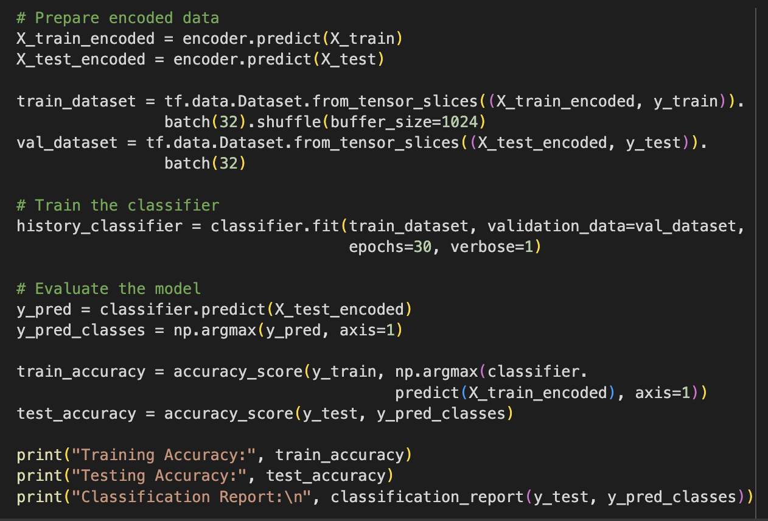
ML Model 2: Auto-Encoder
Define Auto-encoder model.
Extract the model.
Build the classifier.
Prepare the encoded data.
Train the classifier.
Evaluate the model.

Slide 13
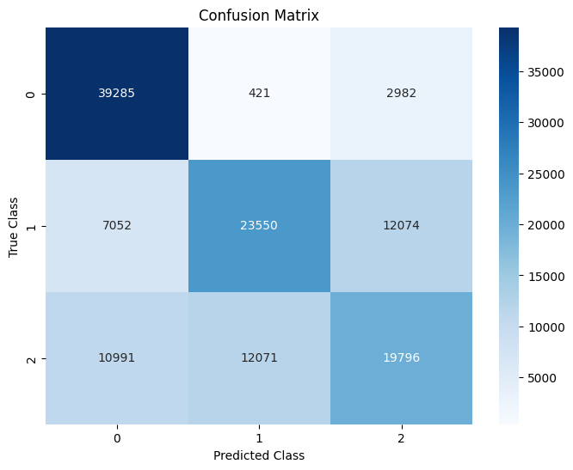
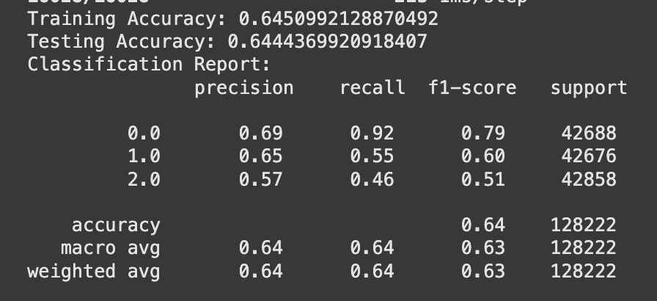
Result:

Slide 14
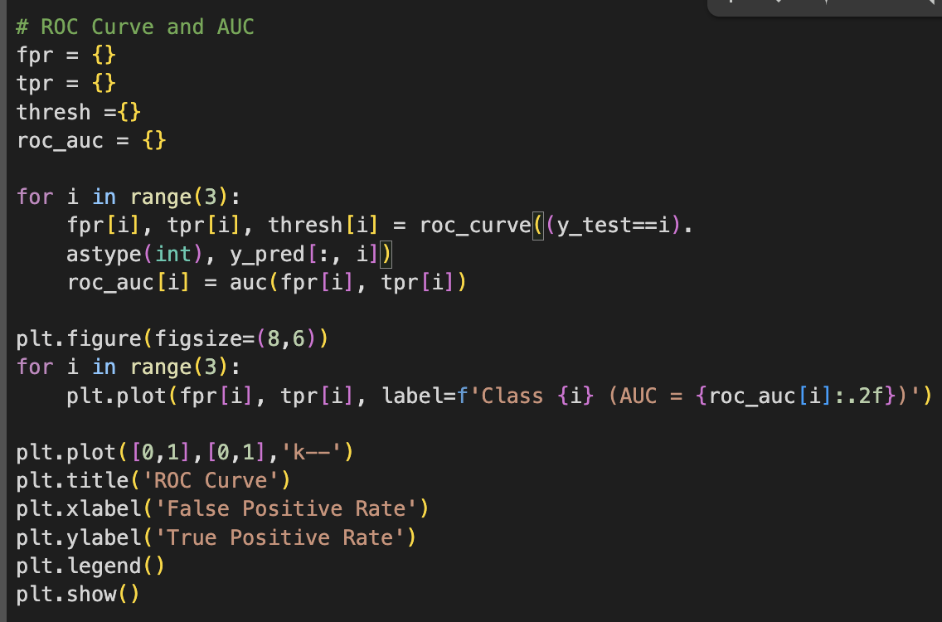
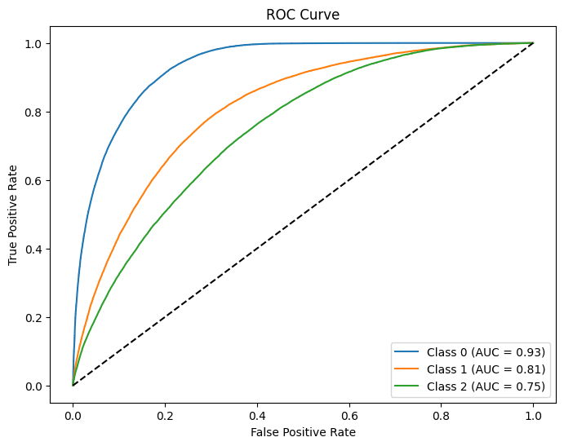
AUC-ROC Curve:

Slide 15
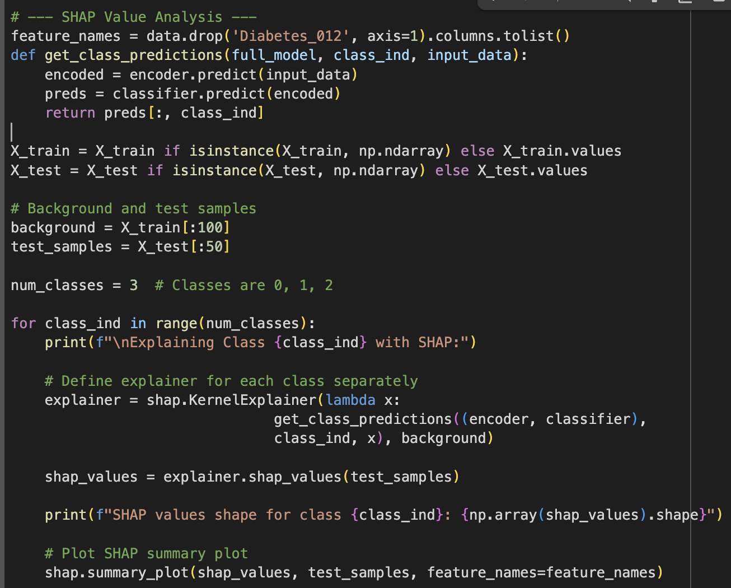
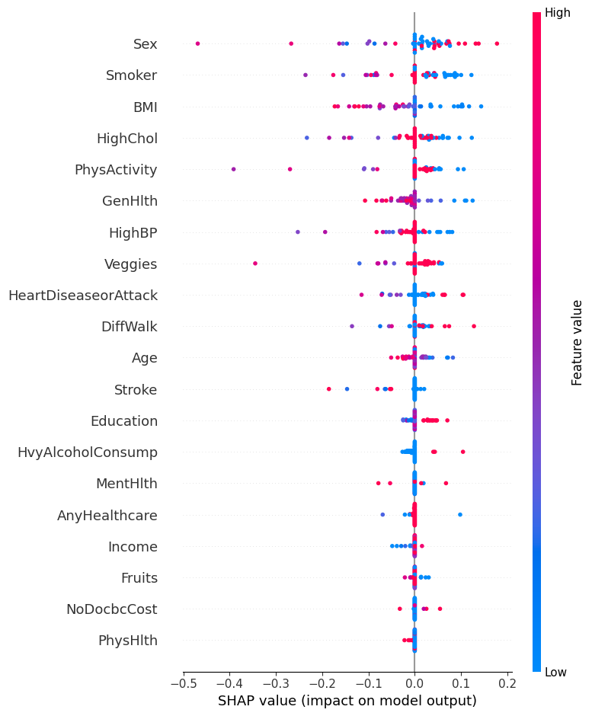
SHAP Values:

Slide 16
Comparison of Results
Aspect | DNN Model | Autoencoder Classifier
Training Accuracy | 85.11% | 64.51%
Testing Accuracy | 84.92% | 64.44%
Class 0 (No Diabetes) | F1-score: 0.92, AUC: 0.83 | F1-score: 0.79, AUC: 0.93
Class 1 (Pre-Diabetes) | F1-score: 0.00, AUC: 0.70 (completely missed) | F1-score: 0.60, AUC: 0.81 (well-handled)
Class 2 (Diabetes) | F1-score: 0.23, AUC: 0.83 | F1-score: 0.51, AUC: 0.75
Macro Avg F1-Score | 0.38 | 0.63
Weighted Avg F1-Score | 0.81 | 0.63
Class Imbalance Handling | Not applied | SMOTE used for resampling
Confusion Matrix | Completely misses Class 1 Heavily favors Class 0 | More balanced confusion across all 3 classes
ROC Curve Quality | Class 0 & 2 have strong separation Class 1 is weak (AUC = 0.70) | Class 0 strong (AUC = 0.93) Class 1 & 2 moderate (AUC > 0.75)
SHAP Interpretability | BMI, GenHlth, HighBP, Smoking important | Sex, Smoker, BMI, Cholesterol, Activity impactful
Training Stability | Smooth learning curves | Stable performance, no overfitting
Model Complexity | Simple Sequential model | Two-stage: Encoder + Classifier

Slide 17
Conclusion
The DNN model demonstrated strong overall accuracy (~85%), with excellent performance on the majority class (Class 0 - No Diabetes).
However, it completely failed to detect Class 1 (Pre-diabetes), making it unreliable in scenarios where early detection is critical.
The Autoencoder Classifier, while less accurate overall (~64% accuracy), provided a much more balanced classification across all classes, particularly performing significantly better for Class 1 and Class 2.
SMOTE was crucial in improving minority class performance in the Autoencoder model.
SHAP analysis in both models confirmed the importance of features like BMI, General Health, HighBP, Physical Activity, and Smoking.

Slide 18
Challenges and Future Work
Challenges
Class Imbalance
Overfitting
Feature Complexity
Low Testing Accuracy
Difficulty Capturing Complex Patterns
Future Improvements
Ensemble Methods: bagging or boosting
Feature Engineering: Extract more informative features to improve model performance and reduce class overlap.
Advanced Class Imbalance Techniques

Slide 19
Contributions:
Daivik Girish
Baseline DNN model development and training.
Sai Sashank Pannala
Baseline DNN evaluation and reporting.
Grahitha Eda
Autoencoder model design and training.
Rushmitha Kommana
Autoencoder evaluation and SHAP analysis.

Slide 20
References:
Dataset:
https://www.kaggle.com/datasets/alexteboul/diabetes-health-indicators-dataset
Autoencoder file:
https://colab.research.google.com/drive/1rqrk6SNWf_Yxei3C8eGa-oZEA9ONwCnf?usp=drive_link
DNN file: https://colab.research.google.com/drive/1ZUFqFu4zsJznl4aagb3qDdzwYRZp75W2?usp=drive_link

