Slide 1
MACHINE LEARNING IN DATABASES
BY DAIYAN KHAN PATHAN

Slide 2
Table of contents
01
02
03
04
Introduction
Demand for ML
What is Machine Learning?
Explore the current need and implementation of ML in DB
Problems and
Solutions
Conclusion
Summary
Explore the current problems and how they can be solved

Slide 3
01
Introduction

Slide 4
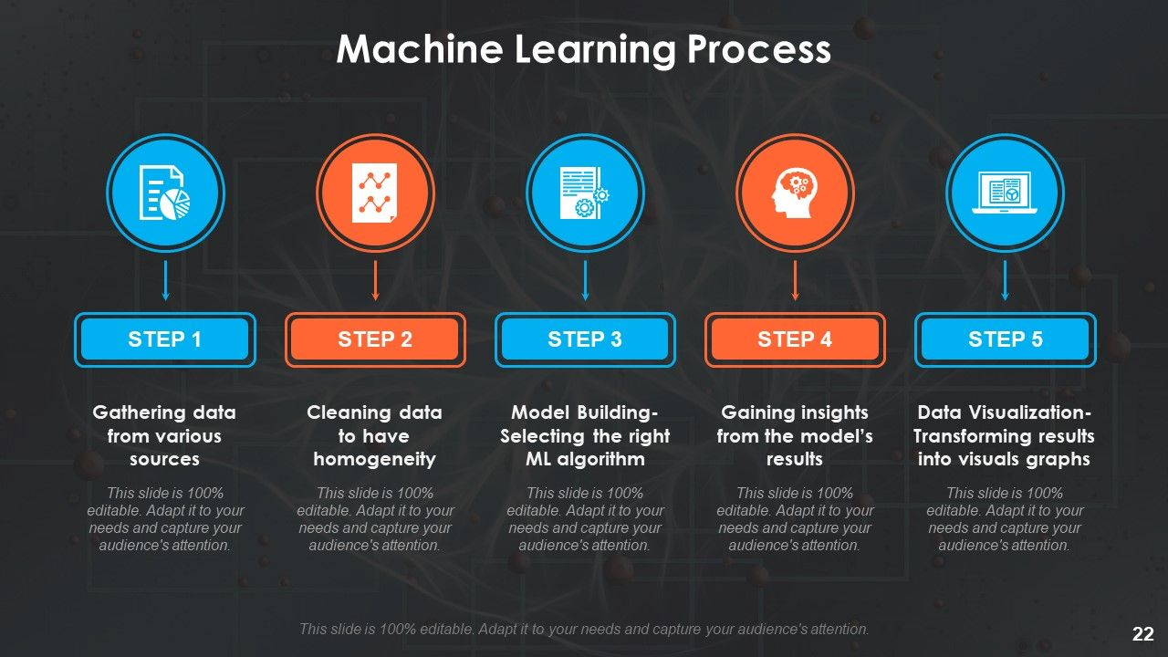

What is Machine Learning?
Machine learning is a subset of artificial intelligence (AI) that focuses on developing algorithms enabling computers to learn from and make predictions or decisions based on data. It involves training models to recognize patterns, adapt to new information, and improve performance over time without being explicitly programmed, thus enhancing automation and decision-making in various applications.

Slide 5
02
Use of ML
How are Machine Learning and Databases codependent

Slide 6

ML and DB relationship
DATABASE
1. Data Analysis: ML algorithms analyze and extract valuable insights from databases, helping businesses make data-driven decisions.
2. Predictive Maintenance: ML predicts when database systems require maintenance, optimizing their performance and reliability.
3. Security: ML is crucial for identifying and mitigating database security threats, safeguarding sensitive data from breaches.
Machine learning
Data Source: ML relies on databases as its primary data source, where vast amounts of structured and unstructured data are stored.
Training Data: Databases provide the training data needed to build and fine-tune ML models, enabling pattern recognition and predictions.
Data Quality: The quality and integrity of data in databases directly impact ML model performance, emphasizing the need for clean and reliable data.

Slide 7
Current application in Databases
Self-Adaptation
continuously analyzes queries, access patterns and system performance, making real-time adjustments for optimal performance, eliminating manual intervention.
Some machine learning applications
NLP
NLP interfaces convert natural language queries into SQL commands, simplifying database interactions for non-technical users.
Resource Management
ML-driven resource allocation optimizes CPU, memory, and storage usage, preventing bottlenecks and ensuring efficient resource utilization based on workload demands.
Data Quality
automate the detection and correction of data quality issues such as duplicates, missing values, and inaccuracies.

Slide 8



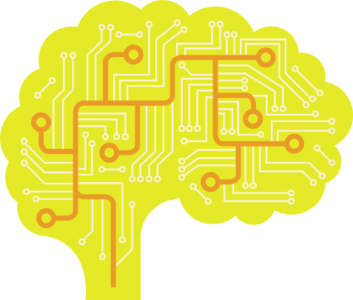






Examples
MS Auto Admin

Slide 9
03
PROBLEMS AND SOLUTIONS
Existing Problems and Solutions

Slide 10
Problems
ML Problems
01
Overfitting
02
Data Privacy and Security
03
Scalability
04
Interpretability

Slide 11

SOLUTIONS
SECURE DATA
OVERFITTING MITIGATION
Data Diversification
Model Optimization
Federal Learning
Multi-party computation
Homomorphic encryption
EVALUATION METRICS
INTERPRETABILITY
Reinforcement Learning
-Markov’s Decision Process
LIME.
Outlier Detection

Slide 12
04
Conclusion
FINAL OVERVIEW

Slide 13
SWOT Analysis
Strength
S
W
Weaknesses
Enhanced Query Optimization
Data Security
Automated Maintenance
Predictive Analytics
Data Dependency
Complexity:
Interpretability
Resource Intensive
Opportunities
O
T
Threats
Improved Performance
Advanced Analytics
Personalization
Real-time Insights
Data Privacy
Algorithm Bias
Security Risks
Resource Constraints

Slide 14

"We're still at the beginning of AI." — Jeff Bezos
THANK YOU

