Slide 1

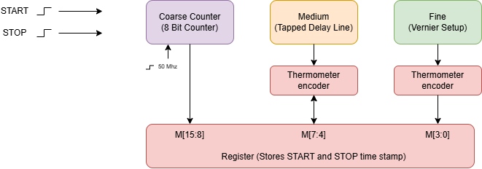
Three-Stage Time-to-Digital Converter
Purpose: Measure the time between START and STOP signals
5.12 µs
200 ps
PROPOSED 16-BIT FORMAT
Target dynamic range
Target resolution
M[15:8]
M[7:4]
M[3:0]
Coarse (C)
Medium (M)
Fine (F)
Readout: SEL selects the upper or lower byte
T = C·T_clk + M·T_medium + F·T_fine
Notes:
Proposal
1. Statement of purpose
2. System diagram
3. IO pin assignment table (Tiny Tapeout pins)
4. Proposed specification
5. Timeline for completion
6. Who does what
Coarse: 8-bit counter, counts whole 50 ns ticks
Medium: splits one tick into 16 pieces of 3.125 ns
Fine: splits one medium piece into 16 pieces of about 195 ps, roughly 200 ps

Slide 2
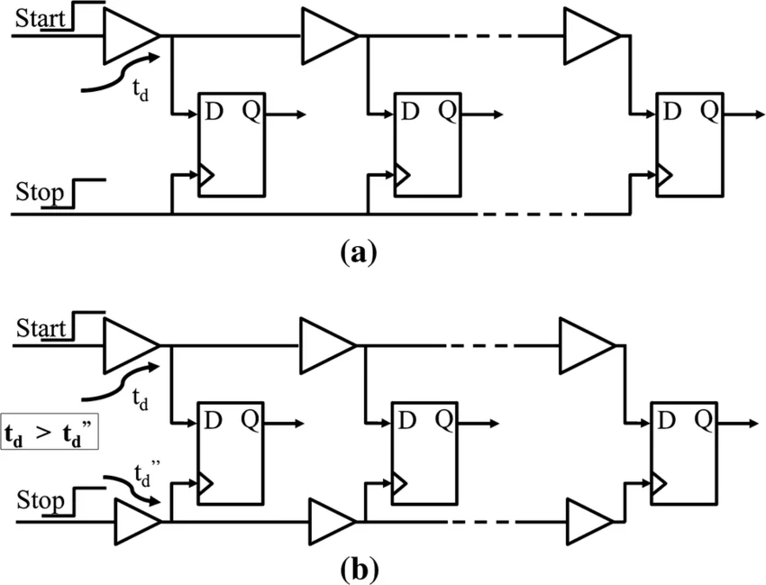

Pinouts:
ui_in[0] - START timing input
ui_in[1] - STOP timing input
ui_in[2] - byte-select control
uo_out[7:0] - 8-bit multiplexed data bus
uio[0] - DONE status flag
More on System + Pinouts
Medium
Fine
Use this delay cell from PDK (1.3n-1.4n)
Custom delay cell (target: epsilon = 200p)
uio[1] - BUSY status flag
uio[2] – ERROR status flag
uio[7:3] - reserved calibration/debug I/O
clk - reference clock
rst_n - active-low reset
Notes:
"We have three kinds of pins.
Inputs: START and STOP are the two edges we're timing. Byte-select chooses which half of the result to read.
Output: The result is 16 bits, but Tiny Tapeout only gives us 8 output pins. So we read it in two halves: byte-select at 0 gives the low byte, at 1 the high byte, and we stitch them together.
Status: BUSY means a measurement is running. DONE means a result is ready. ERROR means don't trust the result, for example if STOP never arrived or the encoder saw an invalid code.
The rest are standard: the 50 MHz reference clock, an active-low reset, and uio[7:3] reserved for calibration and debug, like the DLL later."

Slide 3
Timeline + Responsibilities
PROJECT TIMELINE
PROPOSED WORK SPLIT
Weeks 1–2
Architecture & RTL
Elisa- Digital logic
Oct 1–14
Pinout, counter, control logic
and PDK cell characterization
Counter, controller, encoders
and output interface
RTL simulation and testbenches
Weeks 3–4
Fine TDC & Integration
Oct 15–25
Medium / Vernier delay lines,
residue generation and integration
Daiyan- Delay-cell design
PDK delay-cell characterization
Custom Vernier cells and layout
Circuit and corner simulations
Weeks 5–6
Layout & Verification
Nov 2 – Nov 11
Custom-cell layout, DRC/LVS,
place & route and extracted timing
Together - Integration
Weeks 7–8
Testing & Submission
Nov 12–25
Residue generation and timing
Full-chip verification
Report and final demo
Corner tests, fixes, documentation
and final demonstration
Stretch goal: dual-DLL calibration after the baseline TDC works
Notes:
We have two checkpoints. At week 1, we confirm we fit in the area. At week 4, the fine stage has to actually work. If it doesn't, we fall back to a coarse-plus-medium TDC and report against the 200 ps target. The dual DLL only happens once the baseline works."

