Slide 1

FINAL-YEAR CSE PROJECT
FINAL-YEAR CSE PROJECT
AI Cyber Threat
Detection Platform
AI Cyber Threat
Detection Platform
AI-Powered Network Intrusion Detection and SOC Dashboard
AI-Powered Network Intrusion Detection and SOC Dashboard
Manoj Kumar S 4NI24CS414 GUIDE/CO GUIDE: Shalparni P Y , Mr.Mahesha A M
Mohammed Daiyan 4NI24CS416
Md.Farhaan Jameel 4NI24CS417
Nartan Maruti Naik 4NI24CS419
Department of Computer Science & Engineering
National Institute of Engineering, Mysore
2026
2026

Slide 2
CONTEXT
Introduction
THE CHALLENGE
• Modern networks face DDoS, brute-force, malware and reconnaissance attacks.
• SOC teams must inspect large volumes of alerts and network telemetry.
• Raw security logs are technical, repetitive and difficult to triage quickly.
WHY AI?
Detect patterns
prioritize incidents
explain alerts
A practical layer between raw network data and human investigation — reducing the effort needed to understand each alert.
AI Cyber Threat Detection Platform
02

Slide 3
LITERATURE REVIEW – 1
Sl.No | Year of Publication | Title of Paper | Research Findings | Research Gaps
1 | 2009 | A Detailed Analysis of the KDD CUP 99 Data Set / NSL-KDD | The study examined intrusion-detection datasets and identified issues such as redundant records and biased evaluation. NSL-KDD provides a more practical benchmark for NIDS experiments. | Older benchmark data may not represent present-day network traffic. Models can have limited generalisation to new environments and modern attack techniques.
2 | 2011 | Scikit-learn: Machine Learning in Python | Provides tools for preprocessing, classification and evaluation, making it suitable for building reproducible machine-learning pipelines for intrusion detection. | It is a general ML framework and does not directly address cybersecurity-specific problems such as evolving attacks, imbalance, explainability or deployment.
3 | 2018 | Framework for Improving Critical Infrastructure Cybersecurity – NIST CSF | Introduces the Identify, Protect, Detect, Respond and Recover functions. It emphasizes continuous monitoring, detection and organized incident response. | It is a high-level framework and does not define a specific ML-based NIDS or an integrated SOC dashboard with automated explanations.
4 | 2018+ | Signature-based NIDS – Snort / Suricata | Signature and rule-based detection is effective for known threats and produces alerts that are relatively easy to interpret. | It depends on updated signatures and may miss previously unseen or modified attacks. Large alert volumes can also cause analyst fatigue.
AI Cyber Threat Detection Platform – Literature Review

Slide 4
LITERATURE REVIEW – 2
Sl.No | Year of Publication | Title of Paper | Research Findings | Research Gaps
5 | 2019+ | Anomaly / Behaviour-based Intrusion Detection | Learns normal behavior and identifies deviations. This can help detect unusual activity that does not match predefined signatures. | Legitimate unusual behaviour may be classified as malicious, producing false positives. Reliable baselines are difficult in changing networks.
6 | 2019+ | Machine Learning for Network Intrusion Detection | ML learns patterns from traffic features and can automatically classify multiple attack categories, reducing dependence on manually written rules. | Results depend on dataset quality, feature selection and class balance. Performance can decrease when traffic patterns and attacks evolve.
7 | 2020+ | Explainable AI for Cybersecurity | XAI can help analysts understand why a model produced an alert, improving trust and supporting investigation and triage. | Explanations must be faithful and useful. Security systems need concise, actionable explanations rather than only technical model outputs.
8 | 2023+ | Large Language Models for Security Alert Explanation | LLMs can translate technical alert fields into concise plain-English summaries, helping analysts understand and prioritize incidents. | LLM responses require controlled prompts and validation. They should complement reliable threat detection rather than replace the detection model.
AI Cyber Threat Detection Platform – Literature Review

Slide 5
CONTEXT
RESEARCH GAP IN AI-BASED CYBER THREAT DETECTION
Detection and monitoring are disconnected: Most research stops at model accuracy, with no live SOC dashboard for analysts
Alerts are hard to interpret: ML outputs labels and scores, but analysts need plain-language explanations to act quickly
Coarse attack labelling: Many systems give only a binary normal/attack result, with no attack type or confidence
Messy raw attack taxonomy: NSL-KDD's 38 low-level attack names are not directly usable by SOC teams
Weak trend visibility: Few prototypes combine real-time alerts with 7/30/90-day traffic trends
AI Cyber Threat Detection Platform
02

Slide 6
CONTEXT
HOW OUR PROJECT ADDRESSES THE GAP
Existing Limitation → Our Approach
Detection without monitoring → End-to-end platform: ML detection + live React SOC dashboard
Unexplained alerts → Google Gemini AI explains alerts in simple English
Binary classification only → Random Forest classifies 6 categories with confidence scores
Complex attack labels → 38 attack names mapped into 6 clean categories
No historical context → KPI counters, attack distribution charts, 7/30/90-day trends
Result: 98.99% accuracy on NSL-KDD (14,834 balanced records, 38 flow features)
AI Cyber Threat Detection Platform
02

Slide 7
WHY THIS PROJECT
Problem Statement & Objectives
01
False positives
02
Alert fatigue
03
Jargon barrier
Too many low-value alerts
Analysts spend time sorting noise
Raw features are hard to interpret
PROJECT OBJECTIVE
• Classify network traffic into six threat categories using Random Forest.
• Store and serve incidents through FastAPI + PostgreSQL.
• Present a clear SOC dashboard for monitoring and investigation.
• Use Gemini AI to turn technical alerts into concise plain-English explanations.
• Goal: help an analyst move from detection to understanding faster.
AI Cyber Threat Detection Platform
03

Slide 8
CURRENT PRACTICE
Existing System
TYPICAL FLOW
KEY LIMITATIONS
Network traffic
• High alert volume and false positives
• Heavy dependence on predefined rules
• Manual correlation and triage
• Technical logs require experienced analysts
• New or modified attack patterns can be missed
• Result: analysts may spend more time validating alerts than investigating threats.
• This makes human triage an important part of the existing workflow.
↓
Rule / signature engine
↓
Raw alerts / SIEM
↓
Manual investigation
AI Cyber Threat Detection Platform
6

Slide 9
OUR APPROACH
Proposed System
ML
Threat classification
API
FastAPI services
DB
PostgreSQL storage
Detect six classes
Serve filters & analytics
Persist incidents
UI
React SOC dashboard
AI
Gemini explanations
Monitor & investigate
Explain in plain English
Result: a single workflow from network telemetry → detection → prioritization → investigation.
AI Cyber Threat Detection Platform
7

Slide 10
COMPARISON
Existing vs Proposed System
Aspect
Existing approach
Proposed platform
Detection
Rules / signatures
Random Forest classification
Alerts
Large raw alert streams
Severity + structured incidents
Investigation
Mostly manual
Dashboard + filters + status
Explanation
Technical fields
Gemini plain-English summary
Storage
Logs / SIEM
PostgreSQL threat history
Workflow
Reactive triage
Continuous simulated alert feed
Supports continuous demonstration and testing
AI Cyber Threat Detection Platform
8

Slide 11
ENVIRONMENT
System Requirements
HARDWARE
SOFTWARE
• CPU: Intel i3 / Ryzen 3 minimum
• RAM: 4 GB minimum; 8 GB recommended
• Storage: ~500 MB free space
• Internet required for cloud DB / Gemini features
• Windows, Linux or macOS
• Python 3.8–3.11
• Node.js 20+
• PostgreSQL / Neon
• Modern web browser
AI Cyber Threat Detection Platform
9

Slide 12
IMPLEMENTATION
Technology Stack
Python
Scikit-learn
FastAPI
PostgreSQL
ML & preprocessing
Random Forest pipeline
REST backend
Threat persistence
React + Vite
Tailwind CSS
Gemini AI
SOC frontend
UI styling
Alert explanations
Architecture choice: lightweight, widely supported and practical for a final-year deployment.
AI Cyber Threat Detection Platform
10

Slide 13
END-TO-END FLOW
System Architecture
CIC
Dataset
Pre-
processing
Random
Forest
Threat
Database
FastAPI
Backend
React SOC
Dashboard
prediction
Gemini AI
Explanation
explain selected alert
AI Cyber Threat Detection Platform
11

Slide 14
THREAT CLASSIFICATION
Machine Learning
PIPELINE
6 CLASSES
• CIC network intrusion dataset
• Clean + transform numerical/categorical features
• Group attacks into six classes
• StandardScaler + OneHotEncoder
• Random Forest: 100 estimators
Normal
DDoS
Port Scan
Recon
Brute Force
Malware
SEVERITY ENGINE
Critical
DDoS / high-confidence Malware
High
Brute Force / lower-confidence Malware
Medium / Low
Port Scan / Recon / Normal
AI Cyber Threat Detection Platform
12

Slide 15
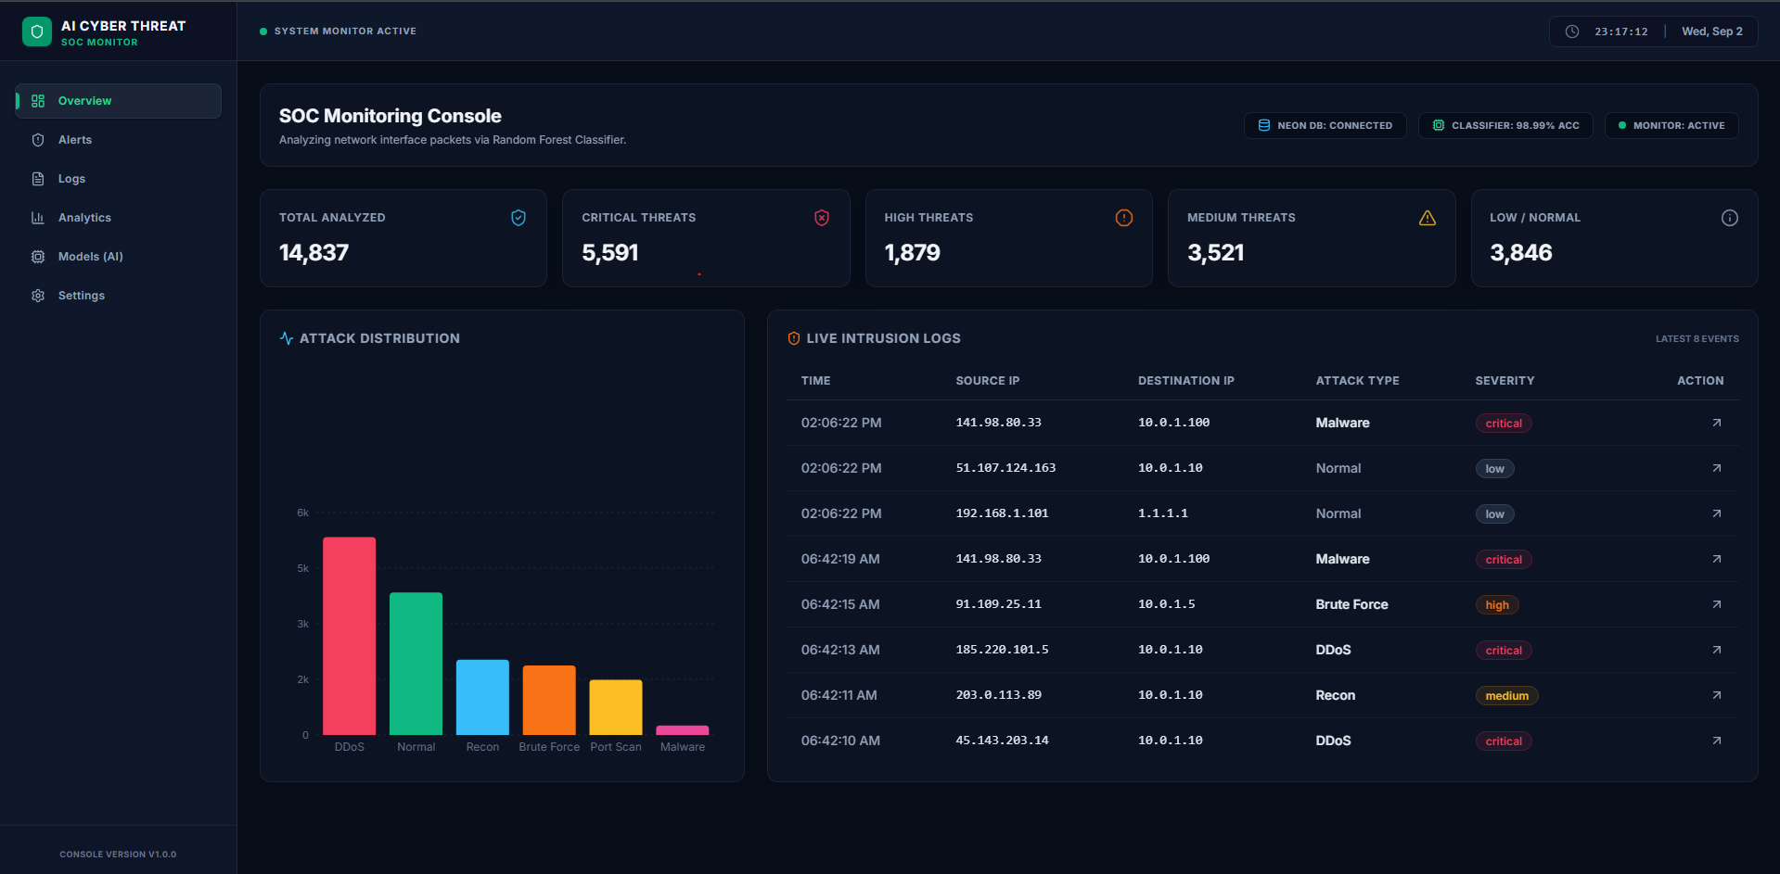
USER-FACING LAYER
SOC Dashboard/IMPLEMENTATION
INVESTIGATION
• Open → Investigating → Resolved
• Search by IP or attack type
• Inspect network features
• Request AI explanation
• This gives every alert
AI Cyber Threat Detection Platform
13

Slide 16
MODEL PERFORMANCE
Results
Accuracy
Macro Precision
Macro Recall
Macro F1
98.99%
97.43%
98.38%
97.79%
BF
DDoS
Mal
Norm
Scan
Recon
Confusion matrix (validation set)
BF
369
0
1
3
0
0
DDoS
0
1066
0
1
0
2
Mal
1
0
48
1
0
0
Norm
3
1
4
759
1
1
Scan
0
0
0
0
294
2
Recon
14
14
14
14
14
401
AI Cyber Threat Detection Platform
14

Slide 17
NEXT STEPS
Future Enhancements
01
Live PCAP monitoring
02
SOAR response
Capture real network traffic with Scapy / Zeek.
Automate controlled blocking and containment.
03
Local AI models
04
MITRE ATT&CK
Run security-focused models without external API dependency.
Map detected behaviors to techniques and tactics.
05
RBAC + authentication
Add secure multi-user access and permissions.
AI Cyber Threat Detection Platform
15

Slide 18
CONCLUSION
From raw telemetry
to explainable incidents.
01
98.99% validation accuracy
02
Six threat categories
The platform combines ML detection, FastAPI services, PostgreSQL storage, a React SOC dashboard and Gemini-based explanations into one practical security workflow.
03
Prioritized SOC incidents
04
Human-readable AI explanations
THANK YOU

Slide 19
REFERENCES
Key sources used to build the detection, backend, dashboard and AI explanation layers
1.
Tavallaee et al. (2009)
NSL-KDD / KDD intrusion data analysis — dataset and intrusion-detection research basis.
2.
Pedregosa et al. (2011)
Scikit-learn — machine-learning and preprocessing implementation reference.
3.
NIST (2018)
Cybersecurity Framework v1.1 — security operations and incident-management reference.
4.
FastAPI Documentation
REST API layer used to serve incidents, filters and analytics.
5.
PostgreSQL Documentation
Database layer used for persistent threat and incident storage.
6.
React + Vite Documentation
Frontend stack used to build the SOC monitoring dashboard.
7.
Google Gemini Documentation
AI layer used to convert technical alerts into concise explanations.
Reference takeaway
These sources support the dataset, ML method, security framework and technology stack used in the proposed platform.
AI Cyber Threat Detection Platform
17

