Slide 1
AI-Based Constrained
Travel Itinerary Planning
Final Project Presentation
Greedy baseline vs. Beam search with synthetic data

Slide 2
Why This Problem Matters
Travel planning is not just about picking the most attractive places.
Travelers must balance several interacting factors:
Budget, daily available time
Attraction opening hours, travel time
Waiting time before an attraction opens
Because these factors interact, itinerary planning becomes a meaningful AI search and decision-making problem - not just preference, but also scheduling and resource allocation.

Slide 3
Problem Definition
Goal: produce a feasible multi-day itinerary that maximizes total satisfaction.
Satisfaction = sum of priority scores across all visited attractions.
The planner must balance quality and feasibility at the same time.
Related to the Orienteering Problem with Time Windows (OPTW), with extra multi-day and budget dimensions (NP-hard in general).

Slide 4
Inputs
Attractions (N items), each with:
ID, category, coordinates (x, y)
Cost, visit duration, priority score (1-10)
Opening and closing time
Travel-time matrix: (N+1) x (N+1), including a 'hotel' node.
Trip configuration:
Total budget, number of days
Daily start / end time, max waiting time

Slide 5
Hard Constraints
Every plan must satisfy:
Total cost <= budget (over_budget)
Visit finishes before closing_time(closed_before_visit_end)
Waiting time <= max_wait_minutes (too_much_waiting)
Can return to hotel before day_end (cannot_return_to_hotel)
Each attraction visited at most once
A high-scoring itinerary is useless if it cannot actually be followed.

Slide 6
Dataset Design (Synthetic)
Synthetic data - reproducible and free of external API dependencies.
Six attraction categories:
museum, park, restaurant, landmark, market, entertainment
Each category has its own pattern for cost, duration, opening hours.
Spatial layout: 4 cluster centers simulate city districts; attractions placed around centers with a normal distribution.
Travel time: Euclidean distance / 30 km/h * 60 minutes.
Single seed (42) makes every experiment bitwise reproducible.

Slide 7
Algorithm 1: Greedy Baseline
At every step, pick the best currently feasible attraction.
Composite score:
0.40 x normalized priority score
0.35 x time efficiency (score per hour)
0.25 x cost efficiency (score per dollar)
Pros: fast, simple, easy to implement.
Cons: only one-step lookahead - can miss better global solutions (tends to over-pack Day 1 and starve later days).

Slide 8
Algorithm 2: Beam Search
Keeps the top K partial itineraries in parallel (not just top 1).
State-level composite score:
Satisfaction + number of visits (primary drivers)
Travel efficiency + category diversity (quality)
Remaining budget (future-potential heuristic)
Same hard constraints as greedy via check_feasibility() - only the search strategy differs.
Exploring multiple promising paths avoids bad early commitments.

Slide 9
Experimental Setup
Five scenarios stress different constraints:
easy: loose constraints, small instance (N=20)
standard: reference case (N=30, $200, 12h window)
tight_budget: budget is binding ($80)
tight_time: daily window is binding (10:00-17:00)
large_problem: scalability (N=50, 5 days)
Metrics: feasibility, visits, satisfaction, travel ratio, daily balance, diversity, runtime.

Slide 10
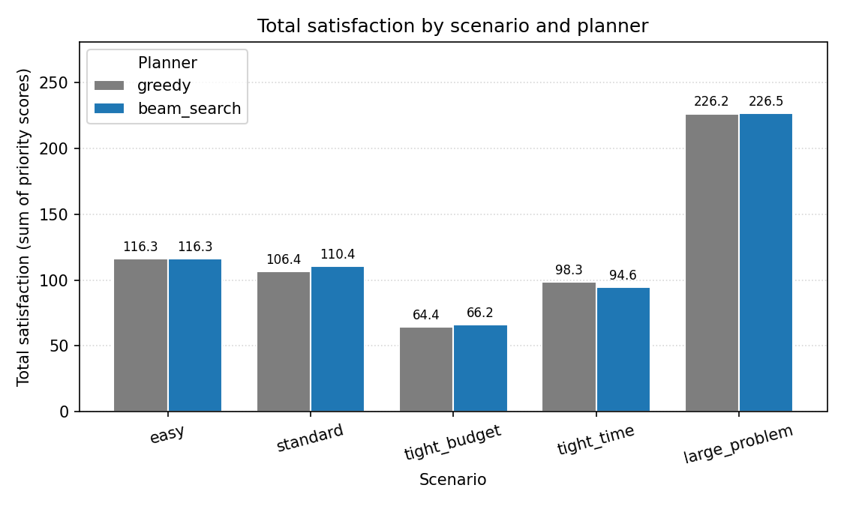
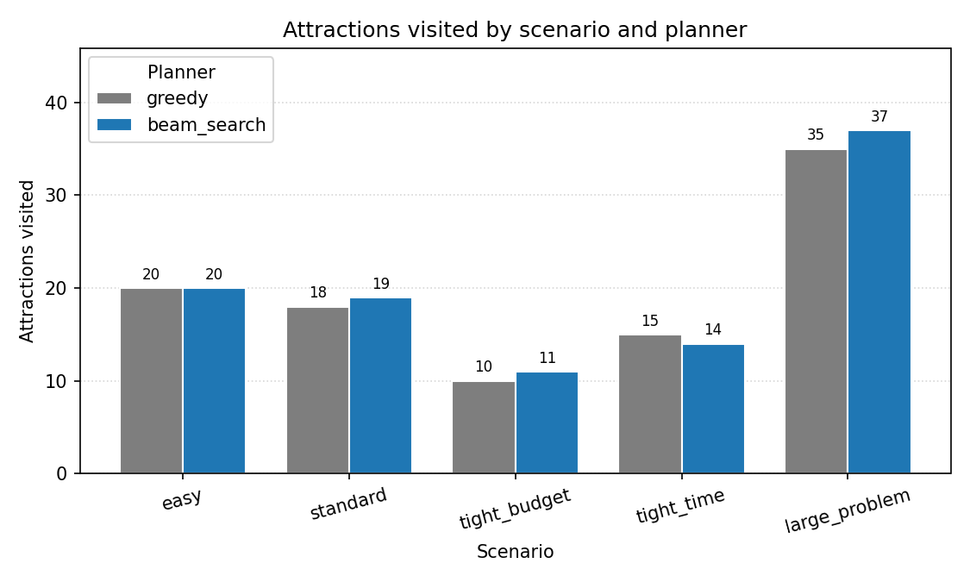
Results: Quality
Total satisfaction (sum of priority scores)
Number of attractions visited
Beam search matches or beats greedy on quality in 4/5 scenarios; the exception is tight_time.

Slide 11
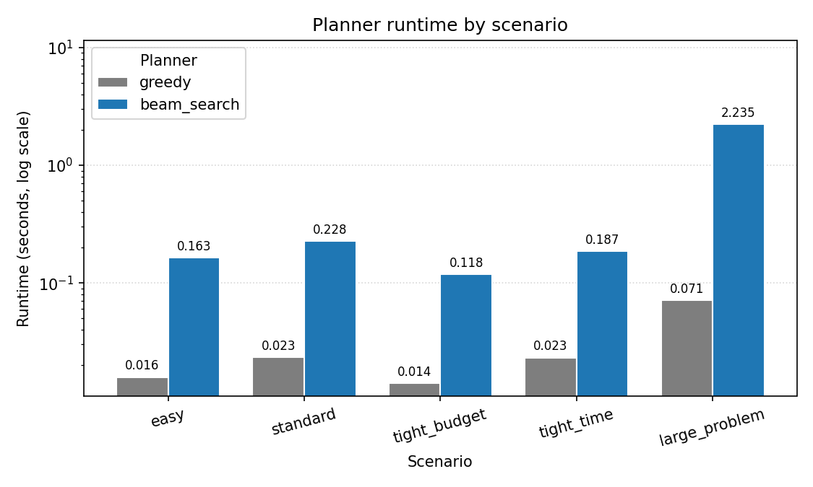
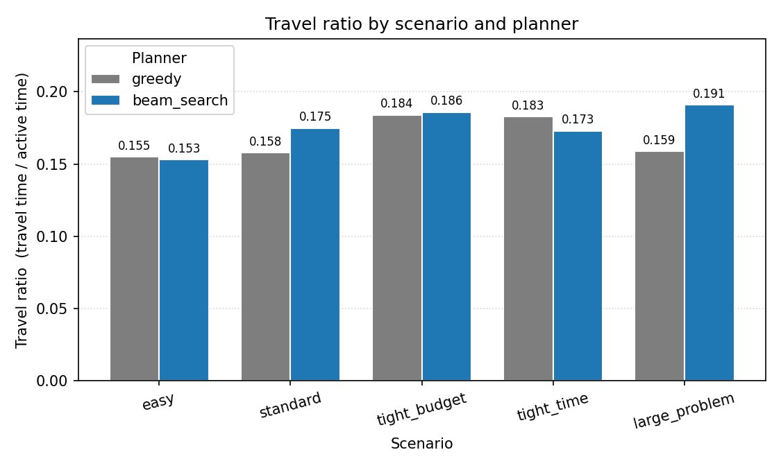
Results: Runtime & Efficiency
Runtime (log scale): beam is 7-30x slower than greedy
Travel ratio: no consistent winner across algorithms
Beam search trades wall-clock time for plan quality; both planners produce travel-efficient itineraries.

Slide 12
Key Findings
Beam search >= greedy on easy, standard, tight_budget, large_problem.
Beam loses to greedy on tight_time (14 vs 15 visits, 94.6 vs 98.3).
Diagnosis: when time (not money) is the binding constraint, the remaining-budget heuristic pushes the beam to save money it cannot spend anyway.
All 10 runs produce feasible itineraries - zero validation violations.
Beam improves daily_balance (e.g. standard: [9,7,2] -> [7,8,4]).
Runtime scales more aggressively for beam, as expected.

Slide 13
Conclusion and Future Work
A complete prototype: data generation, feasibility-aware planning, independent validation, and comparative experiments.
Main takeaway: search breadth helps, but heuristic design matters.
Future directions:
Adaptive scoring weights (detect binding constraint per scenario)
Real data: OSM, Google Places, OSRM travel matrices
Learned user preferences instead of static priority scores
Stochastic travel + real-time re-planning
ILP/MIP baseline to quantify the optimality gap on small instances

