Slide 1
CS461 – RECITATION 10
Machine Learning Principles
Daize Dong
2025-11-17

Slide 2
TODAY’S CONTENT
Quiz 04
Homework 04

Slide 3
QUIZ 04

Slide 4
QUIZ 04
A | B | C | D
2 | 3 | 16 | -
When comparing a HMM to other ML techniques from this course, which is true?
HMMs can be trained with the EM algorithm, similar to GMMs and K-Means.
HMMs capture temporal relationships between observations of arbitrary length, which is difficult to do with the other techniques so far covered in this class.
Both of the above are true.
All of the above are false.
EM in HMM: forward-backward.

Slide 5
QUIZ 04
A | B | C | D
3 | 1 | 15 | -
2. When is a HMM least effective at predicting hidden states given observed states?
When there are no state transitions (meaning each state transitions to itself with probability 1).
When each state's transition probability to remain in the same state is very high, but less than 1.
When state transitions are all equally likely.
A HMM is always effective at predicting hidden states.
Lost all information. (uniform distribution)

Slide 6
QUIZ 04
A | B | C | D
18 | 2 | 1 | -
3. What is true about the stationary distribution, π, of a hidden Markov model?
π= π A.
Unlike the initial state distribution, the stationary distribution does not need to sum to 1.
π= π ABO.
None of the above.
Basic definition.

Slide 7
QUIZ 04
A | B | C | D
- | - | 5 | 14
4. Which statement best describes the kernel trick?
Fitting polynomial parameters will better capture the variance of a dataset.
A perceptron's Gram matrix is multiplied by a kernel function, improving the perceptron.
The kernel trick requires O(n^3) additional computation.
Linear parameters can be mapped onto non-linear spaces, increasing the discriminative power of linear models.
implicitly represent polynomial features
replace inner product
can be any

Slide 8
QUIZ 04
A | B | C | D
17 | 1 | 1 | -
5. Which of these statements about a hidden Markov model with 3 hidden states and a vocabulary of 5 observable tokens is true?
The parameters of the HMM can be trained with the EM algorithm.
The transition matrix, A, is size 3x5.
The emission matrix, B, is size 5x5.
b and C are both true.
5x5
3x5
Transition matrix: probabilities transiting to the next state.
Emission matrix: probabilities of all states during different time steps.

Slide 9
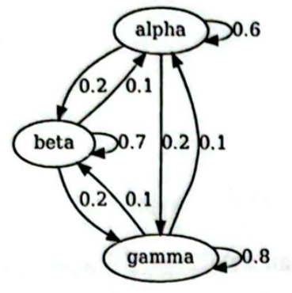
QUIZ 04
6. You are playing a popular online game and would like to maximize the time you spend having fun, which is a great use case for HMMs. There are three servers for the online game, named α, β, and γ, each with their own packet loss characteristics. You do not know which server you connect to, but you suspect that one of them is of better quality than the other two. You begin logging data, binning observations of packet loss over 1 minute intervals. You decide to assign packet loss statistics into three groups: low, medium, and high. After some sleuthing, you learn that users are transitioned from server to server as shown in the figure on the other side of the page.

Slide 10
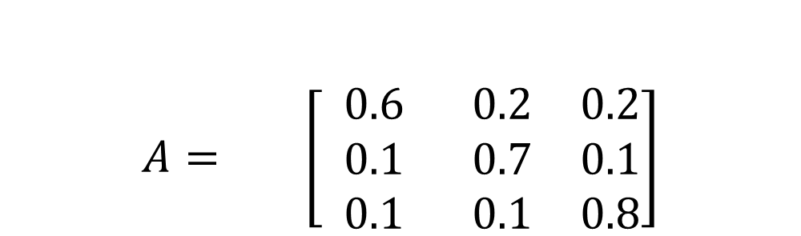
QUIZ 04
Part 1: Populate a state transition matrix, A, using the values in the figure below.
α
β
γ
$$A= \left[\begin{matrix} 0.6 & 0.2 & 0.2 \\ 0.1 & 0.7 & 0.1 \\ 0.1 & 0.1 & 0.8\end{matrix}\right]$$
α
β
γ

Slide 11
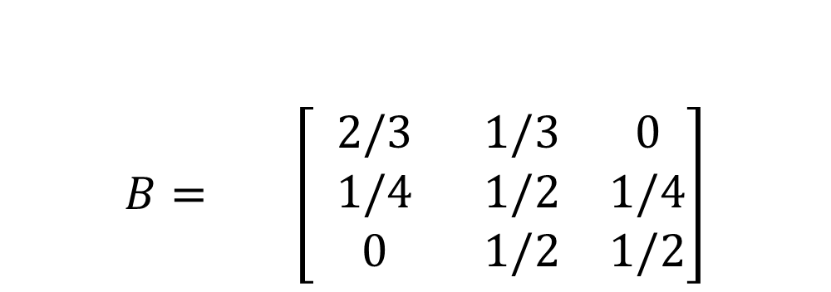
QUIZ 04
Part 2: You learn that α is the best server, with low packet loss 2/3 of the time and medium the other 1/3. β's packet loss is medium half of the time and is evenly split between low and high the other half, while γ has medium packet loss 1/2 of the time and high packet loss the other 1/2. Populate the emission matrix, B.
$$B= \left[\begin{matrix} 2/3 & 1/3 & 0 \\ 1/4 & 1/2 & 1/4 \\ 0 & 1/2 & 1/2\end{matrix}\right]$$
low
mid
high
α
β
γ

Slide 12
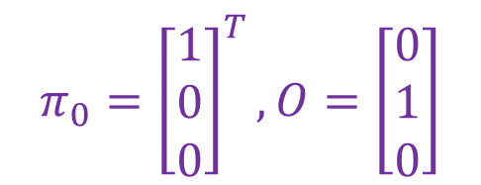
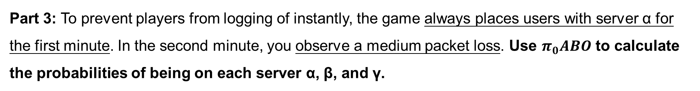
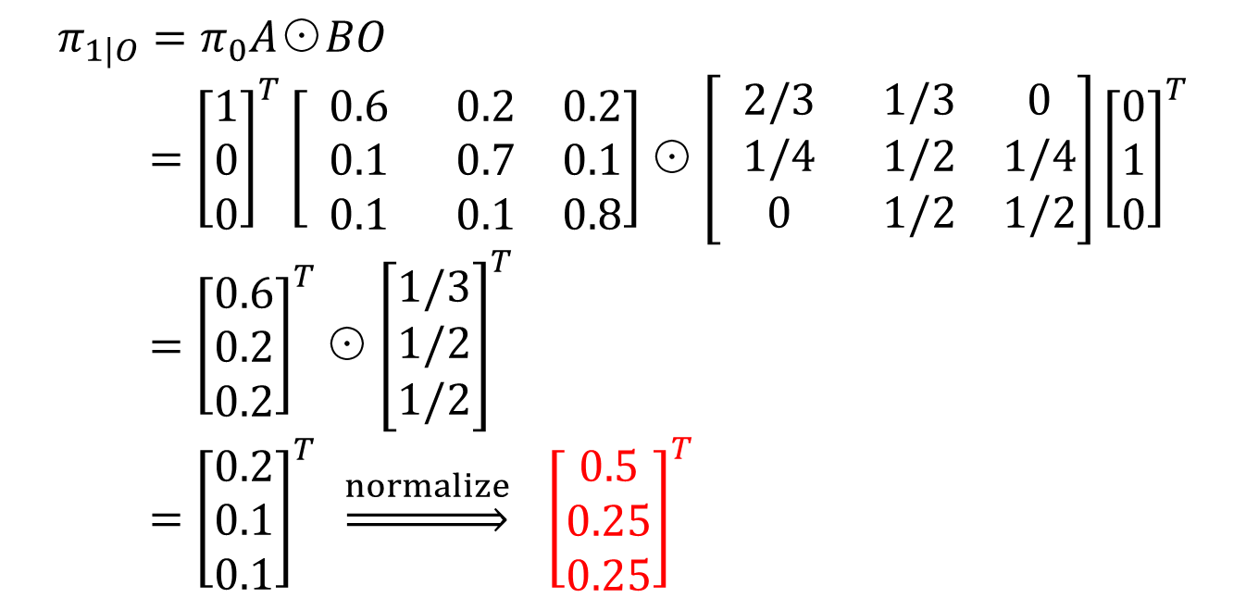
QUIZ 04
Part 3: To prevent players from logging of instantly, the game always places users with server α for the first minute. In the second minute, you observe a medium packet loss. Use $π_{0}ABO$ to calculate the probabilities of being on each server α, β, and γ.
$$π_{0}={\left[\begin{matrix}1 \\ 0 \\ 0\end{matrix}\right]}^{T}, O=\left[\begin{matrix}0 \\ 1 \\ 0\end{matrix}\right]$$
$$π_{1|O}=π_{0}A\text{⊙}BO \\ ={\left[\begin{matrix}1 \\ 0 \\ 0\end{matrix}\right]}^{T}\left[\begin{matrix} 0.6 & 0.2 & 0.2 \\ 0.1 & 0.7 & 0.1 \\ 0.1 & 0.1 & 0.8\end{matrix}\right]\text{⊙}\left[\begin{matrix} 2/3 & 1/3 & 0 \\ 1/4 & 1/2 & 1/4 \\ 0 & 1/2 & 1/2\end{matrix}\right]{\left[\begin{matrix}0 \\ 1 \\ 0\end{matrix}\right]}^{T} \\ ={\left[\begin{matrix}0.6 \\ 0.2 \\ 0.2\end{matrix}\right]}^{T}\text{⊙}{\left[\begin{matrix}1/3 \\ 1/2 \\ 1/2\end{matrix}\right]}^{T} \\ ={\left[\begin{matrix}0.2 \\ 0.1 \\ 0.1\end{matrix}\right]}^{T} \underset{⇒}{normalize} {\left[\begin{matrix}0.5 \\ 0.25 \\ 0.25\end{matrix}\right]}^{T}$$

Slide 13
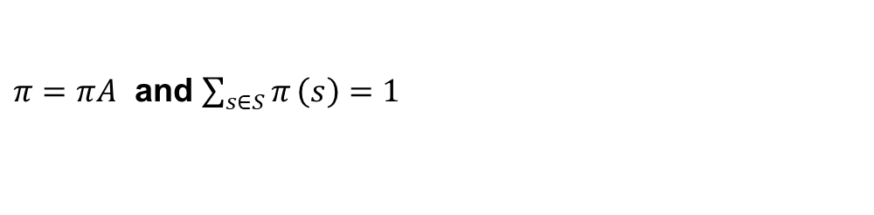
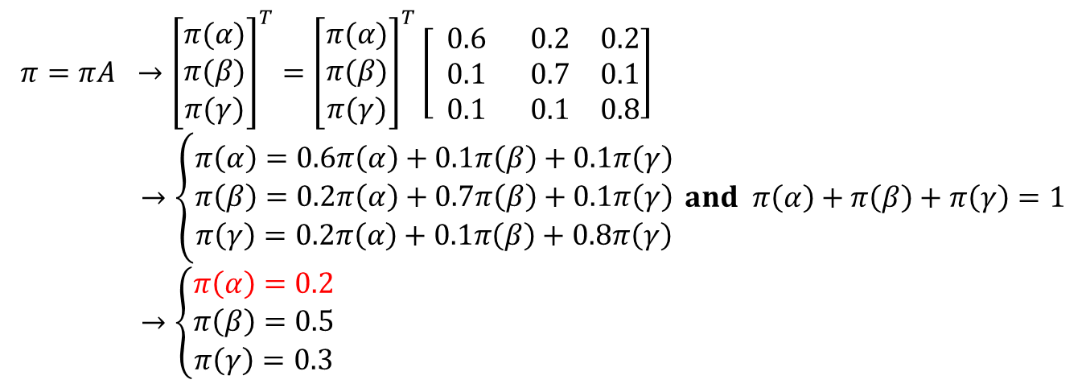
QUIZ 04
Part 4: On the first day of winter break, you decide to do nothing but play this game. You are ecstatic whenever you are using server α and frustrated when using the other servers. What fraction of the time will you spend being ecstatic?
This is to say what is the probability for α in stationary distribution.
$π=πA$ and $\sum_{s∈S}{π}\left(s\right)=1$
$$π=πA →{\left[\begin{matrix}π(α) \\ π(β) \\ π(γ)\end{matrix}\right]}^{T}={\left[\begin{matrix}π(α) \\ π(β) \\ π(γ)\end{matrix}\right]}^{T}\left[\begin{matrix} 0.6 & 0.2 & 0.2 \\ 0.1 & 0.7 & 0.1 \\ 0.1 & 0.1 & 0.8\end{matrix}\right] \\ →\left\{\begin{matrix}π\left(α\right)=0.6π\left(α\right)+0.1π\left(β\right)+0.1π\left(γ\right) \\ π\left(β\right)=0.2π\left(α\right)+0.7π\left(β\right)+0.1π\left(γ\right) \\ π\left(γ\right)=0.2π\left(α\right)+0.1π\left(β\right)+0.8π\left(γ\right)\end{matrix}\right. and π\left(α\right)+π\left(β\right)+π\left(γ\right)=1 \\ →\left\{\begin{matrix}π\left(α\right)=0.2 \\ π\left(β\right)=0.5 \\ π\left(γ\right)=0.3\end{matrix}\right.$$
So it’s 20% time.

Slide 14
homework 04

Slide 15
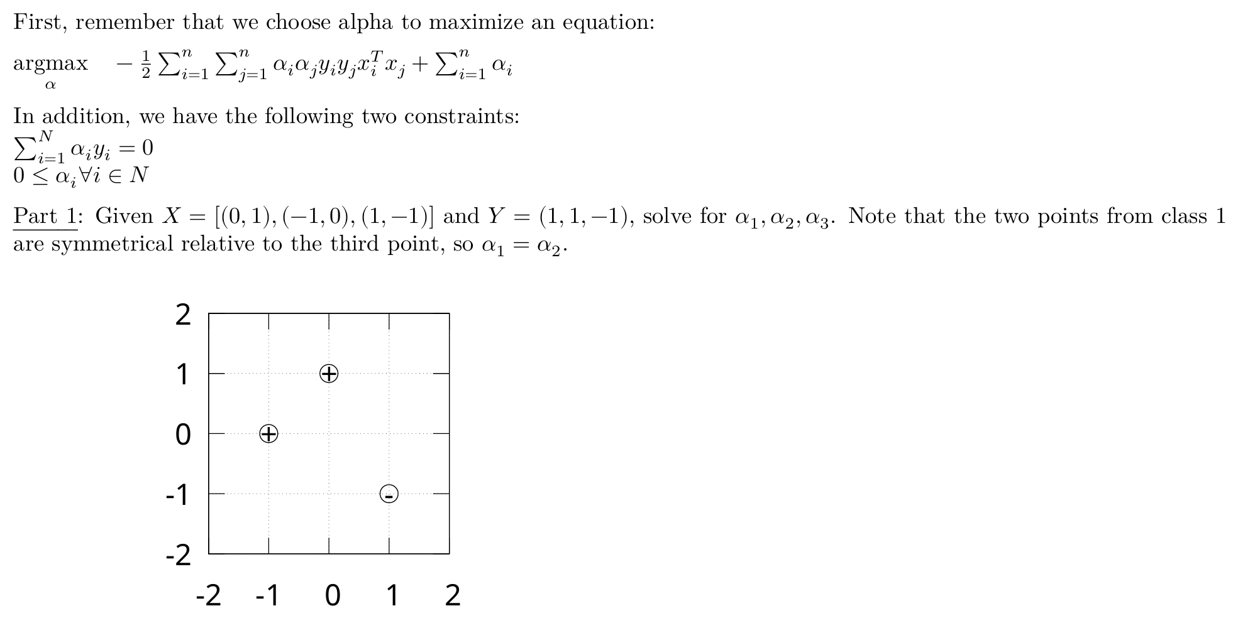
homework 04

Slide 16
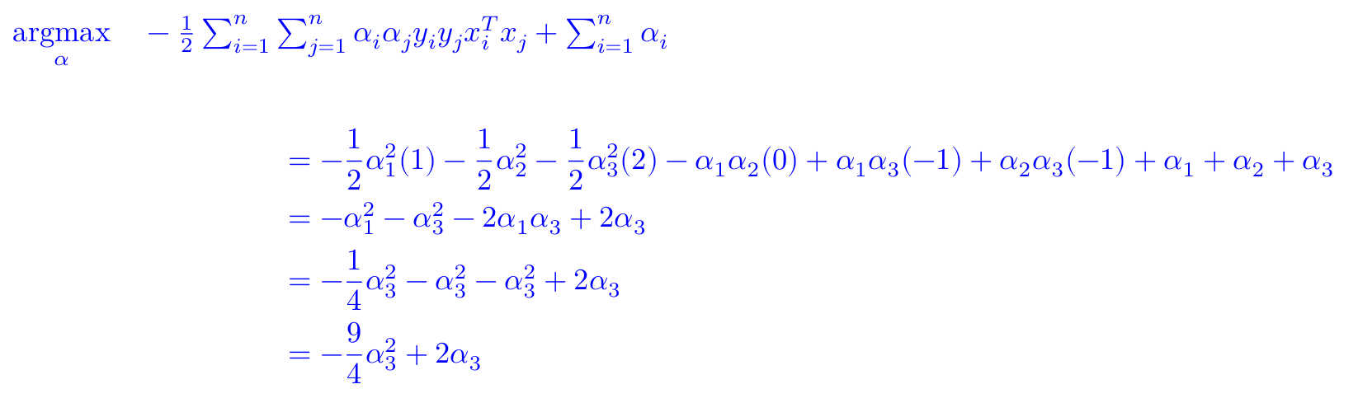
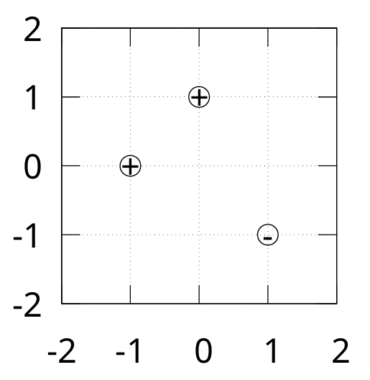
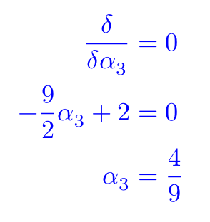
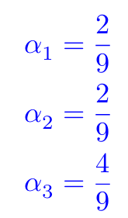

homework 04
$$⇒$$

Slide 17
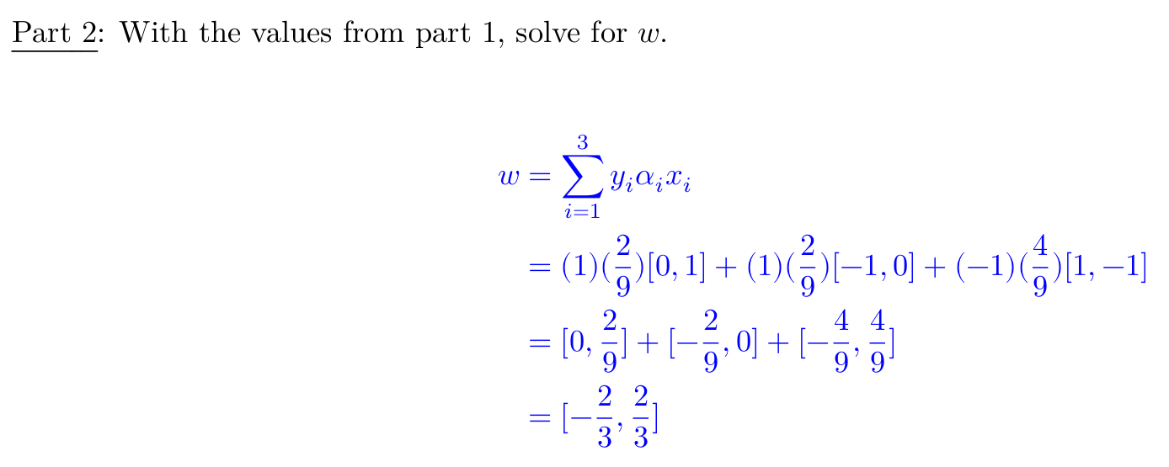
homework 04

Slide 18
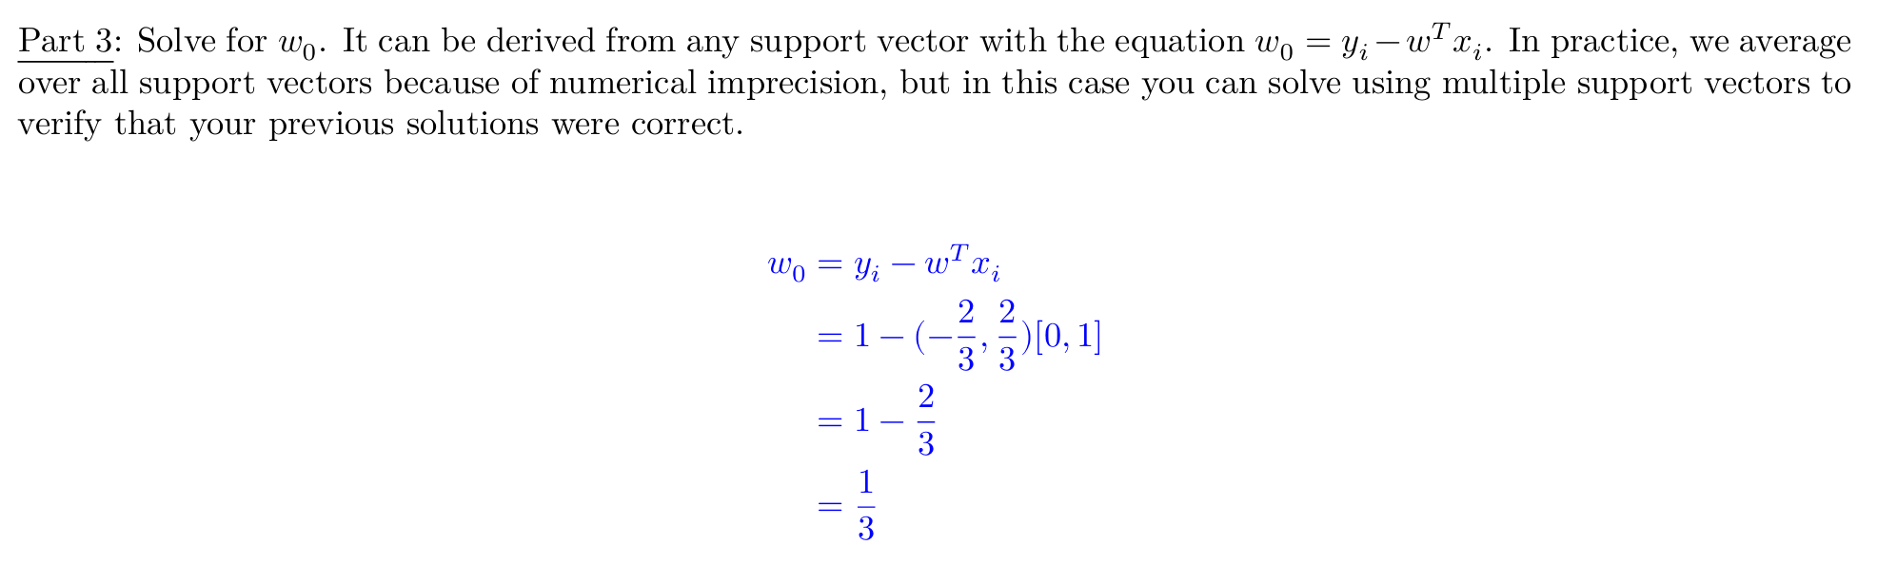
homework 04

Slide 19
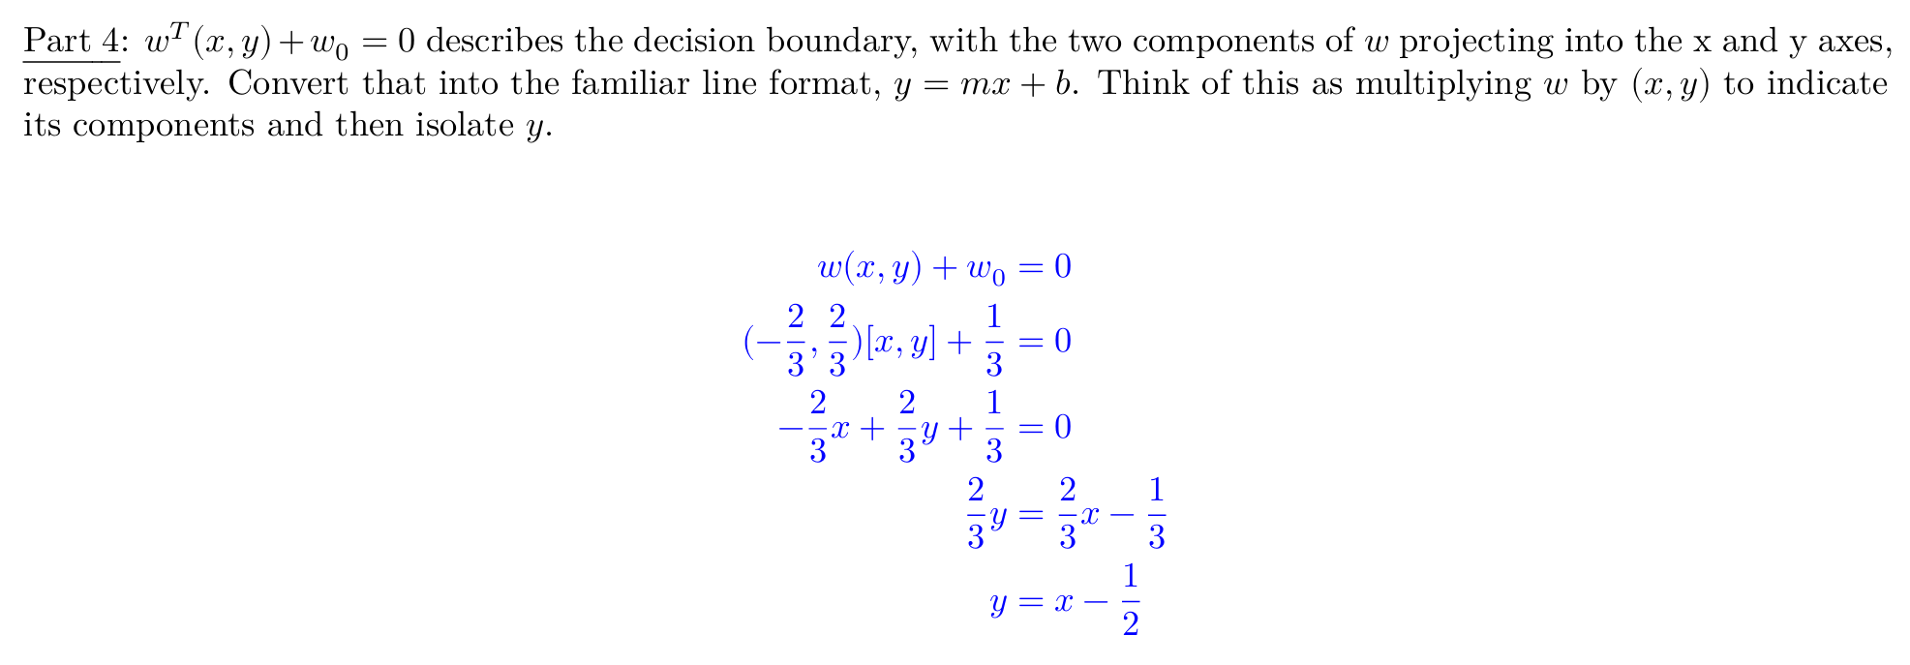
homework 04

Slide 20
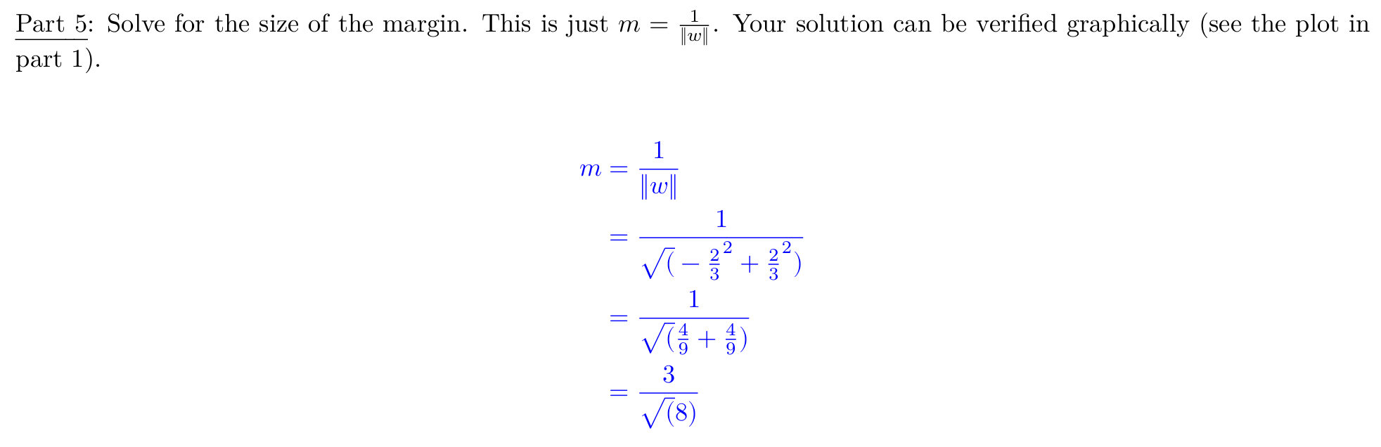
homework 04

