Slide 1
CS461 – RECITATION 07
Machine Learning Principles
Daize Dong
2025-10-27

Slide 2
TODAY’S CONTENT
Markov Model Assignment
Quiz 03

Slide 3
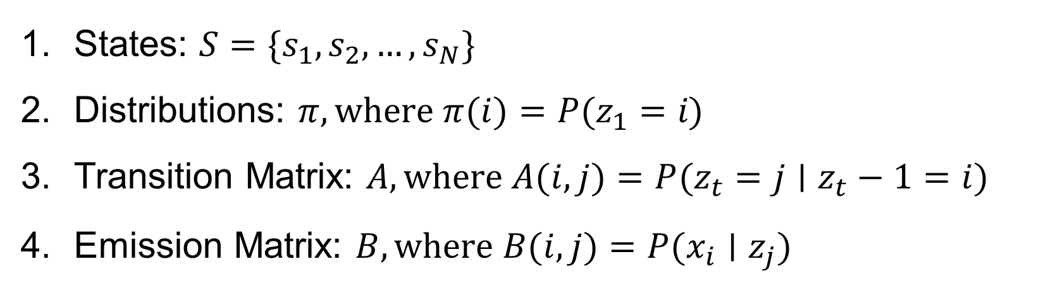
Markov models
States: $S=\{s_{1}​,s_{2}​,…,s_{N}​\}$
Distributions: $π,where π(i)=P(z_{1}​=i​)$
Transition Matrix: $A,where A(i,j)=P(z_{t}​=j∣z_{t}​−1=i)$
Emission Matrix: $B,where B(i,j)=P(x_{i}​∣z_{j}​)$

Slide 4
Markov Example
Imagine a language only containing the following:
class N, nouns: {wolf, parrot, …}
class AND, word {and}
class V, verbs: {run, fly, …}

Slide 5
Markov Example
The state transitions and their probabilities look like:
1.0
bb: begin
N: {wolf, parrot, …}
AND: {and}
V: {run, fly, …}
ee: end
AND
0.6
1.0
0.4
1.0
begin
N
V
end
1.0

Slide 6
Markov Example
1.0
AND
Now solve the following questions:
Populate a state transition matrix A.
Solve this set of equations to determine the stationary distributions, 𝜋.
Use the fraction of time spent in the bb or ee states to deduce the average number of words in a sentence.
0.6
begin
1.0
N
0.4
V
1.0
end
1.0

Slide 7
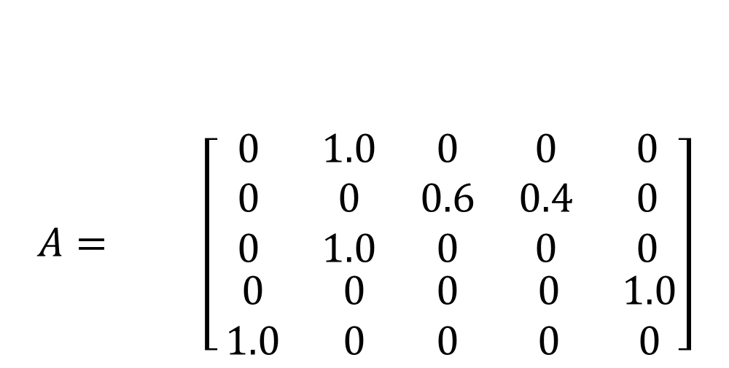
1. Transition Matrix
End Points
$$A= \left[\begin{matrix}\begin{matrix} 0 & 1.0 & 0 \\ 0 & 0 & 0.6 \\ 0 & 1.0 & 0\end{matrix} & \begin{matrix}0 & 0 \\ 0.4 & 0 \\ 0 & 0 \end{matrix} \\ \begin{matrix}0 & 0 & 0 \\ 1.0 & 0 & 0 \end{matrix} & \begin{matrix} 0 & 1.0 \\ 0 & 0\end{matrix}\end{matrix}\right]$$
1.0
AND
bb
N
AND
V
ee
0.6
bb
begin
1.0
N
0.4
V
1.0
end
N
AND
1.0
V
ee
Start Points

Slide 8
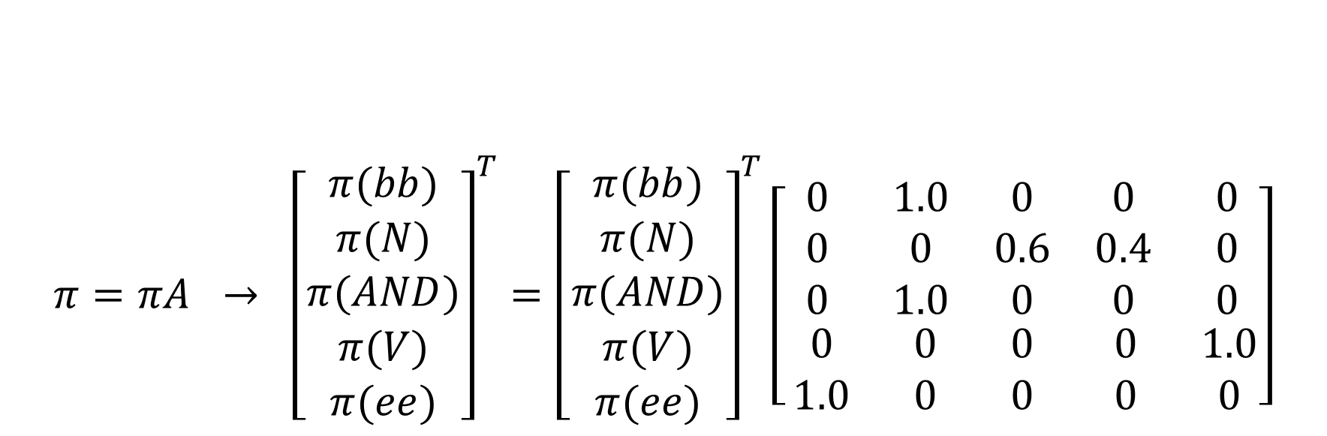
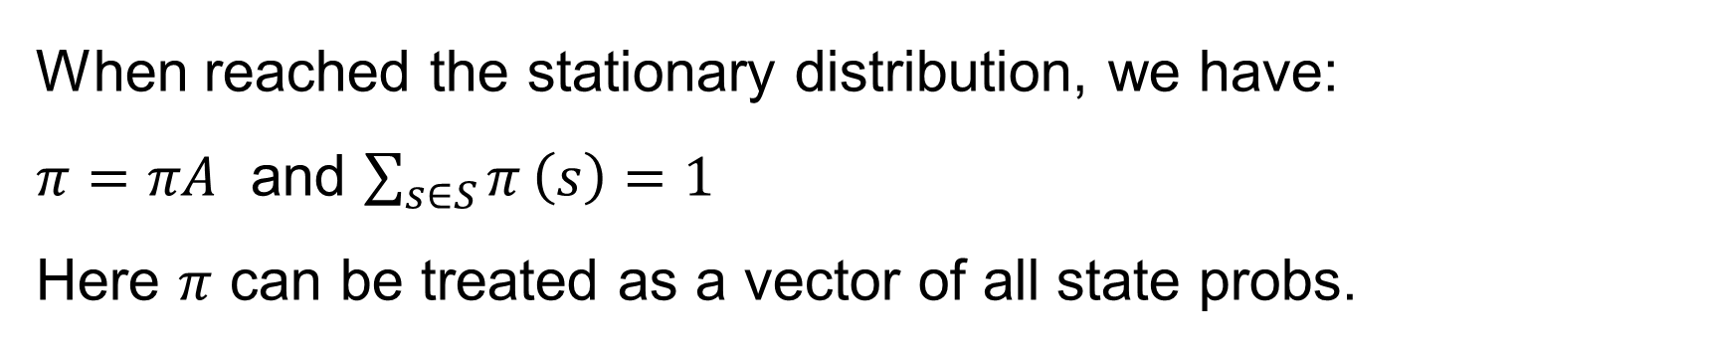
2. Stationary distribution
When reached the stationary distribution, we have:
$π=πA$ and $\sum_{s∈S}{π}\left(s\right)=1$
Here $π$ can be treated as a vector of all state probs.
1.0
AND
0.6
begin
1.0
N
0.4
V
1.0
end
$$π=πA → {\left[\begin{matrix}\begin{matrix}π(bb) \\ π(N) \\ π(AND)\end{matrix} \\ π(V) \\ π(ee)\end{matrix}\right]}^{T}={\left[\begin{matrix}\begin{matrix}π(bb) \\ π(N) \\ π(AND)\end{matrix} \\ π(V) \\ π(ee)\end{matrix}\right]}^{T}\left[\begin{matrix}\begin{matrix} 0 & 1.0 & 0 \\ 0 & 0 & 0.6 \\ 0 & 1.0 & 0\end{matrix} & \begin{matrix}0 & 0 \\ 0.4 & 0 \\ 0 & 0 \end{matrix} \\ \begin{matrix}0 & 0 & 0 \\ 1.0 & 0 & 0 \end{matrix} & \begin{matrix} 0 & 1.0 \\ 0 & 0\end{matrix}\end{matrix}\right]$$
1.0

Slide 9
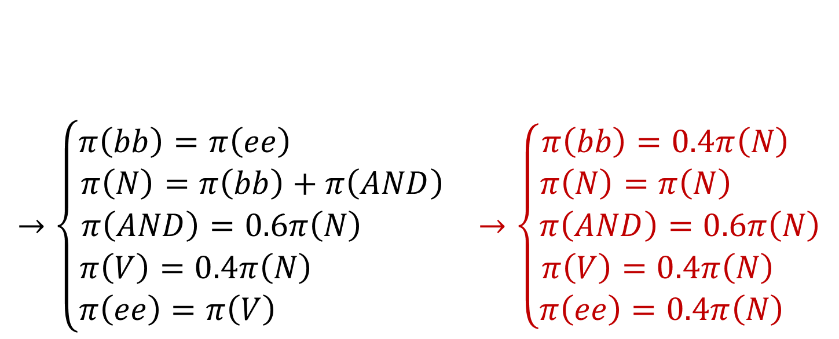
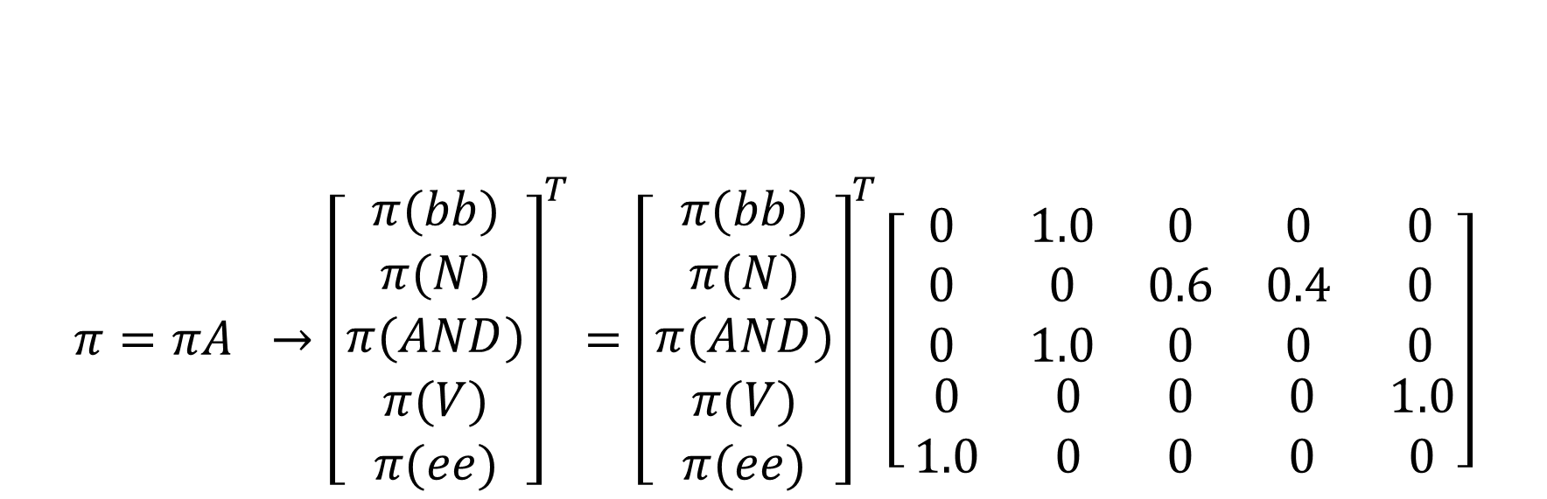
2. Stationary distribution
$$π=πA →{\left[\begin{matrix}\begin{matrix}π(bb) \\ π(N) \\ π(AND)\end{matrix} \\ π(V) \\ π(ee)\end{matrix}\right]}^{T}={\left[\begin{matrix}\begin{matrix}π(bb) \\ π(N) \\ π(AND)\end{matrix} \\ π(V) \\ π(ee)\end{matrix}\right]}^{T}\left[\begin{matrix}\begin{matrix} 0 & 1.0 & 0 \\ 0 & 0 & 0.6 \\ 0 & 1.0 & 0\end{matrix} & \begin{matrix}0 & 0 \\ 0.4 & 0 \\ 0 & 0 \end{matrix} \\ \begin{matrix}0 & 0 & 0 \\ 1.0 & 0 & 0 \end{matrix} & \begin{matrix} 0 & 1.0 \\ 0 & 0\end{matrix}\end{matrix}\right]$$
$$→\left\{\begin{aligned}\begin{matrix}π\left(bb\right)=π\left(ee\right) \\ π\left(N\right)=π\left(bb\right)+π\left(AND\right) \\ π\left(AND\right)=0.6π\left(N\right) \end{matrix} \\ π\left(V\right)=0.4π\left(N\right) \\ π\left(ee\right)=π\left(V\right) \end{aligned} →\left\{\begin{aligned}\begin{matrix}π\left(bb\right)=0.4π\left(N\right) \\ π\left(N\right)=π\left(N\right) \\ π\left(AND\right)=0.6π\left(N\right)\end{matrix} \\ π\left(V\right)=0.4π\left(N\right) \\ π\left(ee\right)=0.4π\left(N\right) \end{aligned}\right.\right.$$
①

Slide 10
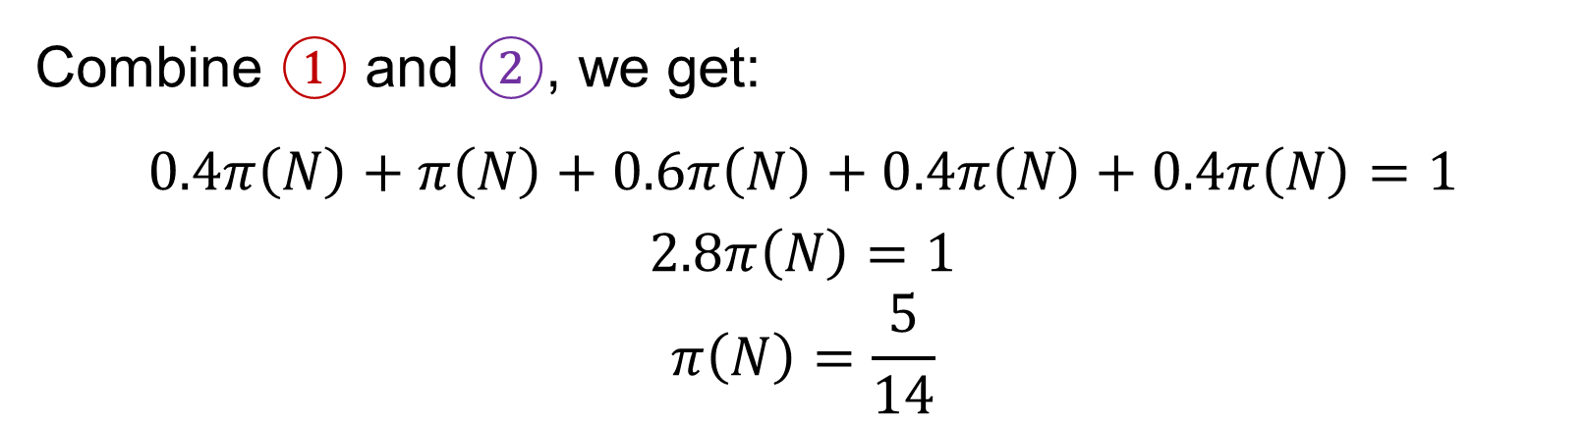
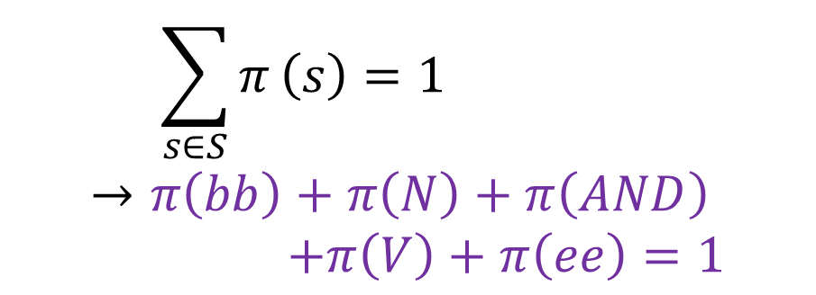
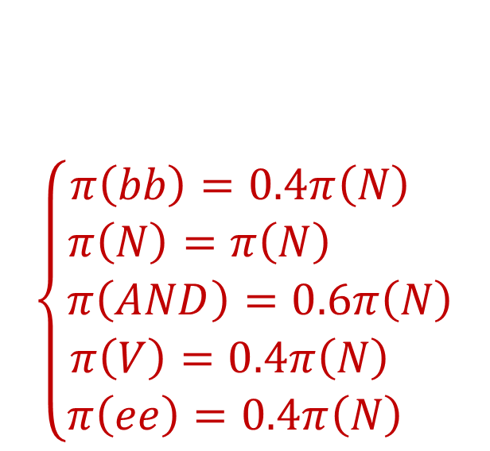
2. Stationary distribution
$$\left\{\begin{aligned}\begin{matrix}π\left(bb\right)=0.4π\left(N\right) \\ π\left(N\right)=π\left(N\right) \\ π\left(AND\right)=0.6π\left(N\right)\end{matrix} \\ π\left(V\right)=0.4π\left(N\right) \\ π\left(ee\right)=0.4π\left(N\right) \end{aligned}\right.$$
$$\sum_{s∈S}{π}\left(s\right)=1 \\ →π\left(bb\right)+π\left(N\right)+π\left(AND\right) \\ +π\left(V\right)+π\left(ee\right)=1$$
①
②
Combine ① and ②, we get: $$0.4π\left(N\right)+π\left(N\right)+0.6π\left(N\right)+0.4π\left(N\right)+0.4π\left(N\right)=1$$
$$2.8π\left(N\right)=1$$
$$π\left(N\right)=\frac{5}{14}$$

Slide 11
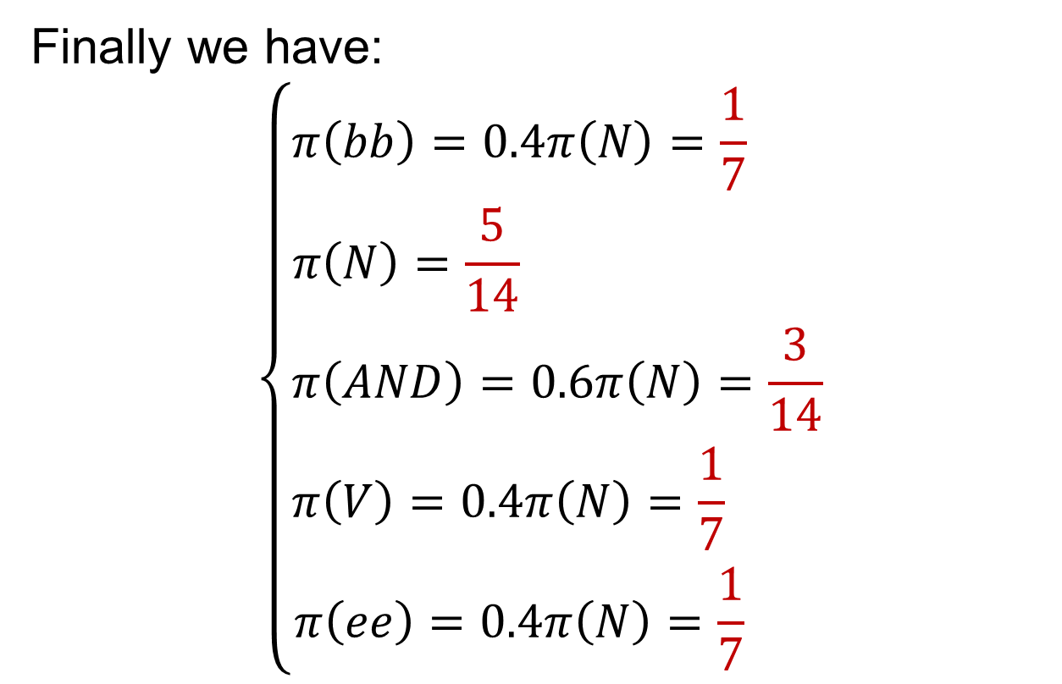
2. Stationary distribution
Finally we have:
$$\left\{\begin{aligned}\begin{matrix}π\left(bb\right)=0.4π\left(N\right)=\frac{1}{7} \\ π\left(N\right)=\frac{5}{14} \\ π\left(AND\right)=0.6π\left(N\right)=\frac{3}{14}\end{matrix} \\ π\left(V\right)=0.4π\left(N\right)=\frac{1}{7} \\ π\left(ee\right)=0.4π\left(N\right)=\frac{1}{7} \end{aligned}\right.$$
1.0
AND
0.6
begin
1.0
N
0.4
V
1.0
end
1.0

Slide 12

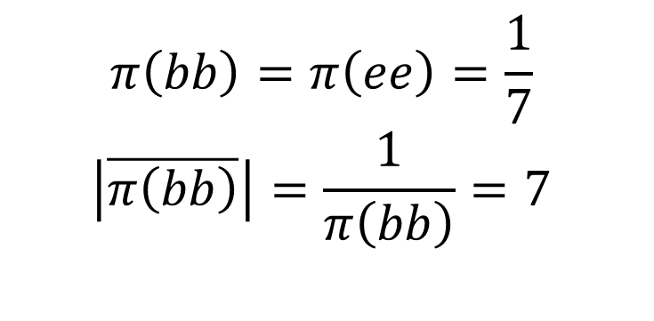
3. Average sentence length
We just need to find the average number of bb OR ee states in the sequence (as all sentences must have 1 bb and 1 ee).
1.0
AND
0.6
begin
1.0
N
0.4
V
1.0
end
1.0
$$π\left(bb\right)=π\left(ee\right)=\frac{1}{7}$$
$$\left|\overline{π\left(bb\right)}\right|=\frac{1}{π\left(bb\right)}=7$$
Remember bb and ee don’t count as words:
$$L=\left|\overline{π\left(bb\right)}\right|−2=5$$

Slide 13
QUIZ 03

Slide 14

QUIZ 03
A | B | C | D
12 | 5 | 0 | 3
What is required to create a good ensemble?
Some independence between members of the ensemble.
A data resampling technique to train members of the ensemble.
Strong individual learners in the ensemble.
Weak individual learners in the ensemble.
, where ρ is the correlation factor
Data resampling is not necessary (random forest uses random features)

Slide 15
QUIZ 03
A | B | C | D
1 | 12 | 2 | 5
2. Which of these does not describe an ensemble technique?
For each learner, change the weights of the different samples, pushing the learning to form a different decision boundary.
For each learner, find the principal components of the dataset and drop low variance features.
For each learner, resample observed samples with replacement, changing the data distribution.
For each learner, select a subset of columns, randomly dropping features.
AdaBoost
Bagging
Random Forest

Slide 16
QUIZ 03
A | B | C | D
0 | 3 | 0 | 17
3. Which of these statements about ensemble techniques and the bias- variance trade-off is false?
Bagging reduces the variance of the training dataset for each ensemble member.
Boosting can ensemble high-bias models to draw complex decision boundaries within datasets that have high variance.
Random forests reduce the variance of the training dataset for each ensemble member.
Adaboost works best with strong learners that already capture the variance of the dataset on their own.
Easy to overfit on strong learners.

Slide 17
QUIZ 03
A | B | C | D
2 | 2 | 13 | 3
4. Which of these statements about (regular, not hidden) Markov models is false?
A time-invariant markov model only looks at the-chain of events within a finite number of steps.
A 0-gram Markov chain prediction has no dependency upon past tokens.
Training n-gram models with larger n takes more computation, but not more space or data.
As the length of n-grams grow, the training data required to fill the transition matrix rapidly grows.
N-gram
scales exponentially
Assume 3-grams with 5 states, then the number of paths is 5^3=125

Slide 18
QUIZ 03
A | B | C | D
2 | 0 | 8 | 10
5. Which of these statements about a hidden Markov model with 3 hidden states and a vocabulary of 5 observable tokens is true?
The transition matrix, A, is size 3x5.
The emission matrix, B, is size 5x5.
The parameters of the HMM can be trained with the EM algorithm.
B and C are both true.
3x5
Transition matrix: probabilities transiting to the next state.
Emission matrix: probabilities of all states during different time steps.

Slide 19
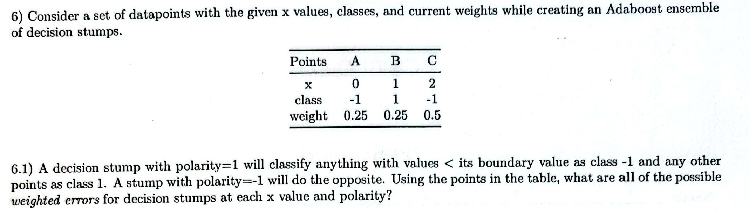
QUIZ 03
w=0.25 w=0.25 w=0.50
X
A(-1) B(1) C(-1)
0 1 2

Slide 20
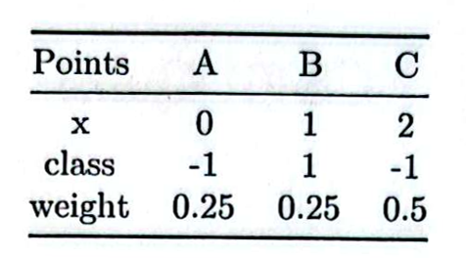
QUIZ 03
w=0.25 w=0.25 w=0.50
X
A(-1) B(1) C(-1)
0 1 2
For Polarity=1
For Polarity=-1
X=0
A(1) B(1) C(1)
A(-1) B(-1) C(-1)
e=0.25 e=0 e=0.50
e=0 e=0.25 e=0
Total error=0.75
Total error=0.25
X=1
A(-1) B(1) C(1)
A(1) B(-1) C(-1)
e=0 e=0 e=0.50
e=0.25 e=0.25 e=0
Total error=0.5
Total error=0.5
X=2
A(-1) B(-1) C(1)
A(1) B(1) C(-1)
e=0 e=0.25 e=0.50
e=0.25 e=0 e=0
Total error=0.75
Total error=0.25

Slide 21
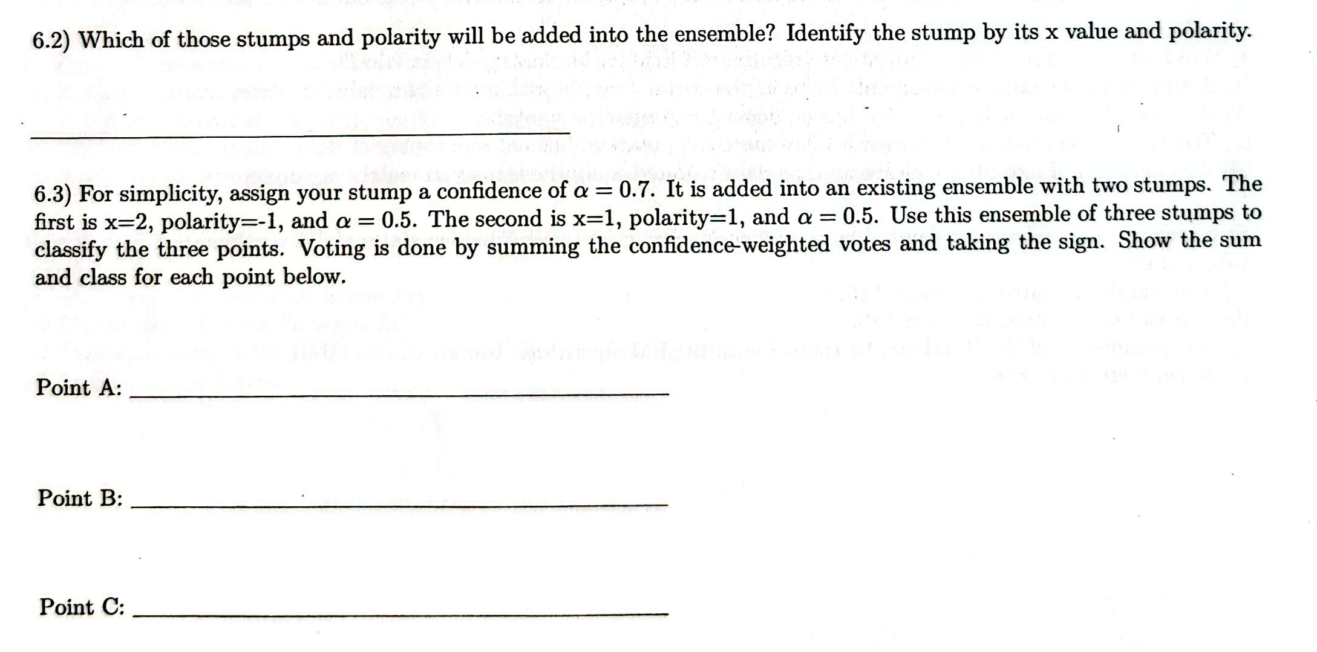

Slide 22
Polarity=-1, X=0 OR 2
Just pick up the model with lowest sum error

Slide 23
QUIZ 03
w=0.25 w=0.25 w=0.50
X
A(-1) B(1) C(-1)
0 1 2
(First Choice)
X=0, Polarity=-1, α=0.7
A(-1) B(-1) C(-1)
-0.7 -0.7 -0.7
X=2, Polarity=-1, α=0.5
A(1) B(1) C(-1)
0.5 0.5 -0.5
X=1, Polarity=1, α=0.5
A(-1) B(1) C(1)
-0.5 0.5 0.5
SUM
A(-1) B(1) C(-1)
-0.7 0.3 -0.7

Slide 24
QUIZ 03
w=0.25 w=0.25 w=0.50
X
A(-1) B(1) C(-1)
0 1 2
(Another situation)
X=2, Polarity=-1, α=0.7
A(1) B(1) C(-1)
0.7 0.7 -0.7
X=2, Polarity=-1, α=0.5
A(1) B(1) C(-1)
0.5 0.5 -0.5
X=1, Polarity=1, α=0.5
A(-1) B(1) C(1)
-0.5 0.5 0.5
SUM
A(1) B(1) C(-1)
0.7 1.7 -0.7

Slide 25
Polarity=-1, X=0 OR 2
Just pick up the model with lowest sum error
-1, s=-0.7 OR 1,s=0.7
1, s=0.3 OR 1,s=1.7
Both are correct.
-1, s=-0.7 OR -1,s=-0.7

Slide 26
Q&A

