Slide 1
CS461 – RECITATION 05
Machine Learning Principles
Daize Dong
2025-10-13

Slide 2
TODAY’S CONTENT
AdaBoost
Quiz 02

Slide 3
AdaBoost
Data:
Iteratively reweight samples
Misclassified ones get higher weight
Model:
Chain many weak learners (decision stumps)
Weight each by its accuracy for final prediction

Slide 4
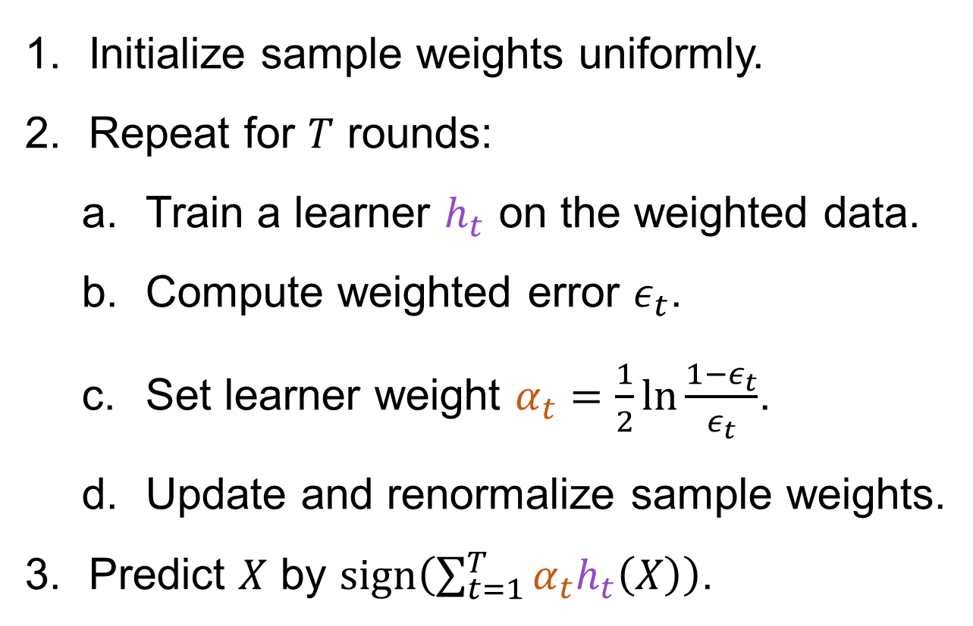
AdaBoost
Initialize sample weights uniformly.
Repeat for $T$ rounds:
Train a learner $h_{t}$ on the weighted data.
Compute weighted error $ε_{t}$.
Set learner weight $α_{t}=\frac{1}{2}\ln{\frac{1−ε_{t}}{ε_{t}}}$.
Update and renormalize sample weights.
Predict $X$ by $sign\left(\sum_{t=1}^{T}{α_{t}h_{t}\left(X\right)}\right)$.

Slide 5
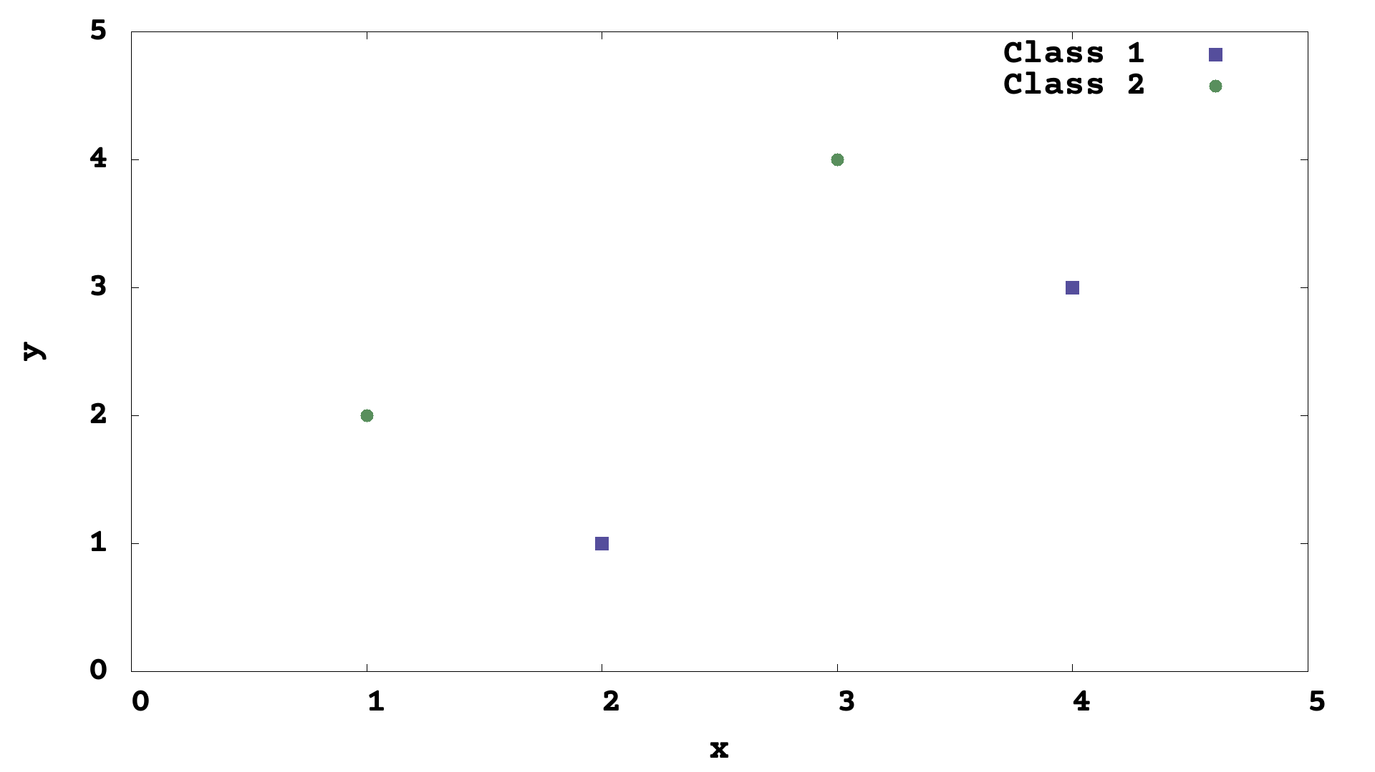
STEP1:
INITIALIZE SAMPLE WEIGHTS
Sample Weights
(0.25, 0.25, 0.25, 0.25)
0.25
0.25
0.25
0.25

Slide 6
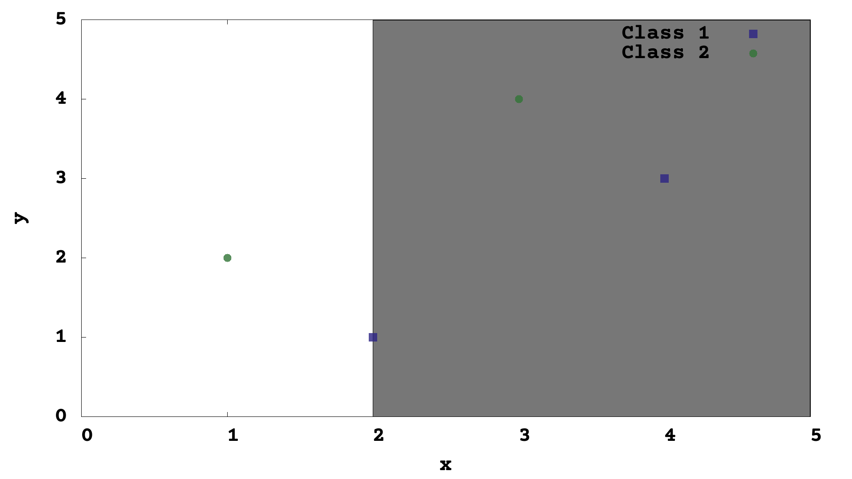


STEP2-a:
TRAIN LEARNER $h_{1}$
2 ← $h_{1}$ → 1
Sample Weights
(0.25, 0.25, 0.25, 0.25)
❌
0.25
✅
0.25
0.25
✅
0.25
✅

Slide 7
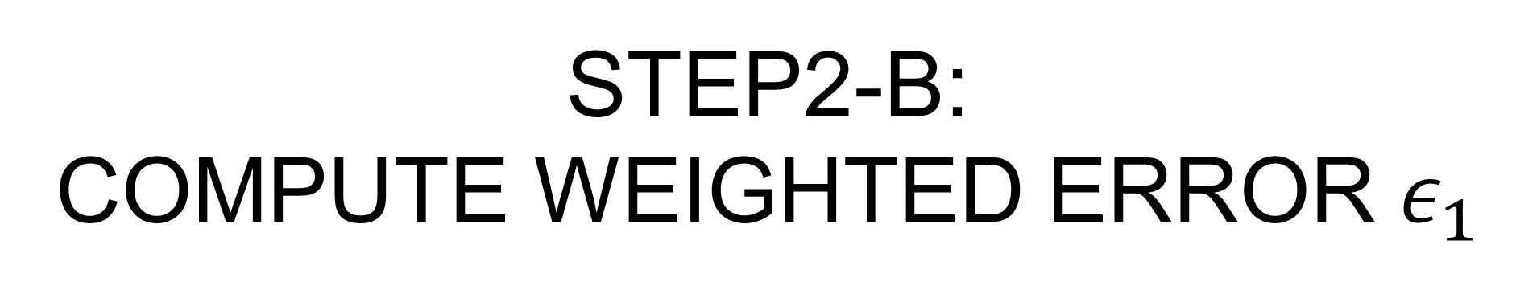
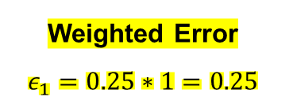

STEP2-b:
COMPUTE WEIGHTED ERROR $ε_{1}$
2 ← $h_{1}$ → 1
Sample Weights
(0.25, 0.25, 0.25, 0.25)
❌
Weighted Error
$$ε_{1}=0.25∗1=0.25$$
0.25
✅
0.25
0.25
✅
0.25
✅

Slide 8
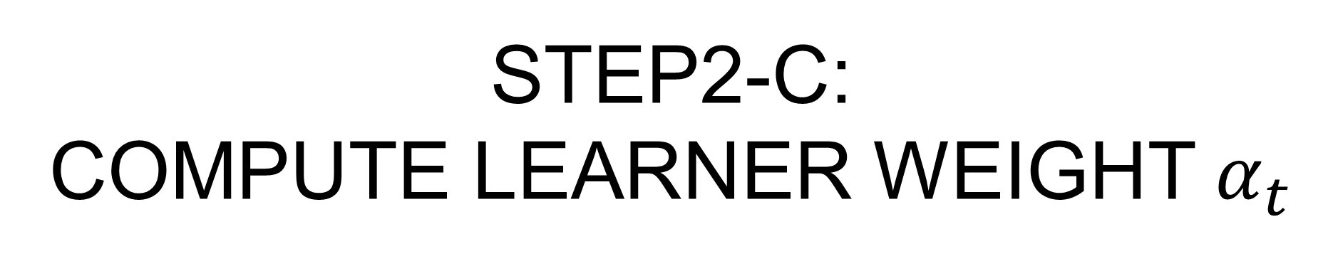
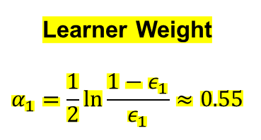
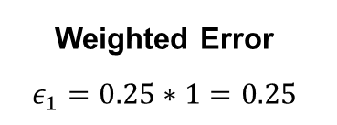
STEP2-C:
COMPUTE LEARNER WEIGHT $α_{t}$
2 ← $h_{1}$ → 1
Sample Weights
(0.25, 0.25, 0.25, 0.25)
❌
Weighted Error
$$ε_{1}=0.25∗1=0.25$$
0.25
✅
Learner Weight
$$α_{1}=\frac{1}{2}\ln{\frac{1−ε_{1}}{ε_{1}}}≈0.55$$
0.25
0.25
✅
0.25
✅

Slide 9
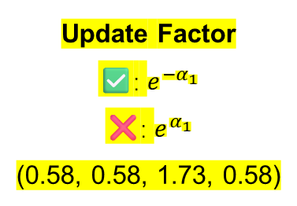
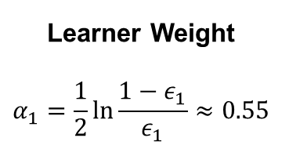
STEP2-D:
UPDATE SAMPLE WEIGHTS
2 ← $h_{1}$ → 1
Sample Weights
(0.25, 0.25, 0.25, 0.25)
↓ multiply factor
(0.14, 0.14, 0.43, 0.14)
↓ renormalize
(0.17, 0.17, 0.50, 0.17)
❌
Weighted Error
$$ε_{1}=0.25∗1=0.25$$
0.50
✅
Learner Weight
$$α_{1}=\frac{1}{2}\ln{\frac{1−ε_{1}}{ε_{1}}}≈0.55$$
0.17
0.17
✅
0.17
✅
Update Factor
✅: $e^{−α_{1}}$
❌: $e^{α_{1}}$
(0.58, 0.58, 1.73, 0.58)

Slide 10
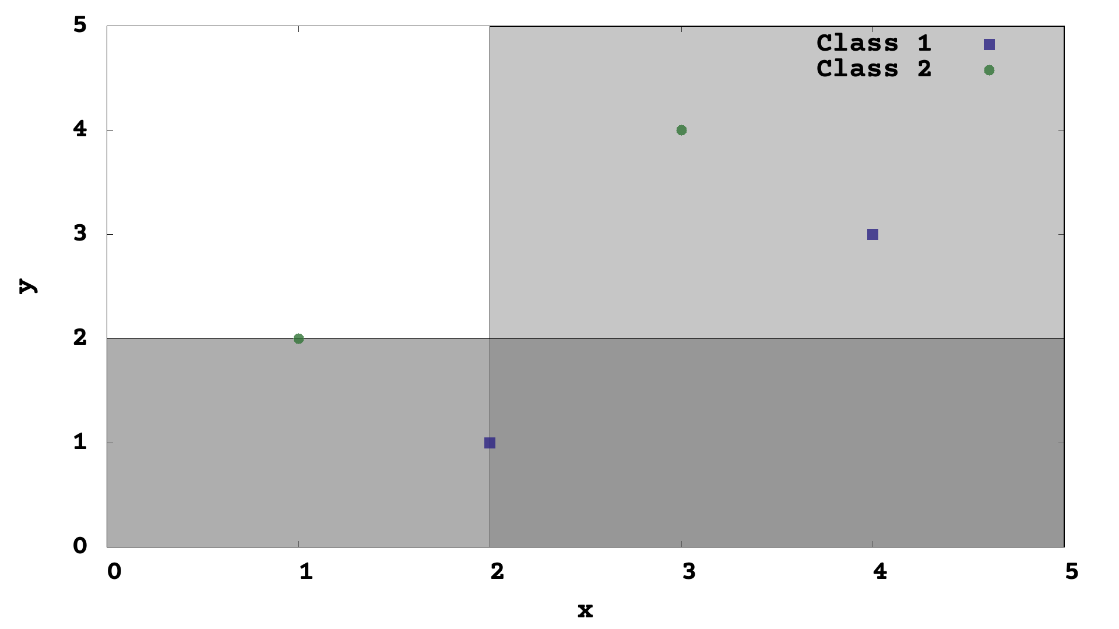

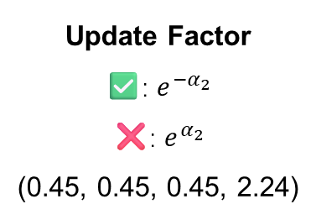
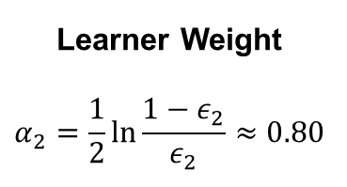
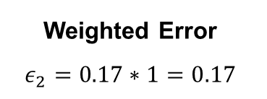
STEP2:
Repeat until convergence
Sample Weights
(0.17, 0.17, 0.50, 0.17)
↓ mul & norm
(0.10, 0.10, 0.30, 0.50)
✅
Weighted Error
$$ε_{2}=0.17∗1=0.17$$
0.50 → 0.30
❌
2 ↑ $h_{2}$ ↓ 1
Learner Weight
$$α_{2}=\frac{1}{2}\ln{\frac{1−ε_{2}}{ε_{2}}}≈0.80$$
0.17 → 0.50
0.17 → 0.10
✅
0.17 → 0.10
✅
Update Factor
✅: $e^{−α_{2}}$
❌: $e^{α_{2}}$
(0.45, 0.45, 0.45, 2.24)

Slide 11
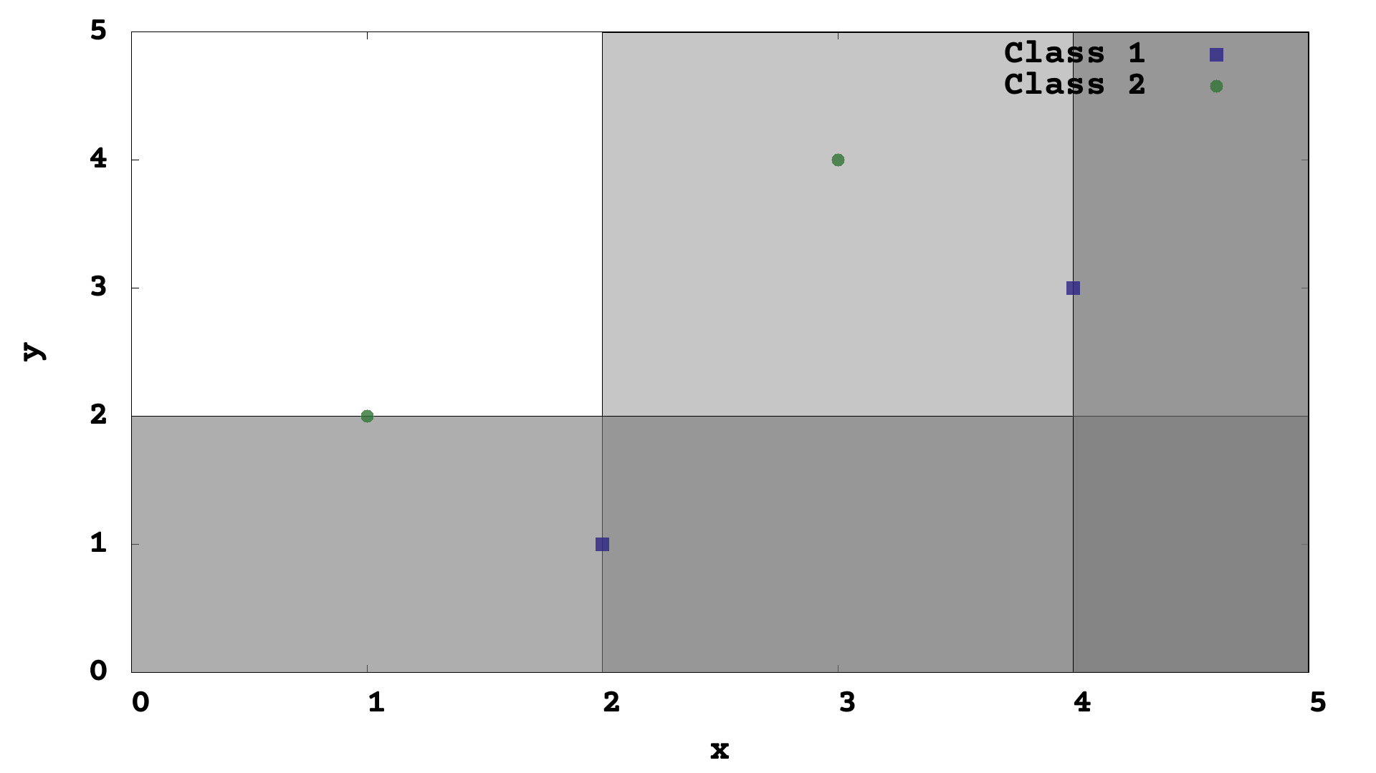
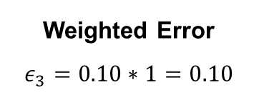


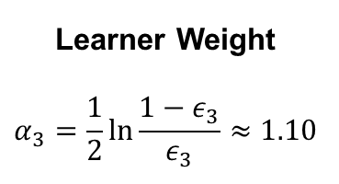
STEP2:
Repeat until convergence
2 ← $h_{3}$ → 1
Sample Weights
(0.10, 0.10, 0.30, 0.50)
↓ mul & norm
(0.06, 0.50, 0.17, 0.28)
✅
Weighted Error
$$ε_{3}=0.10∗1=0.10$$
0.30 → 0.17
✅
Learner Weight
$$α_{3}=\frac{1}{2}\ln{\frac{1−ε_{3}}{ε_{3}}}≈1.10$$
0.50 → 0.28
0.10 → 0.06
✅
0.10 → 0.50
❌
Update Factor
✅: $e^{−α_{3}}$
❌: $e^{α_{3}}$
(0.33, 3.00, 0.33, 0.33)

Slide 12

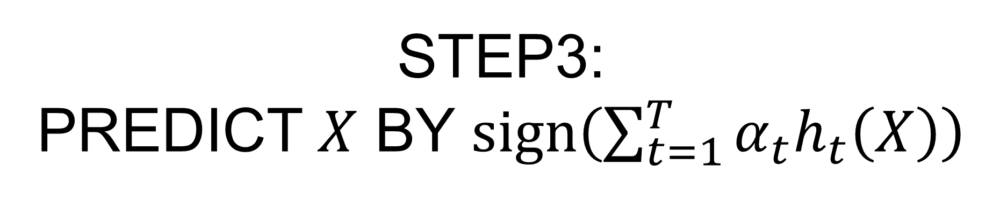


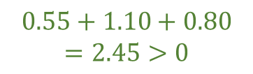




STEP3:
PREDICT $X$ BY $sign\left(\sum_{t=1}^{T}{α_{t}h_{t}\left(X\right)}\right)$
$$α_{1}=0.55$$
$$α_{2}=1.10$$
1 ← $h_{1}$ → -1
1 ← $h_{3}$ → -1
$$−1$$
1
$$0.55+1.10+0.80$$
$$=2.45>0$$
1
1
-1
1 ↑ $h_{2}$ ↓ -1
$$α_{3}=0.80$$
1
-1
-1

Slide 13
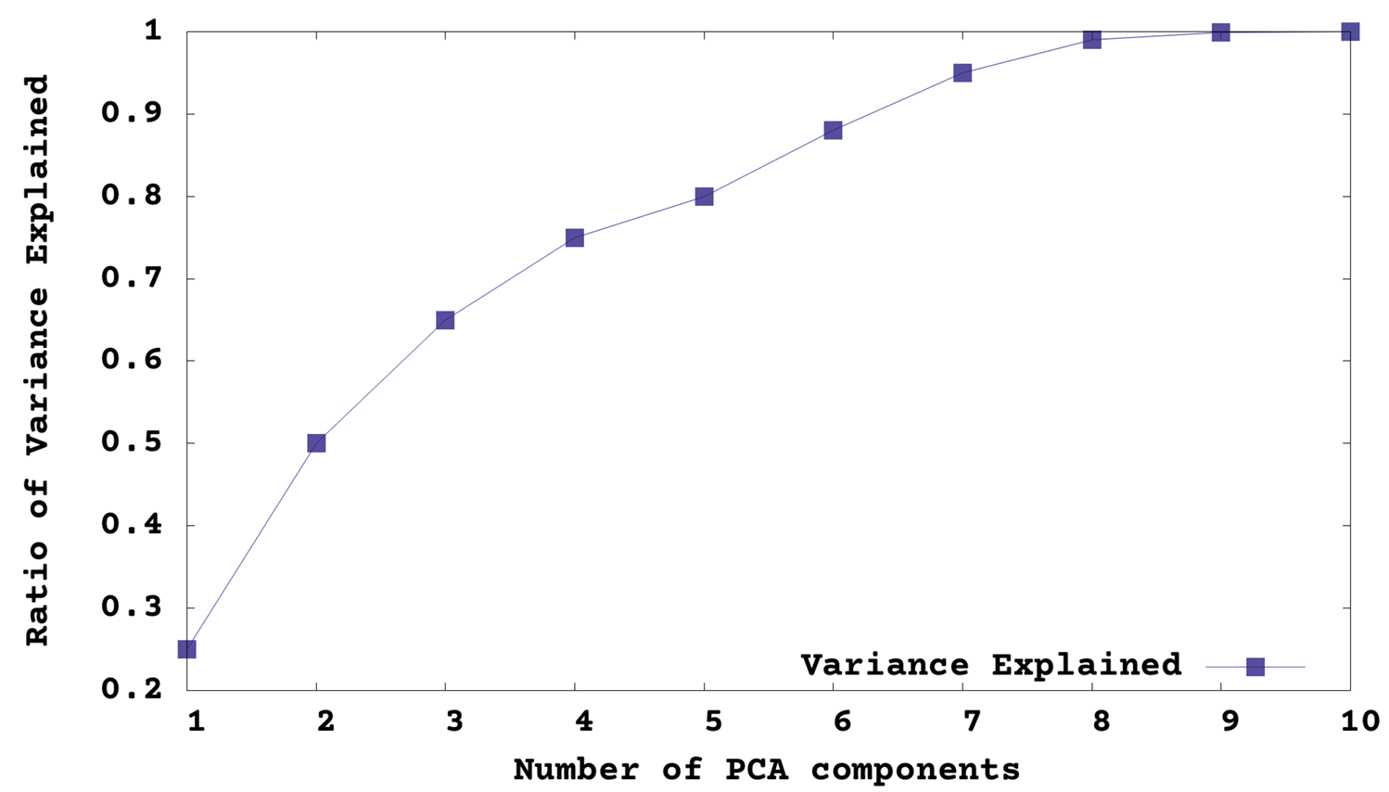
QUIZ 02
A | B | C | D
3 | 1 | 14 | 3
1) When preprocessing data using principal component analysis with eigenvalues, which of the following statements is false?
The eigenvalue from the first component is the largest.
The first two components explain about half of the dataset variance.
The first components explain the most variance. They should be dropped.
The last components explain the least variance. They should be dropped.
Accumulative values

Slide 14
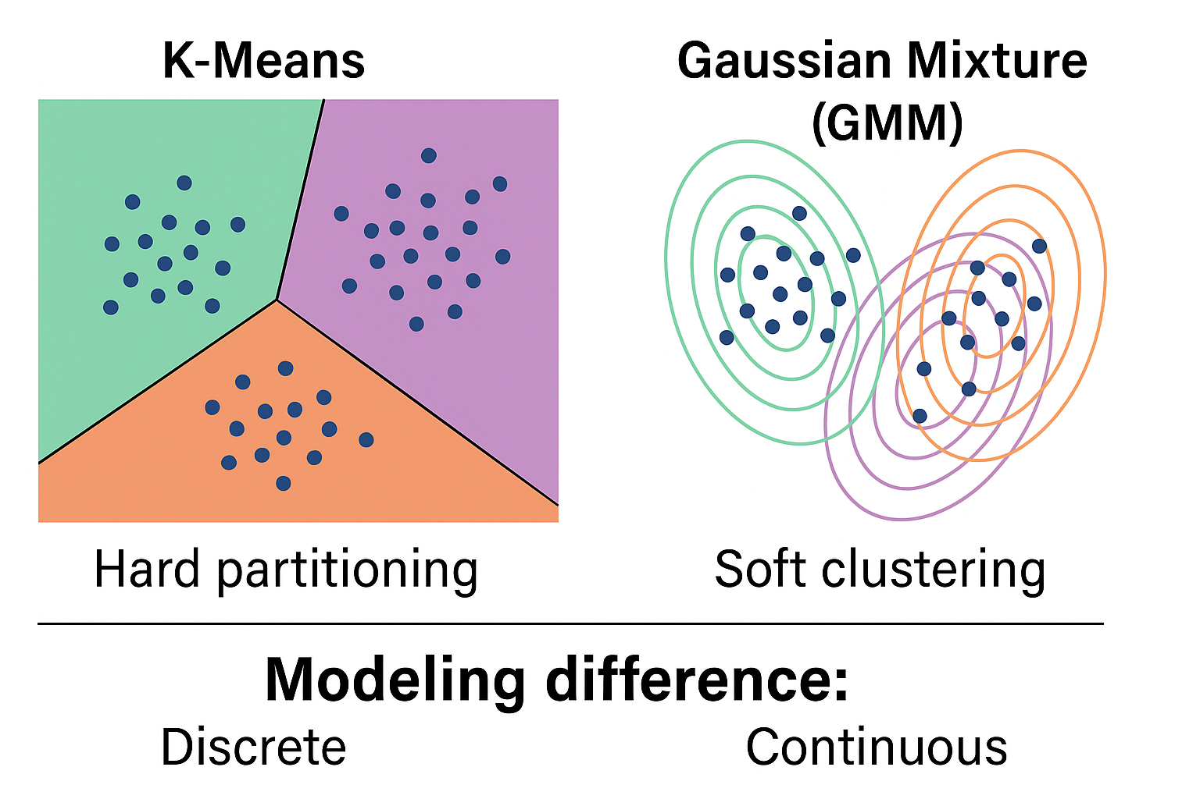
QUIZ 02
A | B | C | D
1 | 2 | 0 | 18
2) Which is true about soft clustering?
Soft clustering is used in K-Means.
Soft clustering is used in K Nearest Neighbors.
Soft clustering is used when making final cluster assignments after training, but not during training.
Soft clustering allows a point’s likelihood to be explained by multiple clusters.
K-Means: hard
GMM: soft

Slide 15
QUIZ 02
A | B | C | D
2 | 15 | 4 | 0
3) Which of the following is a supervised technique?
Guassian Mixture Models
Logistic Regression
Hierarchical Agglomerative Clustering
Principal Component Analysis
All clusterings are un-supervised.

Slide 16
QUIZ 02
A | B | C | D
2 | 15 | 4 | 0
4) Which statement about the K-Means algorithm is true?
K-Means deals well with overlapping clusters of different classes.
K-Means can be improved by choosing initial cluster centers that are far apart.
K-Means is guaranteed to converge on the best cluster split.
K-Means works well when clusters are not spherical.

Slide 17
QUIZ 02
A | B | C | D
3 | 12 | 3 | 3
5) Which of the following statements about decision boundaries is false?
Decision boundaries in decision trees are noisy because small changes in the dataset can lead to large changes in pivot choices.
Linear regression creates a complicated decision boundary that is known to easily overfit to the individual data samples.
The decision boundaries in a Gaussian Mixture Model cluster assignment consider the cluster variance.
With most techniques, poor decision boundaries can be improved with additional data, especially if it is near the decision boundary

Slide 18
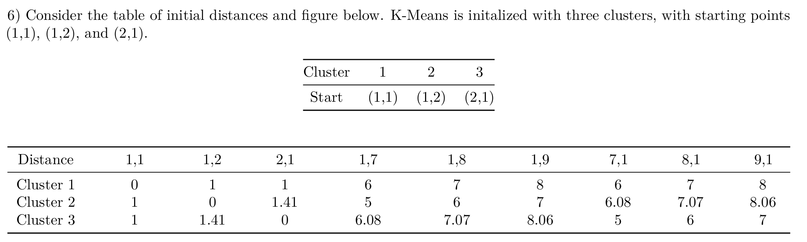
QUIZ 02

Slide 19
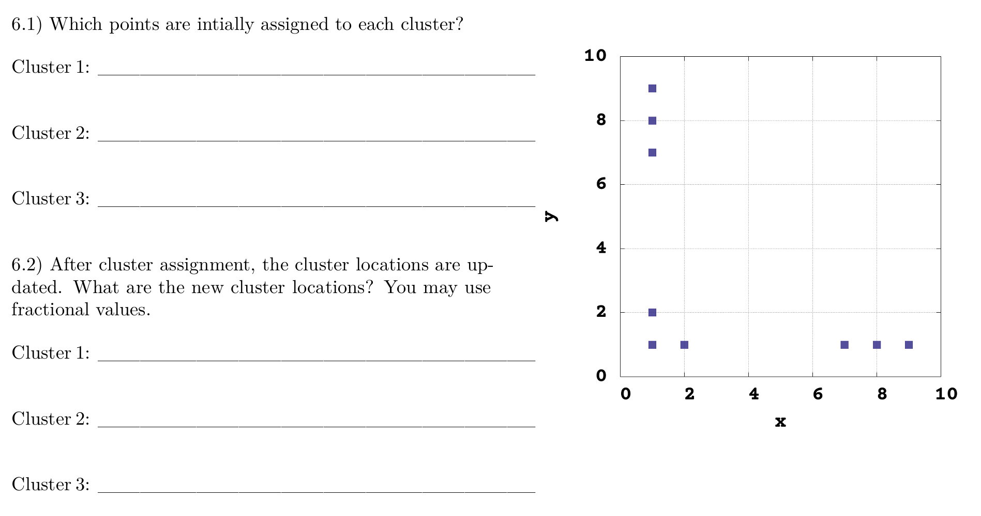

Slide 20
(1,1)
(1,2) (1,7) (1,8) (1,9)
(2,1) (7,1) (8,1) (9,1)

Slide 21
(1,1)
(1,2) (1,7) (1,8) (1,9)
(2,1) (7,1) (8,1) (9,1)
(1,1)
$\left(\frac{1+1+1+1}{4},\frac{2+7+8+9}{4}\right)$ → $\left(1,\frac{13}{2}\right)$
$\left(\frac{2+7+8+9}{4},\frac{1+1+1+1}{4}\right)$ → $\left(\frac{13}{2},1\right)$

Slide 22
Q&A

