Slide 1
CS461 – RECITATION 11
Machine Learning Principles
Daize Dong
2025-11-24

Slide 2
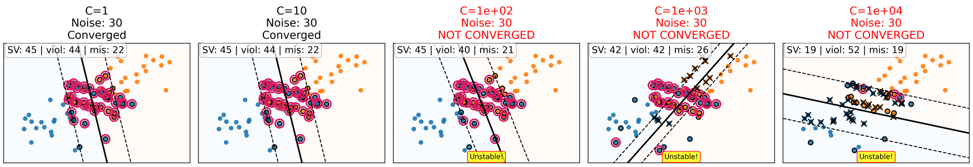
QUIZ 05
A | B | C | D
- | - | - | -
1. What is true about the complexity parameter, C, used with support vector machines?
A very small value of C forces the SVM to use more support vectors.
C is the number of support vectors chosen for each class.
A large value of C makes a simpler model.
All of the above are false.

Slide 3
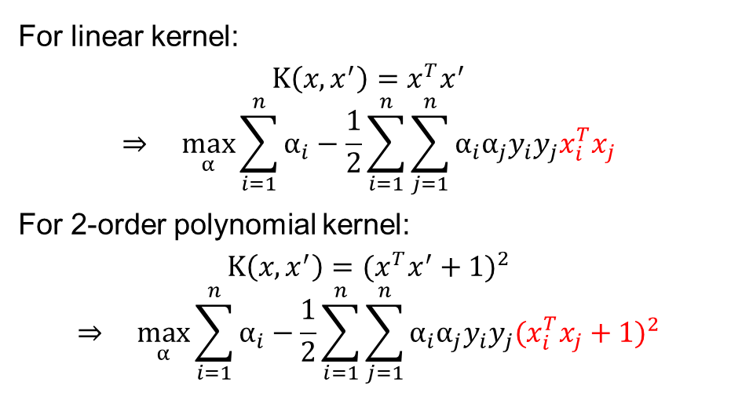
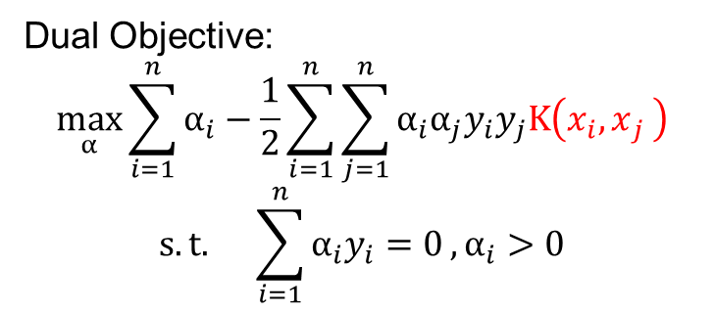
QUIZ 05
A | B | C | D
- | - | - | -
2. What is true of the kernel trick?
The kernel trick makes large margins in SVMs.
The kernel trick replaces a weight matrix with a function of the training data.
The kernel trick turns perceptrons into SVMs.
None of the above are true.
For linear kernel:
$$K\left(x,x^{′}\right)=x^{T}x^{′}$$
$$⇒ \max_{α}{\sum_{i=1}^{n}{α_{i}}−\frac{1}{2}\sum_{i=1}^{n}{\sum_{j=1}^{n}{α_{i}α_{j}y_{i}y_{j}x_{i}^{T}x_{j}}}}$$
For 2-order polynomial kernel:
$$K\left(x,x^{′}\right)={(x^{T}x^{′}+1)}^{2}$$
$$⇒ \max_{α}{\sum_{i=1}^{n}{α_{i}}−\frac{1}{2}\sum_{i=1}^{n}{\sum_{j=1}^{n}{α_{i}α_{j}y_{i}y_{j}{(x_{i}^{T}x_{j}+1)}^{2}}}}$$
Dual Objective:
$$\max_{α}{\sum_{i=1}^{n}{α_{i}}−\frac{1}{2}\sum_{i=1}^{n}{\sum_{j=1}^{n}{α_{i}α_{j}y_{i}y_{j}K\left(x_{i}{,x}_{j}\right)}}} \\ s.t. \sum_{i=1}^{n}{α_{i}y_{i}=0},α_{i}>0$$

Slide 4
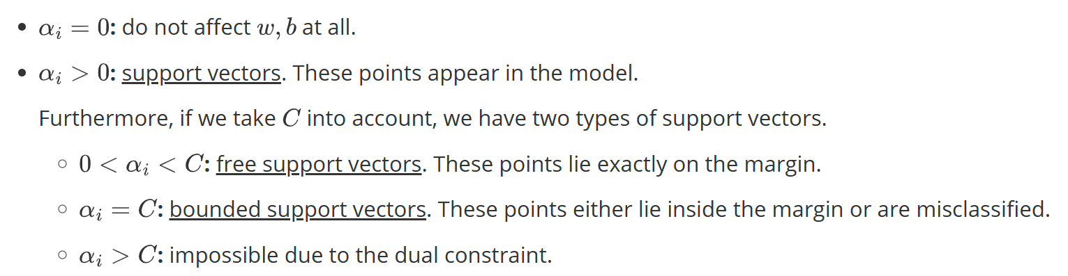
QUIZ 05
A | B | C | D
- | - | - | -
3. When using an SVM, what is true about the weights of the support vectors, 𝛼?
If one vector has 𝛼 = 0.5 and another has 𝛼 = 0.1, the first is nearer to the decision boundary.
The 𝛼 values must sum to 1.
All 𝛼 values must be greater than 0.
None of the above are true.
α measures how strongly points contribute to the boundary, not geometric distance.
May be misread:
True if following “support vectors” in title.
False if α for all points.

Slide 5
QUIZ 05
A | B | C | D
- | - | - | -
4. How are SVMs and Neural Networks different?
Only neural networks can work on image data.
Neural networks are faster to train.
The kernel trick allows SVMs to learn nonlinear decision boundaries, which NNs cannot.
None of the above are true.
MNIST
SVM: No backpropgation
NN learns nonlinear by activation functions.

Slide 6
QUIZ 05
A | B | C | D
- | - | - | -
5. When using the kernel trick, how are SVMs and perceptrons different?
SVMs will be slower at inference since they require a complex decision boundary and dense 𝛼.
The weight matrix of the SVM will not be representable when using a kernel, but it will be when using a perceptron.
Perceptrons cannot use the kernel trick, but SVMs can.
SVMs will be faster at inference since they create a decision boundary using a sparse 𝛼.
Sparse 𝛼 (those > 0)
Obviously representable with linear kernel.
kernel perceptron

Slide 7
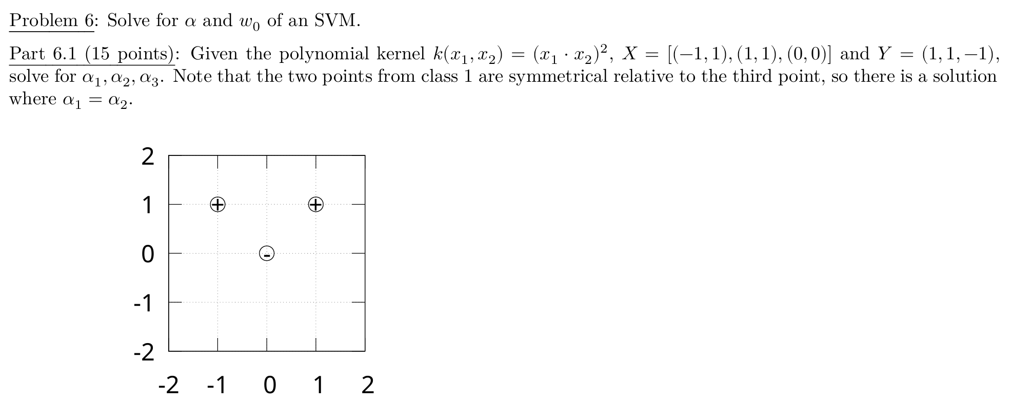

QUIZ 05
First we get the relationship among all $α$:
$$α_{1}=α_{2} (1)$$
$$\sum_{i=1}^{n}{α_{i}y_{i}=0 ⇒ α_{1}+α_{2}−α_{3}=0 ⇒ α_{3}=2α_{1} (2)}$$
Given the polynomial kernel:
$$K\left(x,x^{′}\right)={(x^{T}x^{′})}^{2}$$
The objective turns to:
$$\sum_{i=1}^{3}{α_{i}}−\frac{1}{2}\sum_{i=1}^{3}{\sum_{j=1}^{3}{α_{i}α_{j}y_{i}y_{j}{(x_{i}^{T}x_{j})}^{2}}}$$
1
2
3

Slide 8
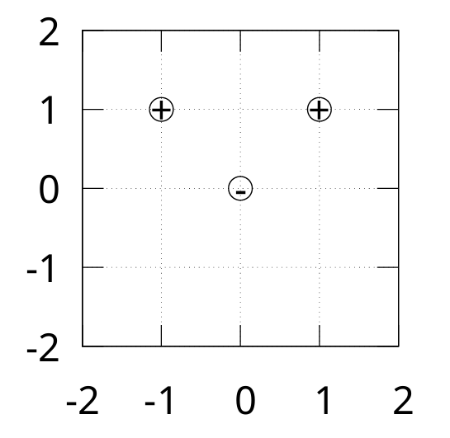
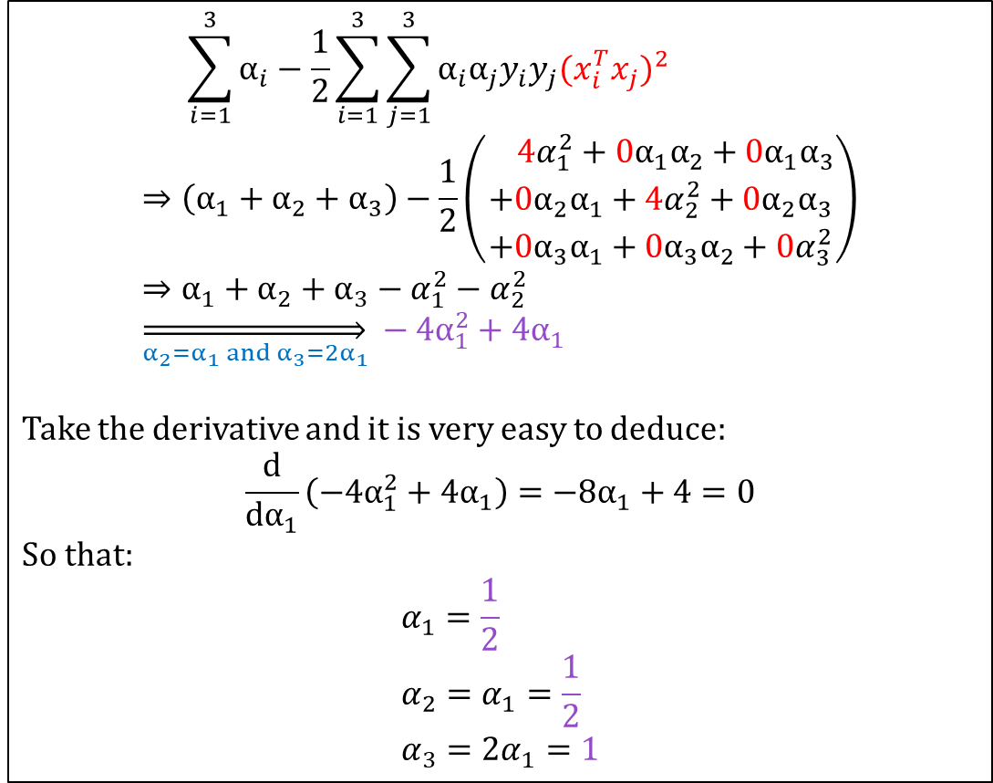
QUIZ 05
$$\sum_{i=1}^{3}{α_{i}}−\frac{1}{2}\sum_{i=1}^{3}{\sum_{j=1}^{3}{α_{i}α_{j}y_{i}y_{j}{(x_{i}^{T}x_{j})}^{2}}} \\ ⇒\left(α_{1}+α_{2}+α_{3}\right)−\frac{1}{2}\left(\begin{aligned} {4α}_{1}^{2}+{0α}_{1}α_{2}+{0α}_{1}α_{3} \\ +{0α}_{2}α_{1}+{4α}_{2}^{2}+{0α}_{2}α_{3} \\ +{0α}_{3}α_{1}+{0α}_{3}α_{2}+{0α}_{3}^{2}\end{aligned}\right) \\ ⇒α_{1}+α_{2}+α_{3}−α_{1}^{2}−α_{2}^{2} \\ \overset{⇒}{α_{2}=α_{1} and{ α}_{3}={2α}_{1}} −4α_{1}^{2}+4α_{1}$$
Take the derivative and it is very easy to deduce:
$$\frac{d}{dα_{1}}\left(−4α_{1}^{2}+4α_{1}\right)=−8α_{1}+4=0$$
So that:
$$α_{1}=\frac{1}{2} \\ α_{2}=α_{1}=\frac{1}{2} \\ α_{3}={2α}_{1}=1$$
1
2
3

Slide 9
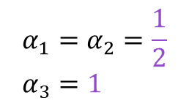
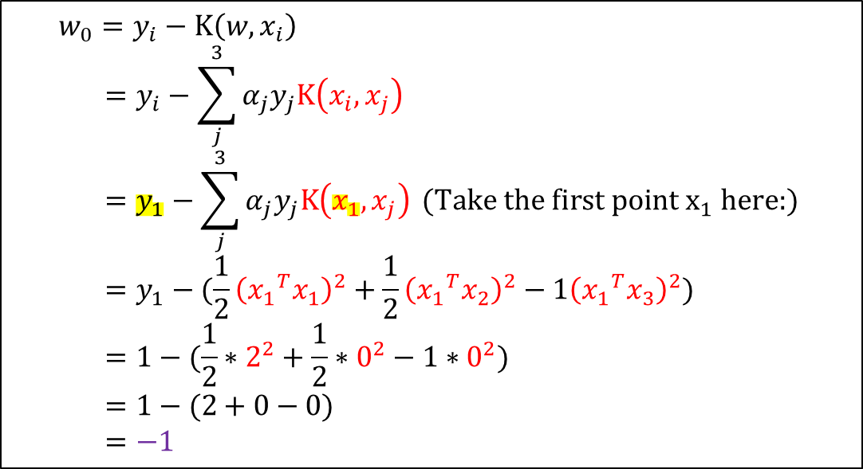
QUIZ 05
$${α_{1}=α}_{2}=\frac{1}{2} \\ α_{3}=1$$
$$w_{0}=y_{i}−K\left(w,x_{i}\right) \\ =y_{i}−\sum_{j}^{3}{{α_{j}y}_{j}K\left(x_{i},x_{j}\right)} \\ =y_{1}−\sum_{j}^{3}{{α_{j}y}_{j}K\left(x_{1},x_{j}\right)} (\text{Take} \text{the} \text{first} \text{point} x_{1} \text{here}\text{:}) \\ =y_{1}−(\frac{1}{2}{\left({x_{1}}^{T}x_{1}\right)}^{2}+\frac{1}{2}{\left({x_{1}}^{T}x_{2}\right)}^{2}−1{\left({x_{1}}^{T}x_{3}\right)}^{2}) \\ =1−(\frac{1}{2}∗2^{2}+\frac{1}{2}∗0^{2}−1∗0^{2}) \\ =1−(2+0−0) \\ =−1$$
1
2
3

