Slide 1
CS461 – RECITATION 01
Machine Learning Principles
Daize Dong
2025-09-15

Slide 2
CONTACT
Teaching Assistant
Email: daize.dong@rutgers.edu
Office (Hours):
Not Yet

Slide 3
BACKGROUND
First-year PhD
Deep Learning
Neural Network Efficiency
High Performance Computation

Slide 4
TODAY’S CONTENT
Recap what you have learned before
Common Distributions
Continuous
Discrete
Hypothesis Testing
P-values
χ² Test

Slide 5
NOISE
Y = β₀ + β₁x + ϵ_{i}
Data points are noised
How to model it?

Slide 6


DISTRIBUTIONS
Continuous
Discrete
Source: https://en.wikipedia.org/wiki/Capillary_wave
Source: https://minecraft.fandom.com/wiki/Water

Slide 7
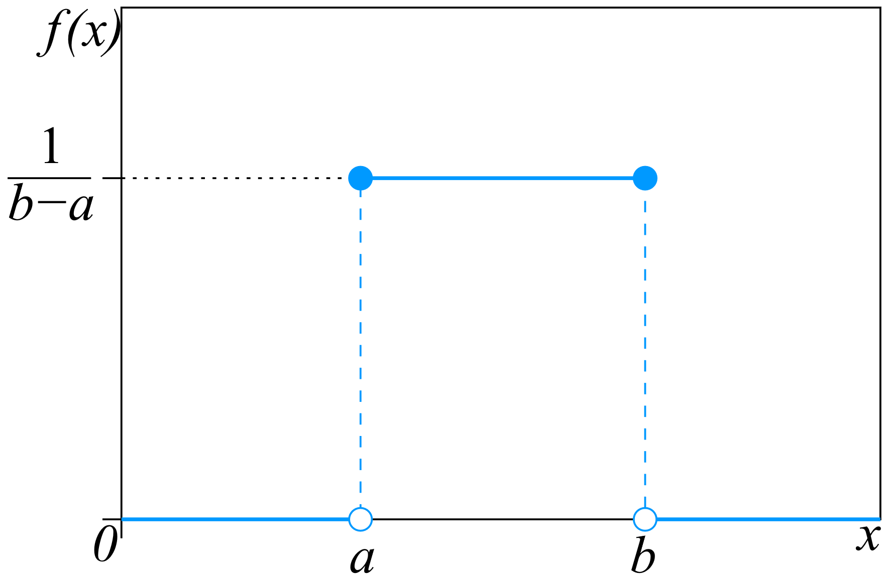
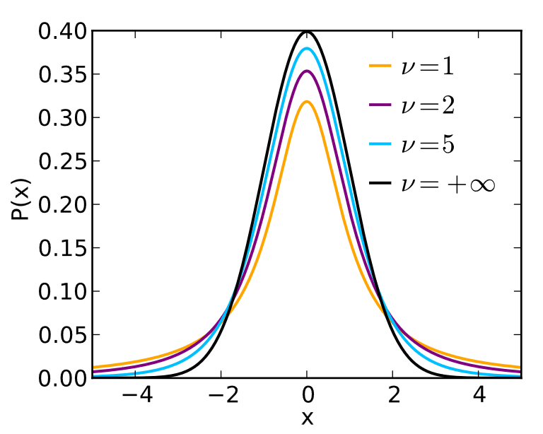
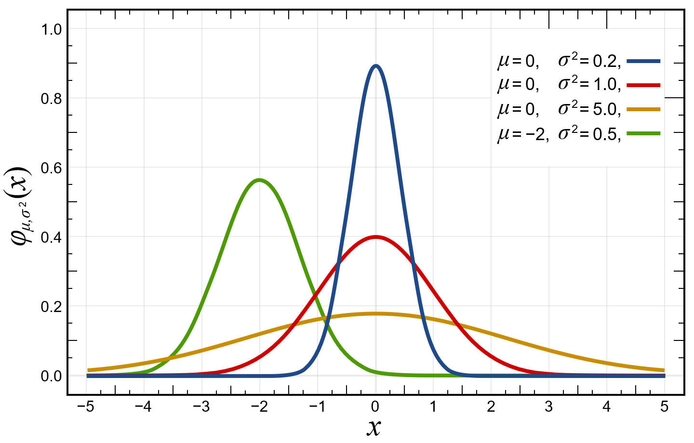
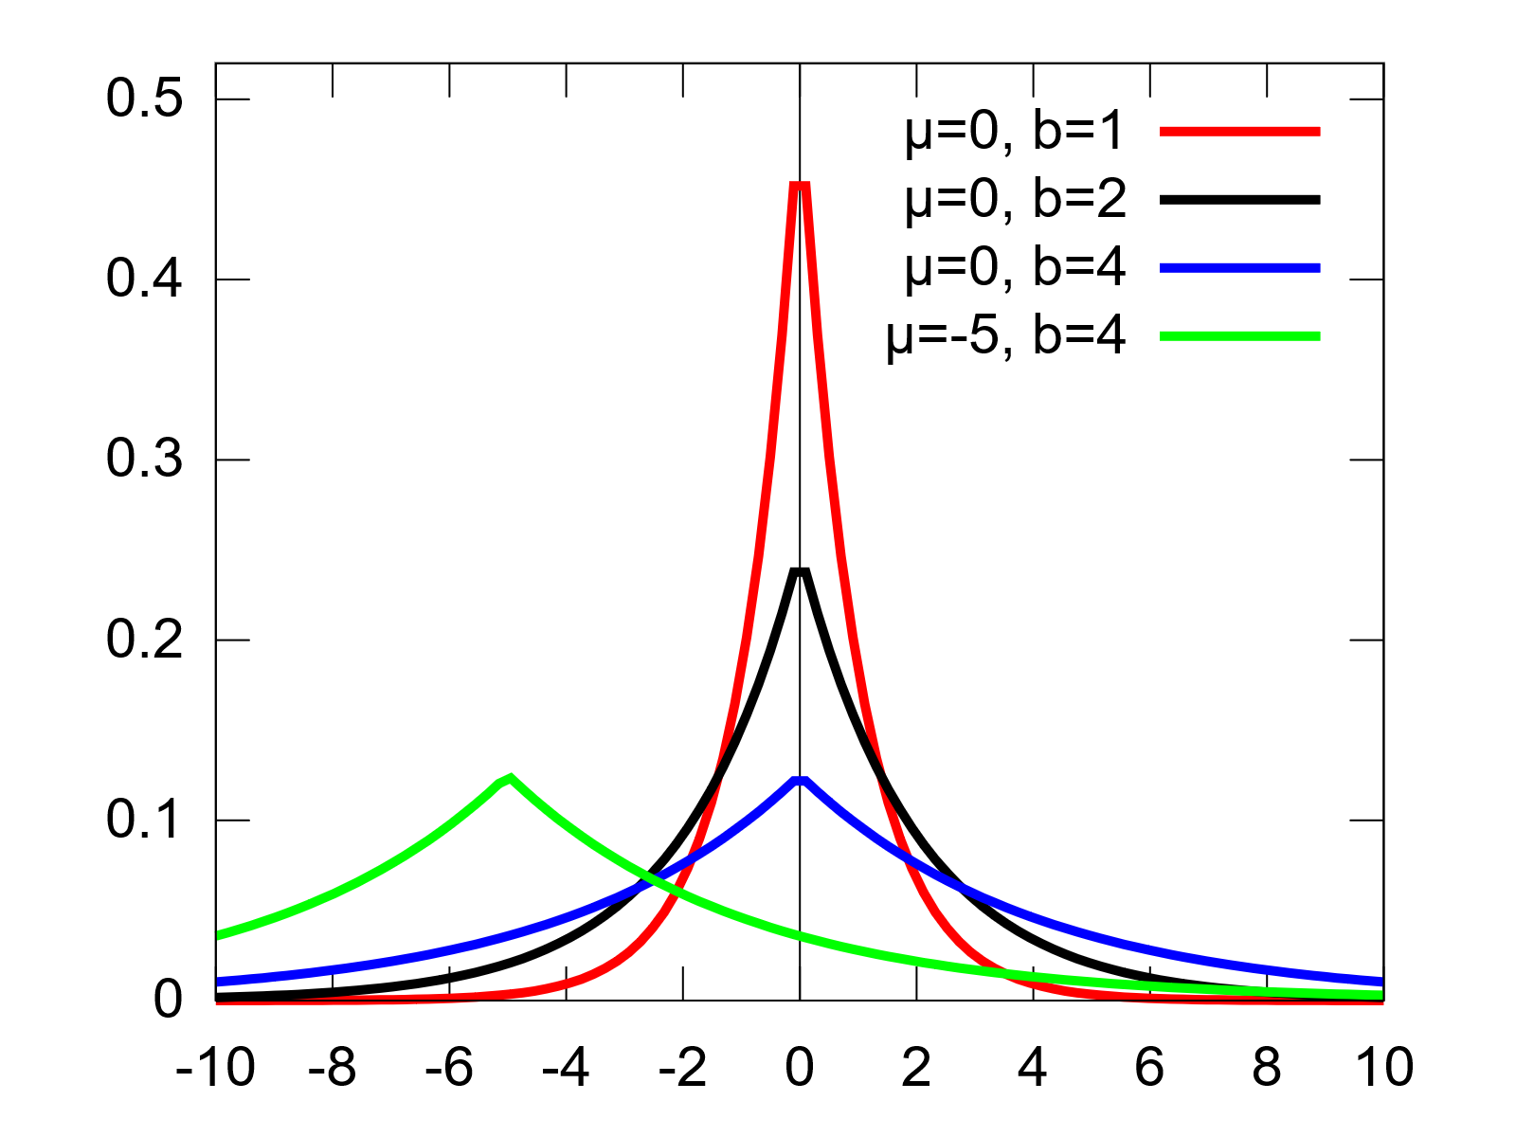
CONTINUOUS DISTRIBUTIONS
Uniform
Student's t
Gaussian
Laplace
Source: https://en.wikipedia.org/wiki/Distribution_(mathematics)

Slide 8
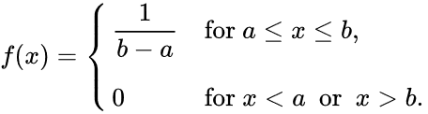
UNIFORM DISTRIBUTION
Perfectly smooth tabletop
numpy.random.uniform(low, high)

Slide 9

GAUSSIAN DISTRIBUTION
Exam scores
Heights and weights
numpy.random.normal(mu, sigma)

Slide 10
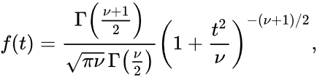
STUDENT’S T DISTRIBUTION
Gaussian distribution w/ fatter tails
Financial modeling (asset returns)
numpy.random.student_t(nu)
f(t)​→N(0,1) as ν→∞
ν: degrees of freedom
Number of data points left after estimating parameters

Slide 11

LAPLACE DISTRIBUTION
Sharper peak at the center
Heavier tails
Signal processing (spiky noise)
numpy.random.laplace(mu, b)

Slide 12
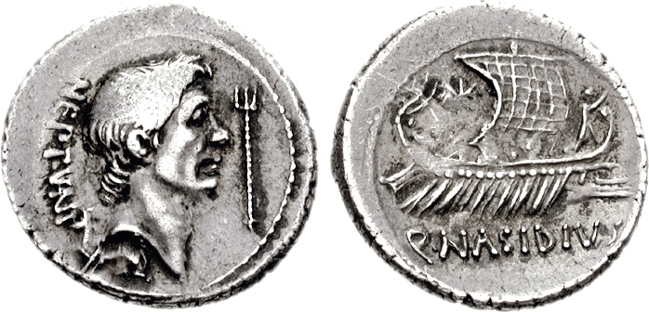
COIN TOSS
Head=1, Tail=0
Not all randomness is continuous
How to measure?
Source: https://en.wikipedia.org/wiki/Coin_flipping

Slide 13
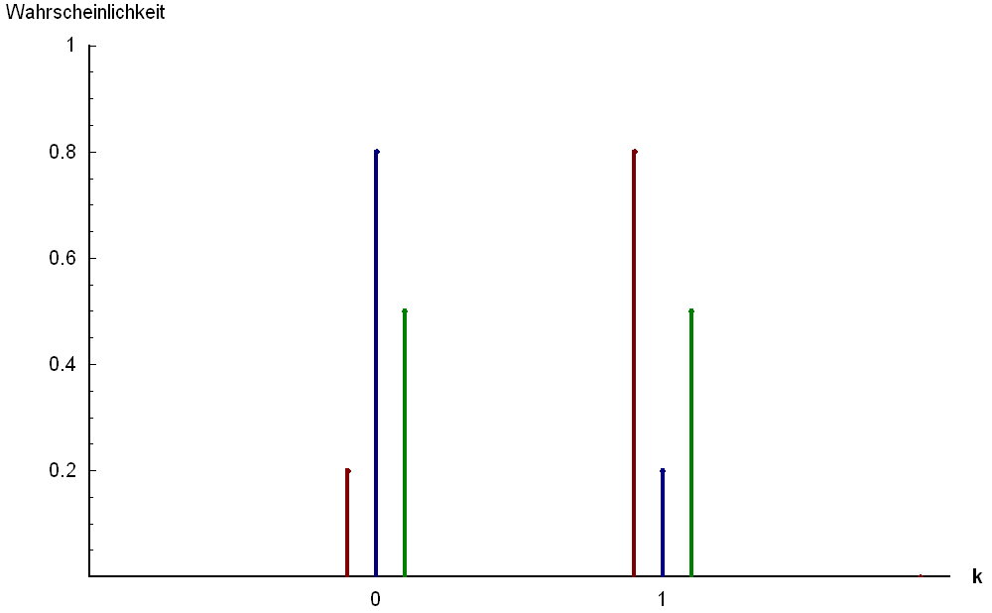
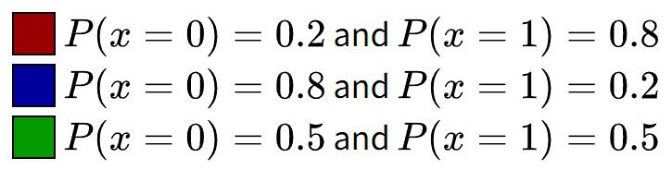
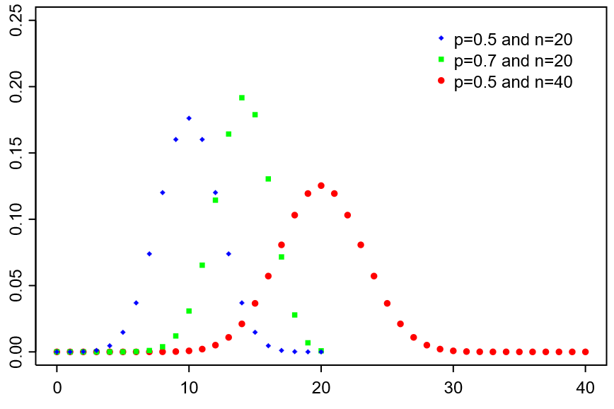
DISCRETE DISTRIBUTIONS
Bernoulli
Binomial
Source: https://en.wikipedia.org/wiki/Distribution_(mathematics)

Slide 14

BERNOULLI DISTRIBUTION
Tossing a coin → heads/tails
Light bulb test → work/fail
numpy.random.binomial(n=1, p)

Slide 15


BINOMIAL DISTRIBUTION
Combination of Bernoulli
Number of heads in 20 tosses
numpy.random.binomial(n, p)

Slide 16
SO FAR
Modeling continuous noise —— how much
Uniform (all values equally likely)
Gaussian (bell curve)
Student’s t (bell curve with heavy tails)
Laplace (sharp peak, heavy tails)
Modeling discrete noise —— how many
Bernouli (single trial)
Binomial (number of successes in n trials)

Slide 17
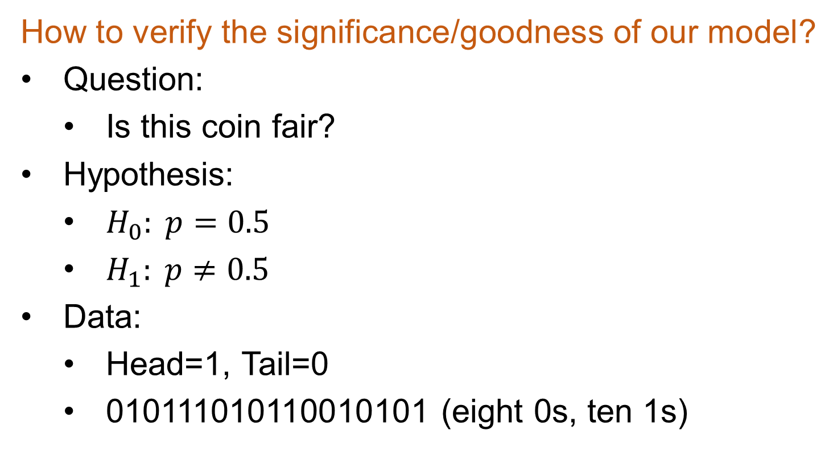
Hypothesis Testing
How to verify the significance/goodness of our model?
Question:
Is this coin fair?
Hypothesis:
$H_{0}: p=0.5$
$H_{1}: p≠0.5$
Data:
Head=1, Tail=0
010111010110010101 (eight 0s, ten 1s)

Slide 18
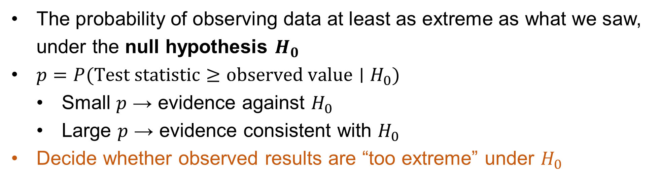
P-values
The probability of observing data at least as extreme as what we saw, under the null hypothesis $H_{0}$
$p=P(Test statistic≥observed value∣H_{0}​)$
Small $p$ → evidence against $H_{0}$
Large $p$ → evidence consistent with $H_{0}$
Decide whether observed results are “too extreme” under $H_{0}$

Slide 19
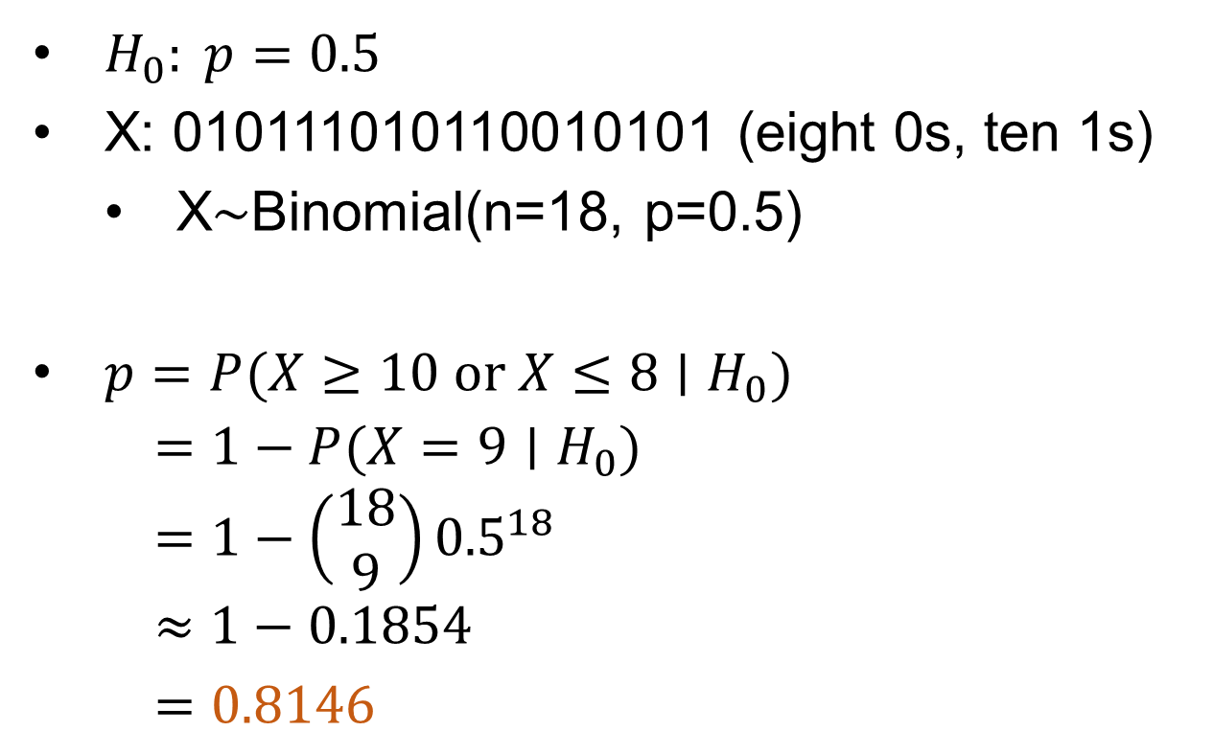
P-values
$H_{0}: p=0.5$
X: 010111010110010101 (eight 0s, ten 1s)
X∼Binomial(n=18, p=0.5)
$p=P(X≥10 or X≤8∣H_{0}​)$
$$=1−P(X=9∣H_{0}​)$$
$$=1−\left(\begin{aligned}18 \\ 9\end{aligned}\right){0.5}^{18}$$
$$≈1−0.1854$$
$$=0.8146$$

Slide 20
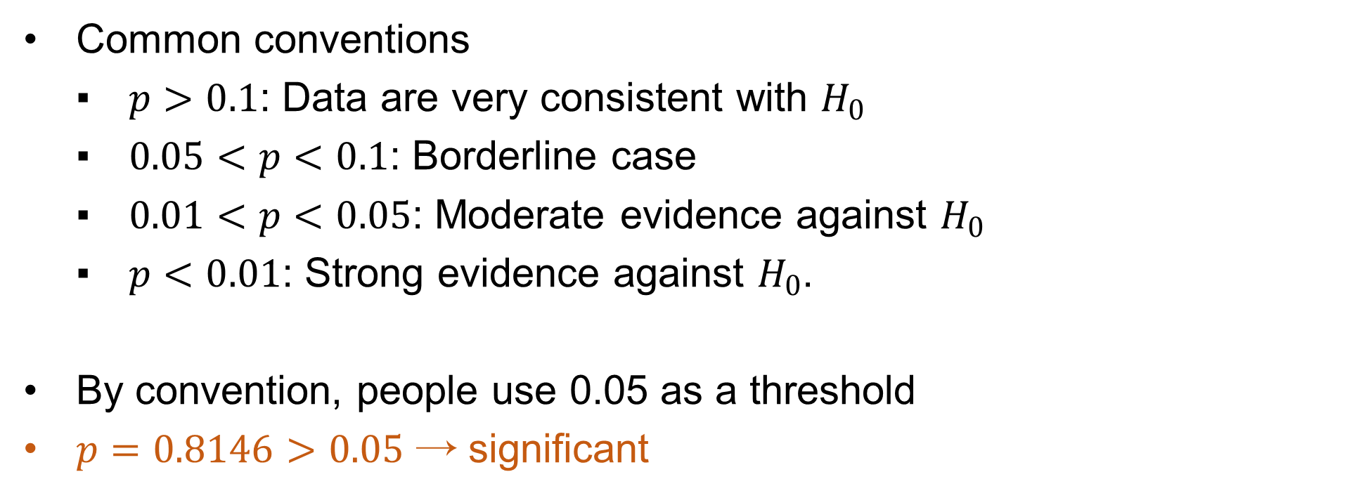
P-values
Common conventions
$p>0.1$: Data are very consistent with $H_{0}$
$0.05<p<0.1$: Borderline case
$0.01<p<0.05$: Moderate evidence against $H_{0}$
$p<0.01$: Strong evidence against $H_{0}$.
By convention, people use 0.05 as a threshold
$p=0.8146>0.05$ → significant

Slide 21
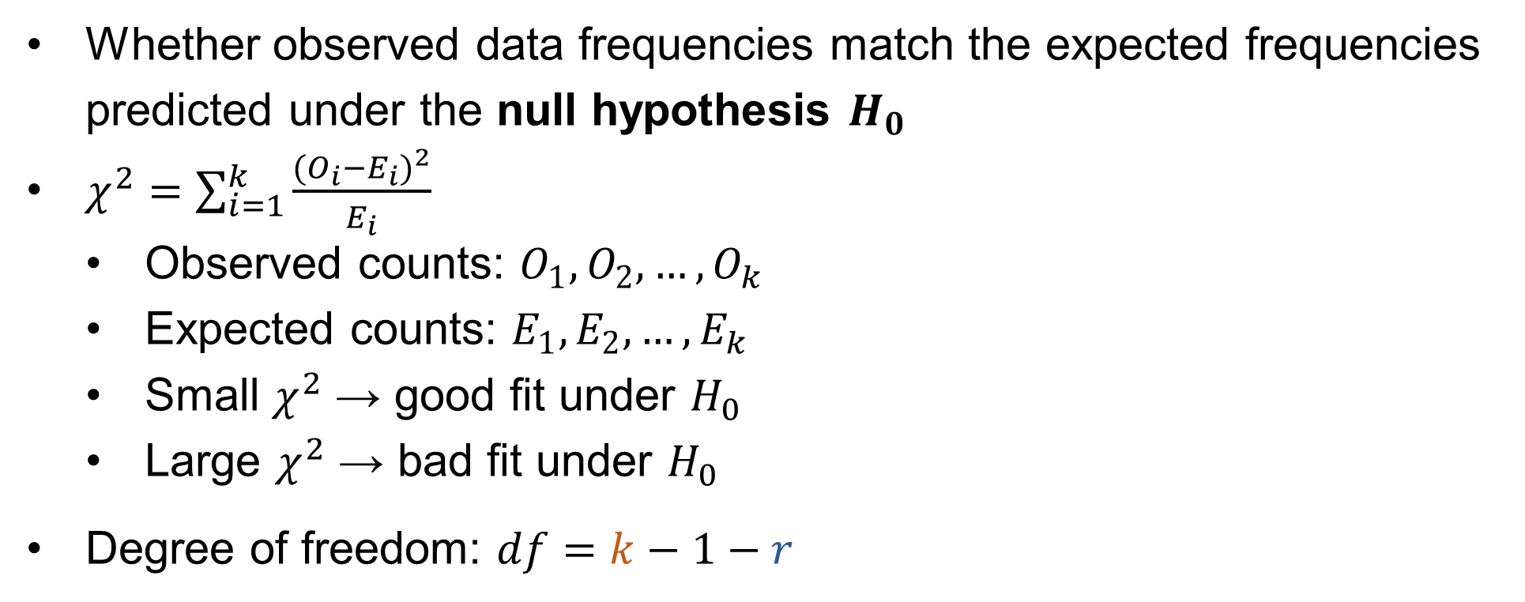
χ²
Test
(Chi-Square)
Whether observed data frequencies match the expected frequencies predicted under the null hypothesis $H_{0}$
$χ^{2}=\sum_{i=1}^{k}{\frac{{(O_{i}−E_{i})}^{2}}{E_{i}}}$
Observed counts: $O_{1},O_{2},…,O_{k}$
Expected counts: $E_{1},E_{2},…,E_{k}$
Small $χ^{2}$ → good fit under $H_{0}$
Large $χ^{2}$ → bad fit under $H_{0}$
Degree of freedom: $df=k−1−r$
Number of
estimated parameters
e.g. μ, σ
Number of classes

Slide 22
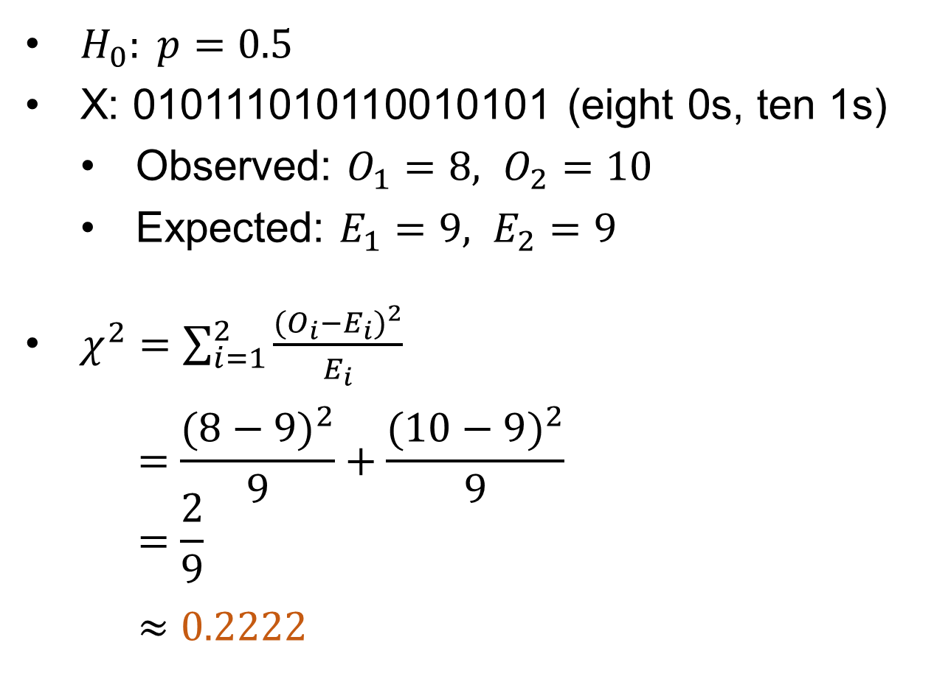

χ²
Test
$H_{0}: p=0.5$
X: 010111010110010101 (eight 0s, ten 1s)
Observed: $O_{1}=8, O_{2}=10$
Expected: $E_{1}=9, E_{2}=9$
$χ^{2}=\sum_{i=1}^{2}{\frac{{(O_{i}−E_{i})}^{2}}{E_{i}}}$
$$=\frac{{(8−9)}^{2}}{9}+\frac{{(10−9)}^{2}}{9}$$
$$=\frac{2}{9}$$
$≈0.$2222
$$df=2−1−0=1$$

Slide 23

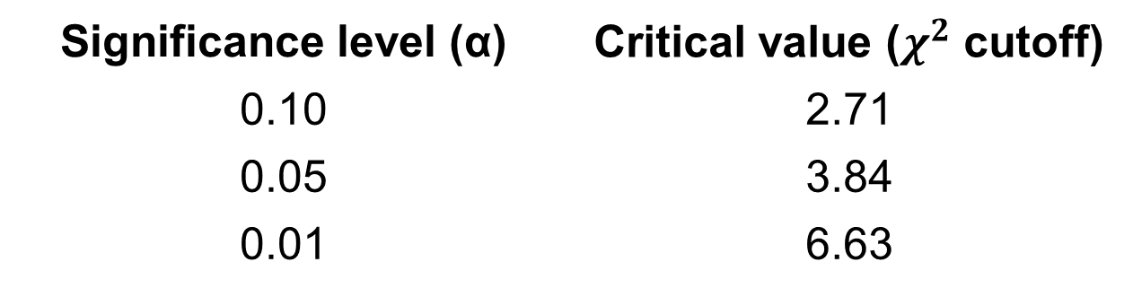
χ²
Test
Reference values for $χ^{2}$ with $df=1$
By convention, people use 0.05 as a threshold
$χ^{2}=0.\text{2222} \text{(}\text{df}\text{=}\text{1}\text{) < }$3.84
Very significant
Significance level (α) | Critical value ($χ^{2}$ cutoff)
0.10 | 2.71
0.05 | 3.84
0.01 | 6.63

Slide 24
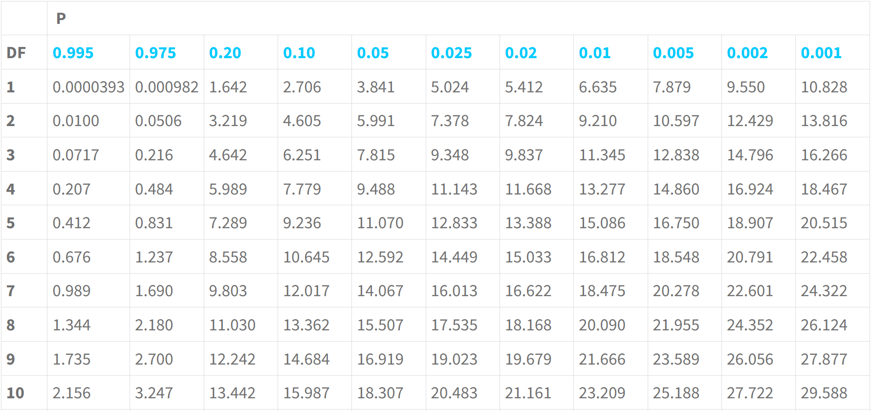
χ²
Test
Chi Square Table & Chi Square Calculator

Slide 25
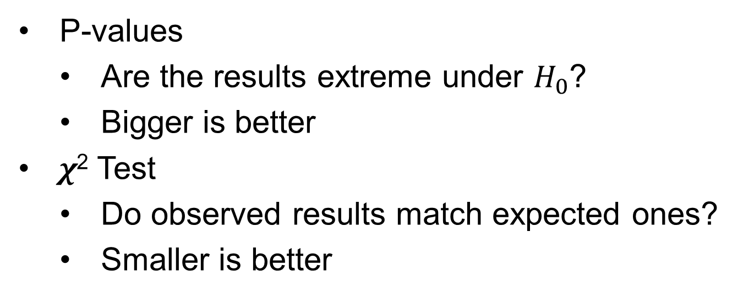
SO FAR
P-values
Are the results extreme under $H_{0}$?
Bigger is better
χ² Test
Do observed results match expected ones?
Smaller is better

Slide 26
Q&A

