Slide 1
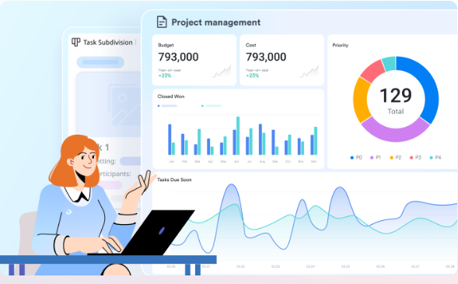
Automated Task Reminder & Tracking Application
Presented by Dakarai Mahisa

Slide 2
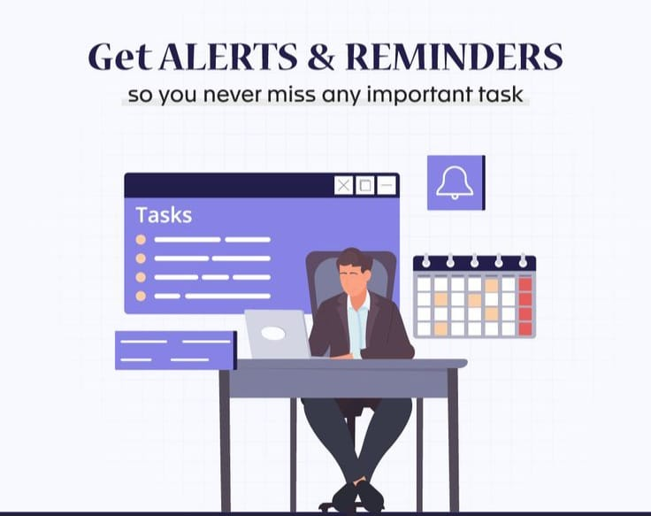
Problem Statement
Problem Addressed:
Traditional manual tracking leads to missed deadlines, "cognitive overload," and fragmented workflows.
why it Matters:
In a fast-paced environment, missing a single task can stall an entire project. Automation ensures accountability and mental clarity.

Slide 3
Project Objectives
Automate Notifications:
Eliminate manual checking by sending real-time alerts.
Centralize Data:
Provide a single source of truth for all pending and completed tasks.
Enhance Security:
Protect user data through robust authentication and OTP verification.
Enable Data Portability:
Allow users to export history via CSV for external reporting.
Improve Time Management:
Help users prioritize high-impact tasks through status tracking.

Slide 4
Technology Stack
Programming & DB
Java, JDBC, Spring Boot framework,JavaScript, css,MYSQL,Thymeleaf
Development Tools
IntelliJ IDEA, GitHub
Testing Frameworks
JUnit & Mockito
Additional Utilities
CSV(OpenCSV library),Java Email API

Slide 5
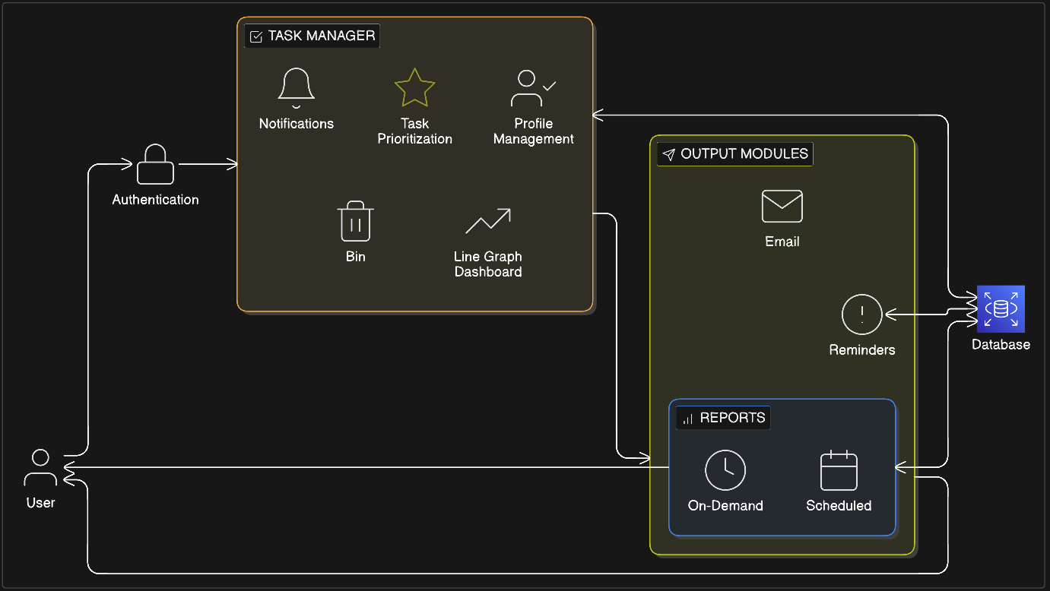
System Architecture

Slide 6
Modules Implemented
Task Manager
Create, update, delete, and categorize tasks.
Auth & OTP
Secure login with email-based One-Time Passwords for verification.
Export Module
Generate and download CSV files of task history.
Customize personal settings and notification preferences.
User Profile
Background service for automated push/email alerts.
Reminder Engine

Slide 7
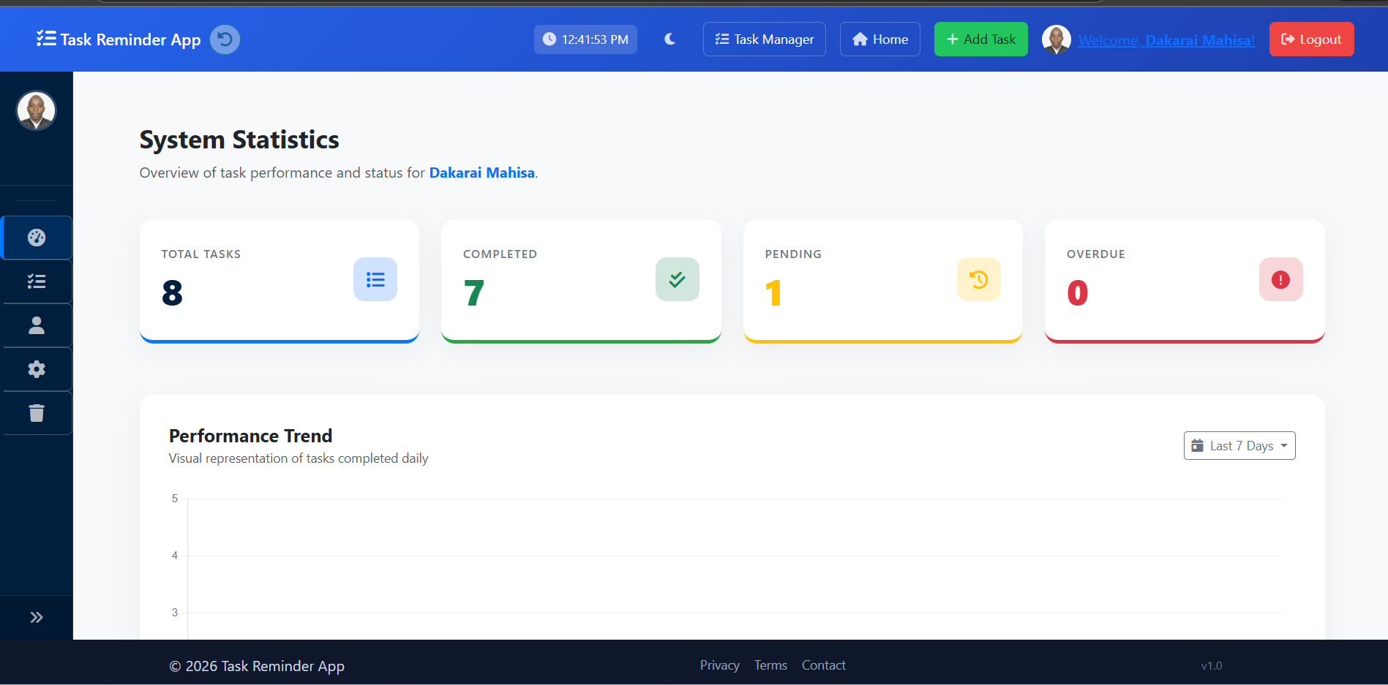
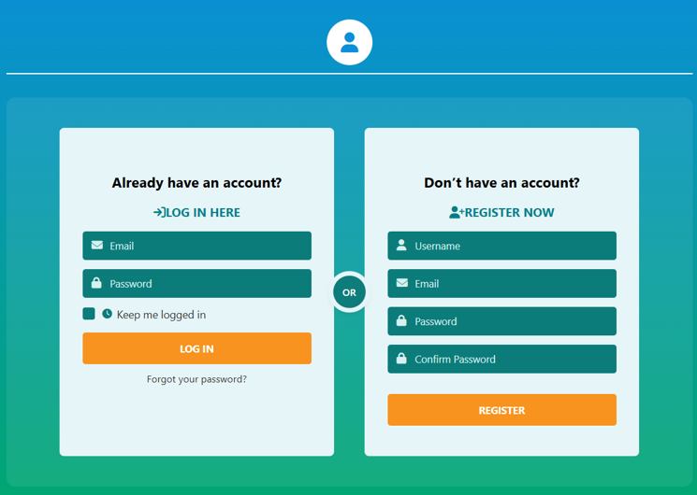
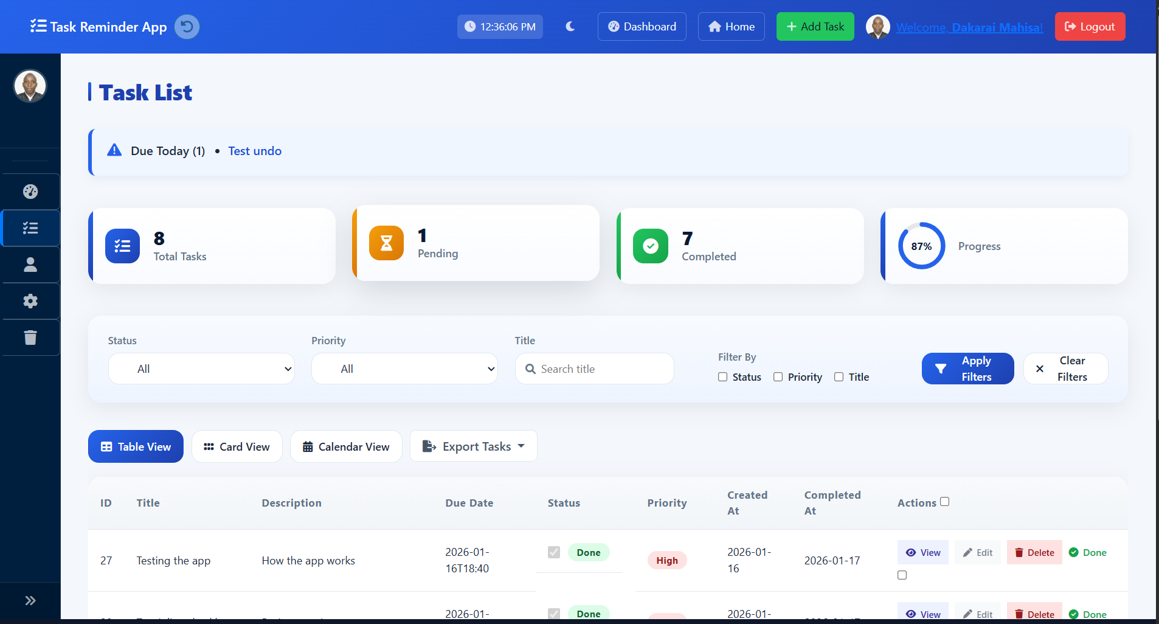
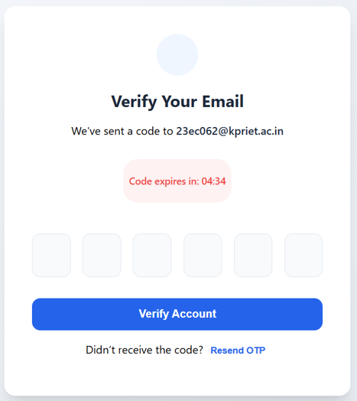
Key Features & UI
Dynamic Dashboard with Overdue and Pending counters.
One-click CSV Exporting.
User authentication.
Reminder engine.
Search and filter options.

Slide 8
Challenges and Learnings
Challenges faced
Learnings
Syncing real-time reminders
Handling multiple integration failures after code refactoring
Customizing Spring Security for effective user authentication
Gained deep experience in asynchronous task scheduling
Improved understanding of secure authentication flows and data integrity
Improved debugging and exception handling skills

Slide 9
Future Enhancements
AI Integration
Mobile App
Collaboration
Adding "Team Spaces" for shared tasks and group reminders.
Smart task prioritization based on user behavior.
Developing a native iOS/Android version for on-the-go alerts.
Integration with Google Assistant and Alexa.
Voice Commands

Slide 10
Thank You!

