Slide 1
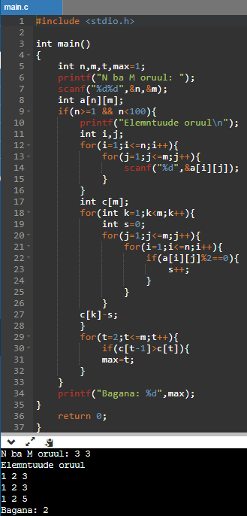
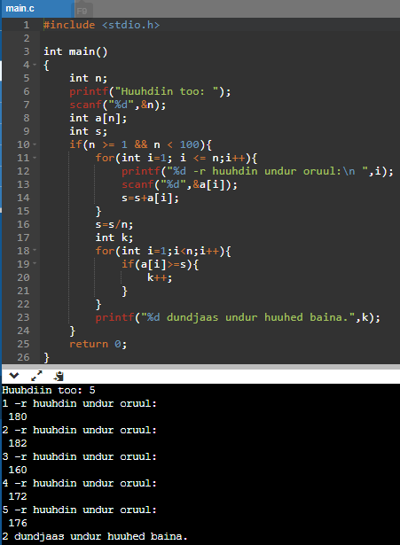
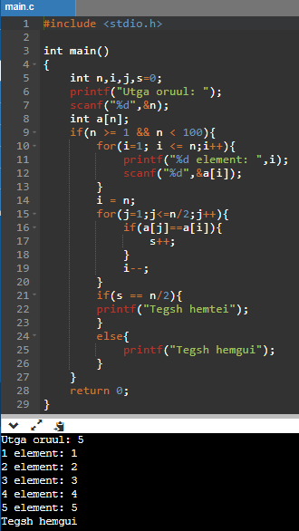
Angid
1
3
2

Slide 2
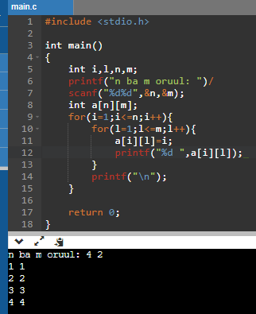
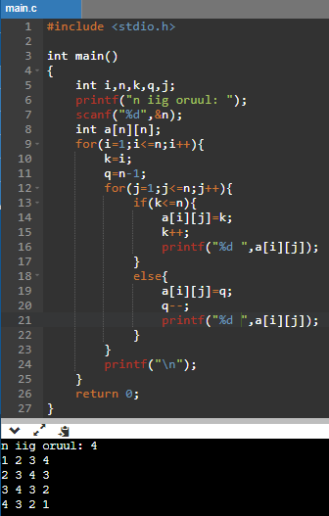
Gert
1 2

Slide 3
#include <stdio.h>
int main()
{
int m, n, p, q, c, d, k, sum = 0;
int ehnii[10][10], hoyrdah[10][10], guravdah[10][10];
printf("Ehnii matritsiin mur bolon baganii toog oruul\n");
scanf("%d%d", &m, &n);
printf("Ehnii matritsiin elemtuudig oruul\n");
for (c = 0; c < m; c++)
for (d = 0; d < n; d++)
scanf("%d", &ehnii[c][d]);
printf("2dah matritsiin mur bolon bagnaniin toog oruul\n");
scanf("%d%d", &p, &q);
if (n != p)
printf("Urjigdeh bolomjgui.\n");
else
{
printf("2dah matritsiin elementuudig oruul\n");
for (c = 0; c < p; c++)
for (d = 0; d < q; d++)
scanf("%d", &hoyrdah[c][d]);
for (c = 0; c < m; c++) {
for (d = 0; d < q; d++) {
for (k = 0; k < p; k++) {
sum = sum + ehnii[c][k]*hoyrdah[k][d];
}
guravdah[c][d] = sum;
sum = 0;
}
}
printf("Guravdah matrits:\n");
for (c = 0; c < m; c++) {
for (d = 0; d < q; d++)
printf("%d\t", guravdah[c][d]);
printf("\n");
}
}
return 0;
}
3

