Slide 1

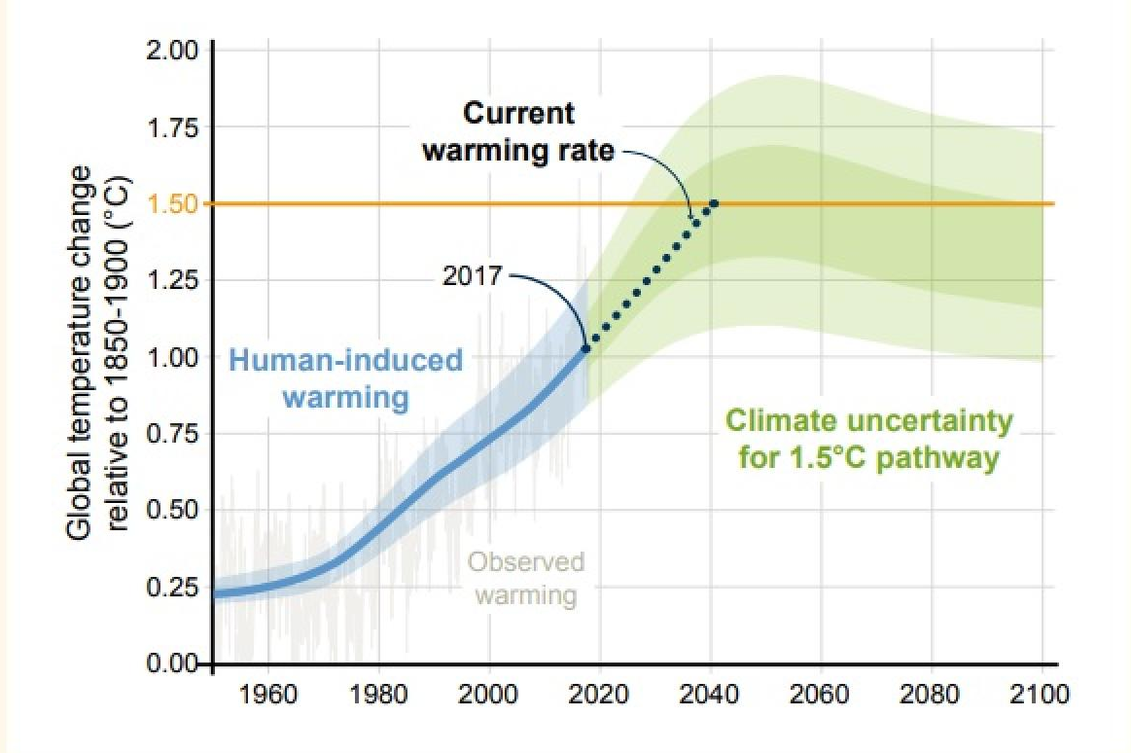
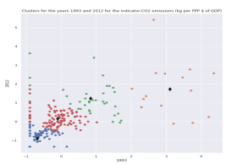
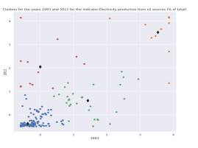
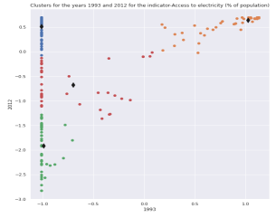
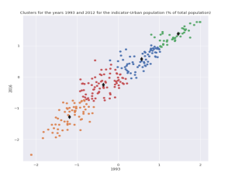
World bank dataset on climate change
Introduction
The primary aim of this undertaken work is to investigate the climate change based on the different kinds of indicators such as CO2 emission, electricity production from oil source, access to electricity and urban population. Through the analysis of these datasets will be beneficial to identify the factors of the climate change and necessary actions will be taken accordingly.
Overview
Evidences shows that human-induced warming can be rise with the continuous green house gas emission if it is not reduced. As it has been seen from the graphical representation that from 2017, the global temperature started to rise in 1º C. It is predicted that global temperatures would reach 1.5º C around 2040. it is also estimated that CO2 emission reduction can be resulted as zero emission by 2055.
The clear indicators of global warming as well as climate change are the global surface temperature, atmospheric carbon dioxide, annual green house gas index, arctic sea ice extent.
Indicator: CO2 emissions (kg per PPP $ of GDP)
Indicator: Electricity production from oil source (% of total)
Indicator: Access to electricity (% of population)
Indicator: Urban population (% of total population)
It can be observed that there are some countries with CO2 emissions:
(i) low in 1993 and low in 2012. (ii) Low in 1993 and increased in 2012. (iii) High in 1993 and increased in 2012.
It can be observed that in some countries, Electricity production from oil sources was low in 1993 and low in 2012. For many countries Electricity production from oil increased by 2012
It can be observed that electricity consumption is high for most countries by 2012. For countries with low access to electricity in 1993, the access (hence demand) increased by 2012.
It can be observed that for almost all the countries. The urban population has increased from 1993 to 2012. This shows an increased demand of electricity.
Conclusion
The indicators shows that urban population is increasing in recent days rapidly which became the reason for increasing demand of the electricity. This resulted as rapid increment in electricity consumption. Also, the data stated that CO2 emission is growing rapidly due to enlarging population and undergoing development. Hence this can be concluded that these factors are contributing in climate change so rapidly.
References
Caminade, C., Kovats, S., Rocklov, J., Tompkins, A. M., amborain-Mason, J. (2020). Social determinants of adaptive and transformative responses to climate change. Nature Climate Change. Dell, M., Jones, B. F., & Olken, B. A. (2018). Climate change and economic growth: Evidence from the last half century (Tech. Rep.). Cambridge, Massachusetts: National Bureau of Economic Research

