Slide 1

Analysis of scientific publishing data
Calori Dakota Davide
Gigli Andrea

Slide 2
Introduction and objective
Do scientific keywords show different gender associations, and are keywords connected according to how they are used in scientific writing?
Instead of looking only at individual papers, we want to see whether keywords form meaningful structures, and whether those structures are related to gender and to the way concepts are described in scientific writing.
Approach
  Extract keywords from scientific abstracts
  Measure agency and communion
  Measure gender bias of keywords
  Build, compare and analyze the two keyword networks

Slide 3
Dataset and keyword extraction
The dataset contains two groups of papers: papers classified as male-only and female-only.
There is a strong imbalance between the groups: about 372 thousand male-only papers versus 50 thousand female-only papers, so roughly seven times as many male papers.
For papers that already had keywords, we used those keywords. When keywords were missing but an abstract was available, we extracted up to 10 keywords using KeyBERT.
We also split abstracts into sentences because the semantic scoring models work at the sentence level.
Missing data
  Abstracts: 7.64% male / 10.88% female
  Keywords: 14.27% male / 15.91% female

Slide 4
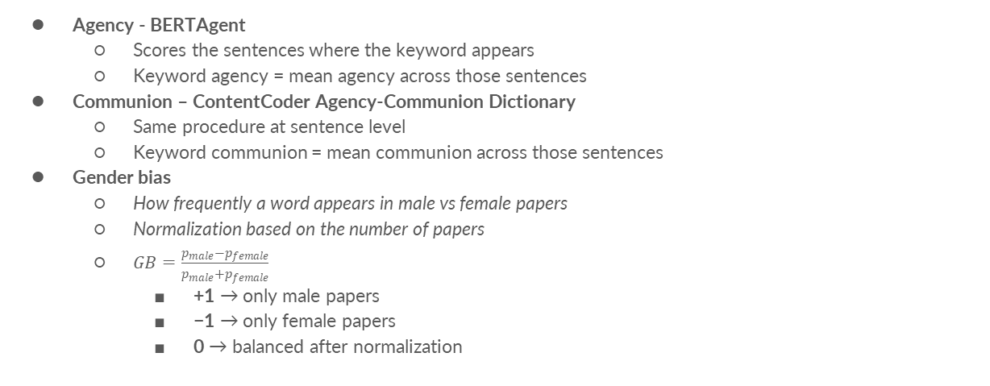
Measuring Agency, Communion and Gender Bias
Agency - BERTAgent
  Scores the sentences where the keyword appears
  Keyword agency = mean agency across those sentences
Communion – ContentCoder Agency-Communion Dictionary
  Same procedure at sentence level
  Keyword communion = mean communion across those sentences
Gender bias
  How frequently a word appears in male vs female papers
  Normalization based on the number of papers
  $GB=\frac{p_{male}−p_{female}}{p_{male}+p_{female}}$
    +1 → only male papers
    −1 → only female papers
    0 → balanced after normalization

Slide 5
Gender bias
The gender-bias score gives us a first picture of the differences between the two groups.
These values should be interpreted as differences in the distribution of keywords across the two datasets, rather than as evidence that a topic is inherently male or female.
This motivates the network analysis: instead of looking at keywords individually, can we see clusters of related concepts with similar patterns?
More male-leaning | More female-leaning
Reinforcement learning → +0.46 | higher education → −0.74
5G → +0.39 | technology → −0.63
neural networks → +0.37 | education → −0.58
simulation → +0.25 | social media → −0.57
optimization → +0.24 | data mining → −0.40

Slide 6
Network structure
Network 1 — Co-occurrence
  Nodes: keywords
  Edges: two keywords appear in the same paper
  Weight: number of shared papers
Network 2 — Semantic correlation
  Nodes: keywords
  Edges: positive correlation in both agency and communion
  Weight: agency correlation
  Minimum overlap for analysis: 5 papers

Slide 7
Network structure
For Network 1, the largest connected component contains about 23 thousand keywords and Louvain finds 93 communities, with a modularity of about 0.61.
Network 2 is smaller, with about 11.8 thousand keywords, but its community structure is stronger: Louvain finds 40 communities and a higher modularity of 0.72, with a lower average Ncut.
The agreement between Louvain and InfoMap is also higher for Network 2, with an NMI of about 0.71 compared with 0.55 for Network 1.
So the semantic network appears to produce fewer and more cohesive groups than the simple co-occurrence network.
 | Network 1 | Network 2
Nodes | 23,201 | 11,815
Louvain communities | 93 | 40
Modularity | 0.606 | 0.717
Avg. Ncut | 0.199 | 0.129
Louvain–InfoMap NMI | 0.554 | 0.714

Slide 8
Communities
Looking at the communities, they are not just mathematical clusters: they correspond to recognizable scientific areas, such as social media, education or robotics.
Main difference:
  Network 1: groups keywords according to what appears together
  Network 2: groups them according to similar patterns of agency and communion.
Overall, the analysis suggests that scientific vocabulary has a strong, non-random network structure, and that gender associations can be studied alongside this structure rather than only keyword by keyword.
Network 1
  Social media, health & education
  Hardware & HPC
  Other large topical clusters
Network 2
  Social media, health & education
  Robotics & autonomous navigation
  More compact semantic structure

Slide 9
Thanks for your attention

