Slide 1
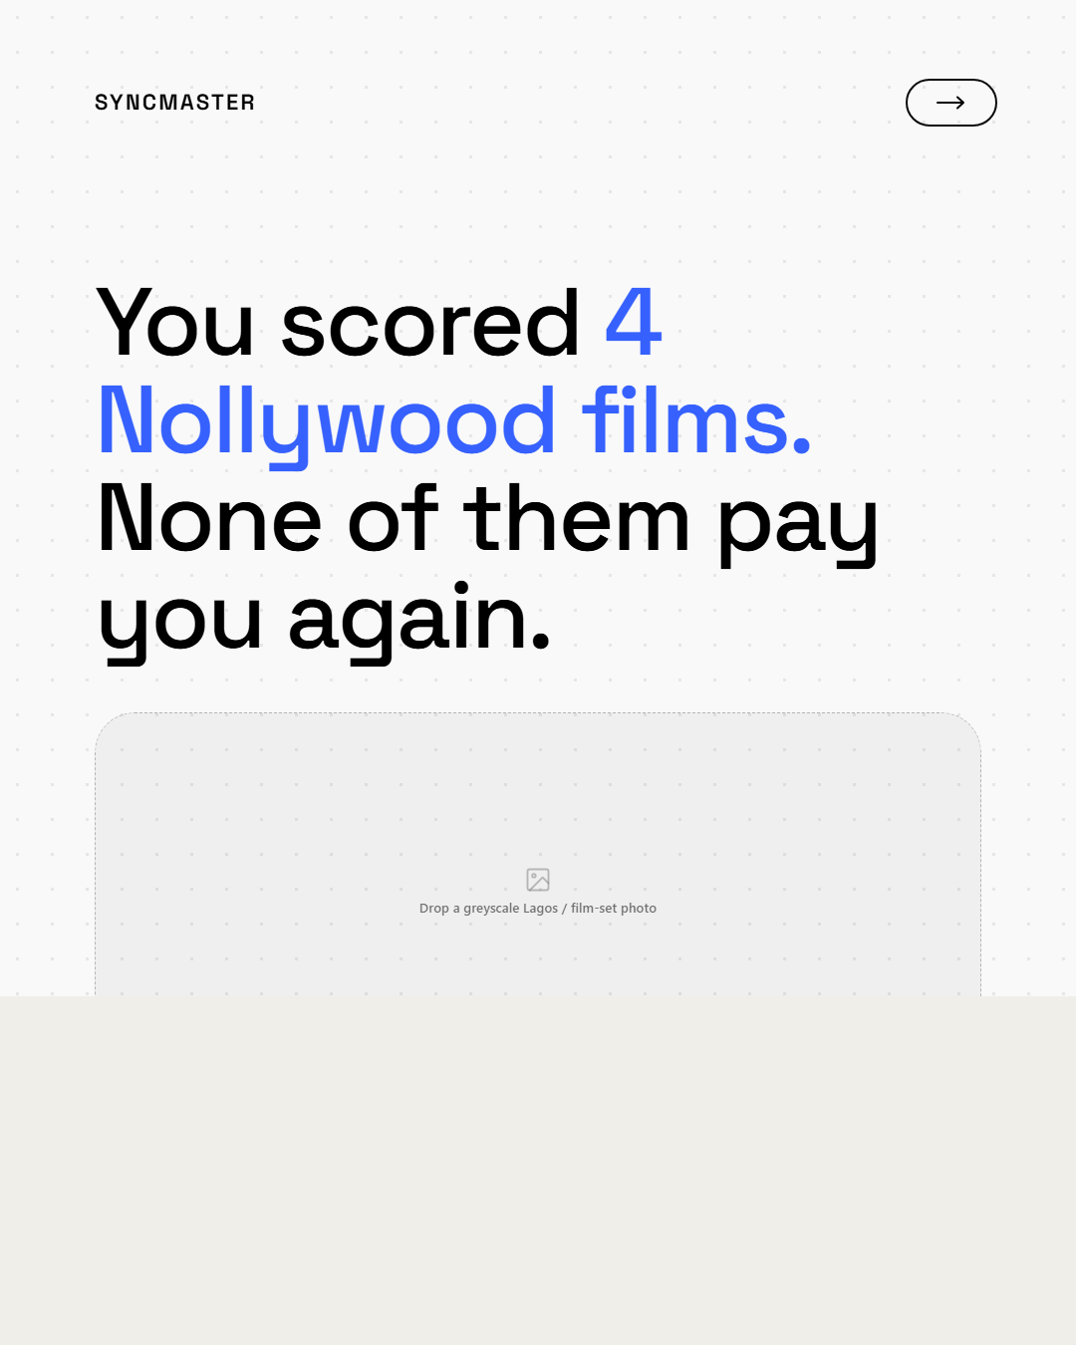
SYNCMASTER
Unlock Global Music Revenue.
01 / 03

Slide 2
SYNCMASTER
812%
Growth in Sync Demand.
02 / 03

Slide 3
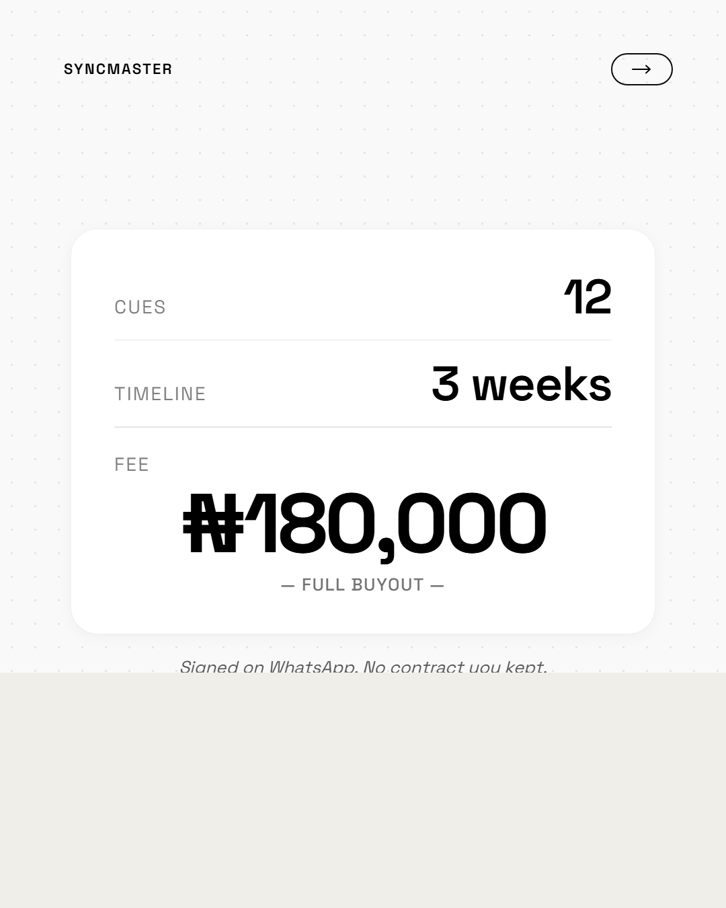
SYNCMASTER
Your Rights Matter.
Don't sign away your future for a one-time fee.
03 / 03

