Slide 1
NYC For-Hire-Vehicle Analysis
By: Dakota Weedon

Slide 2
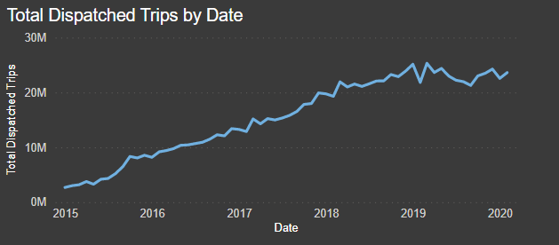
Starts at 2,699,237 total trips in January 2015.
January of 2016 saw 8,184,805 total trips, a 203.2% increase!
Total trips per year increased 357.4% from 2015 through 2019.
All-Time-High during March 2019 – 25,316,006 total trips in one month.

Slide 3
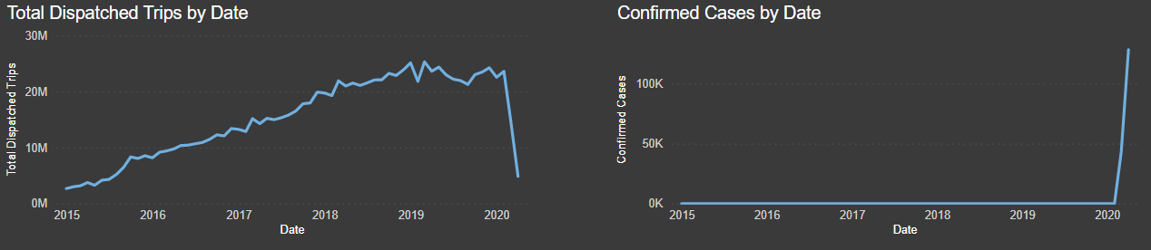
And then….
What happened?

Slide 4
The Lockdown
23,620,693 total trips in February 2020 down to 4,875,885 by April.
Ride Sharing went from 2,816,424 in February all the way to 0 by April.
Vehicles providing services plummeted nearly 71.8%.
Notes:
Covid Cases are 43,139 in March and 128,276 in April.
March 2020 saw 2,192 deaths and April saw 12,732.

Slide 5
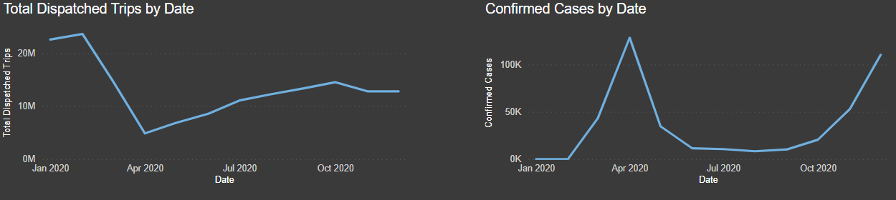
Why did trips not decrease?
Recovered back to 14,519,135 trips in October 2020.
Confirmed cases reaches a low point of 8,357 in August.
Covid-19 Beta variant dominates confirmed cases starting in November.

Slide 6
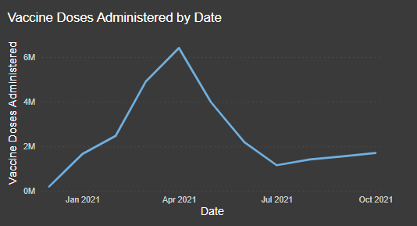
27,632,406 total vaccine doses administered in New York State.
2,512,036.9 average vaccine doses have been administered per month.
Peaked in April 2021 at 6,407,511 doses administered.

Slide 7
