Slide 1
NYC For-Hire-Vehicle Analysis
By: Dakota Weedon
Notes:
Hello, my name is Dakota Weedon, and today I will be going over New York City’s For-Hire-Vehicle services and the impact of Covid-19 over the past two years. I’m from Tennessee and have never been to New York City before, so why did I decide to look at the Taxi and Limousine Commission there?
When I first dove into programming in summer of 2021, I had the privilege of being introduced to my mentor. Throughout the remainder of 2021, him and I would meet over Zoom and discuss not only my learning, but how my life was going. In turn, I would do the same for him. One morning we were discussing how transportation for him was tricky since Covid-19 began. I live in a much smaller area than New York City, and never really considered the impact the Covid-19 virus had on services like Uber and Lyft. While those services are available where I live, it’s common to already own a vehicle. On top of this, NYC (and the state of New York) were put on many restrictions and handed many guidelines on how to handle the pandemic. Where I live, not so much.
After my mentor and I had this conversation, I became curious.

Slide 2
Data Questions
What impact did the Covid-19 pandemic have on the For-Hire-Vehicle (FHV) service industry in New York City (NYC)?
How many trips were these services completing pre-pandemic?
How many trips were these services completing once the pandemic began?
How was “ride sharing” affected by the pandemic?
How many vehicles were still providing services during the pandemic?
Notes:
First, I would like to begin going over some of the questions I will be going over today.
Going into this project, I had the overarching question, “What impact did Covid-19 have on the For-Hire-Vehicle (or FHV) industry in NYC?
Once I dove deeper into the data, more questions started to enter my head, including:
“How were trips before the pandemic? What about once it started? How was “ride sharing” affected? And how many vehicles were still completing trips?”

Slide 3
Data Sources and Tools
Data sources:
Taxi and Limousine Commission’s FHV aggregate report.
John Hopkins University’s Covid-19 Dashboard
Governor.ny.gov
Tools used:
Python
Power BI
Notes:
To answer these questions, I used the Taxi and Limousine Commission’s FHV aggregate report as well as the GitHub repos provided by John Hopkins University’s Covid-19 Dashboard. Using governor.ny.gov I was able to see news stories regarding the state’s policies towards combating coronavirus.
I used Python to explore the data sets as well as construct the data frame used to create an interactive Power BI dashboard that allows the user to quickly look at key statistics in a user-set date range.
Once I got my data and tools ready, I first looked at the industry’s numbers before the pandemic started.

Slide 4
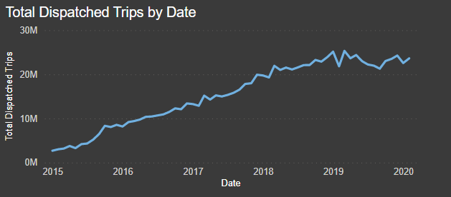
Starts at 2,699,237 total trips in January 2015.
January of 2016 saw 8,184,805 total trips, a 203.2% increase!
Total trips per year increased 357.4% from 2015 through 2019.
All-Time-High during March 2019 – 25,316,006 total trips in one month.
Notes:
This line chart represents the total trips completed month-by-month from January 2015 and ends February 2021. The very first month of the data shows nearly 2.7 million trips were dispatched. Business quickly but steadily rose. Comparing January of 2015 to January of 2016 shows a 203.2% increase in trips dispatched. That steam didn’t die down, as by the end of 2019 trips had risen another 196.4%. That’s a rise of 357.4% from start to finish! If this was a stock, the investor would be filled with glee that their investment has printed sweet gains.
However, just like stocks around the end of this line chart’s date range….

Slide 5
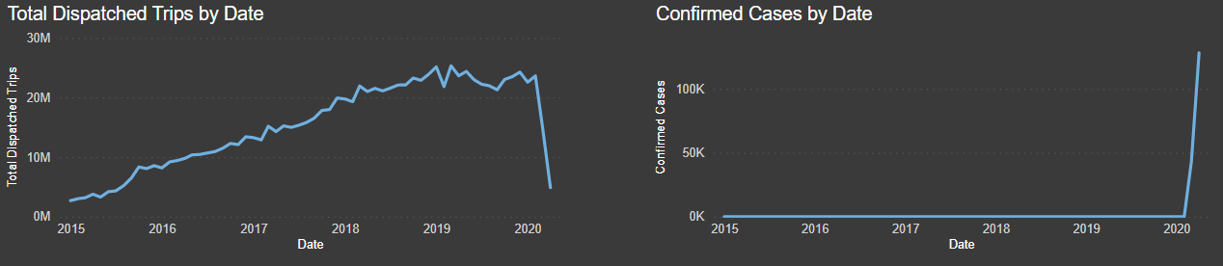
And then….
What happened?
Notes:
It all fell off a cliff. What happened? On the right side of the visual provided, confirmed cases of Covid-19 are seen soaring as trips dispatched on the left are seen racing to the bottom. But it’s not just because of Covid-19.

Slide 6
The Lockdown
23,620,693 total trips in February 2020 down to 4,875,885 by April.
Ride Sharing went from 2,816,424 in February all the way to 0 by April.
Vehicles providing services plummeted nearly 71.8%.
Notes:
The lockdown in NYC and the state of New York played a major role in disrupting the FHV industry. Throughout the beginning months of the pandemic, the area saw a lot of shutdowns and restrictions, the idea being to slow the spread. Mass gatherings were limited, schools were closed, and offices had to run under 75% capacity. Personal care services like barbershops and nail salons were closed, restaurants and bars were either completely closed or highly limited on the number of customers they could serve. Basically, the city that never sleeps was taking a nap.
Looking at the numbers on screen, trips nosedived from over 23.6 million to nearly 4.9 million. Ride sharing during this time was gone, as restrictions put in place prevented the practice. Vehicles out completing trips plummeted close to 71.8%.
Thankfully, it wasn’t all doom and gloom.
Covid Cases are 43,139 in March and 128,276 in April.
March 2020 saw 2,192 deaths and April saw 12,732.

Slide 7
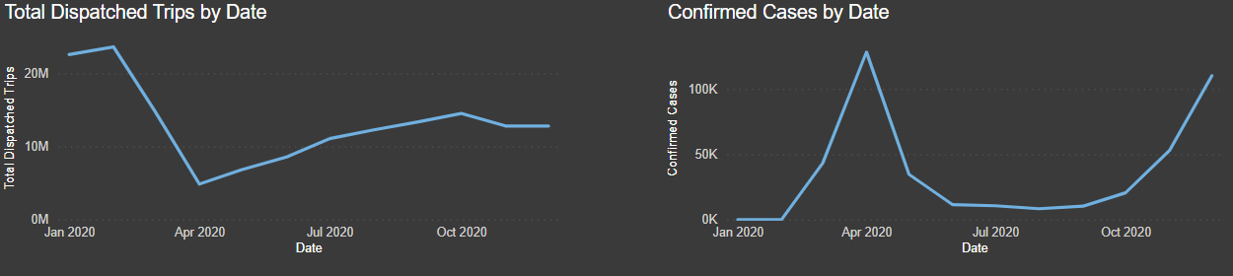
Why did trips not decrease as sharply during the spike at the end of 2020?
Recovered back to 14,519,135 trips in October 2020.
Confirmed cases reaches a low point of 8,357 in August.
Confirmed cases starting in November begin to rapidly increase due to holiday gatherings and new variants.
Notes:
As the year continued, the heavy restrictions of the lockdown started to relax as cases and deaths went down. Throughout the summer of 2020, businesses were starting to slowly reopen, and life was starting to become more “normal”. Trip totals had recovered back to 14.5 million by October, nearing 2017 levels of service. Confirmed cases saw a low in August. Business was on the up and Covid was on the down. However, you may have noticed at the end of the date range in the visual, cases started to spike back up again, but trips didn’t see much of a decline. Why was it different this time around?

Slide 8
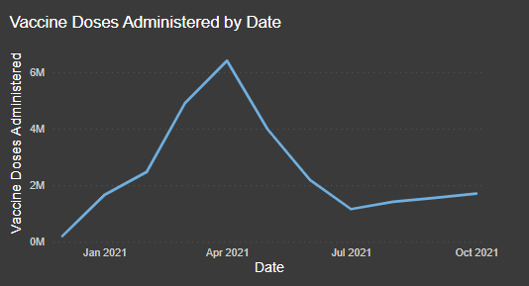
Vaccinations
Starting in December of 2020, Covid-19 vaccines started to roll out.
New York state had strong vaccination numbers.
Notes:
Vaccinations played a huge role in preventing a second lockdown. Starting in December of 2020, they started to roll out in phases. New York state’s government had always been in the spotlight during the lead up to this point, and New York state saw a lot of initial vaccine doses go to them. Looking at the data, it appears New Yorkers during this time really stepped up to receive the vaccine.

Slide 9
27,632,406 total vaccine doses administered in New York State.
2,512,036.9 average vaccine doses have been administered per month.
Peaked in April 2021 at 6,407,511 doses administered.
Notes:
Unfortunately, with the data I had I could not break down further than the state level, but NYC has about 40% of the state’s population, so it is my belief the numbers seen are a close representation of what was happening in the city.
The vaccine was released in phases, with it being available to everyone by April. This led to over 6.4 million doses being administered that month.
From when vaccines started to the end of the dataset, New York state had administered over 27.6 million doses, with an average of about 2.5 million per month.
With citizens having great vaccination rates, restrictions started to get lifted despite confirmed cases staying in the 5-digit range. This is due to deaths from Covid-19 being at a low point since the pandemic began as well as the medical system having better ability to treat the infected.

Slide 10
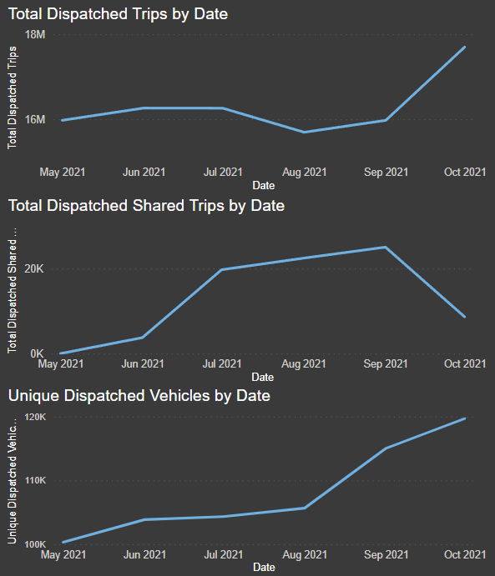
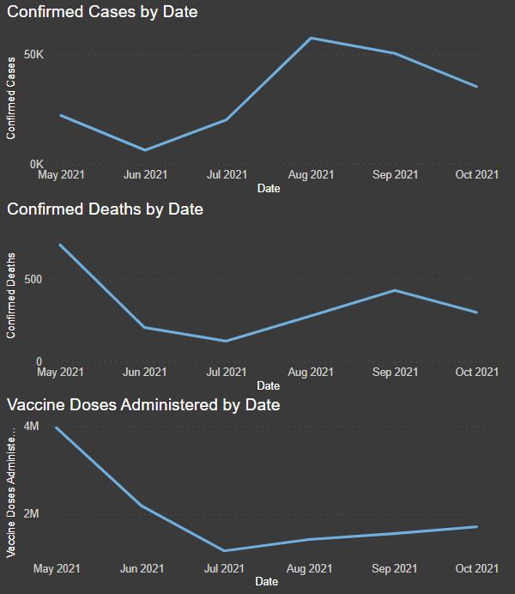
The Return of Ride Sharing
Notes:
Starting in June of 2021, ride sharing had returned! However, it isn’t going as strong as it was pre-pandemic, peaking at around 25k instances in September. Total trips and vehicles in the fleet are also seen on the rise as Covid-19 death totals stay at low levels. Vaccinations saw a sharp decline going into July, but with booster does being approved, the number of doses administered began to rise again as people re-up their immunities.

Slide 11
2019 vs 2020 & 2021
Total Trips | Year
279,578,879 | 2019
158,168,599 | 2020
154,491,469* | 2021
Shared Trips | Year
45,399,619 | 2019
6,896,351 | 2020
79,522* | 2021
Total Vehicles | Year
2,003,307 | 2019
1,072,771 | 2020
1,006,644* | 2021
* Thru October 2021
Notes:
To end off our look at the numbers, let’s quickly compare 2019 to the pandemic years. As a reminder, the data from the TLC only goes as far as October 2021.
While it is unknown if the industry could have kept up the momentum, it’s crazy to think these numbers could have been even higher as more residents migrated towards companies like Uber and Lyft as their main ways to get around the city.
After losing 43.4% of total trips in 2020, it appears to be on pace to reach just over 185 million total trips, up about 17% from the previous year but still 33.8% down from 2019.
Shared trips saw a massive decrease due to the restrictions and guidelines put in place to help keep people safe. It is far too early to tell how its recovery will go in this moment.
Vehicles had a drop of 46.5% from 2019 to 2020, and is on pace to reach 1.2 million in 2021.

Slide 12
Conclusions
Notes:
To conclude, due to the pandemic, the For-Hire-Vehicle service industry is back down to 2017 levels of business but is on the rise. While times are uncertain and we won’t know what happens next, with science and medicine as well as safety precautions, the industry should continue down the path of recovery.
Special thanks to my mentor for inspiring me to complete this analysis and thank you for listening. At this time, I would like to open it up to any questions.

