Slide 1
STUDYCREW
Make group work
visible before it
becomes a problem.
PLAN
COORDINATE
PROVE
not grade
One private workflow for planning, coordination and inspectable contribution evidence.
Group members: Dakota Wu, Leo Li, Jiayuan Zhang, Yizhen Gou
ELEC3609 · ASSIGNMENT 1 · GROUP 06
Notes:
0:00-0:25 · Speaker A
StudyCrew makes group work visible before it becomes a problem. It gives student teams one place to coordinate tasks and meetings, then backs contribution conversations with transparent activity evidence.
[Sources]
- Assignment brief supplied by the unit, 2026.
- StudyCrew System Design Report, Section 1.
[/Sources]

Slide 2
01 / PROBLEM
Group work fails quietly before it fails visibly.
Two disconnected problems reinforce each other.
COORDINATION
CONTRIBUTION
Work is split across
chat, calendars and
task lists.
Teams reconstruct
who did what from
memory.
Status becomes stale. Blockers surface near submission.
Late disputes lack shared facts and context.
ONE WORKFLOW
STUDYCREW | ELEC3609 | GROUP 06
02
Notes:
0:25-1:05 · Speaker A
Today, work is often split across chat, calendars and task lists. Status becomes stale, blockers surface late, and contribution discussions depend on memory. Teams need coordination and evidence together, without a black-box score.
[Sources]
- StudyCrew System Design Report, Section 1.1.
- Team problem synthesis based on the assignment context.
[/Sources]

Slide 3
02 / RESPONSE
A simple loop: plan, coordinate, review evidence.
Every meaningful action retains its context.
01
02
03
PLAN
COORDINATE
REVIEW
→
→
Create projects.
Assign tasks.
Set ownership.
Progress work.
Discuss blockers.
Schedule and RSVP.
See activity totals.
Drill into events.
Have the conversation.
IMMUTABLE ACTIVITY EVENTS
Evidence, not an automated grade
STUDYCREW | ELEC3609 | GROUP 06
03
Notes:
1:05-2:00 · Speaker B
StudyCrew follows a simple loop: plan the work, coordinate delivery, and review evidence. Members create and assign tasks, explain blockers, schedule meetings and RSVP. Each successful action adds an immutable event, so totals always lead back to context.
[Sources]
- StudyCrew functional requirements FR-PROJ-01 through FR-CONTR-02.
- database/schema.sql: activity_events table and related foreign keys.
[/Sources]

Slide 4
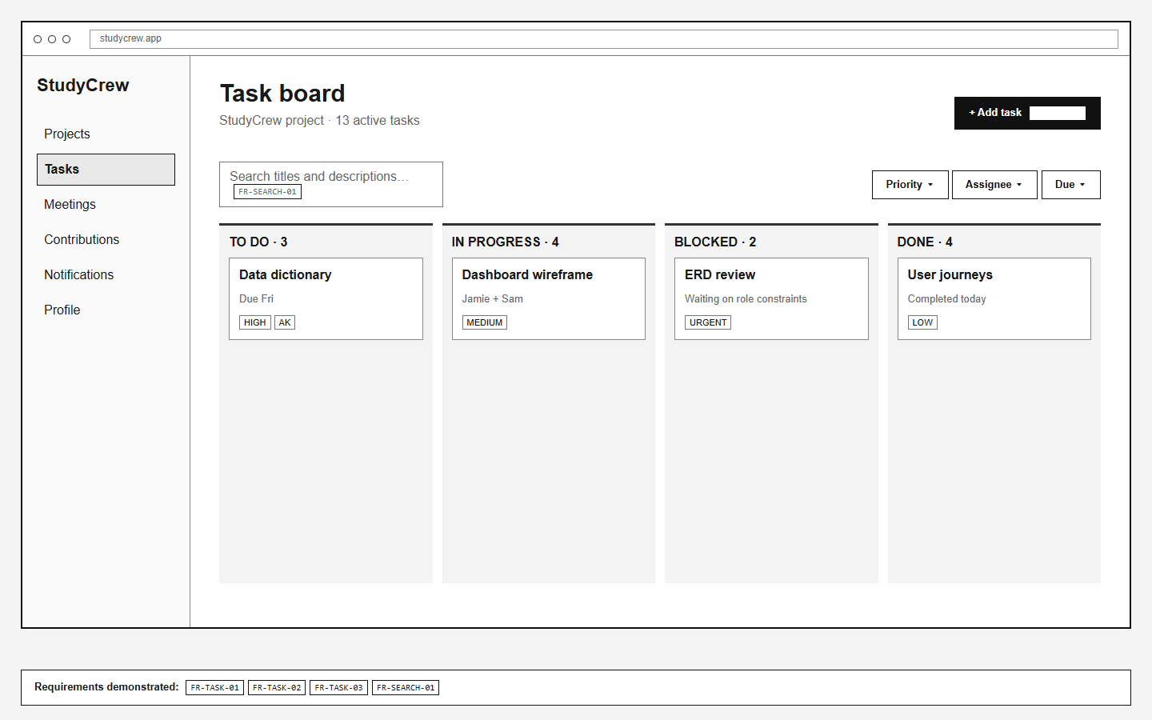
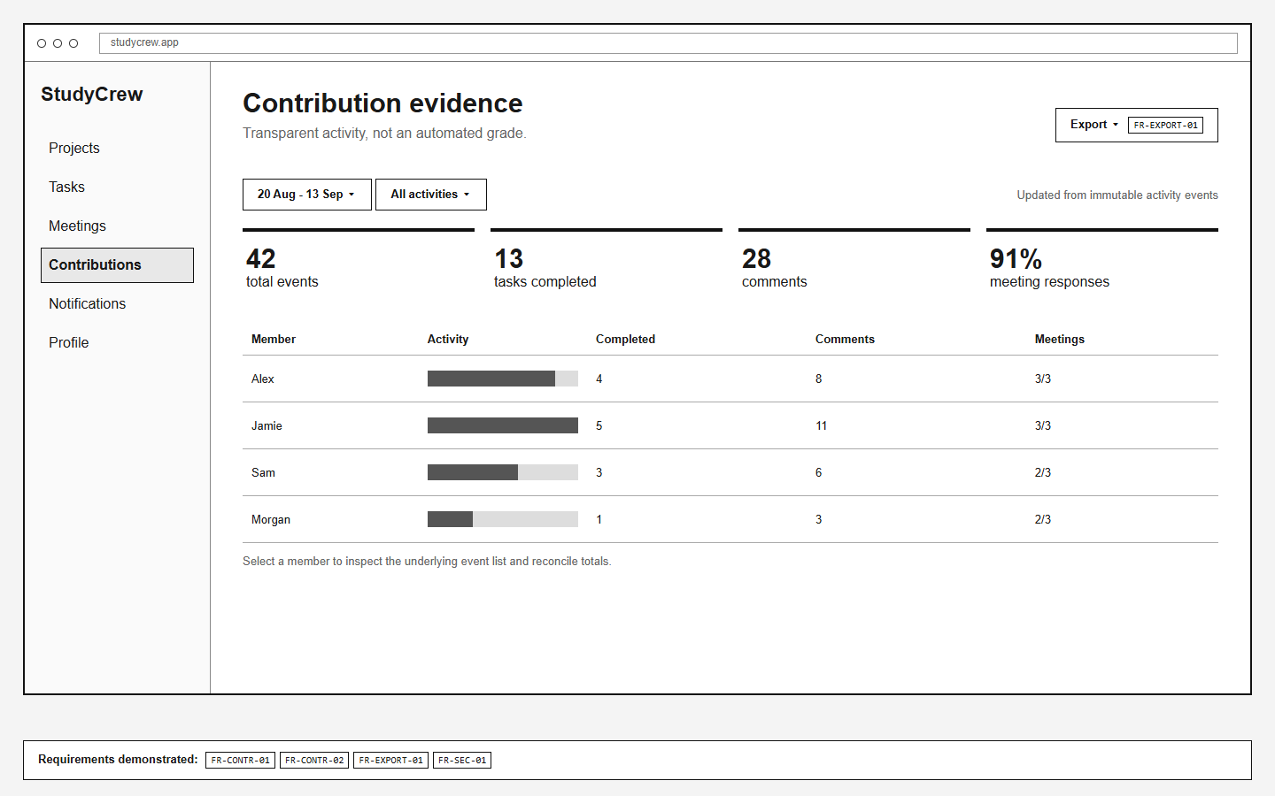
03 / PRODUCT
The workflow is already testable on paper.
Two views demonstrate the core value proposition.
TASK BOARD
Ownership, due dates and blockers at a glance
EVIDENCE
Counts reconcile to inspectable source events
STUDYCREW | ELEC3609 | GROUP 06
04
Notes:
2:00-3:10 · Speaker C
The task board shows ownership and risk at a glance. Task detail keeps assignments, workflow and discussion together. The contribution view compares activity using both a chart and table, but deliberately avoids grading. Selecting a member reveals the events behind each total.
[Sources]
- design/generated/wf-04-task-board.png.
- design/generated/wf-08-contributions.png.
- StudyCrew traceability matrix, FR-TASK-01/02/03 and FR-CONTR-01/02.
[/Sources]

Slide 5
04 / TRUST
The data model makes the promise enforceable.
Normalised relationships, explicit constraints and a project access boundary.
13
18
11
REQUIRED CARDINALITIES
normalised tables
traceable requirements
generic views
users 1 : 1 profiles
projects 1 : N tasks
SECURITY BOUNDARY
Every protected request validates the session, current project membership and role before reading or changing data.
tasks M : N users
BUILD STACK
React · Django + Django REST Framework · PostgreSQL · Django ORM · Django Tests + Playwright · Docker + GitHub Actions
STUDYCREW | ELEC3609 | GROUP 06
05
Notes:
3:10-4:00 · Speaker C
The design is feasible and safe. Thirteen normalised PostgreSQL tables support explicit one-to-one, one-to-many and many-to-many relationships. Every protected request checks current membership. React, Express and PostgreSQL let us deliver in tested vertical slices.
[Sources]
- database/schema.sql, PostgreSQL 16 physical schema.
- StudyCrew System Design Report, Sections 3 and 6.
- IEEE Std 830-1998 is used because the assignment explicitly requests Section 5.3.2.
[/Sources]

Slide 6
05 / DELIVERY
Freeze the MVP. Deliver tested vertical slices.
Weeks 5-12, with search and export held behind the core quality gates.
FRAMEWORKS
React · Django + DRF · PostgreSQL + Django ORM · Django Tests + Playwright · Docker + GitHub Actions
W5
W6
W7
W8
W9
W10
W11
W12
Validate + freeze
Core vertical slices
Integrate + test
Rehearse + harden
MVP DECISION
Approve the 15-requirement baseline; keep search and export as gated stretch work.
STUDYCREW | ELEC3609 | GROUP 06
06
Notes:
4:00-4:50 · Speaker D
Our approved baseline is authentication, private projects, tasks, comments, meetings, notifications and contribution evidence. We will build it with React and Express, PostgreSQL with Prisma, Vitest and Playwright, plus Docker and GitHub Actions. The Gantt moves from MVP validation into core vertical slices, integration and testing, then rehearsal and hardening. Search and export remain gated stretch goals.
4:50-5:00 close
StudyCrew does not judge who worked hardest. It gives teams the shared facts to notice risk earlier, coordinate better, and have fairer conversations. We are ready to validate the MVP and begin implementation.
[Sources]
- StudyCrew Proposed MVP, approved-baseline candidate.
- Assignment brief: milestone and final submission schedule.
- StudyCrew Presentation Script, rehearsal timings.
[/Sources]

