Slide 1
Exp 6
Program for Inserting and Deleting an element in circular Queue

Slide 2
Theory:

Slide 3
A Circular Queue is a type of queue data structure where the last position is connected back to the first position, forming a circle.
It is also called a ring buffer and is used to efficiently utilize memory by reusing freed spaces after dequeuing.
It follows the FIFO (First In First Out) principle but optimizes space usage compared to a simple queue by reusing freed slots after deletions.

Slide 4
In a fixed-size array queue, once the rear reaches the end, no more insertions are possible even if there’s space at the front.
A circular queue solves this by using modulo arithmetic to wrap around indices.
Front pointer: Index of the first element.
Rear pointer: Index of the last inserted element.
Circular movement: (index + 1) % capacity ensures wrap-around.
Time complexity: All main operations run in O(1).

Slide 5
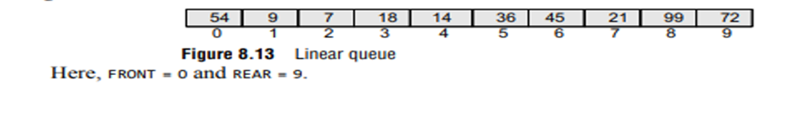

Now, if you want to insert another value, it will not be possible because the queue is completely full. There is no empty space where the value can be inserted. Consider a scenario in which two successive deletions are made. The queue will then be given as shown in Fig.

Slide 6
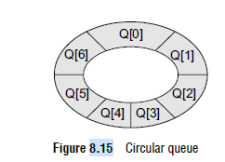
Suppose we want to insert a new element in the queue shown in Fig Even though there is space available, the overflow condition still exists because the condition rear = MAX – 1 still holds true.
This is a major drawback of a linear queue.
To resolve this problem, we have two solutions.
First, shift the elements to the left so that the vacant space can be occupied and utilized efficiently.
But this can be very time-consuming, especially when the queue is quite large.
The second option is to use a circular queue.
In the circular queue, the first index comes right after the last index.
Conceptually, you can think of a circular queue as shown in Fig.

Slide 7
The circular queue will be full only when front = 0 and rear = Max – 1.
A circular queue is implemented in the same manner as a linear queue is implemented.
The only difference will be in the code that performs insertion and deletion operations.
For insertion, we now have to check for the following three conditions:
If front = 0 and rear = MAX – 1, then the circular queue is full.

Slide 8
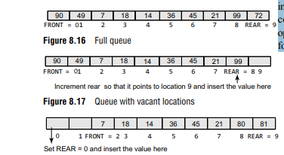
Look at the queue given in Fig. 8.16 which illustrates this point. If rear != MAX – 1, then rear will be incremented and the value will be inserted as illustrated in Fig. 8.17.
If front != 0 and rear = MAX – 1, then it means that the queue is not full. So, set rear = 0 and insert the new element there, as shown in Fig. 8.18

Slide 9
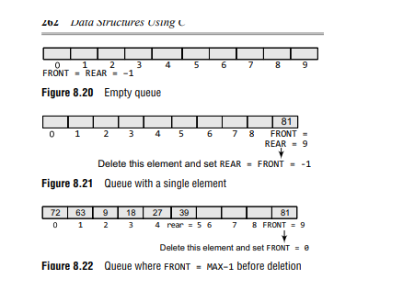
Look at Fig. 8.20. If front = –1, then there are no elements in the queue. So, an underflow condition will be reported.
If the queue is not empty and front = rear, then after deleting the element at the front the queue becomes empty and so front and rear are set to –1.
This is illustrated in Fig. 8.21.
If the queue is not empty and front = MAX–1, then after deleting the element at the front, front is set to 0.
This is shown in Fig. 8.22.

Slide 10
Procedure:

Slide 11
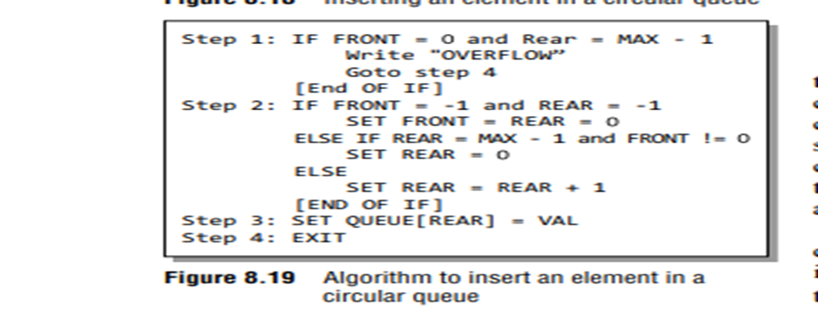
Let us look at Fig. 8.19 which shows the algorithm
to insert an element in a circular queue.
In Step 1, we check for the overflow condition. In Step 2, we make two checks.
First to see if the queue is empty, and second to see if the REAR end has already reached the maximum capacity while there are certain free locations before the FRONT end.
In Step 3, the value is stored in the queue at the location pointed by REAR.

Slide 12
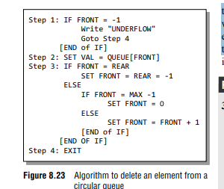
Let us look at Fig. 8.23 which shows the algorithm to delete an element from a circular queue.
In Step 1, we check for the underflow condition.
In Step 2, the value of the queue at the location pointed by FRONT is stored in VAL.
In Step 3, we make two checks. First to see if the queue has become empty after deletion and second to see if FRONT has reached the maximum capacity of the queue. The value of FRONT
is then updated based on the outcome of these checks.

Slide 13
Assignment 1
Implement:
Enqueue
Dequeue
Display
using Circular Queue of size 10.

Slide 14
Assignment 2
Write a C program to implement a Circular Queue using an array and perform the following operations:
Insert (Enqueue)
Delete (Dequeue)
Display
Peek (Front Element)

Slide 15
Perform the following operations manually and write the values of Front and Rear after each operation.
Enqueue(10)
Enqueue(20)
Enqueue(30)
Dequeue()
Enqueue(40)
Enqueue(50)
Enqueue(60)

Slide 16
Operation | Front | Rear
Initial | -1 | -1
Enqueue(10) | ? | ?
Enqueue(20) | ? | ?
Enqueue(30) | ? | ?
Dequeue() | ? | ?
Enqueue(40) | ? | ?
Enqueue(50) | ? | ?
Enqueue(60) | ? | ?

Slide 17
Assignment 3
Assume Circular Queue size = 5.
Perform:
Enqueue(11)
Enqueue(22)
Enqueue(33)
Enqueue(44)
Enqueue(55)
Dequeue()
Dequeue()
Enqueue(66)
Enqueue(77)
Display()
What will be the final queue contents?
What are the values of Front and Rear?
Explain how wrapping takes place.

Slide 18
Assignment 4
A circular queue of size 6 contains:
10, 20, 30, 40
Front = 0
Rear = 3
Perform:
Dequeue()
Dequeue()
Enqueue(50)
Enqueue(60)
Enqueue(70)
Draw the final queue and determine:
Front value
Rear value
Queue elements in proper order

