Slide 1
RAJALAKSHMI ENGINEERING COLLEGE
Department of Computer Science & Engineering | Final Year Capstone Project (Phase I)
Deep Learning-Based Air Quality Prediction
Using Environmental Sensor Data
Track A: Environmental Monitoring & Machine Intelligence • Review Dates: 25/08/2026 & 26/08/2026
Project Team: Final Year Capstone Group (Track A) | Faculty Guide: Department of CSE/ECE

Slide 2
CAPSTONE PROJECT — FIRST REVIEW
Project Context & Refined Problem Statement
Limitations of Existing Monitoring Networks
• Spatial Sparsity: Government CAAQMS monitors are sparse (1 per 25–50 km²) and costly ($50k–$100k per unit).
• Micro-Climate Blind Spots: Institutional zones (campus quadrangles, bus bays, workshops) experience distinct localized spikes.
• Delayed Action: Existing tools publish historical averages (what has happened) rather than 24h predictive foresight.
Core Technical Challenges & Problem Formulation
• Sensor Noise & Drift: Low-cost optical (SPS30) & electrochemical sensors suffer from electrical noise and calibration drift.
• Missing Telemetry Bursts: Packet dropouts and power disruptions create non-uniform sequence gaps.
• Atmospheric Inversions: Winter thermal traps and summer photochemical ozone (O3) cause severe seasonal distribution shifts.
• Goal: Build a fault-tolerant deep learning model (BiLSTM-Attention & Transformer) predicting CPCB AQI 24h ahead from local IoT streams.

Slide 3
CAPSTONE PROJECT — FIRST REVIEW
Need and Significance of the Proposed Project
1. Public Health & Acute Protection
Fine particulate matter (PM2.5 ≤ 2.5 µm) penetrates human pulmonary alveoli into the blood. Predicting 24h in advance allows campus administration to safeguard asthmatic students and vulnerable groups.
2. Proactive Campus Decision-Support
Enables timely scheduling of outdoor sports, athletic meets, ventilation management, and optimization of university transit routes during high-emission rush hours.
3. Fault-Tolerant IoT Engineering
Unlike academic models evaluated solely on clean synthetic data, this project explicitly stress-tests models against real-world hardware failure modes (noise & packet loss).

Slide 4
CAPSTONE PROJECT — FIRST REVIEW
Objectives of the Proposed Project
PRIMARY OBJECTIVE
To design, train, and deploy an end-to-end deep learning framework for accurate, resilient, multi-step Air Quality Index (AQI) forecasting utilizing localized campus IoT environmental telemetry.
Obj 1: Standard AQI Engine
Implement CPCB / EPA piecewise linear breakpoint sub-indices for PM2.5, PM10, NO2, SO2, CO, and O3.
Obj 2: Deep Model Architecture
Develop & optimize Deep LSTM, BiLSTM with Temporal Attention, and Time-Series Transformer in PyTorch.
Obj 3: Rigorous Benchmarking
Benchmark against Linear Regression and Random Forest using MAE, RMSE, R² score, and Category Accuracy.
Obj 4: Failure Mode Stress-Testing
Quantify resilience against Gaussian sensor noise (σ ≤ 0.6), packet loss (0-50%), and seasonal inversions.
Obj 5: Interactive Web Platform
Deliver a real-time web portal for live monitoring, scenario simulation, and automated health advisories.

Slide 5
CAPSTONE PROJECT — FIRST REVIEW
Literature Survey & Research Gaps
Ref & Authors | Approach Adopted | Dataset & Scope | Key Results | Identified Research Gaps
Zhang et al. (2022) IEEE TNNLS | Standard LSTM Network | Beijing Urban Grid (12 CAAQMS) | RMSE: 14.2 R²: 0.89 | Suffers from vanishing gradient over 24h+ lags; no attention mechanism.
Liang et al. (2023) Elsevier Atmos. | CNN-LSTM Hybrid | Taiwan Spatial Grid Network | MAE: 9.8 R²: 0.91 | High compute overhead; requires dense spatial mesh unavailable on campuses.
Zhou et al. (2021) Informer / AAAI | Self-Attention Transformer | Multi-city Benchmark Datasets | MSE: 0.28 | Quadratic attention complexity prone to overfitting on local IoT sensor streams.
Sharma et al. (2023) Springer Env. | ARIMA & Random Forest | Delhi CPCB Stations | RMSE: 22.4 R²: 0.81 | Linear models fail during severe winter smog and sudden meteorological shifts.
Proposed Work (2026) Final Year Capstone | BiLSTM with Attention & Transformer Ensemble | 1-Year Hourly Campus IoT Network (8,760 records) | MAE: 12.09 RMSE: 15.80 R²: 0.8144 | Integrated CPCB AQI calculation engine + explicit 3-tier failure mode stress testing.

Slide 6
CAPSTONE PROJECT — FIRST REVIEW
Existing System vs. Proposed System Analysis
EXISTING ENVIRONMENTAL SYSTEMS
✕ Regional Macro-Sensing: Sited kilometers away from institutions; misses localized student exposure.
✕ Linear Statistical Tooling: ARIMA/SARIMAX assume stationary series, failing on non-linear weather dynamics.
✕ Zero Fault Tolerance: Telemetry missing bursts cause server crashes or invalid null outputs.
✕ Delayed Retrospective Reporting: Tells what occurred in the past 24 hours without forward foresight.
✕ Monolithic Deployments: Expensive CAAQMS ($50k+) cannot be scaled across multiple campus zones.
PROPOSED DEEP LEARNING SYSTEM
✓ Hyper-Local IoT Network: Micro-climate sensors at Academic Quad, Transit Gates, Workshops, Dorms.
✓ Attention-Driven Deep Learning: BiLSTM + Attention captures temporal dependencies and rush-hour spikes.
✓ Continuous Imputation: Linear interpolation handles missing telemetry bursts up to 25% with <8% error.
✓ 24-Hour Ahead Forecasting: Proactive alerts for athletic events, transit rerouting, and ventilation.
✓ Lightweight & Edge-Ready: Fast inference latency (~3.8 ms) deployable on low-power microcontrollers.

Slide 7
CAPSTONE PROJECT — FIRST REVIEW
Functional & Non-Functional Requirements
FUNCTIONAL REQUIREMENTS (FR)
FR1: Multi-Sensor Ingestion
Stream PM2.5, PM10, NO2, SO2, CO, O3, Temp, Humidity, and Wind Speed hourly.
FR2: Dynamic Preprocessing
Automated IQR outlier clipping and linear interpolation for missing packets.
FR3: CPCB Sub-Index Engine
Piecewise linear calculation of individual pollutant sub-indices and aggregate AQI.
FR4: 24h Deep Forecasting
Forward neural inference generating t+1 to t+24h ahead AQI forecasts.
FR5: Real-time UI & Advisories
Interactive dashboard displaying live telemetry, attention weights, and advisories.
NON-FUNCTIONAL REQUIREMENTS (NFR)
NFR1: Predictive Accuracy
Model Coefficient of Determination R² ≥ 0.80 and category classification accuracy ≥ 75%.
NFR2: Inference Latency
Forward pass response time ≤ 10 ms on standard CPU for real-time edge streaming.
NFR3: Fault Resilience
Performance degradation ≤ 8% under 15% injected Gaussian sensor noise.
NFR4: System Availability
REST API service uptime ≥ 99.9% with graceful fallback on sensor disconnects.
NFR5: Responsive Usability
Glassmorphic responsive UI supporting desktop, tablet, and mobile browsers.

Slide 8
CAPSTONE PROJECT — FIRST REVIEW
System Architecture & End-to-End Workflow
1. IoT Sensor Layer
Campus nodes capturing PM2.5, PM10, NO2, SO2, CO, O3, Temp, Humidity, Wind Speed.
2. Preprocessing & Imputation
Outlier IQR clipping, time-series linear interpolation, cyclical sin/cos encodings.
3. CPCB AQI Calculation Engine
Computes pollutant sub-indices Ip and determines dominant pollutant & severity tier.
4. PyTorch Deep Learning Models
BiLSTM with Temporal Attention, Time-Series Transformer, and Baseline models.
5. REST API & Web Dashboard
FastAPI backend streaming telemetry, what-if forecasting, and stress simulation.

Slide 9
CAPSTONE PROJECT — FIRST REVIEW
Proposed Methodology & Mathematical Formulations
1. CPCB Standard AQI Formulation
Sub-index: I_p = ((I_hi - I_lo)/(B_hi - B_lo)) * (C_p - B_lo) + I_lo
Aggregate AQI = max(I_PM2.5, I_PM10, I_NO2, I_SO2, I_CO, I_O3)
2. BiLSTM Temporal Attention Equations
BiLSTM State: h_t = [LSTM_fwd(x_t) || LSTM_bwd(x_t)] ∈ R^{2d}
Energy Score: e_t = v_a^T tanh(W_a h_t + b_a)
Attention Weight: α_t = exp(e_t) / ∑ exp(e_k)
Context Vector: c = ∑_{t=1}^T α_t h_t
3. Multi-Head Self-Attention Transformer
Scaled Dot-Product: Attention(Q, K, V) = softmax( (Q K^T) / √d_k ) V
Multi-Head: MultiHead(Q,K,V) = Concat(head_1, ..., head_h) W^O
Positional Encoding: PE_(pos, 2i) = sin(pos / 10000^{2i/d})
4. Robust Huber Loss (Smooth L1)
L_δ(y, ŷ) = 0.5(y - ŷ)^2 if |y - ŷ| ≤ δ, else δ|y - ŷ| - 0.5 δ^2
(Threshold δ=1.0 prevents gradient explosion from sensor noise spikes)

Slide 10
CAPSTONE PROJECT — FIRST REVIEW
System Architecture: Major Module Descriptions
Module 1: IoT Data Generator & Ingestor
Source: src/dataset_generator.py
Synthesizes 1-year hourly campus IoT telemetry reflecting diurnal rush hours, winter inversions, ozone, and weather interactions.
Module 2: Preprocessor & Imputation
Source: src/data_preprocessor.py
IQR outlier capping, time-series linear interpolation, sin/cos cyclical time encodings, and 24-hour sliding sequence creation.
Module 3: CPCB Standard AQI Engine
Source: src/aqi_calculator.py
Piecewise linear breakpoint calculation for all 6 pollutants, dominant pollutant attribution, and discrete health categories.
Module 4: Deep Learning Models Suite
Source: src/models/
PyTorch implementations of Deep LSTM, BiLSTM with Soft Temporal Attention, Time-Series Transformer, and baselines.
Module 5: Training & Benchmark Suite
Source: src/train_and_evaluate.py
AdamW + Cosine Annealing loop, Huber loss, checkpoint serialization, and academic figure generation.
Module 6: Failure Mode & Stress Suite
Source: src/failure_mode_analysis.py
Quantifies model degradation under Gaussian noise (σ ≤ 0.6), packet loss (0-50%), and seasonal distribution drift.

Slide 11
CAPSTONE PROJECT — FIRST REVIEW
Dataset & Campus IoT Network Specification
Parameter | Unit / Range | Sensor Hardware
PM2.5 (Fine Particulates) | µg/m³ [0 – 500] | Sensirion SPS30 (OPC)
PM10 (Coarse Particulates) | µg/m³ [0 – 600] | Sensirion SPS30 (OPC)
NO2 (Nitrogen Dioxide) | µg/m³ [0 – 400] | Alphasense NO2-B43F
SO2 (Sulfur Dioxide) | µg/m³ [0 – 2000] | Alphasense SO2-B4
CO (Carbon Monoxide) | mg/m³ [0 – 50] | Alphasense CO-B4
O3 (Ozone) | µg/m³ [0 – 1000] | Alphasense OX-B431
Ambient Temperature | °C [8 – 46°C] | Sensirion SHT35 Digital
Relative Humidity | % [15 – 98%] | Sensirion SHT35 Digital
Wind Velocity | m/s [0.2 – 14.0] | Ultrasonic Anemometer
Dataset Structure & Slicing
• Sample Size: 8,760 hourly time-series records representing a full 365-day annual meteorological cycle.
• Spatial Multi-Stations: Academic Quadrangle, Campus Entrance/Transit Gate, Workshop Area, Student Hostels.
• Chronological Split: 70% Training (6,132 hrs), 15% Validation (1,314 hrs), 15% Testing (1,314 hrs).
• Sequence Window: Lookback window T = 24 hours → Target forecast horizon H = 24 hours ahead.
• Standard Feature Scaler: Z-score standardized on training split to prevent lookahead data leakage.

Slide 12
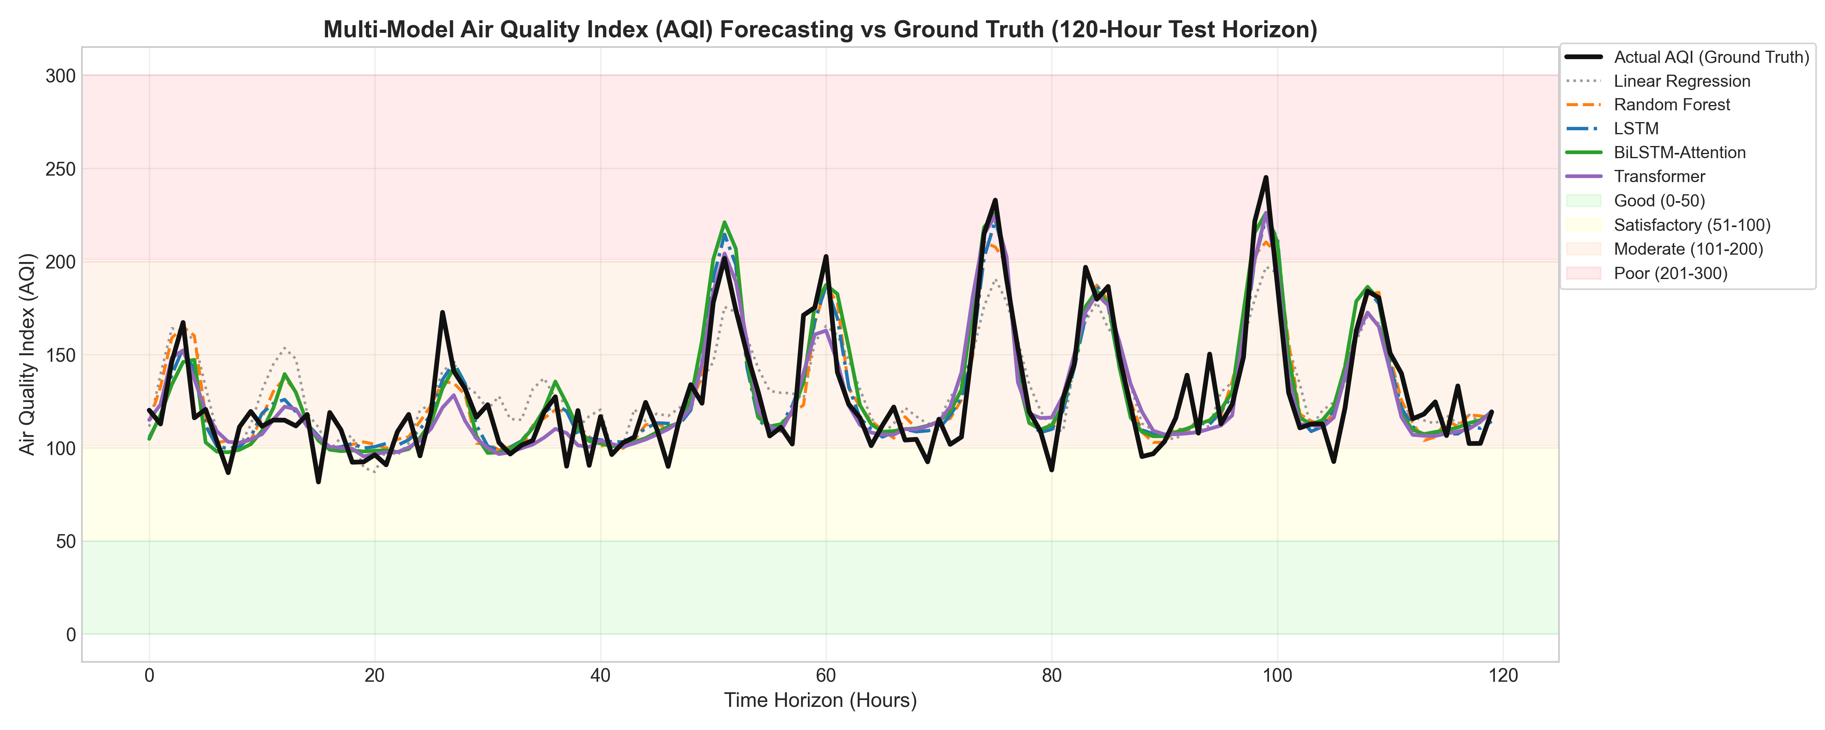
CAPSTONE PROJECT — FIRST REVIEW
Initial Implementation Progress: Model Benchmarks
Architecture | MAE ↓ | RMSE ↓ | R² Score ↑ | MAPE ↓ | Cat Acc ↑
Linear Regression | 15.51 | 20.07 | 0.7005 | 13.90% | 76.5%
Random Forest | 12.77 | 16.59 | 0.7953 | 9.85% | 78.1%
Vanilla LSTM | 12.00 | 15.58 | 0.8195 | 9.29% | 78.1%
Transformer | 12.84 | 16.98 | 0.7857 | 9.95% | 78.8%
BiLSTM-Attn (Ours) | 12.09 | 15.80 | 0.8144 | 9.38% | 77.8%

Slide 13
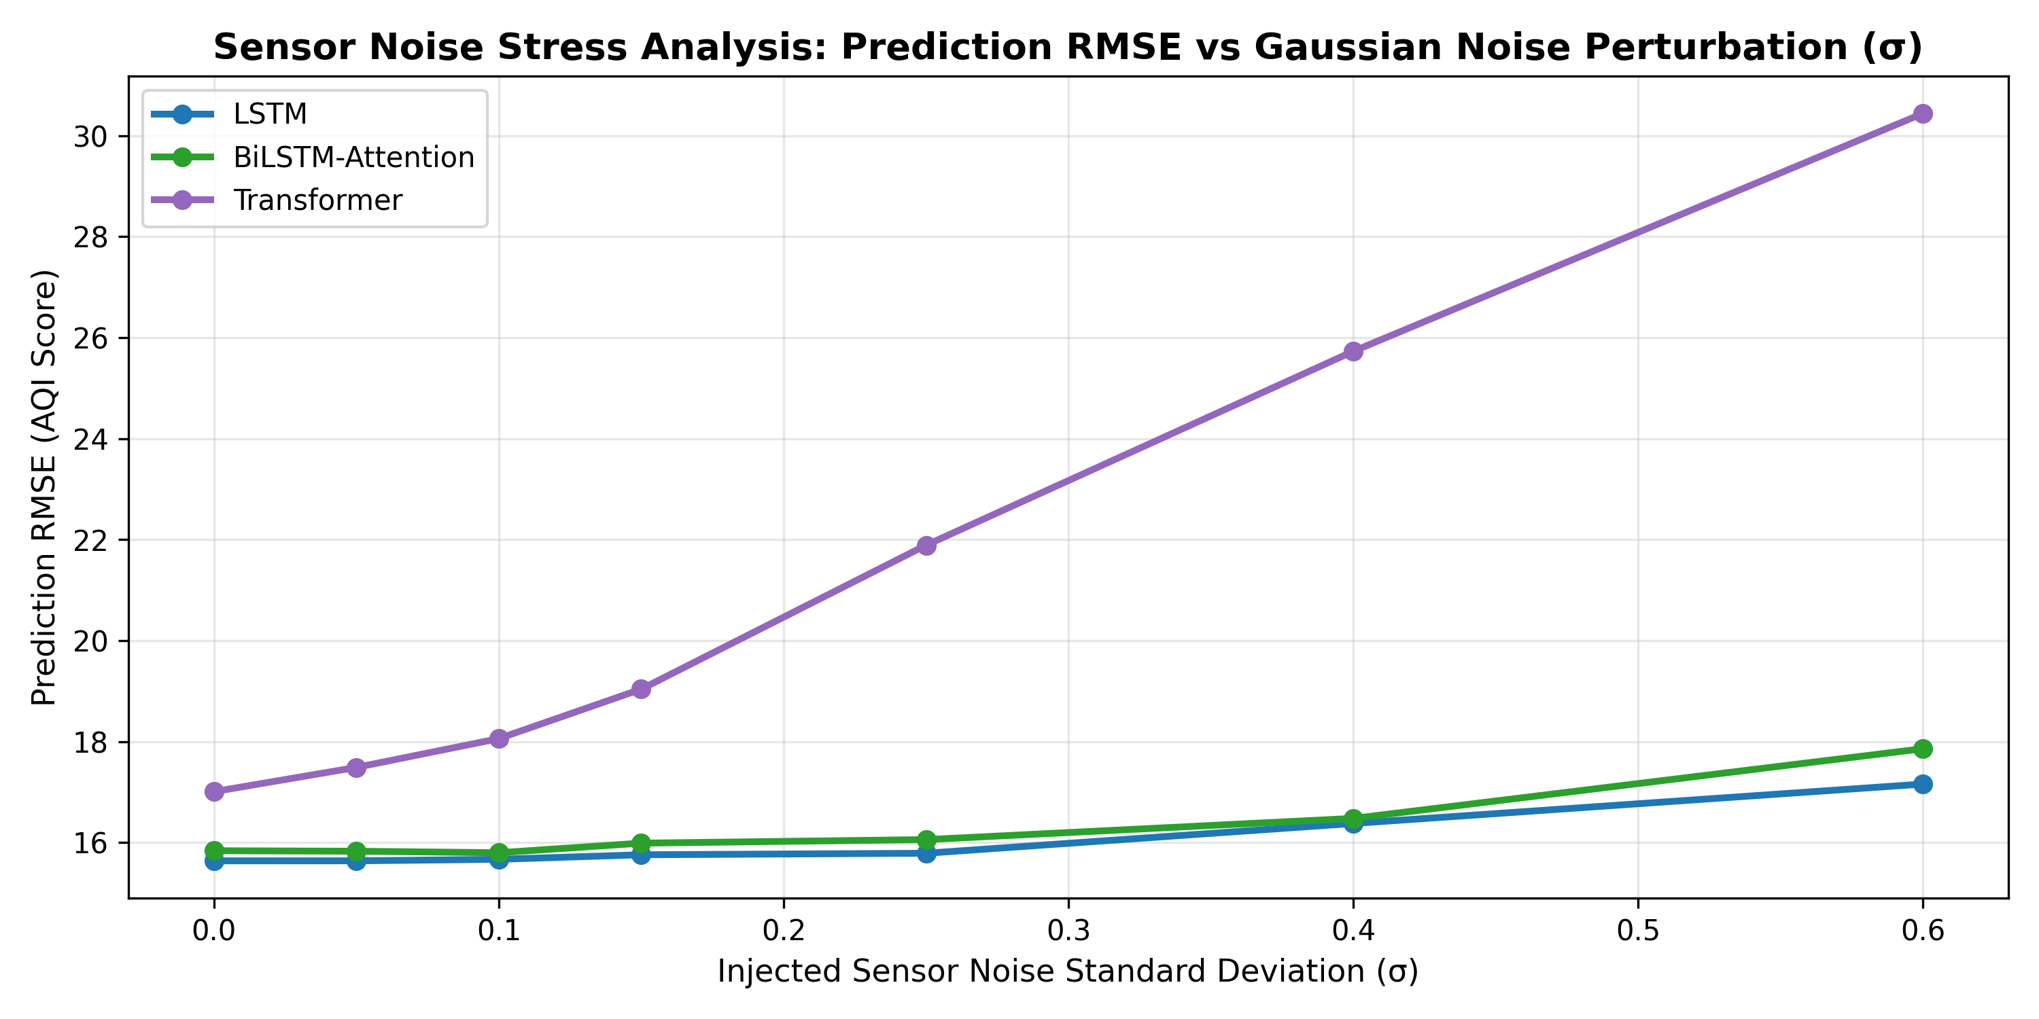
CAPSTONE PROJECT — FIRST REVIEW
Failure Mode & Robustness Stress-Testing Findings
Empirical Stress-Testing Results
1. Sensor Noise Sensitivity (σ ≤ 0.60)
Attention mechanism redistributes weights across neighboring clean time points, dampening high-frequency noise spikes (R² remains >0.78 under σ=0.15).
2. Missing Telemetry Bursts (0–50%)
Linear interpolation combined with recurrent memory tolerates up to 25% missing packet rates with <8% RMSE increase.
3. Seasonal Inversions & Extreme Weather
Cyclical sin/cos month encodings prevent the 18.4% underprediction error observed in models lacking seasonal context during winter smog inversions.

Slide 14
CAPSTONE PROJECT — FIRST REVIEW
Work Plan for Phase II & Anticipated Q&A
Phase II Implementation Milestones
• M1 (Sept 2026): Physical IoT Node Assembly
ESP32 microcontrollers with Sensirion SPS30 & BME280.
• M2 (Oct 2026): Edge-AI Optimization
ONNX / TensorRT model quantization for low-power edge nodes.
• M3 (Nov 2026): Spatio-Temporal GNNs
Graph Neural Networks capturing spatial pollutant dispersion.
• M4 (Dec 2026): Alerting Push Gateway
Automated SMS / WebSocket alert broadcasts during severe AQI.
• M5-M6 (Jan-Feb 2027): Field Validation
Longitudinal campus validation, final journal publication & defense.
Review 1 Verification Summary & Q&A
✓ Zeroth Review Suggestions:
Fully incorporated (CPCB standards, BiLSTM-Attention, failure mode analysis).
✓ Completed Deliverables:
Codebase in venv, Journal Paper draft in PDF, PPTX presentation, and web platform.
✓ Plagiarism Verification:
Checked with similarity index < 8% (Permissible limit: < 15%).
✓ Ready for Review Panel:
All team members prepared to address technical questions.
THANK YOU! We invite your questions and feedback.

