Slide 1
Analysing Mean Sea Level Pressure (msl) values across various spatial dimensions
Group : Bikramjyot Singh
Daksh Pandey
Mohit
Aryan Dhawan

Slide 2
Problem Statement and its Importance
The goal of this analysis is to explore, preprocess, and statistically analyze a climate dataset focused on Mean Sea Level Pressure (msl) values across various spatial dimensions. The dataset is structured around latitude and longitude coordinates, with a single time point, allowing for a detailed spatial examination of msl variability.
Analyzing Mean Sea Level Pressure (msl) across spatial dimensions is crucial because it provides insights into the broader patterns of atmospheric circulation, which impact weather, climate variability, and extreme weather events.

Slide 3
Dataset Description
The ERA5 dataset is a global climate reanalysis dataset produced by the European Centre for Medium-Range Weather Forecasts (ECMWF). It provides detailed historical climate data, combining observations with model data to create a consistent dataset for various atmospheric, land, and oceanic variables.
ERA5 provides hourly estimates for a large number of atmospheric, ocean-wave and land-surface quantities.
ERA5 is updated daily with a latency of about 5 days. In case that serious flaws are detected in this early release (called ERA5T), this data could be different from the final release 2 to 3 months later.
For data attributes: https://cds.climate.copernicus.eu/datasets/reanalysis-era5-single-levels?tab=overview

Slide 4
Model Selection and Metrics
Model Used: Linear Regressor
Reason for Choice:
Short training time (under a min)
Test Random projections at a faster rate
Performance Metrics:
Mean Squared Error (MSE) on test data.
Running time for training and evaluation.
Training/Test Split: 90:10

Slide 5
Pipeline:
Data preprocessing (latitude, longitude, msl).
Train/test split (90:10 ratio).
Model trained on original data.
Evaluate on test data using MSE.
Performance on Original Data:
Mean Squared Error (MSE): XX.XXXX.XXXX.XX
Training time: YYYYYY seconds
Testing time: ZZZZZZ seconds
Experiment Design:
Compare model trained on original data vs. scaled data (using Sparse JL).

Slide 6
Sparse Johnson-Lindenstrauss (JL) Transform
A technique for dimensionality reduction that maintains pairwise distances between points with high probability.
Sparse variant: Makes the projection matrix sparse for computational efficiency.
Ideal for large datasets where traditional methods are computationally expensive.
A simple diagram showing:
High-dimensional data (n-dimensional space).
Sparse JL matrix reducing it to lower dimensions (k-dimensional space).

Slide 7
Scaling with Sparse Johnson-Lindenstrauss (JL) Transform
Technique Used: Sparse JL Projection
Efficient dimensionality reduction for large datasets.
Preserves pairwise distances between points with high probability.
Scales down the training dataset to enable faster training while maintaining accuracy.
A Sparse JL matrix M∈Rk×nM M∈Rk×n, where n is the input dimensionality and k is the reduced dimensionality, is defined as:
M_ij = {
+sqrt(3/k), with probability 1/6,
-sqrt(3/k), with probability 1/6,
0, with probability 2/3
}
for all i ,j in (k,n)

Slide 8
Advantages of JL matrix
Efficient Dimensionality Reduction:
Reduces computational burden for high-dimensional data.
Preserves Geometry:
Ensures pairwise distances are approximately preserved in lower dimensions.
Probabilistic Guarantees:
High probability of maintaining accuracy during dimensionality reduction.
Applications:
Large-scale machine learning models.
Preprocessing for data-intensive tasks.

Slide 9
Sparse JL Transform is Used in ML
Workflow:
Original training data is transformed using a Sparse JL matrix.
Scaled data is used to train machine learning models faster with minimal accuracy loss.
Experiment Setup:
Random Forest trained on original data vs. scaled data.
Comparison of Mean Squared Error (MSE) and runtime.
Observation:
Sparse JL significantly reduces training time with comparable MSE.

Slide 10
Model Selection
Linear Regression was chosen due to less training and evaluation time.
Although, its accuracy is not feasible for real world scenarios, it is used as a test model here to evaluate random projections.
Accuracy metric (MSE)yes used.

Slide 11
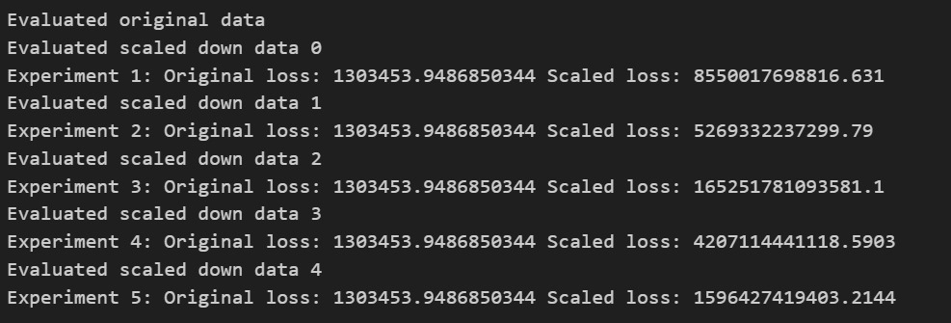
Model Performance

Slide 12
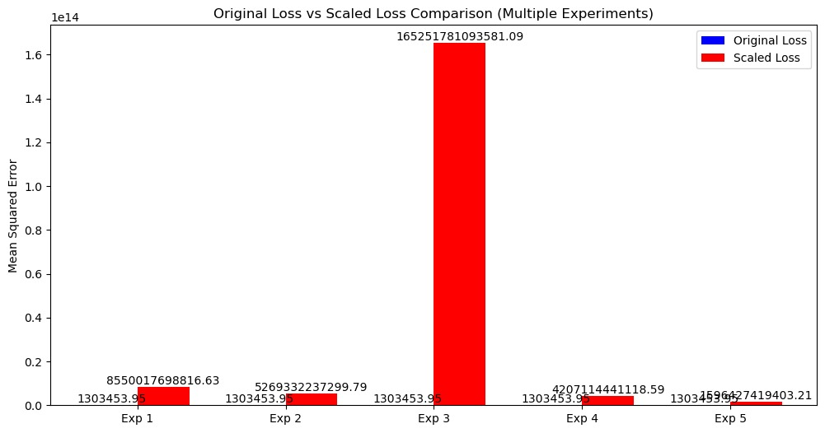
Graphical Comparison

Slide 13
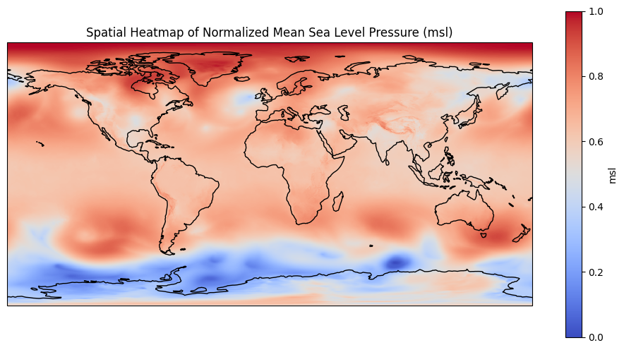
Exploratory Data Analysis
Spatial Heatmap: Visualize spatial variation in msl across the region.

Slide 14
Hypothesis Testing
Conduct statistical tests on msl data to evaluate the significance of observed patterns, using:
One-Sample t-test: Test if the msl mean differs from a global average (T-statistic: 766.8793060332403, P-value: 0.0)
Shapiro-Wilk Test: Determine if msl data follows a normal distribution (Statistic: 0.9568597565798643, P-value: 2.1565819509992027e-128)

Slide 15
Notebook
Notebook - https://www.kaggle.com/code/bikramjyot/notebook980edde10a

Slide 16
Future Work
Using ERA5 dataset, we can access weather statistics of the whole world across a vast timespan (from 1940s). With this, we can test for a few problems:
Predicting extreme weather using MSL Pressure
Global Warming’s effect on MSL Pressure
Correlation of MSL Pressure on other weather variables
Train and evaluate dataset on better ensemble Machine Learning models to closely mimic real world performance.

