Slide 1



TRISHUL
Triple Threat Chargeback Defense for Indian BFSI
Cost-Aware • Drift-Resilient • 4-Class Fraud Detection
Razorpay AI/ML Internship Project

Slide 2

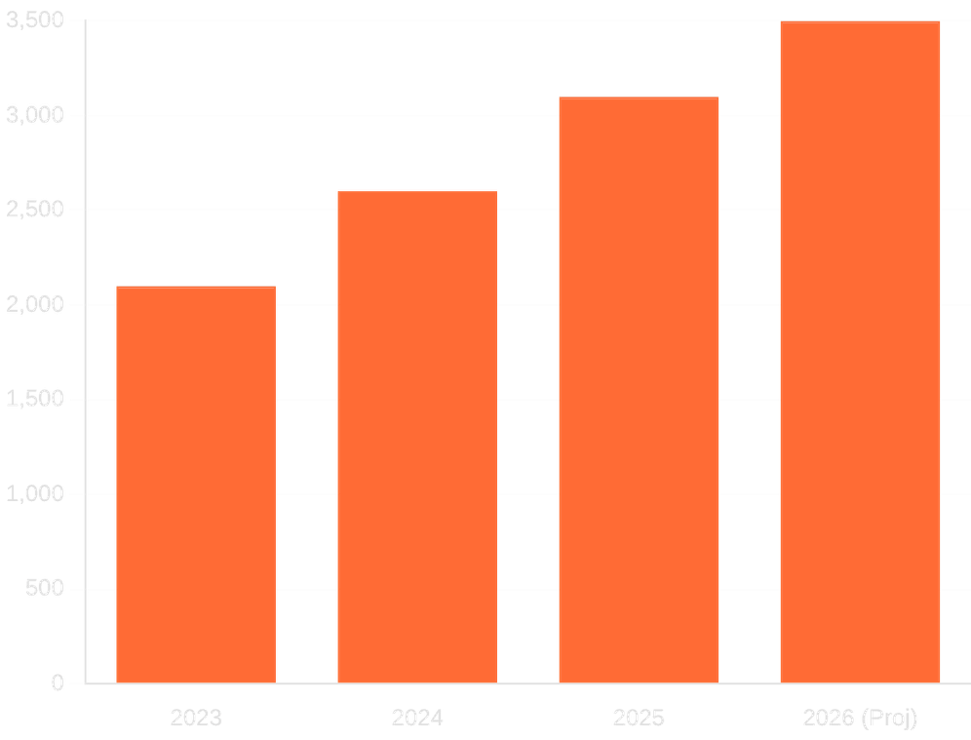
INDIAN MERCHANTS LOSE ₹3,500 CR/YEAR TO CHARGEBACKS
Existing models optimize for
F1-score
, failing to account for real monetary cost.
RBI's asymmetric liability:
Merchants bear the full loss on missed fraud transactions.
Models degrade silently as fraud patterns shift
seasonally
(e.g., Diwali sales).
Binary classification misses
friendly fraud
, which accounts for 60% of disputes.
Annual Chargeback Loss (Estimated ₹ Cr)

Slide 3







TRISHUL: THREE PILLARS OF DEFENSE
Cost-Sensitive Learning
Concept Drift Detection
4-Class Fraud Classification
XGBoost models optimized against the RBI Cost Matrix, prioritizing financial impact over statistical F1-score.
Real-time monitoring using ADWIN, PSI, and Page-Hinkley to trigger adaptive model retraining.
Granular detection of Genuine, Friendly, ATO, and Technical fraud for targeted resolution.
78.5% Cost Savings
98/98 Tests Passing
<50ms API Response

Slide 4











SYSTEM ARCHITECTURE: HOW IT WORKS
REAL-TIME TRANSACTION PIPELINE
Transaction Input
Stage 1: XGBoost Risk Scorer
Stage 2: Random Forest
ALLOW / REVIEW / BLOCK
FastAPI / Pydantic
Threshold: 0.35
4-Class Classification
Final Decision
ASYNCHRONOUS ADAPTIVE LOOP
Data Stream
Drift Monitor (ADWIN / PSI)
Adaptive Retrainer
Parallel monitoring ensures
models remain
drift-resilient
without interrupting live traffic.
PostgreSQL / Redis
River Library
Quarterly / Triggered

Slide 5







PRE-SETTLEMENT DEFENSE: CATCHING FRAUD EARLY
Transaction Authorization
Trishul Analysis
Settlement or Hold
Final Payout
₹100
VS
₹50,700+
VERIFICATION COST
CHARGEBACK COST
"Catch fraud BEFORE funds settle, not AFTER chargebacks are filed."

Slide 6

RBI-ALIGNED COST MATRIX
Outcome
Business Consequence
Illustrative Amount
False Negative
Chargeback + Processing + Churn + RBI Penalty
Full Amt + ₹700 + ₹200 + ₹100
False Positive
Lost Sale + Manual Review + Churn
70% Amt + ₹150 + ₹60
True Positive
Verification cost only
₹100
True Negative
No incremental cost
₹0
ZERO-LIABILITY THRESHOLD
MAX COMPENSATION
₹50,000
₹25,000

Slide 7
MODEL PERFORMANCE: RESULTS & EFFICIENCY
PRECISION
RECALL
F1-SCORE
98%+
96%+
0.97
Held-out Test Set
Held-out Test Set
System Harmonic Mean
COST SAVINGS
API LATENCY
RELIABILITY
78.5%
<50ms
98/98
Vs. Baseline F1-Optimized Model
P99 Response Time
Automated Tests Passing
*Training metrics achieved 100% across all primary indicators.

Slide 8

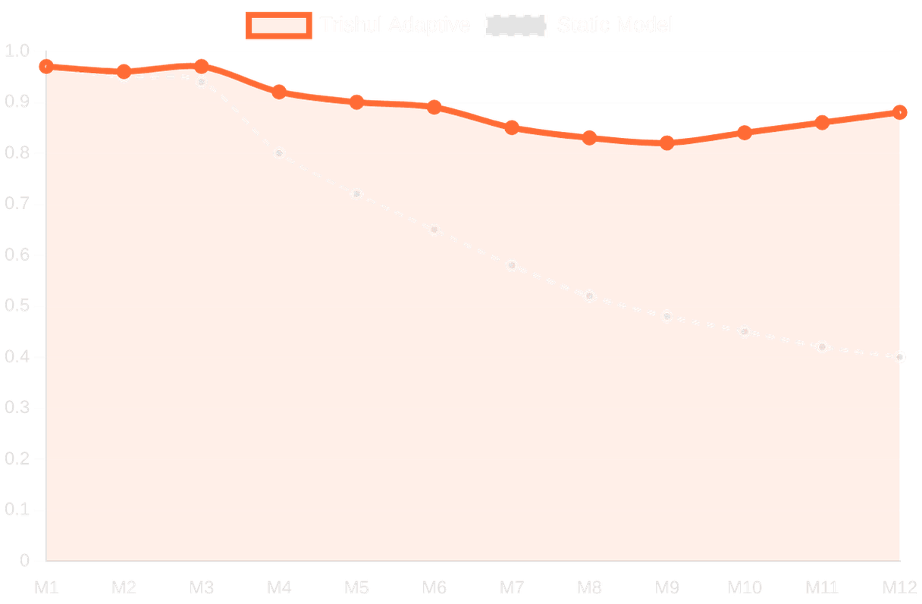
ADAPTIVE RETRAINING: DEFEATING CONCEPT DRIFT
Period
Environment
Fraud
M1-M3
Baseline
2%
M4-M6
Diwali (Seasonal)
8%
M7-M9
Adversarial Shift
5%
M10-M12
Partial Recovery
3%
KEY FINDING
Static model F1 drops to <0.50 by month 9. Trishul Adaptive model maintains >0.82.
12-Month Performance Simulation (F1-Score)

Slide 9





4-CLASS DETECTION: GRANULAR FRAUD ANALYSIS
GENUINE FRAUD
FRIENDLY FRAUD
Stolen card details or unauthorized purchases by malicious third parties.
Legitimate buyers abusing the dispute system to get products for free.
IP-Geolocation Mismatch
Delivery Confirmation
Velocity Triggers
Past Purchase History
Dark Web Leak Check
Social Media Verification
ACCOUNT TAKEOVER
TECHNICAL FAILURE
Compromised user accounts used for unauthorized high-value transactions.
System errors, duplicate charges, or processing malfunctions.
Idempotency Key Check
Device Fingerprinting
Gateway Response Logs
Behavioral Biometrics
Duplicate Transaction ID
MFA Failure History

Slide 10





BUILT WITH: THE TRISHUL TECH STACK
MODELING & ML
API & VALIDATION
Python 3.14 (Latest Stable)
FastAPI (Stateless Async API)
XGBoost (Cost-Sensitive Learning)
Pydantic v2 (Strict Data Validation)
scikit-learn (Preprocessing & RF)
Pytest (98/98 Tests Passing)
DRIFT & DATA
INFRASTRUCTURE
River (Online Drift Detection)
Redis (Real-time Caching)
Pandas & NumPy (Data Engineering)
PostgreSQL (Persistent Storage)
Matplotlib (Visualization)
Kubernetes & GitHub Actions

Slide 11



BUILD CHALLENGES & SOLUTIONS
Technical Challenge
Trishul Solution
Data Leakage
device_trust_score
was inadvertently computed using the target variable.
Issue:
Re-engineered feature extraction to compute scores exclusively from historical device behavior.
Fix:
Threshold Optimization
Default XGBoost objectives optimize for F1-score, ignoring asymmetric financial costs.
Issue:
to find the point of maximum rupee savings.
Fix:
Developed a custom
Cost-Matrix Threshold Sweeper
Fair Model Comparison
Needed a rigorous way to prove adaptive retraining value against static baselines.
Issue:
Implemented a 12-month controlled simulation with quarterly retraining triggers and fixed evaluation windows.
Fix:
[ Engineering Rigor • Data Integrity • Financial Alignment ]

Slide 12








IMPACT & FUTURE ROADMAP
₹1.19 Cr
ANNUAL SAVINGS PER 10K TRANSACTIONS
KEY PROJECT IMPACT
FUTURE DEVELOPMENT
78.5% fewer chargebacks vs. standard models.
Integration with live merchant data streams.
Pre-settlement defense catches fraud before loss.
A/B testing with real-world production traffic.
RBI-compliant: Aligned with July 2026 guidelines.
Real-time streaming pipeline for instant retraining.
Production-ready: Stateless and horizontally scalable.
Multi-tenant support for diverse BFSI clients.
GitHub: github.com/Daksh1308-AI-ML/AI-Risk-Manager

