Slide 1




Enhanced Database Encryption System
2024 5th International Conference on Computing, Power, and Communication Technologies (IC2PCT)
113
Main Track
PIYUSH KUMAR B.Tech | Student SRM INSTITUTE OF SCIENCE AND TECHNOLOGY

Slide 2
Outline
Introduction
Existing Approaches/Related Works
Problems in Existing Approaches
Proposed Methodology
Results and Discussion
Conclusions and Future Work
References

Slide 3
Introduction
Enhanced Database Encryption System is basically a data storage system which allows us to store the employees data more efficient and in systemic manner with help of advanced data storage techniques such as indexing, compression, and partitioning to optimize storage space.
Through efficient data organization, the system ensures faster retrieval times, enabling users to access information promptly without delays or performance bottlenecks. By minimizing the storage footprint and enhancing data retrieval speed, the system contributes to cost savings by reducing the need for expensive storage infrastructure upgrades and maintenance.
The system is made to be easy for people to use. It has things like personalized screens, simple ways to search, and tools to show information visually. This helps users find and work with data easily. It's easy for new users to learn, so more people use it. This makes everyone more productive and happy with the system.
The system has many helpful features to make work easier and faster. It can do tasks automatically, like checking data and following workflows. This saves time and makes fewer mistakes. It also helps teams work together better by sharing updates and messages in real-time. Plus, it gives reports and analysis to help make better decisions and use resources wisely.
The system is like a big storage room for all the important information in the company. It keeps everything organized and up-to-date, so when people need to make decisions, they can trust the information. It also helps them stay on top of what's happening right now in the business world. By looking at past data and making predictions, it helps the company make smart choices and stay ahead of the competition.

Slide 4
Existing Approaches/Related Works
1. Manual Data Storage:
Physical Files and Folders: This traditional approach involves storing data in physical files and folders, such as paper documents, notebooks, and filing cabinets.
Handwritten Records: Before the digital era, handwritten records were commonly used for storing information.
2. Simple Digital Data Storage:
Spreadsheet Software: Users input data into cells organized in rows and columns, allowing for simple.
Text Documents: Storing data in plain text documents, such as TXT files, is a straightforward method.
3. Flat File Databases: Flat file databases store data in a simple, flat format without the use of tables or relationships. Data is stored in a single file, making it easy to implement but limited in scalability and complexity.
4. Relational Databases: Relational databases organize data into tables with rows and columns, establishing relationships between tables. They use SQL (Structured Query Language) for querying and managing data, providing a powerful and widely used method for data storage.

Slide 5
Problems in Existing Approaches
1. In manual data storage, Accessibility is also limited, as physical records are only accessible from specific locations, hindering remote access and collaboration efforts. Additionally, paper documents are susceptible to damage from environmental factors like water, fire, and wear and tear, risking potential data loss.
2. Simple digital data storage, such as spreadsheet software and text documents, faces scalability issues as they struggle to efficiently handle large datasets, leading to performance problems and data management challenges. Furthermore, these formats lack built-in mechanisms to ensure data integrity, making them prone to errors or inconsistencies
3. Common database systems, including hierarchical and network databases, suffer from data redundancy issues where the same information may be stored in multiple places, leading to inefficiencies and increased storage requirements. They also require intricate data modeling and management techniques, making them more challenging to design and maintain compared to relational databases.
4. Relational databases, encounter performance bottlenecks when handling complex queries or large datasets, requiring optimization techniques like indexing and query tuning. Scaling relational databases to accommodate growing data volumes and user concurrency can be cumbersome, often requiring costly hardware upgrades or sharding techniques. The normalization process in relational databases leads to increased storage requirements and query complexity, impacting performance in certain scenarios.

Slide 6
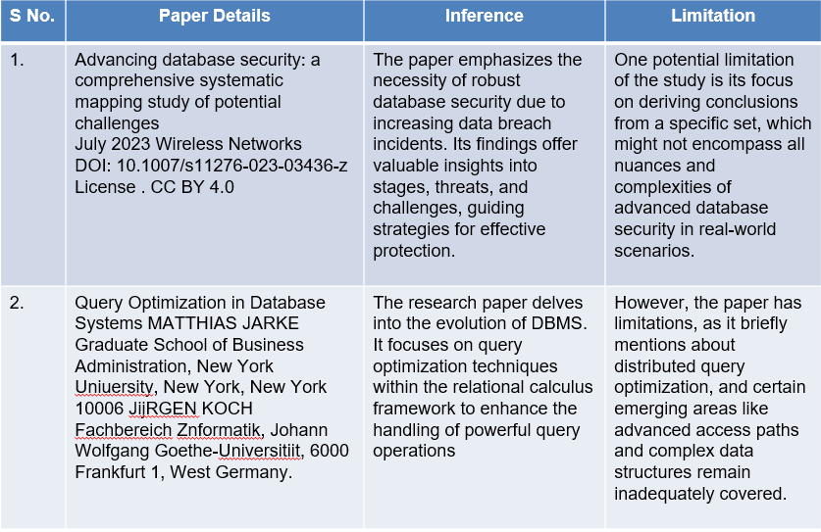
Literature Survey

Slide 7
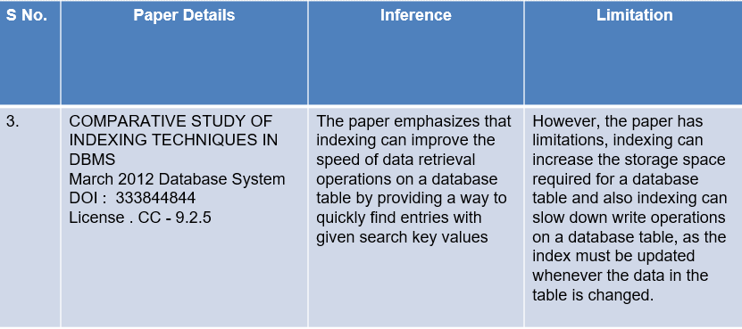
Related Works ….

Slide 8
Proposed Methodology
Query optimization Algorithm: This algorithm analyzes database query structures and access patterns to generate efficient execution plans, minimizing resource usage and response time. By considering factors like index utilization and join strategies, it tailors plans to specific database configurations, enhancing overall system efficiency and user experience. Implementation of this algorithm significantly improves query performance, reducing processing time and enhancing system scalability.
Indexing Algorithm : This algorithms design structures to optimize data retrieval from large databases, enhancing query performance. By organizing data for efficient access, these algorithms reduce search time and improve overall system responsiveness. They employ techniques like B-trees or hash tables to facilitate quick data lookup, enhancing database efficiency and user experience.
KMF Algorithm: The Key Management Framework (KMF) Algorithm facilitates secure key exchange between servers and clients. It employs cryptographic techniques to establish a shared key, ensuring confidentiality and integrity of communication. By securely managing cryptographic keys, KMF enables secure data transmission and enhances overall system security.
Differential Data Recovery Algorithm: This is employed for synchronized periodic backups, utilizing a specialized timing coordination algorithm. This algorithm enables efficient backup processes by identifying and transferring only the changes made since the last backup, reducing storage and bandwidth requirements. By synchronizing backups at specific intervals, it ensures data consistency and minimizes the risk of data loss, enhancing overall backup efficiency and reliability.

Slide 9
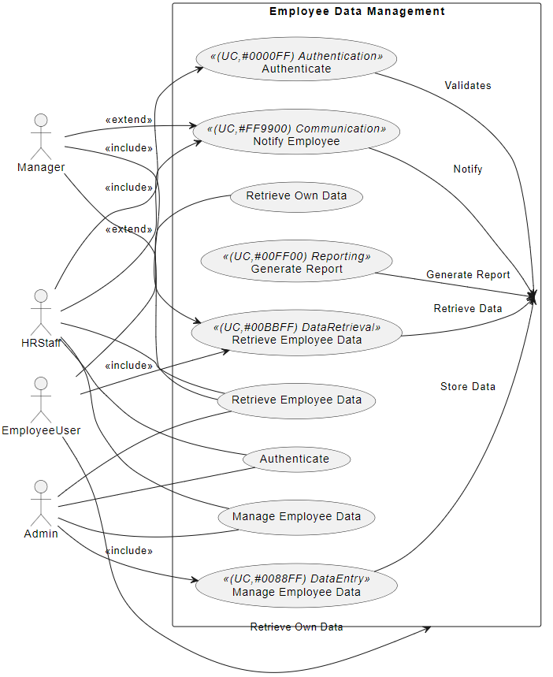
Proposed Methodology

Slide 10
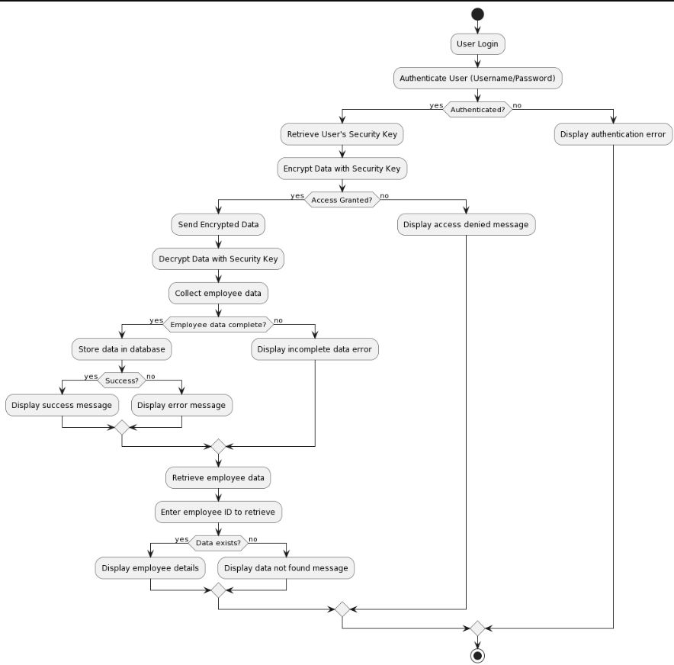
Proposed Methodology/ WorkFlow

Slide 11
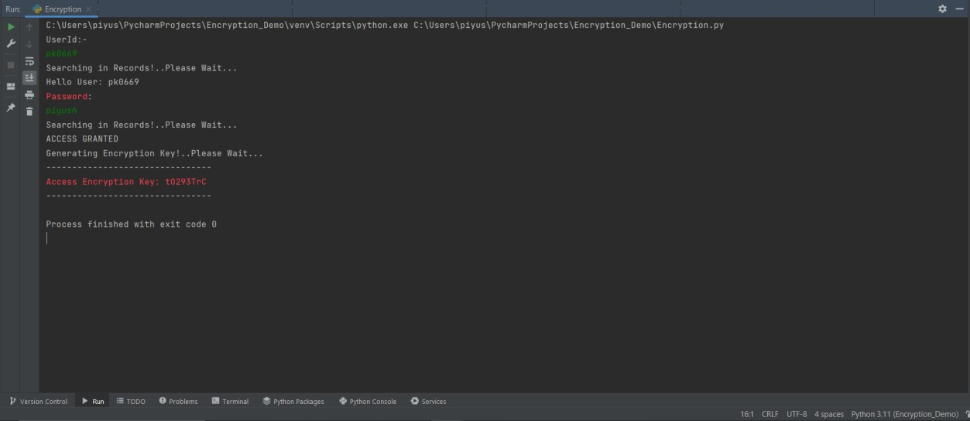
Results and Discussion
1. KMF(Encryption Phase)

Slide 12
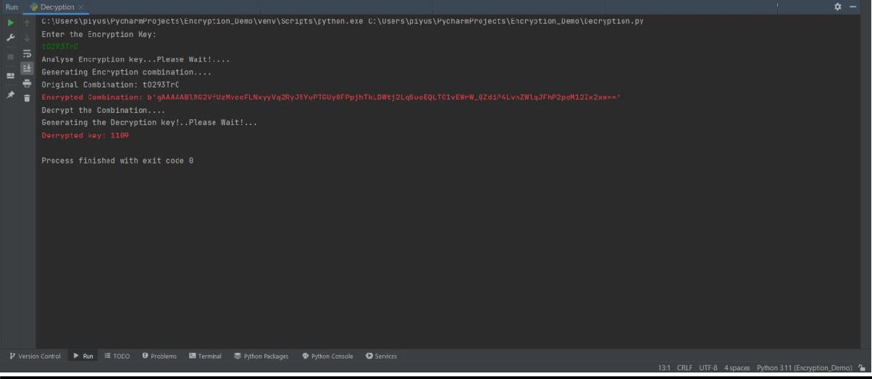
Results and Discussion
2. KMF(Decryption Phase)

Slide 13
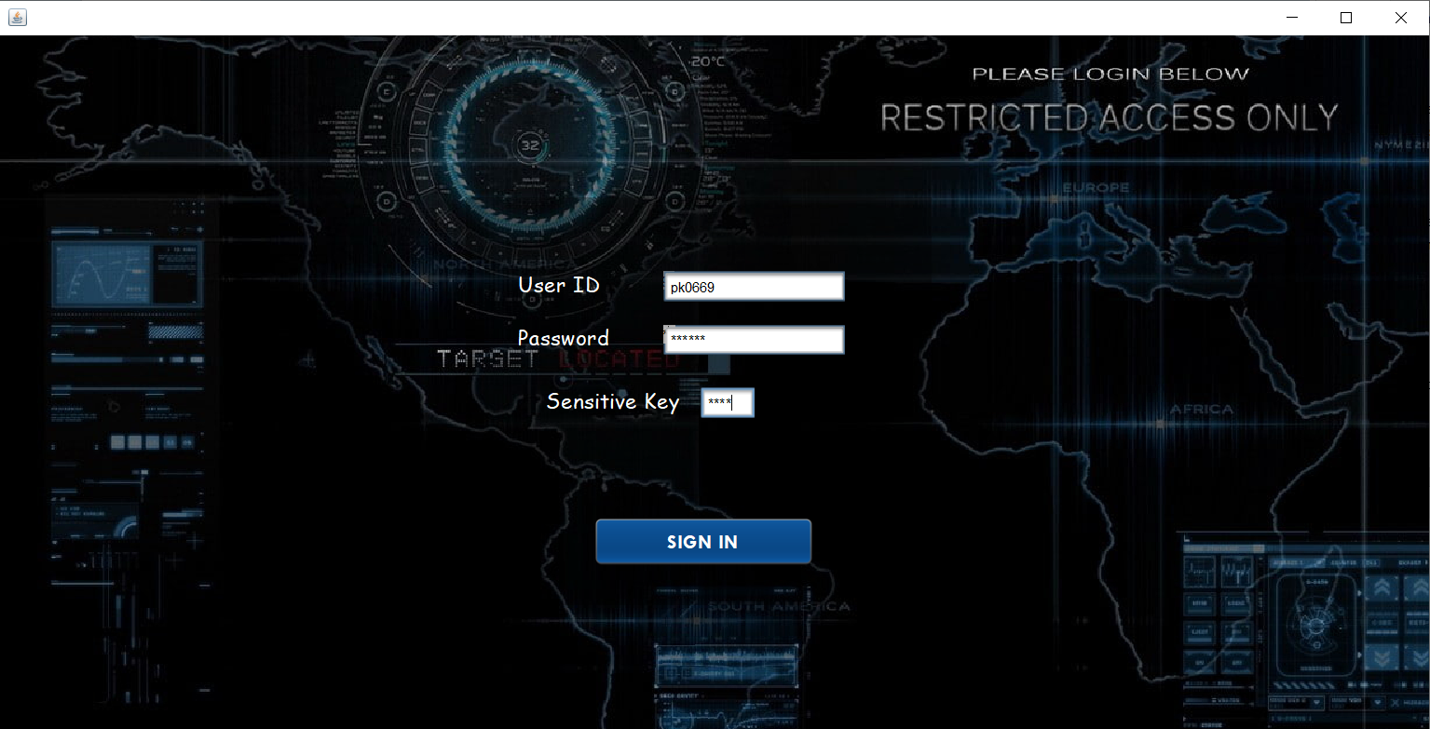
Results and Discussion
3. Authentication
Without validation of the credentials,
user can’t access the database system.

Slide 14
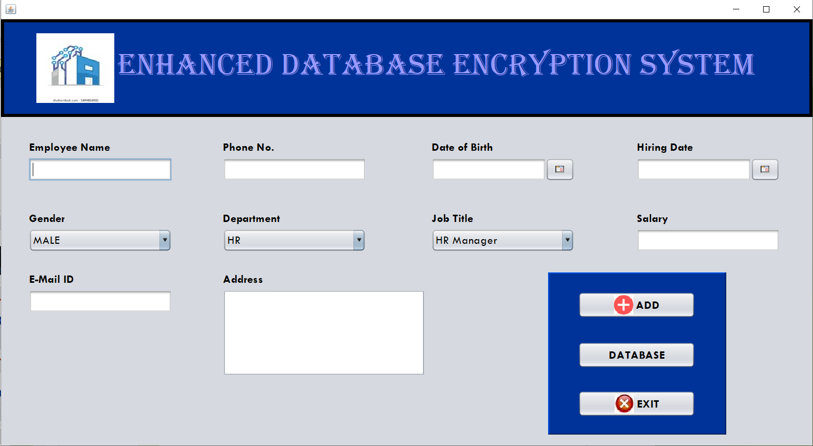
Results and Discussion
4. Cataloging Information In Database
We can easily handle, maintain the
database and store the entries in the
system.

Slide 15
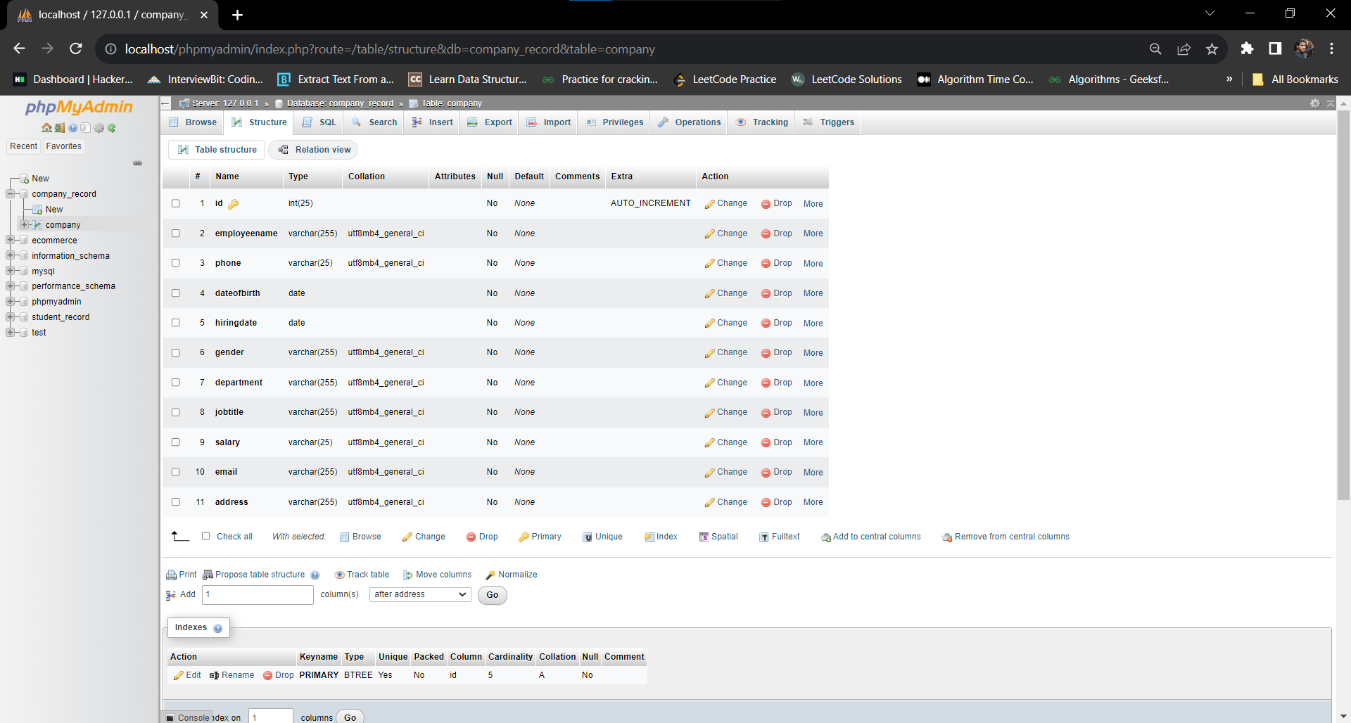
Results and Discussion
5. Local Server Structure

Slide 16
Conclusions and Future Work
The "Enhanced Database Encryption System" is in continuous development to meet the growing demands for data security and privacy. This commitment involves addressing emerging challenges and incorporating advanced technologies. The development efforts include the integration of key technologies such as homomorphic encryption, allowing operations on encrypted data without decryption. Quantum-resistant encryption is also a focus to protect again .To further bolster security, the system incorporates improved zero-knowledge proofs, blockchain integration, and refined access control mechanisms. These measures collectively contribute to creating a robust defense against various security threats potential quantum threats. Additionally, multi-party computation facilitates secure collaborative data analysis.
Advanced hardware security modules (HSMs) play a pivotal role in safeguarding encryption keys, ensuring the physical and logical protection of critical cryptographic components. Recognizing the importance of post-quantum cryptography for long-term security, the system is prepared to withstand potential threats posed by quantum computing. Privacy-preserving analytics enable data analysis without compromising individual privacy. This acknowledges the delicate balance between deriving insights and safeguarding personal information. The ever-evolving landscape of data security necessitates ongoing adaptation to emerging threats and technological advances. This adaptive approach ensures continuous protection of databases and associated assets. User-friendly interfaces and tools are integrated to streamline implementation and management, enhancing accessibility and usability. This contributes to a smoother overall user experience.

Slide 17
Results and Discussion
The project focuses on streamlining data governance within the company by implementing distinct roles for HR staff and managers, ensuring secure handling of sensitive data. Through a carefully designed use case and flowchart diagram, the system illustrates the efficient flow of information, maintaining confidentiality and integrity throughout the process.
Empowering employees is a key aspect of the project's design, particularly through the implementation of the "Retrieve Own Data" use case. By providing a self-service portal, employees gain direct access to their information, reducing dependency on administrative staff and fostering transparency within the organization.
In addition to data management, the project emphasizes comprehensive communication by incorporating features like "Generate Report" and "Notify Employee." These functionalities enable seamless information dissemination across departments, enhancing collaboration and decision-making processes.
The project's success lies in its holistic approach, combining user-friendly interfaces, stringent security measures, and efficient data management practices. By prioritizing user experience and data integrity, the system not only enhances operational efficiency but also ensures the protection of sensitive company information against potential threats and vulnerabilities.

Slide 18
Results and Discussion
The project focuses on streamlining data governance within the company by implementing distinct roles for HR staff and managers, ensuring secure handling of sensitive data. Through a carefully designed use case and flowchart diagram, the system illustrates the efficient flow of information, maintaining confidentiality and integrity throughout the process.
Empowering employees is a key aspect of the project's design, particularly through the implementation of the "Retrieve Own Data" use case. By providing a self-service portal, employees gain direct access to their information, reducing dependency on administrative staff and fostering transparency within the organization.
In addition to data management, the project emphasizes comprehensive communication by incorporating features like "Generate Report" and "Notify Employee." These functionalities enable seamless information dissemination across departments, enhancing collaboration and decision-making processes.
The project's success lies in its holistic approach, combining user-friendly interfaces, stringent security measures, and efficient data management practices. By prioritizing user experience and data integrity, the system not only enhances operational efficiency but also ensures the protection of sensitive company information against potential threats and vulnerabilities.

Slide 19
References
[1] Data Compression in Database Systems | W.P. Cockshott | D. McGregor | N. Kotsis | J. Wilson Department of Computer Science, University of Strathclyde 26 Richmond Street, Glasgow, G1 1XH, Scotland MAY 2014 | - | 37643652
[2] A Database Encryption Scheme for Enhanced Security and Easy Sharing; Computer Supported Cooperative Work in Design, 2006. CSCWD'06. 10th International Conference on; Publishing year 2006, page(s): 1–6
[3] Advancing database security: a comprehensive systematic mapping study of potential challenges July 2023 Wireless Networks DOI: 10.1007/s11276-023-03436-z License. CC BY 4.0.
[4] Query Optimization in Database Systems MATTHIAS ARKE Graduate School of Business Administration, New York University, New York, New York 10006 Jürgen KOCH Flacherie Informatic, Johann Wolfgang Goethe-Universiteit, 6000 Frankfurt 1, West Germany
[5] Data Security and Privacy: Concepts, Approaches, and Research Directions | IEEE Conference Publication | IEEE Xplore
[6] A semi-automatic data integration process of heterogeneous databases – ScienceDirect
[7] COMPARATIVE STUDY OF INDEXING TECHNIQUES IN DBMS March 2012 Database System DOI: 333844844 License. CC - 9.2.5
[8] Hsu, F.-H.; Hwang, Y.-L.; Tsai, C.-Y.; Cai, W.-T.; Lee, C.-H.; Chang, K. TRAP: A Three-Way Handshake Server for TCP Connection Establishment. Appl. Sci. 2016, 6, 358. https://doi.org/10.3390/app6110358
[9] Data dependencies for query optimization | Jan Kossmann1 || Thorsten Papenbrock1 || Felix Naumann || JUNE 2021 DOI: 10.1007/s00778-021-00676- 3
[10] Analytical Approach for Data Encryption Standard Algorithm. May 2023 Interactive encryption technology DOI: 10.3991/ijxx.vx.ix.xxxx License. CC BY 2.2.0

