Slide 1

ATTENDIFY
EFFORTLESS ATTENDANCE MANAGEMENT​

Slide 2

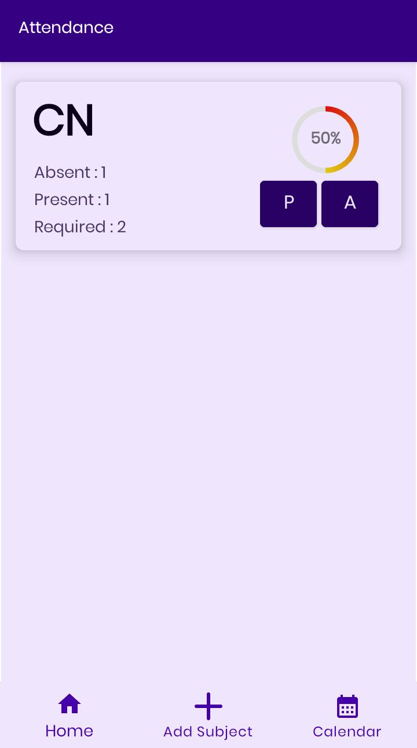
Agenda
To Develop a user-friendly and comprehensive android application that empowers college students to effectively manage their attendance and improved engagement in their studies

Slide 3
APP FEATURES
SIMPLE AND USER-FRIENDLY INTERFACE
COMPATIBILITY WITH WIDE RANGE OF ANDROID DEVICES
(MIN. ANDROID VERSION : ANDROID OREO(V8.1.0))
VISUALIZED PRESENTATION OF ATTENDANCE PERCENTAGE OF EACH SUBJECT
AUTOMATIC CALCULATION FOR NO. OF LECTURES NEED TO BE REQUIRED TO ACHIEVE 75% ATTENDANCE
INTEGRATED SHORTCUT TO OPEN CALENDAR

Slide 4
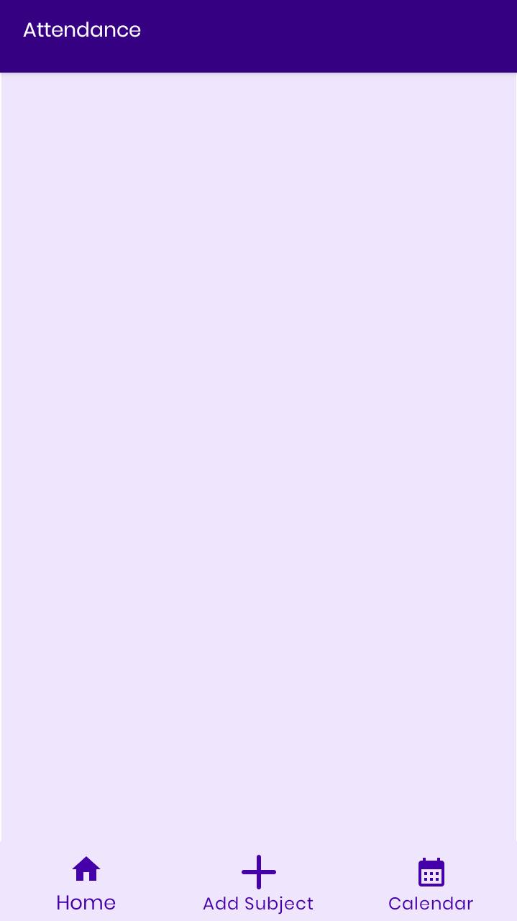
SPLASH SCREEN
MAIN SCREEN

Slide 5
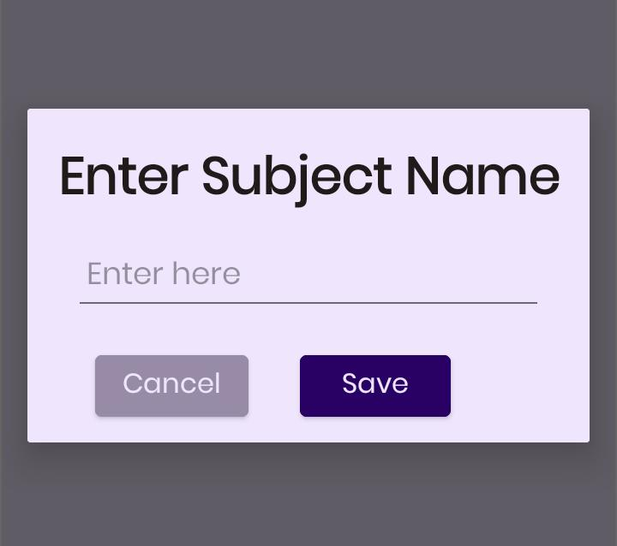
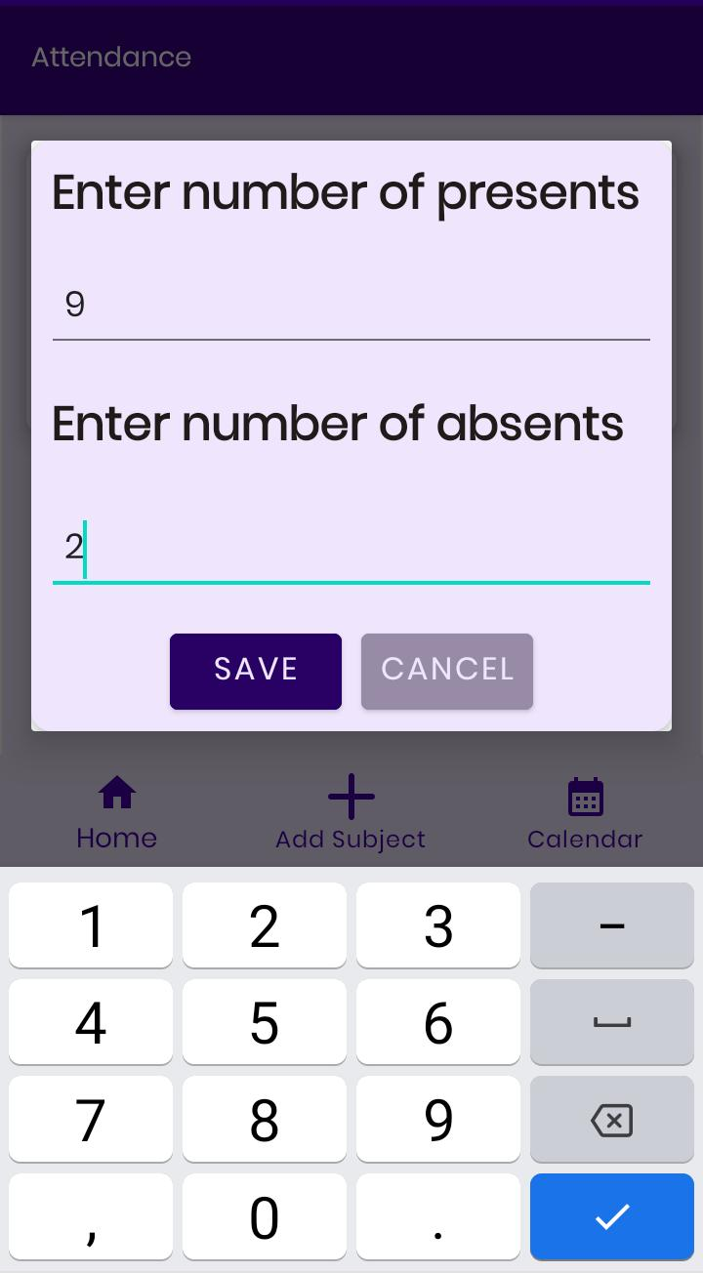
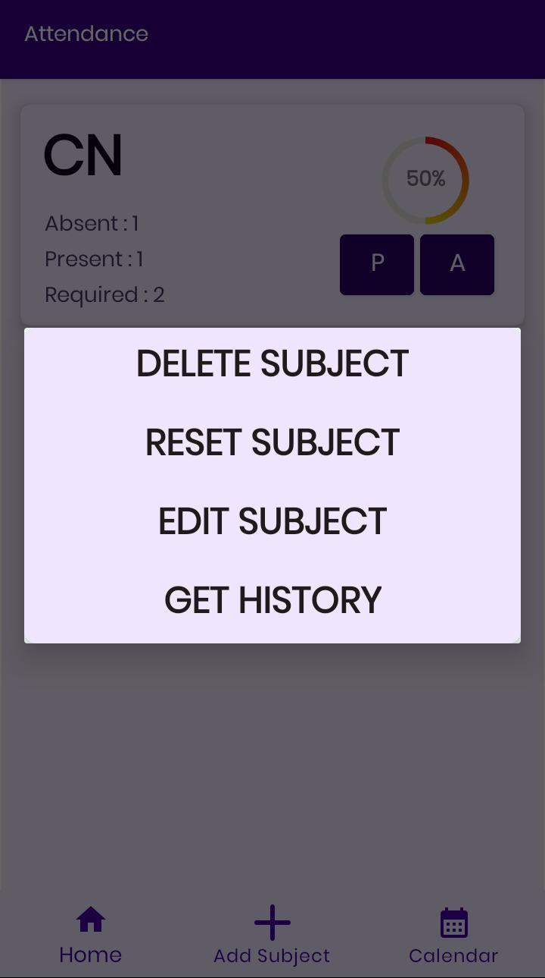
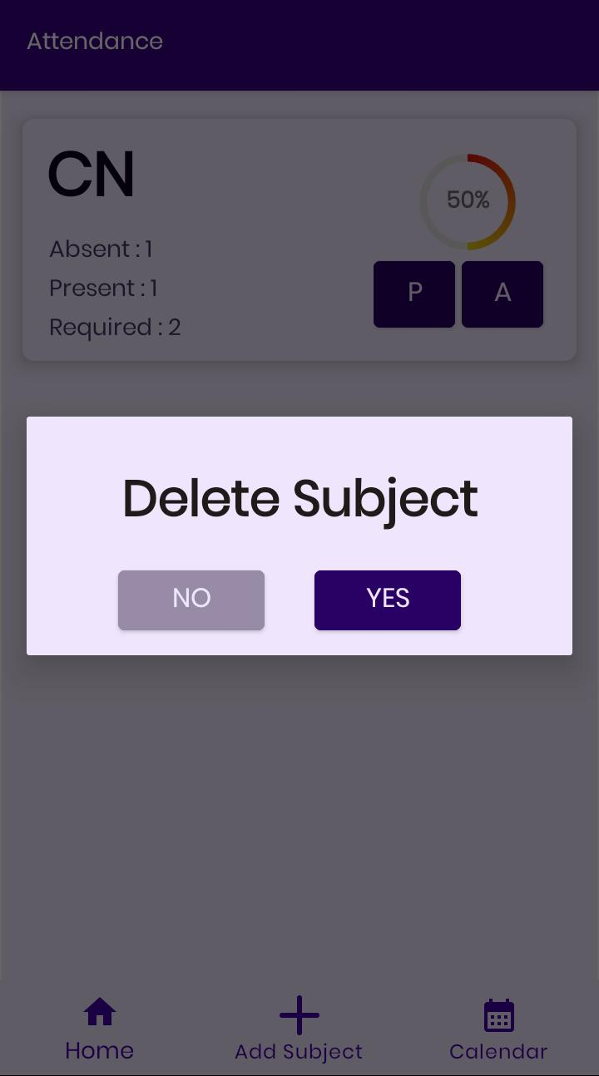
Different dialogs
ADD DIALOG
OPTIONS DIALOG
EDIT DIALOG
DELETE DIALOG

Slide 6
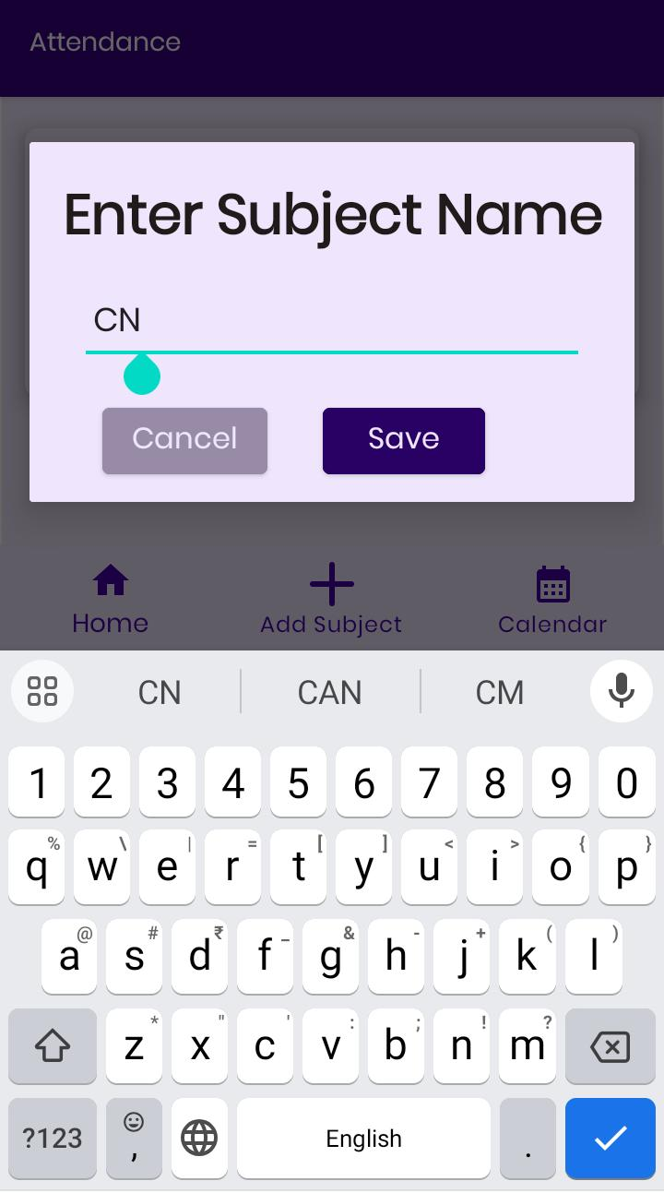
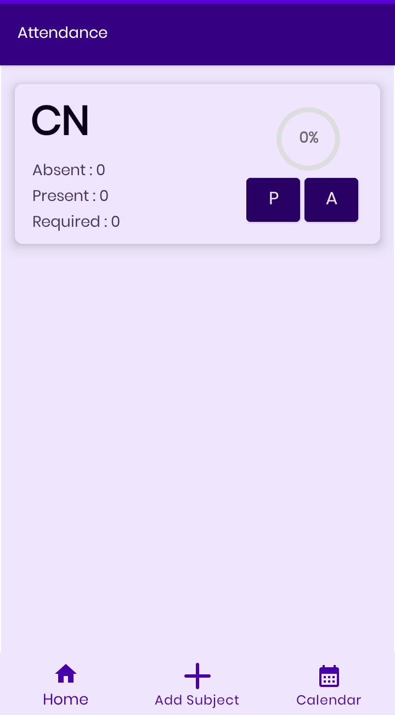
ADDING SUBJECT
CLICK ON ADD SUBJECT
ENTER SUBJECT NAME
SUBJECT ADDED
CLICK SAVE

Slide 7
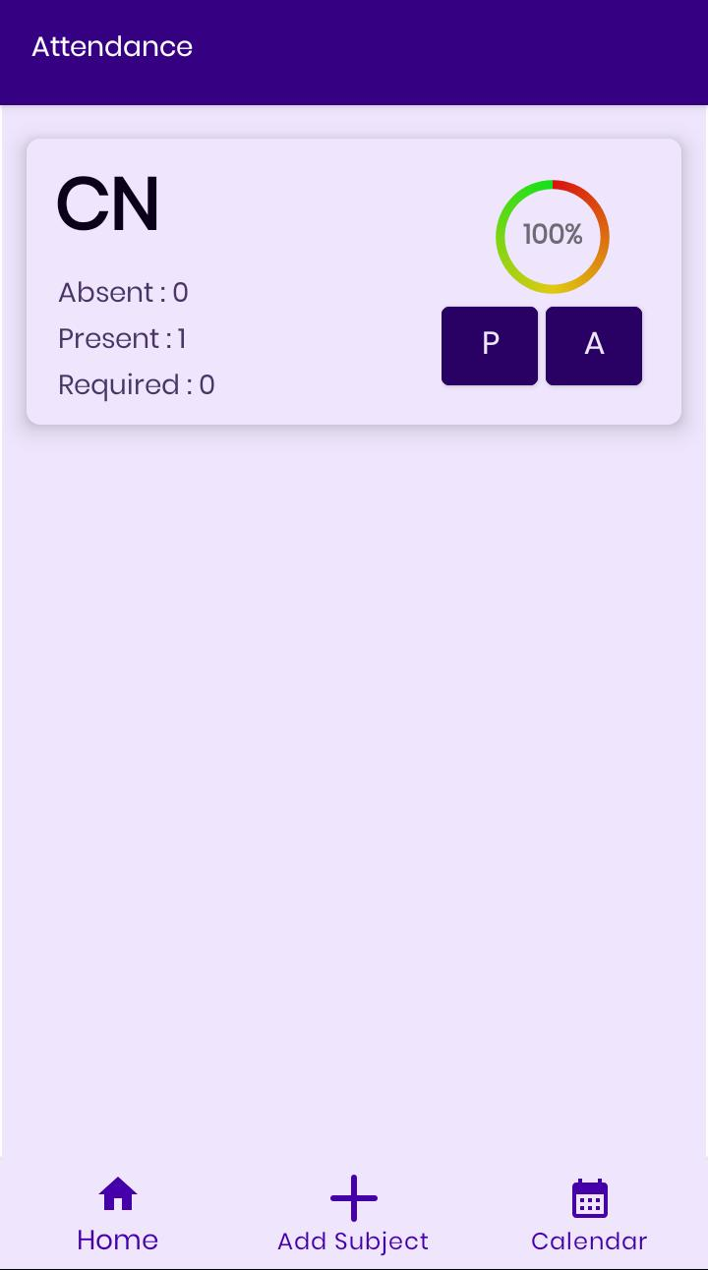
ADDING DATA
INITIAL DATA
CLICK ‘P’ FOR PRESENT
CLICK ‘A’ FOR ABSENT

Slide 8
RESET DATA
LONG PRESS THE SUBJECT CARD
CLICK ON RESET SUBJECT
SUBJECT DATA RESET

Slide 9
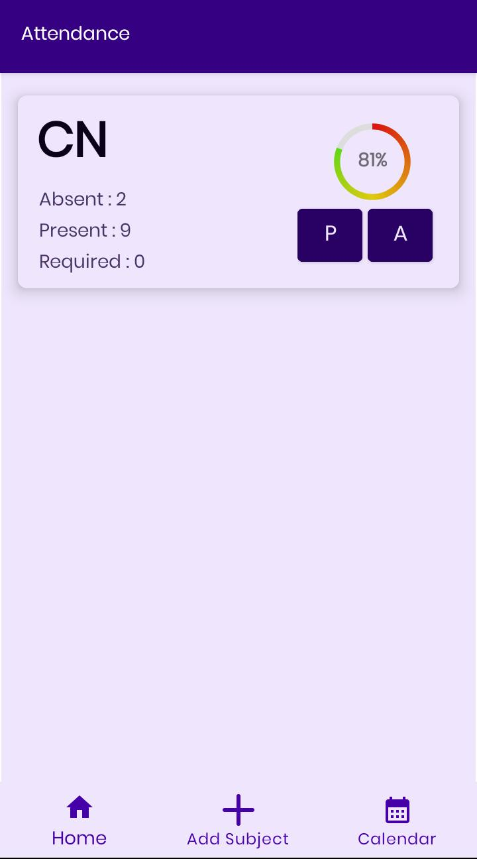
EDITING DATA
LONG PRESS THE SUBJECT CARD
Enter values
SUBJECT DATA EDITED
Click on edit subject
CLICK SAVE

Slide 10
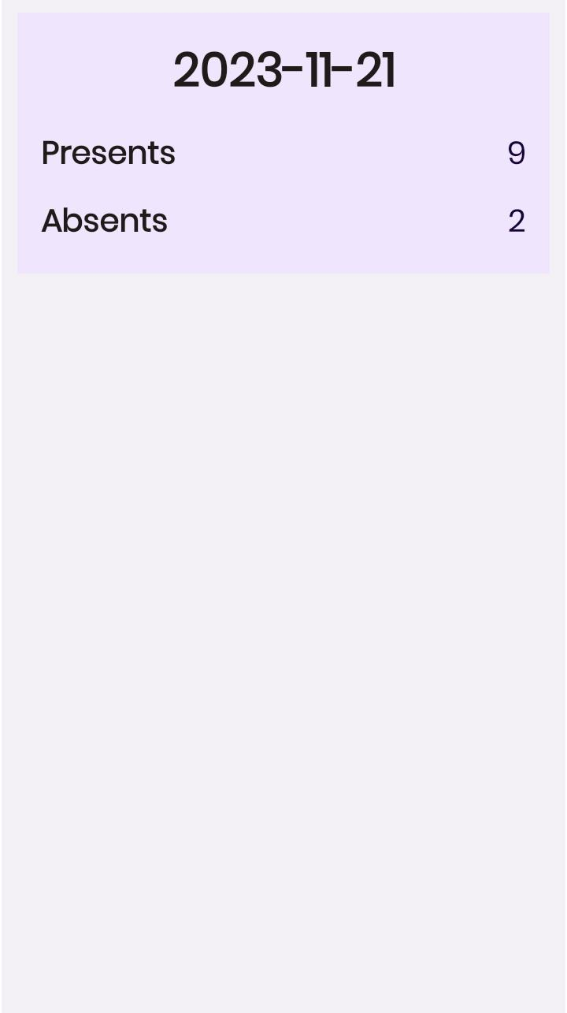
FETCHING HISTORY
LONG PRESS THE SUBJECT CARD
DATA APPEARS
Click on GET HISTORY

Slide 11
DELETING SUBJECT
LONG PRESS THE SUBJECT CARD
CLICK YES TO DELETE
SUBJECT DELETED
Click on DELETE subject

Slide 12

Thank you
DAKSH VERMA
dakshverma3rd@gmail.com | ph:62840-37820

