Slide 1
Dice Rolling Simulator
Name-Daksh Chawla
Roll No. -2210990243

Slide 2
Introduction
In this presentation, we will explore how to create a simple yet fun project that simulates rolling dice using Python programming language.
Whether you're a beginner or an experienced programmer, this project offers a great opportunity to practice your Python skills and learn new concepts.

Slide 3
Objective
To create a simple dice rolling simulator

Slide 4
Tools and Working
Tools –
Random module: Python's built-in library for generating random numbers.
Working –
The roll_dice function simulates rolling multiple dice with a specified number of sides each.
It takes two arguments: num_dice (number of dice) and num_sides (number of sides on each die).
Inside the function:
It prints a message indicating the setup for rolling the dice.
It iterates through each die using a loop and generates a random number for each die roll using random.randint(1, num_sides).
It prints the result of each die roll.

Slide 5
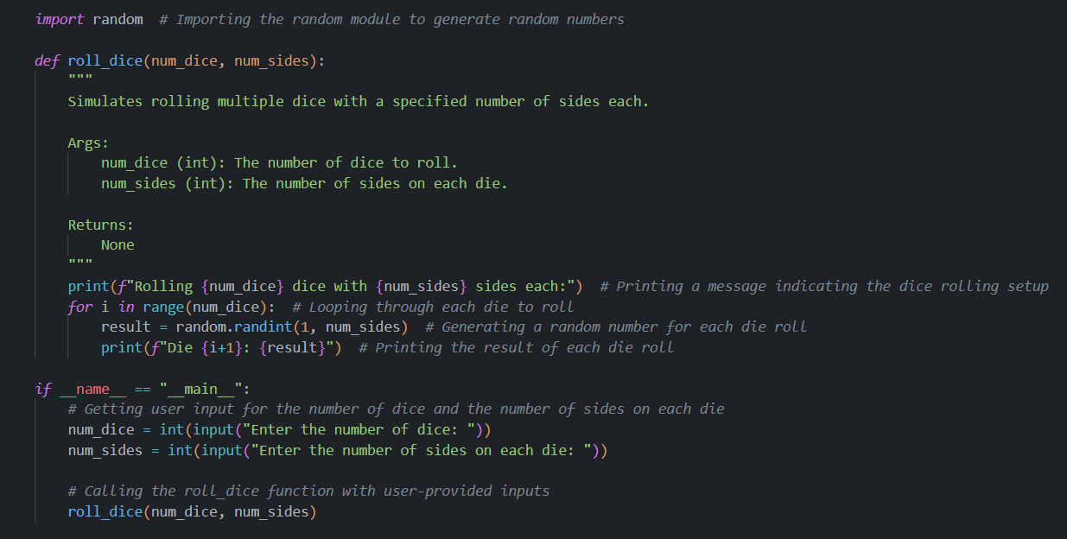
Code Snippet

Slide 6

Output

Slide 7
Conclusion
In conclusion, we have successfully developed a simple yet effective dice rolling simulator using Python. Throughout this project, we have learned and applied fundamental programming concepts, including working with functions, loops, user input, and the random module.
This simulator provides a practical demonstration of how programming can be used to mimic real-world scenarios, such as rolling dice in games or conducting statistical experiments. By customizing the number of dice and the number of sides on each die, users can tailor the simulation to suit their specific needs.
Additionally, this project serves as a valuable learning experience for Python beginners, allowing them to practice coding skills in a fun and interactive way. Through this project, users have gained insights into problem-solving, code organization, and user interaction.

