Slide 1
Wine Quality Prediction
Team Member and Roll No:
Avikam Bir(2210990198)
Daksh Chawla(2210990243)
Ashish Karakoti(2210990186)

Slide 2
Index
Objective
Introduction
Problem Statement
Methodology, Approach & Techniques
Algorithm
Result
Reference

Slide 3
Objective
Develop a predictive model using machine learning techniques to predict wine quality.
Main objectives that we have focused on are
Data Collection and Preprocessing
Model Development
Evaluation and Validation

Slide 4
Introduction
Wine quality prediction is a compelling application of machine learning (ML) that combines data science with oenology, the study of wines. The objective of this project is to develop an ML model capable of predicting the quality of wines based on various physicochemical properties. By analyzing a dataset containing attributes such as acidity, residual sugar, pH level, and alcohol content, the model will learn to estimate the quality ratings typically assigned by human experts.
This project not only aids winemakers in quality control but also enhances the efficiency of the wine production process. Leveraging ML techniques for such predictions can significantly reduce the need for extensive manual tasting sessions, thereby saving time and resources while maintaining high standards of quality. Furthermore, it opens the door for new insights into how different chemical properties influence the perceived quality of wine, potentially guiding the production of superior wines in the future.

Slide 5
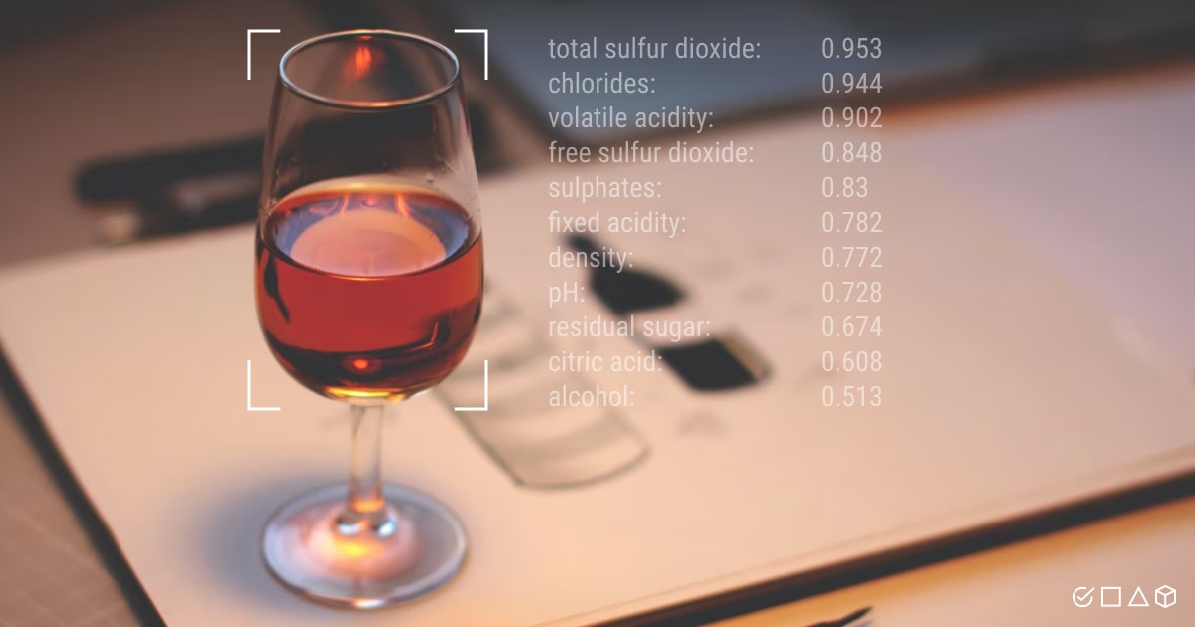
Problem Statement
Develop a model of Wine Quality prediction using machine learning.

Slide 6
Methodology, Approach & Techniques
Methodology:
Data Preprocessing: Handle missing values: Impute missing data using techniques like mean, median, or mode imputation.
Compare the performance of different models and choose the best-performing one.

Slide 7
Methodology, Approach & Techniques
APPROACH:
Data Import and Cleaning:
Imported necessary libraries for data analysis and visualization.
Read the dataset from a CSV file using Pandas.
Made a copy of the dataset for manipulation.
Exploratory data analysis
It helps us to uncover the underlying structure of data and its dynamics through which we can maximize the insights.
EDA is also critical to extract important variables and detect outliers and anomalies.
EDA is considered one of the most critical parts to understand the data.

Slide 8
Methodology, Approach & Techniques
TECHNIQUES
Machine Learning Models:
Decision trees are particularly useful for predicting wine quality due to their interpretability, ability to handle both numerical and categorical data, and robustness to non-linear relationships.
Random Forest is particularly useful for predicting wine quality due to its high accuracy, ability to handle a large number of input features, and resistance to overfitting.
SVM is particularly useful for predicting wine quality due to its effectiveness in high-dimensional spaces, versatility with different kernel functions, and robustness against overfitting
Logistic Regression is particularly useful for predicting wine quality due to its simplicity, interpretability, and efficiency with large datasets.

Slide 9
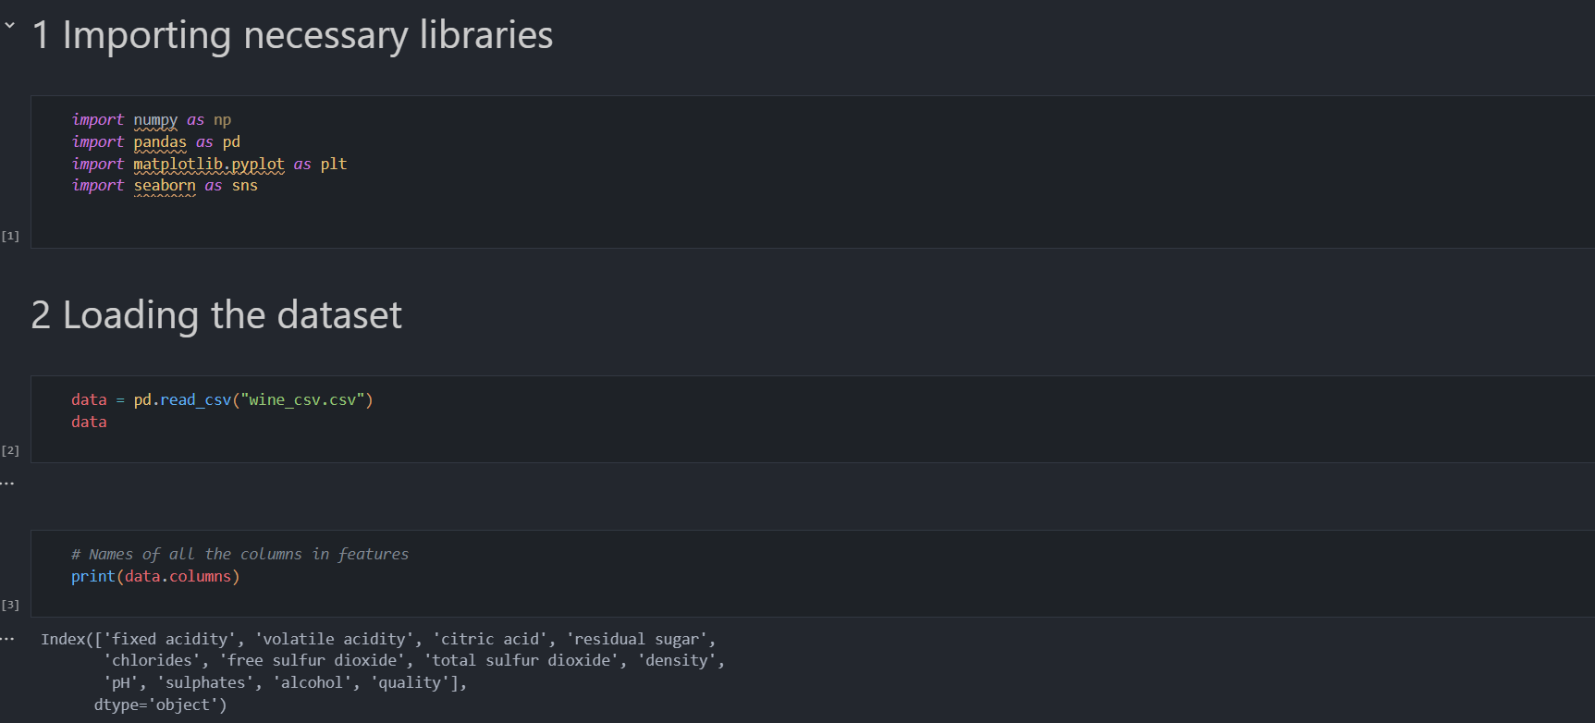
Source Code (screenshots)

Slide 10
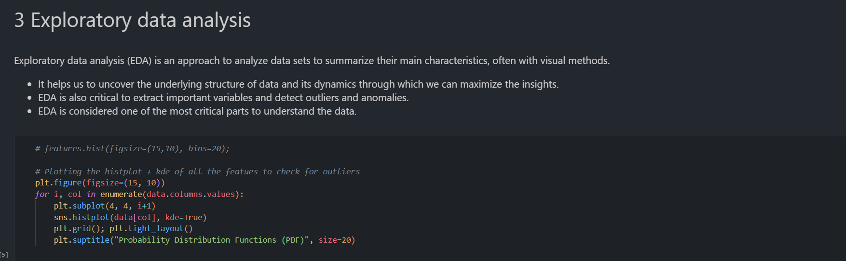
Source Code (screenshots)

Slide 11
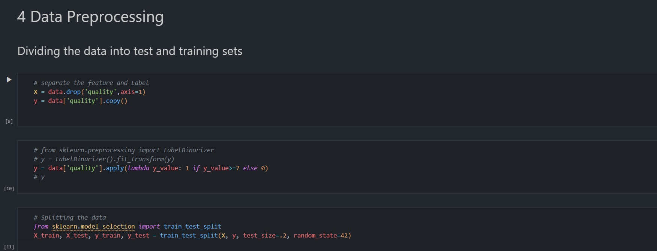
Source Code (screenshots)

Slide 12
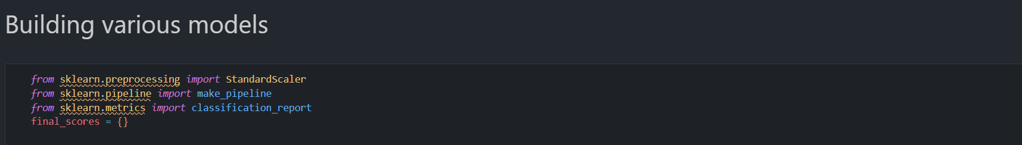
Source Code (screenshots)

Slide 13
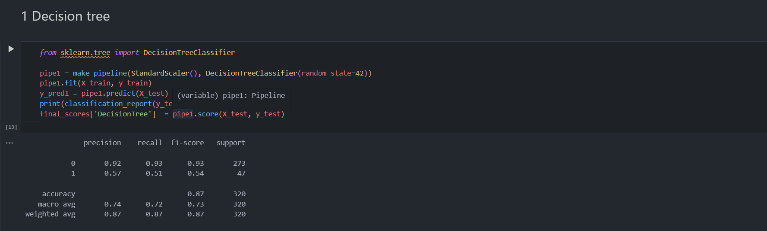
Source Code (screenshots)

Slide 14
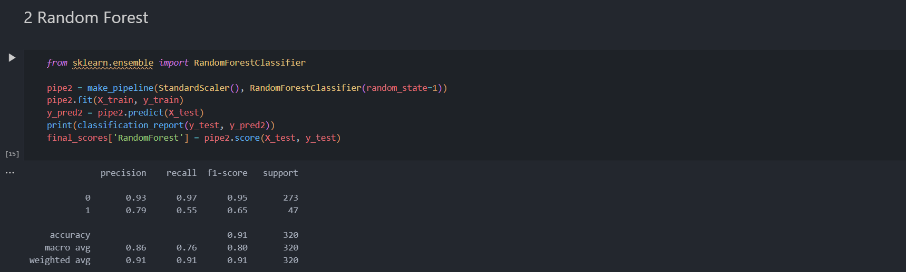
Source Code (screenshots)

Slide 15
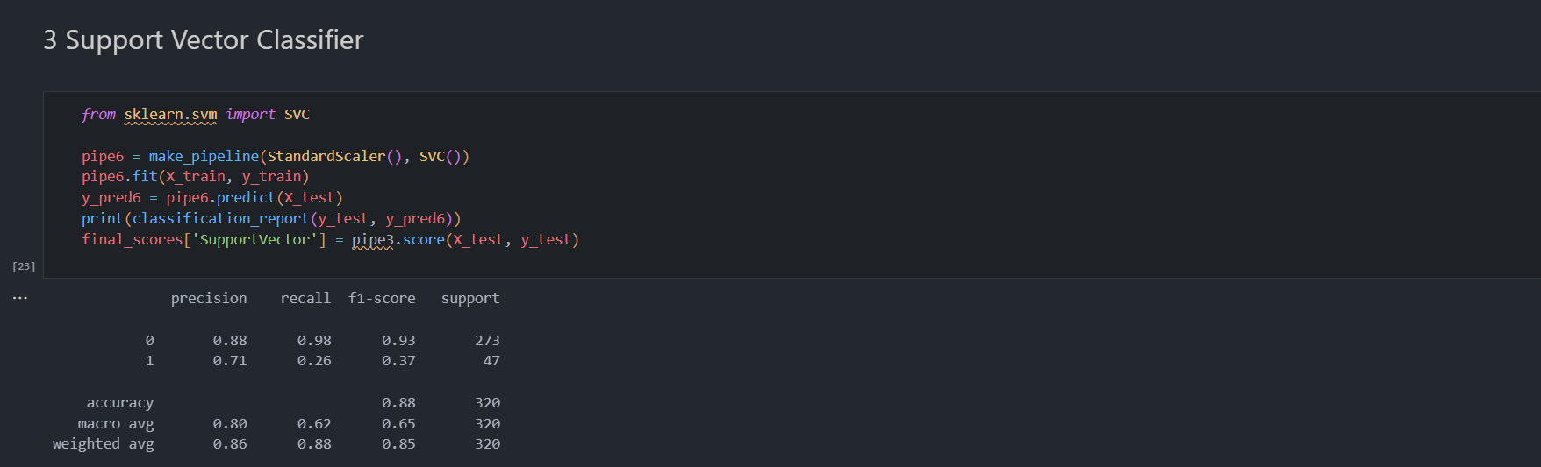
Source Code (screenshots)

Slide 16
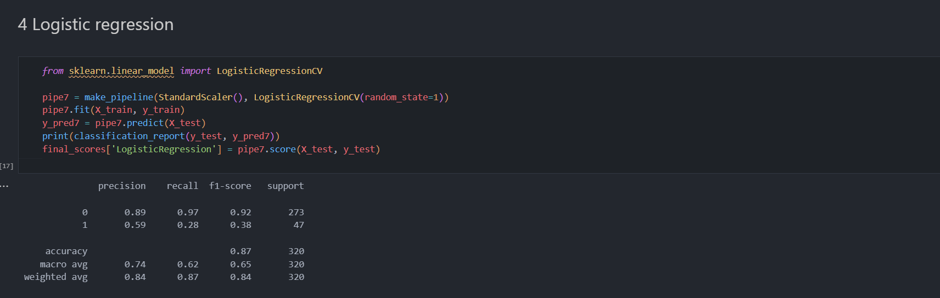
Source Code (screenshots)

Slide 17
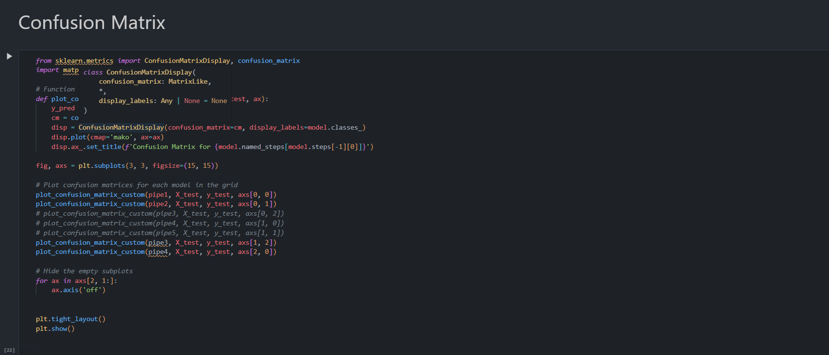
Source Code (screenshots)

Slide 18
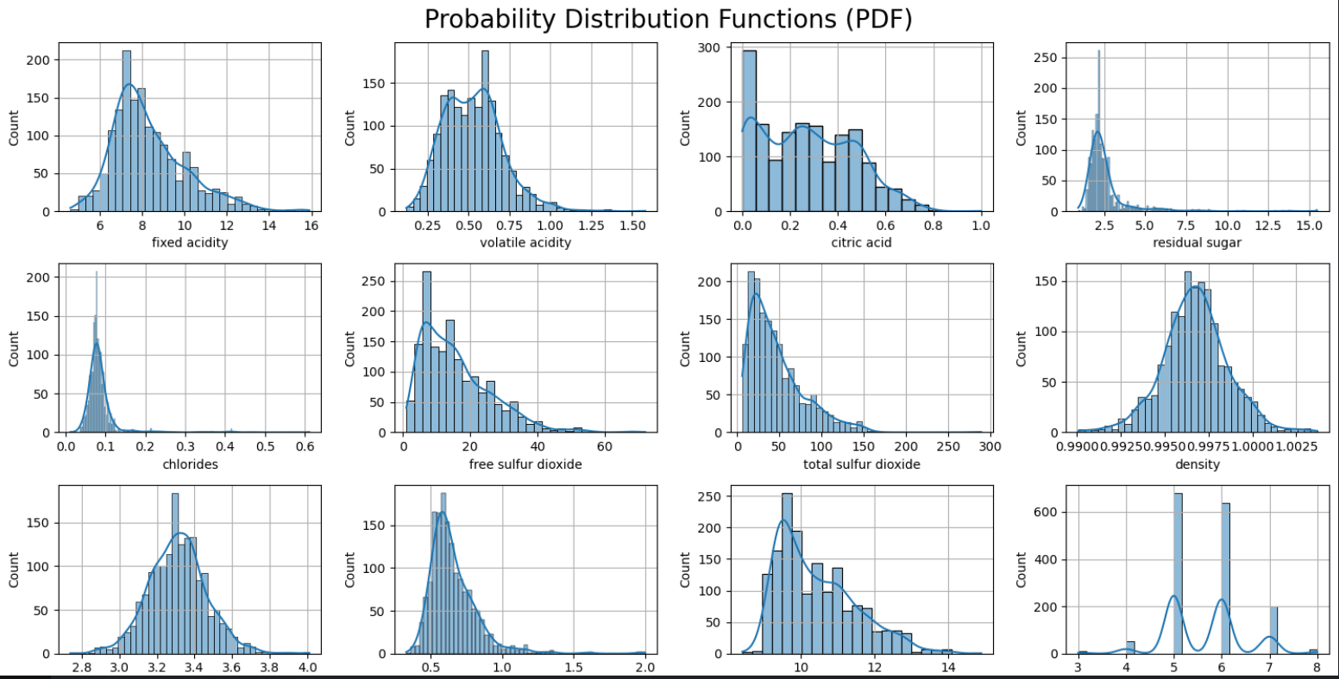
Result
Probability Distribution Functions(PDF):

Slide 19
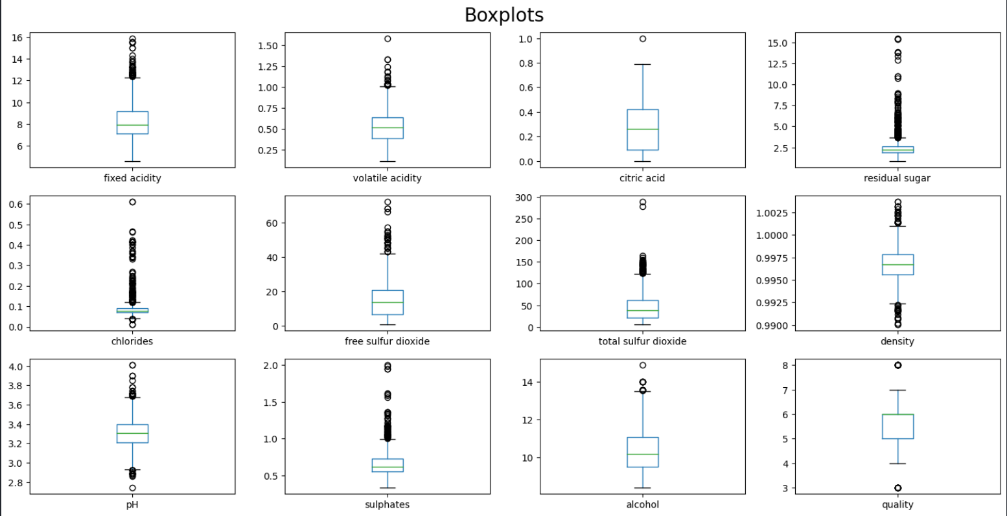
Result
Box-Plot:

Slide 20
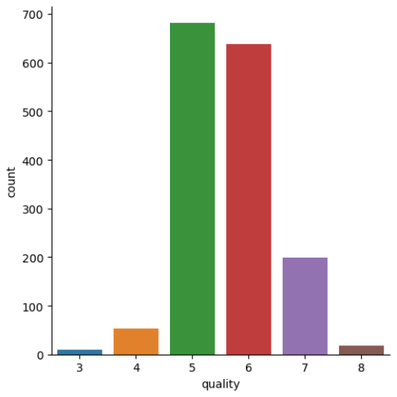
Result
Visualizing the count of all 6 classes of target label:

Slide 21
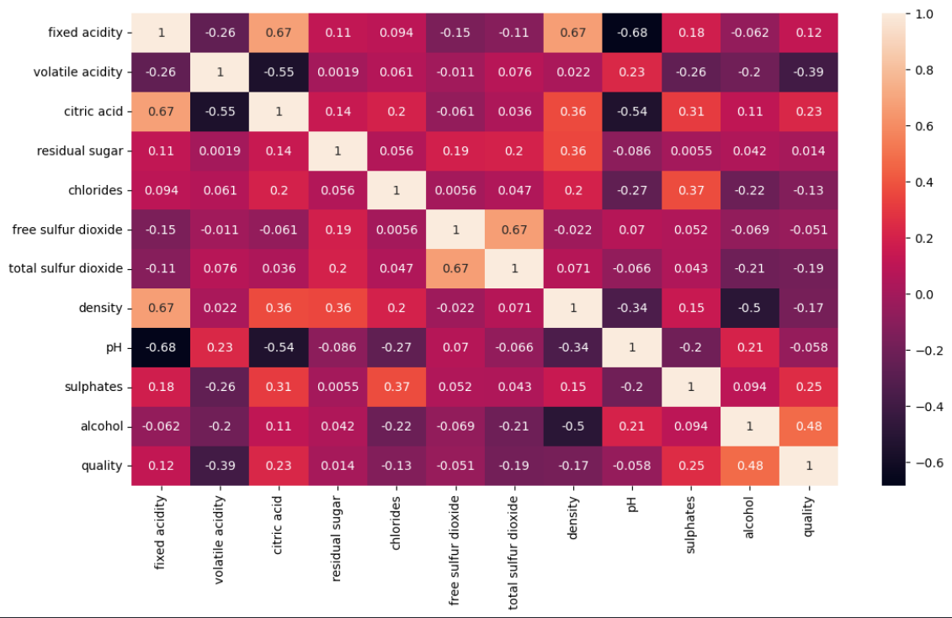
Result
Correlation Matrix:

Slide 22
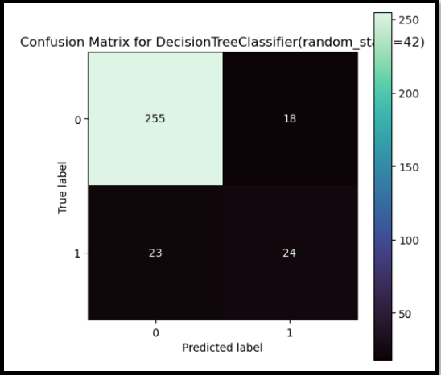
Result
Confusion matrix for decision tree

Slide 23
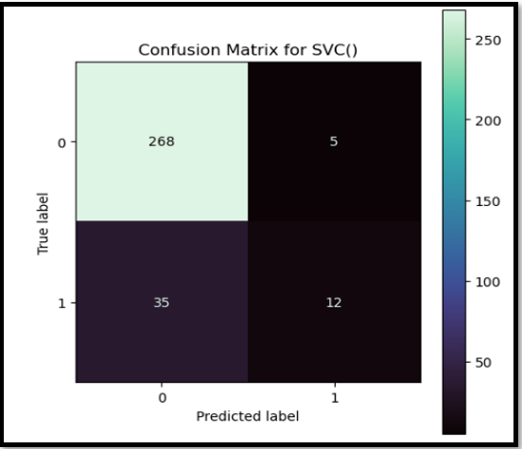
Result
Confusion matrix for SVC

Slide 24
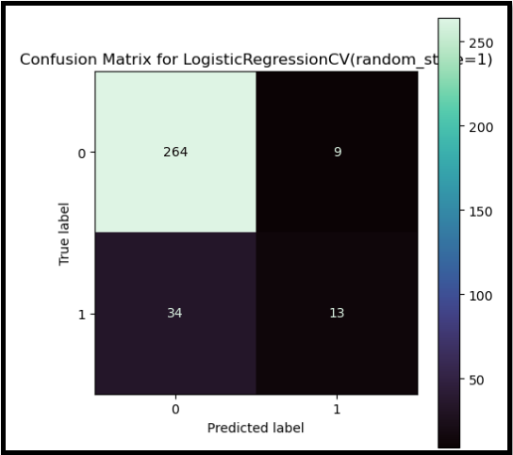
Result
Confusion matrix for logistic regression:

Slide 25
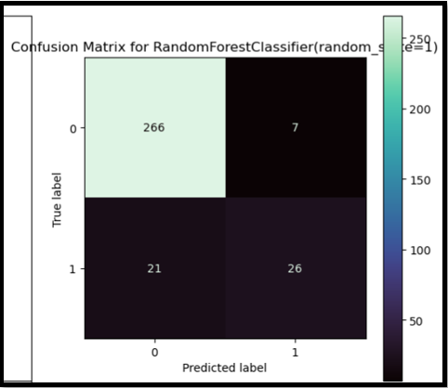
Result
Confusion matrix for random forest:

Slide 26
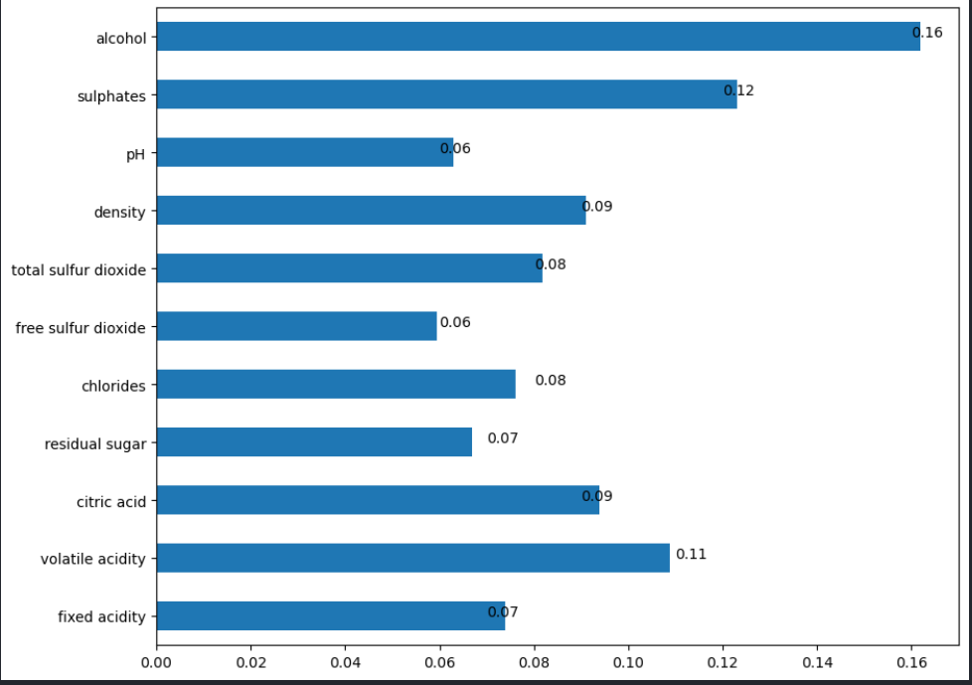
Result
Selecting the best features on which which wine quality depends

Slide 27

Conclusion
Accuracy of each model used:
Therefore after applying the most suitable machine learning algorithms,random forest was the most accurate algorithm with 91.25% accuracy.
Another conclusion that came into light after using these algorithms was that alcohol content was the most important factor in predicting wine quality.

Slide 28
Reference
https://www.youtube.com/siddhardhan
https://www.geeksforgeeks.com
www.javatpoint.com

Slide 29
The End

