Slide 1
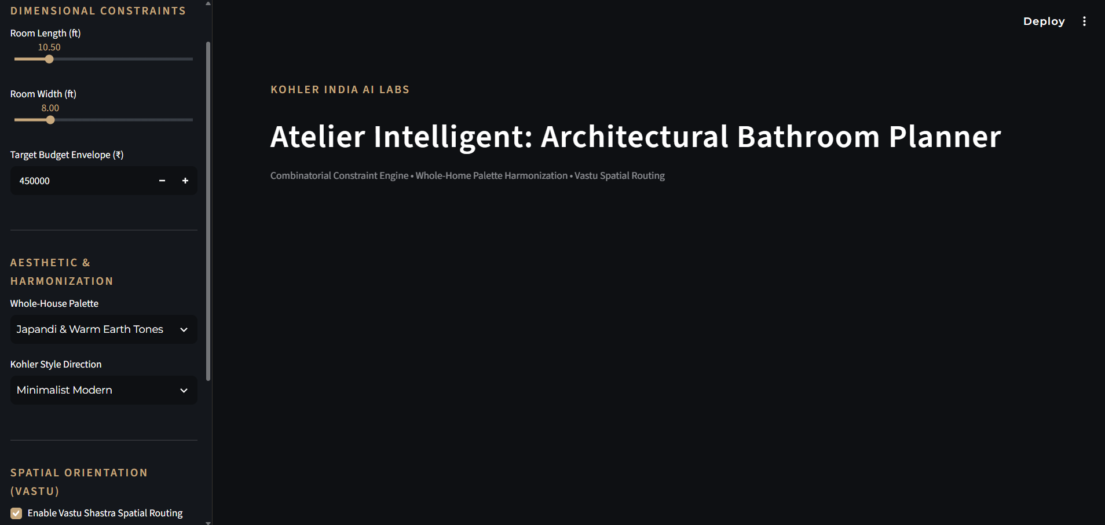
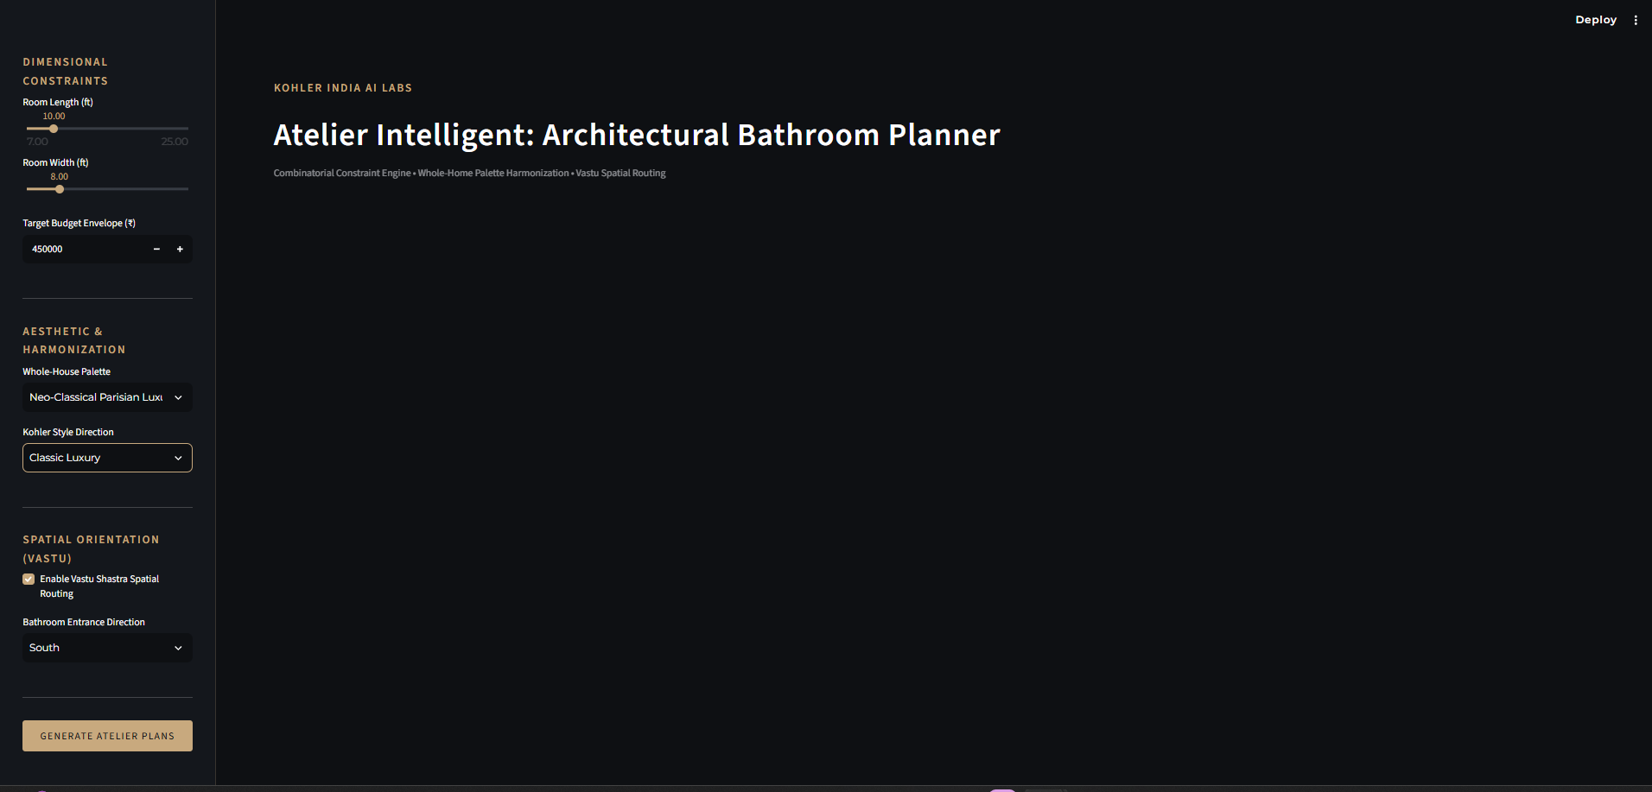

ATELIER INTELLIGENT
COMBINATORIAL CONSTRAINT ENGINE
VASTU ROUTING
DYNAMIC WALLET SHARE
Atelier Intelligent
Architectural Bathroom Planner
A custom Python engine that bypasses LLM hallucinations entirely. It applies strict mathematics — not language-model guesswork — to filter millions of Kohler product combinations against budget limits and ADA-compliant physical floor space, keeping fixture occupancy under 40% of the room envelope.
[ Insert Screenshot 1:
Streamlit App Hero / Sidebar ]

Slide 2



ATELIER INTELLIGENT
System Architecture
PILLAR 01
PILLAR 02
PILLAR 03
Input Layer
Core Engine — Python
Presentation UI — Streamlit
Room Dimensions — floor plan boundaries
Budget Envelope — total spend ceiling
Aesthetic Palette — finish & style intent
Vastu Entrance Direction — orientation input
Knapsack Solver — evaluates 5-item arrays
AABB Collision Detection — scans 2D grid matrix
Vastu Spatial Router — orientation-aware placement
Matplotlib CAD Generator — to-scale floor drawing
Dynamic Rendering — live layout updates
3-Step Showroom Checkout — guided purchase flow

Slide 3

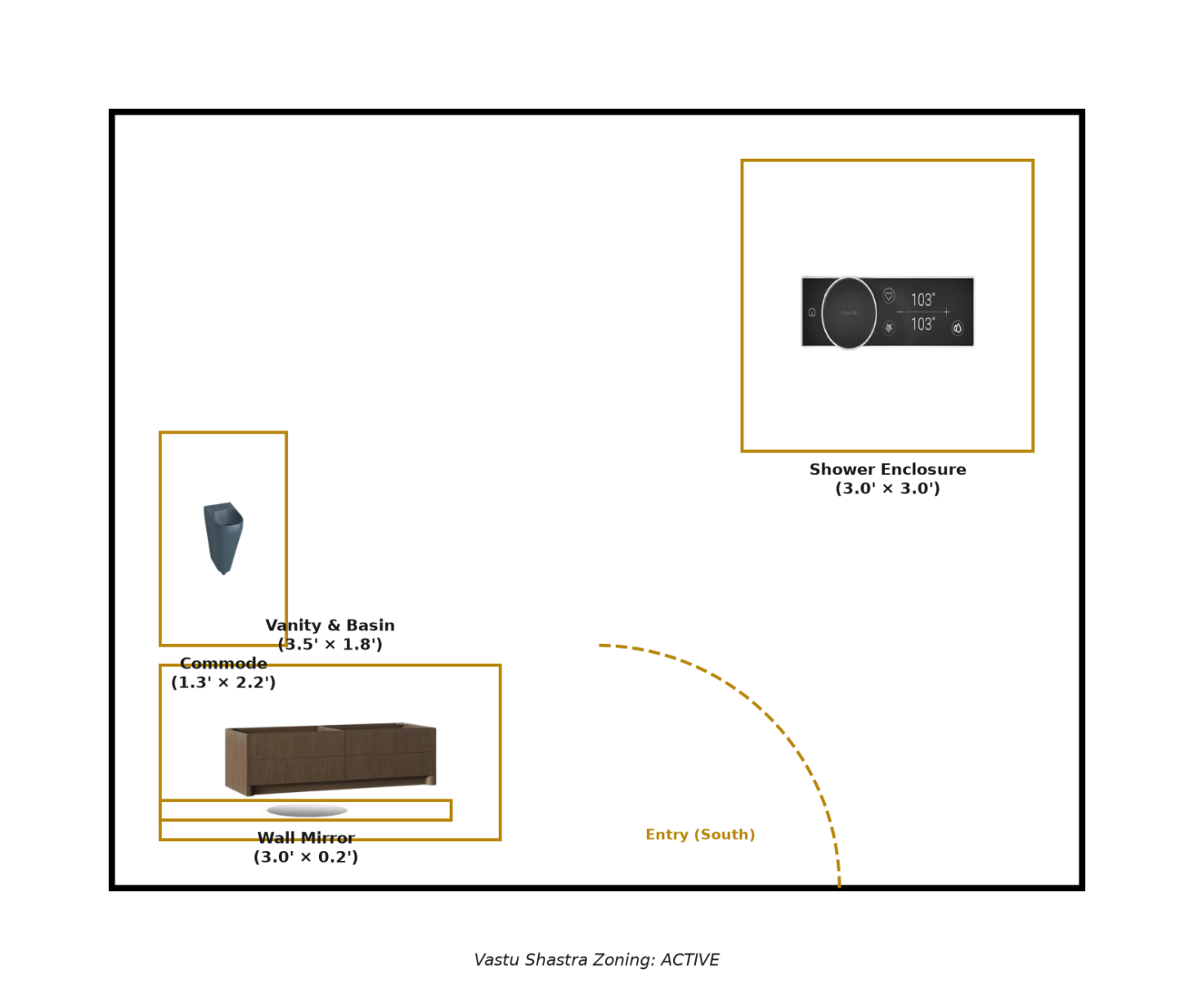


ATELIER INTELLIGENT
Precision Engineering Over Generative Guesswork
The Math
Every valid bundle is scored on a weighted formula, so the highest-ranked combination is provably the best fit — not the most plausible-sounding one.
[ Insert Screenshot 2:
Matplotlib 2D CAD Blueprint ]
Collision Avoidance
Axis-Aligned Bounding Box logic acts as true pathfinding. If an ideal coordinate is blocked by the door swing, the engine reroutes automatically.
Local Processing
Runs entirely on-device with zero API calls — highly stable and instantly deployable on showroom iPads, even offline.

Slide 4

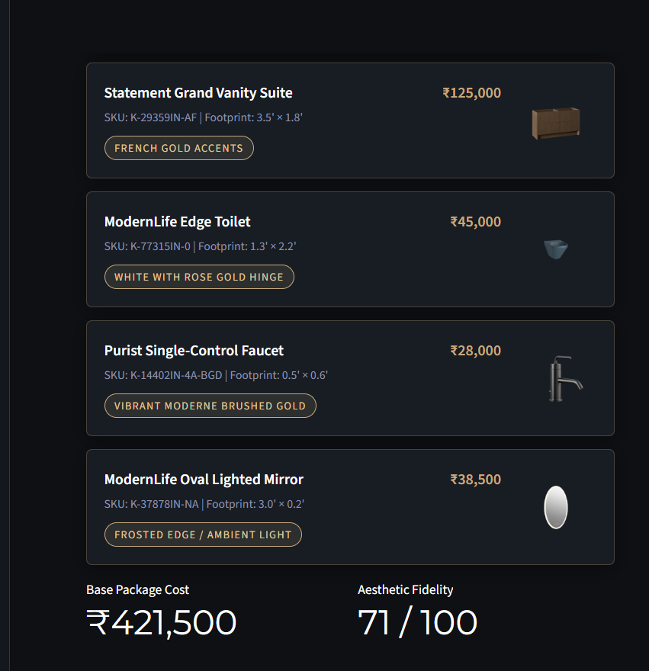


ATELIER INTELLIGENT
Wallet Share Optimization
STEP 01
Dynamic Budget Masking
The engine hides the remaining budget during base selection, keeping focus on core plumbing fixtures instead of the price tag.
STEP 02
Intelligent Upselling
Once the base is set, the engine calculates the exact remaining financial envelope and triggers the “Complete the Suite” module.
[ Insert Screenshot 3:
Step 2 Accessory Checkout UI ]
STEP 03
Targeted Conversions
Only premium accessories — towel warmers, smart mirrors — that mathematically fit the remaining budget are surfaced, acting as a digital sales associate without inducing sticker shock.

