Slide 1


SMART INDIA HACKATHON 2025
Problem Statement ID – SIH25022
Problem Statement Title- Maximizing Section Throughput Using Al-Powered Precise Train Traffic Control
Theme- Transportation & Logistics
PS Category- Software
Team ID-
Team Name- KRITAGYA

Slide 2
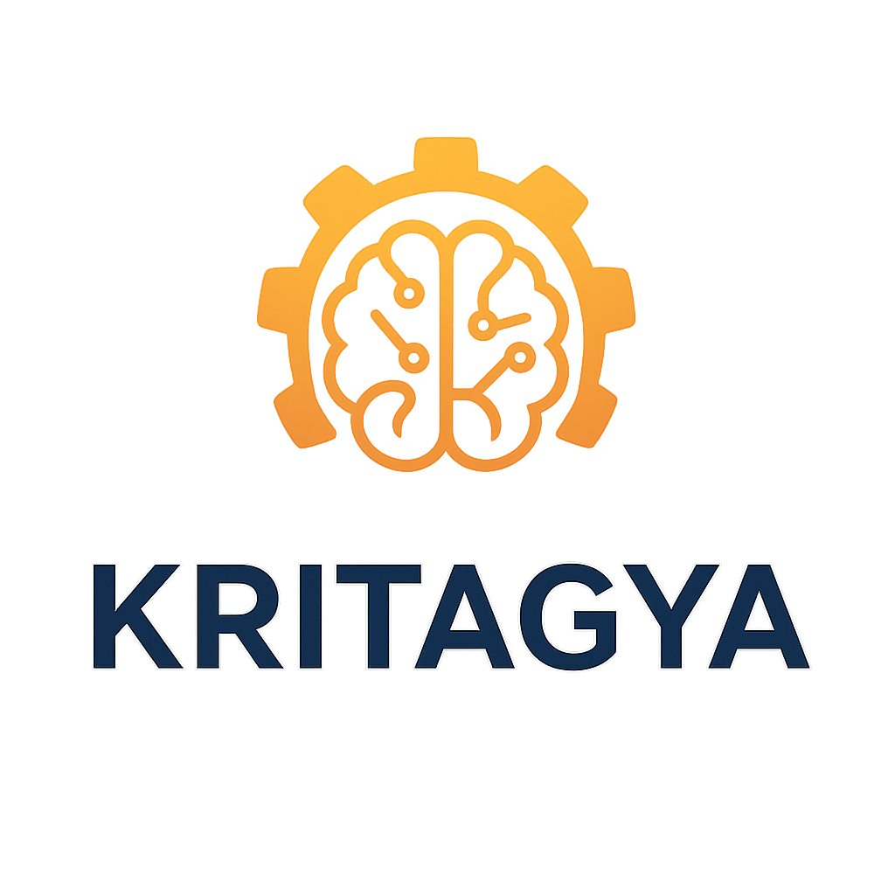
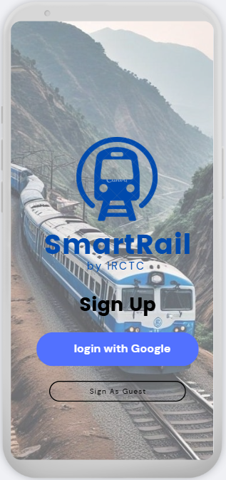
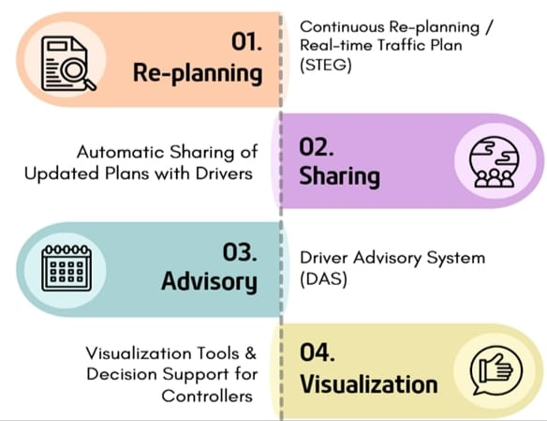
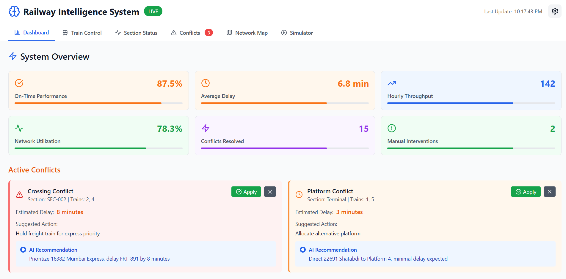
Maximizing Section Throughput Using Al-Powered Precise Train Traffic Control
UNIQUENESS & INNOVATION
SOLUTION EXPLANATION
AI-powered train traffic control system that uses real-time data (GPS, speed, delays, weather) to optimize scheduling and train spacing.
Driver Advisory System (DAS) guides optimal speed and eco-driving, while controllers get visual dashboards for better decision-making.
Using AI-driven analytics, optimization, and real-time updates, the system cuts delays, improves safety, and increases throughput by 30–40% without new infrastructure.
Smarter Tracks, Smoother Trains – AI That Moves Railways Forward
PROTOTYPE LINK-
https://indian-railways-inte-191

Slide 3
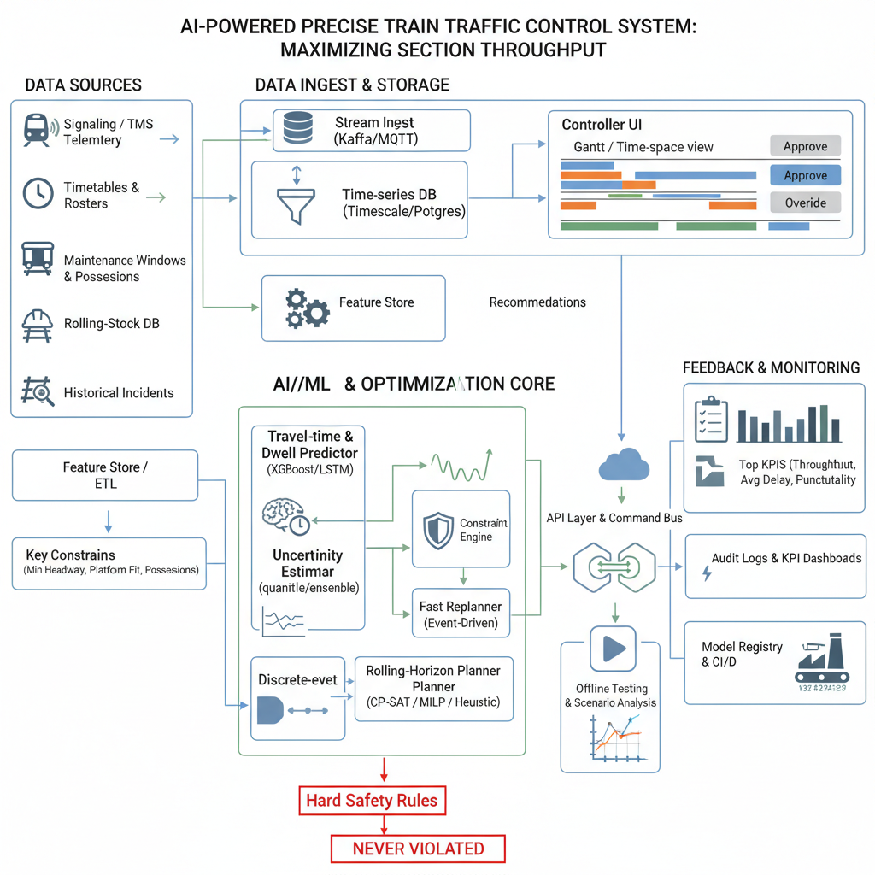
TECHNICAL APPROACH
Data Management
Efficient data management with Kafka, MQTT, TimescaleDB.
1
Machine Learning
Advanced machine learning using XGBoost, LSTM models.
2
Tech Stack
3
Optimization
Optimization through Constraint Engine, CP-SAT, MILP solvers.
4
API and Deployment
5
Seamless API deployment with CI/CD, Model Registry.
Monitoring and Logging
Robust monitoring and logging with Grafana/Kibana, Audit Logs.

Slide 4
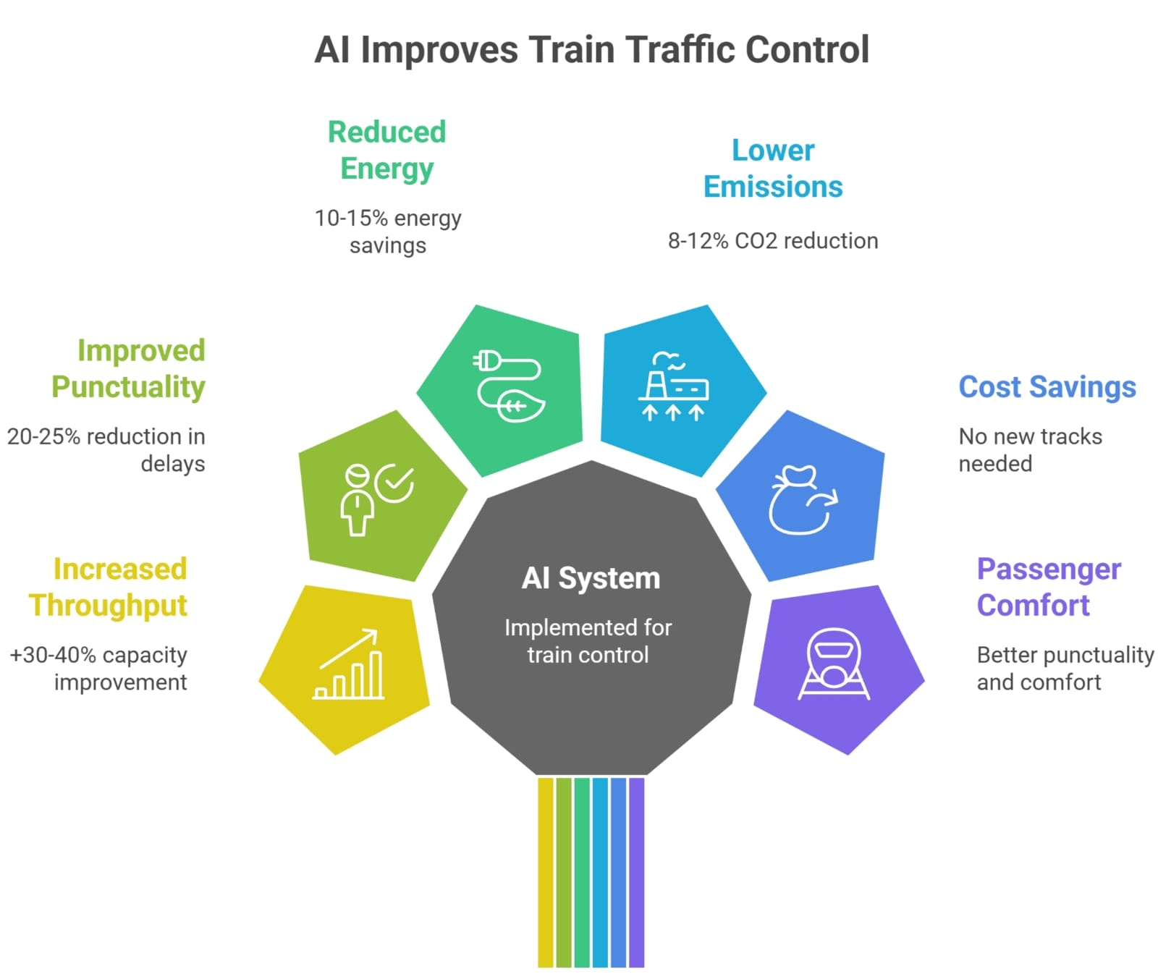

FEASIBILITY AND VIABILITY
FEASIBILITY
🌱
Energy Efficiency
📉
Conflict Reduction
Safety Assurance
📊
Scalability

Slide 5
IMPACT AND BENEFITS
Increased Section Throughput
AI-driven rescheduling + optimal headways → up to 30–40% more trains per section
AI-Powered Rail Network Optimization
Reduced Delays & Improved Punctuality
Real-time adaptive planning cuts average delays by 20–30%
Enhanced Competitiveness
Continuous Optimization
Energy & Environmental Gains
Eco-driving + DAS lowers energy consumption by 12–18%
Long-Term Cost Savings
Innovation and Development
Operational Efficiency
Controller workload reduced by 40% with visualization & decision-support tools
Exceptional Reliability
Data-Driven Decisions
Scalability
Uses open datasets (Indian Railways, GTFS, ONTIME) for nationwide rollout
Sustained High Throughput
Sustainable Operations

Slide 6
RESEARCH AND REFERENCES
Title: Artificial Intelligence in Railway Transport: Taxonomy, Regulations, and Applications
Authors: Nikola Bešinović, Lorenzo De Donato, Francesco Flammini, Rob M. P. Goverde, Zhiyuan Lin, Ronghui Liu
Published in: IEEE Transactions on Intelligent Transportation Systems.
Title: Remote Sensing and Machine Learning for Safer Railways: A Review
Authors: Helmi, W.; Bridgall, R.; Askarzadeh, T.
Published in: Applied Sciences, 2024, 14(9):3573
DOI: 10.3390/app14093573
Title: Towards a Safe MLOps Process for the Continuous Development and Safety Assurance of ML-based Systems in the Railway Domain
Authors: Marc Zeller, Thomas Waschulzik, Reiner Schmid, Claus Bahlmann
Published: arXiv preprint, 2023
Title: Improving Theoretic Train Driving Time with AI and TensorFlow
Authors: Emil Krsak, Tomas Kello
Conference: 2020 4th International Symposium on Informatics and its Applications (ISIA), IEEE

