Slide 1
Federated Risk-Sensitive Q-Learning in Continuous Time
Reproducing Xie (2025) and extending to heterogeneous financial markets
DDLS Spring 2026 · Universität Bern · April 28, 2026

Slide 2
Why This Paper?
Finance is where risk-sensitive RL actually matters
THE PROBLEM
THE FIX
• Portfolio allocation is a continuous-time decision
• Banks, pension funds, hedge funds all face it daily
• Classical RL: risk-neutral agents + discrete time
• Neither assumption holds in real finance
• CT-RS-q: continuous-time risk-sensitive q-learning
• Handles non-linear objectives: mean-variance, CVaR, exponential utility
• Risk-sensitivity baked into the algorithm via OCE framework
• Provably optimal policy
"Most RL papers either ignore risk or bolt it on as a constraint. This paper bakes risk-sensitivity into the learning algorithm itself."

Slide 3
The Problem Setup
Wealth follows a stochastic process; maximize a risk-sensitive functional
Portfolio SDE
dX_t = X_t (a_t·r₁ + (1−a_t)·r₂) dt + X_t (a_t·σ₁·dW₁ + (1−a_t)·σ₂·dW₂)
a_t ∈ [0,1] — fraction of wealth in asset 1 at time t
Objective (Mean-Variance)
MV(X_T) = E[X_T] − (α/2)·Var(X_T) α = risk aversion
WHY CLASSICAL BELLMAN FAILS
THE FIX — STATE AUGMENTATION
Non-linear objectives break the Markov property. Optimal policy is not Markovian in just (t, X_t).
Augment state to (t, X_t, B⁰_t, B¹_t) B⁰ accumulates rewards; B¹ tracks OCE discounting → Bellman works again on the augmented state

Slide 4
The Algorithm: CT-RS-q
Jointly learns value function J_θ and q-function q_ψ via continuous-time TD
Two Learned Objects (8 scalar parameters total)
Policy (Gaussian)
• J_θ(t,x) — value function, quadratic in x [3 params: θ]
• q_ψ(t,x,a) — q-function, quadratic in (a−a*) [5 params: ψ]
• No neural nets — provably optimal parameterization
π_ψ(a | t, x) = N( a*(t,x), σ²_τ(t,x) ) mean = optimal allocation a*(t,x) variance = exploration temperature τ
1. ROLLOUT
2. TD ERRORS
3. GRADIENT UPDATE
4. UPDATED POLICY
Run trajectory under current policy π_ψ
→
TD_k = J_{k+1} − J_k − q_k·dt
→
Ascent on θ and ψ using TD as multiplier
→
New π_ψ with refined mean & variance
"The learned object is an allocation rule — at every instant t, given current wealth x, it tells you what fraction to invest in asset 1."

Slide 5
What We Reproduced
Table 1, Figure 1, Figure 2 — MV objective within 1.5% of the paper
Policy | Cum Return | Std Dev | MV Objective
Baseline (a=0.5) ours / paper | 0.221 / 0.222 | 0.095 / 0.096 | 1.217 / 1.217
Optimal (closed form) ours / paper | 0.709 / 0.713 | 0.720 / 0.721 | 1.450 / 1.453
CT-RS-q (learned) ours / paper | 0.729 / 0.816 | 0.791 / 0.872 | 1.416 / 1.437
• Baseline and Optimal land within Monte Carlo noise — essentially exact
• CT-RS-q: MV within 1.5% of paper — the 10.7% cumulative return gap traces to a single
• parameter overshooting on this seed (stochasticity, not a code error)

Slide 6
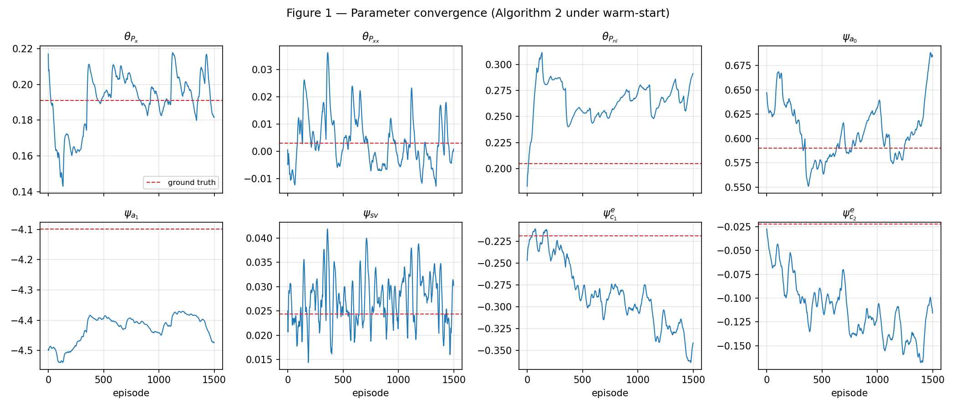
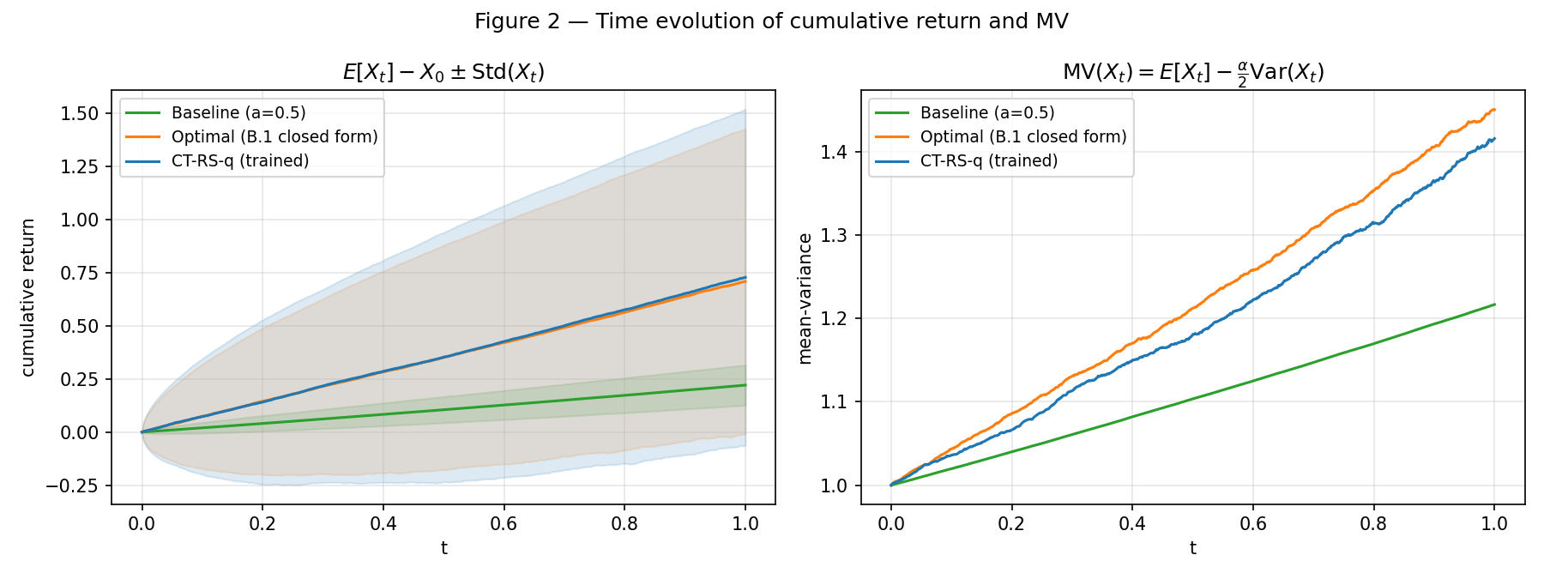
Convergence & Time Evolution
Qualitative picture matches the paper — two findings to highlight
Fig 1 — 8-panel parameter convergence Note ψ_ce1 and ψ_ce2 drifting in parallel →
Fig 2 — CT-RS-q tracks optimal on MV Both strongly beat baseline

Slide 7
What We Found: Structural Non-Identifiability
The paper's parameterization has a flat direction the authors don't acknowledge
The Observation
ψ_ce1 and ψ_ce2 drift in parallel in Figure 1. Individual values diverge from ground truth — but their DIFFERENCE stays constant.
The Math
a_ψ ∝ ψ_a0 − ψ_a1·(1 + c1_ψ / (2·c2_ψ·x)) c1_ψ / c2_ψ ∝ exp( (ψ_ce1 − ψ_ce2)·τ )
ψ_ce1 and ψ_ce2 enter the loss ONLY through their difference. Gradient is zero along (+1, +1) direction → flat null-space. No training resolves individual values.
Paper says
Why FedAvg Fails Here
"ψ_ce1 and ψ_ce2 do not fully converge due to non-zero τ" → Incomplete: cause is structural, not an exploration artifact
Each worker drifts to a DIFFERENT point in the null-space. FedAvg averages those points — a third meaningless point. → FedAvg is broken by construction on this loss.
We found something the authors missed — and it turns out to be the exact reason vanilla FedAvg fails.

Slide 8
The Federated Setting
Finance is naturally federated — this is not a forced extension
• Banks, asset managers, pension funds: each has its own market data, its own clients, its own risk tolerance
• They cannot and do not share raw data
• Each institution has a different risk aversion α — a pension fund and a hedge fund should NOT share a policy
Worker | r₁, r₂ | σ₁, σ₂ | Risk α
Worker 1 | 0.15, 0.25 | 0.10, 0.12 | 1.0
Worker 2 | 0.30, 0.10 | 0.20, 0.15 | 2.0
Worker 3 | 0.05, 0.08 | 0.05, 0.06 | 0.5
Worker 4 | 0.20, 0.20 | 0.25, 0.30 | 3.0
Held-out market | 0.12, 0.18 | 0.15, 0.18 | 1.5
Heterogeneous markets AND heterogeneous risk preferences — both dimensions the original paper has no mechanism for.

Slide 9
Our Extension: Three Methods
Local (no comms) vs FedAvg (fails) vs PF-CT-RS-q (our contribution)
LOCAL CT-RS-q
VANILLA FedAvg
PF-CT-RS-q (ours)
Each worker trains independently. No communication. Baseline — upper bound for personalization.
Server averages ALL parameters (θ and ψ). Fails because: 1. Null-space averaging makes ψ_ce1, ψ_ce2 meaningless 2. Averaging ψ across different α destroys risk calibration
Federate θ only (shared market structure) Keep ψ local (risk preferences are personal) Null-space fix: freeze ψ_ce2 — pins the flat direction θ / ψ split comes directly from the math of the paper
✓ Personalized ✗ No knowledge sharing
✗ Null-space collapse ✗ Risk calibration lost
✓ Shared dynamics ✓ Personalized risk ✓ Null-space pinned
The θ/ψ split is principled: θ captures dynamics (transferable), ψ captures risk preferences (personal).

Slide 10
Decentralized Extension
Same principled split, no server needed — connects directly to Week 7 (Dec-RL)
Setup
Why Harder Than Federated
• Remove central server — workers communicate peer-to-peer
• Two topologies: Ring (2 neighbors) and Fully Connected
• Mixing weights: Metropolis-Hastings (standard for gossip)
• Same parameter split: gossip θ, keep ψ local
• Same null-space fix: freeze ψ_ce2
• No central aggregator to correct null-space drift
• Each worker's θ must converge via local averaging only
• Freeze on ψ_ce2 becomes even more critical
• FC topology: faster consensus (O(log n) mixing)
• Ring topology: slower consensus — tests robustness
Ring Topology 1 — 2 — 3 — 4 — 1 (2 neighbors each)
Fully Connected Every worker ↔ every other (max connectivity, fastest mixing)
Phase 3 — in design. Building after Phase 2 is verified (target: May 19).

Slide 11
What We Will Show
Concrete, honest plan — one primary plot, honest timeline
Primary Result: MV on held-out market
Local CT-RS-q (avg over workers)
─────────────────────
X (reference)
Vanilla FedAvg
────────── X
drops — null-space collapse
PF-CT-RS-q (ours)
─────────────────────
✓ principal result
Dec CT-RS-q ring
───────────────────
✓ slightly lower
Dec CT-RS-q FC
─────────────────────
✓ matches federated
Timeline
Phase 2 (federated)
Phase 3 (decentralized)
Final report draft
Final presentation
May 12
May 19
May 22
May 26
"We're not just applying FedAvg — we're using a property of the paper's own parameterization to motivate why it will fail and how to fix it. That's the scientific contribution."

Slide 12
Summary
Phase 1 done, extension principled and locked, ready for Phase 2
✅
Reproduced Table 1, Figure 1, Figure 2 (MV within 1.5% of paper)
✅
Found and formalized structural non-identifiability in B.2 parameterization
✅
Extension design: θ federation, ψ personalization, null-space pinning
⏳
Phase 2 (Federated, Module FL): in progress — target May 12
⏳
Phase 3 (Decentralized RL, Module Dec-RL): after Phase 2 verified — May 19
This paper is a strong choice for DDLS extensions because the math of continuous-time risk-sensitive RL gives you a principled reason why federated averaging fails — and a principled fix.

