Slide 1
Payment Behaviour & Digital Payment Intelligence
Fundamentals of Machine Learning (MLE2503) | Semester 5
Amity School of Engineering and Technology
DAKSH VERMA
Enrollment Number: A501132524005

Slide 2
Problem Background
Customers use different payment modes: cash, cards, UPI/wallets and EMI/BNPL.
Payment preferences can vary with spending, frequency, channels and offer usage.
Goal: discover meaningful customer segments from observed behaviour.
Business use: payment incentives, cashback planning and better checkout experiences.

Slide 3
Objectives
Inspect and clean transaction-level data.
Aggregate transactions into customer-level behavioural features.
Compare payment-mode-only features with payment + spending + frequency + offer usage.
Compare K-Means and Agglomerative clustering.
Evaluate with Elbow, Silhouette Score, Davies–Bouldin Index and PCA plots.
Translate cluster profiles into cautious, evidence-based recommendations.

Slide 4
Dataset and Data Quality
Synthetic demonstration dataset: 18,109 transaction rows before cleaning; 1,000 unique customers.
Fields: transaction date, payment mode, amount, cashback, discount, EMI use and channel.
The data intentionally includes missing payment modes, duplicated transaction IDs and extreme values.
Important: replace with faculty-provided/approved data if available; synthetic findings are not real-world claims.

Slide 5
Preprocessing and Feature Engineering
Remove duplicate transactions using transaction_id.
Parse transaction dates; handle missing payment modes; remove invalid/non-positive amounts.
Cap extreme amounts at the 99th percentile for this demonstration.
Aggregate to customer level: spend, average value, transaction count, payment ratios, cashback/discount/EMI usage.
Standardize numerical features because distance-based clustering is scale-sensitive.

Slide 6
Machine Learning Methodology
K-Means: groups customers by minimizing within-cluster squared distances.
Elbow Method: inspect how inertia changes as K increases.
Agglomerative clustering: hierarchical alternative for comparison.
Silhouette Score: higher generally indicates better-separated clusters.
Davies–Bouldin Index: lower generally indicates better separation/compactness.
PCA: projects features to two dimensions for visualization; not a predictive model.

Slide 7
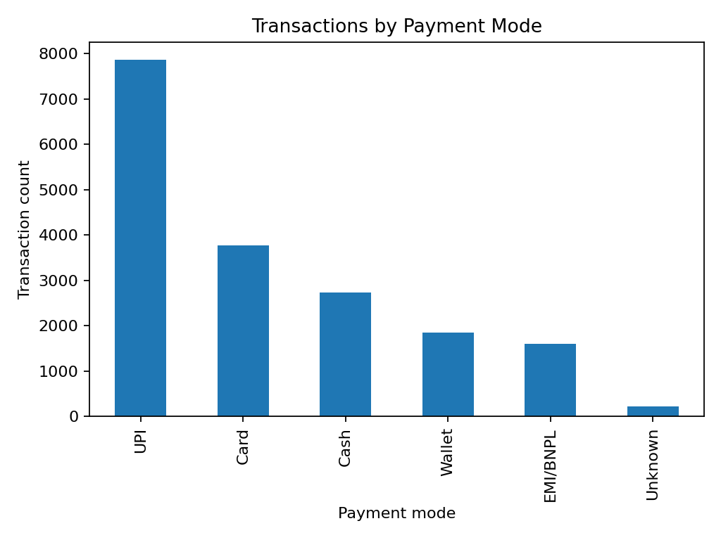
EDA: Payment Mode Distribution
Shows how often each payment mode appears in the synthetic transaction sample.
Use it to discuss the distribution, not to claim actual market share.

Slide 8
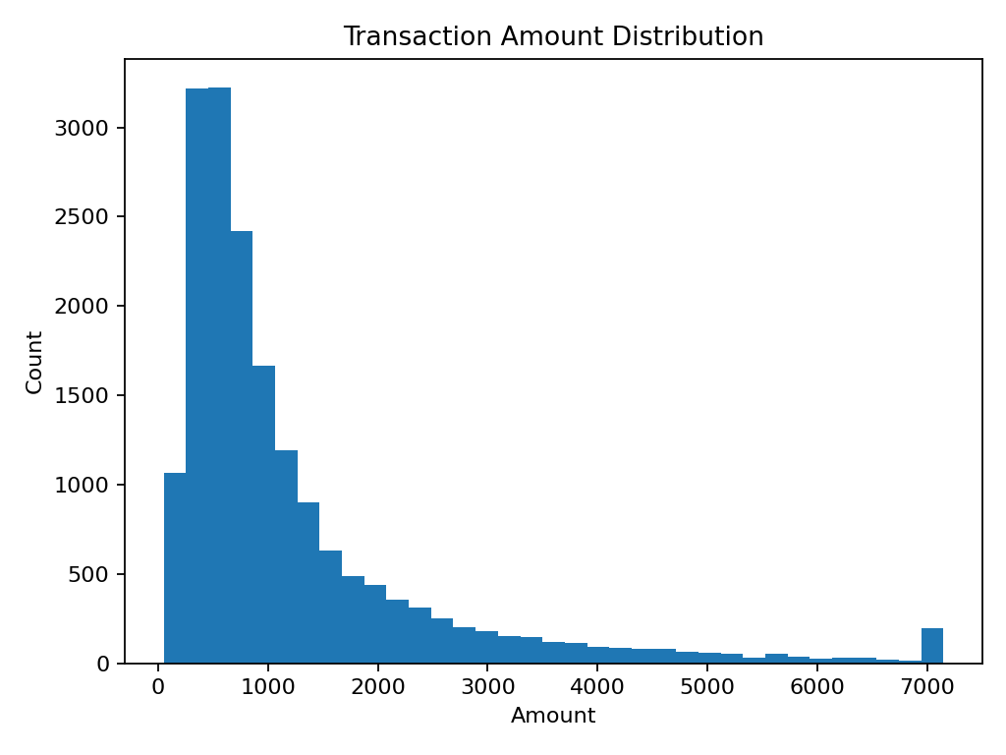
EDA: Transaction Amounts
Amounts are right-skewed in the generated sample. Extreme values can dominate distance-based methods, motivating investigation and robust preprocessing.

Slide 9
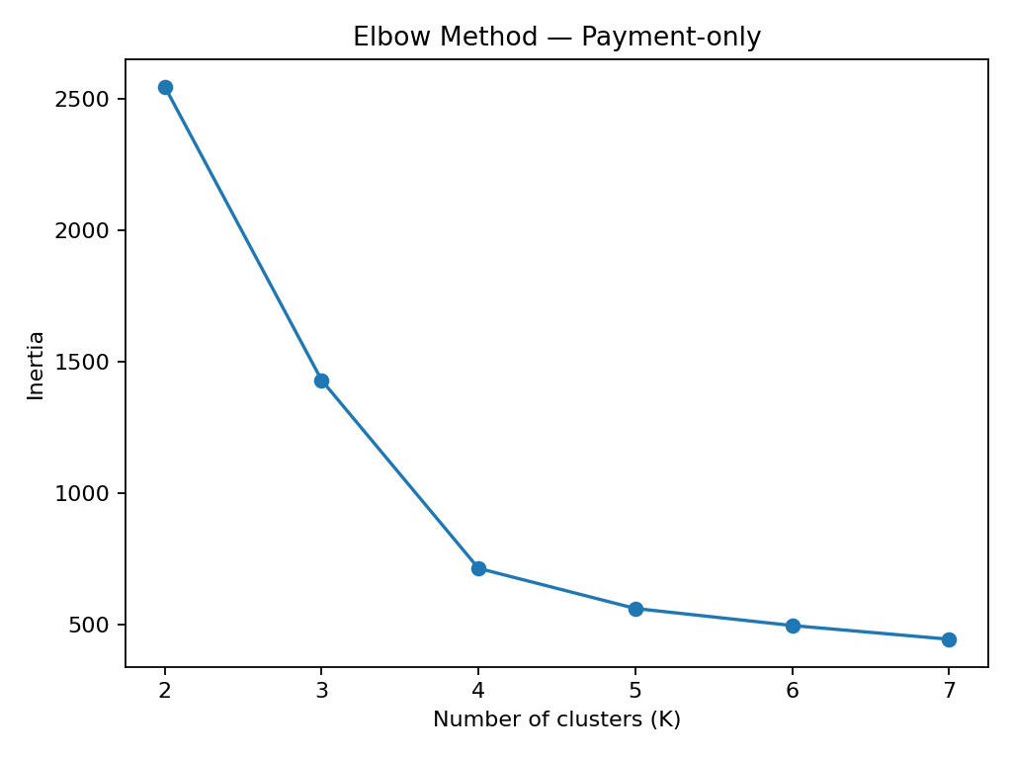
Elbow Method: Payment-only Features
Compare inertia across candidate K values. The elbow is a heuristic, not a definitive automatic answer.

Slide 10
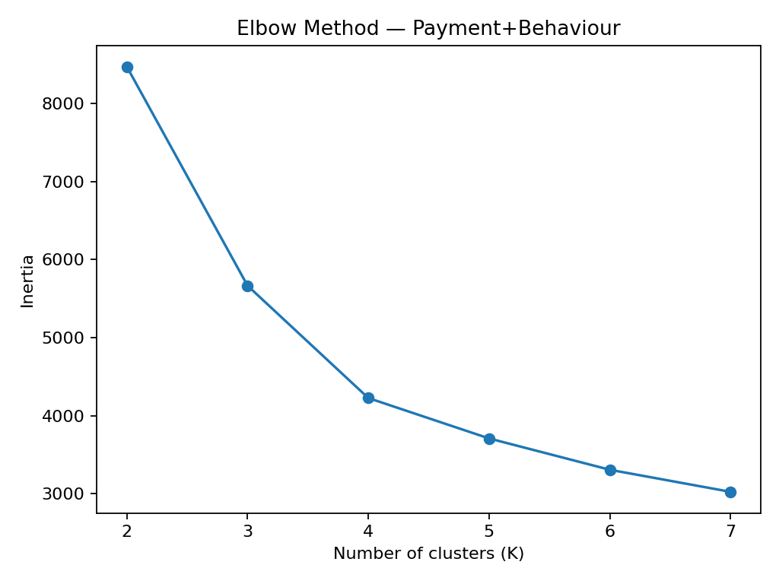
Elbow Method: Combined Features
The combined feature set adds spending, frequency and offer-use behaviour. Interpret the curve alongside cluster usefulness.

Slide 11
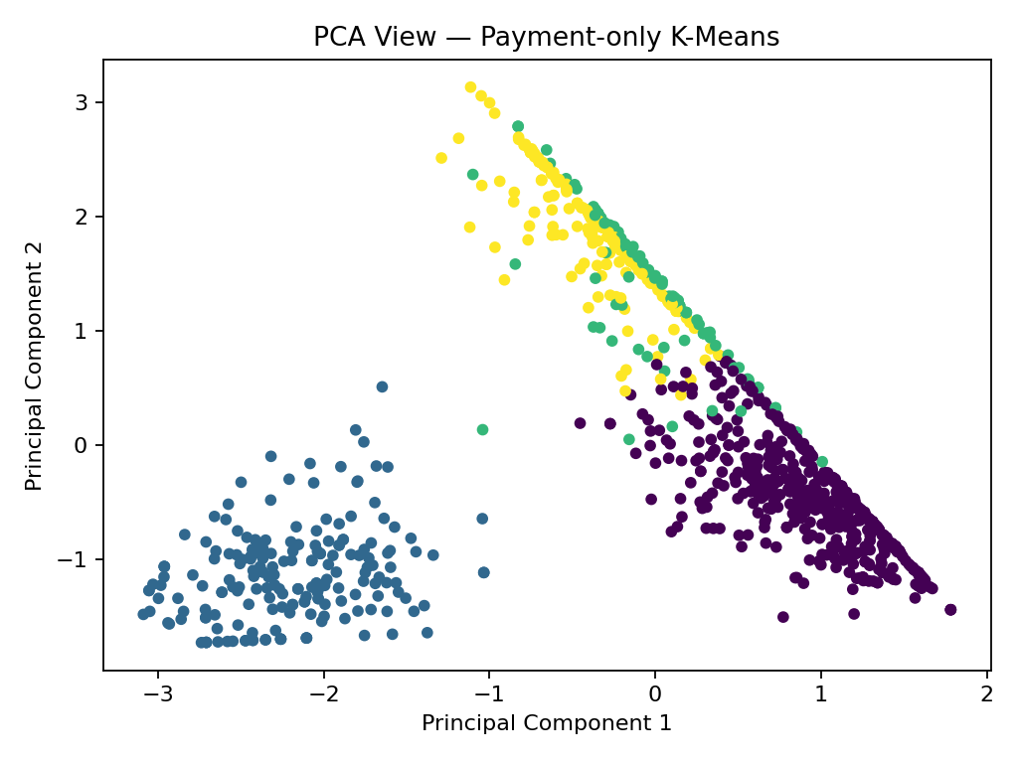
PCA: Payment-only Clusters
Each point represents a customer projected into two principal components. Colours indicate K-Means cluster assignments.

Slide 12
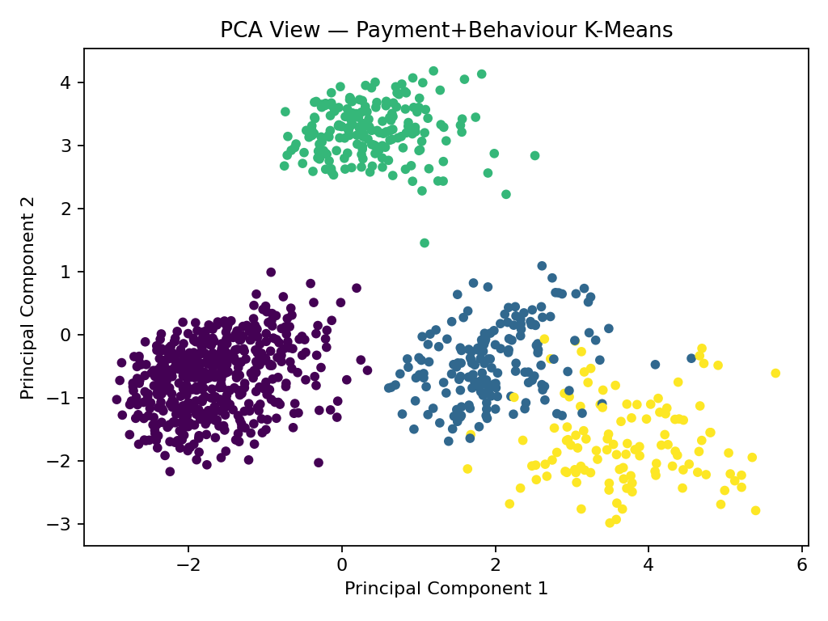
PCA: Payment + Behaviour Clusters
PCA helps visualize overlap and separation. Two dimensions cannot show every pattern in the original feature space.

Slide 13
Model Comparison
Feature set | Model | K | Silhouette ↑ | Davies-Bouldin ↓
Payment-only | K-Means | 5 | 0.536 | 0.802
Payment-only | Agglomerative | 5 | 0.475 | 0.794
Payment+Behaviour | K-Means | 4 | 0.442 | 1.017
Payment+Behaviour | Agglomerative | 4 | 0.419 | 1.203
Final synthetic-data metrics (K-Means): payment-only K=5, Silhouette=0.536, Davies-Bouldin=0.802. Payment + behaviour K=4, Silhouette=0.442, Davies-Bouldin=1.017.
Payment-only Agglomerative: K=5, Silhouette=0.475, Davies-Bouldin=0.794.
Combined-feature Agglomerative: K=4, Silhouette=0.419, Davies-Bouldin=1.203.
These are internal metrics on synthetic data. Consider interpretability and real-data validation too.

Slide 14
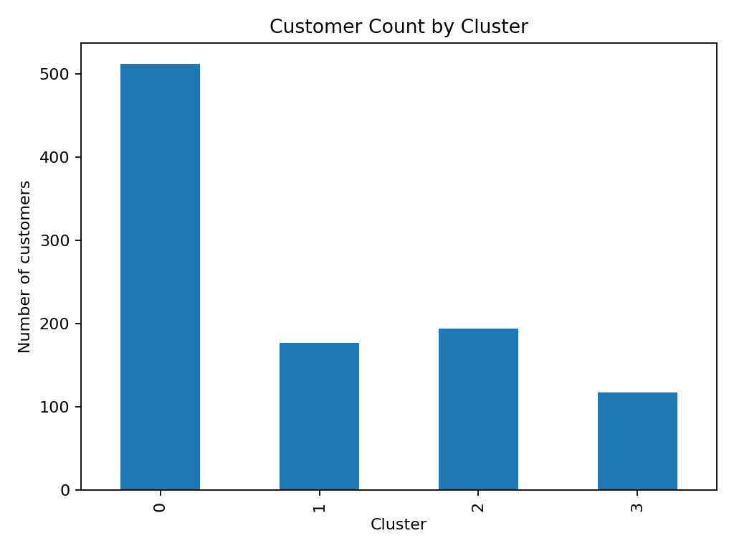
Cluster Sizes
Check whether any cluster is extremely small or dominates the customer population. Cluster labels (0, 1, 2...) are arbitrary.

Slide 15
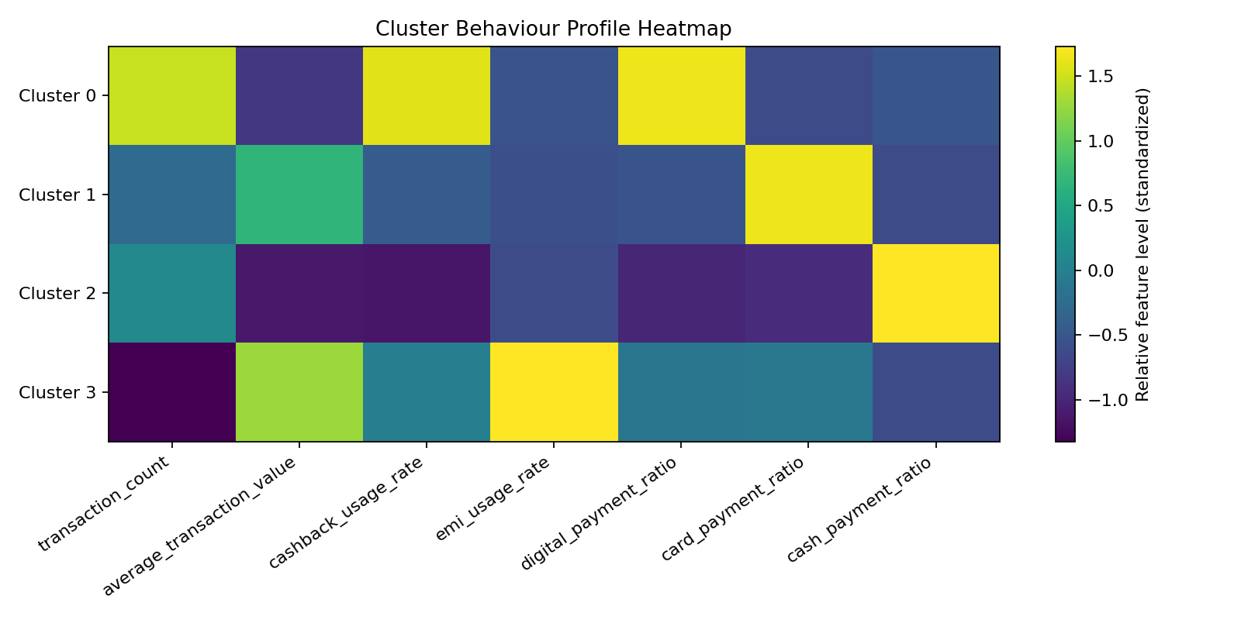
Cluster Behaviour Profile Heatmap
Use the profile table to identify relatively high spending, digital use, cashback use or EMI use. Name clusters only after examining their measured values.

Slide 16
Industry Recommendations
Digital-heavy segments: test targeted UPI/wallet benefits and smooth QR/app checkout.
High-spend card segments: evaluate card-linked rewards where incremental value justifies cost.
EMI/BNPL users: present transparent instalment terms and affordability information.
Cash-oriented segments: retain accessible payment options and avoid forcing digital-only flows.
Offer-sensitive customers: test cashback thresholds and measure incremental lift rather than rewarding every purchase.

Slide 17
Limitations and Conclusion
Dataset is synthetic; findings do not represent real customers or market shares.
Clustering discovers patterns, not causation; it does not predict fraud or creditworthiness.
Internal metrics are useful but do not guarantee business usefulness.
The project demonstrates an end-to-end ML workflow from EDA through model comparison and interpretation.
Next step: validate with approved real data and controlled experiments.

Slide 18
Customer Cluster Profiles
Cluster | Customers | Avg. txn value | Digital ratio | Card ratio | Cash ratio | Cashback rate | EMI rate
0 | 512 | Rs 870 | 73% | 14% | 4% | 70% | 8%
1 | 194 | Rs 492 | 15% | 7% | 71% | 4% | 6%
2 | 177 | Rs 2,798 | 25% | 66% | 1% | 21% | 7%
3 | 117 | Rs 3,573 | 34% | 26% | 1% | 31% | 79%
Cluster 0: frequent digital and cashback users. Cluster 1: cash-oriented with lower average transaction value. Cluster 2: card-oriented with higher average transaction value. Cluster 3: EMI-oriented with higher average transaction value. These descriptions are based on this synthetic dataset and should be regenerated if the input data changes.

Slide 19
What the Results Mean
• Payment-only K-Means has a higher Silhouette Score in this synthetic sample.
• The combined feature set adds spending, frequency and offer-use information, which can make the groups more useful for business planning.
• No single metric decides the best model. Consider separation, cluster size, stability and how clearly the profiles support a decision.
• The results are an educational demonstration, not evidence about actual customers or the Indian payment market.

Slide 20
Methodological Decision: No Train-Test Split
This is an unsupervised clustering task with no labelled target variable to predict.
A conventional supervised train-test split is not required for the main clustering experiment; the models are compared on the cleaned customer-level dataset.
Silhouette and Davies–Bouldin scores therefore describe in-sample cluster structure, not generalization to unseen customers.
Before real deployment, validate segment stability across time periods and test business outcomes using approved, representative data.

Slide 21
Supporting Literature and References
MacQueen, J. (1967). Some methods for classification and analysis of multivariate observations. Proceedings of the Fifth Berkeley Symposium, Vol. 1, pp. 281–297.
Rousseeuw, P. J. (1987). Silhouettes: A graphical aid to the interpretation and validation of cluster analysis. Journal of Computational and Applied Mathematics, 20, 53–65. doi:10.1016/0377-0427(87)90125-7.
Davies, D. L., & Bouldin, D. W. (1979). A cluster separation measure. IEEE TPAMI, PAMI-1(2), 224–227. doi:10.1109/TPAMI.1979.4766909.
Amity School of Engineering and Technology. Assignment, July–Dec 2026, Fundamentals of Machine Learning (MLE2503), Problem Statement 7.
Documentation: scikit-learn (https://scikit-learn.org/stable/) and pandas (https://pandas.pydata.org/docs/).

