Slide 1
Customer Lifetime Value
Italian economist Vilfredo Pareto states that 80% of the effect comes from 20% of the causes, this is known as 80/20 rule or Pareto principle. Similarly, 80% of companies business comes from 20% customers. Companies need to identify those top customers and maintain the relationship with them to ensure continuous revenue. In order to maintain a long-term relationship with customers, companies need to schedule loyalty schemes such as the discount, offers, coupons, bonus point, and gifts.

Slide 2
Targeting a new customer is more costly than retaining existing customers because you don’t need to spend resources, time, and work hard to acquire new customers. You just have to keep the existing customers happy. Business analyst's accurately calculate customer acquisition cost using CLTV(Customer Lifetime Value). CLTV indicates the total revenue from the customer during the entire relationship. CLTV helps companies to focus on those potential customers who can bring in the more revenue in the future.

Slide 3
In this tutorial, you are going to cover the following topics:
Introduction
Customer Lifetime value(CLTV)
Related Work of CLTV
CLTV Formulas
Implementing CLTV in Python
Prediction model for CLTV
Pros and Cons
Conclusion

Slide 4
Customer Lifetime Value(CLTV)
Customer Lifetime Value is a monetary value that represents the amount of revenue or profit a customer will give the company over the period of the relationship“ (Source). CLTV demonstrates the implications of acquiring long-term customers compare to short-term customers. Customer lifetime value (CLV) can help you to answers the most important questions about sales to every company:
How to Identify the most profitable customers?
How can a company offer the best product and make the most money?
How to segment profitable customers?
How much budget need to spend to acquire customers?

Slide 5
Calculate Customer Lifetime Value
There are lots of approaches available for calculating CLTV. Everyone has his/her own view on it. For computing CLTV we need historical data of customers but you will unable to calculate for new customers. To solve this problem Business Analyst develops machine learning models to predict the CLTV of newly customers. Let's explore some approaches for CLTV Calculation:
1) You can compute it by adding profit/revenue from customers in a given cycle. For Example, If the customer is associated with you for the last 3 years, you can sum all the profit in this 3 years. You can average the profit yearly or half-yearly or monthly, but in this approach, you cannot able to build a predictive model for new customers.

Slide 6
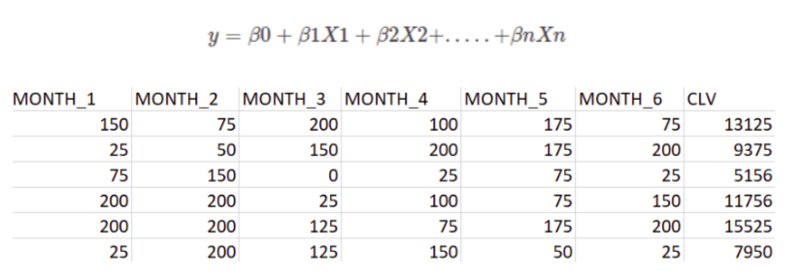
2) Build a regression model for existing customers. Take recent six-month data as independent variables and total revenue over three years as a dependent variable and build a regression model on this data.
3) CLTV can also implement using RFM(Recency, Frequency, Monetary) values. For more details, you can refer to my tutorial.

Slide 7
4) Using the following equation:
CLTV = ((Average Order Value x Purchase Frequency)/
Churn Rate) x Profit margin.
Customer Value = Average Order Value * Purchase Frequency
Average Order Value(AOV): The Average Order value is the ratio of your total revenue and the total number of orders. AOV represents the mean amount of revenue that the customer spends on an order
Average Order Value = Total Revenue / Total Number of Orders

Slide 8
Purchase Frequency(PF): Purchase Frequency is the ratio of the total number of orders and the total number of customer. It represents the average number of orders placed by each customer
Purchase Frequency = Total Number of Order / Total Number of Customer
Churn Rate: Churn Rate is the percentage of customers who have not ordered again.
Customer Lifetime: Customer Lifetime is the period of time that the customer has been continuously ordering.
Customer Lifetime: = 1 / Churan Rate

Slide 9
Repeat Rate: Repeat rate can be defined as the ratio of the number of customers with more than one order to the number of unique customers. Example: If you have 10 customers in a month out of who 4 come back, your repeat rate is 40%.
Churan Rate = 1 – Repeat Rate

