Slide 1


Slide 2
TYPES OF VARIABLE
Dependent Variables and Independent Variables
An independent variable, sometimes called an experimental or predictor variable, is a variable that is being manipulated in an experiment in order to observe the effect on a dependent variable, sometimes called an outcome variable

Slide 3
CATEGORICAL AND CONTINUOUS VARIABLES
Categorical variables are also known as discrete or qualitative variables.
Nominal - when there is no natural ordering among the categories
Ordinal - when there is a natural order among the categories, such as, ranking scales or letter grades.
Dichotomous - when there are only two possible levels
Continuous can take on any value between its minimum value and its maximum value

Slide 4
TYPES OF MACHINE LEARNING ALGORITHMS
Supervised Learning
Unsupervised Learning
Reinforcement Learning:

Slide 5
SUPERVISED LEARNING
Supervised learning is done using a ground truth
Best approximates the relationship between input and output observable in the data

Slide 6
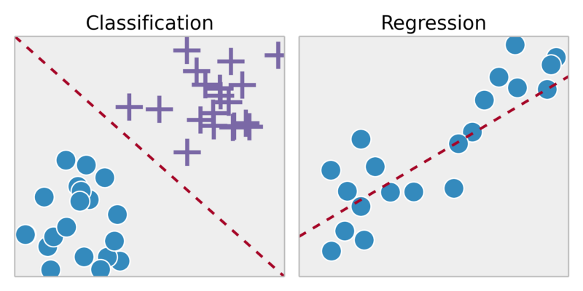
CLASSIFICATION VS REGRESSION

Slide 7
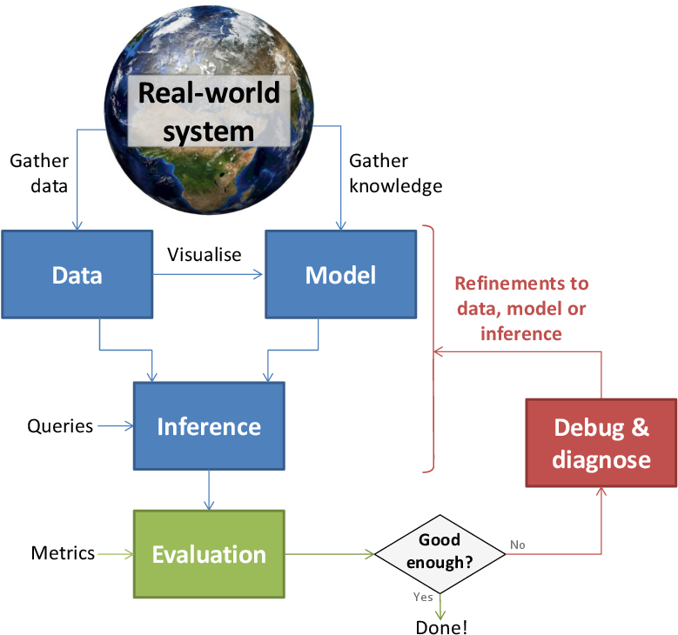
MACHINE LEARNING CYCLE
Training
Testing
Validation

Slide 8
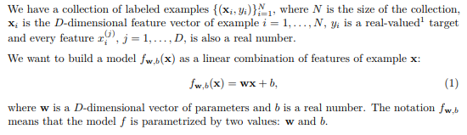
LINEAR REGRESSION
Linear regression is a popular regression learning algorithm that learns a model which is a linear combination of features of the input example.

Slide 9

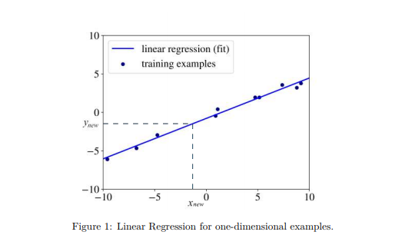
LINEAR ALGEBRA

Slide 10
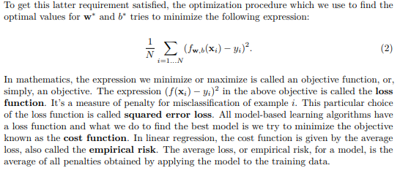
SOLUTION

Slide 11
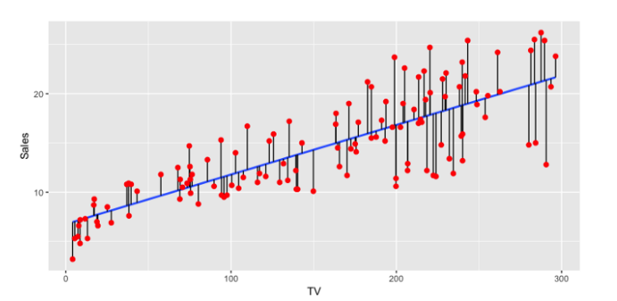

MATHEMATICAL INTUITION BEHIND SIMPLE LINEAR REGRESSION
Ready to find the line of best fit?
Let’s start by defining a few things.
1.Given N inputs and outputs…

Slide 12

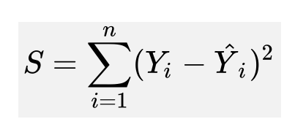
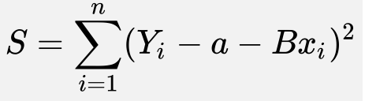
CONTINUED
We define the line of best fit line as…
Such that the best fit line looks to minimize the cost function we named S…
For our reference, we will input the line of best fit into our cost function distributing the subtraction, resulting in…

Slide 13
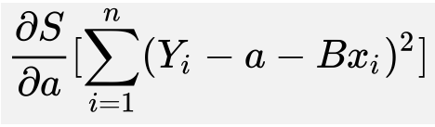
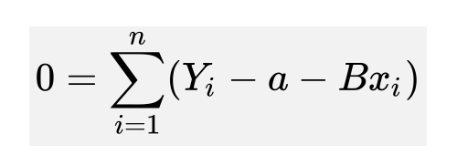
DERIVATIVE
To minimize our cost function, S, we must find where the first derivative of S is equal to 0 with respect to a and B. The closer a and B are to 0, the less the total error for each point is.
Let’s start with the partial derivative of a first.
Finding a

Slide 14
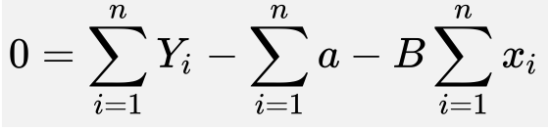
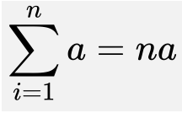
DERIVATIVE
Let’s do something semi clever. Let’s break the summation into 3 parts and pull the constant B outside the summation
We notice that summation of a to n is simply.

Slide 15
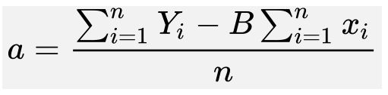
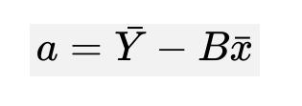
DERIVATIVE
The last thing we need to do is solve for a, so we add nato both sides and divide by n.
The two summations of Y and x divided by the number of observations is simply the mean :). So after all that work, minimizing the cost function of S with respect to a is simply…

Slide 16
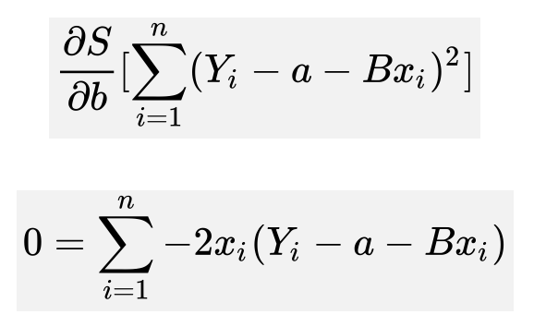
DERIVATIVE
Finding B
We’ve minimized the cost function of S with respect to a. Let’s find the last part which is S with respect to b.

Slide 17
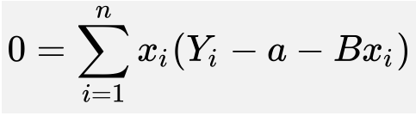
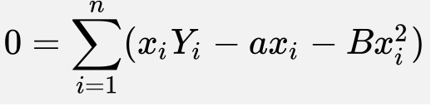
Let’s strip out the -2 and divide it by both sides.
Let’s distribute the x for ease of viewing.

Slide 18
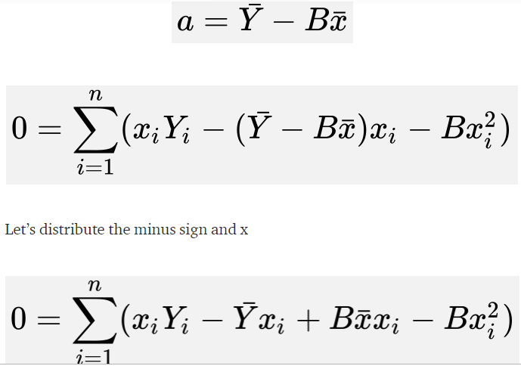
CONTINUE
Let’s substitute a (derived formula below) into the partial derivative of S with respect to B above. We’re doing this so we have a function of a and B in terms of only x and Y.

Slide 19
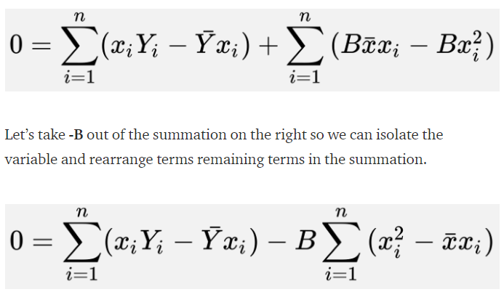
DERIVATIVE
This looks messy but algebra kicks ass in this front. Let’s split up the sum into two sums.

Slide 20
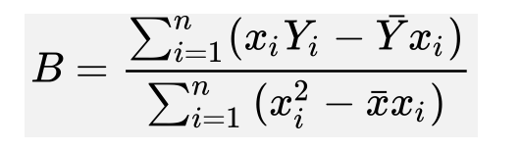
DERIVATIVE
Isolating B by subtracting the first summation and dividing by the second summation

Slide 21
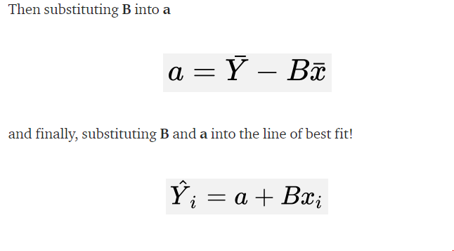
SUMMING IT UP

Slide 22
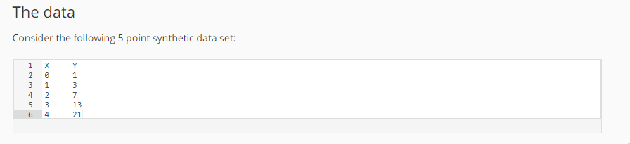
GRADIENT DESCENT
We will need a starting value for the slope and intercept, a step_size and a tolerance
initial_intercept = 0
initial_slope = 0
step_size = 0.05
tolerance = 0.01

Slide 23
HOW GRADIENT WORKS
In e
Each step of the gradient descent we will do the following:
1. Compute the predicted values given the current slope and intercept
2. Compute the prediction errors (prediction - Y)
3. Update the intercept:
compute the derivative: sum(errors)
compute the adjustment as step_size times the derivative decrease the intercept by the adjustment
4. Update the slope:
compute the derivative: sum(errors*input)
compute the adjustment as step_ size times the derivative decrease the slope by the adjustment
5. Compute the magnitude of the gradient
6. Check for convergence

Slide 24
The algorithm in action
First step:
Intercept = 0
Slope = 0
1. predictions = [0, 0, 0, 0, 0]
2. errors = [-1, -3, -7, -13, -21]
3. update Intercept
sum([-1, -3, -7, -13, -21]) = -45
adjustment = 0.05 * 45 = -2.25
new_intercept = 0 - -2.25 = 2.25
4. update Slope
sum([0, 1, 2, 3, 4] * [-1, -3, -7, -13, -21]) = -140
adjustment = 0.05 * -140 = -7
new_slope = 0 - -7 = 7
5. magnitude = sqrt(( -45)^2 + (-140)^2) = 147.05
6. magnitude > tolerance: not converged

Slide 25
The algorithm in action
First step:
Intercept = 0
Slope = 0
1. predictions = [0, 0, 0, 0, 0]
2. errors = [-1, -3, -7, -13, -21]
3. update Intercept
sum([-1, -3, -7, -13, -21]) = -45
adjustment = 0.05 * 45 = -2.25
new_intercept = 0 - -2.25 = 2.25
4. update Slope
sum([0, 1, 2, 3, 4] * [-1, -3, -7, -13, -21]) = -140
adjustment = 0.05 * -140 = -7
new_slope = 0 - -7 = 7
5. magnitude = sqrt(( -45)^2 + (-140)^2) = 147.05
6. magnitude > tolerance: not converged

Slide 26
Let’s skip forward a few steps… after the 77th step we have gradient magnitude 0.0107.
78th Step:
Intercept = -0.9937
Slope = 4.9978
1. predictions = [-0.99374, 4.00406, 9.00187, 13.99967, 18.99748]
2. errors = [-1.99374, 1.00406, 2.00187, 0.99967, -2.00252]
3. update Intercept
sum([-1.99374, 1.00406, 2.00187, 0.99967, -2.00252]) = 0.009341224
adjustment = 0.05 * 0.009341224 = 0.0004670612
new_intercept = -0.9937 - 0.0004670612 = -0.994207
4. update Slope
sum([0, 1, 2, 3, 4] * [-1.99374, 1.00406, 2.00187, 0.99967, -2.00252]) = -0.0032767
adjustment = 0.05 *-0.0032767 = -0.00016383
new_slope = 4.9978 --0.00016383 = 4.9979
5. magnitude = sqrt[()^2 + ()^2] = 0.0098992
6. magnitude < tolerance: converged!
Final slope: -0.994
Final Intercept: 4.998
If you continue you will get to (-1, 5) but at this point the change in RSS (our cost) is negligible.

Slide 27
THANK YOU

