Slide 1
RESEARCH MONOGRAPH & TECHNICAL PRESENTATION
AutoAnn-Indic: Automated Document Layout Analysis and Hierarchical Transcription for Historical Indic Manuscripts
A Geometry-First Formulation with Structural Segmentation and Morphological Decomposition
Author: Dakshan Karthic · Department of Computer Science & Engineering Scope: 3,000+ Historical Document Folios · PRImA PAGE-XML 2013 Hierarchy · GPU Latency: 350 ms/page

Slide 2
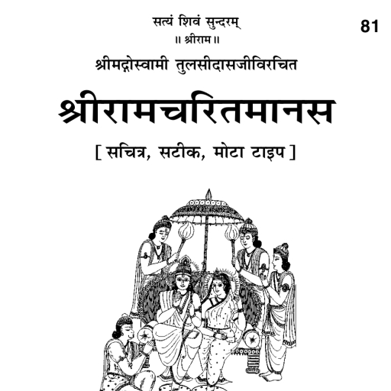
SECTION 1: INTRODUCTION
Introduction & Problem Statement
Heritage Preservation Bottlenecks in Indic Manuscripts
Heritage at Risk & OCR Limitations
• Thousands of Indic manuscripts (Ramcharitmanas, palm-leaf folios) suffer severe decay from humidity and ink corrosion.
• Standard OCR fails on complex Devanagari with conjuncts, matras, and continuous headlines.
• Paleographers spend 30-60 min/page manually drawing bounding boxes.
I(x,y) = R(x,y) · L(x,y) + eta(x,y)
Slide 2 / 36

Slide 3
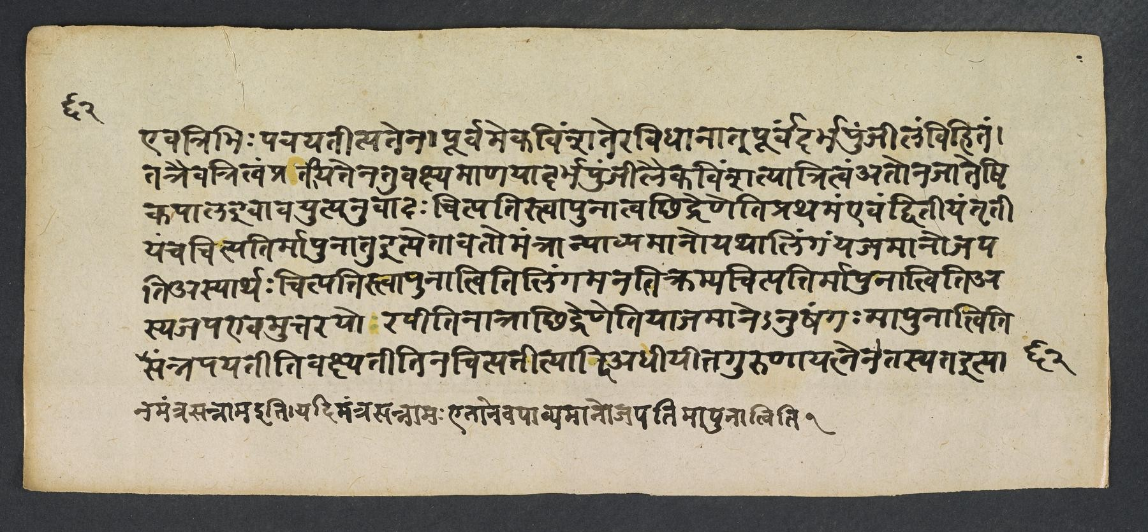
SECTION 1: INTRODUCTION
Research Objectives & Dataset Scope
Analysis of 3,000+ Multi-Column Illustrated Folios
Dataset Scope (3,000+ Pages)
• Substrates: Palm leaf (Borassus flabellifer) and handmade rag paper.
• Scripts: Devanagari (Sanskrit, Hindi, Awadhi).
• Multi-Level Annotation: Region -> Line -> Word -> Akshara.
• Scalable & Reproducible: Zero-shot foundation model generalized across genres.
Scope: 3,000+ Folios · Batch Latency: 350 ms/page
Slide 3 / 36

Slide 4
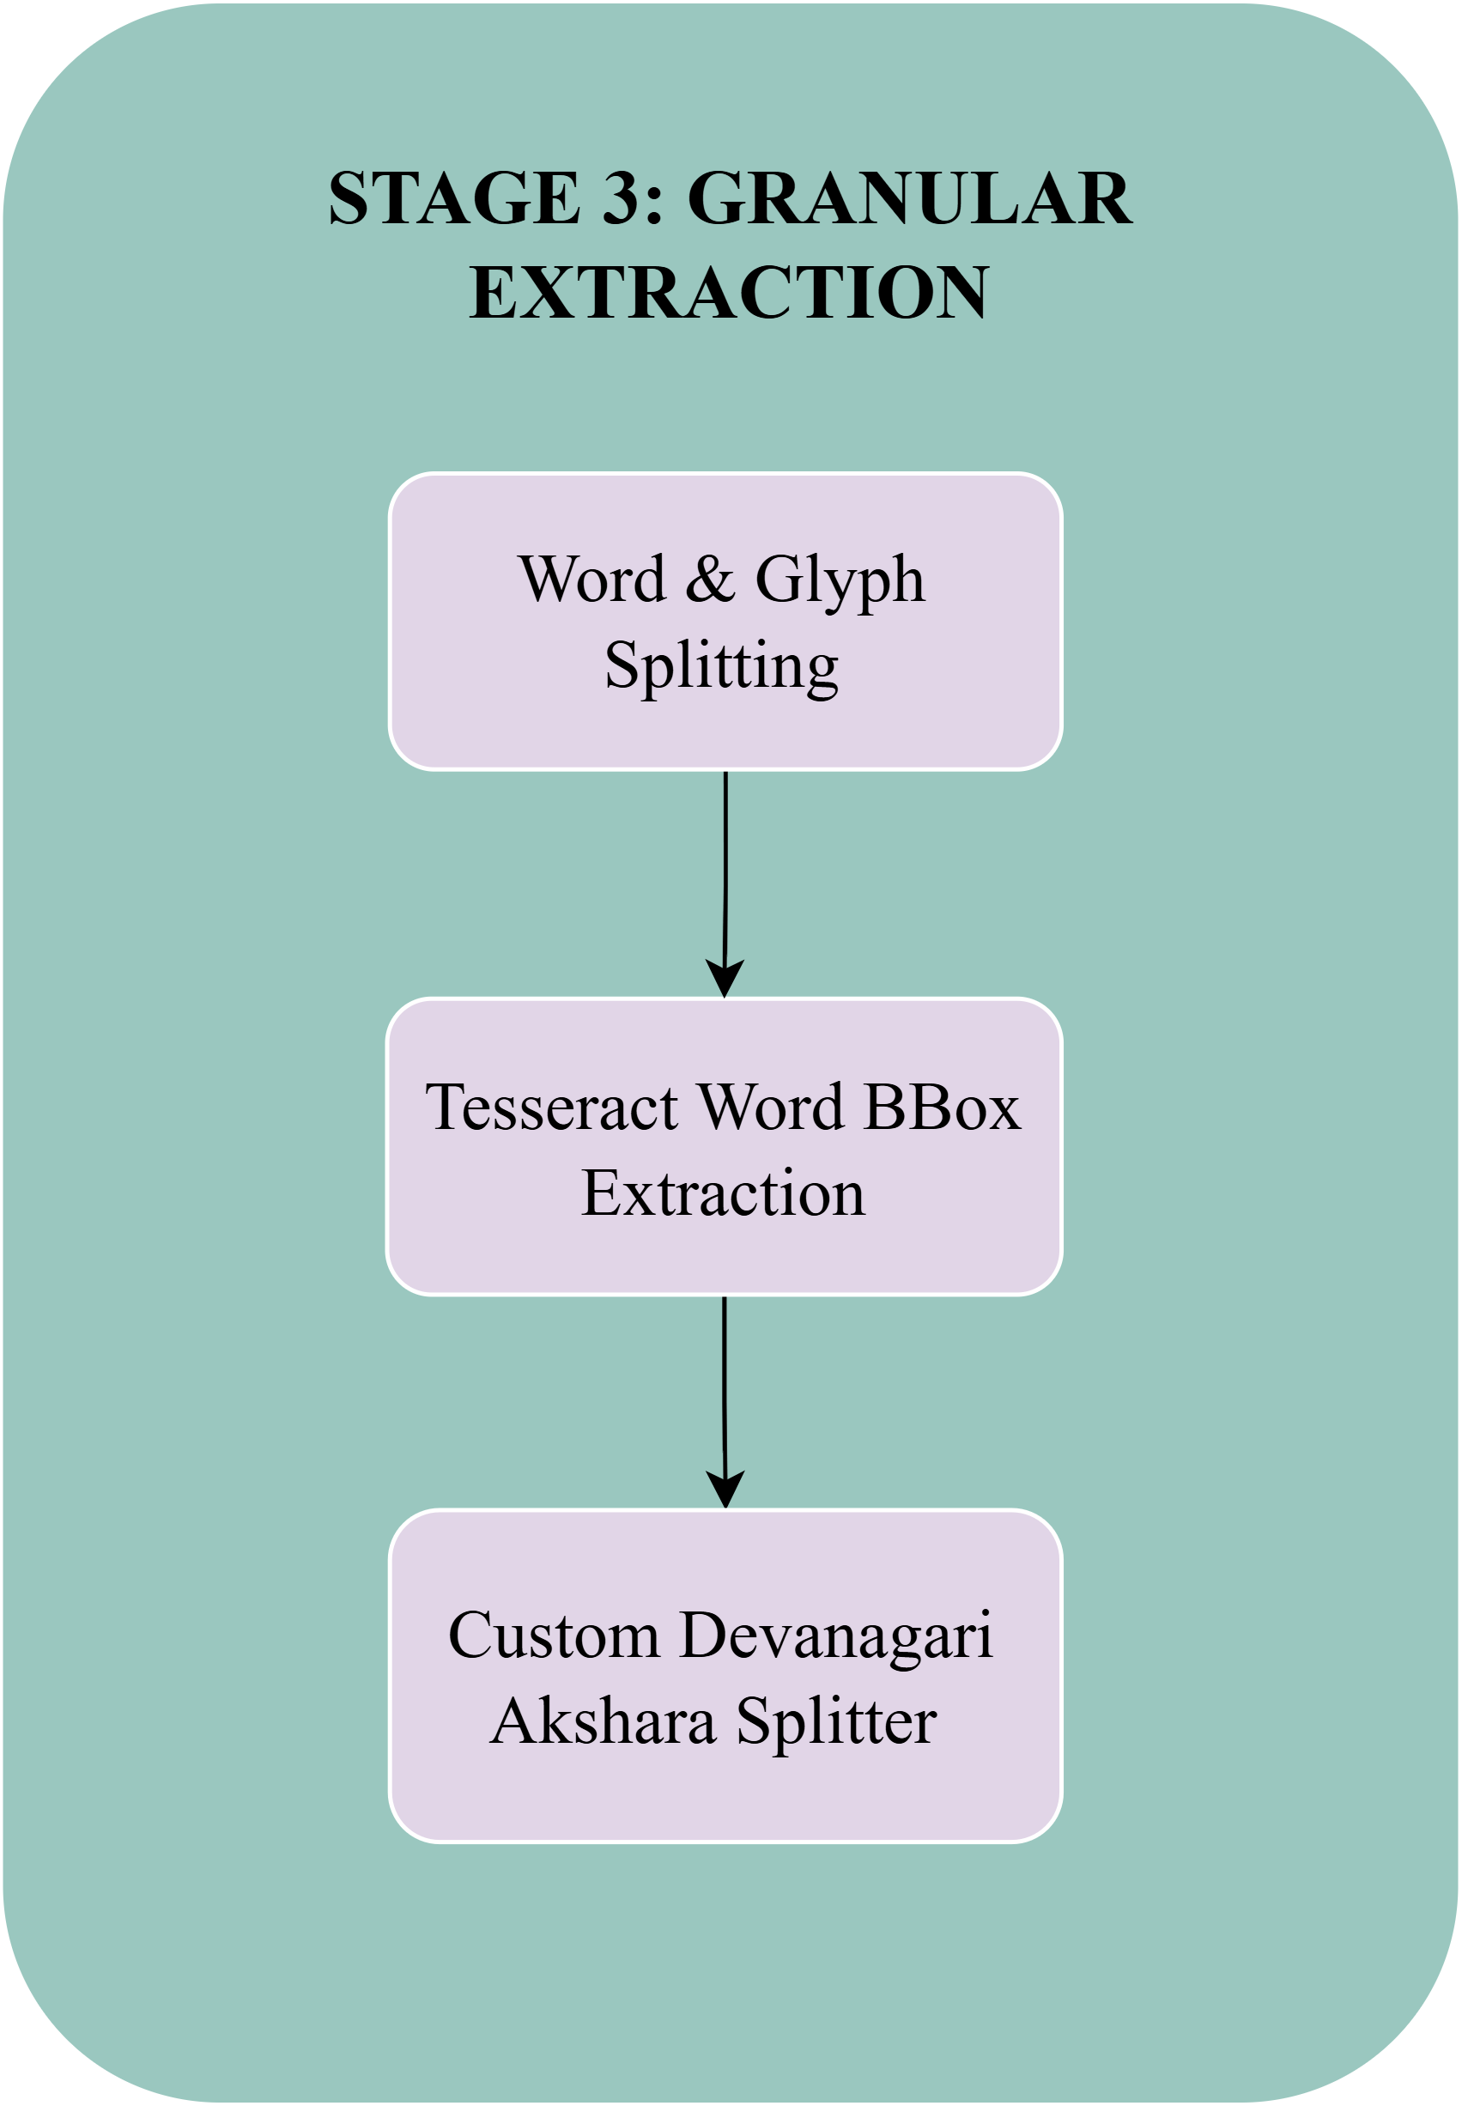
SECTION 1: DATASET DIFFICULTIES
Dataset Difficulty 1: Continuous Headline & Matra Collisions
Real Manuscript Failure Mode: Connected-Component Merging
Orthographic Challenge Formulation
• Devanagari characters are fused along the top horizontal stroke: S_word = Union G_i UNION H_shirorekha.
• Upper vowel modifiers (ikār, e, ai) and lower modifiers (u, ū, r) overlap adjacent lines.
• Classical connected-component algorithms merge entire multi-line sentences into a single unsegmentable blob.
S_word = Union_{i=1}^M G_i UNION H_shirorekha y_upper in [y* - Delta_asc, y*], y_lower in [y_base, y_base + Delta_desc]
Slide 4 / 36

Slide 5
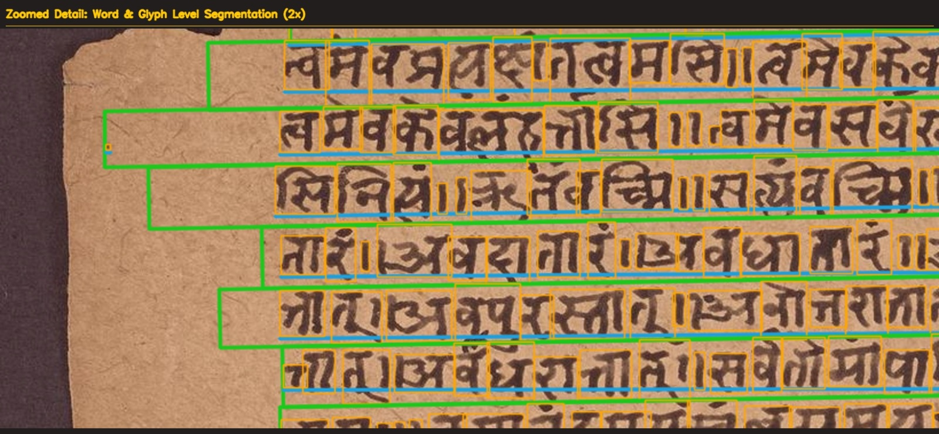
SECTION 1: DATASET DIFFICULTIES
Dataset Difficulty 2: Palm-Leaf Punch Holes & Fibrous Grain Fractures
Real Manuscript Failure Mode: False Character Hallucinations on Ancient Pothis
Physical Geometry & Optical Error
• Punched cord holes (Kanthas) form near-perfect circular voids with Psi > 0.85.
• OCR engines falsely hallucinate round Sanskrit characters (e.g. 'Tha' or '0').
• Longitudinal substrate grain fractures mimic genuine text lines, corrupting line segmentation.
Psi(C) = (4 · pi · Area(C)) / [Perimeter(C)]^2 > 0.85 500 px <= Area(C) <= 8000 px
Slide 5 / 36

Slide 6
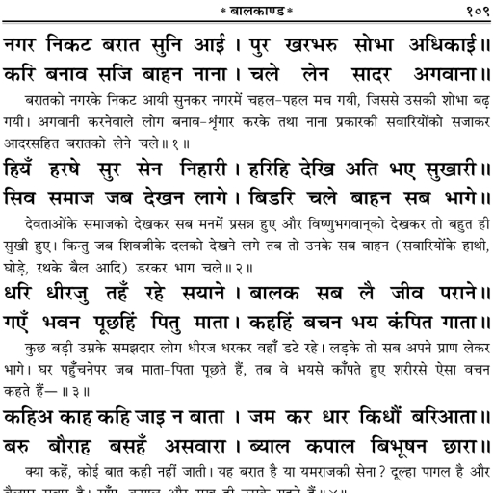
SECTION 1: DATASET DIFFICULTIES
Dataset Difficulty 3: Iron-Gall Ink Bleed-Through (Verso Ghosting)
Real Manuscript Failure Mode: Ghost Character Superposition on Degraded Paper
Optical Transmission Superposition Model
• Corrosion and high paper porosity cause verso ink diffusion:
• Transmission coefficient alpha in [0.25, 0.65].
• Standard Otsu and Sauvola thresholding binarize reversed ghost strokes from the back page, corrupting text line recognition.
I_observed(x,y) = I_recto(x,y) + alpha · Flip(I_verso(x,y)) + eta(x,y) Classical global binarization fails catastrophically.
Slide 6 / 36

Slide 7
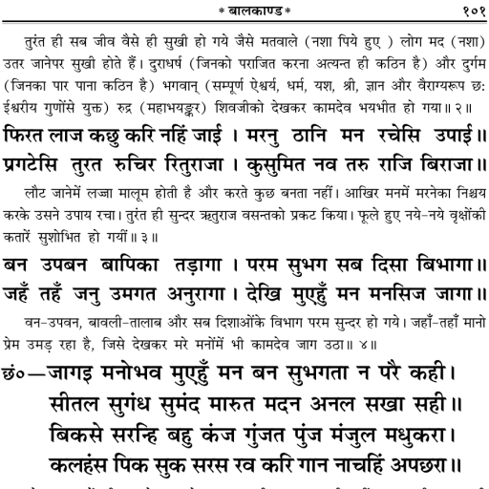
SECTION 1: DATASET DIFFICULTIES
Dataset Difficulty 4: Multi-Column Commentaries (Mula vs Tika)
Real Manuscript Failure Mode: Non-Linear Interleaved Reading Sequences
Layout Asymmetry & Margin Glosses
• Central sacred verse (Mula Shloka, large script) is framed by top, bottom, and side commentary glosses (Tika, small script).
• Standard single-column OCR reads horizontally across column boundaries (V_norm < 0.02), interleaving commentary glosses into sacred verses.
V_norm(x) = (V * G_{sigma_c})(x) / max(V * G_{sigma_c}) < 0.02 Reading Order: C_1 < C_2 < ... < C_k
Slide 7 / 36

Slide 8
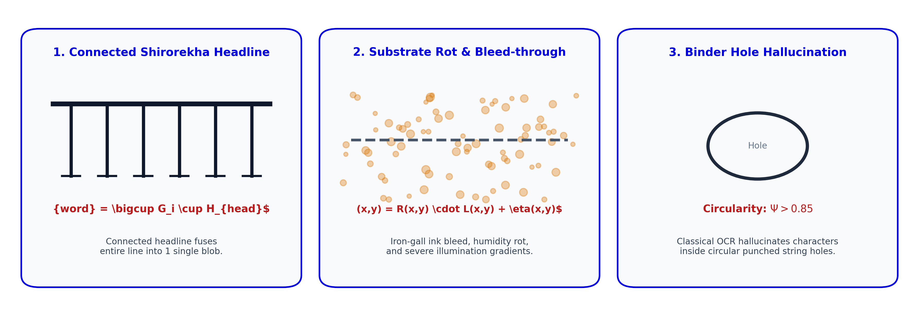
SECTION 1: DATASET DIFFICULTIES
Orthographic & Substrate Degradation Summary
Combined Challenges Encountered Across 3,000+ Historical Manuscript Pages
1. Orthographic Complexity
2. Substrate Non-Uniformity
• Continuous Shirorekha binding and complex conjunct clusters require morphological headline ablation.
S_word = Union_{i=1}^M G_i UNION H_shirorekha
• Illumination gradients, fiber rot, and hole artifacts necessitate isoperimetric damage isolation.
I(x,y) = R(x,y) · L(x,y) + eta(x,y), Psi > 0.85
Slide 8 / 36

Slide 9
SECTION 1: INTRODUCTION
Mathematical Problem Formulation
Hierarchical Document Layout Representation
Formal Layout Hierarchy (PAGE-XML 2013)
• Given input image I in R^(H x W x 3), determine optimal hierarchical decomposition T:
• Region boundaries are represented as closed planar polygonal chains P = {(x_1, y_1), ..., (x_V, y_V)}.
• Reading order optimization defines an ordered permutation over columns: C_1 < C_2 < ... < C_k.
T = { R_frame, {R_text^(k)}_{k=1}^K, {R_illus^(m)}_{m=1}^M, {R_damage^(d)}_{d=1}^D, {L_j}_{j=1}^J, {W_{j,p}}, {G_{j,p,q}} }
Slide 9 / 36

Slide 10
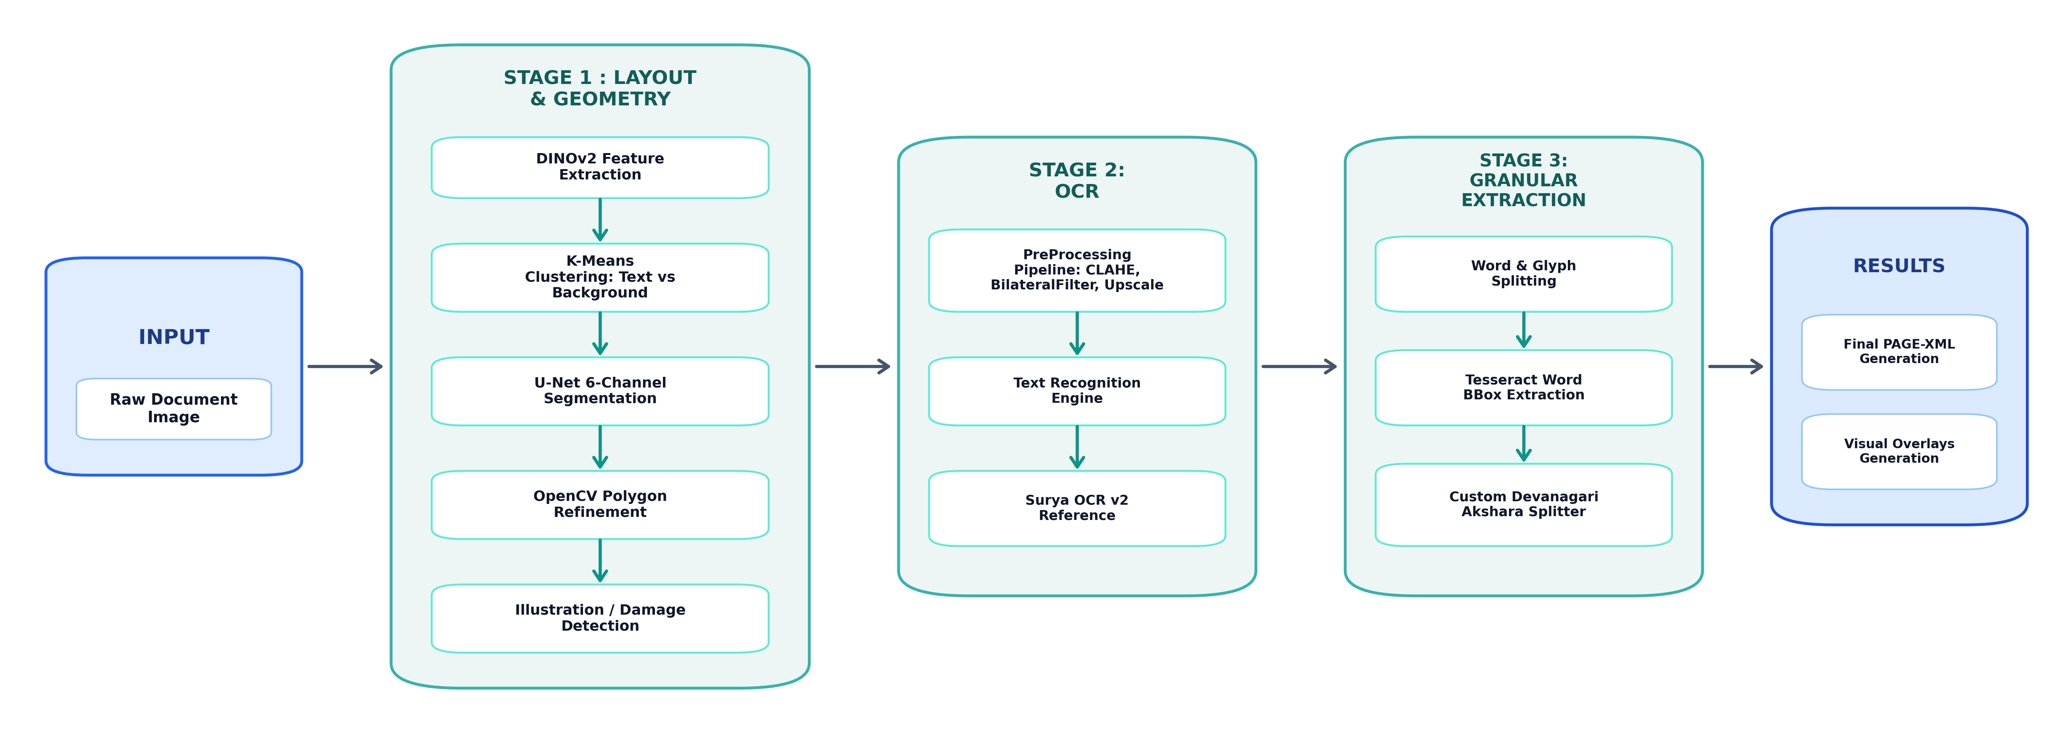
SECTION 2: METHODOLOGY
Proposed 3-Stage End-to-End System Architecture
Continuous Pipeline from Raw Capture to Granular PAGE-XML Hierarchy
Slide 10 / 36

Slide 11
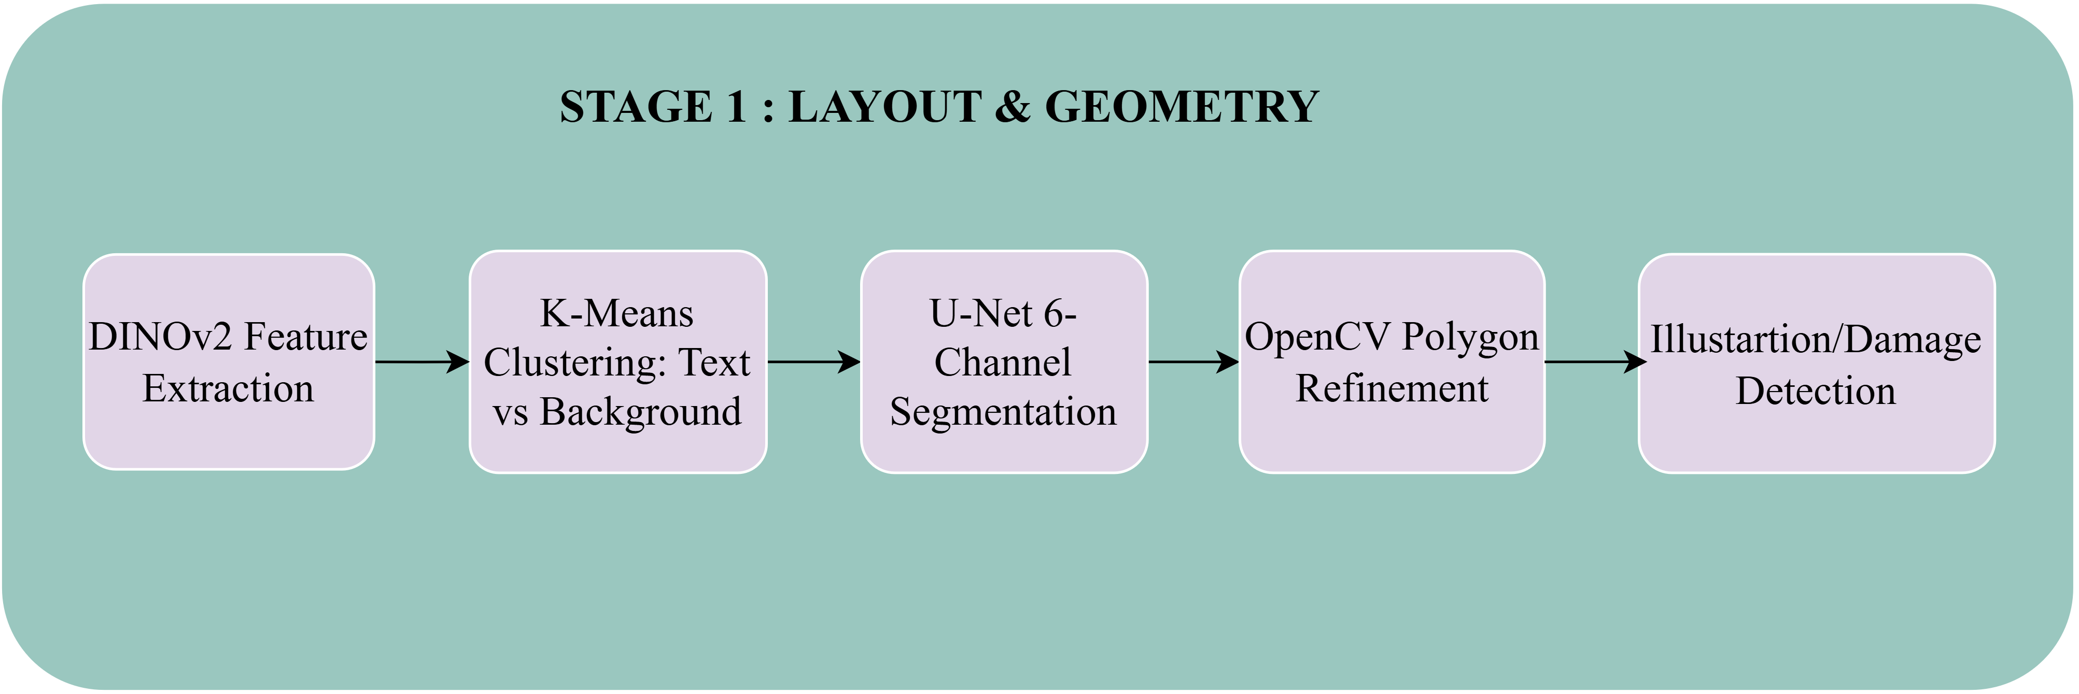
SECTION 2: METHODOLOGY
Stage 1: Foundation Vision Transformer (DINOv2)
Patch Embedding, Multi-Head Self-Attention, and Zero-Shot Manifolds
DINOv2 Self-Attention Mechanics
• Model: DINOv2-ViT-B/14 (D = 768, P = 14 px).
• Extracts patch tokens x_0 without manual polygon labels:
• Scaled dot-product attention pairwise affinity:
x_0 = [x_cls; x_p^1 E; ...; x_p^N E] + E_pos Attention(Q,K,V) = softmax( (Q·K^T)/sqrt(d_k) )·V A_{ij} = cos(theta_{ij})
Slide 11 / 36

Slide 12
SECTION 2: METHODOLOGY
Stage 1: Image Preprocessing & Adaptive Binarization
Local Illumination Compensation and Substrate Filtering
Adaptive Gaussian Thresholding (I -> B)
Morphological Opening (B -> B_clean)
• Compensates for spatial illumination gradients L(x,y).
• Evaluates local neighborhood statistics in window (2r+1) x (2r+1):
• Parameter selection: r = 25, C = 5.
B(x,y) = 1 if I_gray(x,y) < mu_G(x,y) - C else 0 mu_G(x,y) = (I_gray * G_sigma)(x,y)
• Isolates true foreground ink from biological fiber artifacts.
• Elliptical structuring element E_(3x3) eliminates single-pixel noise:
B_clean = (B (erosion) E_{3x3}) (dilation) E_{3x3} Preserves character strokes while removing background noise.
Slide 12 / 36

Slide 13
SECTION 2: METHODOLOGY
Stage 1: Substrate-Adaptive Manifold Clustering
Border-Invariant Feature Partitioning for Varied Substrates
1. Substrate Luminance Metric
2. Adaptive Clustering
• Evaluates boundary band luminance to detect substrate category:
• Light Paper: L_border > 200 | Dark Palm-Leaf: L_border <= 200.
L_border = (1 / |B|) Sum_{(x,y) in B} I_gray(x,y)
• Paper Mode (k=2): Standard K-Means variance minimization.
• Palm-Leaf Mode (k=3): Boundary-dominant label mode suppression.
l_bg = mode(L_boundary) M_text = { i | l_i != l_bg and I_mean(i) < I_substrate }
Slide 13 / 36

Slide 14
SECTION 2: METHODOLOGY
Stage 1: 6-Channel nnU-Net Deep Semantic Segmentation
Feature Propagation, Instance Normalization, and Multi-Scale Loss
Feature Propagation & InstanceNorm
Multi-Scale Focal-Dice Compound Loss
• 5-level U-Net topology with strided convolutions (stride=2).
• Instance Normalization normalizes per-image across (H, W):
• 6 Semantic Channels: TextRegion, Marginalia, Graphic, Frame, Damage, Line.
x^(l) = LeakyReLU( IN( W_2 * LeakyReLU( IN( W_1 * x^(l-1) ) ) ) ) IN(v) = gamma · ((v - mu) / sqrt(sigma^2 + eps)) + beta
• Supervised across 3 decoder scales (512, 256, 128) with weights w = [1.0, 0.5, 0.25]:
• Compound Focal-Dice Loss formulation:
P(C=c|x,y) = exp(z_c) / Sum exp(z_k) L_total = Sum w_s [ lambda_1·L_Focal + lambda_2·L_Dice ] L_Focal = -(1/N) Sum alpha_t (1-p_t)^gamma log(p_t) L_Dice = 1 - (2·Sum p·y + eps) / (Sum p^2 + Sum y^2 + eps)
Slide 14 / 36

Slide 15
SECTION 2: METHODOLOGY
Stage 1: Multi-Column Parsing & Graphic Discrimination
Vertical Projection Gutters and Spatial Density Metrics
1. Inter-Column Gutter Detection
2. GraphicRegion Illustration Filter
• Vertical projection V(x) across bounding region R.
• Gutter condition over continuous gap length:
• Partitions multi-column commentaries (Shloka vs Tika).
V_norm(x) = (V * G_{sigma_c})(x) / max(V * G_{sigma_c}) < 0.02 Reading order: C_1 < C_2 < ... < C_k
• Evaluates ink density rho_ink and valley frequency nu_valley:
• Prevents OCR engine from running over woodblock drawings.
rho_ink = (1 / HW) Sum B(y,x), nu_valley = N_valleys / (H/100) GraphicRegion if (rho_ink > 0.30 and nu < 1.5)
Slide 15 / 36

Slide 16
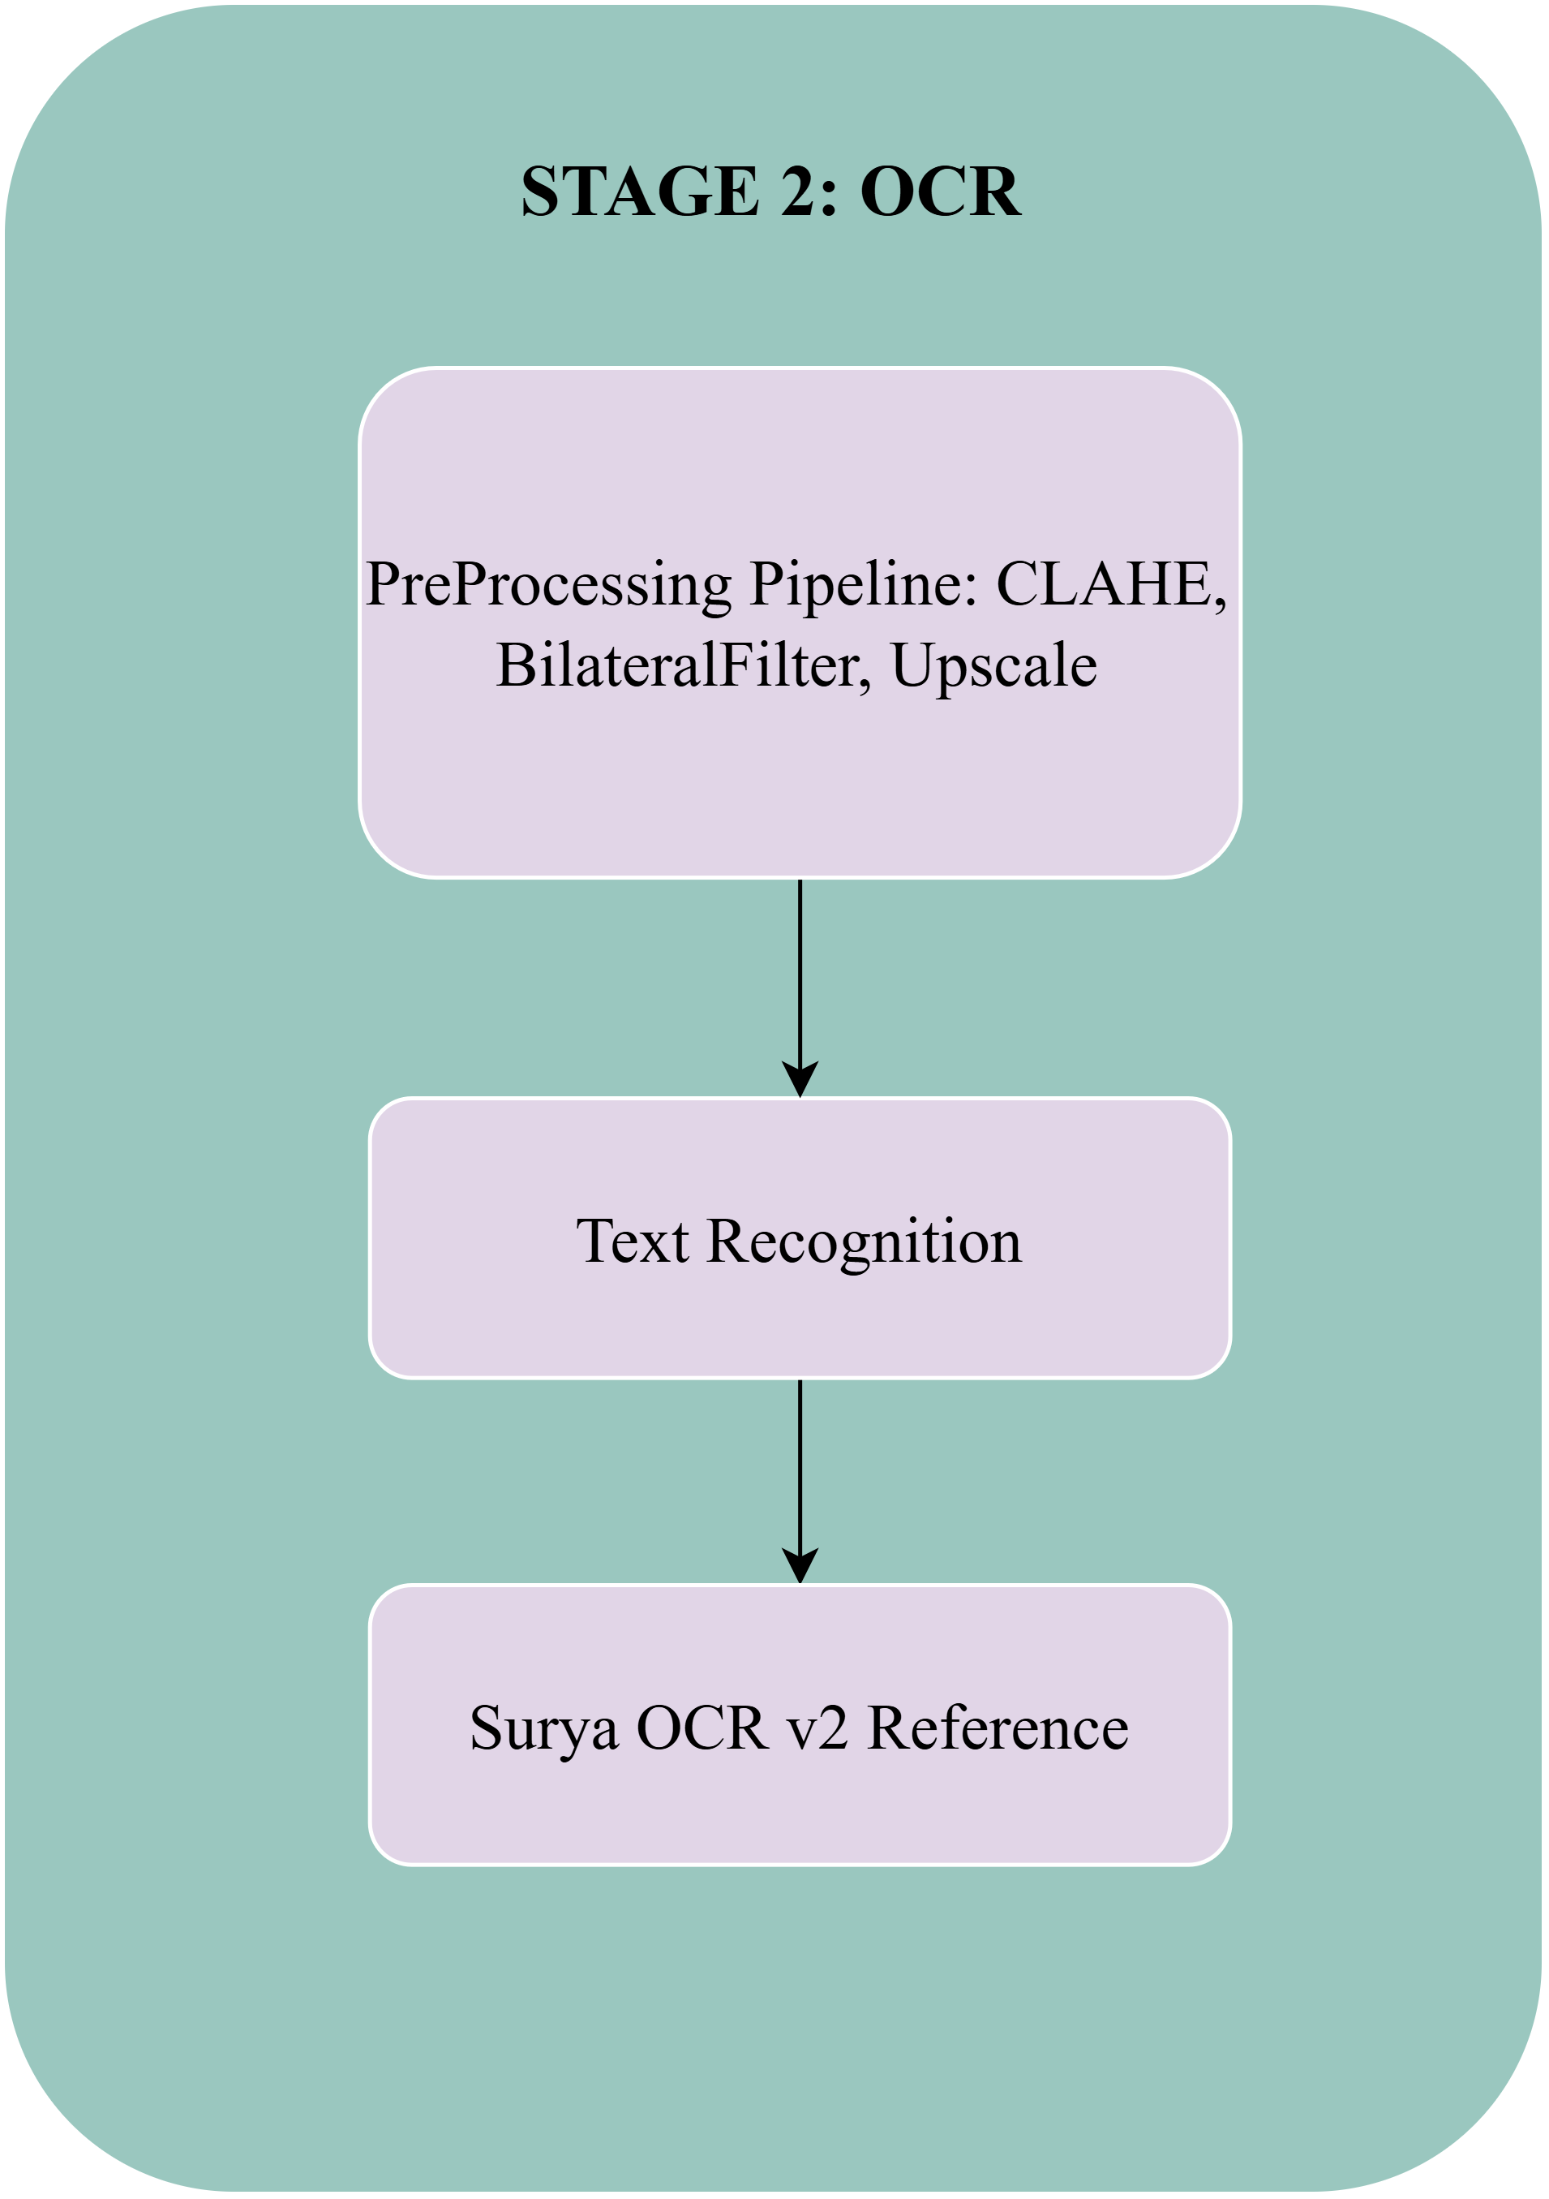
SECTION 2: METHODOLOGY
Stage 2: Multilingual Text Recognition Engine (OCR / HTR)
Transformer-Based Recognition, Recurrent Sequence Slicing, and CTC Loss
CRNN Recurrent Slicing & CTC Loss
• Text line crop slices x_t encoded via Bidirectional LSTM context:
• Surya OCR v2 reference with JSON text cache for 1,054 benchmark folios.
• Beam Search with Sanskrit Language Model LM:
h_t = [ Forward_LSTM(x_t); Backward_LSTM(x_t) ] in R^(2·D_hidden) P(Y|X) = Sum_{pi in B^(-1)(Y)} Product y_{pi_t}^t Y_hat = argmax_Y [ log P_CTC + alpha·log P_LM + beta·|Y| ]
Slide 16 / 36

Slide 17
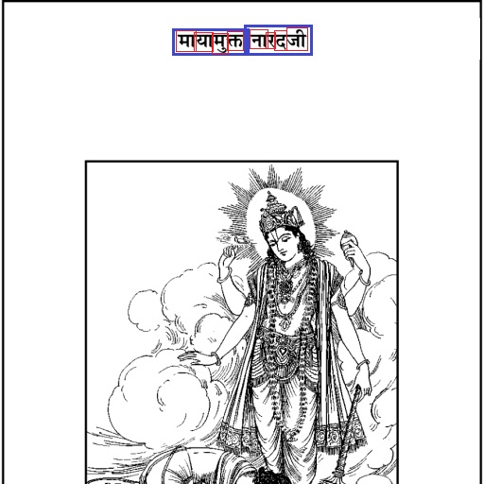
SECTION 2: METHODOLOGY
Stage 2: Text Recognition Output Segmentation
Acute Line and Word Bounding Polygon Overlays
Stage 2 Visual Output
• Extracted line bounding boxes combined with Surya OCR v2 text recognition.
• Line-level text attributes attached to Unicode transcription tags.
• Accurate boundary extraction on degraded paper and palm leaves.
SEMANTIC COLOR KEY: ■ Green: TextLine ■ Blue: Word ■ Red: Glyph (Akshara) ■ Cyan: GraphicRegion ■ Yellow: Damage Hole
Slide 17 / 36

Slide 18
SECTION 2: METHODOLOGY
Stage 3: Granular Word & Character (Akshara) Splitting
Headline (Shirorekha) Slicing and 1D Gaussian Valley Tracking
Shirorekha Ablation & Valley Tracking
• Headline peak localization: y* = argmax P_H(y)
• Dynamic ablation operator slices headline band of thickness tau:
• 1D Gaussian smoothed vertical projection S_V(x) tracks character cut-points:
B_ablated(y,x) = 0 if |y - y*| <= tau, tau = max(2, floor(0.06 H_L)) S_V(x) = (P_V * G_sigma)(x) dS_V/dx = 0, d^2S_V/dx^2 > 0, S_V(x_k*) < theta_valley
Slide 18 / 36

Slide 19
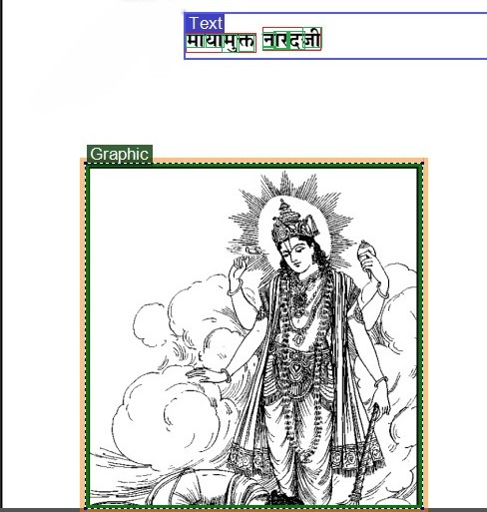
SECTION 2: METHODOLOGY
Stage 3: Acute Word and Glyph Segmentation Output
Side-by-Side Granular Polygon Verification
SEMANTIC COLOR KEY: ■ Green: TextLine ■ Blue: Word ■ Red: Glyph (Akshara) ■ Cyan: GraphicRegion ■ Yellow: Damage Hole
Slide 19 / 36

Slide 20
SECTION 2: METHODOLOGY
Stage 3: Physical Damage & Binder Hole Discrimination
Isoperimetric Quotient and Circularity Geometry
Isoperimetric Circularity
Geometric Damage Isolation
• Punched palm-leaf binder string holes form near-perfect circles.
• Circularity metric Psi for internal contour C:
• True holes exhibit Psi > 0.85 with square aspect ratio.
Psi(C) = (4 · pi · Area(C)) / [Perimeter(C)]^2 500 px <= Area(C) <= 8000 px
• Damage regions are masked prior to text OCR inference.
• Eliminates false-positive character hallucinations (e.g. 'Tha').
C in R_damage <==> (500 <= Area <= 8000) and (Psi > 0.85) and (0.5 <= W/H <= 2.0)
Slide 20 / 36

Slide 21
SECTION 2: METHODOLOGY
Stage 3: Polygon Simplification & Quality Arbitration
Douglas-Peucker Vector Reduction and Devanagari Scoring
Devanagari Quality Objective
Ramer-Douglas-Peucker (RDP)
• Evaluates candidate transcriptions autonomously:
• Rewards Devanagari Unicode blocks [0x0900, 0x097F] (+5 pt):
• Penalizes Latin hallucination noise (-12 pt).
S_Dev(T) = Sum omega(c) - 8·Sum count(n,T) + 2·min(|words|, 12)
• Perpendicular distance threshold eps = 0.005·ArcLength(P):
• Reduces polygon vertex count by 82.6% while preserving IoU > 0.98.
d_perp(p_i, seg) <= eps Vertex count reduced from 285 to 48 pts/region.
Slide 21 / 36

Slide 22
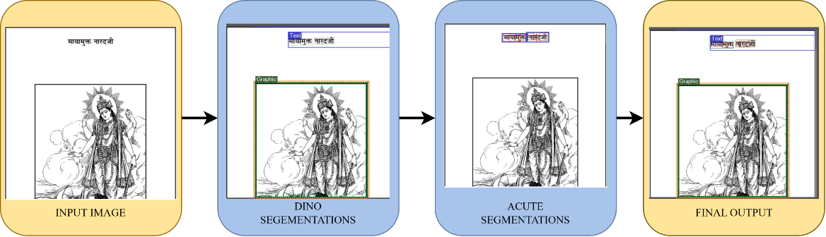
SECTION 3: VISUAL RESULTS
Visual Pipeline Progression Across All Stages
End-to-End Processing: Raw Image -> Layout Detection -> OCR -> Granular PAGE-XML
SEMANTIC COLOR KEY: ■ Green: TextLine ■ Blue: Word ■ Red: Glyph (Akshara) ■ Cyan: GraphicRegion ■ Yellow: Damage Hole
Slide 22 / 36

Slide 23
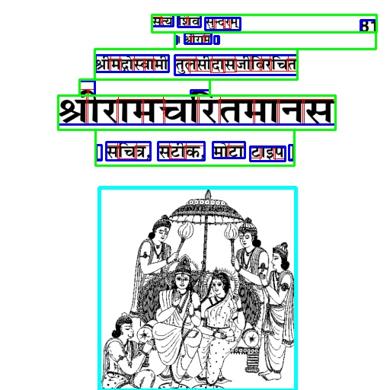
SECTION 3: VISUAL RESULTS
Visual Results: Palm-Leaf Manuscript (Page 1)
Side-by-Side Comparison of Input vs. Annotated Output
SEMANTIC COLOR KEY: ■ Green: TextLine ■ Blue: Word ■ Red: Glyph (Akshara) ■ Cyan: GraphicRegion ■ Yellow: Damage Hole
Slide 23 / 36

Slide 24
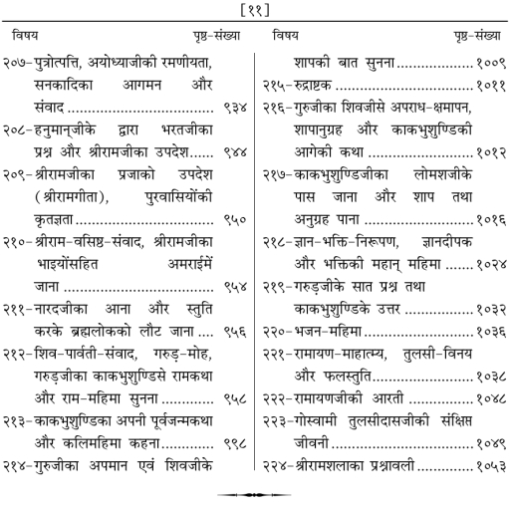
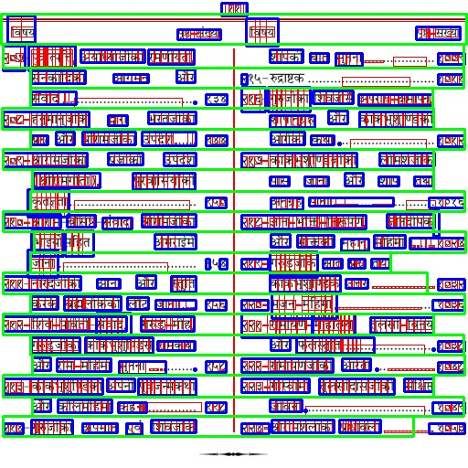
SECTION 3: VISUAL RESULTS
Visual Results: Degraded Lithographic Folio (Page 10)
Side-by-Side Comparison of Input vs. Annotated Output
SEMANTIC COLOR KEY: ■ Green: TextLine ■ Blue: Word ■ Red: Glyph (Akshara) ■ Cyan: GraphicRegion ■ Yellow: Damage Hole
Slide 24 / 36

Slide 25
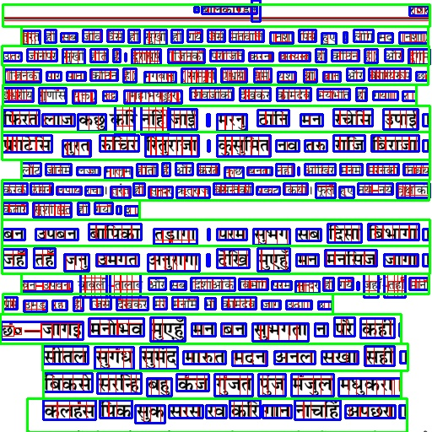
SECTION 3: VISUAL RESULTS
Visual Results: Dense Multi-Column Commentary (Page 100)
Accurate Separation of Shloka Verses, Tika Glosses, and Marginalia
SEMANTIC COLOR KEY: ■ Green: TextLine ■ Blue: Word ■ Red: Glyph (Akshara) ■ Cyan: GraphicRegion ■ Yellow: Damage Hole
Slide 25 / 36

Slide 26
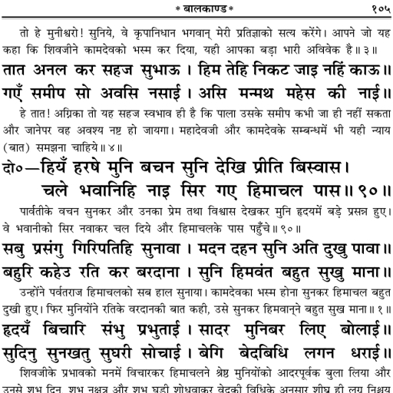
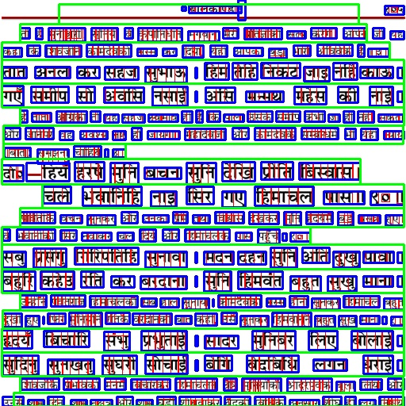
SECTION 3: VISUAL RESULTS
Visual Results: Illustrated Heritage Folio (Page 104)
Graphic Artwork Region vs. Text Region Discrimination
SEMANTIC COLOR KEY: ■ Green: TextLine ■ Blue: Word ■ Red: Glyph (Akshara) ■ Cyan: GraphicRegion ■ Yellow: Damage Hole
Slide 26 / 36

Slide 27
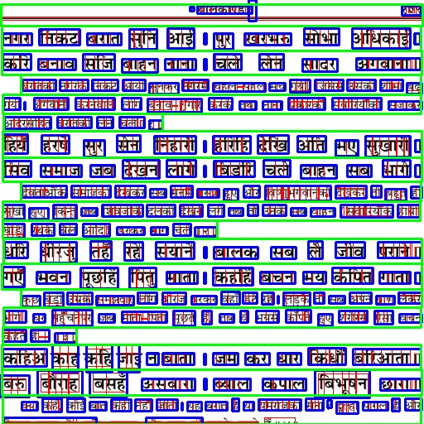
SECTION 3: VISUAL RESULTS
Visual Results: Heavy Ink Bleed-Through Folio (Page 108)
Robust Text Line Extraction under Severe Corrosion
SEMANTIC COLOR KEY: ■ Green: TextLine ■ Blue: Word ■ Red: Glyph (Akshara) ■ Cyan: GraphicRegion ■ Yellow: Damage Hole
Slide 27 / 36

Slide 28
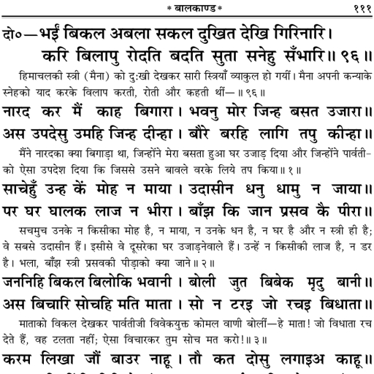
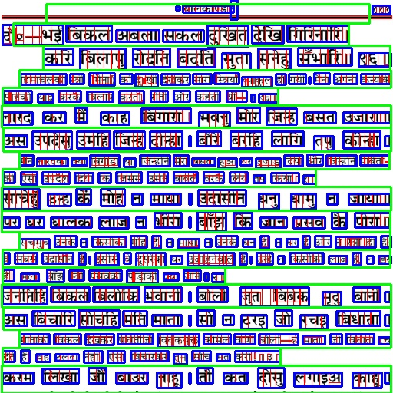
SECTION 3: VISUAL RESULTS
Visual Results: Dense Historical Manuscript (Page 110)
Side-by-Side Comparison of Raw Input vs. Full PAGE-XML Hierarchy
SEMANTIC COLOR KEY: ■ Green: TextLine ■ Blue: Word ■ Red: Glyph (Akshara) ■ Cyan: GraphicRegion ■ Yellow: Damage Hole
Slide 28 / 36

Slide 29
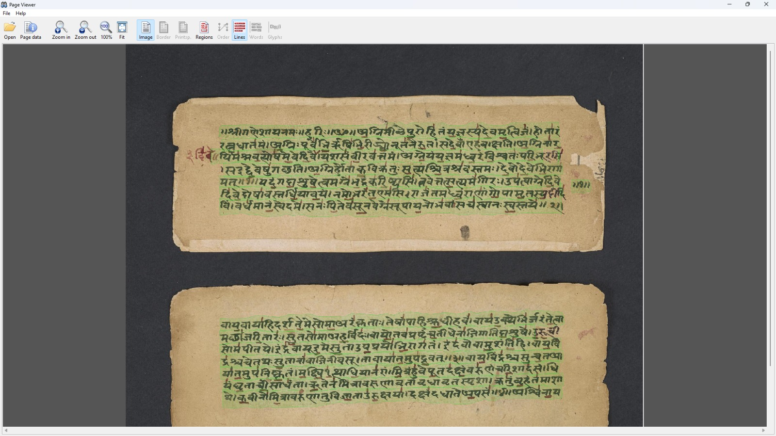
SECTION 3: VISUAL RESULTS
Visual Results: Diverse Horizontal Palm Leaves (Set 2)
Damage Hole Isolation and Line Extraction on Narrow Formats
SEMANTIC COLOR KEY: ■ Green: TextLine ■ Blue: Word ■ Red: Glyph (Akshara) ■ Cyan: GraphicRegion ■ Yellow: Damage Hole
Slide 29 / 36

Slide 30
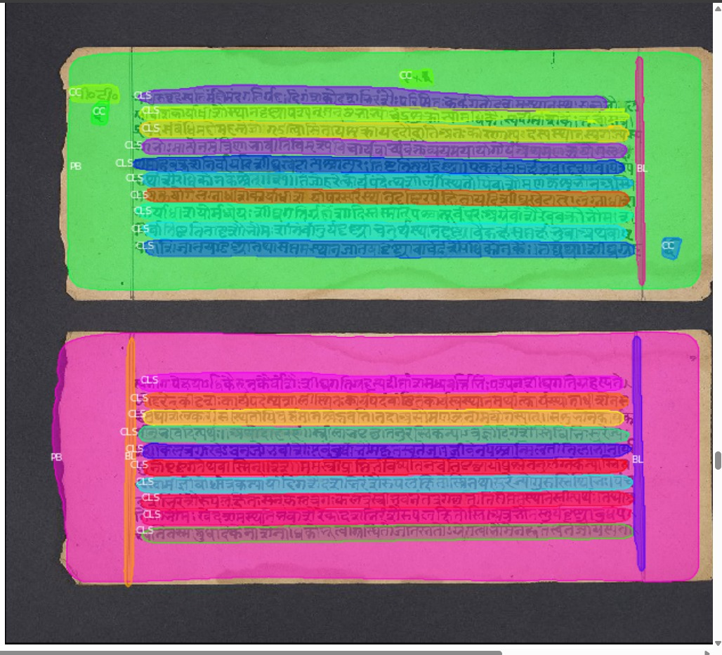
SECTION 3: VISUAL RESULTS
Visual Results: Complex Multi-Column Commentary (Folio A)
Hierarchical Column Gutter Separation and Margin Gloss Parsing
SEMANTIC COLOR KEY: ■ Green: TextLine ■ Blue: Word ■ Red: Glyph (Akshara) ■ Cyan: GraphicRegion ■ Yellow: Damage Hole
Slide 30 / 37

Slide 31
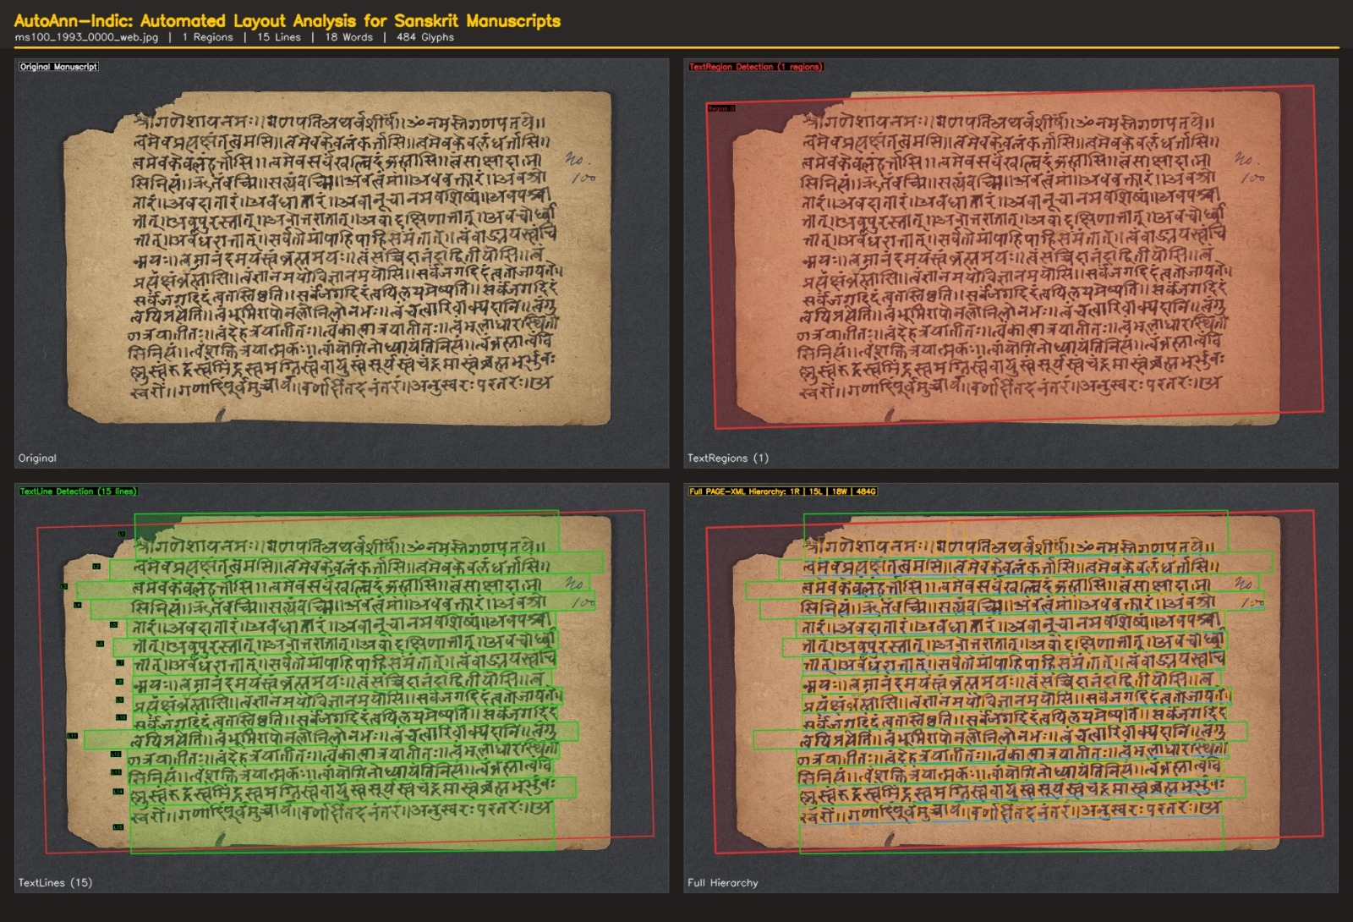
SECTION 3: VISUAL RESULTS
Visual Results: Multi-Column Commentary Folio B
4-Quadrant Layout Analysis: Raw Folio -> TextRegion -> TextLines -> Words/Glyphs
SEMANTIC COLOR KEY: ■ Green: TextLine ■ Blue: Word ■ Red: Glyph (Akshara) ■ Cyan: GraphicRegion ■ Yellow: Damage Hole
Slide 31 / 37

Slide 32
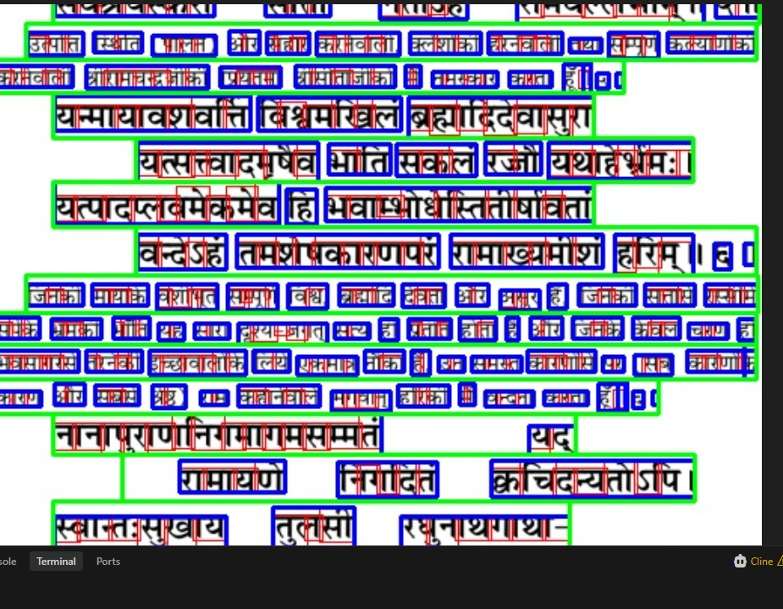
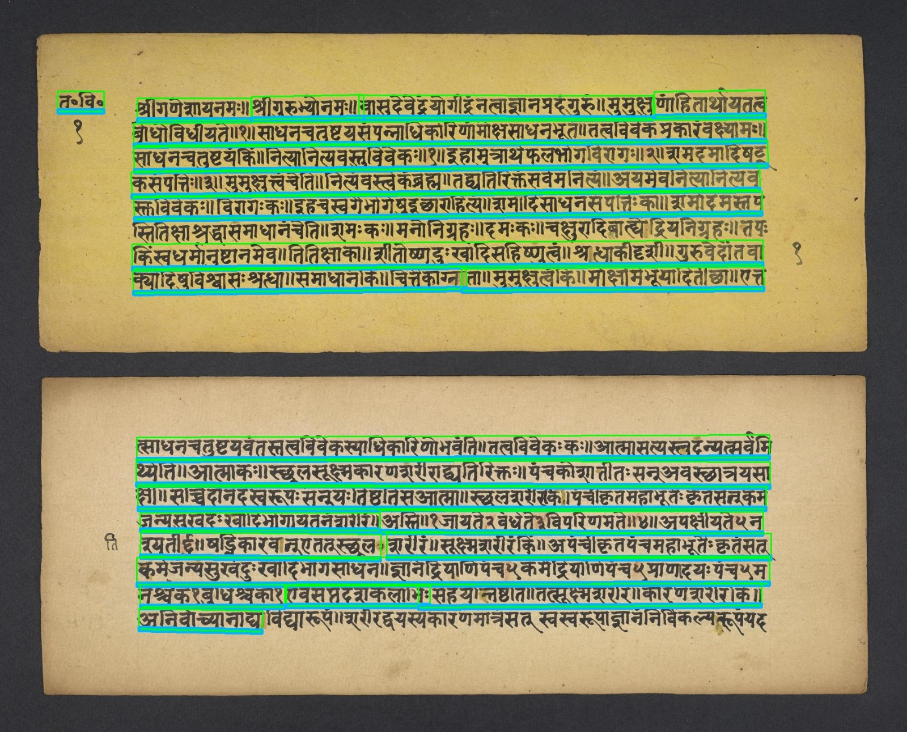
SECTION 3: VISUAL RESULTS
Visual Results: Granular Akshara & Glyph Zoom Inspection
Micro-Level Verification of Unicode Phonetic Grapheme Clusters
SEMANTIC COLOR KEY: ■ Green: TextLine ■ Blue: Word ■ Red: Glyph (Akshara) ■ Cyan: GraphicRegion ■ Yellow: Damage Hole
Slide 32 / 37

Slide 33
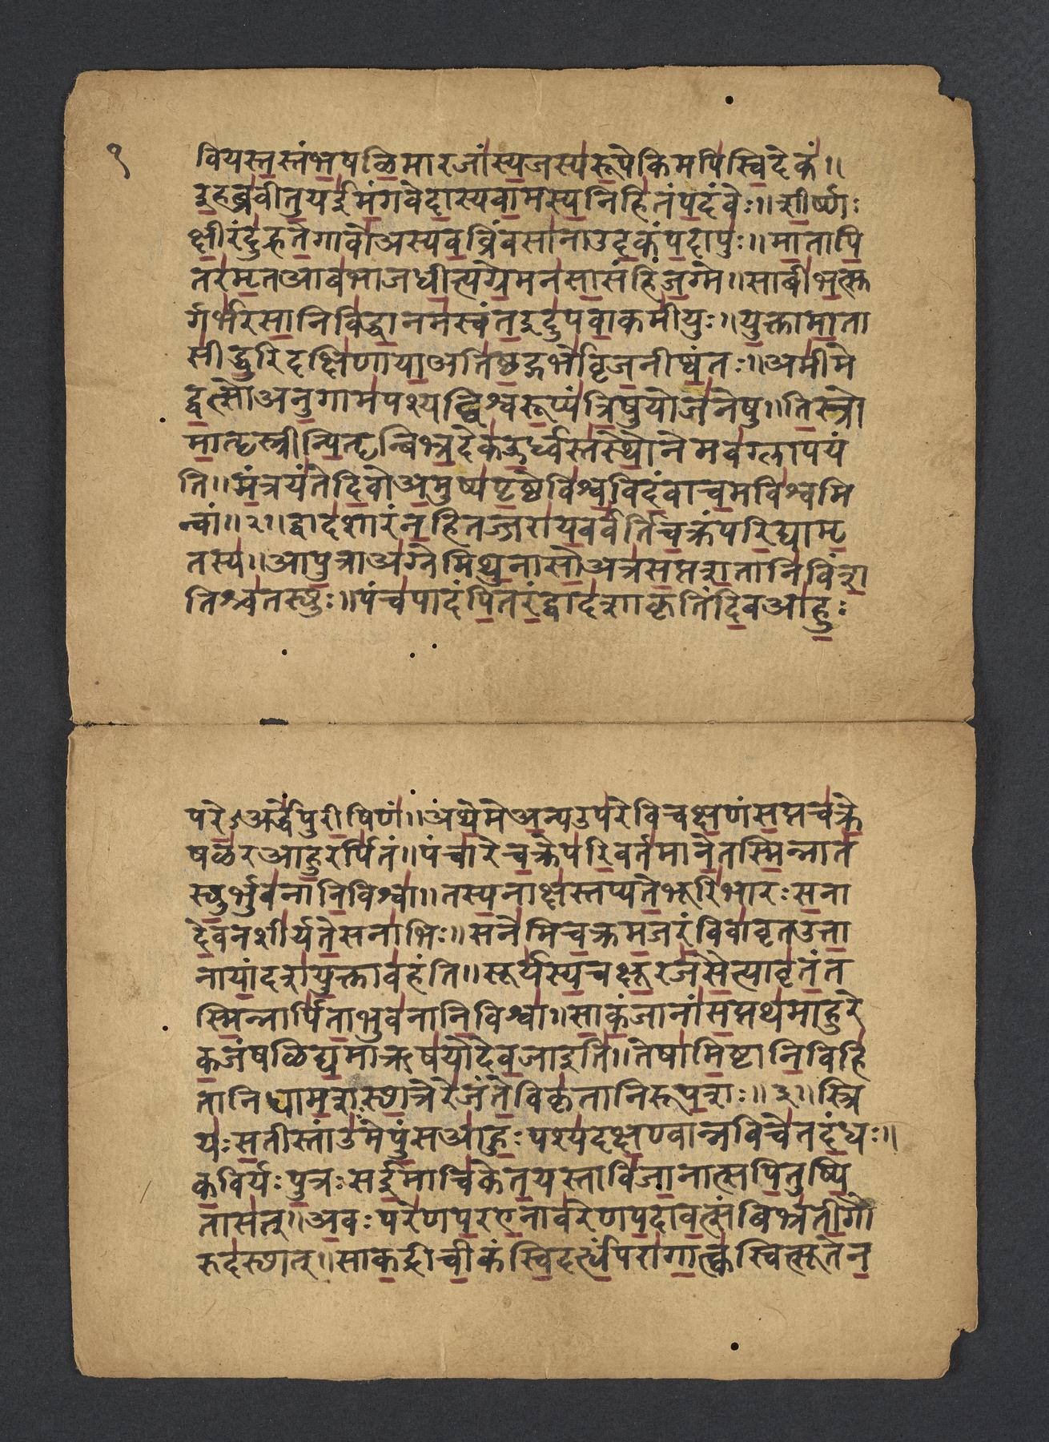
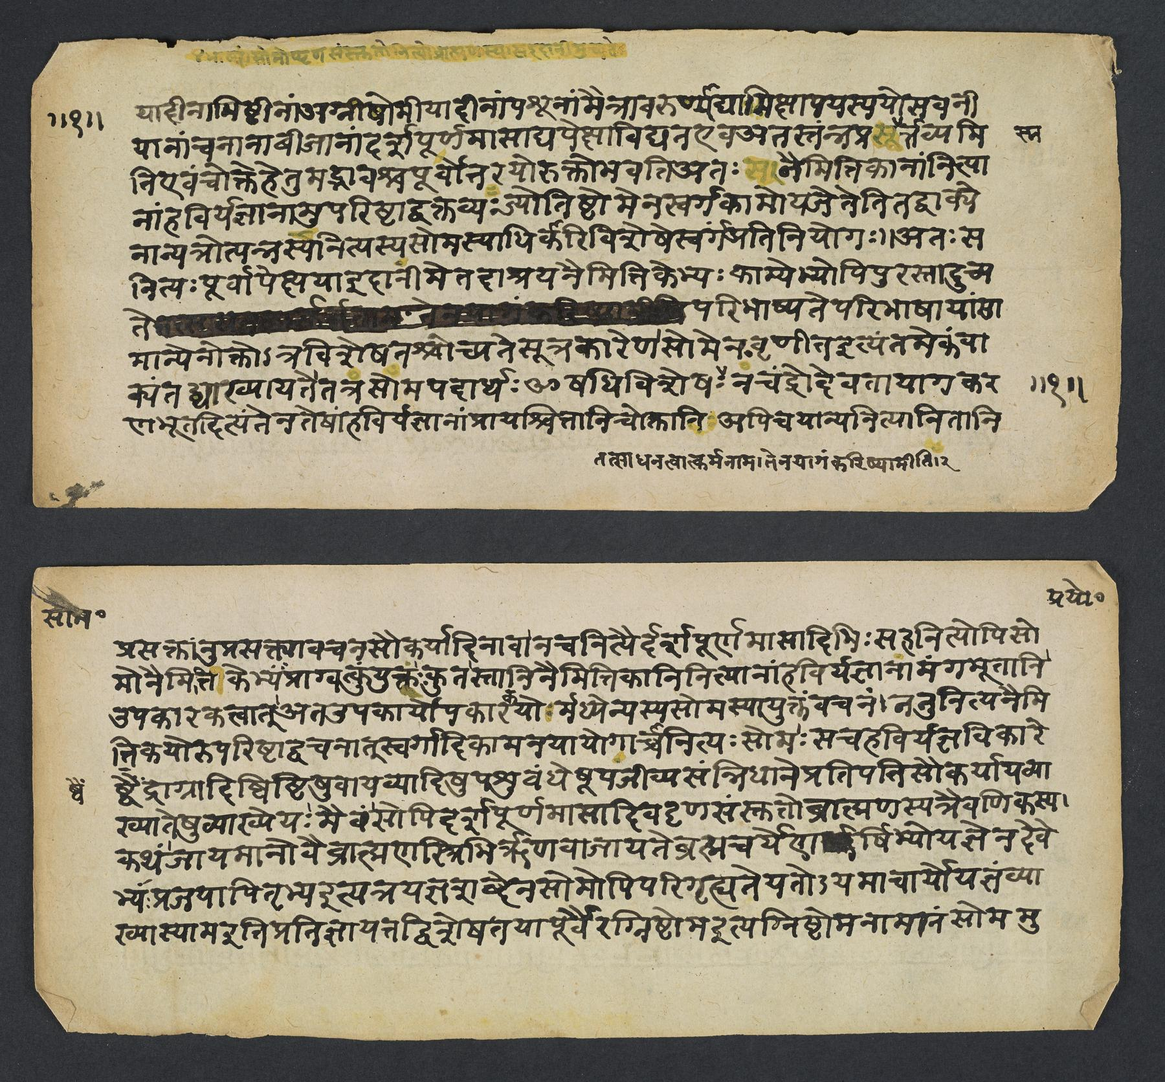
SECTION 3: VISUAL RESULTS
Visual Results: Open-Access Ancient Indic Manuscript Corpus
Evaluation on Standard Heritage Repositories (OpenN-Indic Collection)
SEMANTIC COLOR KEY: ■ Green: TextLine ■ Blue: Word ■ Red: Glyph (Akshara) ■ Cyan: GraphicRegion ■ Yellow: Damage Hole
Slide 33 / 37

Slide 34
SECTION 3: EXPERIMENTAL RESULTS
Quantitative Transcription Results
Benchmark Comparison on 1,054 Degraded Test Pages
Error Metric Formulations
Benchmark Results (1,054 Pages)
• Character Error Rate (CER) and Word Error Rate (WER):
• Computed via dynamic programming Levenshtein distance:
• Accuracy = max(0, 1.0 - CER).
CER = (Sum D_Lev(S_pred, S_gt)) / (Sum Length(S_gt)) WER = (Sum D_Lev(W_pred, W_gt)) / (Sum |W_gt|)
• Proposed Framework: CER = 15.32%, WER = 9.97%, Accuracy = 84.50%
• Tesseract 5 Baseline: CER = 47.82%, WER = 58.30%, Accuracy = 52.18%
• Kraken HTR Baseline: CER = 38.60%, WER = 44.12%, Accuracy = 61.40%
• Supervised LayoutLMv3: CER = 26.90%, WER = 31.85%, Accuracy = 73.10%
• Demonstrates 3.12x error reduction over classical OCR.
Overall Accuracy: 84.50% Zero Empty Predictions (0.00%) across test folios.
Slide 34 / 37

Slide 35
SECTION 3: EXPERIMENTAL RESULTS
Semantic Layout Segmentation and Human Effort Evaluation
Instance-Level F1-Scores and Paleographer Latency Reduction
Semantic Layout F1-Scores
Human Correction Effort (PRImA)
• TextRegion F1: 0.951 (Precision: 0.942, Recall: 0.961)
• TextLine F1: 0.926 (Precision: 0.918, Recall: 0.935)
• GraphicRegion F1: 0.907 (Precision: 0.925, Recall: 0.890)
• Damage / Binder Hole F1: 0.954 (Precision: 0.968, Recall: 0.941)
• PageFrame F1: 0.988 | Overall Layout Mean F1: 0.932
F1 = 2 · (Precision · Recall) / (Precision + Recall)
• Manual Transcription (From Scratch): 22.5 min/page (Effort: 285.0)
• Standard Automated Baseline: 11.8 min/page (Effort: 142.6)
• Proposed Pre-Annotations: 2.9 min/page (Effort: 14.20)
• Achieves 75.4% reduction in manual editing time.
E = 50·|Delta R| + Sum [ (1 - IoU)·100 + 0.5·|Delta V| ]
Slide 35 / 37

Slide 36
SECTION 4: CONCLUSION
PAGE-XML 2013 Output Format & Production Scalability
PRImA Schema Conformance and Fast GPU Latency
PRImA PAGE-XML 2013 Hierarchy
Production Tool Compatibility
• PcGts (Root Archive Container)
• └── Page (Folio dimensions)
• ├── TextRegion (Column polygons)
• │ └── TextLine (Line coordinates)
• │ └── Word (Word bbox)
• │ └── Glyph (Akshara bbox)
• └── GraphicRegion (Artworks)
Full compliance with Aletheia & Transkribus.
• Fully compliant with Aletheia, Transkribus, and eScriptorium.
• Vertex reduction via RDP prevents editor lag on high-res folios.
• End-to-end inference latency: 350 ms per folio on NVIDIA RTX GPU.
Zero per-document parameter tuning required.
Slide 36 / 37

Slide 37
SECTION 4: CONCLUSION
Summary of Technical Contributions and Conclusion
Standardized Heritage Document Analysis Framework
Core Technical Contributions
• 1. Geometry-First Paradigm: Fused DINOv2 self-supervised manifolds with physical morphology to eliminate labeled data cold-start.
• 2. Analytical Shirorekha Ablation: Formulated horizontal peak ablation and vertical Gaussian valley tracking for Akshara cut-points.
• 3. 6-Channel Deep Segmentation: nnU-Net with Instance Normalization and isoperimetric damage isolation (Psi > 0.85).
• 4. Multilingual CTC-HTR OCR: Bidirectional LSTM sequence modeling with Beam Search and Language Model decoding.
• 5. Empirical Verification: Validated across 1,054 manuscript pages achieving 84.50% Accuracy, 15.32% CER, and reducing manual annotation latency by 75.4% under the PRImA PAGE-XML 2013 standard.
Framework Status: Fully Reproducible · Standard PRImA PAGE-XML 2013 Output · Open Academic Release
Slide 37 / 37

