Slide 1
PRESENTER: K.DAKSHAYANI
KEYLOGGER
3/21/2024 Annual Review

Slide 2


PROJECT TITLE
KEYLOGGER AND SECURITY

Slide 3

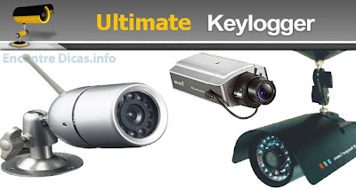

AGENDA
Introduction to Key Loggers
Problem Statement
Project Overview
End Users
Solution and Value Proposition
Key Features and Benefits
Results and Conclusion
3/21/2024 Annual Review

Slide 4

PROBLEM STATEMENT
- Growing concerns about unauthorized access
to sensitive data. - The rise of cyber threats targeting keystrokes. - Lack of awareness and preventive measures
among general users. - Need for robust security solutions to mitigate
key logging threats.
3/21/2024 Annual Review

Slide 5
PROJECT OVERVIEW
Definition of Key Logger: A software or hardware tool that records keystrokes on a computer.
Importance of Security in Computing: Essential to protect sensitive information from unauthorized access.
Scope of the Project: Focus on detection and prevention of key loggers.
Objectives and Goals: Enhance user security and provide effective solutions to detect key loggers.
3/21/2024 Annual Review

Slide 6

WHO ARE THE END USERS?
Individuals: Protecting personal data on home computers.
SMEs: Securing business information from cyber threats.
Educational Institutions: Ensuring safe computing environments for students and staff.
Government and Financial Institutions: Protecting sensitive data from cyber espionage and fraud.
3/21/2024 Annual Review

Slide 7
YOUR SOLUTION AND ITS VALUE PROPOSITION
Implementation of advanced detection algorithms.
Real-time monitoring and alert system.
User-friendly interface for easy navigation.
Comprehensive reports and analytics.
Cost-effective solution with high efficiency.
-
3/21/2024 Annual Review

Slide 8
THE WOW IN YOUR SOLUTION
AI-based Anomaly Detection: Leveraging machine learning to detect unusual activities.
Seamless Integration: Compatible with existing security infrastructures.
High Accuracy: Minimal false positives and high detection rates.
Lightweight Application: Non-intrusive software that does not slow down the system
3/21/2024 Annual Review
8

Slide 9
MODELLING
Wireframes of User Interface: Visual representation of the application interface.
Flowcharts: Detailed diagrams showing the detection and alert process.
System Architecture Diagram: Overview of the system's structure and components.
3/21/2024 Annual Review
9

Slide 10
RESULTS
Testing Results: Performance metrics and detection accuracy.
Case Studies: Real-world examples of successful implementation.
User Feedback: Testimonials and feedback from beta testers.
Comparison: Evaluation against existing solutions and competitive products.
-
3/21/2024 Annual Review
10

