Slide 1
Types of Data Warehouse Schema
Star Schema
Snowflake Schema
Galaxy Schema

Slide 2
Star Schema
Fact table surrounded by Dimension tables
Highly denormalized schema.
It can have data integrity and storage issues.

Slide 3
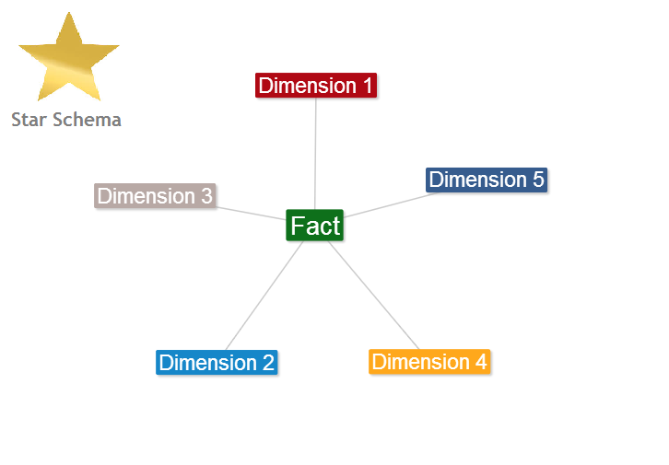

Slide 4
Snowflake Schema
Data is splitted into different dimension tables
Dimensions are normalized
Join complexity increases
Data storage and integrity issues are resolved to some extent.

Slide 5
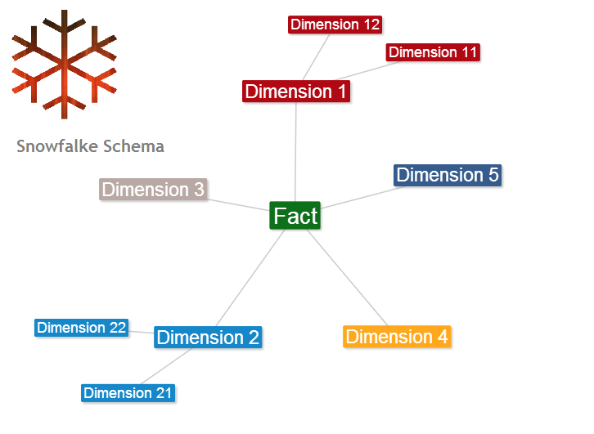

Slide 6
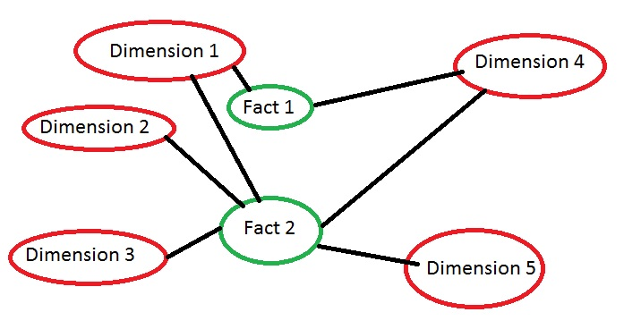
Fact Constellation Or Galaxy Schema

