Slide 1
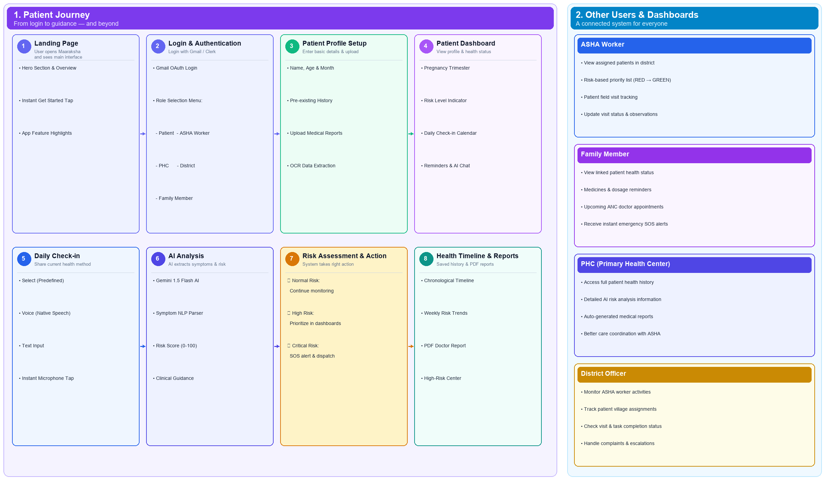
Your Team
Name
MAARAKSHA - Every Mother’s Health Matters
SMART INDIA
HACKATHON
2026
▪ Maaraksha is an AI-powered maternal health early-warning and monitoring system designed to provide timely attention and support to expecting mothers, particularly in rural areas.
▪ In India, ASHA workers serve as vital grassroots links between pregnant women and the healthcare system. Maaraksha aims to digitalize and streamline this health monitoring process.
▪ Patients can create their health profile, upload medical reports, and check in daily through text, voice, or predefined options. AI analyzes this information to identify potential risks and provide guidance.
▪ Maaraksha digitalizes the records of expecting women assigned to ASHA workers, improving record maintenance, patient follow-up, and risk-based prioritization for timely assistance.
The website uses role-based login for patients, ASHA workers, family members, PHC personnel, and district officers, allowing each to access relevant information. Higher authorities can monitor patient assignments, ASHA activities, and overall health-tracking progress.

